Slide 1

Capstone Project Report

Slide 2
Capstone - Project
Idea :
In this capstone project we are doing analysis on the “College” Dataset from ISLR package. Here we are trying to classify the colleges as either public or private based on certain characteristics
Based on this classification government funding can be given to schools who are public or scholarship to top students so as to improve public schools and bring them at par with private schools.
This analysis may be used by the Education department of the Government They may use the analysis to decide on which areas to increase the spending e.g. creating more board rooms for students as they may study in more concentrated way and provide more privacy thus improving graduation rates

Slide 3
Capstone – Project ….
Dataset:
The data is taken from the ISLR package. The data frame used is the ‘College’ data frame. Fields to be studied are
Room.Board Room
F.Undergrad Number of fulltime undergraduates
Grad.Rate Graduation rate
There are many other variables can be analyzed like number of PhDs or cost of books or ratio of student to faculty these may not qualify to classify a school as public or private.

Slide 4
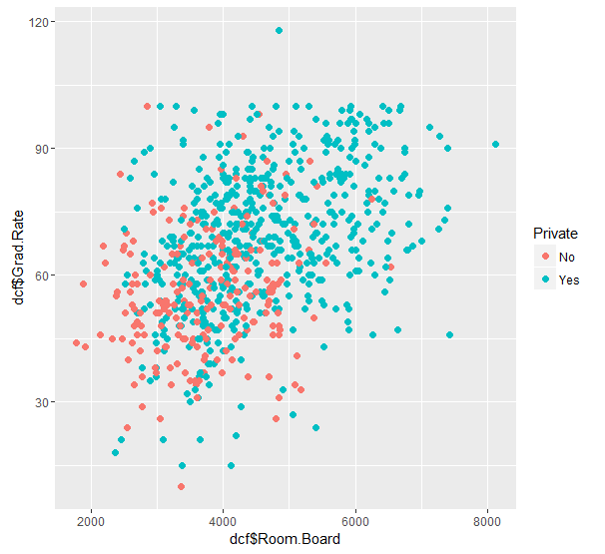
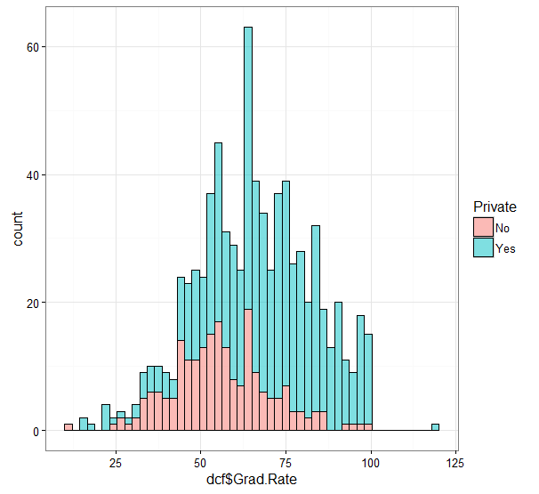
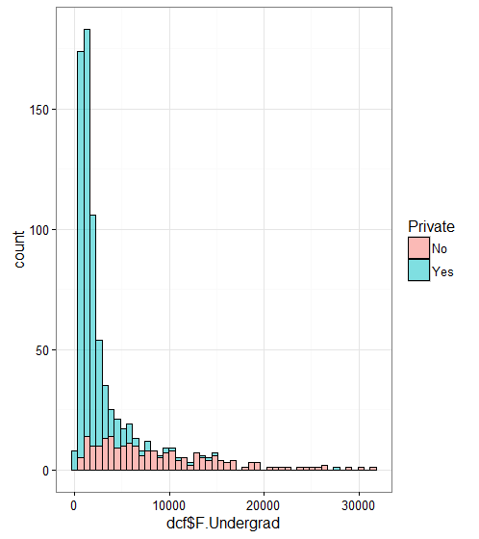
Capstone – Project ….
Exploratory Data analysis
We create a scatterplot, histogram for initial data analysis

Slide 5
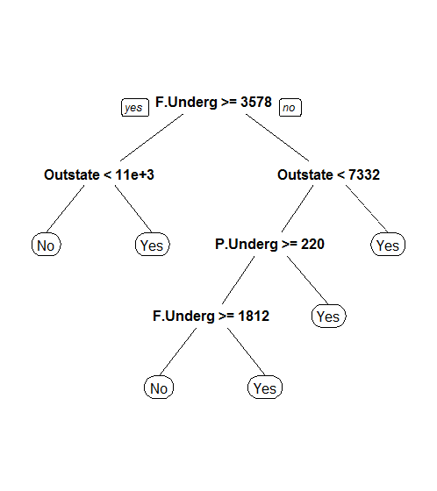
Capstone – Project ….
Decision Trees
We use decision tree and randomTree methods to predict which schools are public and which are private. We also use the confusion matrix to check for accuracy in our prediction.

Slide 6
Capstone – Project ….
Conclusion
Private and public schools have certain characteristics which can be used to classify them as either public or private.
Using the available dataset in the ISLR library we were able to analyze relationship between boardrooms and graduation rates, number of undergrads enrolled and number of graduates and based on this analysis of relationship use decision tree and randomForest methods to classify schools as public or private.
This classification can be used by Government etc to analyze and grant support to required schools.

Slide 7
Thank You!

