Slide 1

Eating Burger!
Course no. : CSE 4110
Course title : Artificial Intelligence Laboratory.
Presented by:
Abdullah-Al-Zobayer : 1607008
Samrat Alam Shanto : 1607022
Sajal Das Shovon : 1607030

Slide 2
Problem Statements
Eating Burger is an AI based game where there are 2 players (one player is human and
Other is computer).
Input:
1. First of all, player one needs to input the number of Burger boxes where the quantity of Burger in each box is randomly generated.
2. Player one (Human) selects the box which one’s Burger he will eat.
3. This will continue until the last box is selected.

Slide 3
Game rules and Solutions:
Rules:
1. Player one (human) selects a box to eat the Burger of that box.
2. If there are any remaining box/boxes before the box player one selected , player tow (computer) will automatically eat the Burgers of those boxes.
3. Then, player two(computer) randomly selects the box from remaining boxes and eat the Burger of selected box.
4. If there are any remaining box/boxes before the box player two selected , player one (human) will automatically eat the Burgers of those boxes.

Slide 4
Game rules and Solutions:
Solution:
1. In the end, The player who will eat more quantity of Burgers between them, will win the game.

Slide 5
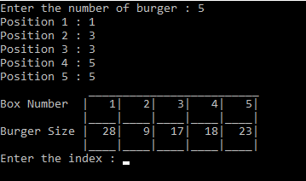
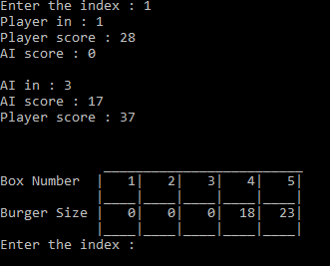
Simulation:
Step-1
Step-2

Slide 6
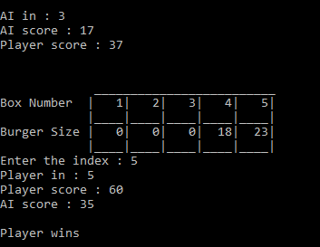
Simulation:
Step-3

Slide 7
Thank You!!!

