Slide 1

Thesis Defense
Tolerating Soft Errors in Ternary Content Addressable Memory
Presented By:
Abdullah-Al-Zobayer (1607008 ) Samrat Alam (1607022 )
Supervised By:
Prof. Dr. Kazi Md. Rokibul Alam
Department of Computer Science and Engineering
Khulna University of Engineering & Technology(KUET)

Slide 2
Outline
Introduction
Related Works
Objectives
Proposed Methodology
Experimental Analysis
Conclusions

Slide 3
Introduction
Ternary Content Addressable Memory (TCAM) is a specialized type of high speed memory that searches its entire contents in a single clock cycle.
TCAM is vulnerable to soft errors which corrupts the stored bits in the memory.
When reliability is a matter of concern, the soft errors cause the whole system failure.
That is why for tolerating soft errors, we proposed a method to detect and correct these errors for TCAM.

Slide 4
Related Works
There are few methods which are proposed to tolerate soft error. Let us discuss some of them.
Reviriego et al. [1] method:
Merit:
For small data, it can correct all single bit errors
Demerit:
It can not correct multiple bit errors.
For the large data, it can not correct all single bit errors.

Slide 5
Related Works
Syafalni et al. [2] method:
Merit:
It detects and corrects all single bit errors
Demerit:
It is relatively costly for using a Static Random Access Memory (SRAM)
Pontarelli et al. [3] filter-based method:
Merit:
It detects and corrects all single bit errors
Demerit:
Using bloom filter makes it expensive

Slide 6
Gap in the Research
There are some gap in the previous research works.
Correct only single bit errors in TCAM
Need relatively more bit overhead
Expensive

Slide 7
Objectives
To propose an efficient soft error detection and correction method for TCAM.
To minimize information redundancy and other overheads without sacrificing error detection ability.

Slide 8
Contribution
The major contributions of this research are
To correct 100% errors with relatively low redundant bits.
To detect and correct single bit as well as multiple bit errors.

Slide 9
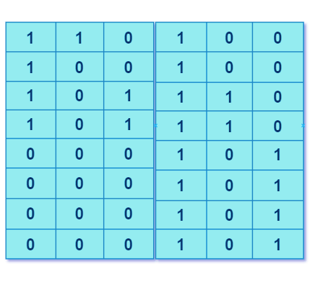
Proposed Methodology
This method is divided into two parts.
Generating rules from input data in sender end
Error detection and correction in receiver end
In sender part:
Let’s see an example, where
n(data word size) = 6
m(number of data words) = 8
k(number of blocks) = 2
p(number of rules) = 3
Fig. 1: Example of an (8X6) input message (data words).

Slide 10
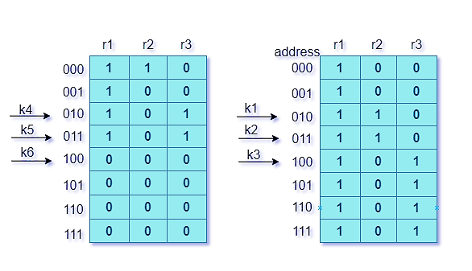
Proposed Methodology : Generating rules
At first, the input message is divided into two blocks.
Then, the rules are generated.
Rules | Bit-1’s position in 2nd block | Bit-1’s position in 1st block | Rules for 2nd block | Rules for 1st block
r1 | 000,001,010,011 | 000,001,010,011, 100,100,110,111 | 0XX | XXX
r2 | 000 | 010,011 | 000 | 01X
r3 | 010,011 | 100,101,110,111 | 01X | 1XX
Block 2
Block 1
the rules are r1 = 0XXXXX, r2 = 00001X and r3 = 01X1XX

Slide 11
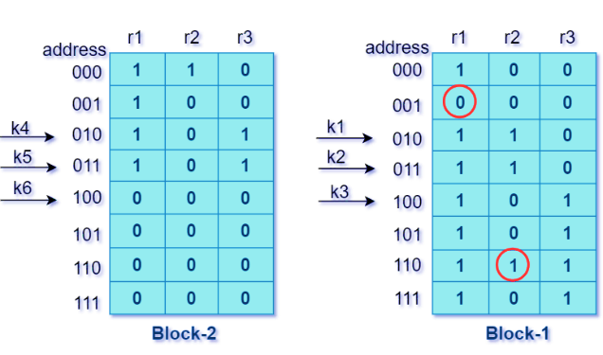
Proposed Methodology : Error injection
Lets consider, the input message from the sender is corrupted by soft errors in the transmission medium.
Block 2
Block 1
Fig. 2: Example of erroneous message.

Slide 12
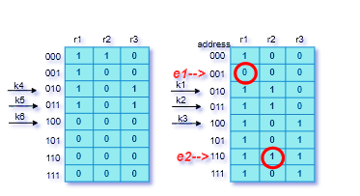
Proposed Methodology : Error detection and correction
In the receiver part, the receiver program will detect the errors by generating 1’s position from the rules.
Columns | Bit-1’s position for 1st block | Detecting erroneous bit positions
1 | 000,001,010,011,100,101, 110,111 | 001
2 | 010,011 | 110
3 | 100,101,110,111 | No error!!!
Block 2
Block 1
Here are the erroneous bit positions 001 and 110 in 1st column and 2nd column in 1st block of the message.

Slide 13
Proposed Methodology : Error Free Message
After the error detection and correction in the receiver end, the correct message from the example is shown below
Fig. 3: Error free correct message.

Slide 14
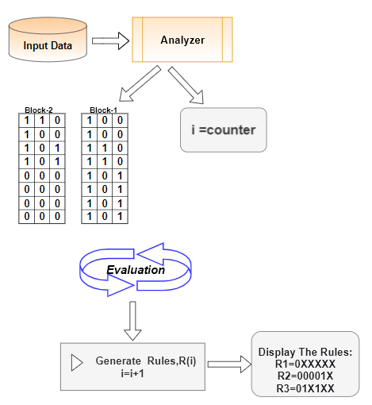
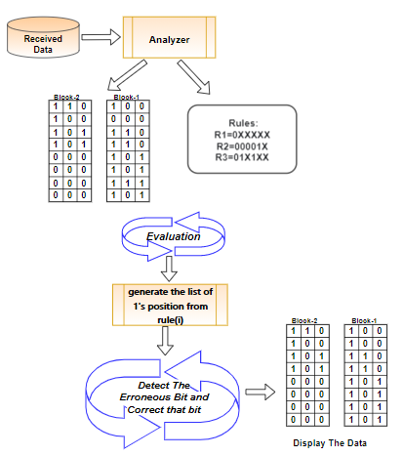
Proposed Methodology : Flow diagram
Fig. 5: Flow diagram of generating rules
Fig. 6: Flow diagram of error detection and correction

Slide 15
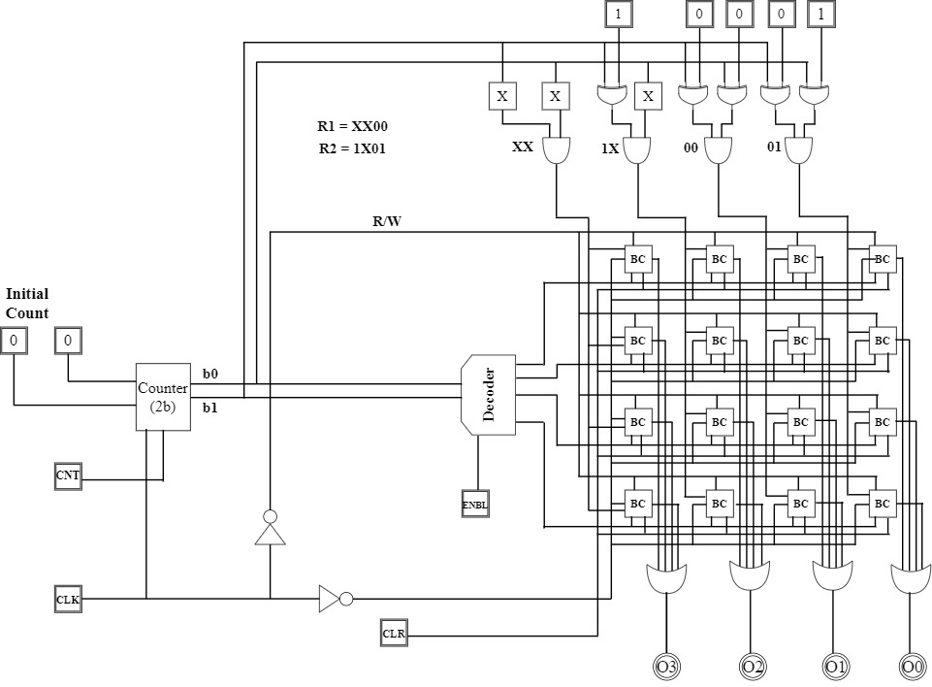
Proposed Methodology : Circuit Diagram
Fig. 4: Circuit diagram of the proposed method.

Slide 16
Experimental Analysis
Experimental Setup:
Intel(R) Core (TM) i7-7700HQ CPU @ 2.80GHz
16 GB RAM
Operating system Windows 10 - 64 bit
CodeBlocks (IDE 16.03)
Pspice OrCAD for simulation

Slide 17
Experimental Analysis
Comparison of bit overhead between Reviriego et al. [1] and the proposed method
Comparison of execution time(sec) between Reviriego et al. [1] and the proposed method
Fig. 7: Comparison of bit overhead
Fig. 8: Comparison of execution time(sec).
17

Slide 18
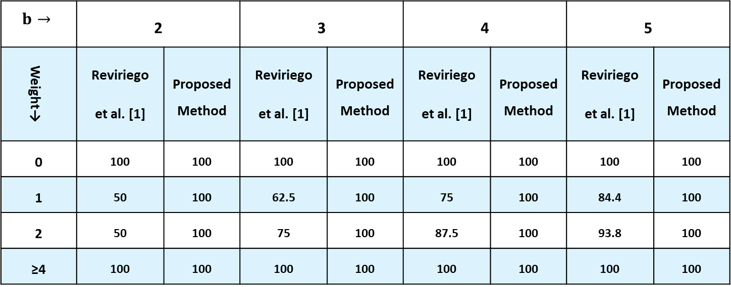
Experimental Analysis
TABLE I: Percentage of correctable single bit-error patterns for block memories
$$b→$$ | 2 |  | 3 |  | 4 |  | 5
Weight→ | Reviriego et al. [1] | Proposed Method | Reviriego et al. [1] | Proposed Method | Reviriego et al. [1] | Proposed Method | Reviriego et al. [1] | Proposed Method
0 | 100 | 100 | 100 | 100 | 100 | 100 | 100 | 100
1 | 50 | 100 | 62.5 | 100 | 75 | 100 | 84.4 | 100
2 | 50 | 100 | 75 | 100 | 87.5 | 100 | 93.8 | 100
≥4 | 100 | 100 | 100 | 100 | 100 | 100 | 100 | 100

Slide 19
Conclusions
The main contribution of this method is to correct a hundred percent of soft errors.
This proposed method requires relatively less redundant bits.
It can detect and correct soft errors in both sequential and random data words in TCAM.

Slide 20
Future Work
In our future work, We will try
To improve our method which will require less time for execution.
To develop this method from volatile to non-volatile.

Slide 21
Acknowledgment
We are grateful to Prof. Dr. Muhammad Sheikh Sadi sir for assistance in deciding thesis idea.

Slide 22
Publication
Our thesis work was published in the 2nd International Conference on Robotics, Electrical and Signal Processing Techniques 2021 (ICREST’21). The source is given below.
S. Alam, A. A. Zobayer and M. S. Sadi, "Towards Tolerating Soft Errors in TCAM," 2021 2nd International Conference on Robotics, Electrical and Signal Processing Techniques (ICREST), 2021, pp. 722-726, doi: 10.1109/ICREST51555.2021.9331148.

Slide 23
References
[1] P. Reviriego, S. Pontarelli and A. Ullah, "Error Detection and Correction in SRAM Emulated TCAMs," in IEEE Transactions on Very Large Scale Integration (VLSI) Systems, vol. 27, no. 2, pp. 486-490, Feb. 2019.
[2] I. Syafalni, T. Sasao, X. Wen, S. Holst and K. Miyase, "Soft-error tolerant TCAMs for high-reliability packet classifications," 2014 IEEE Asia Pacific Conference on Circuits and Systems (APCCAS), Ishigaki, 2014, pp. 471-474.
[3] S. Pontarelli, M. Ottavi, A. Evans and S. Wen, "Error detection in Ternary CAMs using Bloom Filters," 2013 Design, Automation & Test in Europe Conference & Exhibition (DATE), Grenoble, France, 2013, pp. 1474-1479.

Slide 24

Thank You

