Slide 1
SECURE DATA HIDING IN IMAGES USING STEGANOGRAPHY
SECURE THE DATA TO PREVENT HACKERS
Presented By:
Student Name : APOORV SINGH BHANDARI
College Name & Department : Graphic Era University (BTECH CSE)

Slide 2
OUTLINE
Problem Statement
Technology used
Wow factor
End users
Result
Conclusion
Git-hub Link
Future scope

Slide 3
Problem Statement
In today's digital world, protecting sensitive information is crucial. Traditional communication methods are vulnerable to interception. This project addresses the need for secure communication by hiding secret messages inside image files. Using image steganography, the project allows users to embed hidden messages in images and retrieve them with password protection. This ensures that only authorized users can access the confidential information.

Slide 4
Technology used
Python – A versatile programming language for building the entire application.
OpenCV – Handles image manipulation and pixel-level operations for encoding and decoding messages.
Tkinter – Provides a graphical user interface for easy interaction with the encoding and decoding process.
NumPy – Efficiently processes image data as arrays, enabling fast pixel manipulation.
Pillow – Supports handling various image formats (JPEG, PNG, BMP) for greater compatibility.
Cryptography – (Optional) Can be used to add advanced encryption algorithms like AES for enhanced message security.
OS Module – Manages file operations like opening images, saving encoded files, and interacting with the system.

Slide 5
Wow factors
Secure Message Hiding – This project hides messages within the RGB pixel values of an image without visibly altering the image.
Password Protection – The system requires a password to decode and retrieve hidden messages, ensuring only authorized users can access the information.
User-Friendly Interface – With the Tkinter-based GUI, users can easily choose images, input messages, and retrieve hidden data without technical knowledge.
Efficiency – The tool efficiently encodes and decodes messages without significantly altering the image quality.
Cross-Platform – Works on Windows, macOS, and Linux systems.

Slide 6
End users
Cybersecurity Professionals – Use it to securely share confidential information without being detected.
Journalists & Whistleblowers – Protect sensitive information when communicating in restrictive environments.
Privacy-Conscious Users – Ensure private communication by embedding hidden messages in ordinary image files.
Educational Institutions – Use it to teach concepts of data hiding and steganography techniques.

Slide 7
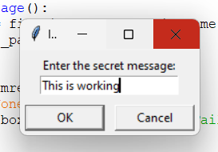
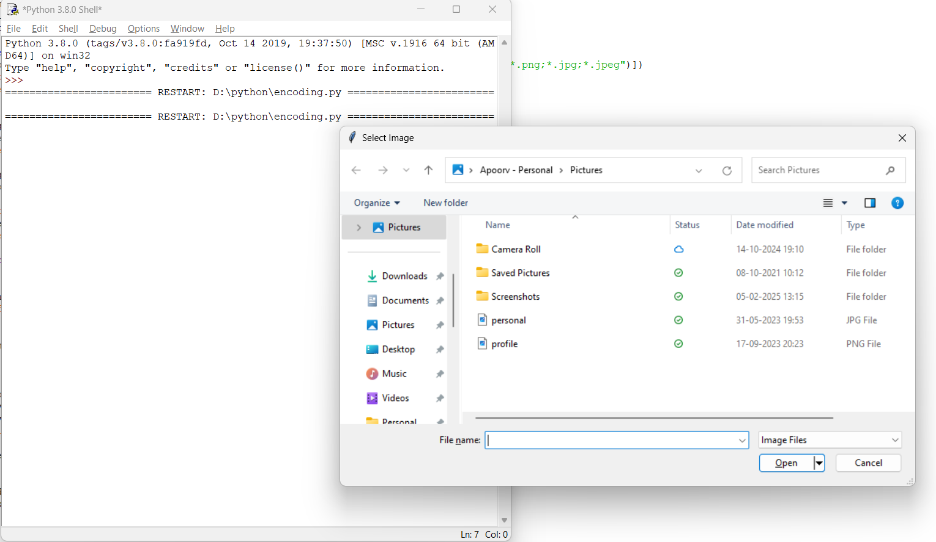
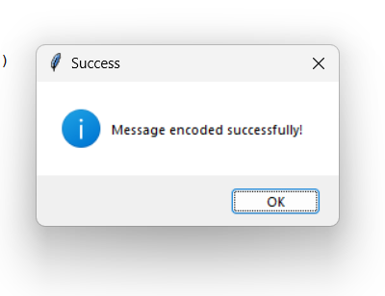
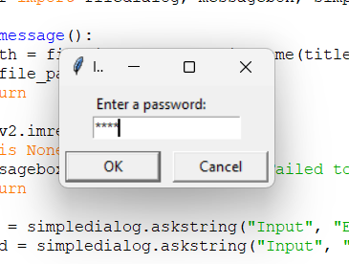
Results
Encoding

Slide 8
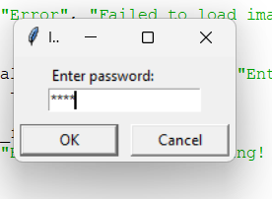
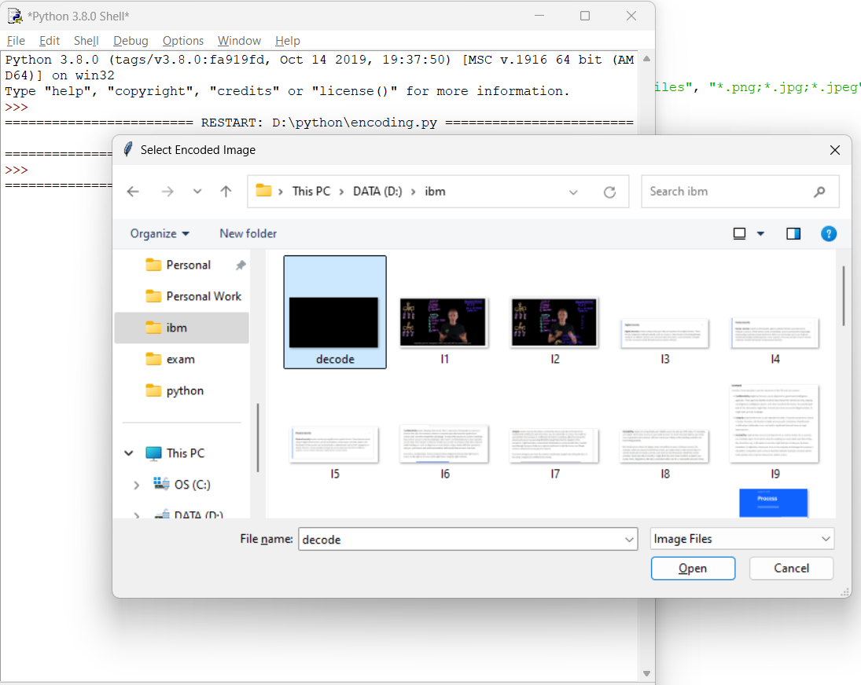
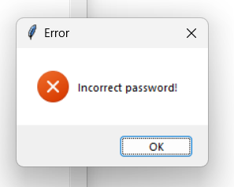
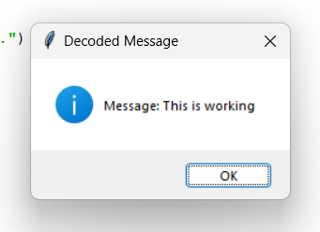
Decoding

Slide 9
Conclusion
The Image Steganography Using Python project provides a secure, reliable, and user-friendly way to hide sensitive messages within image files. By combining steganography techniques with password protection, the system enhances the confidentiality of digital communication. This project successfully addresses the need for secure, hidden communication in environments where privacy is essential.

Slide 10
GitHub Link
https://github.com/samratapoorv/AICTE_internship.git

Slide 11
Future scope(optional)
Advanced Encryption – Implement stronger encryption algorithms for added security.
Increased Capacity – Enhance the system to hide longer messages without affecting image quality.
File Format Support – Extend compatibility to other image formats (e.g., BMP, GIF).
Detection Resistance – Improve the encoding algorithm to resist detection by steganalysis tools.
Stealth Mode – Allow embedding in multiple image channels for deeper concealment.

Slide 12
THANK YOU

