Slide 1
Hackathon

Slide 2
Team and Use Case
Team Name | Team Member Name | Mail Id | PU
Gladiator | Samrat Basu | samrat.basu01@Infosys.com | STG
 | Deepa R. | DeepaR@infosys.com | STG
 | Dheeraj Kumar Reddy | Dheerajkumar_K@infosys.com | STG
Use Case description | Work and performance related updates are captured on iCount system by majority of the employees only twice a year. How can we simplify the process of capturing inputs (work updates/ awards/ feedback/ task completion) by integrating iCount with other platforms (Outlook/ InfyMe/ Chat tools etc).

Slide 3
iCount New Features
New Features | Description
connectors and form UI | Employees can push feedback, appreciations etc. using connectors and form UI. iCount login is not required. Connectors are Add-ins to outlook and chat services.
adapter-api | APIs to integrate iCount with external services. Here are a few examples of external services - Trainings, Course, Lex, Outlook, Jira etc. adapter API can pull tasks from Jira. We will provide a basic API for this function. The Jira REST API can be invoked to push the data either sprint level or project level or task completion to iCount under specific goals or under additional documents in goals are not matching.
awards-based-system | Employees acquire coins by providing feedback, completing course/trainings, uploading appreciations etc. Coins can be configurable and they can be redeemed using InfyGold+
campaign manager | iCount deals can be announced through campaign manager and more coins can be accumulated by the employees for specific duration.
performance score-card | Leadership dashboard to view and track the performance of individual project teams.
todo-icount-notifications | Employee engagement tool to publish icount news, new features and how to use them.

Slide 4
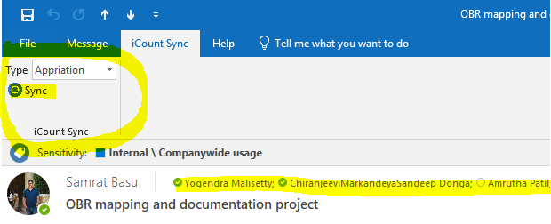
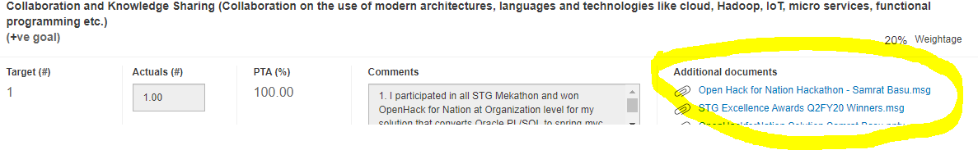
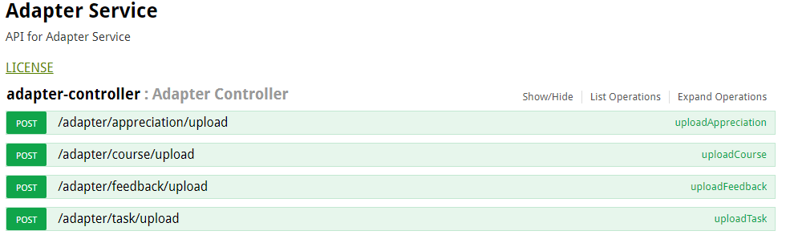
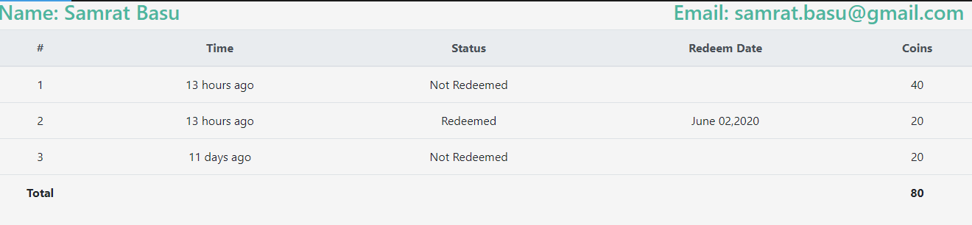
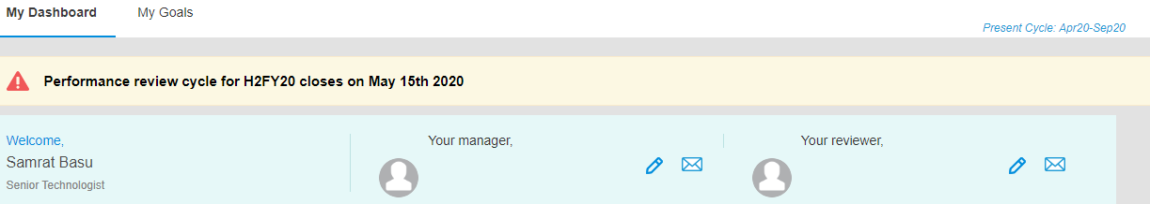
iCount New Feature Details
Feature | Proposed View | Impacted Audience | Target Application/Person
connectors and form UI |  | Employees | iCount
adapter-api |  | Employees | iCount consumes data through proxy-api
awards-based-system |  | Employees | iCount

Slide 5
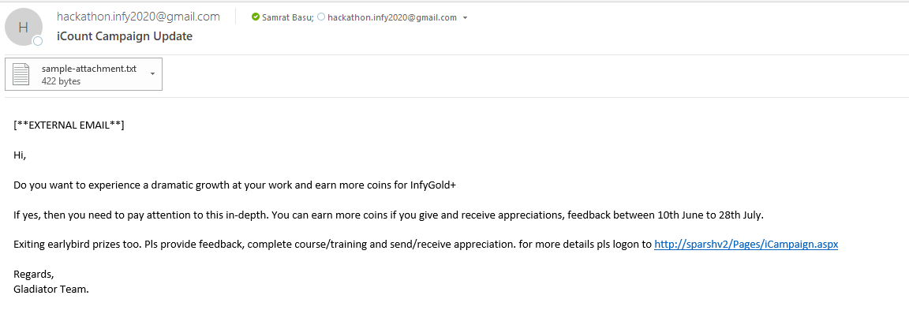
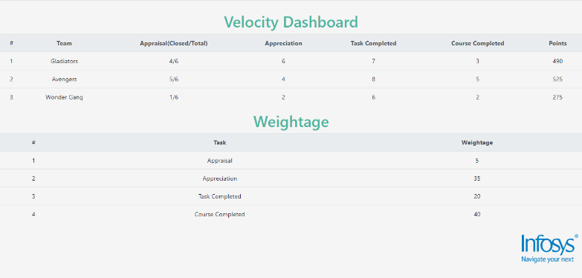
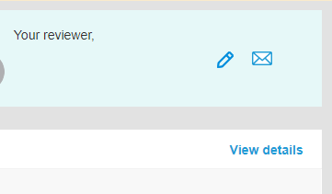
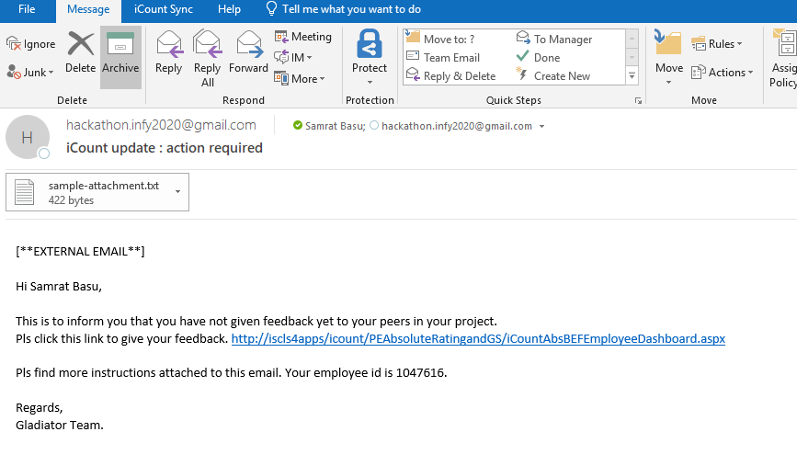
iCount New Feature Details
Feature | Proposed View | Impacted Audience | Target Application/Person
campaign manager |  | Employee | Employee receive Outlook Message/email
performance score-card |  | Employee | Only Reviewer Can see this dashboard
todo-icount-notifications |  | Employee | Employee receive Outlook Message/email

Slide 6
Functionalities
Functionality | Description
Easy Accessibility | Collect, capture and store work updates, awards, feedback, task completion from different source system through adapters. iCount Login is not required
 | Employee can provide feedback and upload appreciation using outlook plugins and outlook forms/UIs. Infosys iCount login is not required
 | APIs are exposed for course completion, task etc. so that iCount is updated automatically by other sys.
Employee Engagements | Automated notifications can be sent to the employees if iCount is not updated frequently
 | Notification frequency can be configured.
 | Notification send to employees in real-time on feedback, appreciation, task/course completion and awards updates. Acknowledgement will be issued at the same time
 | Deals can be announced through campaign management and more coins can be accumulated by the employees for specific duration.
 | Outbox will be blocked if employee do NOT use iCount capabilities for certain duration.
Award-Based system | Employees acquire coins by providing feedback/completing course-trainings/uploading appreciations etc.
 | Coins can be redeemed using InfyGold
NFR (Non Functional Req) | Enabled 2nd level JPA cache for icount consumptions for better performance
 | Security and compliance will be checked before stream data to iCount

Slide 7
Functionalities Continued…
Functionality | Description
Transparency | Employees send or receive feedback and appreciations in real-time
 | Employees can restrict feedback and achievements visibility public/private
 | Course/task completion status will be updated in real-time
 | Employees can receive continuous feedback from team peers or other employees.
Management | Single repo for various data stream and pipelines. Hence easy to maintain
 | Exclusion can be processed based on approvals. Example Subcons exclusion/onsite exclusion etc.
 | Performance score-card allow management to view, collate and analyze the performance across the team.
Please note that this application to targeted to all the employees of the company. An option is also provided to exempt the employees to whom it is not applicable ( Ex: Subcons, Consultants etc...)

Slide 8
Technologies, Libraries, packages etc. used in the solution
Technology/Libraries | Description / Reason for using
SpringBoot 2.2.x | Spring Boot is an efficient framework for creating RESTFul Micro Service
C# .Net | C# is a strong typing, lexically scoped, imperative, declarative, functional, generic, object-oriented, and component-oriented programming disciplines
VSTO Add-ins | Visual Studio Tools for Office (VSTO) is a set of development tools available in the form of a Visual Studio add-in (project templates)
apache.poi 4.1.0 | Apache POI, a project run by the Apache Software Foundation, and previously a sub-project of the Jakarta Project, provides pure Java libraries for reading and writing files in Microsoft Office formats
Log4j 1.2.17 | Log4j is a fast, flexible and reliable logging framework
Swagger 2.4.0 | Used to generate online API specification and automate documentation.
Cron Jobs | Cron allows Linux and Unix users to run commands or scripts at a given date and time
JPA | The Java Persistence API is a Java application programming interface for DB specifications
jackson-2.7.5 | Jackson is a very popular and efficient java based library to serialize or map java objects to JSON and vice versa. We used this framework to generate target dependency.
SpringBatch | Spring Batch is an open source framework for batch processing.
Kafka | Apache Kafka is an open-source stream-processing software platform developed by LinkedIn and donated to the Apache Software Foundation, written in Scala and Java.
Apache-velocity and free-marker | Java-based template engine that provides a template language
React | React is an open-source JavaScript library for building user interfaces.

Slide 9
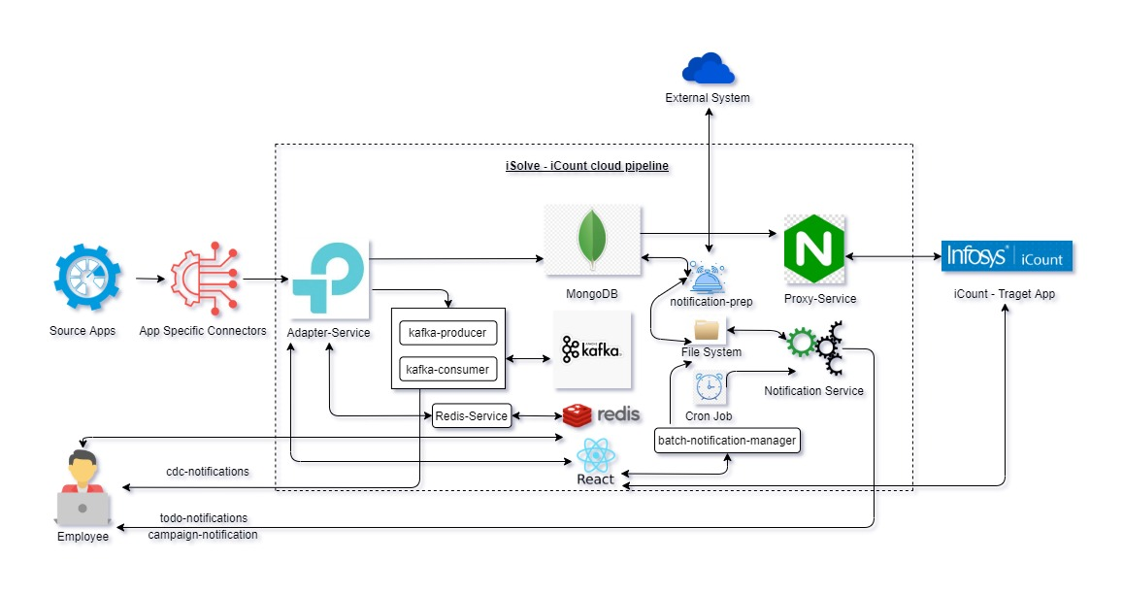
iSolve – iCount Pipeline : Problem Statement 1

Slide 10
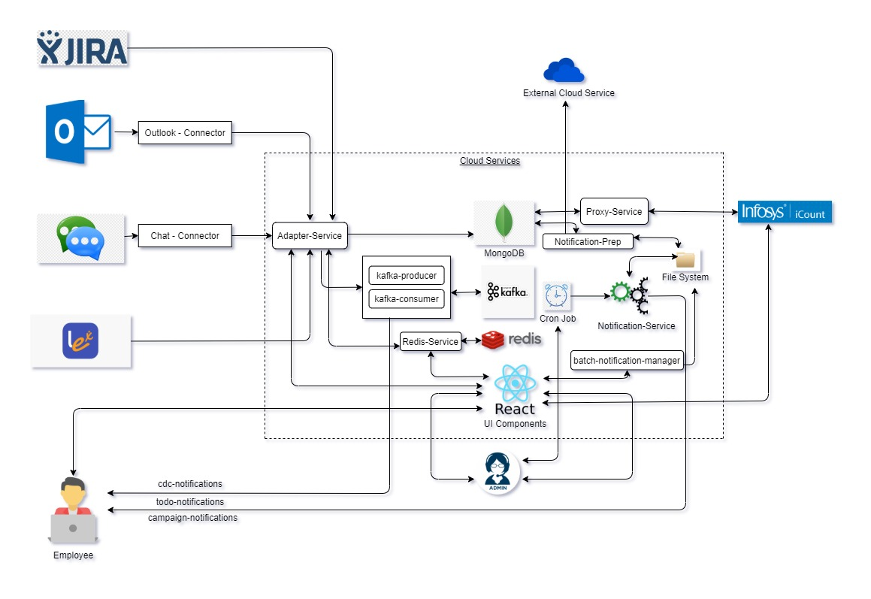
Architecture Diagram of iSolve – iCount : Problem Statement 1

Slide 11
Technical Details of individual components
This is a Hybrid application and we have used following Technologies for each of these components.
App specific connectors – Used to create connectors. Developed using VSTO Add-ins in C#.Net.
Adapter-Service (AS) – Entry point to the pipeline. Developed using Springboot and integrated with Swagger UI.
Proxy-Service (PS) – End points for iCount consumption. Developed using springboot, apache poi and integrated with Swagger UI.
Notification-Service (NS) – Developed using Spring-batch. Used to send notifications to the empoloyees who is not using iStore functionalities
Cron Job – Unix Cron Scheduler for notification batch
Kafka –Streams data and send notifications in real-time to the employees who seek feedback, upload appreciation, complete task/course etc.
Redis-Service – Stores coins configurations. Developed using springboot.
Batch-notification-manager (BNM) – Updates notification template build using apache velocity and freemarker frameworks

Slide 12
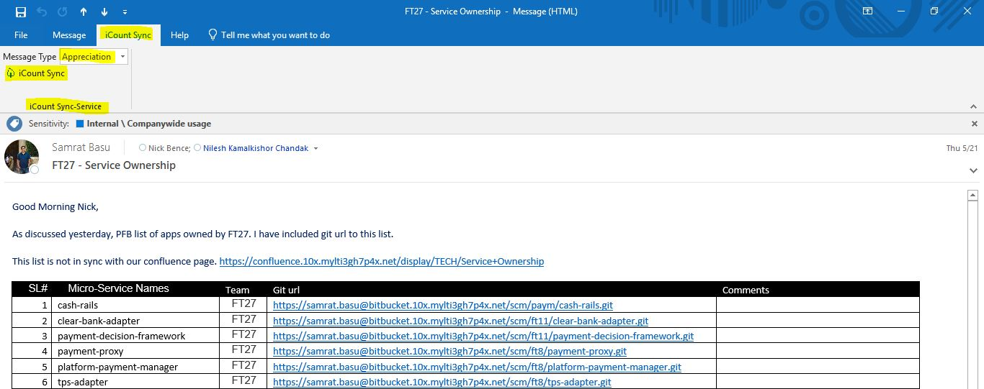
Technical Solution
Connector : Connectors push data to adapter and it is application specific. User use connectors to Push MS Outlook / Messenger data to pipeline.
It parse the message and attachments and check for its compliance.
If the message is compliant then user can push such text to the pipeline on cloud for iCount consumption. Here is one example outlook-connector
In the below screenshot we are searching for keyword which is parameterized (Certification/Award/Appreciation etc.. and moving that mails to icount application under relevant goal category, if the category is not part of goals then under additional documents section the mails would be uploaded.
- Appreciation and Feedback can be captured using UI as well. The links will be shared via todo-notification emails.

Slide 13
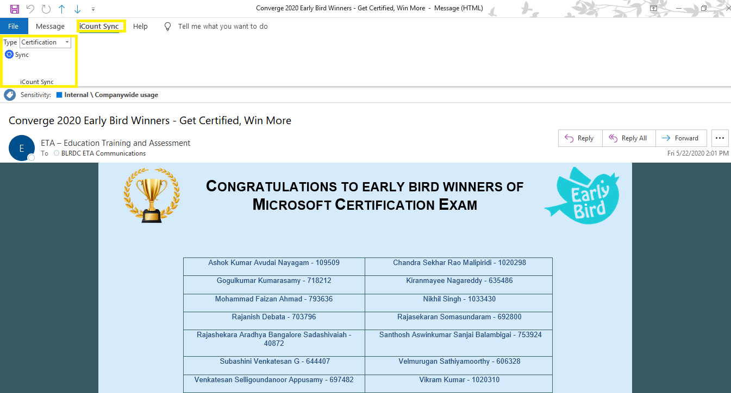
Technical Solution – Contd..
In the below screenshot we are searching for keyword which is parameterized (Certification/Award/Appreciation etc.. and moving that mails to icount application under relevant goal category, if the category is not part of goals then under additional documents section the mails would be uploaded.
In the screenshot below we are moving mails with Certification keyword.
- Appreciation and Feedback can be captured using UI as well. The links will be shared via todo-notification emails.

Slide 14
Technical Solution Continued…
Adapter-Service (AS): Adapter is an entry point of external messages in the pipeline like work updates, awards, feedback, task completion, award management etc.
Through Adapter APIs user can push following message categories - appreciation, feedback, task, course completion etc. Data will be stored in Mongo db. We can store files to GCP bucket, but as part of template creation we store them in Unix box.
- It can pull Tasks and status from Jira, we will provide a basic API around this service
Here is one Payload example for Appreciation
http://13.59.15.42:8300/adapter/appreciation/upload
{
"employeeId": "1047617",
"name": "krishna Basu",
"email": "krishna@gmail.com",
"date": 1242353553,
"appreciation": [{
"appreciatorName": "Sekhar3",
"appreciatorEmail": "Krishna1@gmail.com",
"appreciationSub": "Well cdone",
"description": "Hi ",
"appreciationDate": 3525346346,
"fileInfo": null
}]
}

Slide 15
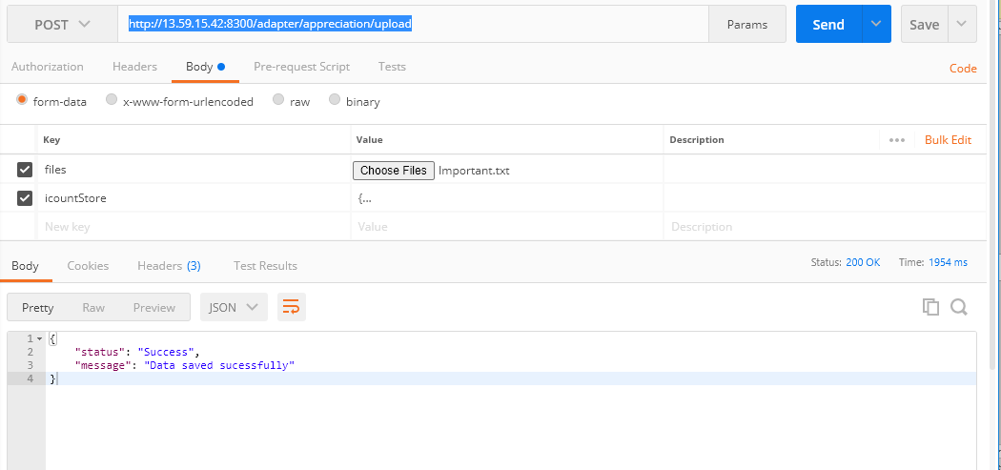
Technical Solution Continued …

Slide 16
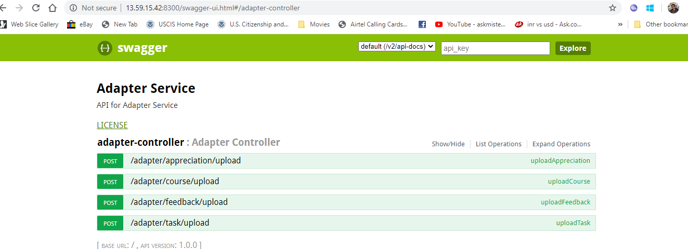
Technical Solution Continued…
Similarly we have following REST endpoints for adapter
http://13.59.15.42:8300/adapter/awards/upload
http://13.59.15.42:8300/adapter/task/upload
http://13.59.15.42:8300/adapter/feedback/upload

Slide 17
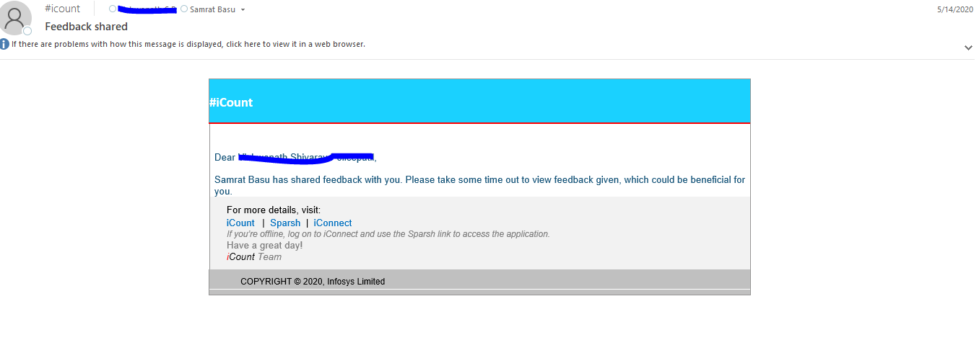
Technical Solution Continued…
Employee can acquire coins by providing and receiving feedback, appreciation, completing course etc. Accumulated coins of a specific duration can be redeemed in InfyGold+
Adapter calls kafka producers and consumers for real-time cdc-notifications to the employees who receive/give feedback, upload appreciations, complete tasks/course etc. Here is an example of feedback shared.

Slide 18
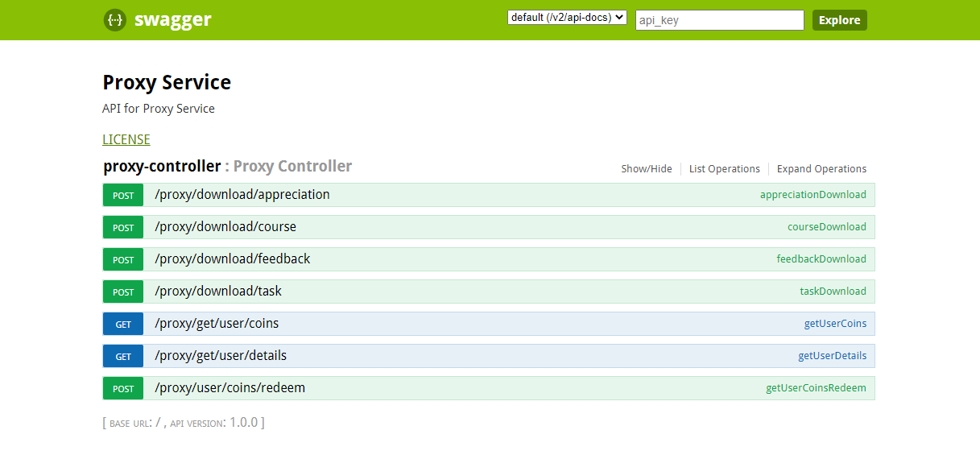
Technical Solution Continued…
Proxy-Service : It exposes REST end points for iCount & Leadership data consumption. Leadership dashboard and award management are part of this component. Here are a few example endpoints :

Slide 19
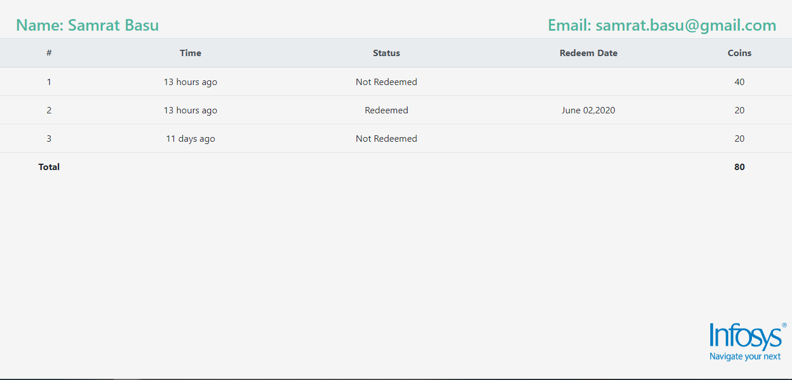
Technical Solution Continued…
Example of award dashboard

Slide 20

Technical Solution Continued…
Leadership/Velocity dashboard is visible to the reviewers

Slide 21
Technical Solution Continued…
Notification-Prep
Connects external system and get the list of employees and creates a list of people those are not using iCount capabilities after applying exclusion list (Example – Subcons/onsite employees) for specifc duration.
Send/upload employee list in csv format to notification batch to notify employees.
Notification-Batch :
- Consist of Campaign Manager and ToDo Notification generator.
Notify employees who are NOT using or actively using iCount.
Campaign management can be configured in todo-notification batch.
1. Deals like early bird – can be announced through campaign management service.
Frequency and rules of todo-notifications are configurable.
Example of rules :
1. Escalation rule for not being use iCount for specific duration.
2. lock/unlock other services such as outbox etc.

Slide 22
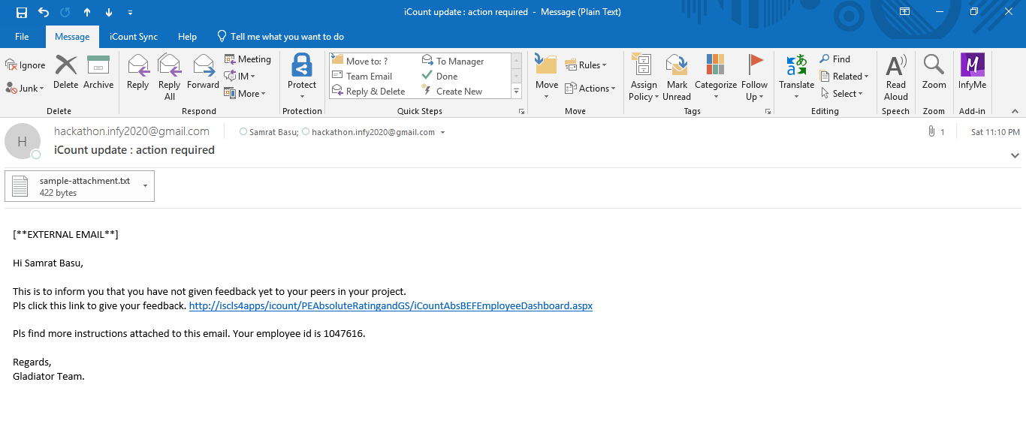
Technical Solution Continued : Example - Todo-Notification…

Slide 23
Technical Solution Continued …
Cron Job :
Cron jobs is being used to set notification frequency.
Interval can be configurable.
Miscellaneous :
There are 2 types of notifications
To-Do Notifications to the employees who are not using iCount for certain duration.
CDC-Notifications from the adapter service for appreciation, feedback, course/task completion etc. In short for any DB activity.
Coins can be accumulated by giving or receiving feedback, appreciations etc. and redeemed using InfyGold+
Deals can be announced for more coins
Default coins can be setup/configured in the application.
Performance score-card allow management to collate, analyze and view the performance across the team.
- System calculated automated process.
Velocity/Performance, Timeliness are attributes to measure.
1. Performance can be determined based on # of feedbacks, appreciations, tasks and course completion.
2. Timeliness is how much time it takes to close the appraisal for that team.

Slide 24
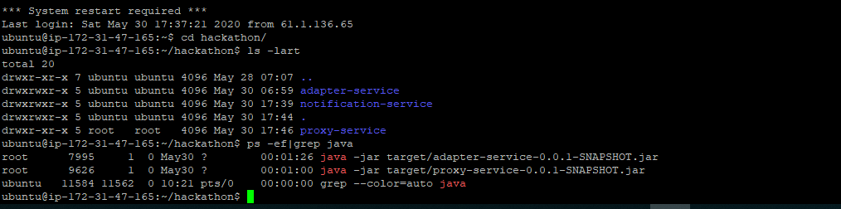
Technical Solution
Depoyment
We want to deploy iCount Store to AWS cloud. This micro-service is running on port 8300, 8301 and 8302 and can be accessed through following urls
http://13.59.15.42:8300/adapter/appreciation/upload http://13.59.15.42:8301/proxy/get/user/details?emailId=samrat.basu%40gmail.com
http://13.59.15.42:8302/notification-service

Slide 25
Thank You

