Slide 1
Hackathon

Slide 2
Team and Use Case
Team Name | Team Member Name | Mail Id | PU
Gladiator | Samrat Basu | samrat.basu01@Infosys.com | STG
 | Deepa R. | DeepaR@infosys.com | STG
 | Dheeraj Kumar Reddy | Dheerajkumar_K@infosys.com | STG
Use Case description | Work and performance related updates are captured on iCount system by majority of the employees only twice a year. How can we simplify the process of capturing inputs (work updates/ awards/ feedback/ task completion) by integrating iCount with other platforms (Outlook/ InfyMe/ Chat tools etc).

Slide 3
Functionalities
Functionality | Description
Easy Accessibility | Collect, capture and store work updates, awards, feedback, task completion from different source system through adapters. iCount Login is not required
 | Employee can provide feedback and upload appreciation using outlook plugins and outlook forms/UIs. Infosys iCount login is not required
 | APIs are exposed for course completion, so that iCount is updated automatically by other sys.
Employee Engagements | Automated notifications can be sent to the employees if iCount is not updated frequently
 | Notification frequency can be configured.
 | Notification send to employees in real-time on feedback, appreciation, task/course completion and awards updates. Acknowledgement will be issued at the same time
 | Deals can be announced and coins will be accumulated
 | Outbox will be blocked if employee do NOT use iStore at all.
Award-Based system | Employees acquire coins by providing feedback/course completion/uploading appreciation
 | Coins can be redeemed using InfyGold
NFR (Non Functional Req) | Enabled 2nd level JPA cache for icount consumptions for better performance
 | Security and compliance will be checked before stream data to iCount

Slide 4
Functionalities Continued…
Functionality | Description
Transparency | Employees get and receive feedback and appreciations in real-time
 | Employees can choose to make feedback and achievements public/private
 | Course/task completion status will be updated on real-time
 | Employees can receive continuous feedback from team peers or other employees.
Management | Single repo for various data stream and pipelines. Hence easy to maintain
 | Exclusion can be processed based on approvals. Example Subcons exclusion/onsite exclusion etc.

Slide 5
Technologies, Libraries, packages etc. used in the solution
Technology/Libraries | Description / Reason for using
SpringBoot 2.2.x | Spring Boot is an efficient framework for creating RESTFul Micro Service
C# .Net | C# is a general-purpose, multi-paradigm programming language encompassing strong typing, lexically scoped, imperative, declarative, functional, generic, object-oriented, and component-oriented programming disciplines
VSTO Add-ins | Visual Studio Tools for Office (VSTO) is a set of development tools available in the form of a Visual Studio add-in (project templates)
apache.poi 4.1.0 | Apache POI, a project run by the Apache Software Foundation, and previously a sub-project of the Jakarta Project, provides pure Java libraries for reading and writing files in Microsoft Office formats
Log4j 1.2.17 | Log4j is a fast, flexible and reliable logging framework
Swagger 2.4.0 | Used to generate online API specification and automate documentation.
Cron Jobs | Cron allows Linux and Unix users to run commands or scripts at a given date and time
Hibernate 4.x | Used to generate target entity class
jackson-2.7.5 | Jackson is a very popular and efficient java based library to serialize or map java objects to JSON and vice versa. We used this framework to generate target dependency.
SpringBatch | Spring Batch is an open source framework for batch processing.
kafka | Apache Kafka is an open-source stream-processing software platform developed by LinkedIn and donated to the Apache Software Foundation, written in Scala and Java.

Slide 6
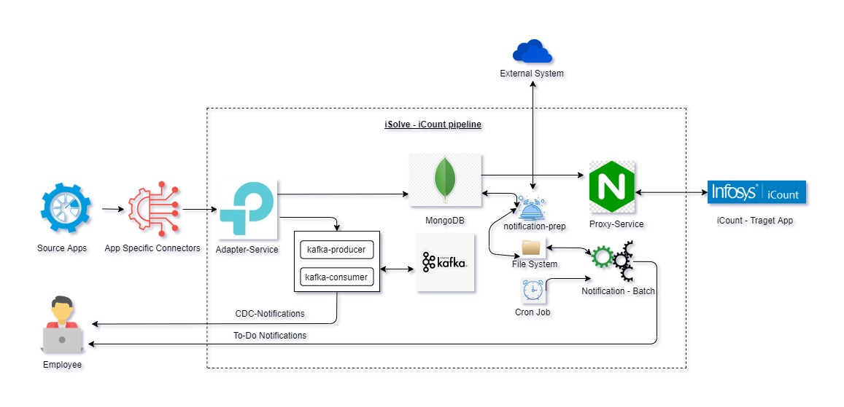
iSolve – iCount Pipeline : Problem Statement 1

Slide 7
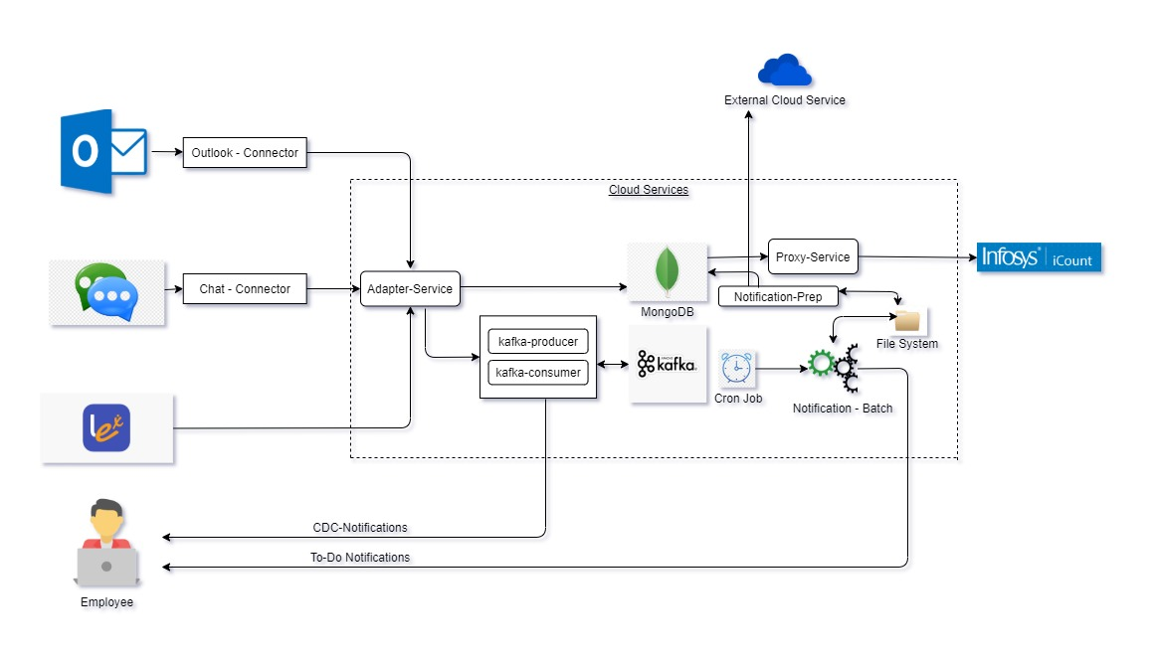
Architecture Diagram of iSolve – iCount : Problem Statement 1

Slide 8
Technical Details of individual components
We have used following Technologies for each of these components. This is a Hybrid application
App specific connectors – Used to create connectors. Developed using VSTO Add-ins in C#.Net.
Adapter-Service (AS) – Entry point to the pipeline. Developed using Springboot and integrated with Swagger UI.
Proxy-Service (PS) – End points for iCount consumption. Developed using springboot, apache poi and integrated with Swagger UI.
Notification-Batch (NB) – Developed using Spring-batch. Used to send notifications to the empoloyees who is not using iStore functionalities
Cron Job – Unix Cron Scheduler for notification batch
Kafka –Streams data and send notifications in real-time to the employees who seek feedback, upload appreciation, complete task/course etc.

Slide 9
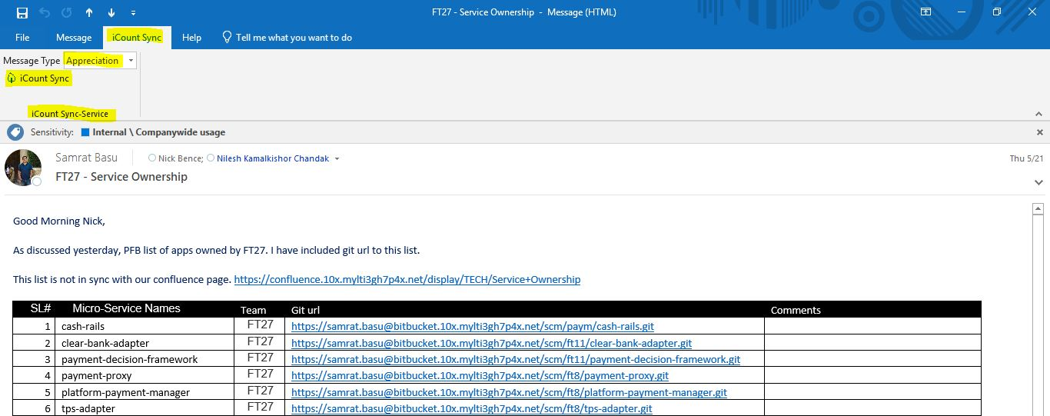
Technical Solution
Connector : Connectors push data to adapter and it is application specific. User use these service to Push MS Outlook / Messenger data to pipeline.
It parse the message and attachments and check for its compliance.
If the message is compliant then user can push such text to cloud pipeline for iCount consumption. Here is one example outlook-connector
- Appreciation and Feedback can be captured using UI as well. The links will be shared in notification emails.

Slide 10
Technical Solution Continued…
Adapter-Service (AS): Adapter is an entry point of external messages like work updates, awards, feedback, task completion etc.
- Adapter exposes REST endpoints so that user can push following message categories - work updates, awards, feedback, task completion etc. And the data will be stored in Mongo db. We can store files to GCP bucket, but as part of template creation we store them in Unix box.
Here are some Payload examples
Appreciation Payload :
http://13.59.15.42:8300/adapter/appreciation/upload
{
"employeeId": "1047617",
"name": "krishna Basu",
"email": "krishna@gmail.com",
"date": 1242353553,
"appreciation": [{
"appreciatorName": "Sekhar3",
"appreciatorEmail": "Krishna1@gmail.com",
"appreciationSub": "Well cdone",
"description": "Hi ",
"appreciationDate": 3525346346,
"file": null
}],
"course": null,
"feedback": null,
"task": null
}

Slide 11
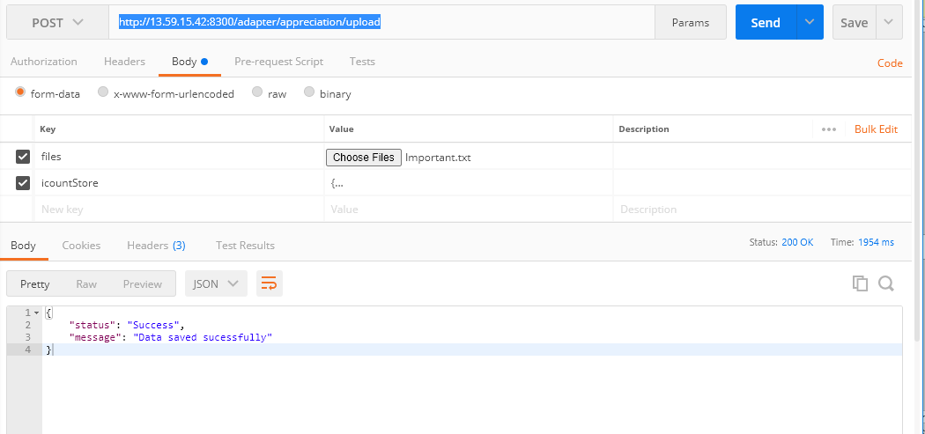
Technical Solution Continued …

Slide 12
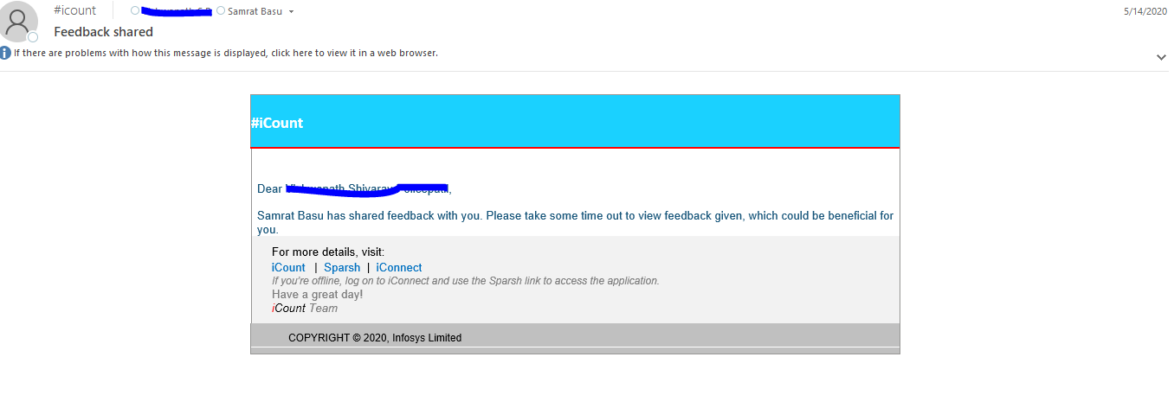
Technical Solution Continued…
Similarly we have following REST endpoints
http://13.59.15.42:8300/adapter/awards/upload
http://13.59.15.42:8300/adapter/task/upload
http://13.59.15.42:8300/adapter/feedback/upload
Employee can acquire coins for providing feedback, appreciation, completing course etc. These coins can be redeemed in InfyGold+
Adapter calls kafka producers and consumers for real-time notifications to the employees who receive/give feedback, upload appreciations, complete tasks/course etc. Here is an example of feedback shared.

Slide 13
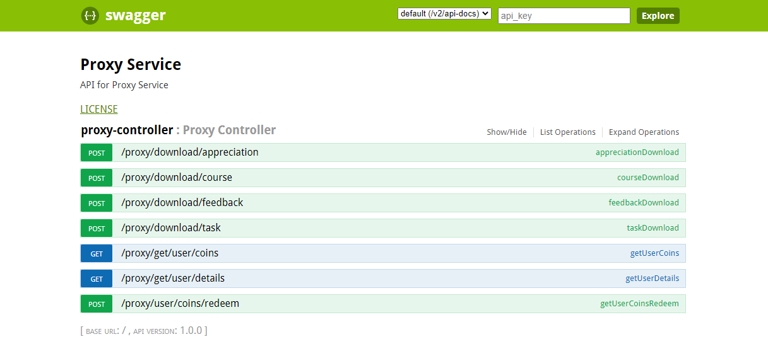
Technical Solution Continued…
Proxy-Service : It exposes REST end points to iCount for data consumption. Here are a few example endpoint :

Slide 14
Technical Solution Continued…
Notification-Prep
Connects to external system and get the list of employees and creates a list of people those are not using iCount capabilities after applying exclusion list (Example – Subcons/onsite employees).
Send employee list in csv format to notification batch to notify employees.
Notification-Batch :
Notify employees who are NOT using or actively using iCount.
Frequency and rules of notifications can be configurable.
Example of rules :
1. Escalation rule for not being use iCount.
2. It can lock other services such as outlook etc. for not at all use.

Slide 15
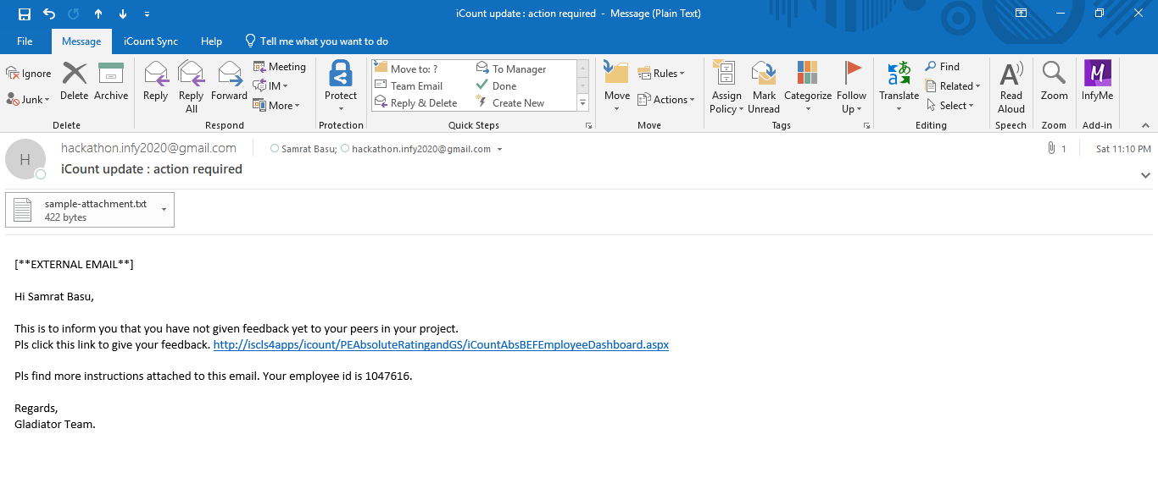
Technical Solution Continued …

Slide 16
Technical Solution Continued …
Cron Job :
Cron jobs is being used to set notification frequency.
Interval can be configurable.
Miscellaneous :
There are 2 types of notifications
To-Do Notifications to the employees who are not using iCount for certain duration.
CDC-Notifications from the adapter service for appreciation, feedback, course/task completion etc.
Coins can be accumulated and redeemed using InfyGold+
Deals can be announced for more coins
Default coins can be setup by the application

Slide 17
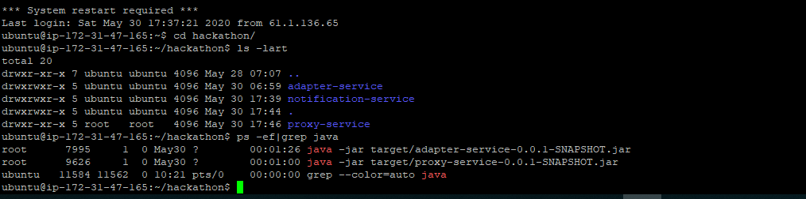
Technical Solution
Depoyment
We want to deploy iCount Store to AWS cloud. This micro-service is running on port 8300, 8301 and 8302 and can be accessed through following urls
http://13.59.15.42:8300/adapter/appreciation/upload http://13.59.15.42:8301/proxy/get/user/details?emailId=samrat.basu%40gmail.com
http://13.59.15.42:8302/notification-service

Slide 18
Thank You

