Slide 1
Project on : MULTI MODALITY IMAGE FUSION
BY –
SAMRATH SINGH

Slide 2
PROBLEM STATEMENT
Every single modality image has its own drawbacks in providing needed information because each image is captured with different radiation power. In order to overcome this it is highly required to obtain information from multiple modalities which is used for clinical diagnosis. In this situation, fusion is a technique used to combine multimodality medical images such as CT, MRI, PET etc.

Slide 3
METHODOLOGY
Reading the images.
Applying the wavelet transform on the images.
Using the Bilateral Filter
Applying the Entropy Based Fusion.
Inverse Wavelet Transformation.
Displaying the Fused Image

Slide 4
Tools / Language used :-
MATLAB R2018a
MATLAB (matrix laboratory) is a multi-paradigm numerical computing environment and proprietary programming language developed by MathWorks. MATLAB allows matrix manipulations, plotting of functions and data, implementation of algorithms, creation of user interfaces, and interfacing with programs written in other languages.
Although MATLAB is intended primarily for numerical computing, an optional toolbox uses the MuPAD symbolic engine allowing access to symbolic computing abilities. An additional package, Simulink, adds graphical multi-domain simulation and model-based design for dynamic and embedded systems.

Slide 5
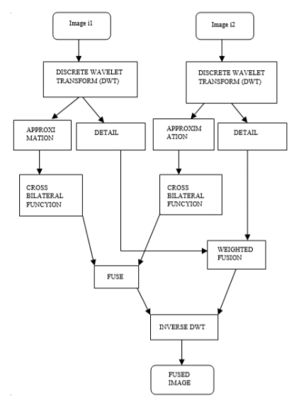
ALL ABOUT THE PROJECT.
The proposed method has been demonstrated in image.
In the given chart two blurred images are accessed for input.
These images are fused using wavelet transform where
approximation and detail part is obtained. Over the both
approximation part, cross bilateral filer is applied and over
the detail part, weighed fusion is performed.

Slide 6
Step 1
So we start off simple.
We input the two images we need to fuse.
For example- In my case , I have used a MRI scan image and a CT scan image of the same part of brain.
- The images used -

Slide 7
STEP 2
Step 2 calls for wavelet transformation of the 2 images.
Wavelet transform give the coefficients with respect to some other special kind of functions. Once these coefficients are obtained, they can be used for any purpose. If we have the coefficients, we can reconstruct the image, denoise it, compress it, etc.
The wavelet transform is similar to the Fourier transform (or much more to the windowed Fourier transform) with a completely different merit function. The main difference is this: Fourier transform decomposes the signal into sines and cosines, i.e. the functions localized in Fourier space; in contrary the wavelet transform uses functions that are localized in both the real and Fourier space.

Slide 8
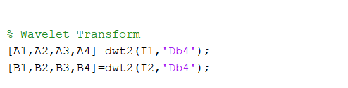
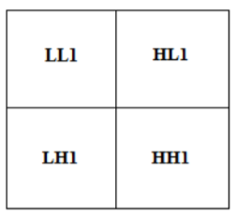
How we used the wavelet Transformation.
First level-based DWT decomposition

Slide 9
Step 3
Going on and applying the Bilateral Filter to certain aspects of the values obtained from the Wavelet Transformation.
A bilateral filter is a non-linear, edge-preserving, and noise-reducing smoothing filter for images. It replaces the intensity of each pixel with a weighted average of intensity values from nearby pixels. This weight can be based on a Gaussian distribution. Crucially, the weights depend not only on Euclidean distance of pixels, but also on the radiometric differences (e.g., range differences, such as color intensity, depth distance, etc.). This preserves sharp edges.

Slide 10
More about Bilateral Filter?
In image processing, filters are used to stifle the high frequency in any image. It means clear and sleeking the images. Filters process is also used to enhance the quality of image as well as detecting edges. There is no. of filters techniques used in image processing and in between the Gaussian filter is one of plausible filter providing sharpness and isolates unnecessary noisy information from the existing images but the drawback of this method is that it ignores the accurate details. To track this kind of problem, cross bilateral filter was proposed by the scientists naming tomasi and manduchi.
Bilateral filter is called as a non-linear filtering technique used to preserve the edges and it’s also for reducing the noise of an image. It protects the sharper details. Further we extend this bilateral filter technique using two different filter kernels. These are spatial based filter kernel and range based filter kernel. Spatial based filter kernel is considered as low passing filter used to gain geometric pattern closeness amid the neighborhood pixels now those range based filter kernel is just an edges stopping function applicable for the scaling of gray color. Both type of filter kernels are depends on particular gaussian distribution process weighted acquired by means of Euclidian distance and gray or color spaces

Slide 11
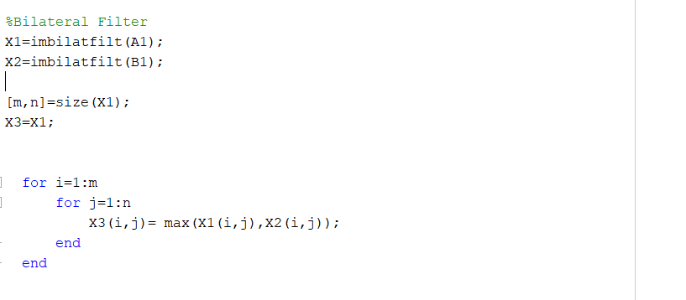
How it was used.

Slide 12
Step 4
The lengthy and arguably the most important part of the project. Now we apply entropy based fusion.
Entropy was introduced by Shanon (1948), were the higher value of Entropy = more detailed information. Entropy is a measure of image information content, which is interpreted as the average uncertainty of information source. In Image, Entropy is defined as corresponding states of intensity level which individual pixels can adapt. It is used in the quantitative analysis and evaluation image details, the entropy value is used as it provides better comparison of the image details.

Slide 13
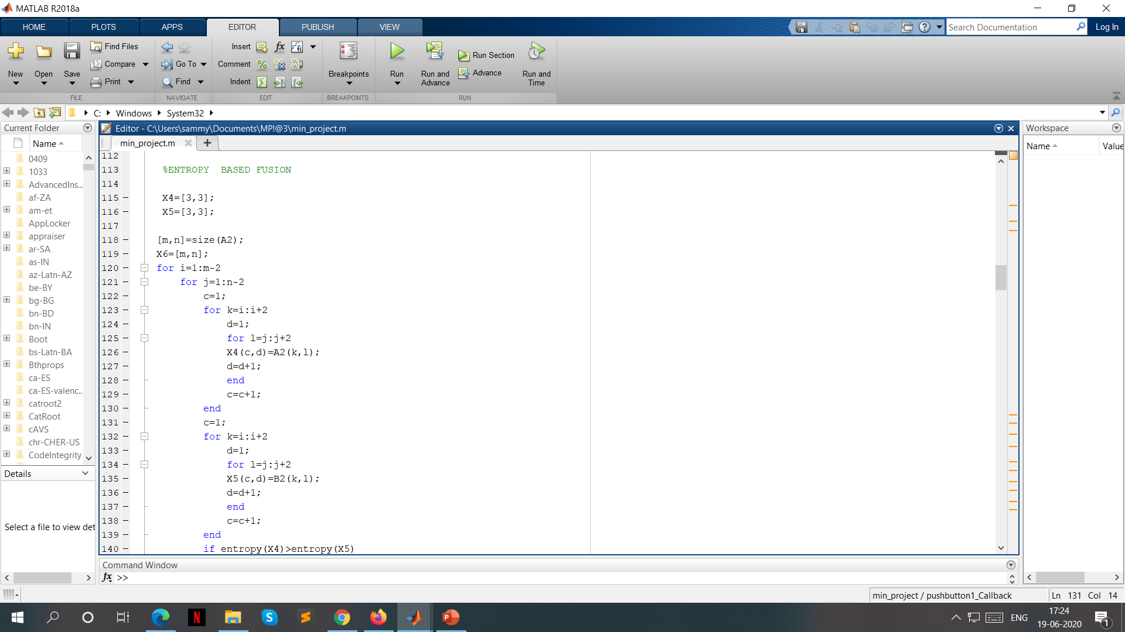
How it was applied in the project?

Slide 14
How it was applied in the project?(contd.)
We basically have 2 matrix as of now. The thing is that we are trying to fuse the two images(matrix) so we compare the entropy of the two matrix , value by value and keep the value that is required for the perfect fused image , i.e. the features of both the images need to be retained while the fusion is taking place. Hence the entropy value which is greater will be stored in another matrix , which is going to help us form the final image.
This is done on all the parts of the image.
We will get 4 values after this , which will help us in forming the final image.

Slide 15
Step 5
Inverse Wavelet Transform
Once we arrive at our discrete wavelet coefficients, we need a way to reconstruct them back into the original signal (or a modified original signal if we played around with the coefficients). In order to do this, we utilize the process known as the inverse discrete wavelet transform.
Much like the DWT can be explained by using filter bank theory, so can the reconstruction of the IDWT. The process is simply reversed. The DWT coefficients are first upsampled (the approximation and the detail coefficients are handled separately) by placing zeros in between every coefficient, effectively doubling the lengths of each. These are then convolved with the reconstruction scaling filter for approximation coefficients (the reconstruction scaling filter is simply the original scaling filter that has been flipped left to right) and the reconstruction wavelet filter for the detail coefficients. These results are then added together to arrive at the original signal.
Similar to how we made the signal periodic before doing our DWT calculations on it, we must make our dwt coefficients periodic before convolving to obtain the original signal. This is done by simply taking the first N/2-1 coefficients from the DWT coefficients, and appending them to the end. Remember that N is the length of our scaling filter.
After the convolution and addition, to grab the part of the signal we want away from the convolution ‘junk’, we grab the coefficients from N to the length of the signal + N -1. This will give us our original signal.

Slide 16
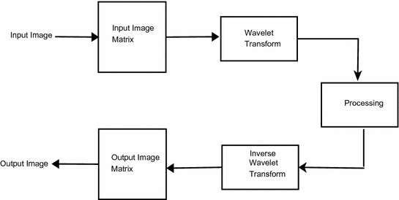
Simple explanation of the working

Slide 17
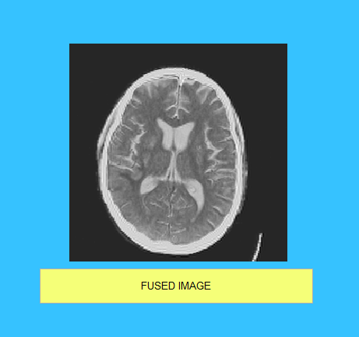
Step 6
Resulting image is displayed.
Resulting fused image of the 2 images used.

Slide 18
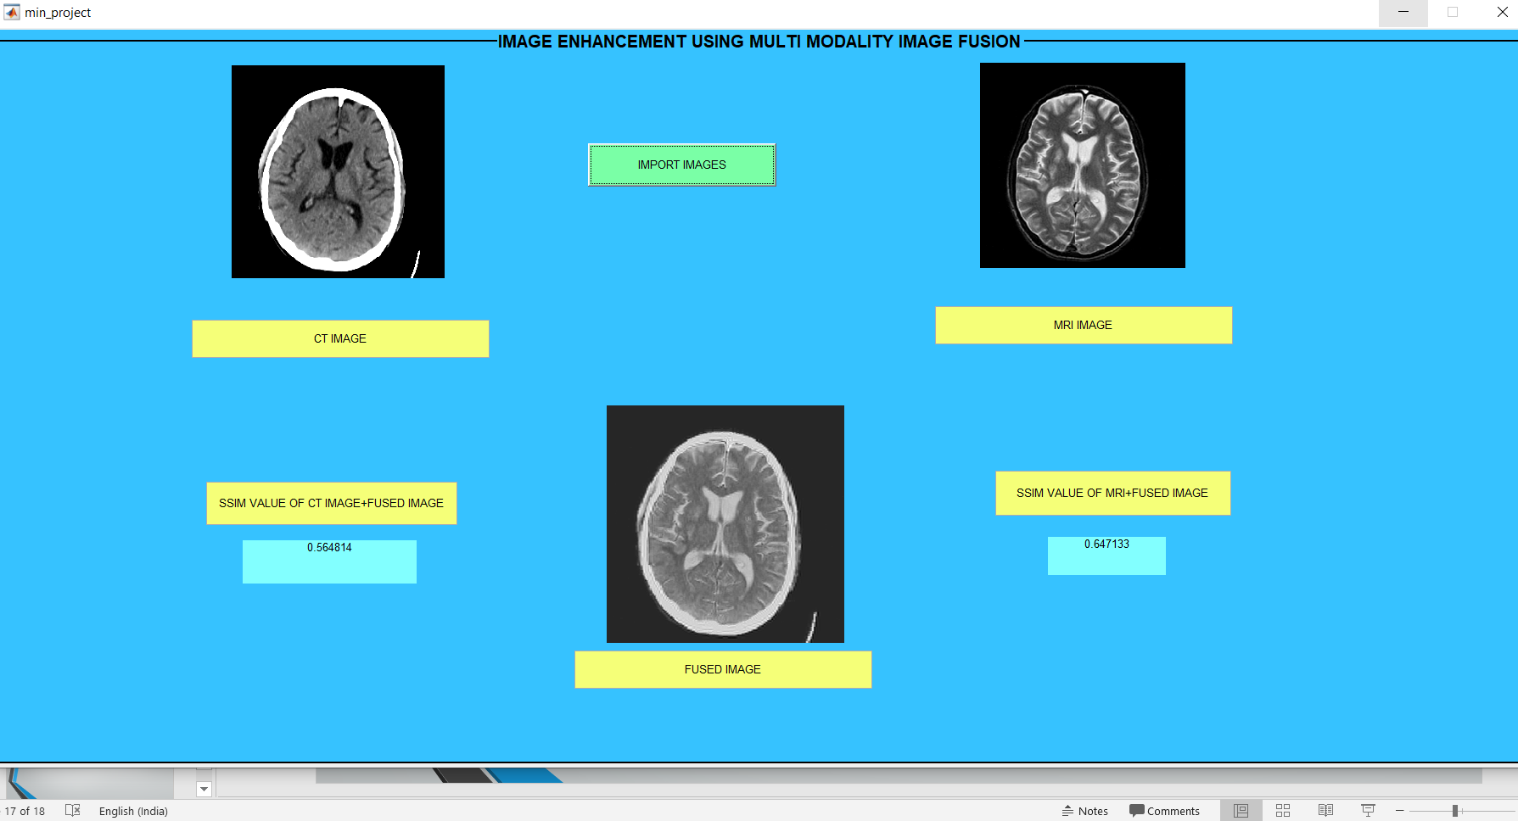
Some screenshots of the working of project.

Slide 19
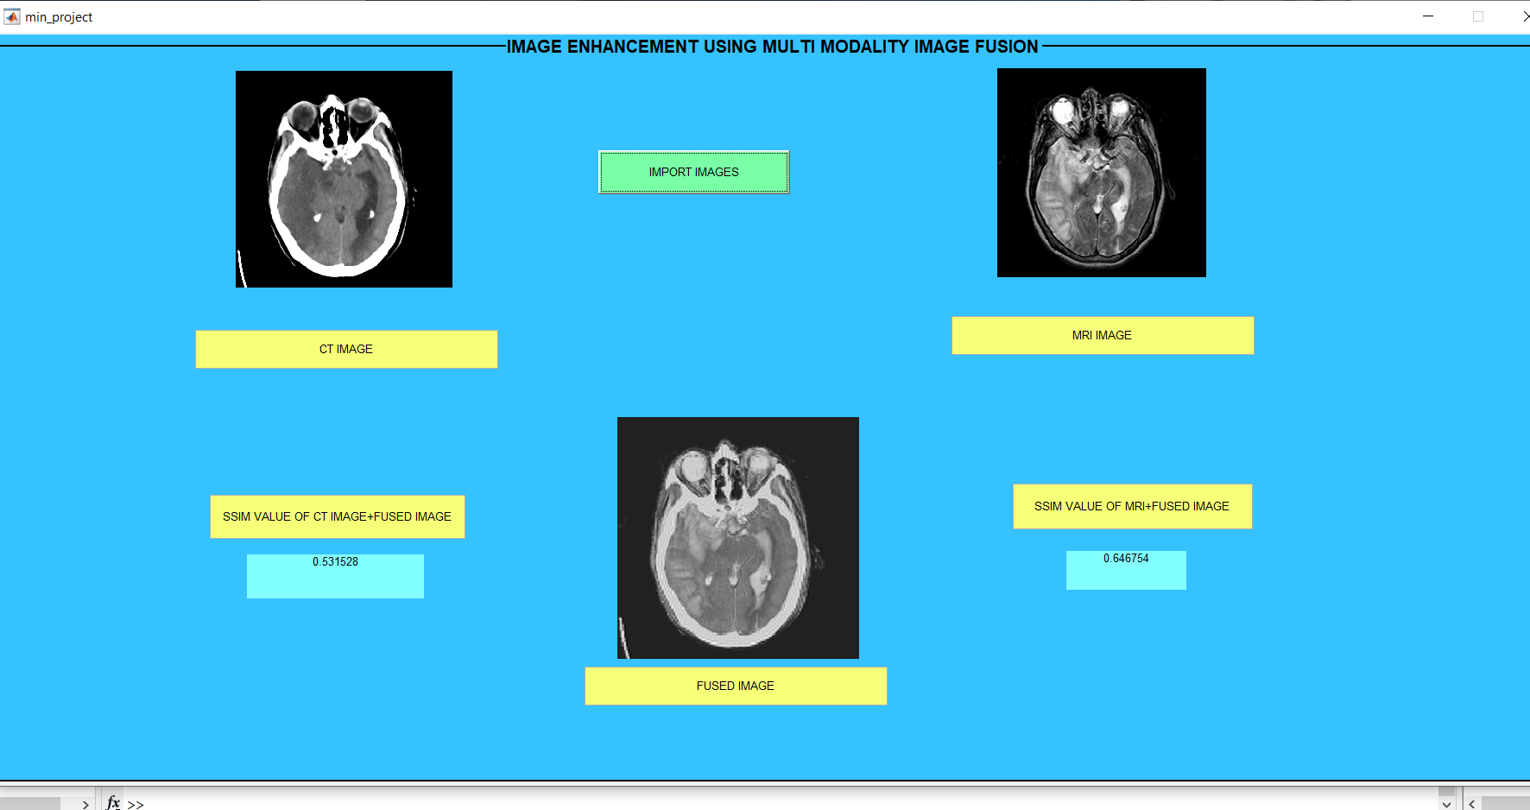

Slide 20
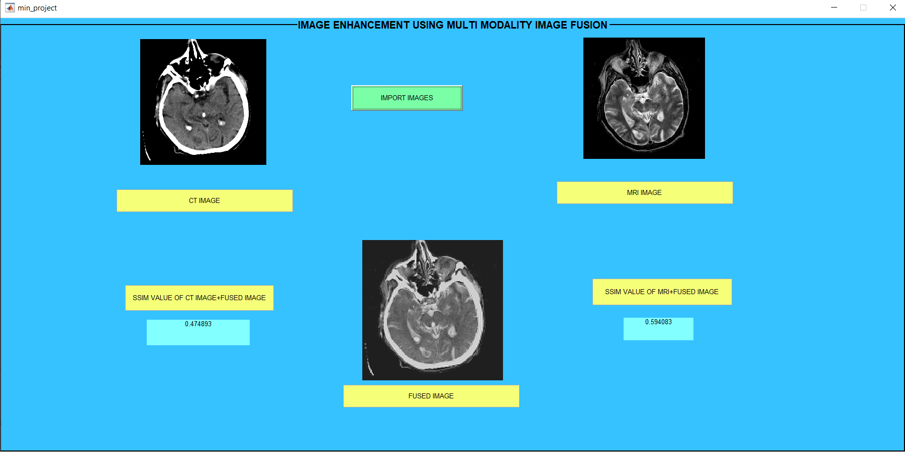

Slide 21
Checking The Results.
SSIM value
The Structural Similarity Index (SSIM) is a perceptual metric that quantifies image quality degradation caused by processing such as data compression or by losses in data transmission. It is a full reference metric that requires two images from the same image capture— a reference image and a processed image.

Slide 22
SSIM value(contd.)
The SSIM values ranges between 0 to 1, 1 means perfect match the reconstruct image with original one. Generally SSIM values 0.97, 0.98, 0.99 for good quality reconstruction techniques.
Since we have to fairly get
both of the image’s features
and fuse them into one,
we do get a pretty decent SSIM score.

Slide 23
Thank you.

