Slide 1
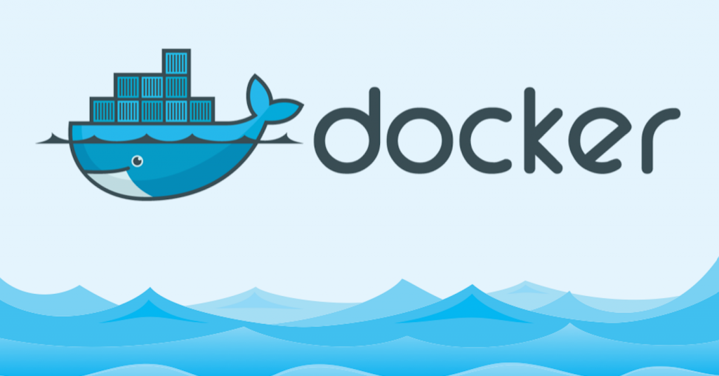
Docker is software containerization
Platform.
It makes the process of application deployment very easy and efficient and
resolves a lot of issues related to deploying applications

Slide 2
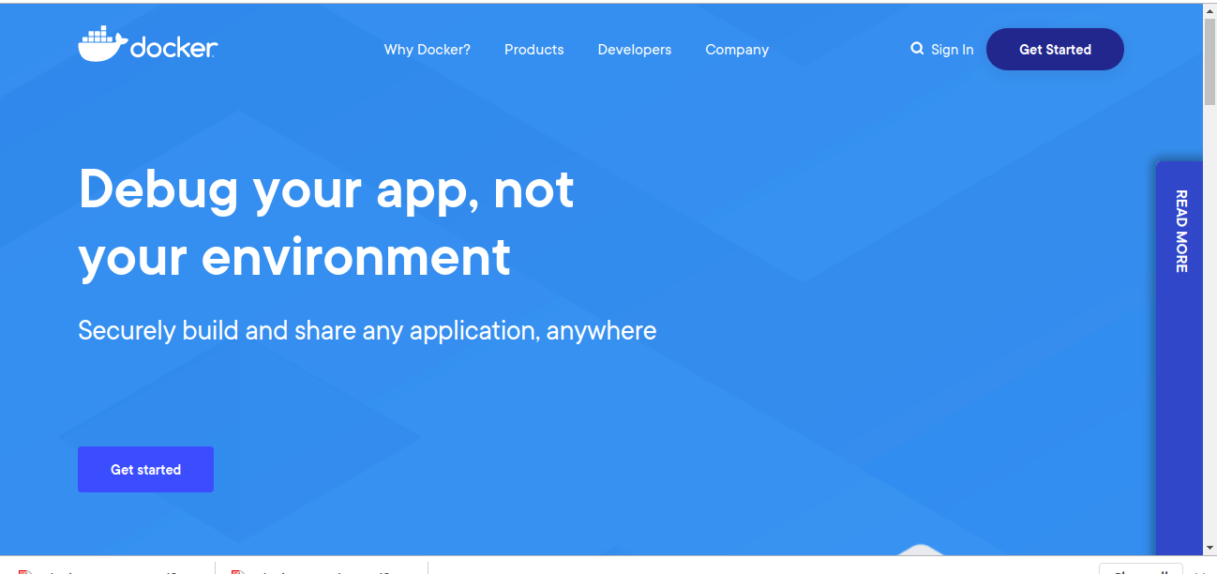

Slide 3
Problems Before Docker
Shipping of Software/Application was not standardised caussed usual issues.
Developers faced issue like Application working in one environment but not in other.
e.g There can be a software wich is updated on Prod but remain same on dev.
Advent Microservice and microservice deployement
Virtual Machines was one of the solution earlier which is costly and time consuming compaired to Docker container

Slide 4
Virtualization VS Containerization
Containerization is an evolved version of Virtualization One of the popular ways of deploying and scalling application and instances. The same task can also be achieved using Virtual Machines, however it is not very efficient, lots of memmory waistage and not optimum utilization of resources.
Containerization uses resources (CPU, Memory, Network, RAM etc) as and when required, In case of virtual machine resources (CPU, Memory, Network, RAM etc) need to be assign in advance.
What is Virtualization?
Virtualization is the technique of importing a Guest operating system on top of a Host operating system. This technique was a revolutionary at the beginning because it allowed developers to run multiple operating systems in different virtual machines all running on the same host. This eliminated the need for extra hardware resource. The advantages of Virtual Machines or Virtualization are:
Multiple operating systems can run on the same machine
* Host OS isolated from virtual machine so no imact on host in case of curruption in VM.
Maintenance and Recovery were easy in case of failure conditions
Total cost of ownership was also less due to the reduced need for infrastructure

Slide 5
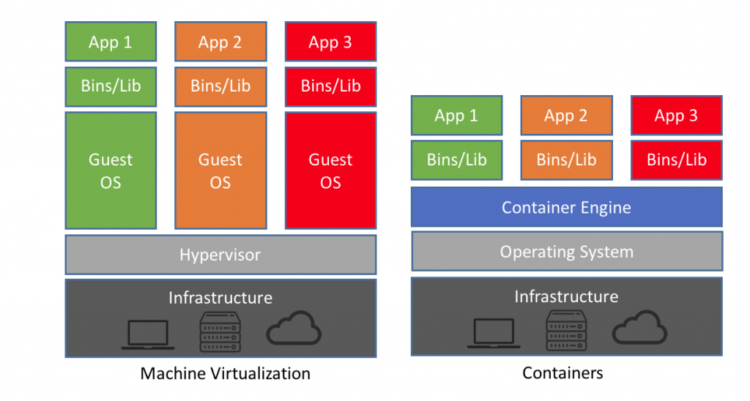
Virtual Machine Vs Container
Vmware / Virtualbox
Docker

Slide 6
Benefits of using Docker
* Flexibility — Even the most complex applications can be containerized.
* Build app only once : An application inside docker container can run on any platform that has docker installed. So there is no need to build and configure app multiple times for different environments.
* Portability across machines – No worries that the application will not perform the same way it did on testing env, an application and all its dependencies can be bundled into a single container that is independent from the host version of Linux kernel, platform distribution, or deployment model. This container can be transfered to another machine that runs Docker, and executed there without compatibility issues.
* Version Control:
* Isolation :Docker makes sure each container has its own resources that are isolated from other containers.
* Security : Docker makes sure that applications that are running on containers are completely segregated and isolated from each other, from a security point of view, by granting us complete control over traffic flow and management.
* Standardization & Productivity : Docker containers ensure consistency across multiple development, You can build locally, deploy to the cloud, and run anywhere. Standardizing service infrastructure across the entire pipeline allows to work in a production parity environment. This reduces the amount of time wasted on defects and increases the amount of time available for feature development.

Slide 7
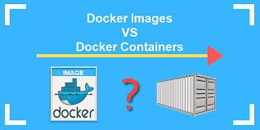
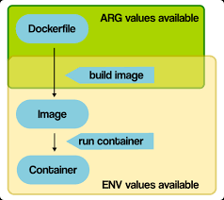
Docker Image Container
Containerize and share any application Across any combination of clouds, languages, and frameworks
It’s not possible to explain what Docker is without explaining what containers are, so let’s look at a quick explanation of containers and how they work.
A container is a special type of process that is isolated from other processes. Containers are assigned resources that no other process can access, and they cannot access any resources not explicitly assigned to them.
Docker File : Docker also gives you the capability to create your own Docker images, and it can be done with the help of Docker Files. A Docker File is a simple text file with instructions on how to build your images.
Docker image : A Docker image is a file, comprised of multiple layers, that is used to execute code in a Docker container. An image is essentially built from the instructions for a complete and executable version of an application, which relies on the host OS kernel.
Running instance of an image is container.

Slide 8
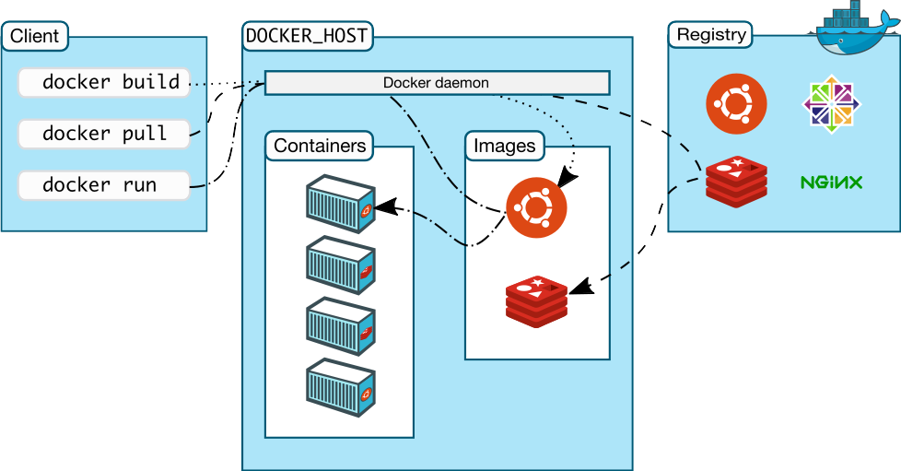
Docker Architechture

Slide 9
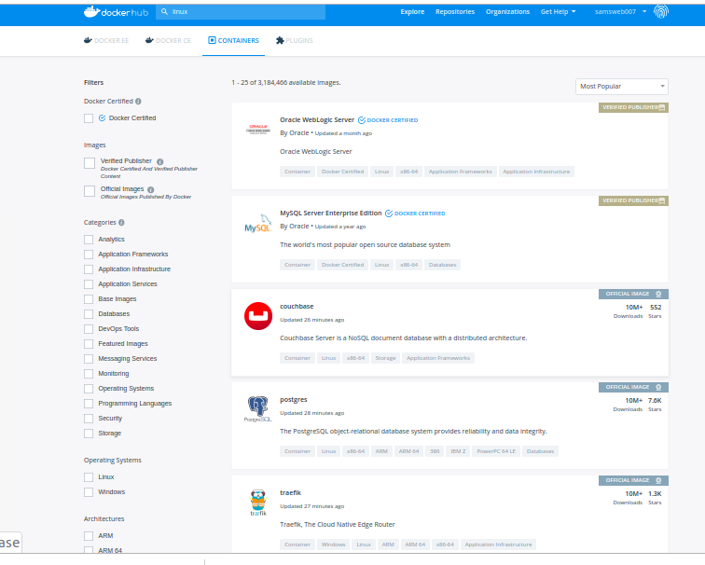
Docker Hub

Slide 10
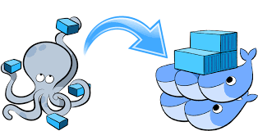
Docker Compose
Docker Compose is a YAML file which contains details about the services, networks, and volumes for setting up the Docker application. So, you can use Docker Compose to create separate containers, host them and get them to communicate with each other. Each container will expose a port for communicating with other containers.
Docker Compose is basically used to run multiple Docker Containers as a single server.
Example:
Suppose if I have an application which requires Node, DB and NPM. I can create one file which would start both the containers as a service without the need to start each one separately. It is really useful especially if you have a microservice architecture.
It is really useful especially if you have a microservice architecture. It can also sequence to operation of running dependent one earlier.

Slide 11
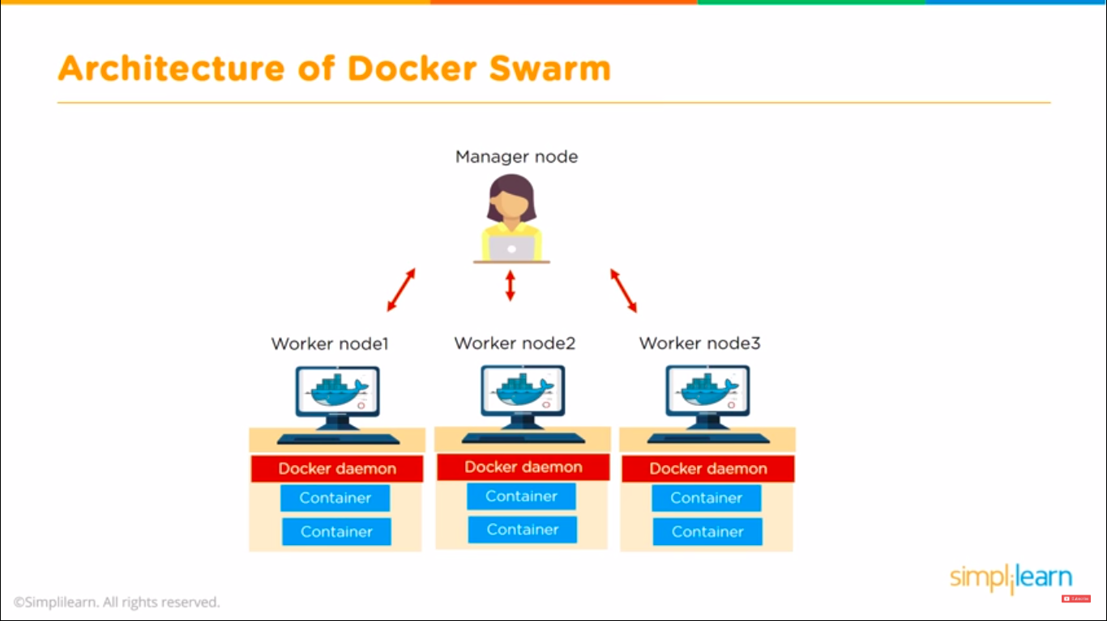
Docker Swarm
A swarm is a cluster of one or more computers running Docker. It can consist of one or more machines, so you can use swarm functionality on your local machine. With the introduction of swarm mode, Docker received built-in orchestration, clustering and scheduling capabilities.
Node can be Follower, Candidate, Leader state. Process of selection is called Leader Election.
Two types of node in Docker Swarm. Manager and worker. Manager node knows status of all nodes in cluster.
There can be multiple manager one primary and other secondary.
In swarm containers are launched using services.
A service is group of containers of same image.
Services enable to scale application.
Create a machine. Requires the --driver flag to indicate which provider (VirtualBox, DigitalOcean, AWS, etc.)

Slide 12
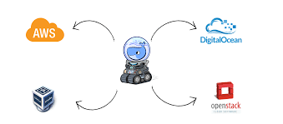
Docker Machine
Docker Machine allows you to provision Docker machines in a variety of environments, including virtual machines that reside on your local system, on cloud providers, or on bare metal servers (physical computers).
Create a machine. Requires the --driver flag to indicate which provider (VirtualBox, DigitalOcean, AWS, etc.)
# docker-machine
$ docker-machine create
$ docker-machine create --driver amazonec2/virtualbox --help
$ docker-machine create --driver amazonec2/virtualbox <machine-name> (swarm-vm1)
$ docker-machine ip <machine-name>
$ docker-machine start <machine-name>
$ docker-machine stop <machine-name>
$ docker-machine ssh <machine-name>
e.g docker-machine stop manager1

Slide 13
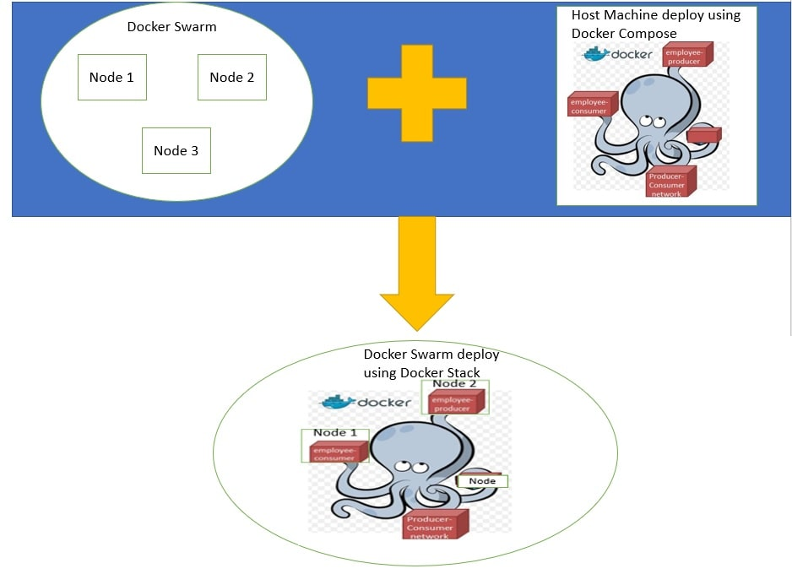
Doker stack deploy
Compose is for single instance for stack we need to use following cammand to deploy service on stack.
$ docker stack deploy -c docker-compose.yml
$ docker swarm init --advertise-addr MANAGER_IP
# Joining as Manager/Worker Node
$ docker swarm join-token worker
$ docker swarm join-token manager

Slide 14
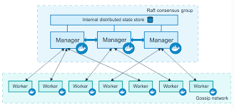
Swarm Cluster
* In docker swarm, service can be accessed by any node in same cluster.
Service is Either Global OR Replicated.
Global service run on each swarm node.
In Replicated service Manager node distributes service to worker nodes.
Having the same consistent state across the cluster means that in case of a failure, any Manager node can pick up the tasks and restore the services to a stable state. For example, if the Leader Manager which is responsible for scheduling tasks in the cluster dies unexpectedly, any other Manager can pick up the task of scheduling and re-balance tasks to match the desired state.
Promote or demote a node (only manager nodes execute )

Slide 15
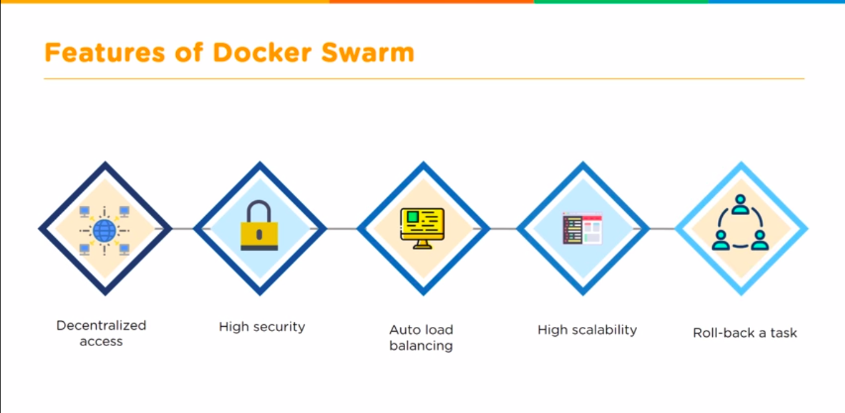
Features Docker Swarm

Slide 16
Container Orchestrator And Clustering
Tools to manage, scale, and maintain containerized applications are called orchestrators, and the most common examples of these are Kubernetes and Docker Swarm. Other includes Apache Mesos, Openshift, Amazon EC2 Container Service (ECS), AWS EKS Service, Azhure EKS.
Orchestration tools helps you to manage a containerized application in various types of physical, virtual, and cloud environments.
Docker swarm is Docker’s own container’s orchestration system.

Slide 17
Container Orchestrators
KUBERNETES
  1. Created by Google
  2. Huge Developer community
  3. Better for large containers (100-1000)
  Can scale upto 5000 nodes with 150,000 pods
  4. Seting up cluster is challanging and complicated
  5. Automatic scalling based on trafic
  6. Manual configuration for load balancing traffic
  7. Rolling updates
  8. Automatic rollback to previous stable state
9. Inbuilt GUI kubernetes dashboard
10. Upto 5000 nodes support
DOCKER SWARM
  1. Created and maintained by Docker Inc
  2. Community is not as big as of K8’s
  3. Better for small no of containers
  Can scale upto 1000 nodes with 30,000 containers.
  4. Setting up cluster is simple and require two commands.
  5. Manual scalling needed
  6. Swarm dose auto Load balancing
  7. Rolling update for container
  8. Manual rollback
  9. Need to use 3rd party GUI visualizers
  10. Up to 2000+ nodes supports.

