Slide 1

courage over comfort
Samrat Kar

Slide 2
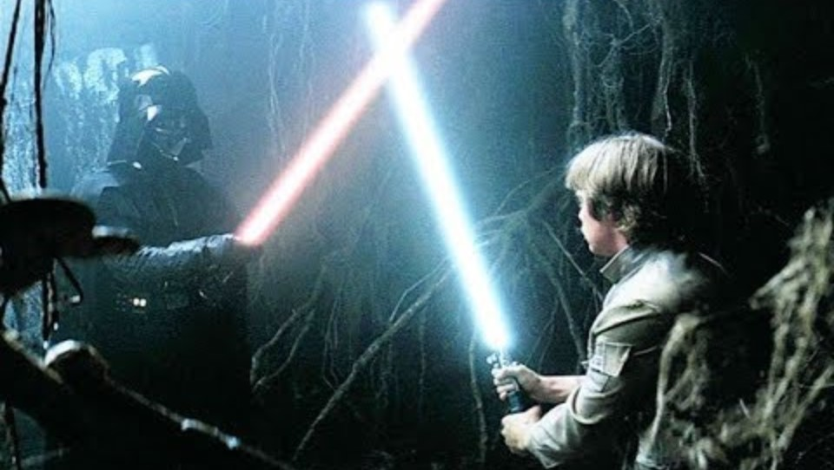
the conflict of comfort
https://www.youtube.com/watch?v=_qiDuHCKSc8

Slide 3

The Cave
… the cave is dangerous and strong with the dark side of the Force. Luke looks confused and afraid, but Yoda’s response is simply, “in you must go”
What is in the cave? “Only what you take with you”
As Luke straps on his weapons, Yoda hauntingly advises, “Your weapons, you will not need them”
Only it isn’t Darth Vader’s face that’s revealed; it’s Luke’s. Luke is staring at his own head on the ground.

Slide 4
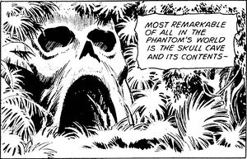
The Dark Forces
The cave you fear to enter,
Holds the treasure you seek.
- Joseph Campbell
The Pattern
… but it’s actually
just stand still.
In the exact same place.
In fear.
Assembling the armor
I am not good enough
I blame
I am better than them

Slide 5
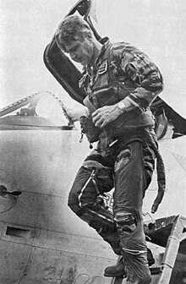

Stockdale Paradox
unwavering faith in the endgame
… Another long pause, and more walking. Then he turned to me and said, “This is a very important lesson.
You must never confuse faith that you will prevail in the end—which you can never afford to lose—with the discipline to confront the most brutal facts of your current reality, whatever they might be.”
stoically accept the brutal facts of reality
https://www.jimcollins.com/concepts/Stockdale-Concept.html

Slide 6
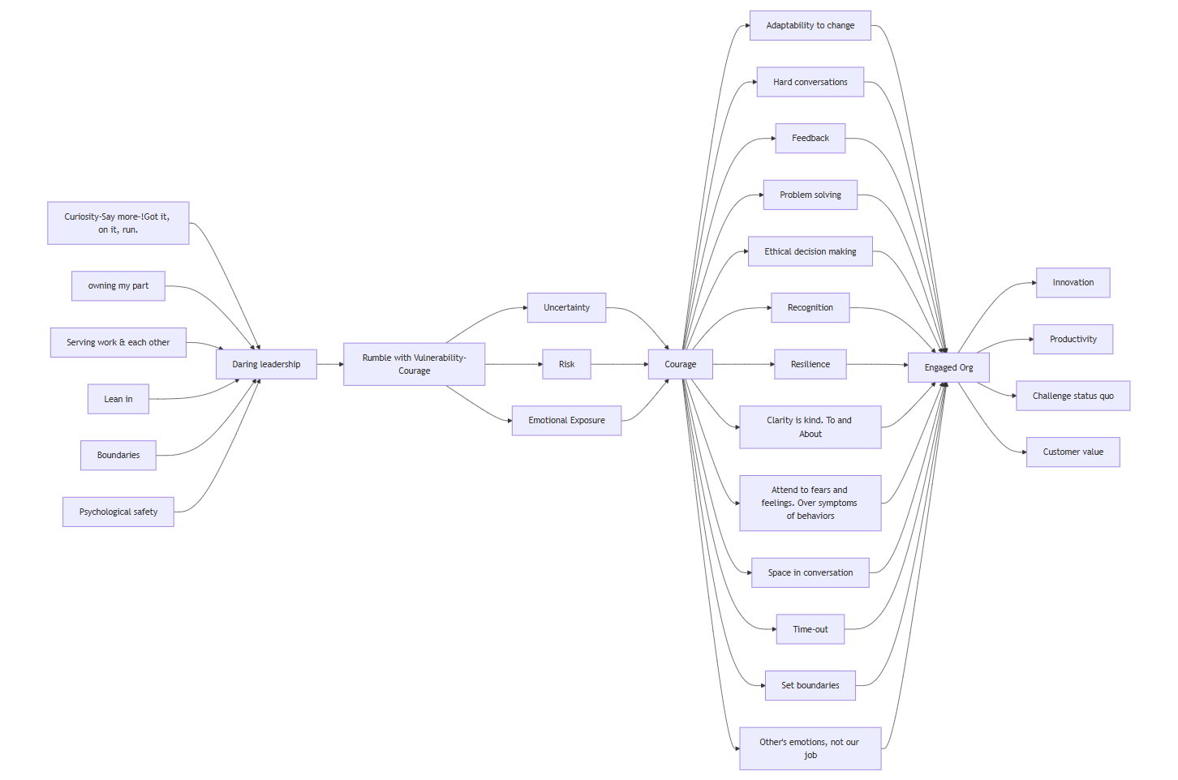
the map

