Slide 1

courage over comfort
Samrat Kar

Slide 2
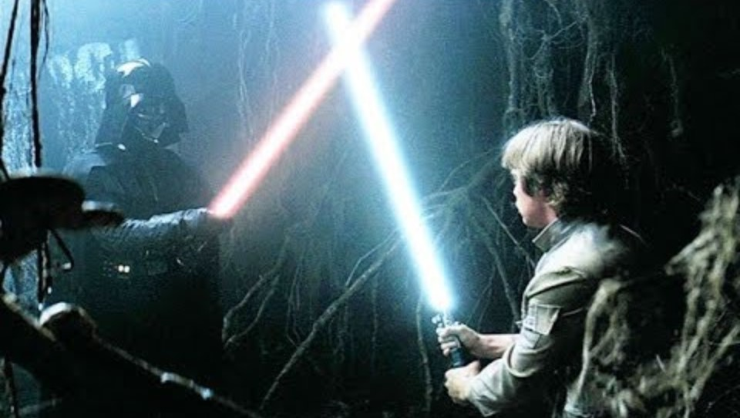
the conflict of comfort
https://www.youtube.com/watch?v=_qiDuHCKSc8

Slide 3

The Cave
… the cave is dangerous and strong with the dark side of the Force. Luke looks confused and afraid, but Yoda’s response is simply, “in you must go”
What is in the cave? “Only what you take with you”
As Lukas straps on his weapons, Yoda hauntingly advises, “Your weapons, you will not need them”
Only it isn’t Darth Vader’s face that’s revealed; it’s Luke’s. Luke is staring at his own head on the ground.

Slide 4
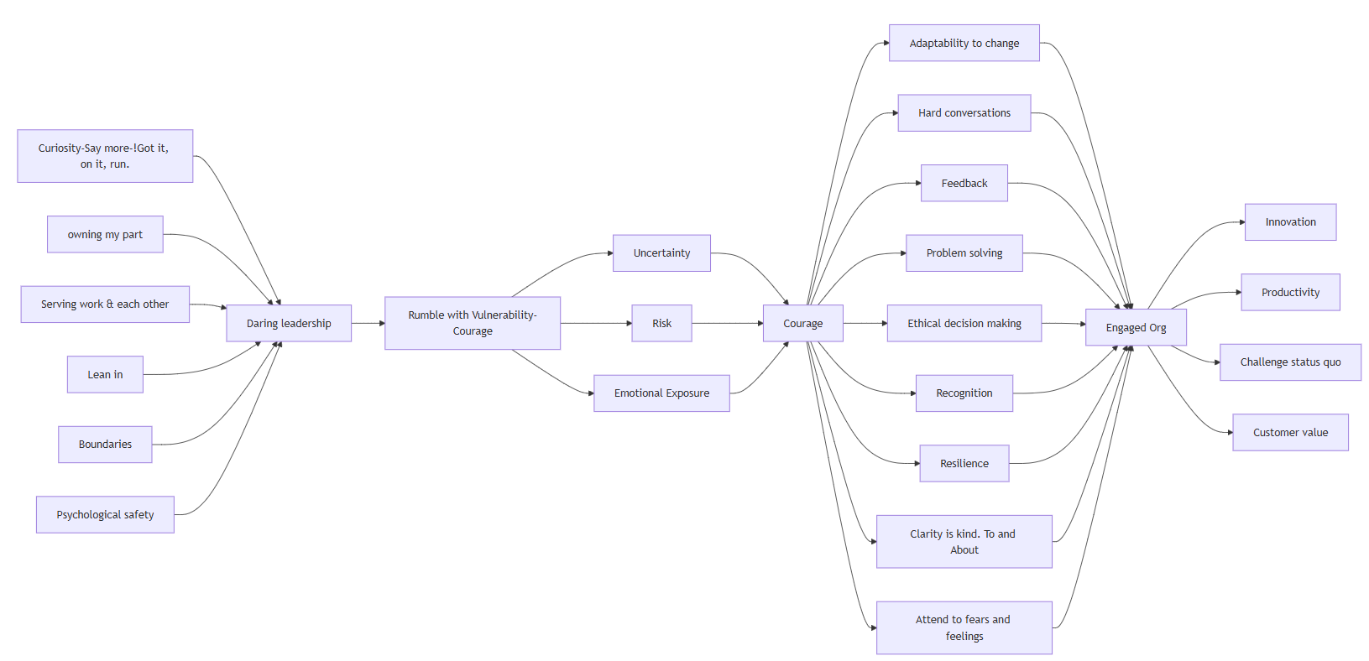
the map

