Slide 1
DATA_SCI_8110 · GENOMICS ANALYTICS · COURSE PROJECT
Differential Gene Expression
Analysis of PBMC RNA-Seq in
Acute Ischemic Stroke
RNA
DATASET GSE122709 (NCBI GEO) · BioProject PRJNA506047
COHORT 15 PBMC samples · 5 Controls · 5 Day-1 Stroke · 5 Day-2 Stroke
PLATFORM Illumina HiSeq X Ten · 150 bp paired-end
PIPELINE FastQC → HISAT2 → featureCounts → DESeq2 → clusterProfiler
Presented by Samrat · April 2026
Notes:
Welcome and introduction. This presentation walks through a complete bulk RNA-seq pipeline applied to publicly available PBMC samples from GSE122709. We compare gene expression in 5 healthy controls against 5 Day-1 (acute) and 5 Day-2 (subacute) ischemic stroke patients. The entire pipeline runs on a 16 GB Windows laptop via WSL2 — accessibility was a design constraint.

Slide 2
i
ROADMAP
Presentation Outline
From raw FASTQ to biological insight — a reproducible, low-resource RNA-seq workflow.
1
Background
2
Research Questions
3
Dataset & Cohort
4
Pipeline
Stroke biology & PBMCs
Three primary objectives
GSE122709, n = 15
Seven sequential steps
5
Results
6
Discussion
7
Clinical Relevance
8
Conclusions
QC → DEGs → Pathways
Biological themes
NETs, biomarkers, therapy
Key takeaways & limits
GSE122709 · Differential Gene Expression in Acute Ischemic Stroke · DATA_SCI_8110
SLIDE 2 / 26
Notes:
This roadmap shows the eight sections of the presentation. Total of 26 slides — pacing target ~45 seconds per slide for a 20 minute talk plus 5 minutes Q&A.

Slide 3
B
BACKGROUND
What is Acute Ischemic Stroke?
CLINICAL DEFINITION
T
Time-Sensitive Emergency
A blood clot blocks an artery feeding the brain — oxygen and nutrients are cut off and brain tissue dies within minutes.
“Time is brain.” Each minute without treatment ≈ 1.9 million neurons lost. Treatment window for thrombolysis: ≤ 4.5 hours.
BEYOND THE BRAIN
♥
Systemic Immune Response
Stroke triggers a powerful secondary immune cascade throughout the body. The systemic alarm spreads through blood within hours, activating neutrophils and monocytes, and changes the molecular state of every immune cell in circulation.
Beyond brain damage, stroke triggers cytokine storms, neutrophil activation, and platelet hyperreactivity.
+
Long-Term Disability
Stroke is the leading cause of acquired adult disability. Post-stroke immune dysregulation affects recovery and infection risk.
GLOBAL BURDEN
12.2M new strokes / year worldwide · 6.5M deaths annually
“ We can’t easily biopsy the brain — but blood tells the story.
GSE122709 · Differential Gene Expression in Acute Ischemic Stroke · DATA_SCI_8110
SLIDE 3 / 26
Notes:
Open by emphasizing scale: stroke is one of the leading causes of death and disability globally. Highlight that the systemic immune response — not just the local brain damage — matters for outcomes.

Slide 4
T
BACKGROUND
Why Sample Peripheral Blood?
PBMCs — A WINDOW INTO STROKE
WHAT IS RNA-SEQ?
Peripheral Blood Mononuclear Cells
A high-throughput technology that quantifies expression of every gene simultaneously by sequencing complementary DNA from RNA.
Monocytes · T cells · B cells · NK cells
APPROXIMATE COMPOSITION
1
2
3
4
5
T lymphocytes
70%
B lymphocytes
15%
Blood draw
RNA isolation
cDNA library
Sequencing
Quantify
NK cells
10%
Monocytes / dendritic
5%
WHY THIS MATTERS
Comparing PBMC transcriptomes between healthy people and stroke patients reveals which genes are activated or suppressed in the post-stroke immune response — and exposes molecular mechanisms that may serve as biomarkers or drug targets.
Each immune cell rewires its transcriptome within hours of stroke — measuring RNA reveals the hidden molecular alarm.
GSE122709 · Differential Gene Expression in Acute Ischemic Stroke · DATA_SCI_8110
SLIDE 4 / 26
Notes:
PBMCs are easy to collect (a normal blood draw), survive freezing well, and can be processed in a standard hospital lab — making them practical for clinical research.

Slide 5
?
OBJECTIVES
Three Research Questions
Q1
Q2
Q3
Which genes are differentially expressed in acute stroke?
How does the response evolve over time?
Which biological pathways are enriched?
Identify genes with significant up- or down-regulation in PBMCs from stroke patients vs healthy controls (padj < 0.05, |log2FC| > 1).
Compare the transcriptomic signatures between Day 1 (acute) and Day 2 (subacute) post-stroke timepoints to characterize the temporal dynamics.
Apply GO, KEGG, and GSEA enrichment to the DEGs and uncover the systems-level biological themes.
DEG identification
Temporal dynamics
Pathway enrichment
GSE122709 · Differential Gene Expression in Acute Ischemic Stroke · DATA_SCI_8110
SLIDE 5 / 26
Notes:
These three questions structure all downstream analysis — DEG discovery, temporal comparison, and pathway interpretation. Q1 and Q2 are descriptive; Q3 is interpretive.

Slide 6
D
DATASET
GSE122709 — PBMC RNA-seq Cohort
GEO ID
BIOPROJECT
SRA STUDY
PLATFORM
READ LENGTH
TOTAL SUBJECTS
GSE122709
PRJNA506047
SRP169610
Illumina HiSeq X Ten
150 bp paired-end
15 (5 + 5 + 5)
STUDY GROUPS & SAMPLE BREAKDOWN
NC
Healthy Controls
D1
Acute Stroke
D2
Subacute Stroke
n = 5
n = 5
n = 5
subjects
subjects
subjects
No known neurological disease
Day 1 post-ischemic stroke
Day 2 post-ischemic stroke
SRR8207876–SRR8207890 range
SRR8207876–SRR8207890 range
SRR8207876–SRR8207890 range
98 GB compressed FASTQ · 30 files (R1+R2 per sample) · 41–51 M read pairs / sample · 150 bp PE
GSE122709 · Differential Gene Expression in Acute Ischemic Stroke · DATA_SCI_8110
SLIDE 6 / 26
Notes:
GSE122709 is a publicly available dataset deposited to NCBI GEO. Highlight the balanced n=5 design — small but adequate for DESeq2's negative binomial model.

Slide 7
P
METHODS
Bioinformatics Pipeline — End to End
STEP 1
↓
STEP 2
✓
STEP 3
⇄
STEP 4
#
Data Acquisition
Quality Control
Genome Alignment
Quantification
SRA Toolkit · prefetch · fasterq-dump
15 samples × 2 paired-end FASTQ
FastQC v0.12 · MultiQC v1.18
Per-base quality, adapter, GC, dup
HISAT2 v2.2.1 → SAMtools sort+index
GRCh38 splice-aware alignment
featureCounts (Subread v2.0.6)
GENCODE v44 · 62,700 genes
STEP 5
Δ
STEP 6
H
STEP 7
≡
RUNTIME & RESOURCES
Differential Expression
Functional Enrichment
Visualization
10–20 hrs total runtime
16 GB RAM Windows + WSL2
150 GB disk (SSD recommended)
DESeq2 v1.42 · ~ condition design
apeglm shrinkage · BH correction
clusterProfiler v4.10
GO + KEGG + GSEA · org.Hs.eg.db
ggplot2 · pheatmap · enrichplot
PCA · Volcano · Heatmap · GSEA
GSE122709 · Differential Gene Expression in Acute Ischemic Stroke · DATA_SCI_8110
SLIDE 7 / 26
Notes:
All seven steps run from a single Bash master script (run_pipeline.sh). We deliberately chose HISAT2 over STAR because of the 16 GB RAM constraint.

Slide 8
↓
STEP 1 / 7
Data Acquisition — SRA Download
DOWNLOAD WORKFLOW
STORAGE
FILE COUNT
98 GB
30
1
esearch / efetch
Resolve GSE122709 → 15 SRR accessions
Total compressed FASTQ
Paired-end FASTQ files
2
prefetch
Download SRA archive files
SAMPLES
RUNTIME
3
fasterq-dump --split-3
15
~6 hr
Decompress to FASTQ — split into R1/R2
4
pigz
Patient samples
Download time (parallel)
Multi-threaded gzip compression
5
Verify
SAMPLE COMMAND
MD5 checksum & file count = 30
$ prefetch SRR8207876
$ fasterq-dump SRR8207876 --split-3 --skip-technical
GSE122709 · Differential Gene Expression in Acute Ischemic Stroke · DATA_SCI_8110
SLIDE 8 / 26
Notes:
SRA Toolkit v3.0.7 was used. The split-3 flag separates paired reads into R1/R2. We used pigz instead of gzip for multi-core compression — saves hours.

Slide 9
✓
STEP 2 / 7
Read Quality Control — FastQC + MultiQC
QC RESULTS — ALL 30 FASTQ FILES
BIOLOGY HIDING IN THE QC
METRIC
OBSERVATION
STATUS
Lower duplication in stroke samples is a real biological signal
Read length
150 bp
PASS
Reads / sample
41–51 M pairs
PASS
NC (Controls)
71%
Per-base quality
Q-score > Q30
PASS
D1 (Acute stroke)
47%
Adapter content
None detected
PASS
GC content
44–50%
Why this matters: Lower duplication = more diverse transcripts. Acute stroke patients show a broader, more activated transcriptional landscape.
PASS
Sequence duplication
Bio-expected
FAIL*
Per-base content
Hexamer bias
FAIL*
* Expected biology in RNA-seq, not a quality issue
DECISION
All 15 samples passed quality thresholds. No read trimming or sample exclusion. Proceed directly to alignment.
GSE122709 · Differential Gene Expression in Acute Ischemic Stroke · DATA_SCI_8110
SLIDE 9 / 26
Notes:
Two checks 'fail' by FastQC defaults but are expected in RNA-seq: duplication and per-base content (random hexamer bias).

Slide 10
⇄
STEP 3 / 7
Genome Alignment — HISAT2 → SAMtools
PER-SAMPLE ALIGNMENT RATES (HISAT2 → GRCh38)
HISAT2 PARAMETERS
NC_1
94.82%
--dta downstream transcript-friendly --rna-strandness RF (paired reverse) -p 4 4 alignment threads Reference GRCh38 (basic, no SNP)
NC_3
95.71%
NC_4
95.78%
NC_5
95.19%
NC_6
92.45%
D1_1
95.28%
D1_2
95.85%
D1_3
94.69%
D1_4
95.52%
MEAN ALIGNMENT RATE
D1_5
95.56%
95.1 %
D2_1
95.48%
D2_2
95.42%
D2_3
95.22%
MEMORY MANAGEMENT
D2_4
94.84%
HISAT2 loads the GRCh38 index (~8 GB) into RAM. Samples processed sequentially to fit within 16 GB system limit.
D2_6
96.04%
90 % 100 %
GSE122709 · Differential Gene Expression in Acute Ischemic Stroke · DATA_SCI_8110
SLIDE 10 / 26
Notes:
All 15 samples aligned with rates between 92.45% and 96.04% — uniformly excellent. We chose HISAT2 over STAR specifically because of the 16 GB RAM constraint.

Slide 11
#
STEP 4 / 7
Gene Quantification — featureCounts
FEATURECOUNTS PARAMETERS
UNIVERSE
TESTED
62,700
23,995
-p --countReadPairs count fragments, not reads -s 0 unstranded counting -B both reads must map -C exclude chimeric pairs -t exon -g gene_id exon-level → gene Annotation GENCODE v44 GTF
Annotated GENCODE genes
Genes after pre-filter
ASSIGNED
COVERAGE
34–47%
14–25 M
Read assignment rate
Assigned read pairs / sample
PRE-FILTERING RATIONALE
Drop genes with < 10 counts in fewer than 5 samples → removes ~62% of annotated features that are noise-only. This dramatically improves multiple-testing power without removing biology — DESeq2 still applies independent filtering downstream.
GSE122709 · Differential Gene Expression in Acute Ischemic Stroke · DATA_SCI_8110
SLIDE 11 / 26
Notes:
featureCounts is part of the Subread package — fast, memory-light, deterministic. Pre-filtering is conservative.

Slide 12
Δ
STEP 5 / 7
Differential Expression — DESeq2
1
≡
2
M
3
ƒ
4
⇄
5
≣
Size factors
Dispersion
GLM Fit
Contrasts
apeglm Shrink
Normalize for library-size differences
Estimate per-gene biological variance
Negative binomial ~ condition
D1 vs NC & D2 vs NC
Stabilize log2 fold changes
SIGNIFICANCE THRESHOLDS
DESIGN FORMULA
padj < 0.05 Benjamini-Hochberg FDR control |log2FC| > 1 At least 2-fold change Independent filtering Auto-applied by DESeq2 Cook's distance flag Outlier-driven genes excluded
dds <- DESeqDataSetFromMatrix(counts, coldata, ~ condition )
Three factor levels: control · stroke_d1 · stroke_d2
Two independent contrasts run on the same fitted model — preserves variance estimates and improves dispersion accuracy across all 15 samples.
GSE122709 · Differential Gene Expression in Acute Ischemic Stroke · DATA_SCI_8110
SLIDE 12 / 26
Notes:
DESeq2 v1.42. Both contrasts share the same dispersion estimate from the full model — much more accurate than running each pairwise comparison separately.

Slide 13
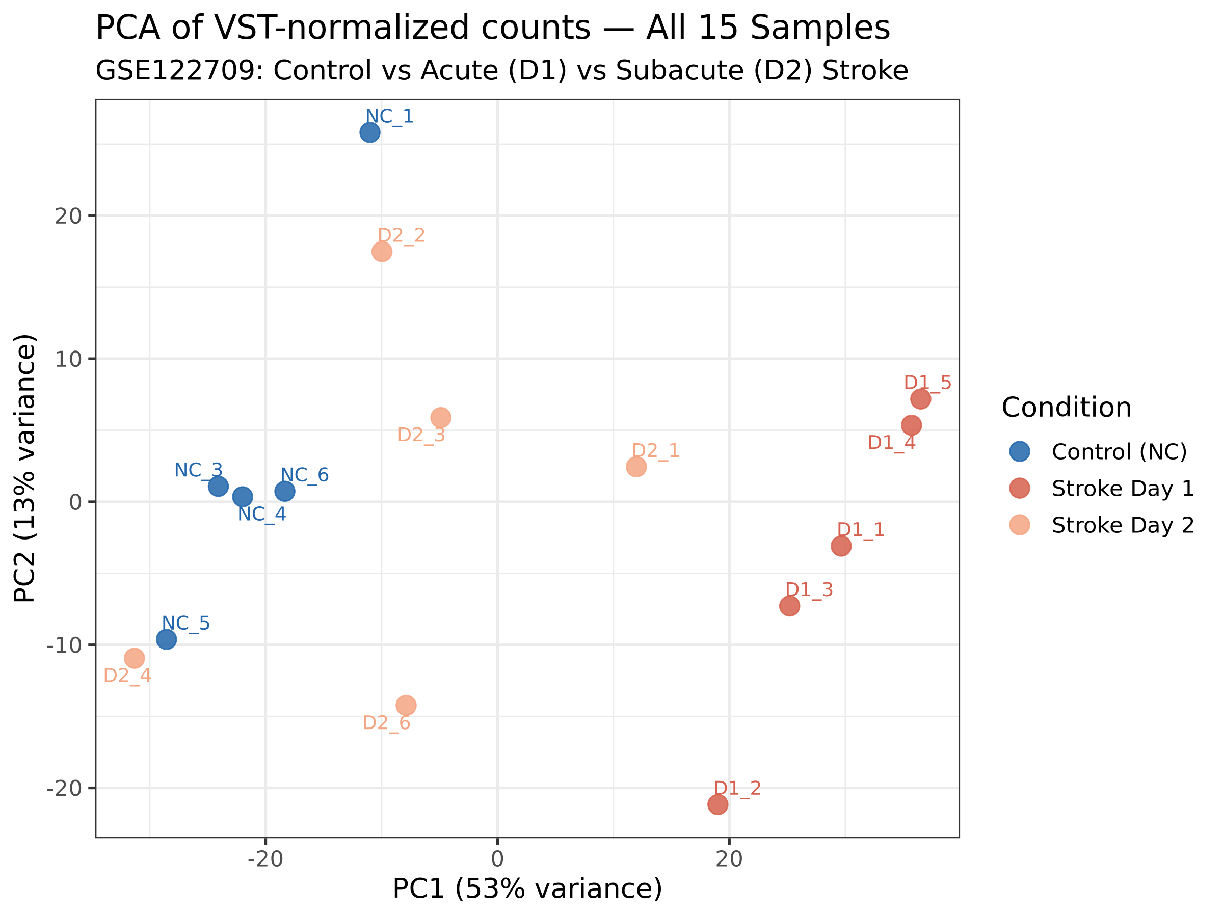
P
RESULT 1 / 8
Sample-Level Quality — PCA
WHAT IS PCA?
PCA reduces 24,000-dimensional gene-expression data into two summary axes (PC1, PC2). Samples that cluster together have similar transcriptomes.
KEY OBSERVATIONS
G
Three groups separate cleanly
PC1 captures most variance — controls vs stroke gradient.
·
D2 sits between NC and D1
Consistent with partial transcriptomic recovery by Day 2.
✓
No outliers detected
All 15 samples within group ellipses — no batch effect.
✓ Biological signal dominates — proceed to DGE analysis
GSE122709 · Differential Gene Expression in Acute Ischemic Stroke · DATA_SCI_8110
SLIDE 13 / 26
Notes:
PCA on VST counts. The clean three-group separation tells us the experimental design captures real biology. No batch effects.

Slide 14
Δ
RESULT 2 / 8
DEG Summary — Acute Stroke (D1 vs NC)
PADJ < 0.05 · |LFC| > 1
HIGHER IN STROKE
LOWER IN STROKE
8,594
4,890
3,704
Total DEGs
Up-regulated
Down-regulated
35.8% of all expressed genes are dysregulated — an extraordinary systemic alarm
TOP UP-REGULATED (selected)
TOP DOWN-REGULATED (selected)
RPL/RPS family ribosomal proteins · global translation Histones (H1/H2A/H2B/H3/H4) chromatin / NET CXCL9, CXCL10, CXCL5 pro-inflammatory chemokines ELANE neutrophil elastase · NET formation S100A12 alarmin · myeloid activation
PPBP (CXCL7) platelet chemokine · LFC = −4.69 RGS18 platelet activation regulator · LFC = −3.2 CXCR4 chemokine receptor · lymphocyte trafficking CD160 T/NK cell receptor · cytotoxicity IL7R lymphocyte survival · immunosuppression
GSE122709 · Differential Gene Expression in Acute Ischemic Stroke · DATA_SCI_8110
SLIDE 14 / 26
Notes:
8,594 DEGs is huge — for context, LPS stimulation of monocytes typically yields 2,000–4,000 DEGs.

Slide 15
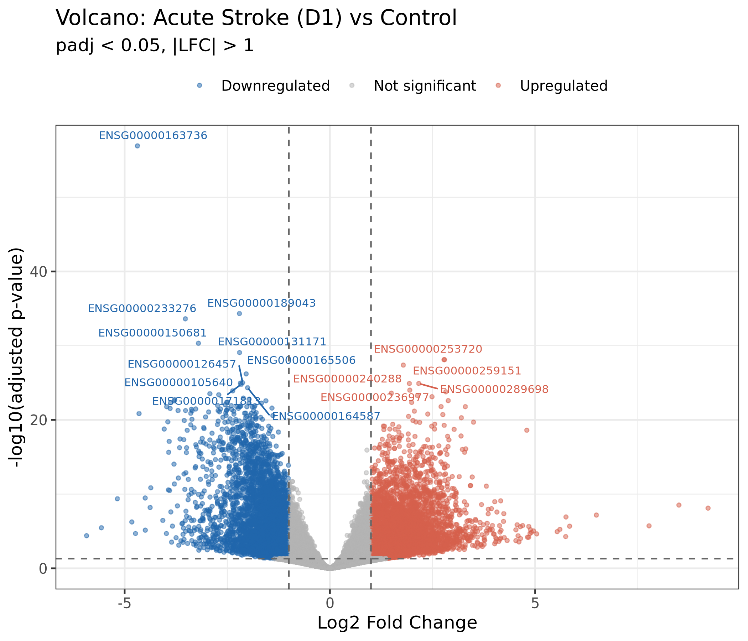
V
RESULT 3 / 8
Volcano Plot — Acute Stroke (D1 vs NC)
HOW TO READ
X-axis: log2 fold change
Y-axis: −log10(adjusted p-value)
Distance from origin = significance × effect
Up-regulated DEG
Down-regulated DEG
Not significant
KEY TAKEAWAYS
• Volcano is wide & tall — extreme effect & significance • Right side dominated by ribosomal & immune effectors • Far left tail driven by PPBP and platelet transcripts • padj approaches 10⁻²⁰⁰ for ribosomal RPL/RPS family
GSE122709 · Differential Gene Expression in Acute Ischemic Stroke · DATA_SCI_8110
SLIDE 15 / 26
Notes:
The volcano plot makes it obvious that the acute stroke transcriptome is wildly different from controls. PPBP is a true outlier on the down-regulated side.

Slide 16
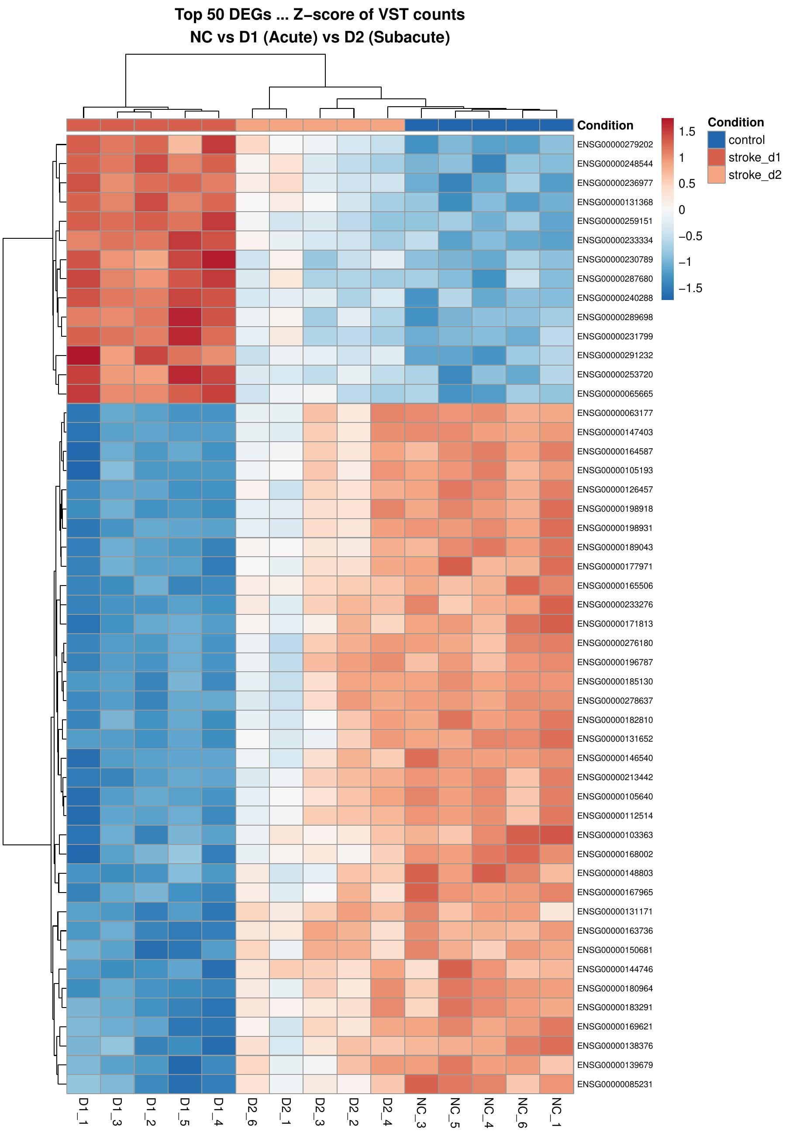
H
RESULT 4 / 8
Heatmap — Top 50 DEGs Across All Samples
ROW Z-SCORED EXPRESSION
Each row is a gene, each column a sample. Colors show how many SD a sample is above (red) or below (blue) the gene's mean.
LOW
HIGH
CLUSTERING REVEALS …
G
Two main column blocks
Stroke vs control samples cluster cleanly.
≣
Two row gene programs
Up vs down DEGs separate as horizontal bands.
T
D2 partially resembles NC
Recovery signature visible at 48 h post-stroke.
GSE122709 · Differential Gene Expression in Acute Ischemic Stroke · DATA_SCI_8110
SLIDE 16 / 26
Notes:
Top 50 most significant DEGs across all 15 samples. Pheatmap performed hierarchical clustering. Some Day 2 samples cluster closer to controls.

Slide 17
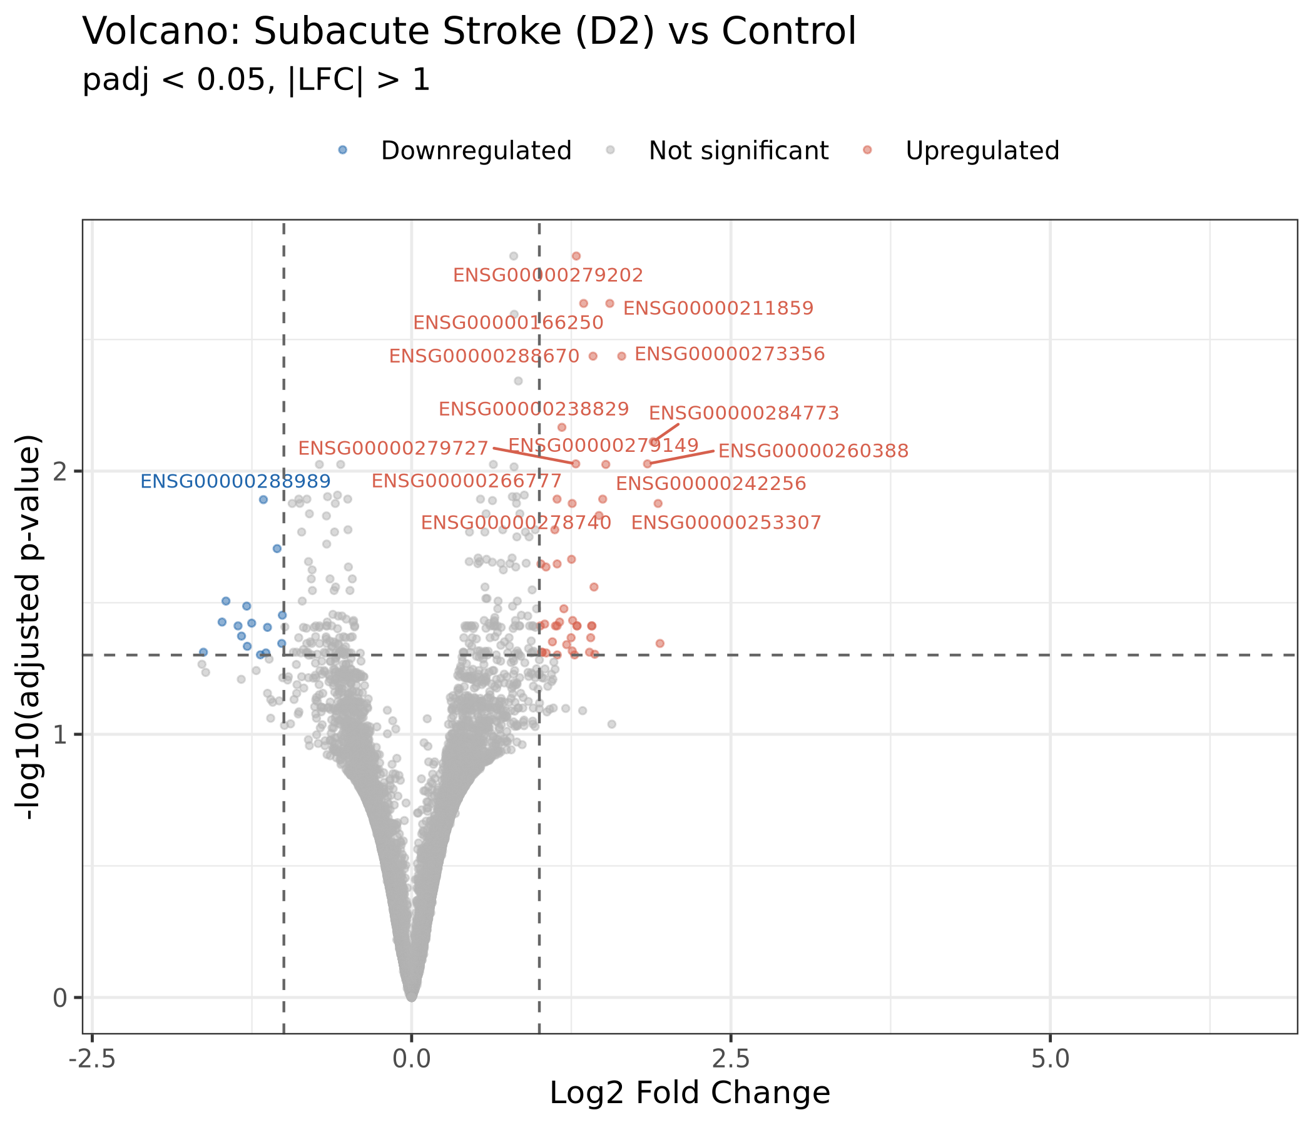
T
RESULT 5 / 8
Subacute Phase — D2 vs NC
THE COLLAPSE
From 8,594 to 60 DEGs in 24 hours
8,594
60
DAY 1 DEGs
DAY 2 DEGs
≈ 143× reduction in just 24 hours
WHAT'S DRIVING THE NORMALIZATION?
DUSP2 and DUSP8 — dual-specificity phosphatases — are upregulated. They actively dephosphorylate ERK and p38 MAPK to shut down inflammatory signaling.
GSE122709 · Differential Gene Expression in Acute Ischemic Stroke · DATA_SCI_8110
SLIDE 17 / 26
Notes:
Over 99% of Day 1 DEGs return toward baseline within 24 hours. DUSP2/DUSP8 are active brakes on the MAPK cytokine cascade.

Slide 18
∩
RESULT 6 / 8
Temporal Overlap — Persistent vs Transient
D1 ∩ D2 DEG VENN
BIOLOGICAL READOUT
D1 (Acute)
D2 (Subacute)
PERSISTENT
55
Sustained changes — prime candidates for biomarkers and therapeutic targets.
genes
ACUTE-ONLY
8,539
D1 only
8,539
Shared
55
D2 only
5
Massive transient alarm — resolves quickly. Time-of-sampling is critical.
genes
LATE-EMERGING
5
Newly altered at 48 h — recovery / resolution program.
genes
GSE122709 · Differential Gene Expression in Acute Ischemic Stroke · DATA_SCI_8110
SLIDE 18 / 26
Notes:
The 55 shared genes are the most important biological set in this study — candidate biomarkers and drug targets.

Slide 19
H
STEP 6 / 7
Functional Enrichment — Three Complementary Tests
OVER-REPRESENTATION (ORA)
PATHWAY-LEVEL ORA
RANK-BASED ANALYSIS
GO
KG
GS
Gene Ontology (GO)
KEGG Pathways
GSEA
Test whether DEGs are over-enriched for biological processes (BP), molecular functions (MF), or cellular components (CC) compared to chance. Hypergeometric test on background of all tested genes.
Test whether DEGs are over-enriched for curated KEGG pathway gene sets (e.g., NET formation, oxidative phosphorylation, TLR signaling). Provides systems-level interpretation of DEG lists.
Use the entire gene list ranked by sign(LFC) × −log10(p). Tests whether members of a gene set are coordinately enriched at the top or bottom of the ranking — no significance cutoff needed.
63 GO / 6 GO (D1 / D2)
12 KEGG / 2 KEGG (D1 / D2)
189 GSEA / 155 GSEA (D1 / D2)
GSE122709 · Differential Gene Expression in Acute Ischemic Stroke · DATA_SCI_8110
SLIDE 19 / 26
Notes:
Three complementary methods. ORA requires hard DEG cutoff; GSEA captures coordinated subtle shifts. clusterProfiler v4.10 + org.Hs.eg.db.

Slide 20
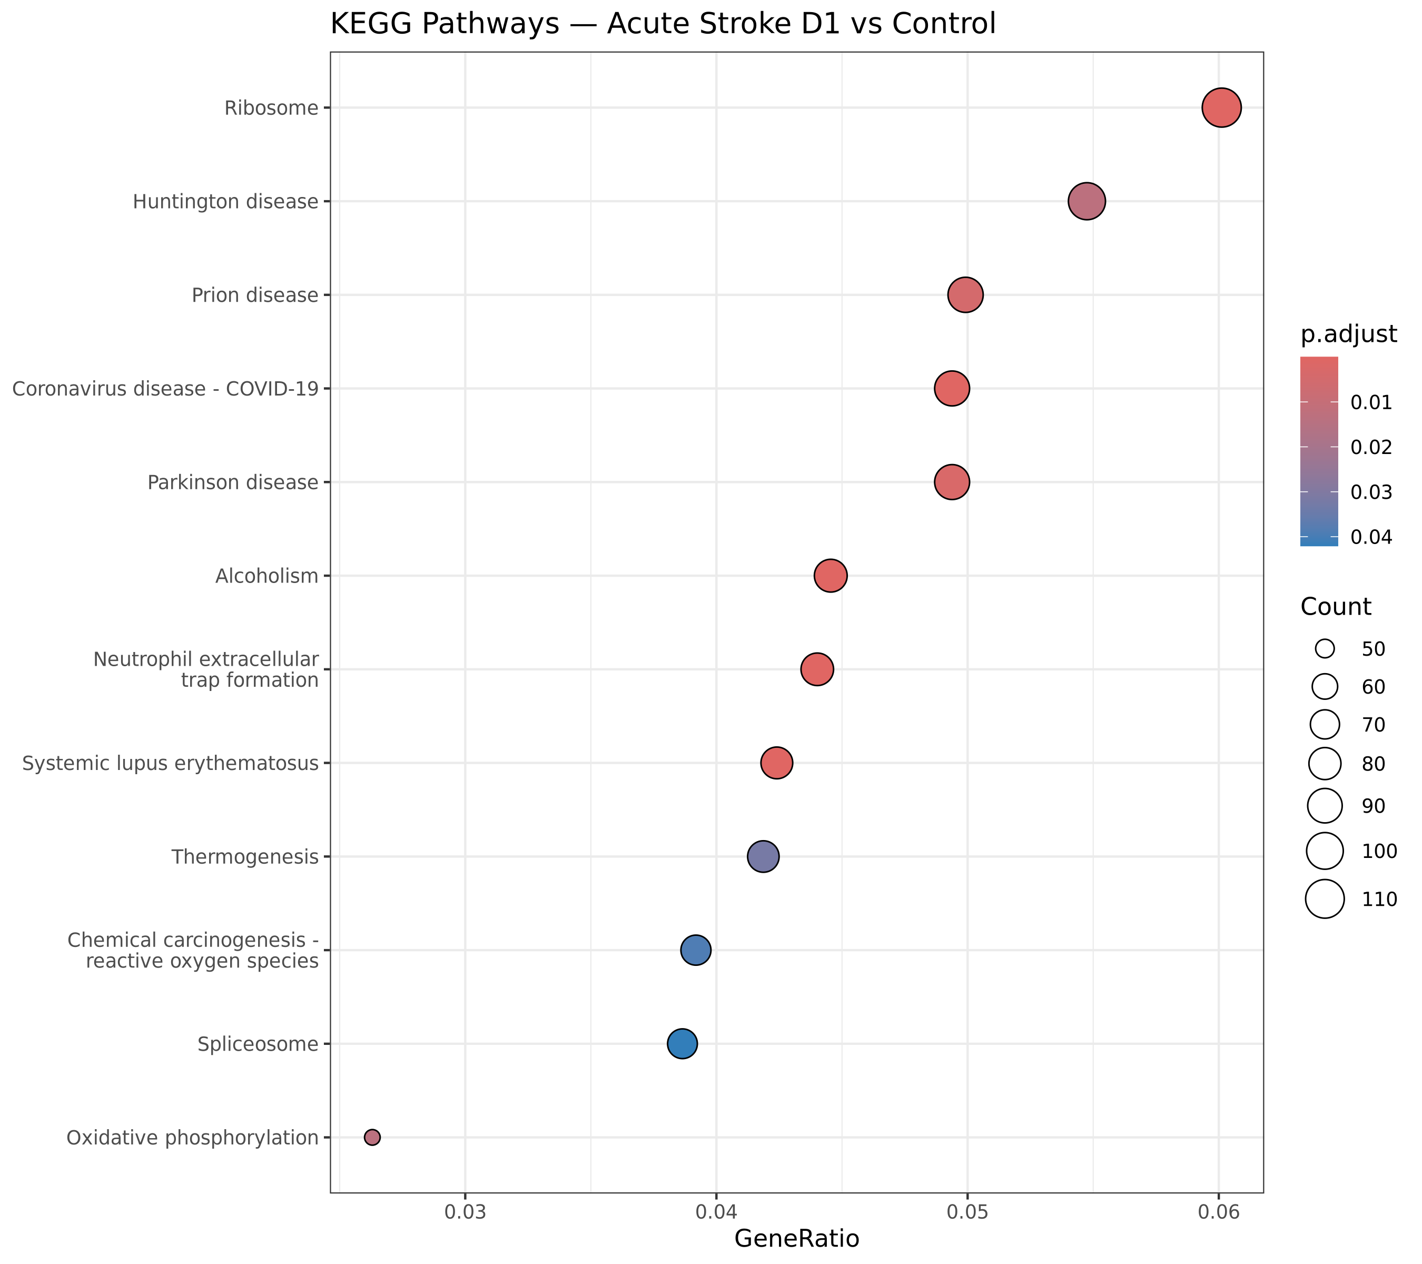
K
RESULT 7 / 8
KEGG Pathway Enrichment — Acute Stroke
TOP KEGG PATHWAYS · D1 vs NC
PATHWAY
GENES
p.adj
Ribosome
112
5.7e-23
Systemic lupus erythem.
79
1.1e-16
Alcoholism (chromatin)
83
9.3e-11
COVID-19
92
8.9e-07
NET formation
82
1.0e-05
Parkinson disease
92
2.8e-03
Oxidative phosphorylation
49
1.4e-02
Spliceosome
72
4.2e-02
Four biological themes emerge → next slides
GSE122709 · Differential Gene Expression in Acute Ischemic Stroke · DATA_SCI_8110
SLIDE 20 / 26
Notes:
Dotplot: dot size = gene count, dot color = adjusted p-value. Ribosome pathway dominates with 112 genes.

Slide 21
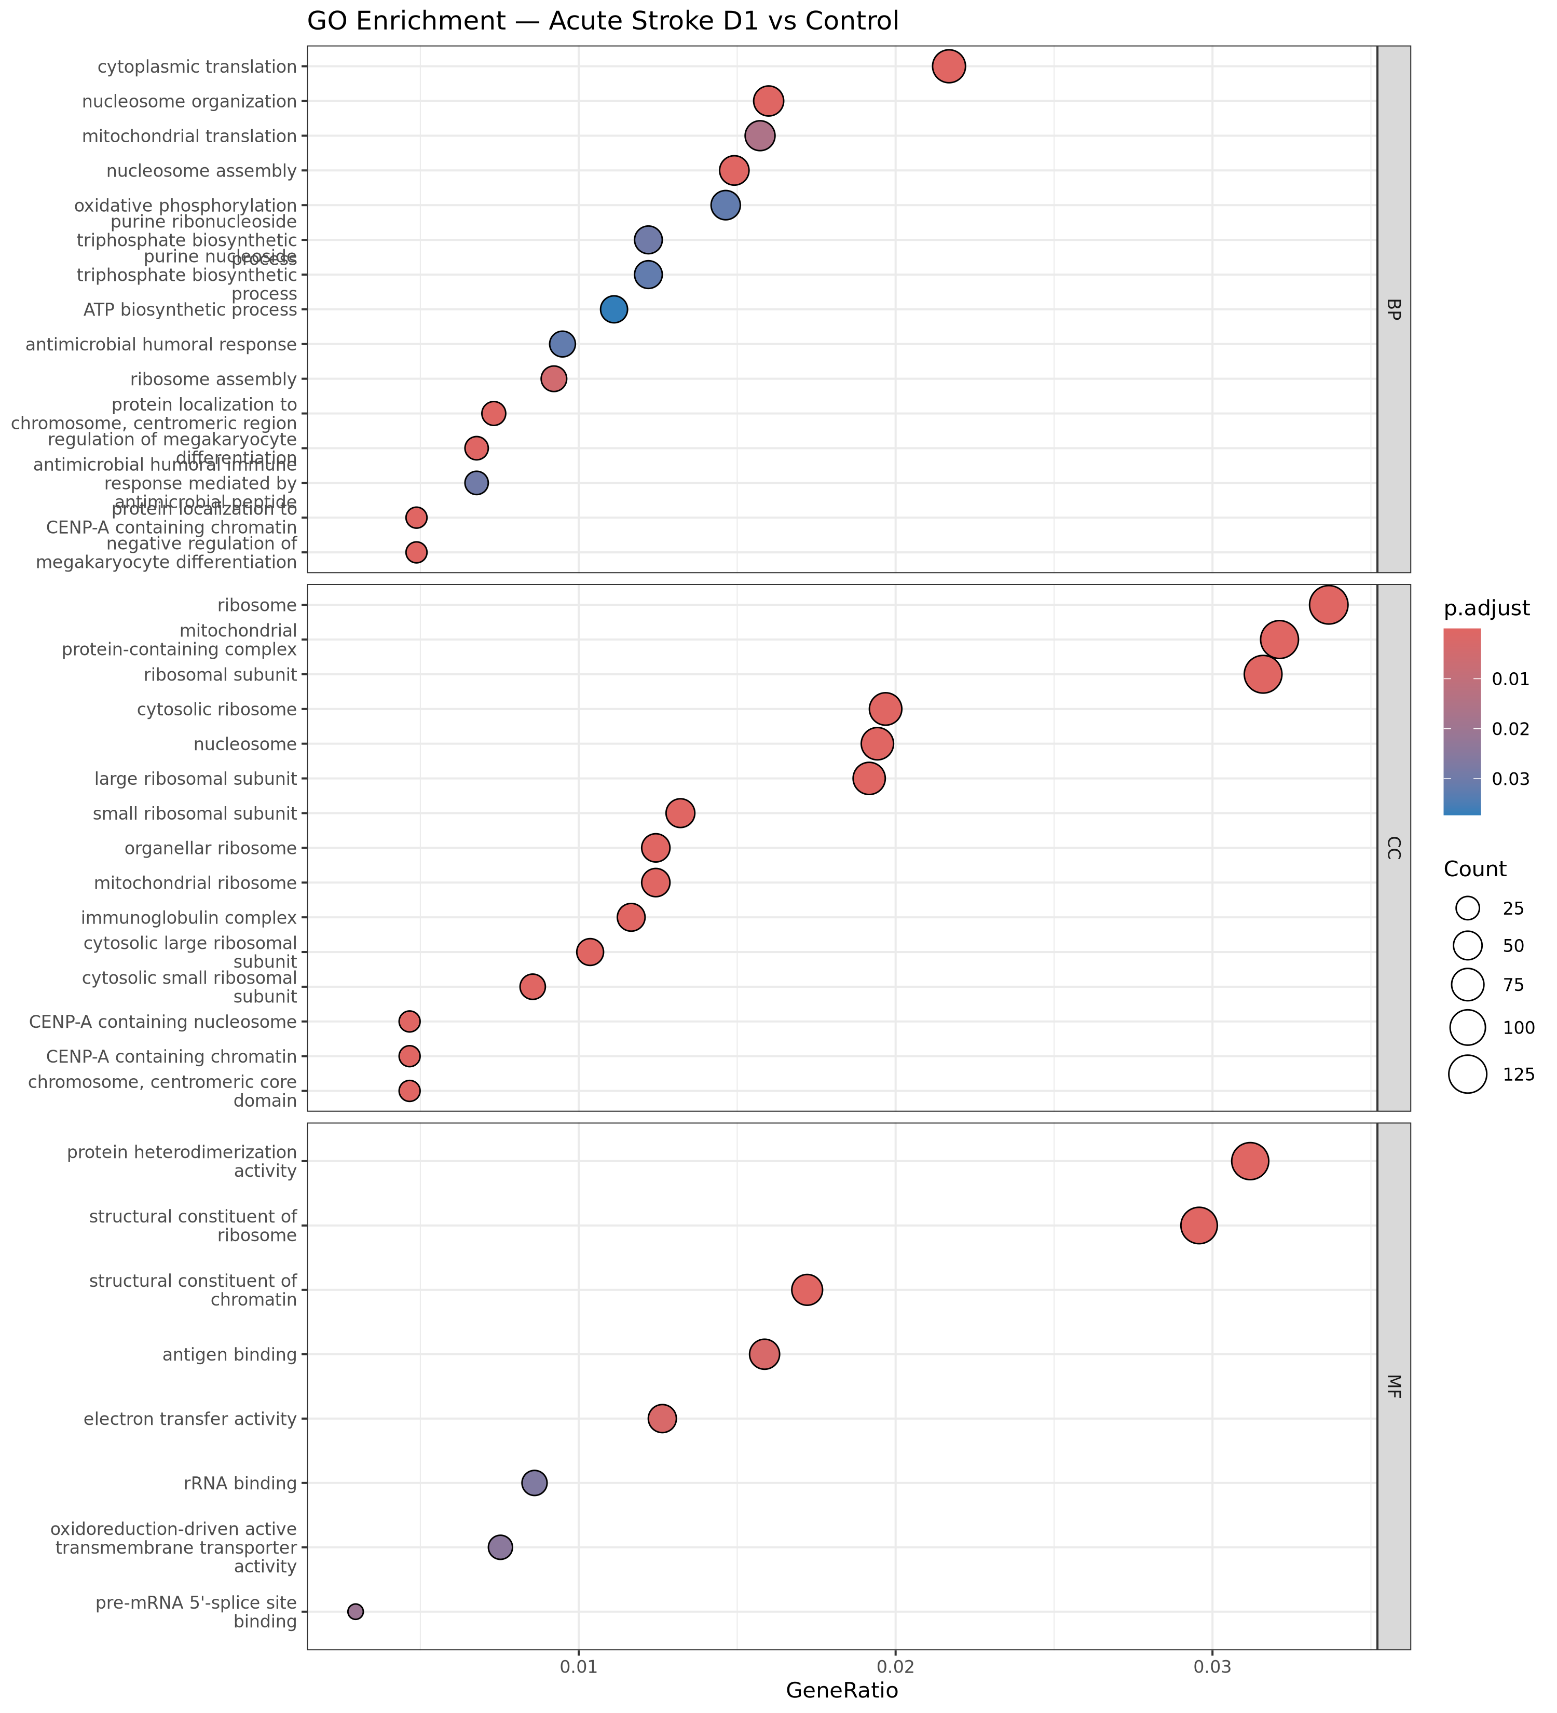
G
RESULT 7B / 8
GO Biological Process — Acute Stroke
M
Translation & Ribosome
112 RPL/RPS genes coordinately upregulated → immune cell activation primes for rapid protein synthesis.
S
NET Formation
82 genes including ELANE, histones, MPO → neutrophil web release into circulation.
⚡
Oxidative Phosphorylation
49 mitochondrial genes upregulated → metabolic reprogramming for cytokine production.
!
Antimicrobial Response
CXCL5/9/10, S100A12, ELANE → recruit and activate immune effectors.
GSE122709 · Differential Gene Expression in Acute Ischemic Stroke · DATA_SCI_8110
SLIDE 21 / 26
Notes:
Convergence on innate-immune, neutrophil-activation, and ribosome-biogenesis terms — the four themes of the discussion.

Slide 22
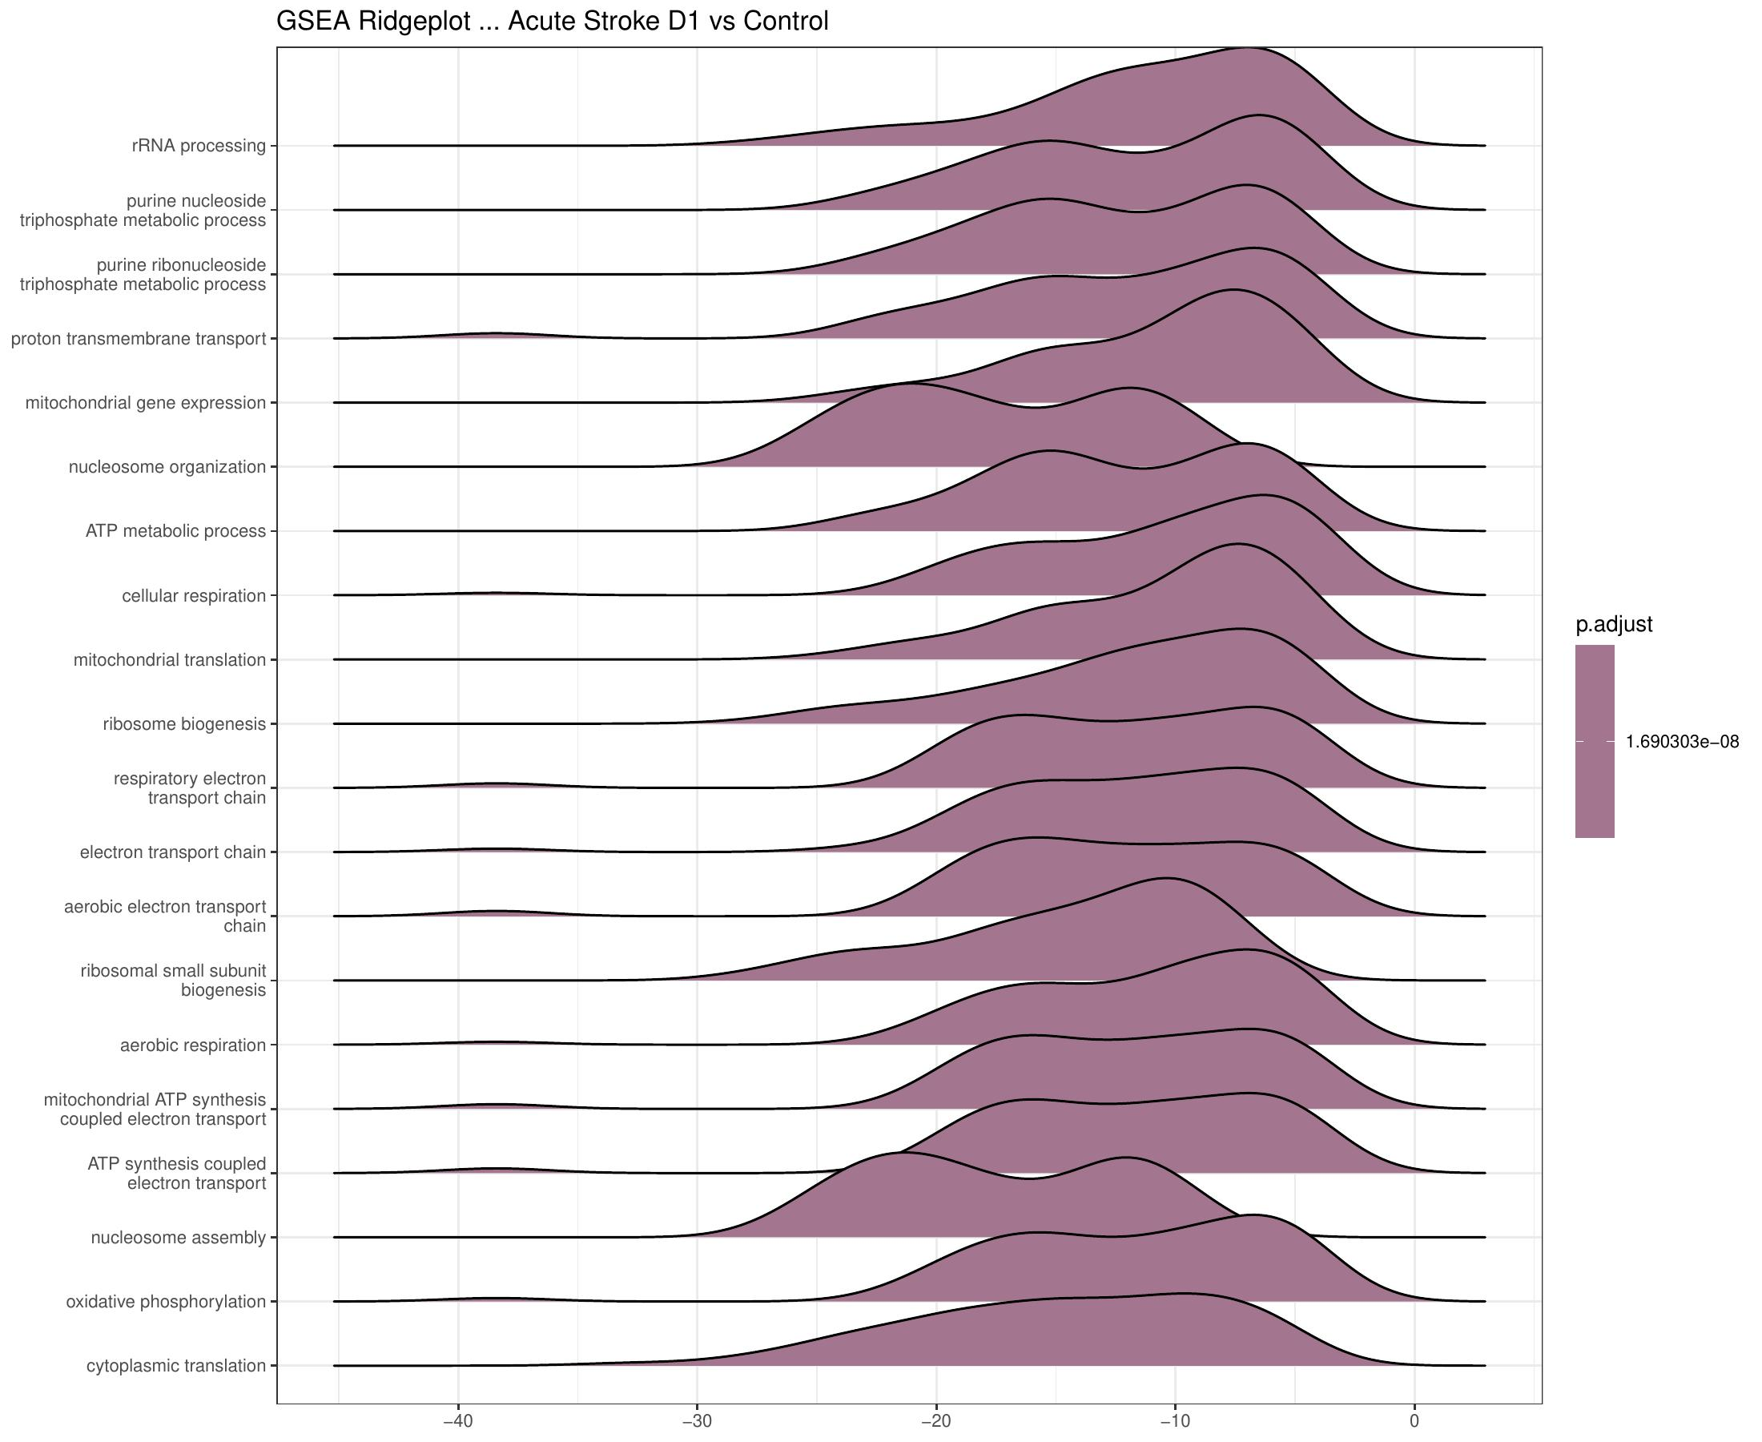
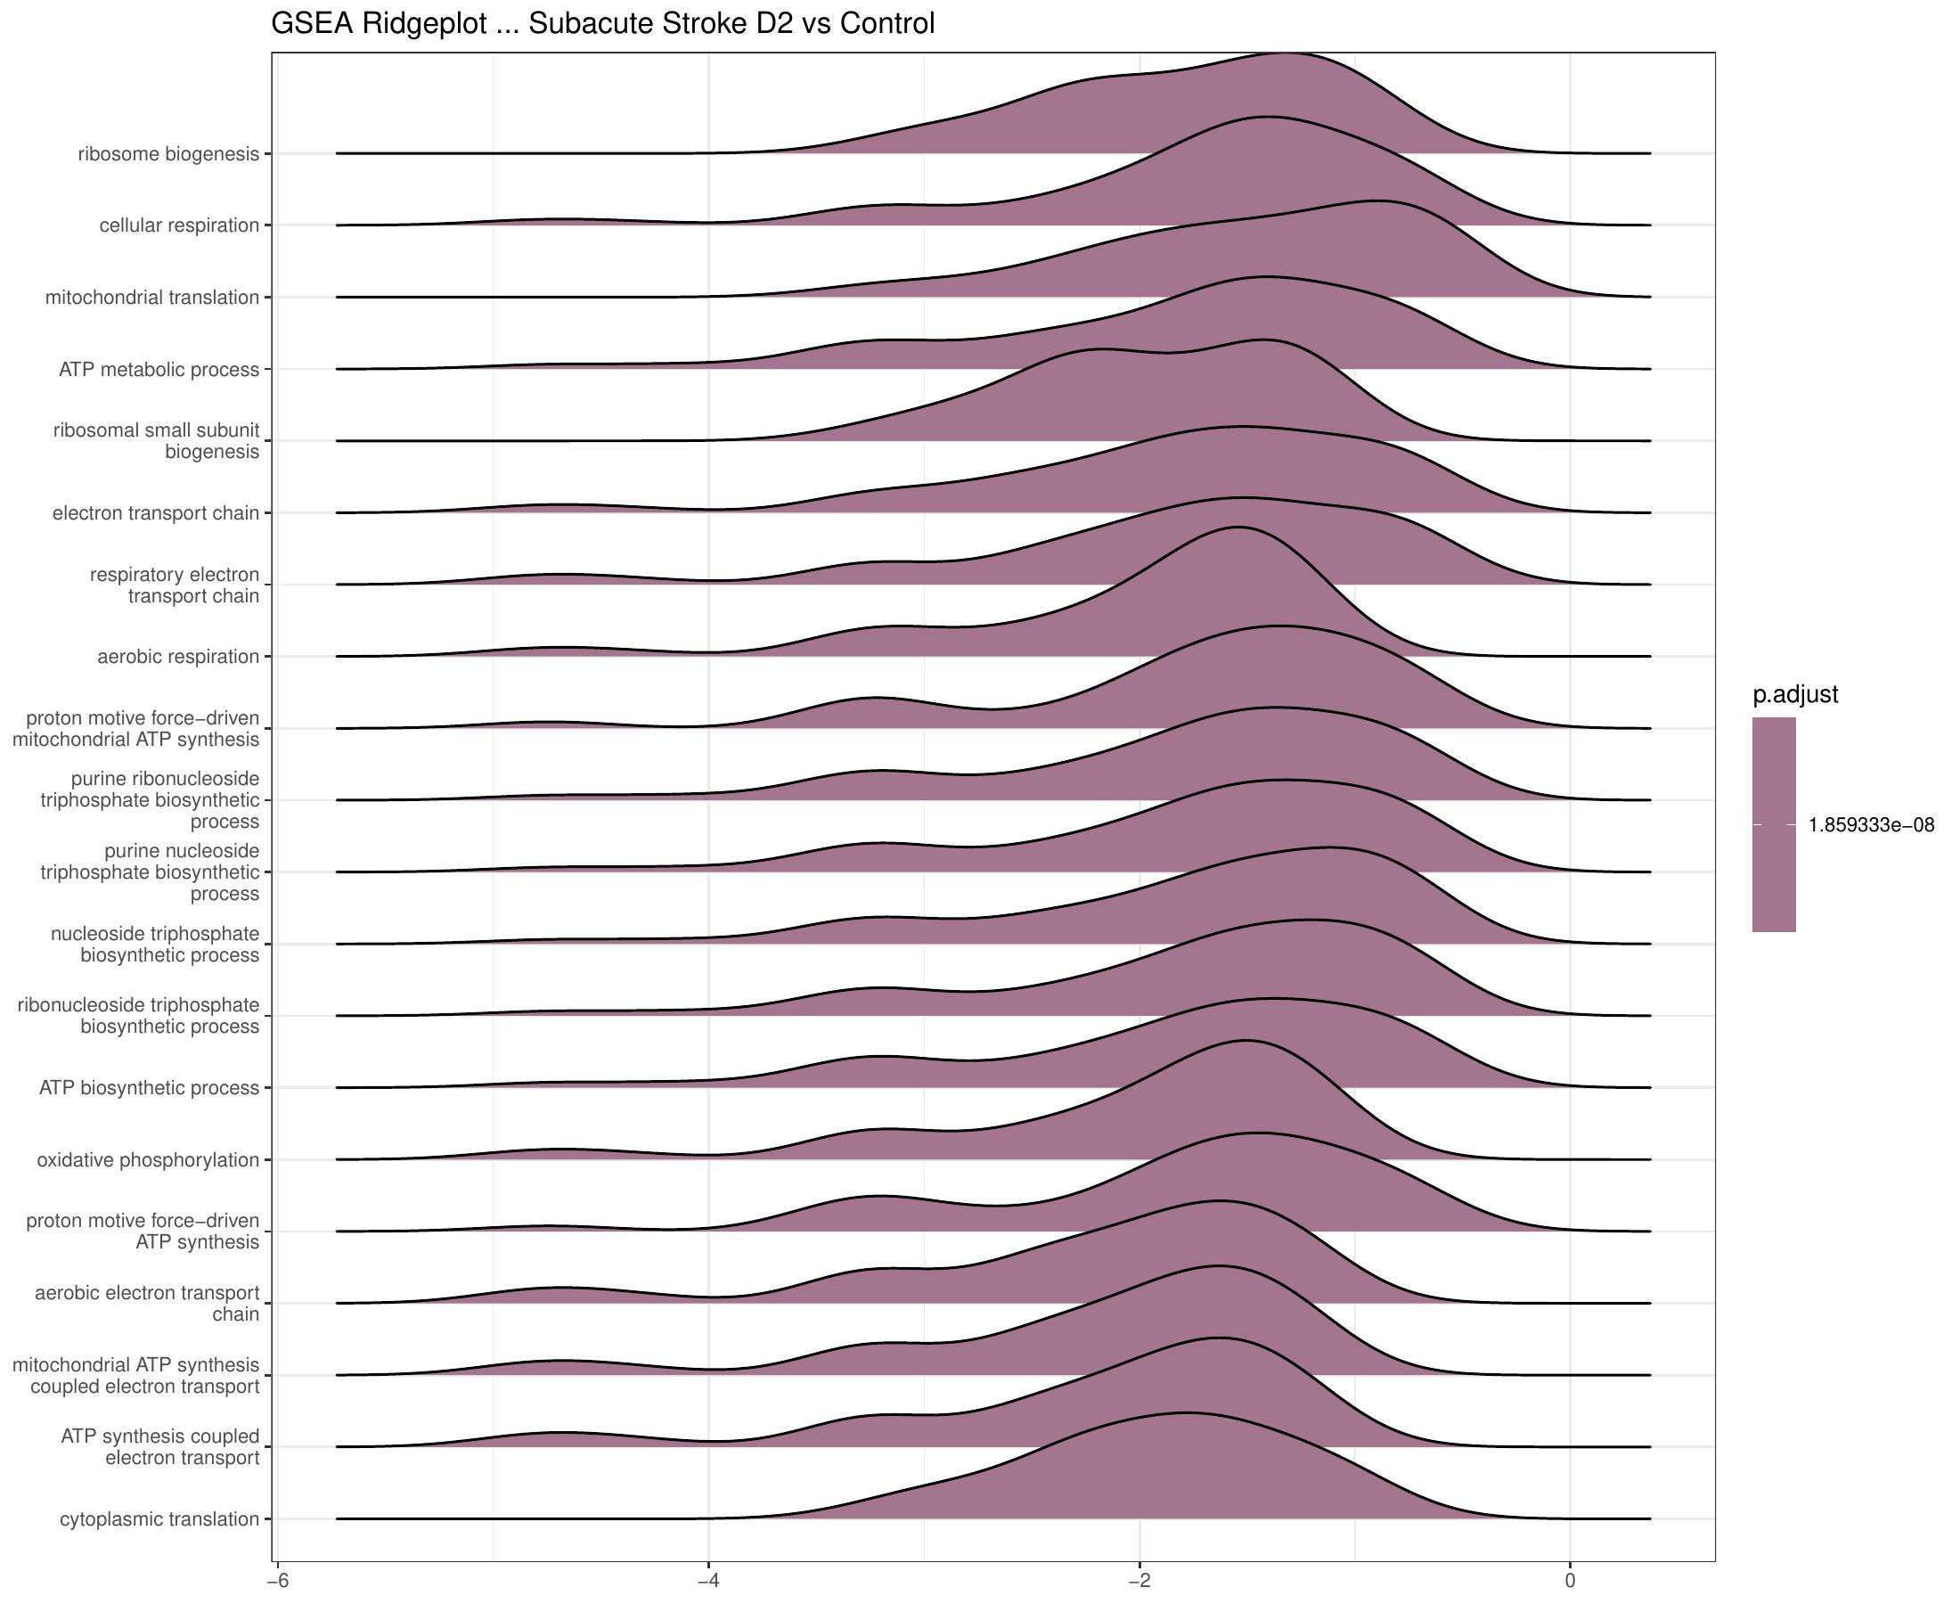
S
RESULT 8 / 8
GSEA — Coordinated Pathway Shifts
D1 vs NC · 189 enriched GO-BP terms
D2 vs NC · 155 enriched GO-BP terms
GSE122709 · Differential Gene Expression in Acute Ischemic Stroke · DATA_SCI_8110
SLIDE 22 / 26
Notes:
D2 has 155 enriched terms despite only 60 DEGs — GSEA's rank-based design captures subtle coordinated shifts.

Slide 23
L
DISCUSSION
Four Biological Themes — Synthesized
M
THEME 1
N
THEME 2
Translational Machinery
Neutrophil Extracellular Traps
Activated immune cells dramatically upregulate ribosomal proteins to produce cytokines, surface receptors, and effectors. Translates directly into the systemic inflammatory profile measured in plasma.
Activated neutrophils release web-like structures of decondensed chromatin and granule proteins. NETs promote thrombosis at the cerebral lesion and can damage the blood-brain barrier.
Evidence: 112 ribosomal genes (KEGG p = 5.7×10⁻²³)
Evidence: Histone H1/H2A/H2B/H3/H4 + ELANE upregulated
⚡
THEME 3
!
THEME 4
Mitochondrial Reprogramming
Antimicrobial Effectors
PBMCs shift toward oxidative phosphorylation to meet the energy demand of immune activation. Coordinated upregulation of mtDNA-encoded and nuclear-encoded electron-transport chain genes.
Chemokine release (CXCL5/9/10), alarmins (S100A12), and granule proteases mobilize and activate immune defenders systemically — the classic 'sterile inflammation' of injury.
Evidence: OxPhos enriched (49 genes, padj = 0.014)
Evidence: Antimicrobial humoral response (p = 5.4×10⁻⁵)
GSE122709 · Differential Gene Expression in Acute Ischemic Stroke · DATA_SCI_8110
SLIDE 23 / 26
Notes:
Four themes form a coherent biological narrative — each has independent literature support and clinical relevance.

Slide 24
+
CLINICAL RELEVANCE
From Bench to Bedside
B
X
S
Biomarkers
Therapeutic Targets
Risk Stratification
The 55 genes persistently dysregulated at 48 h could form a blood-based stroke severity / prognosis panel — feasible with a simple PCR or NanoString assay in any clinical lab.
DNase I trials are exploring NET degradation as a stroke therapy. Our results validate the relevance of NET-related genes in peripheral blood as response markers.
PIDS — post-stroke immunodepression syndrome — predisposes patients to pneumonia and UTIs. The DUSP2/DUSP8 signature at Day 2 may flag patients at highest risk.
SPOTLIGHT · PPBP (CXCL7) DOWNREGULATION
LFC = −4.69, padj = 1.2×10⁻⁵⁷ — likely reflects platelet consumption at the thrombotic site and active suppression of platelet-derived neutrophil recruitment. A potential single-gene marker of acute stroke biology in blood.
GSE122709 · Differential Gene Expression in Acute Ischemic Stroke · DATA_SCI_8110
SLIDE 24 / 26
Notes:
The 55 persistent genes are the most exciting biomarker candidates. PIDS prediction is critical for prophylactic antibiotics decisions.

Slide 25
!
LIMITATIONS & OUTLOOK
What We Couldn't Answer · What's Next
LIMITATIONS
FUTURE DIRECTIONS
G
Small sample size
S
Validate in larger cohort
n = 5 per group limits power; minor effects may be missed.
Replicate persistent 55-gene signature in n ≥ 50 patient cohort.
↹
PBMC heterogeneity
·
Single-cell RNA-seq
Bulk averages mask which cell type drives each signal — single-cell would resolve this.
Resolve which PBMC cell subset drives each signal.
C
Two timepoints only
T
Extended longitudinal sampling
No data beyond Day 2 — we cannot trace recovery dynamics out to weeks.
Add Day 7, Month 1 and Month 3 timepoints.
≡
Assignment rate 34–47%
+
Couple to clinical outcomes
Below ideal 60% benchmark — may reflect intronic reads / unstranded protocol.
Correlate gene signatures with stroke severity, infections, 90-day mRS.
P
No clinical metadata
V
Functional validation
Demographics, stroke severity (NIHSS), or outcome data not linked here.
DUSP2/DUSP8 knockdown in monocyte models.
GSE122709 · Differential Gene Expression in Acute Ischemic Stroke · DATA_SCI_8110
SLIDE 25 / 26
Notes:
Single-cell follow-up would be the most informative — PBMC bulk averages mask which cell type drives each gene change.

Slide 26
CONCLUSIONS
Five Things We Learned
1
8,594 DEGs at Day 1
Acute ischemic stroke triggers a transcriptomic alarm in PBMCs that exceeds typical immune stimulation by 2–4×.
2
Four convergent themes
Translation, NET formation, oxidative phosphorylation, and antimicrobial effectors dominate the response.
3
Rapid Day-2 normalization
Only 60 DEGs remain at 48 hours — over 99% of changes are transient.
4
55 persistent biomarker genes
Sustained at both timepoints — candidates for blood-based diagnostic / prognostic panels.
5
DUSP-driven resolution
DUSP2/8 upregulation at Day 2 indicates active MAPK suppression — possibly underlying post-stroke immunodepression.
Thank you. Questions, critique, and methodological suggestions are most welcome.
Notes:
Five concrete takeaways. Invite questions specifically on (1) methodology, (2) the 55 persistent genes, and (3) clinical translation.

