Slide 1
Course No. PHY- 1131, Physics I
Chapter 4
Waves and Oscillation
Nazmus Sakib
Lecturer of Physics

Slide 2
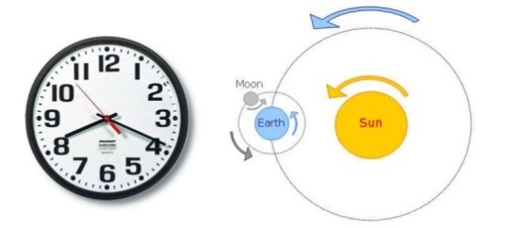
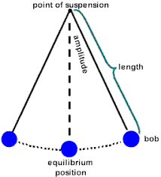
Waves and Oscillations
Periodic Motion
A motion which repeats itself over and over again after a regular interval of time is known as periodic motion. This path may be circular, elliptical. Linear or more complex
Figure: Periodic motion
Oscillatory Motion
A particle having periodic motion remains half of its time period in one direction and the rest of time period remains in another direction along the same line, then its motion is called oscillatory motion

Slide 3
Simple Harmonic Motion
If the acceleration of an oscillatory particle is proportional to distance from its equilibrium position and always towards the equilibrium position, then that motion is called simple harmonic motion.
Simple Harmonic Motion is a periodic motion..
In Simple Harmonic Motion the acceleration of a body is directly proportional to its distance from mean position.
In Simple Harmonic Motion the acceleration of a body is always directed towards its mean position.
Examples
Mass attached to a spring
Simple pendulum

Slide 4
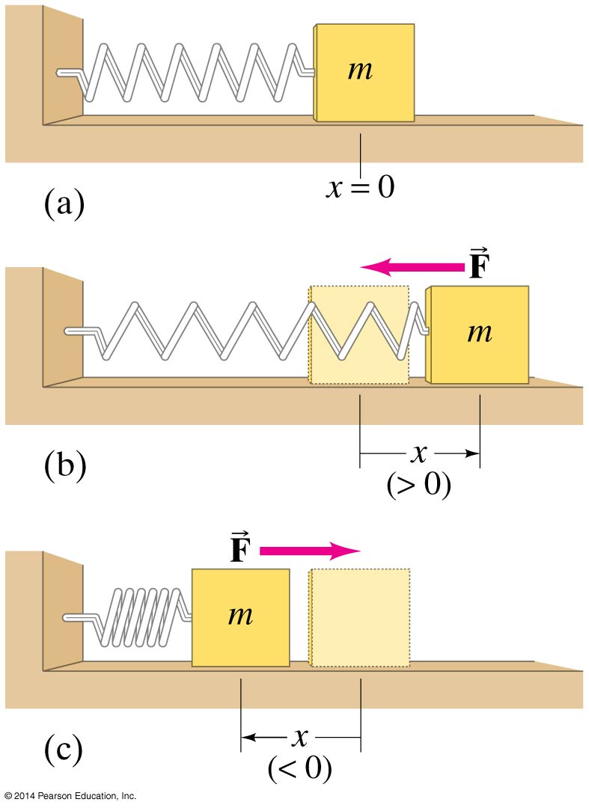
Simple Harmonic Motion—Spring Oscillations
If an object vibrates or oscillates back and forth over the same path, each cycle taking the same amount of time, the motion is called periodic. The mass and spring system is a useful model for a periodic system.

Slide 5
Simple Harmonic Motion—Spring Oscillations
We assume that the surface is frictionless. There is a point where the spring is neither stretched nor compressed; this is the equilibrium position.
We measure displacement from that point (x = 0 on the previous figure).
The force exerted by the spring depends on the displacement:
The minus sign on the force indicates that it is a restoring force—it is directed to restore the mass to its equilibrium position.
k is the spring constant. The force is not constant, so the acceleration is not constant either

Slide 6
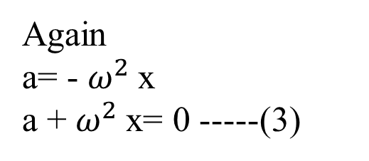
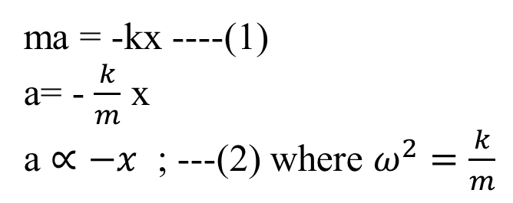
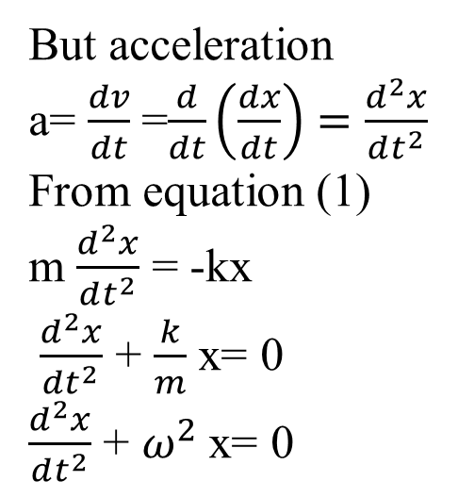
Simple Harmonic Motion—Spring Oscillations(Cont.)
Again from Newtons second law of motion we know that if m be the mass and a be the acceleration the F = ma
ma = -kx ----(1)
a= - $\frac{k}{m}$ x
a $∝−x$ ; ---(2) where $ω^{2}=\frac{k}{m}$
Again
a= - $ω^{2}$x
a + $ω^{2}$x= 0 -----(3)
But acceleration
a= $\frac{dv}{dt}$ =$\frac{d}{dt}\left(\frac{dx}{dt}\right)=\frac{d^{2}x}{dt^{2}}$
From equation (1)
m $\frac{d^{2}x}{dt^{2}}$ = -kx
$\frac{d^{2}x}{dt^{2}}$ + $\frac{k}{m}$ x= 0
$\frac{d^{2}x}{dt^{2}}$ + $ω^{2}$x= 0
This is the differential equation of SHM

Slide 7
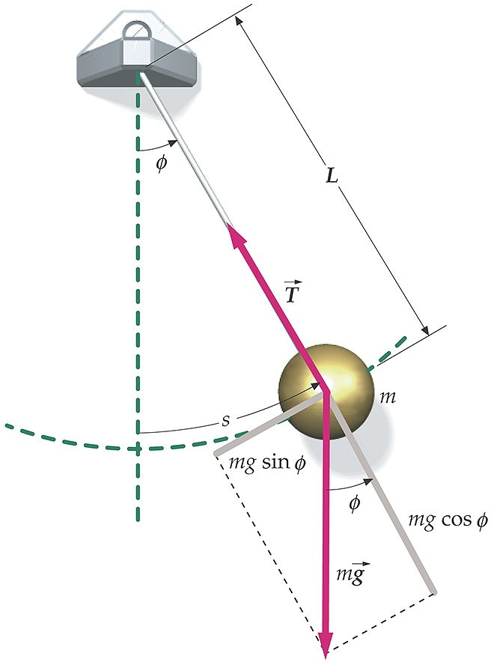
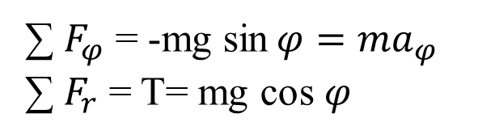
The Simple Pendulum
A simple pendulum is constructed by attaching a mass to a thin rod or a light string. We will also assume that the amplitude of the oscillations is small.
The pendulum is best described using polar coordinates.
The origin is at the pivot point. The coordinates are (r, φ). The r-coordinate points from the origin along the rod. The φ- coordinate is perpendicular to the rod and is positive in the counter clockwise direction.
Apply Newton’s 2nd Law to the pendulum
∑ $F_{φ}$ = -mg sin$φ=ma_{φ}$
∑ $F_{r}$ = T= mg cos $φ$

Slide 8
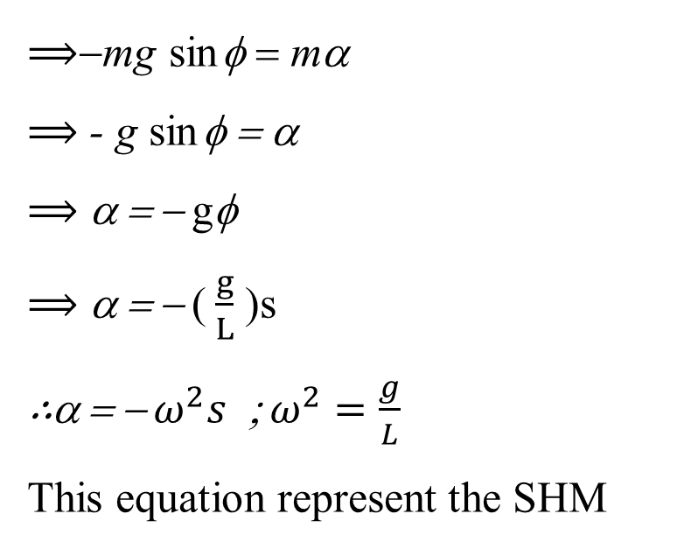
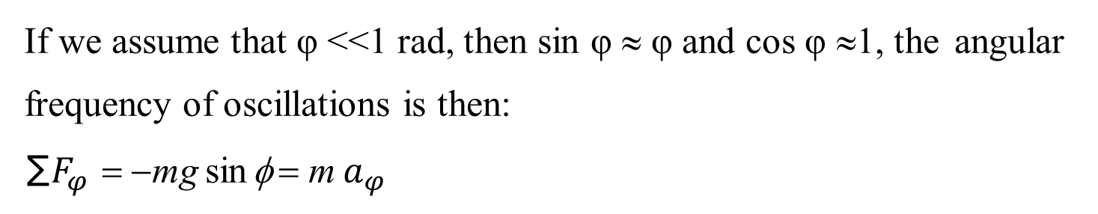

If we assume that φ <<1 rad, then sin φ ≈ φ and cos φ ≈1, the angular frequency of oscillations is then:
∑ $F_{φ}$ = −mg sin φ = m $a_{φ}$
$⟹$−mg sin φ = mα
$⟹$- g sin φ = α
$⟹$α = − gφ
$⟹$α = − ( $\frac{g}{L}$ )s
∴α = − $ω^{2}s$ ; $ω^{2}=\frac{g}{L}$
This equation represent the SHM
Therefore, The time period T = $\frac{\text{2}π}{ω }$ = $\text{2}π \sqrt{\frac{L}{g}}$ ;

Slide 9
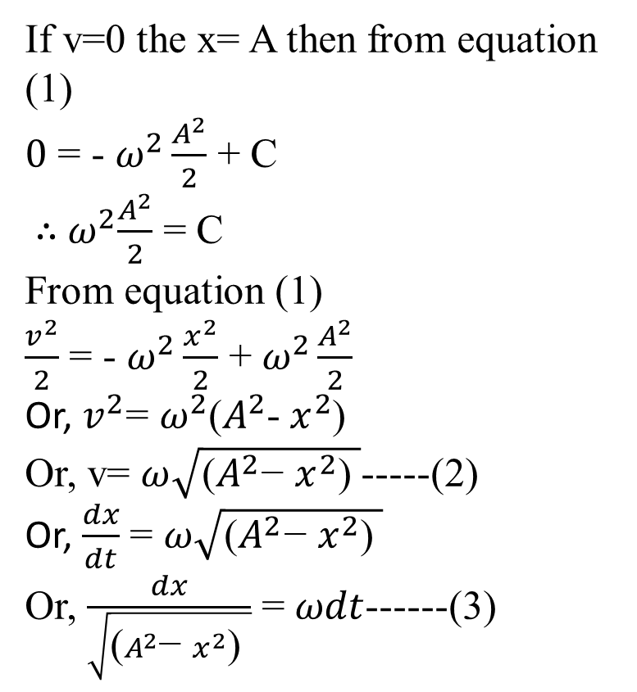
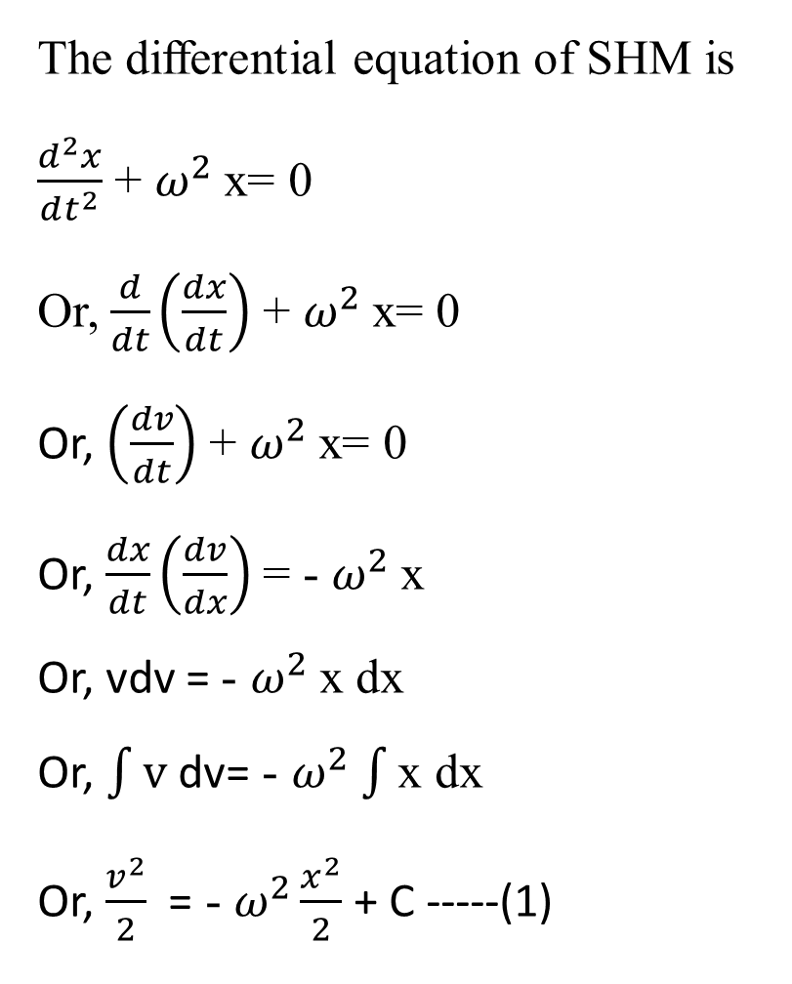
A solution to the differential equation of Simple Harmonic Motion
The differential equation of SHM is
$\frac{d^{2}x}{dt^{2}}$ + $ω^{2}$x= 0
Or, $\frac{d}{dt}\left(\frac{dx}{dt}\right)$ + $ω^{2}$x= 0
Or, $\left(\frac{dv}{dt}\right)$ + $ω^{2}$x= 0
Or, $\frac{dx}{dt}\left(\frac{dv}{dx}\right)$ = - $ω^{2}$x
Or, vdv = - $ω^{2}$x dx
Or, $\int{\text{v} \text{dv}}$= - $ω^{2}$ $\int{\text{x} \text{dx}}$
Or, $\frac{v^{2}}{2}$ = - $ω^{2}\frac{x^{2}}{2}$ + C -----(1)
If v=0 the x= A then from equation (1)
$0$ = - $ω^{2}\frac{A^{2}}{2}$ + C
∴${ ω}^{2}\frac{A^{2}}{2}$ = C
From equation (1)
$\frac{v^{2}}{2}$ = - $ω^{2}\frac{x^{2}}{2}$ + $ω^{2}\frac{A^{2}}{2}$
Or, $v^{2}$= $ω^{2}$($A^{2}$- $x^{2}$)
Or, v= $ω\sqrt{\text{(}A^{2}\text{− }x^{2}\text{) }}$-----(2)
Or, $\frac{dx}{dt}$ = $ω\sqrt{\text{(}A^{2}\text{− }x^{2}\text{) }}$
Or, $\frac{dx}{\sqrt{\text{(}A^{2}\text{− }x^{2}\text{) }}}$ = $ωdt$------(3)

Slide 10
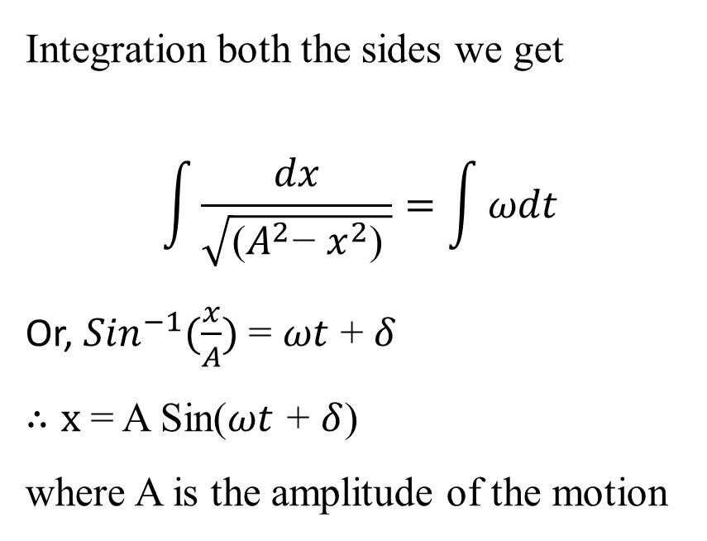
A solution to the differential equation of Simple Harmonic Motion
Integration both the sides we get
$$\int{\frac{dx}{\sqrt{\text{(}A^{2}\text{− }x^{2}\text{) }}}}=\int{ωdt}$$
Or, ${Sin}^{−1}(\frac{x}{A})$ = $ωt$ + $δ$
$∴x$ = A Sin($ωt$ + $δ$)
where A is the amplitude of the motion

Slide 11
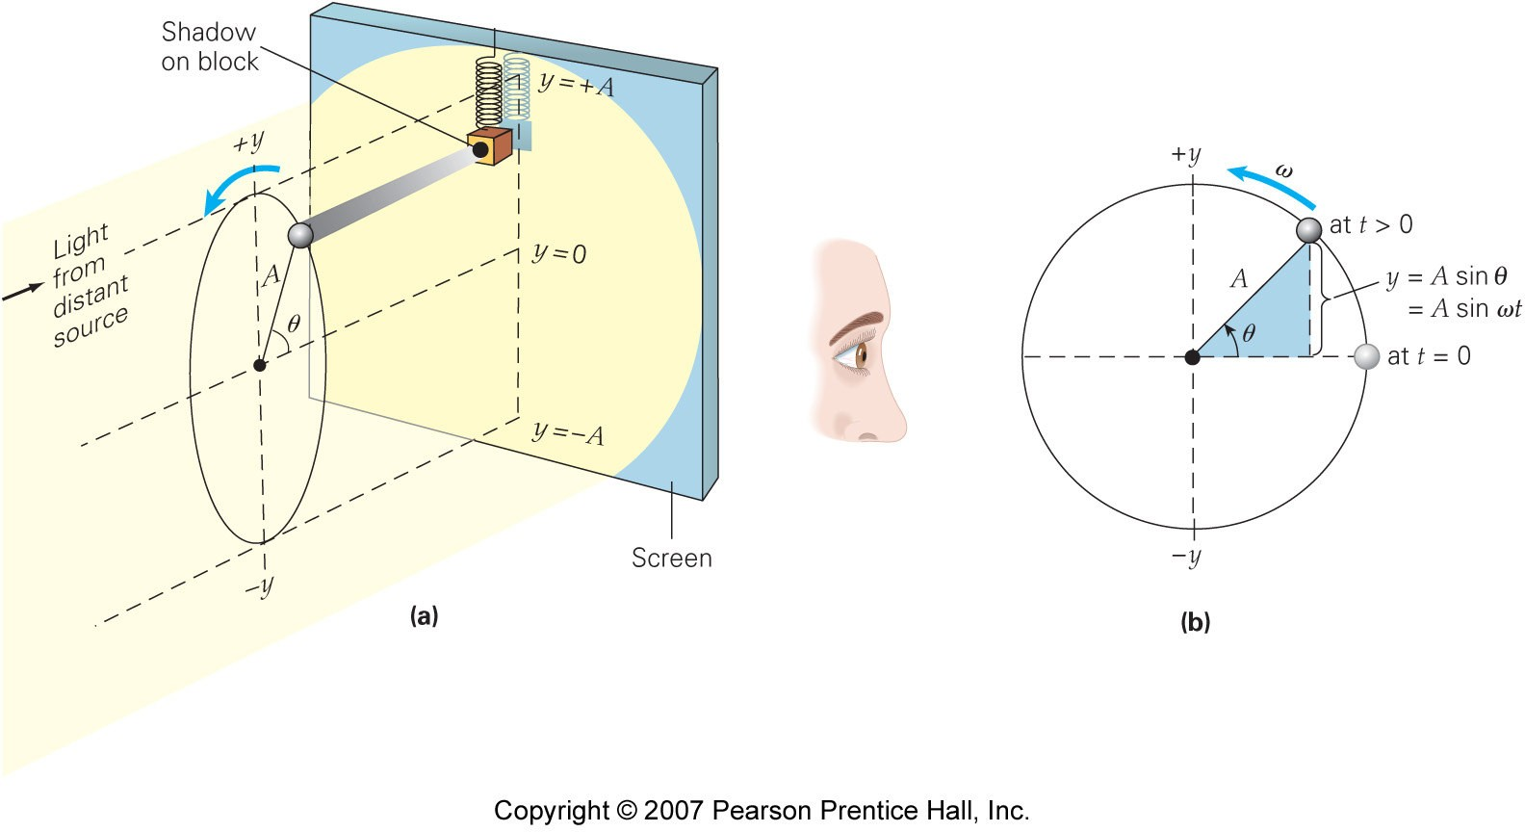
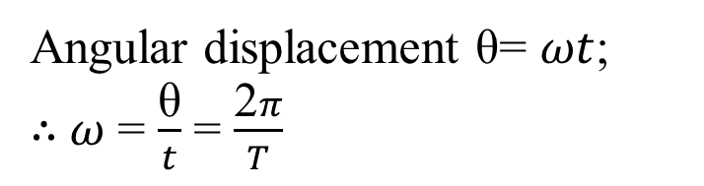
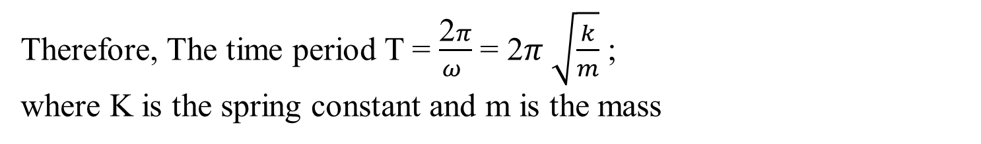
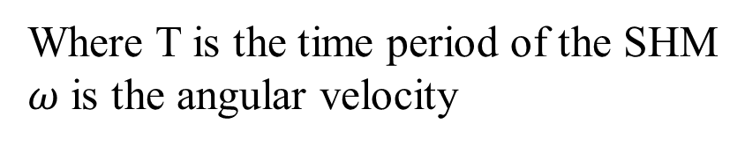
Projection of Circular Motion
Angular displacement θ= $ωt$;
∴$ω$ = $\frac{\text{θ}}{t}$ = $\frac{\text{2}π}{T}$
Where T is the time period of the SHM
$ω$ is the angular velocity
Therefore, The time period T = $\frac{\text{2}π}{ω }$ = $\text{2}π \sqrt{\frac{k}{m}}$ ;
where K is the spring constant and m is the mass

Slide 12
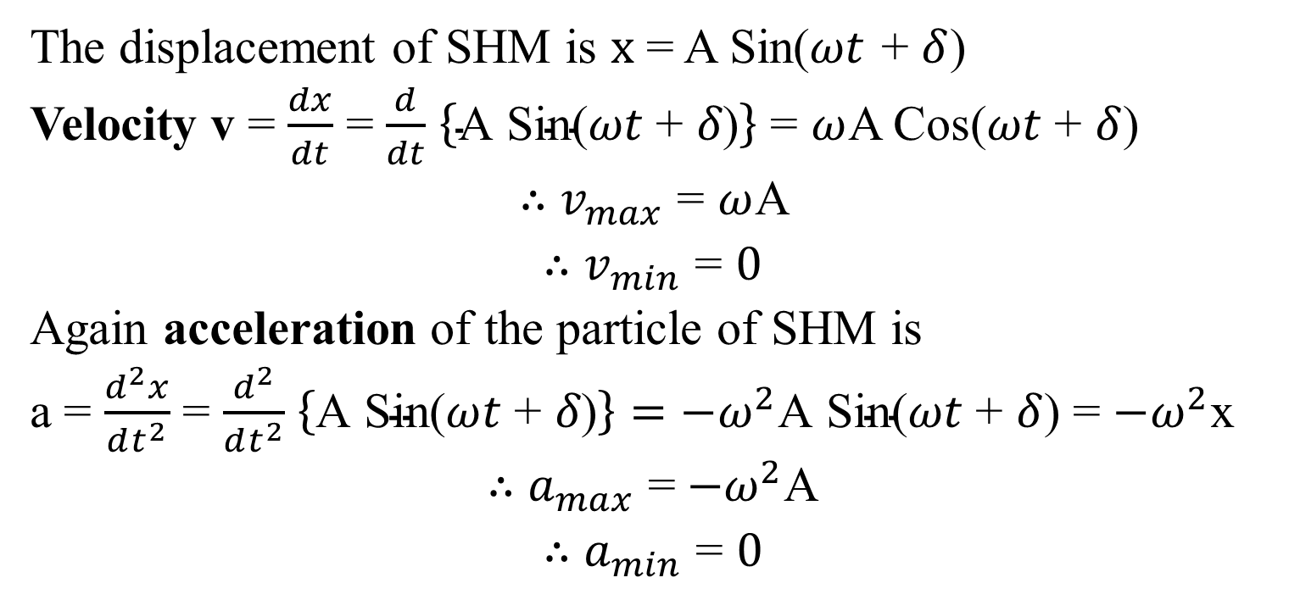
Velocity and acceleration of a SHM
The displacement of SHM is $x$ = A Sin($ωt$ + $δ$)
Velocity v = $\frac{dx}{dt}$ = $\frac{d}{dt}$ $\left\{\text{A} \text{Sin}\text{(}ωt\text{ + }δ\text{)}\right\}$ = $ω$A $\text{C}\text{os}\text{(}ωt\text{ + }δ$)
∴ $v_{max}$ = $ω$A
∴ $v_{min}$ = $0$
Again acceleration of the particle of SHM is
a = $\frac{d^{2}x}{dt^{2}}$ = $\frac{d^{2}}{dt^{2}}$ $\left\{\text{A} \text{Sin}\text{(}ωt\text{ + }δ\text{)}\right\}=$ ${−ω}^{2}\text{A} \text{Sin}\text{(}ωt\text{ + }δ$) = ${−ω}^{2}\text{x}$
∴ $a_{max}$ =${−ω}^{2}\text{A}$
∴ $a_{min}$ = $0$

