Slide 1
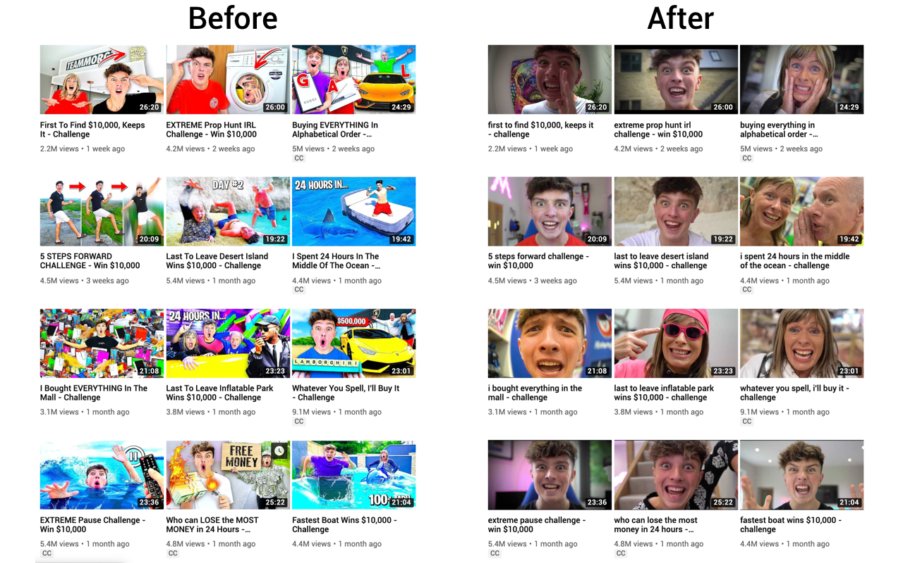
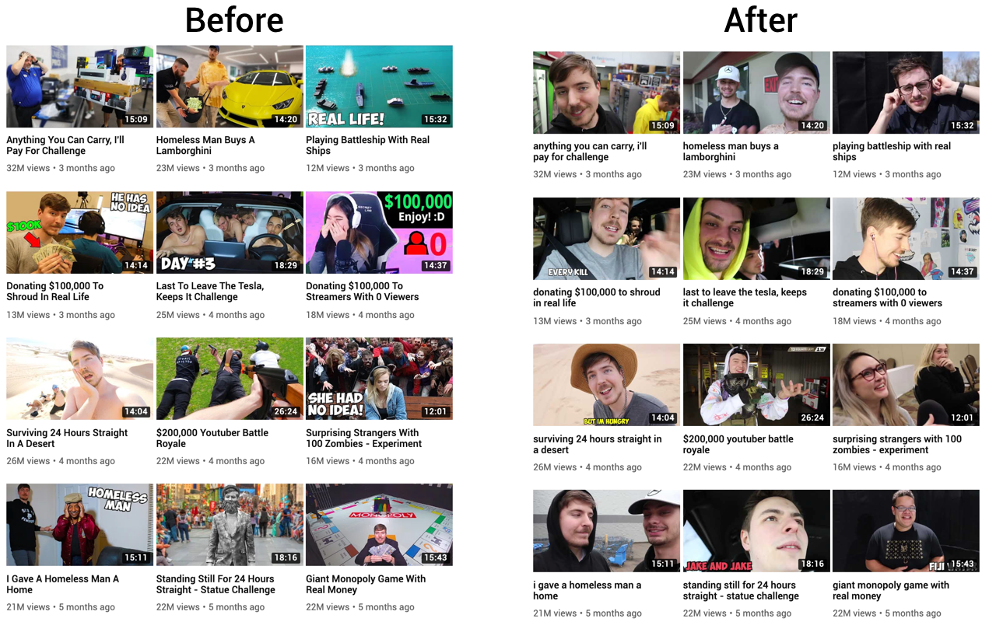
Notes:
Youtube as unicorn in social media landscape ->
Youtube as one of the only social media platforms in which we at least somewhat have the active choice what we want to choose
Only thing we ase our decision on what to click is the thumbnail and the title
How important are title and thumbnail really and can we computationally detect differnces in this unstructured data

Slide 2

Image embedding Model
[5, 2, 4, ..……, 42, 6 ,2]
Image Embeddings
MLP
Performance / Quality
Text embedding Model
[5, 2, 4,……., 42, 6 ,2]
Text Embeddings

Slide 3

Views
Likes
Dislikes
Channel Data
Quality or Performance Metric
Notes:
Predicting performance vs. Predicting Clickbait?

