Slide 1
AMG HOLDINGS
ICT: System Development Division
Monthly Report
(Sep 10 – Oct 15)
Oct 15, 2025

Slide 2
Executive Summary
During October, the Software Development Team advanced AMG Holding’s digital transformation across all business units. The Sales Management System reached full completion, with workshops held in Gelan and Adama, followed by one-to-one user training to ensure smooth adoption. Key enhancements identified during the sessions were successfully implemented.
Key Projects:
CRM System, Manufacturing Management System, Procurement System, and Custom Job Portal.
Outcomes:
Strengthened system integration
Improved operational efficiency
Progress toward a unified ERP ecosystem supporting data-driven decision-making

Slide 3
Projects Progress
No | project | User dep’t | Status | Target | Next Target | Reason for deviation | remark | Responsible Person
1 | Sales management system | Commerce Finance Financial Audit | 90 (%) | 100 (%) | 100 (%) | Significant Req’s should have to be added raised during the workshop |  | Kibirom and Melese
2 | Fleet Management | HR | 100 (%) | 100 (%) | 100 (%) |  |  | Kibrom
3 | Manufacturing management system | Input Production commerce | 60 (%) | 70 (%) | 80 (%) |  |  | Kibrom and Melese
4 | Coffee farmers data management system | AMG Coffee | 100 (%) | 100 (%) | 100 (%)
5 | Coffee Track Management system | AMG Coffee | 96 (%) | 100 (%) | 100 (%)
7 | Website migration with email server(7) | ICT | 57.14 (%) | 100 (%) | 57.14 (%) |  | Basic foundation is completed | Kibirom & Muluken & Haile & Mussie
8 | CRM System | Marketing | 85 (%) | 100 (%) | 100 (%) | Samrawi was on HR system KPI support Melese shifted to Sales management system | Most of the modules are addressed will be finalized in the coming month | Samrawi and Melese
9 | Sage 50 Integration with SMS | Finance Commerce | 60 (%) | 100 (%) | 100 (%) | Authentication error issue persist | Collaborate as a team and explore | Feven
10 | JOB portal System | HR | 100 (%) | 100 (%) | 100 (%) |  | Custom export and UI/UX change on the current portal | Muluken
11 | Procurement management system | Procurement (local & foreign) | 20 (%) | 40 (%) | 60 (%) | Muluken was assigned to the job portal | Muluken has finished the Job portal it will have an important progress | Feven and Muluken
12 | Coffee certification System | AMG Coffee | 100 (%) | 100 (%) | 100 (%) |  |  | ICT

Slide 4
Reports
Sales Management System
The Sales Management System project has successfully reached 100% completion, and the team is now preparing to make it live. A key part of the implementation plan focused on end-user engagement through comprehensive and practical training sessions.
User Engagement & Workshop Training
  Workshops conducted in both Gelan and Adama
  Attended by top management and over 107 participants
  Featured active discussions, feedback sessions, and demonstrations
  Followed by one-to-one practical training to ensure personalized understanding
  Each sales representative received a unique username and password to access the system
Implement Solutions for Questions Raised at the Workshop
  Introduced Multiple Bank Deposit Slip functionality per one Sales Order (Appendix I)
  Added Financial Audit Checkup to the Commission module (Appendix I)
  Implemented Copy Button instead of repetitive search for one product on Sales Orders for efficiency (Appendix I)
  Update Commission Agent after Invoice confirmation (Appendix I)
Next Steps
  Address Remaining questions raised during the workshop that needs to be resolved Quickly
  Create a main environment for Production purpose and use the current one for test as it is
  Cleanup roles , Products, warehouse locations and migrate it to the main production
  Make the platform live and perform testing with real transactions.

Slide 5
Reports
Manufacturing Management System (Partially)
The Manufacturing Management System project has reached 60% completion, and we can use it with the sales management system for managing the manufacturing-based orders.
User Engagement & Workshop Training
  Training is conducted parallel with the sales management system
  One to one Training conducted at Gelan Manufacturing Place
Implemented Solutions
  Define clear Role Based access for manufacturing users
  Enable Manufacturing step to 3 step flow .
    Pick components form raw material store
    Manufacture products
    Move Products to Finished Product store
Next Steps
  Update Products with the 3-step flow
  Implement Quality Control Module
  Implement Product Placement

Slide 6
Reports
CRM System
The CRM System is designed to streamline sales operations, enhance customer relationship management, and provide actionable insights for decision-making. The focus is on improving efficiency, visibility, and collaboration across the sales team while ensuring data-driven decisions.
Development (Appendix V)
  KPI Module: Enables tracking and measurement of key performance indicators for sales teams, providing actionable insights for decision-making.
  Telemarketing Module: Streamlines inbound , outbound call management, and lead follow-ups.
  Market Intelligence Module: Collects and analyzes market data
  Price Log: Tracks pricing history and adjustments to maintain transparency and accuracy.
  Encounter Visit Module: Records Sales Rep visits, meetings, and interactions
Next Steps
  Ensure Role-Based Access Control (RBAC) is fully implemented and functioning across all modules.
  Develop KPI target vs. actual analysis reporting to track team performance.
  Create custom reports on leads, KPIs, and other key sales metrics.
  Design and implement a CRM dashboard tailored for the Marketing Manager, providing actionable insights at a glance.

Slide 7
Reports
JOB Portal System
The job portal System project has successfully reached 100% completion, and training is conducted and it is in production A key part of the implementation plan focused on customizing the UI/UX of the current JOB Portal system .
Development (Appendix II)
  Add new plugin for exporting applicants Data with customized format (AMG file Export)
  Enhance the UI/ UX of the current portal for better user engagement and accessibility
Training
  Conducted hands-on Job Portal training for the HR Department (Ato Wendesen Eshete and Dagimawit)
  Featured active discussions, feedback sessions, and demonstrations
Next Steps
  Address the training for the rest of the HR team
  Improvement on the Cloud storage issue

Slide 8
Reports
Procurement Portal System
The Procurement Management System project has achieved significant progress, with key modules developed and tested in a live environment. The focus has been on streamlining procurement operations, improving approval workflows, and enhancing security through role-based controls.
Development (Appendix III)
  Store Requisition Module: Fully implemented for smooth creation and processing of store requests.
  Budget Setting Module: New module developed, enabling complete budget creation and management. (Appendix IV)
  Enhanced Approval Workflow: Multi-stage approval process integrated to ensure efficient authorization.
  Role-Based Access Control (RBAC): Users now have secure, restricted access to their own requisitions, supporting granular permissions.
  Inventory Integration: Products are connected with HR, Store Requisition, Budget, and Department modules for seamless operations.
  Store Issue Voucher (SIV) Printing: Feature now fully functional.
Next Steps
  RBAC development for Budget Module
  Initiate Purchase Requisition
  Tender Management
  Implement Purchase order

Slide 9
General Activities
System Up-time Assurance: Morning Checklist
Performance evaluation system: End user training
HR System Support
Provided support for Adama staff, including comprehensive training for IT focal Persons (Adam and Tsegab) on how to effectively use the KPI Evaluation System within the HCM platform.
Create account on active directory for selected users provided from HR
Identify evaluators and give approval access on their perspective dep’t
NO | Role | Location | Number | Totale
1 | Users | Adama | 66 | 82
2 | Evaluators | Adama | 16
3 | Users | Gelan | 57 | 68
4 | Evaluators | Gelan | 11
Total |  |  |  | 150

Slide 10
4. Challenges and Proposed solutions
Sage 50: Authentication error issue is persistent.
  Proposed solution: Collaborate with the team to conduct a deeper investigation and explore additional troubleshooting steps to resolve the problem.
Numeric Value Support:
  The current Job Portal does not support numeric values.
  Proposed Solution: Implement a validation mechanism using JavaScript to ensure numeric inputs are correctly handled.
Cloud storage Challenge is accepted and we have planned to work on it in the coming month

Slide 11
Next Month Detailed Plan
NO | Activities | Project
1 | Prepare Production Environment | Sales Management System
2 | RBAC cleanup on Inventory , Manufacturing, Finance | Sales Management System
3 | Go live with the production environment with actual orders | Sales Management System
4 | Product update with new placement and 3 step manufacturing Flow | Manufacturing Management System
5 | Implement Quality Control Module | Manufacturing Management System
6 | Implement KPI traget vs Actual anlaysis Report | CRM System
7 | Develop Custom Reporting on leads , opportunity and MI | CRM System
8 | Develop CRM dashboard for Marketing Manager | CRM System
9 | Ensure RBAC access for sales Person Leader Company managers and Marketing Manager | CRM System
10 | Conduct Training for Marketing Dep’t (CRM) | CRM System
11 | Initiate Purchase Requisition | Procurement Management System
12 | Implement RBAC for Budget | Procurement Management System
13 | Implement Tender Management | Procurement Management System
14 | Develop Purchase Order | Procurement Management System
15 | Implement temporary solution for Cloud storage issue | Job Portal
16 | Training for Remaining HR teams | Job Portal

Slide 12
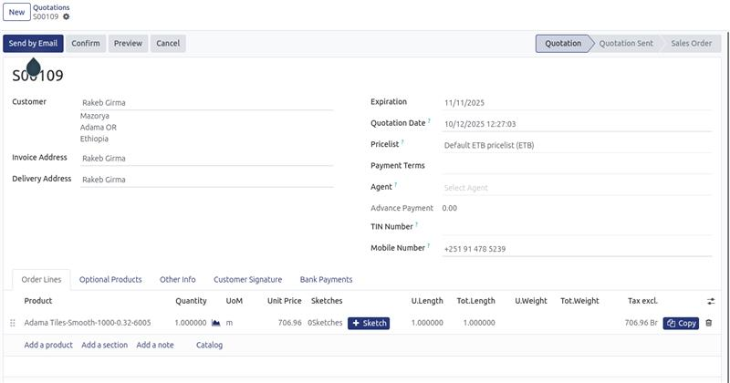
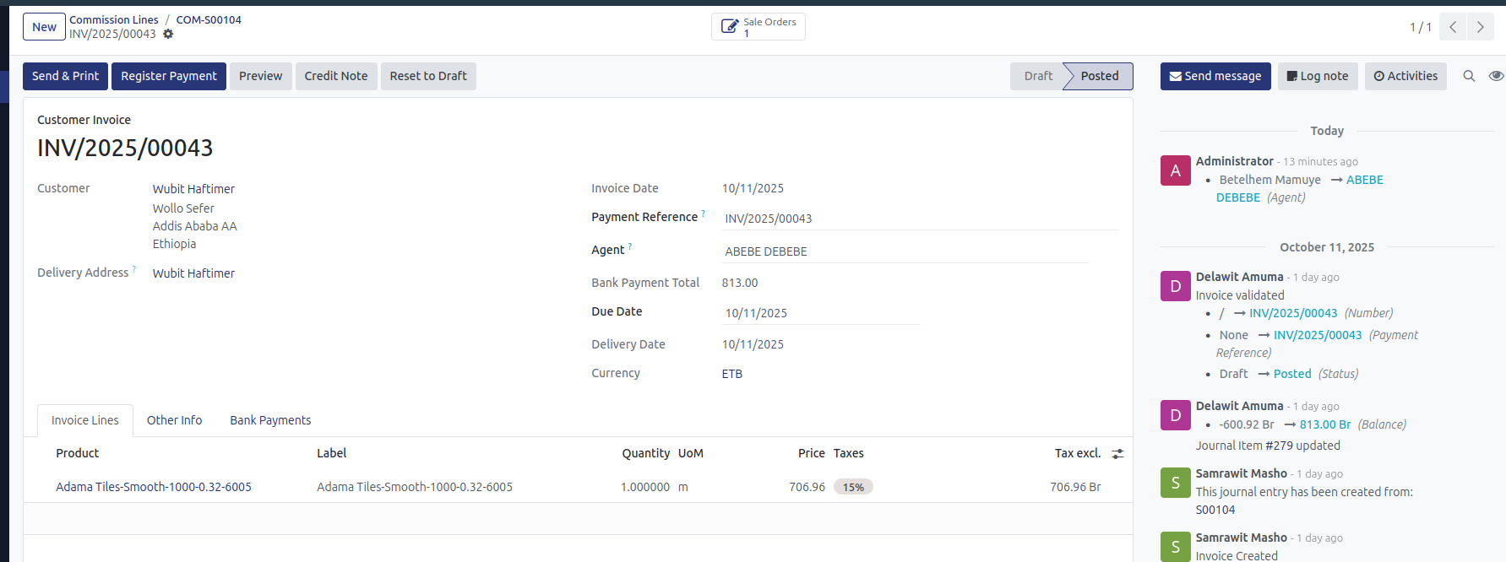
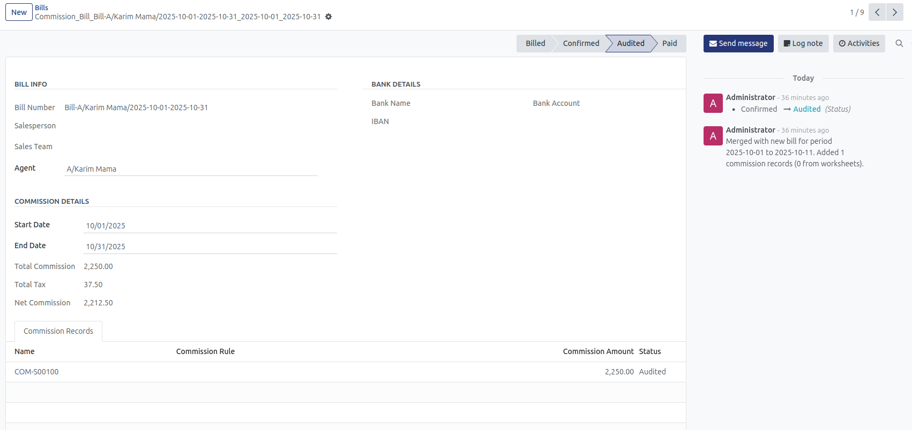
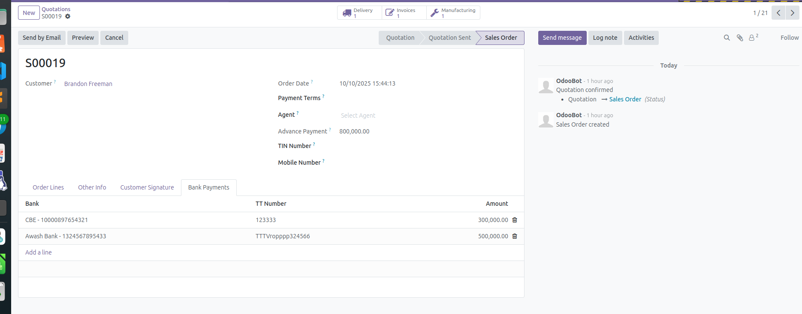
Appendix I
#Reports

Slide 13
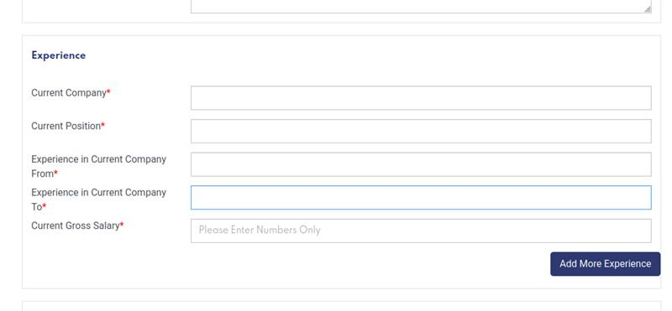
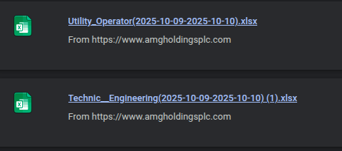
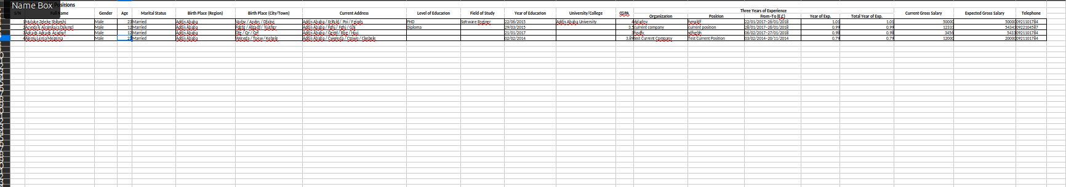
Appendix II
#Reports (4)

Slide 14
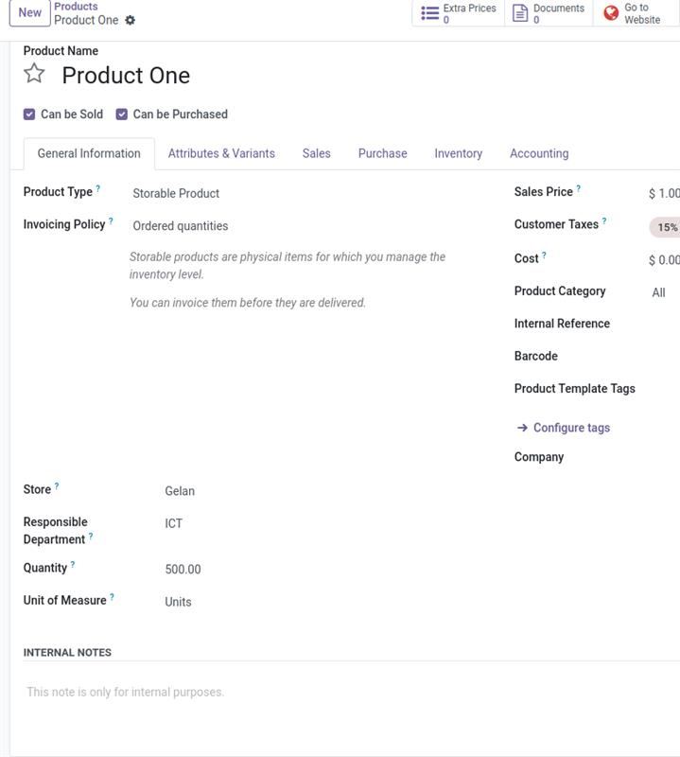
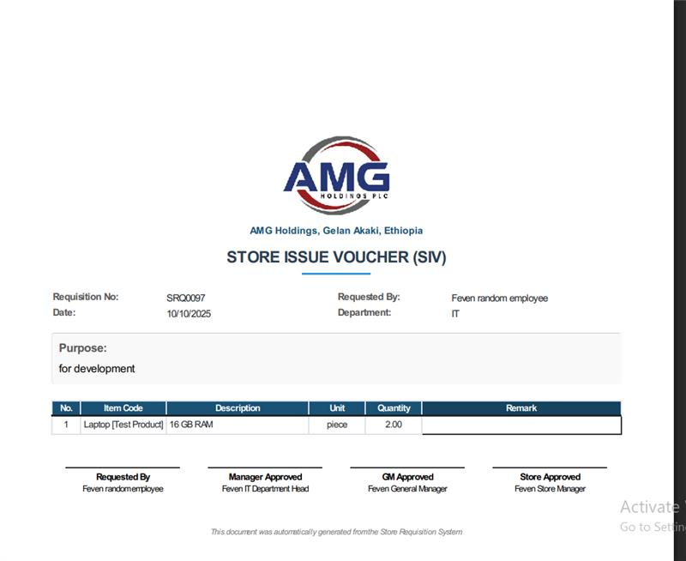
Appendix III
#Reports (5)

Slide 15
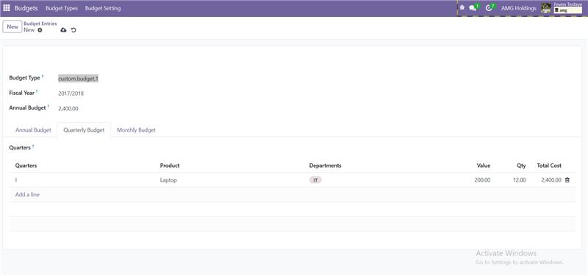
Appendix IV
#Reports (5)

Slide 16
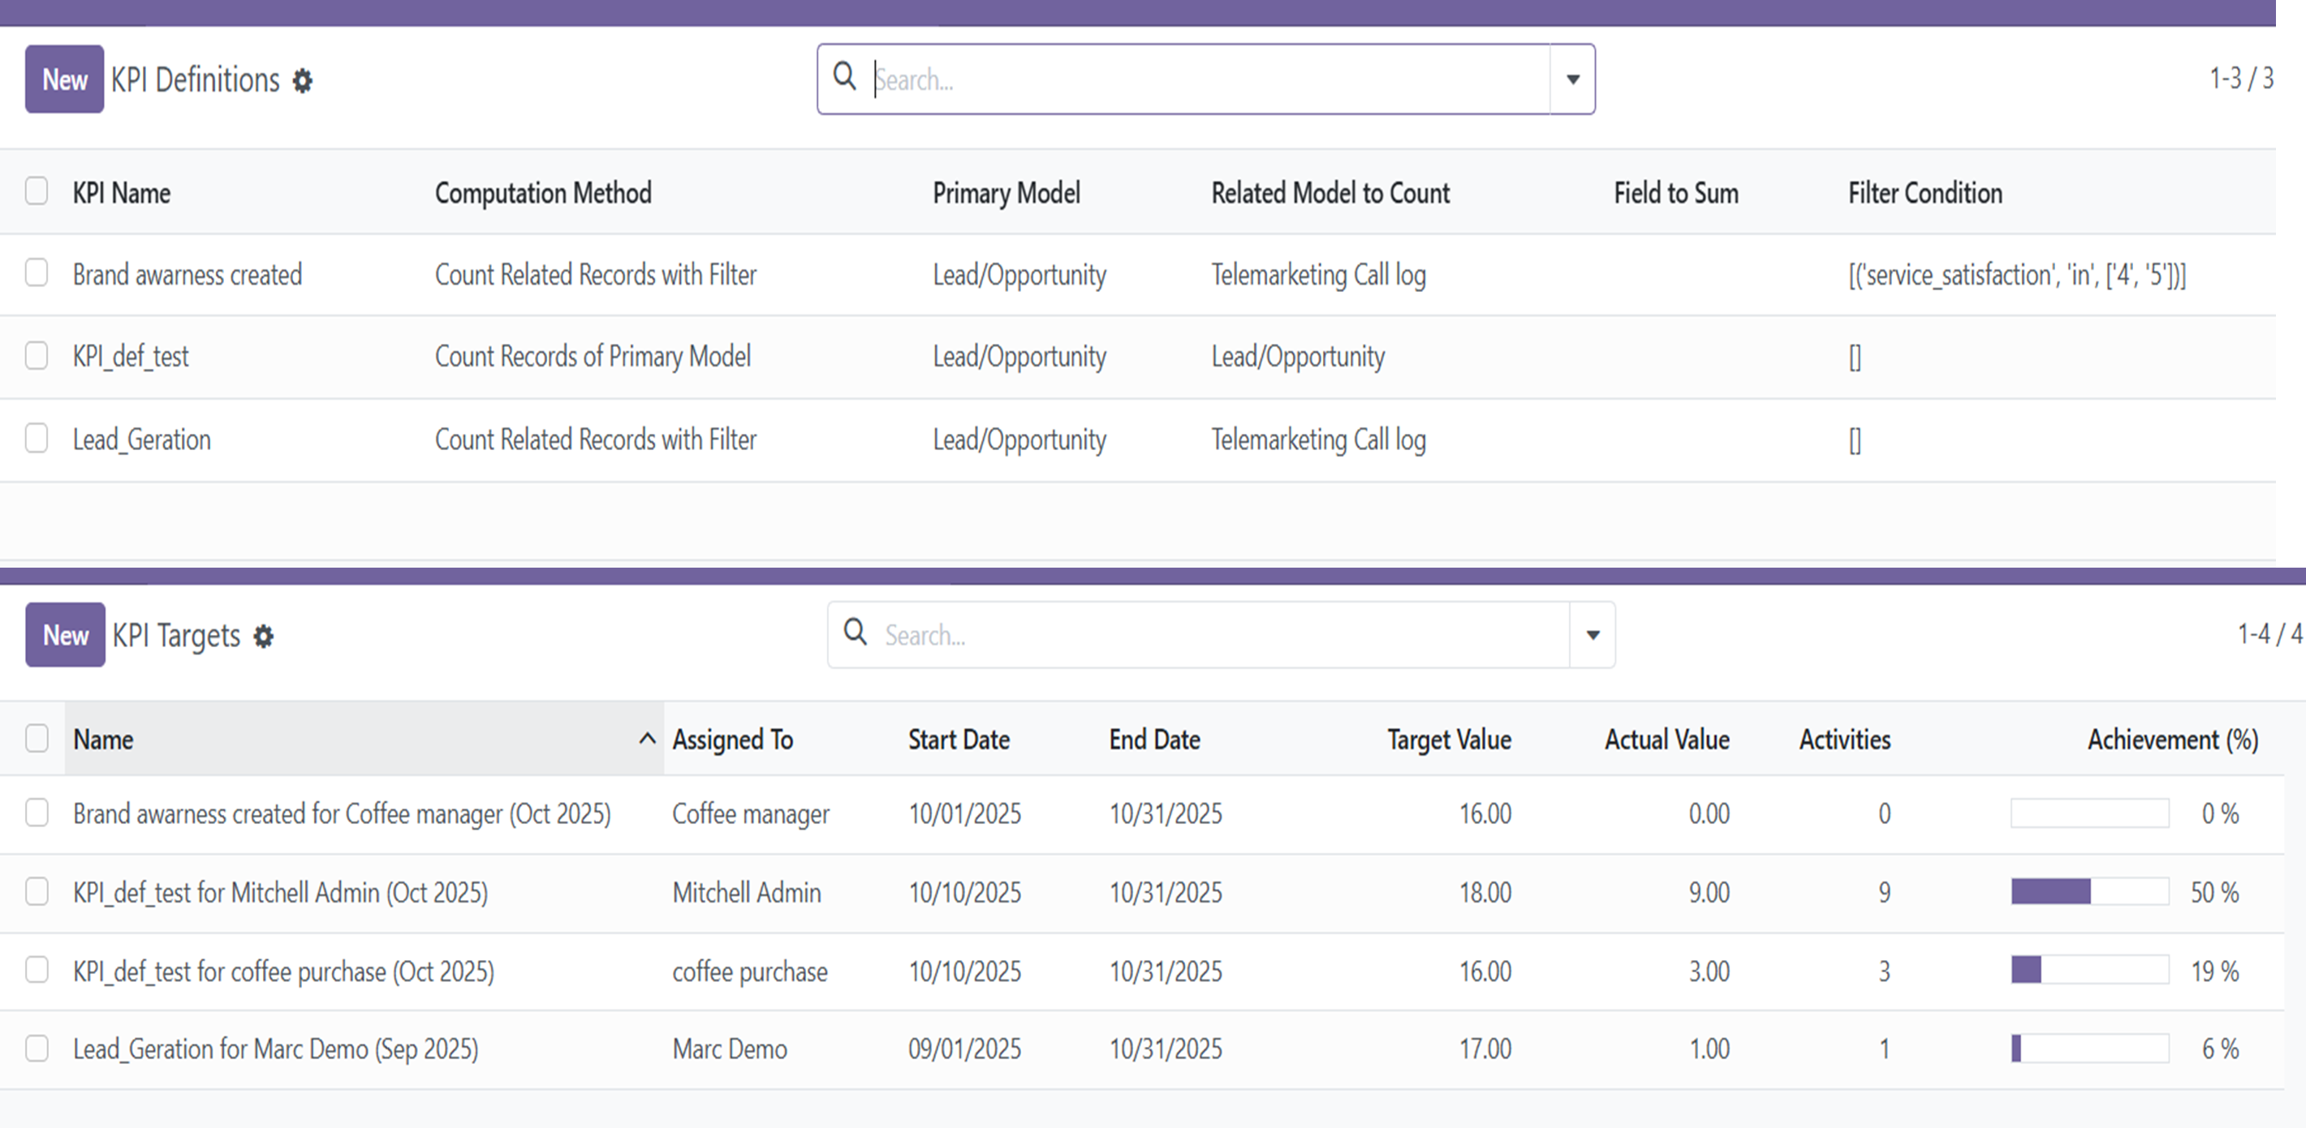
Appendix V
#Reports (3)

Slide 17
THANK YOU!
Oct 15 , 2025

Slide 18
Monthly Report (October 15 – November 5, 2025)
ICT: System Development Division
AMG HOLDINGS

Slide 19
Executive Summary
During this reporting period, the Software Development Team finalized the CRM System and achieved significant milestones in stabilizing AMG’s IT infrastructure. The CRM module was refined, tested, and integrated with the KPI Framework, completing the planned business automation cycle for the marketing and sales divisions.
Additionally, the team successfully resolved a major Active Directory (AD) user lockout incident, restoring access for all domain users and implementing stronger monitoring policies.

Slide 20
CRM System Overview
The CRM System is designed to streamline sales operations, enhance customer relationship management, and provide actionable insights for decision-making. Its goal is to improve efficiency, visibility, and collaboration across the sales and marketing departments while supporting data-driven decisions.
Key Modules:
- KPI Module: Tracks and measures key performance indicators for sales teams, providing real-time insights.
- Telemarketing Module: Streamlines inbound and outbound call management, lead registration, and data quality confirmation.
- Market Intelligence Module: Collects and analyzes market data for decision support.
- Price Log: Tracks historical pricing and competitor comparisons for transparency.
- Encounter Visit Module: Records field visits, meetings, and customer interactions.
This integrated design enhances traceability, accountability, and analytics across business processes.

Slide 21
Recent Accomplishments
- Integrated all custom CRM modules into a unified 'Marketing System'.
- Embedded data quality and telemarketing confirmation processes within the core CRM workflow.
- Completed the KPI framework for target vs. actual performance measurement.
- Restored domain user access following a system-wide AD lockout issue.
- Prepared the CRM and KPI systems for ICT department presentation.
- Conducted testing and reviewed department feedback for refinements.

Slide 22
Next Steps and Upcoming Focus
- Ensure Role-Based Access Control (RBAC) is fully implemented and consistent across modules.
- Develop KPI target vs. actual analysis reporting for performance tracking.
- Create custom reports on leads, KPIs, and other key sales metrics.
- Design and implement a JS-based CRM dashboard for the Marketing Manager, featuring AMG vs. Competitor price comparison charts.
- Continue refining module documentation and preparing for deployment.

