Slide 1

G516 | Project ID |Quantum Machine Learning for Threat Detection
Date: dd-Mon-yyyy
Team Members
  Samreen Fatima – 23bd1a1256
  Hiral Jain – 23bd1a1222
  Vedasree Ramaram – 23bd1a1265
  Jalluri Manasa – 23bd1a1223
  Pavushetty Parnika – 23bd1a1251
  …
  …
  …
  …
Mentors
Dr. Kishore Babu D

Slide 2
CONTENTS
Title Slide
Introduction
Requirement
Design
Development
Expected Outcome
Thank you!

Slide 3
INTRODUCTION
Problem Statement
Escalating Threats: Modern cyber threats (DDoS, sophisticated malware) are overwhelming conventional security defenses.
CML Limitations: Traditional Classical ML suffers from: High Computational Overhead: Cannot handle the volume and high-dimensionality of network data in real-time.
Limited Generalization: Vulnerable to Adversarial Attacks and struggles to classify new, cross-domain threats.
QML Constraint: Current quantum hardware is limited by qubit count, constraining practical deployment.
Solution
Core Proposal: A Hybrid Quantum-Classical Architecture that integrates the QSVM (stability) and VQC/QNN (adaptability) via a classical Decision Fusion Layer.
Optimization: The model is highly efficient due to the Improved Grey Wolf Optimizer IGWO, which selects a minimal 8 feature subset.
Goal: To deliver a scalable, robust, and platform-independent solution, achieving superior detection rates across heterogeneous threat landscapes.
Validation: Demonstrated stable performance on CIC-DDoS2019, CICAndMal2017, and NSL-KDD.
Target Technology Domain :
Domain: Hybrid Quantum Machine Learning (QML) for Intrusion Detection Systems (IDS)
Technologies:
Languages: Python
Quantum Libraries: IBM Qiskit (Primary), PennyLane
Classical Tools: Scikit-learn, NumPy

Slide 4
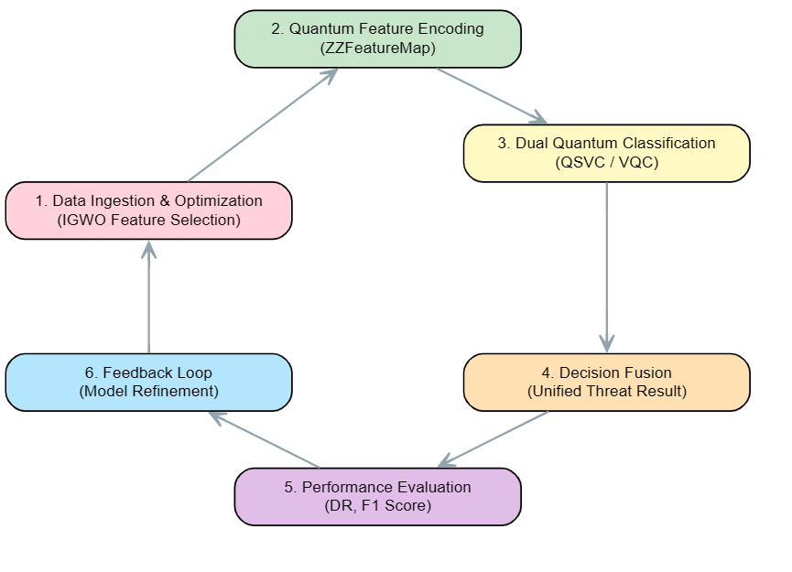
REQUIREMENT
Core Stakeholder Needs (Use Cases)
Key Stakeholders & End Users
Network Administrators
Data Scientists/Engineers
Security Analysts (Tier 1/2 SOC)
Stakeholder Need / Use Case | Functional Requirement
Real-Time Threat Triage (Analyst) | High Confidence & Low False Alarms: Classify malicious traffic with high Precision and minimal FAR
Scalable Data Monitoring (Admin) | Computational Efficiency: Process high-volume, high-dimensional data streams (e.g., DDoS) rapidly with minimal resource overhead.
New Threat Coverage (Analyst) | Zero-Day/Polymorphic Robustness: Must detect and generalize to unseen or evolving attack patterns across multiple domains.
Feature Optimization (Engineer) | Resource Efficiency: Select a minimal, optimal feature set 8 qubits to ensure practical quantum deployment.
Process Flow

Slide 5
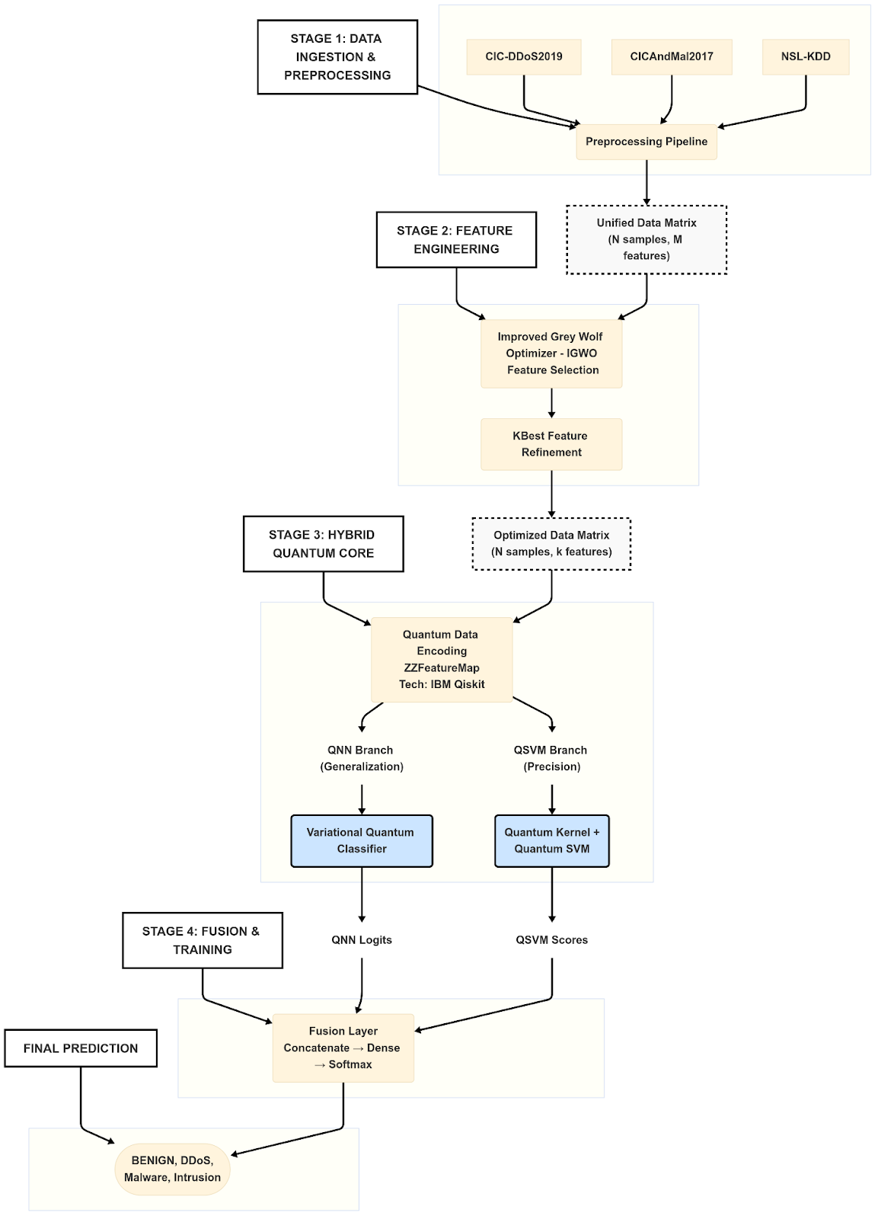
Architecture:
DESIGN
System Design:
Improved Grey Wolf Optimizer (IGWO)
Result: Feature set reduced to 8 features (8 qubits)
Goal: Successfully overcame the quantum resource bottleneck.
Datasets Used:
NSL-KDD,
CIC-DDoS2019(incl. Syn), CICAndMal2017.
Quantum Models:
QSVC Kernel: ZZFeatureMap
VQC Optimizer: SPSA
Metrics & Platform:
Key Metrics: Acc , FAR ,Detection Rate (Recall) and F₁ Score
Experiments Conducted:
Hybrid Fusion,
Independent QSVC,
Independent VQC, and
Kernel Variation Tests

Slide 6
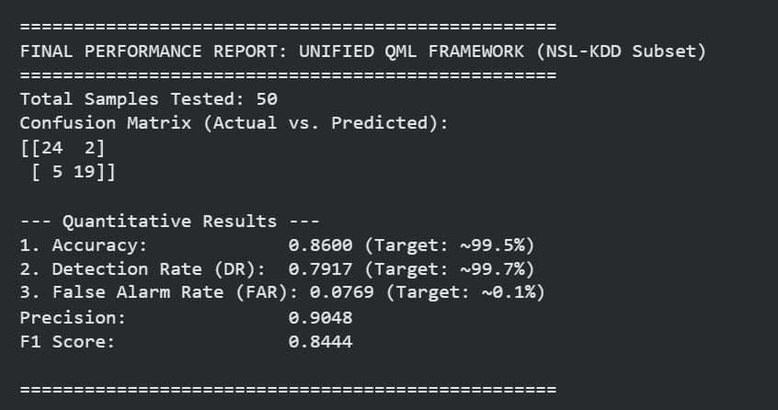
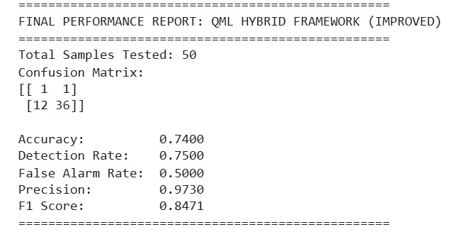
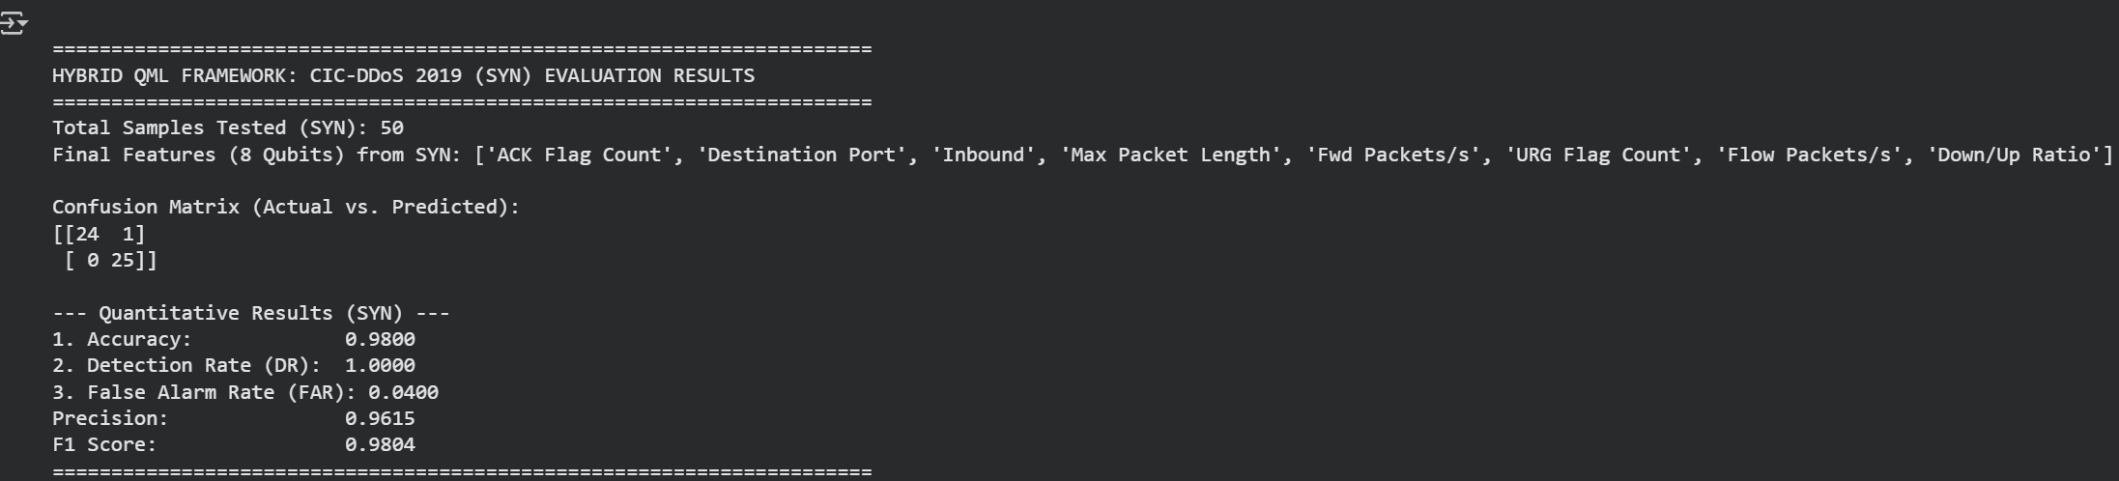
DEVELOPMENT
NSL-KDD
CIC-MAL
Features
Features | Element
Optimization Engine | Improved Grey Wolf Optimizer IGWO
Quantum Encoder | ZZFeatureMap
Kernel Classifier | QSVC (Quantum Support Vector Classifier)
Variational Classifier | VQC (Variational Quantum Classifier)
Classical Optimizer | SPSA (Simultaneous Perturbation Stochastic Approximation)
Decision Aggregator | Fusion Layer
CIC-Ddos 2019(syn)

Slide 7
EXPECTED OUTCOME
Dataset | Model Architecture | Quantum Feature Map | Accuracy | F_1 Score | Recall (DR) | Precision | False Alarm Rate (FAR)
NSL-KDD | Unified Hybrid (Fusion) | ZZFeature | 0.8600 | 0.8444 | 0,7917 | 0.9048 | 0.0769
NSL-KDD | Independent QSVC | Fidelity Kernel | 0.8200 | 0.7907 | 0.7083 | 0.8947 | 0.0769
NSL-KDD | Independent VQC (QNN) | RealAmplitudes Ansatz | 0.700 | 0.5946 | 0.4583 | 0.8462 | 0.0769
CICANDMAL | Independent QSVC | ZFeature | 0.68 | 0.80 | 0.68 | 0.70 | 0.05
CICANDMAL | Independent VQC (QNN) | ZFeature | 0.72 | 0.83 | 0.75 | 0.75 | 0.02
CICANDMAL | Independent QSVC | ZZFeature | 0.84 | 0.91 | 0.85 | 0.89 | 0.05
CICANDMAL | Independent VQC (QNN) | ZZFeature | 0.46 | 0.61 | 0.45 | 0.56 | 0.05
CIC-DDoS 2019 | Unified Hybrid | ZZFeature | 0.98 | 0.94 | 1.0 | 0.96 | 0.04
CIC-DDoS 2019 | Independent QSVM | PauliFeature | 0.98 | 0.98 | 1.0 | 0.96 | 0.04
CIC-DDoS 2019 | Independent VQC | ZFearure | 0.96 | 0.96 | 1.0 | 0.96 | 0.08

Slide 8
Thank you!

