Slide 1
Furniro - E-Commerce Website

Slide 2

Problem Statement
Traditional furniture shopping is time-consuming, expensive, and often lacks transparency in pricing and delivery. Customers face issues with high delivery costs and limited choices in quality yet affordable furniture.

Slide 3

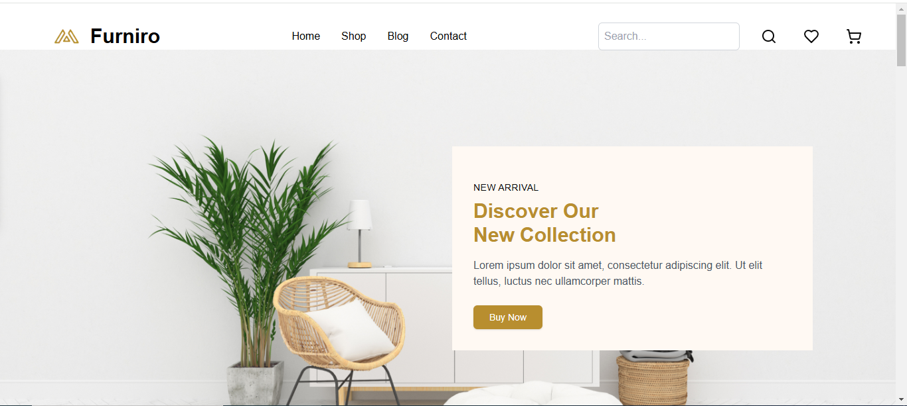
Solution : Furniro - E-Commerce Website

Slide 4

Target Audience
Individuals looking for stylish yet affordable furniture.
Homeowners and renters wanting a seamless online furniture shopping experience.
Budget-conscious consumers who prefer free delivery and added shopping incentives.

Slide 5





Unique Selling Proposition (USP)
High Quality Items
Free Delivery
Gift Vouchers
Seamless
User experience

Slide 6





Key Features
User-Friendly Interface
Secure Payment Processing-
Powered by Stripe.
Seamless Delivery Integration
–ShipEngine
Fast & Responsive Design
Cart & Checkout System

Slide 7


Technology Stack
Backend
Frontend

Slide 8


Technology Stack
Shipping
Payments

Slide 9

Revenue Model
Furniro is completely free to use, making revenue through:
Future premium services (e.g., personalized furniture recommendations).
Partnerships with home decor and interior brands.

Slide 10

Future Plans
Expanding product range to include household items like kitchen accessories, bathroom fittings, and home decor.

Slide 11

Future Plans
Introducing AI-based furniture recommendations for a personalized shopping experience.

Slide 12

Future Plans
Implementing a customer loyalty program to enhance user retention

Slide 13
Conclusion

Slide 14

Furniro aims to redefine online furniture shopping by offering affordable, high-quality products with free delivery and shopping incentives. With a strong technological foundation and a customer-centric approach, it has the potential to become a leading platform in the e-commerce space for home essentials.

Slide 15
Thank You

