Slide 1

Context-Aware Memory Augmentation System
AI that recalls information when it matters most
FINAL YEAR PROJECT
AI-POWERED
"Remembering at the right moment."

Slide 2

The Problem: Lost Knowledge
Human Forgetting Curve
Passive Information Storage
Valuable information fades over time, even if recorded.
Notes and reminders require manual retrieval; they don't prompt us.
Context-Blind Reminders
Generic alerts, poor timing, no understanding of user activity.
Result: Knowledge stored but rarely utilized when most beneficial.

Slide 3


Current Solutions: Gaps in Recall
Notes & To-Do Lists
Basic Reminders
Require manual search; lack proactive recall.
Time-based, not context-aware; often irrelevant.
Search AI Assistants
No semantic understanding; don't explain utility.
These tools miss the "when" and "why" of memory recall.

Slide 4

Our Solution: Intelligent Memory Augmentation
Semantic Storage
Contextual Understanding
Memories stored by meaning, not keywords.
System understands user's current situation.
Proactive Recall
AI suggests relevant memories when useful.
AI decides WHEN a memory is useful—not just WHAT it contains.

Slide 5

System Flow: Seamless Integration
Save Memory
Semantic Store
Provide Context
Suggest Memories
AI Match
Our system prioritizes accuracy, timing, and relevance for effective knowledge delivery.

Slide 6



Context Awareness: MVP Approach
Simulated Location
Current Activity
Time of Day
E.g., Bookstore, Office, Home for web-based MVP.
E.g., Studying, Shopping, Working selected by user.
Integrated into context for nuanced recall.
Web-based MVP for privacy-friendly demonstration and evaluation. No background tracking.

Slide 7


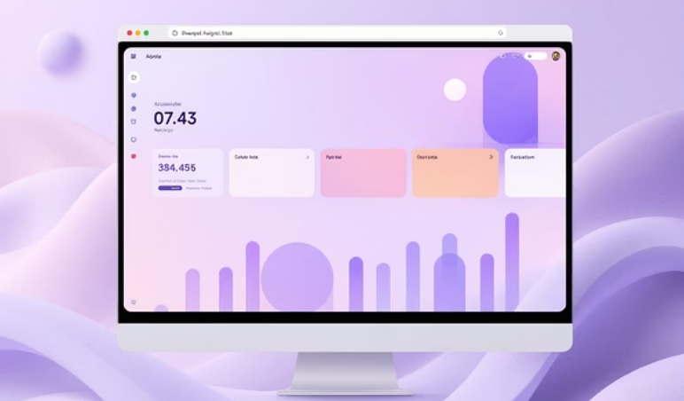





Under the Hood: Technology Stack
Base44 / Lovable
Semantic Embeddings
AI-powered app development framework.
Meaning-based retrieval for deep context.
Web Application
Database Storage
Browser-based, intuitive user interface.
Robust storage for memory records.

Slide 8

Market & Scope: Real-World Impact
Target Users & Market Need
Students & Learners: Enhanced revision & recall.
Knowledge Workers: Improved productivity & insights.
Researchers & Professionals: Streamlined information access.
Growing demand for Personal Knowledge Management (PKM) and AI productivity tools.
Project Scope
Academic and demo-ready MVP. Built for scalability:
Future mobile integration.
Real-world context detection.

Slide 9





Advantages & Applications
Improved Knowledge Reuse
Reduced Cognitive Load
Relevant insights resurface when needed.
AI handles recall, freeing up mental resources.
Explainable AI
System transparently shows recall logic.
Learning & Revision
Optimized study material recall.
Shopping Recommendations
Context-aware suggestions.

Slide 10

Conclusion & Future Vision
AI-Powered Contextual Recall
Moves beyond traditional note-taking.
Enhancements
GPS context, mobile notifications, wearable integration.
Cognitive Collaboration
A step towards human-AI partnership.
This project represents a step toward human–AI cognitive collaboration.

