Slide 1

BULB AND FAN CONTROL BY ARDUINO AND WIFI
MINOR PROJECT
SUBMITTED BY-
JASPREET KAUR,URN-1805518,CRN-1821030
SAMREET KAUR,URN-1805553,CRN-1821067
HARJOT BAMRAH,URN-1805514,CRN-1821027
MARCH 2021
GURU NANAK DEV ENGINEERING COLLEGE
LUDHIANA-141006, INDIA

Slide 2

INTRODUCTION
Seeing an increasing demand for smart homes, where appliances react automatically to changing environment conditions and can be easily through one common device. We have come up with a new system called Arduino based Bulb and Fan automation. This system is super cost effective and can give the user, the ability to control these device without even spending for a remote control. This system allows automated Bulb and Fan for better convenience, energy efficiency, and security.

Slide 3
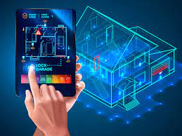
OBJECTIVES
1.To implement a low cost, reliable and scalable automated Bulb and Fan that can remotely controlled.
2.TO PROVIDE ANYTIME AND ANYWHERE ACCESS
3.HELP HANDICAPPED AND OLD
4. ENERGY SAVING
5. TO SETUP EXCELLENT CONTROL OVER SWITCH

Slide 4


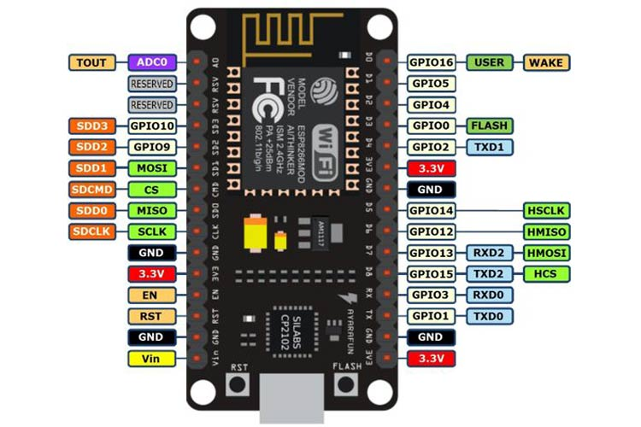
FEASIBILITY STUDY
The project is executed within a one semester frame. The time frame allocated for this project is limited but adequate through proper time management and planning. The aim of this project is to design an open source, easy-to-use and affordable bulb and fan automation. For this reason the Arduino IDE and Node MCU Esp8266 is used, acting as the main controller for the system by sending signals to control bulb and fan. A smartphone application - Blynk app works as the user interface while a standard wireless network is used as the medium between Arduino and smartphone application.

Slide 5
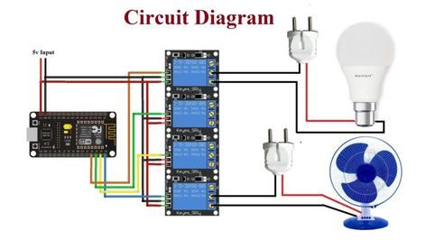
METHODOLOGY
After confirmation of the project title, preliminary research is done to analyze it.
A coding is written in the C language, which is than given into the NODE MCU module.
The connections are made as per the connection diagram.
Source supply is provided to the bulb and fan.
With the help of application in the android, the switching of bulb and fan can be controlled.

Slide 6
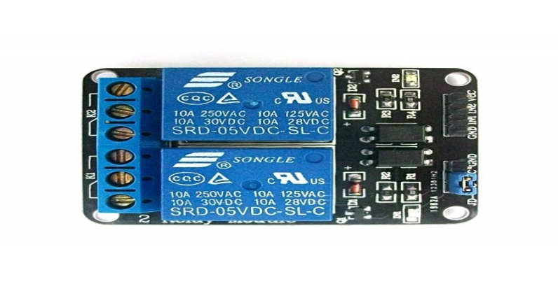
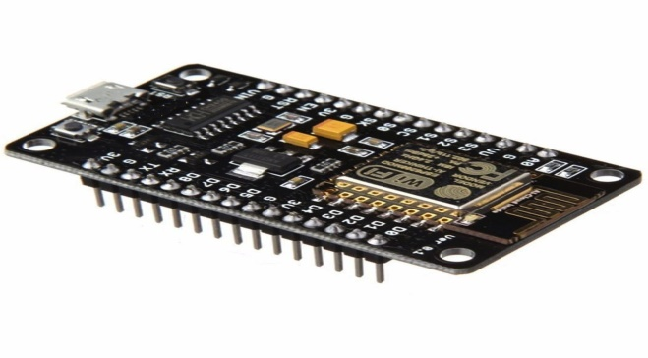
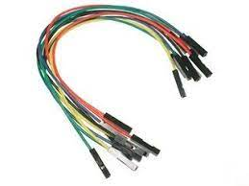
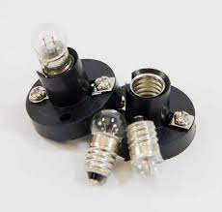
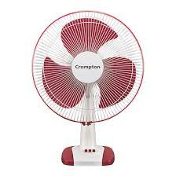
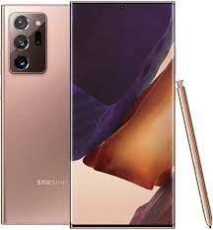
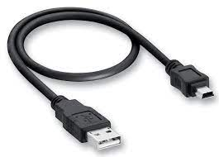
FACILITIES REQUIRED FOR PROPOSED WORK
HARDWARE REQUIREMENTS

Slide 7


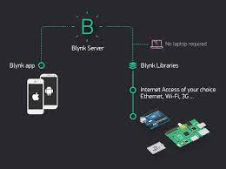
SOFTWARE REQUIREMNETS

Slide 8
REFERENCES
Sukhan Lee and George N. Saridis, “Title of paper” IEEE Transactions on Automatic Control, Vol. 29, Issue No 4. pp. 290–302, April 1984.
IoT based Simple Home Automation using NODEMCU by Aditya Vikram Jajodia, Suprabhat Das, December 2017 DOI: 10.14445/22315381/IJETT-V53P222 .
Designing Of Smart Home Automation System Based On NODE MCU by Ravi Prakash Saini,Bhanu pratap singh,Mahesh kumar sharma,N. leeprechanon, Conference: ADVANCEMENT IN SCIENCE AND TECHNOLOGY: Proceedings of the 2nd International Conference on Communication Systems (ICCS-2015), At Rajasthan, India, Volume: AIP Conference Proceedings 1715(1):020016.

