Slide 1
APEX TRADER
A Stock and Cryptocurrency Trading Database Management System
with an In-Database Matching Engine and a Double-Entry Ledger
BCSE302P — Database Systems Lab
Submitted by
24BCE2863 Kumar Paritosh
24BCE2865 Samrender Singh Saini
24BCE2886 Vartika Chaudhary
Under the guidance of
Prof. Nithya N S
School of Computer Science and Engineering
Vellore Institute of Technology, Vellore
PostgreSQL 16 · Python 3.13 · FastAPI
38 tables · 84 routines · 24 RLS policies · 150 SQL assertions · 118 API checks · 51 browser checks

Slide 2
What this presentation covers
The guideline sequence, with the evidence for each claim
Design
• Abstract and problem statement
• Objectives and scope
• System architecture and workflow
• ER diagram
• Relational schema and normalization
Implementation
• CREATE TABLE and constraints
• Sample data and volumes
• SQL queries and their outputs
• The order round trip
• Operations the database refuses
Advanced + proof
• Procedures, triggers, views
• Transaction control
• Row Level Security
• Partitioning and indexing
• Surveillance, screenshots, testing
Every output in this deck is a captured transcript from the running database. Nothing on the following slides was typed by hand.
2

Slide 3
Abstract and Problem Statement
Apex Trader is a database management system for a stock and cryptocurrency trading venue. The limit order book is a relation, matching is a stored procedure, settlement is a journal entry, and all three execute inside one database transaction. The database is the exchange — not a store behind one.
The problem
• Who owns what, at what price it changed hands, and whether the trade was allowed are three answers that depend on each other.
• They must all hold while many users trade on the same instrument at once.
• Risk in Python, matching in Python, then writing balances cannot be made atomic without a global lock or a distributed transaction.
• A stored balance can silently diverge from the history that produced it, and nothing in the schema says so.
The approach
• Matching, settlement and risk run in ONE transaction, in PL/pgSQL.
• No balance is stored. Every balance is derived from an append-only double-entry journal.
• A DEFERRABLE INITIALLY DEFERRED constraint verifies at COMMIT that each entry sums to zero, so value can move but never be created.
• Tenant isolation by Row Level Security, not by remembering a WHERE clause.
3

Slide 4
Objectives
Eight objectives, and how each was realised
Model a complete trading venue relationally — 38 base tables in BCNF across 12 bounded-context schemas
Implement order matching inside the database — price-time priority, 6 order types, 4 time-in-force policies
Guarantee accounting integrity by construction — append-only journal, derived balances, deferred zero-sum constraint
Enforce risk before a trade, not after — a pre-trade gate that runs inside the order transaction
Isolate tenants in the database layer — 24 Row Level Security policies over 16 tables
Detect market abuse using analytical SQL — wash trading, spoofing, momentum ignition, volume anomaly
Support multiple currencies without loss of integrity — 10 currencies, conversion is a four-legged journal entry
Demonstrate correctness rather than assert it — 150 SQL assertions, 118 API checks, 51 browser checks, 18 invariants
Scope delivered
38 + 30
tables + partitions
84
routines
20
triggers
12 + 2
views + matviews
348
indexes
24
RLS policies
28
migrations
Two asset classes on one engine: equities and ETFs in a 390-minute session, eight crypto pairs trading 24×7. What differs is data on the instrument, not code in the engine.
4

Slide 5
Scope and Delimitations
What the system does, and what it deliberately does not
In scope
• Continuous auction with price-time priority on a per-instrument book.
• Market, limit, stop, stop-limit, trailing-stop and iceberg orders.
• DAY, GTC, IOC and FOK time-in-force policies.
• Double-entry settlement with derived balances in 10 currencies.
• Pre-trade risk: buying power, short-sale gate, notional cap, concentration, rate limit, daily loss, price band, halts.
• Surveillance, audit trail, copy trading, watchlists and price alerts.
• Minute bars, arbitrary chart intervals, and technical indicators in SQL.
Out of scope, and why
• Opening and closing auctions — the session model supports them, but the auction algorithm is a separate piece of work.
• Clearing-house interposition and T+1 settlement — the journal already carries occurred_at; a settlement date completes it.
• Corporate actions applied to historical prices — modelled, not back-applied.
• Options and futures — the ledger needs a third asset class.
• Full order-book depth beyond top of book over the wire.
• Replication and clustering — single-node by design for this submission.
5

Slide 6
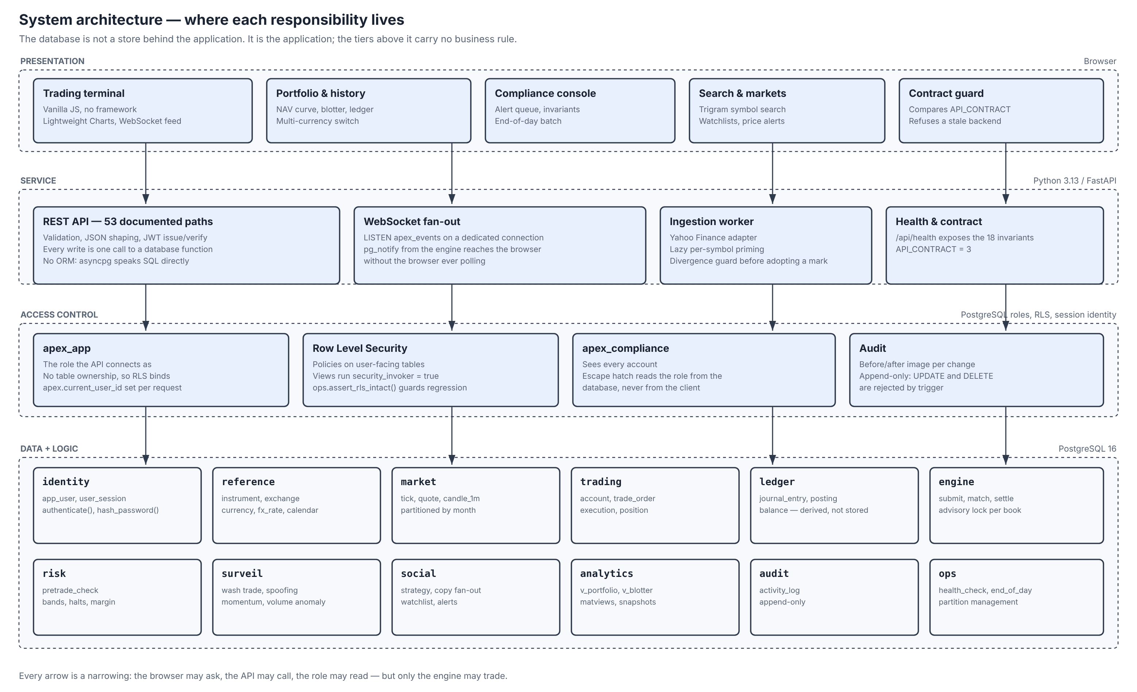
System Architecture
Four tiers — and the business logic lives in exactly one of them
The service tier validates request shape and emits JSON. It calls one database function per write and contains no rule that could disagree with the database.
6

Slide 7
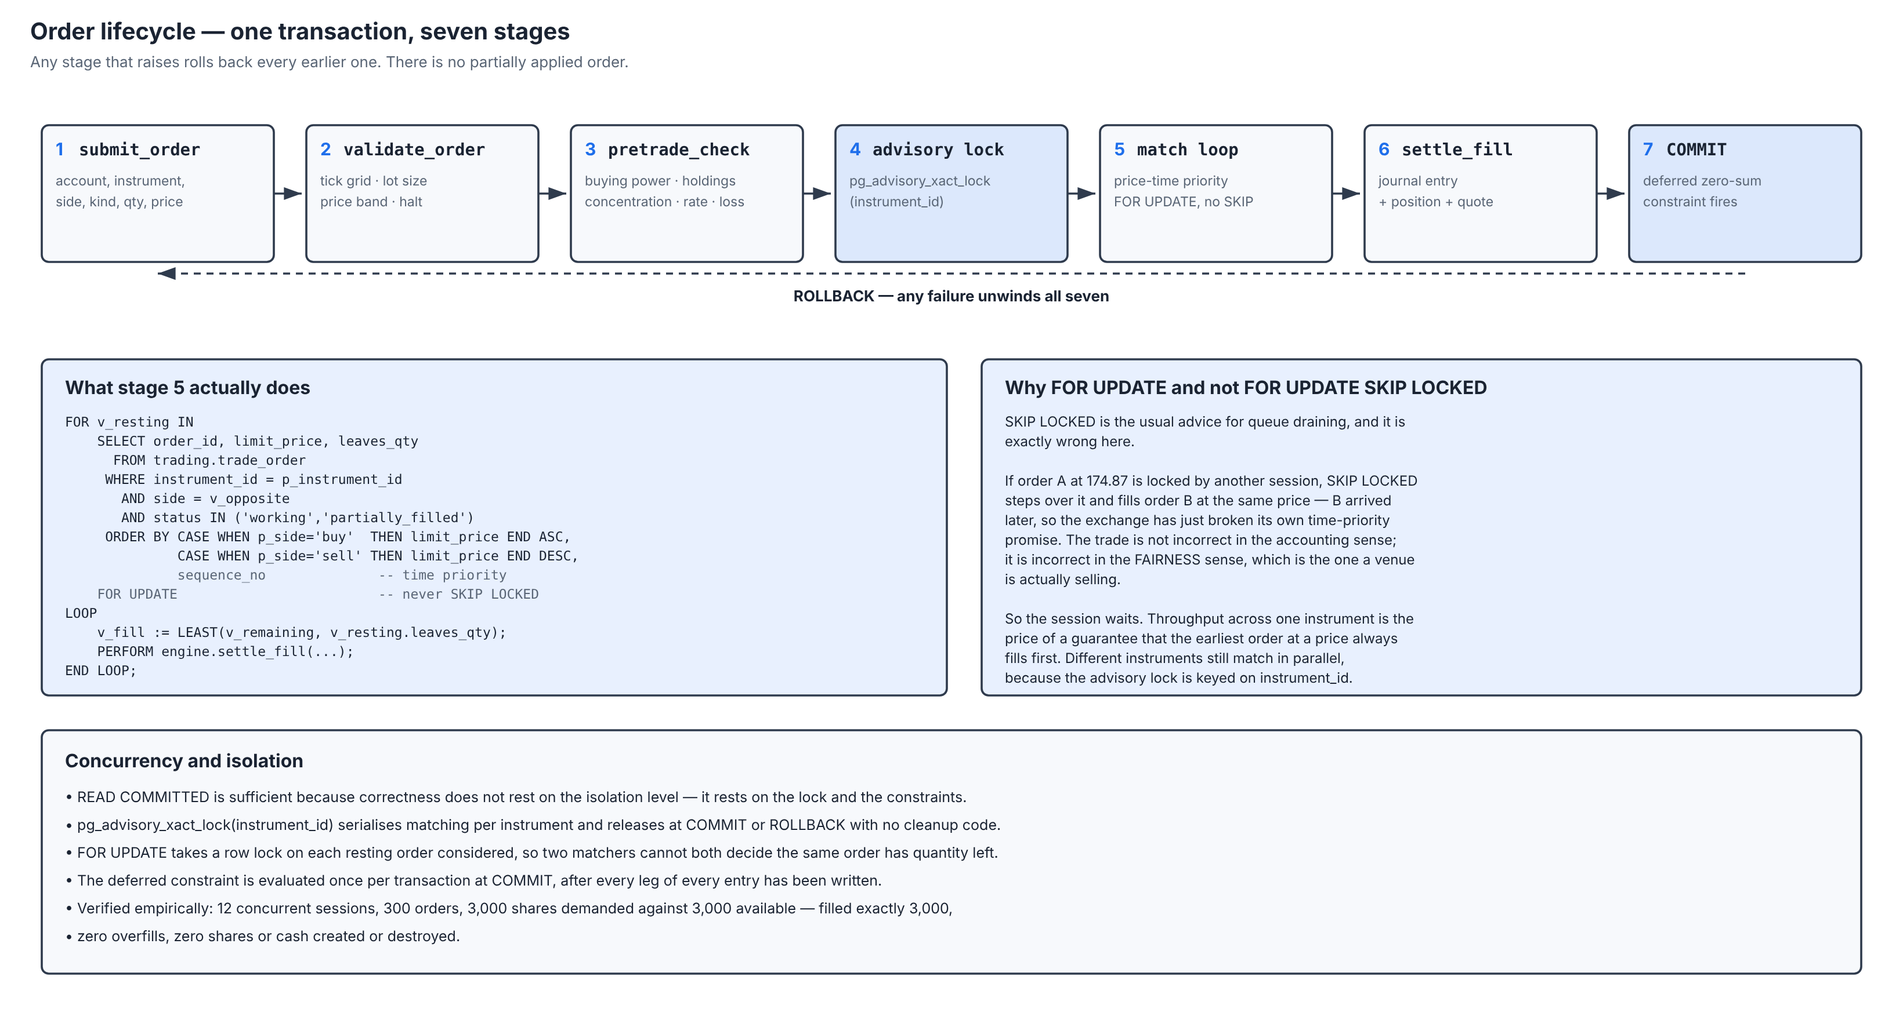
Workflow — the life of an order
Seven stages, one transaction. Any failure unwinds all seven.
Stage 4 is the serialisation point and stage 7 is where the ledger invariant is checked. Between them, the engine may fill against many resting orders.
7

Slide 8
Database Management System
Three capabilities on which the design depends
PostgreSQL 16. Version 15 is the minimum, and the reason is on this slide.
Deferrable constraint triggers
The legs of a journal entry are inserted one row at a time, so the entry is
legitimately unbalanced DURING the transaction. The check must run at COMMIT.
MySQL has no DEFERRABLE constraint, so the rule would move into application
code — precisely the place this design removes it from.
Row Level Security
Tenant isolation becomes a property of the data rather than of the queries
that read it. A query that omits its account predicate returns an empty set
instead of another trader’s rows. MySQL offers no equivalent.
NULLS NOT DISTINCT (PostgreSQL 15+)
A cash balance has no instrument. Under standard SQL two NULLs are distinct,
so a conventional unique key would let one account hold two cash balances in
the same currency. This one clause sets the minimum version for the project.
CREATE UNIQUE INDEX uq_balance_slot ON ledger.balance
(account_id, asset_class, currency, instrument_id) NULLS NOT DISTINCT;
8

Slide 9
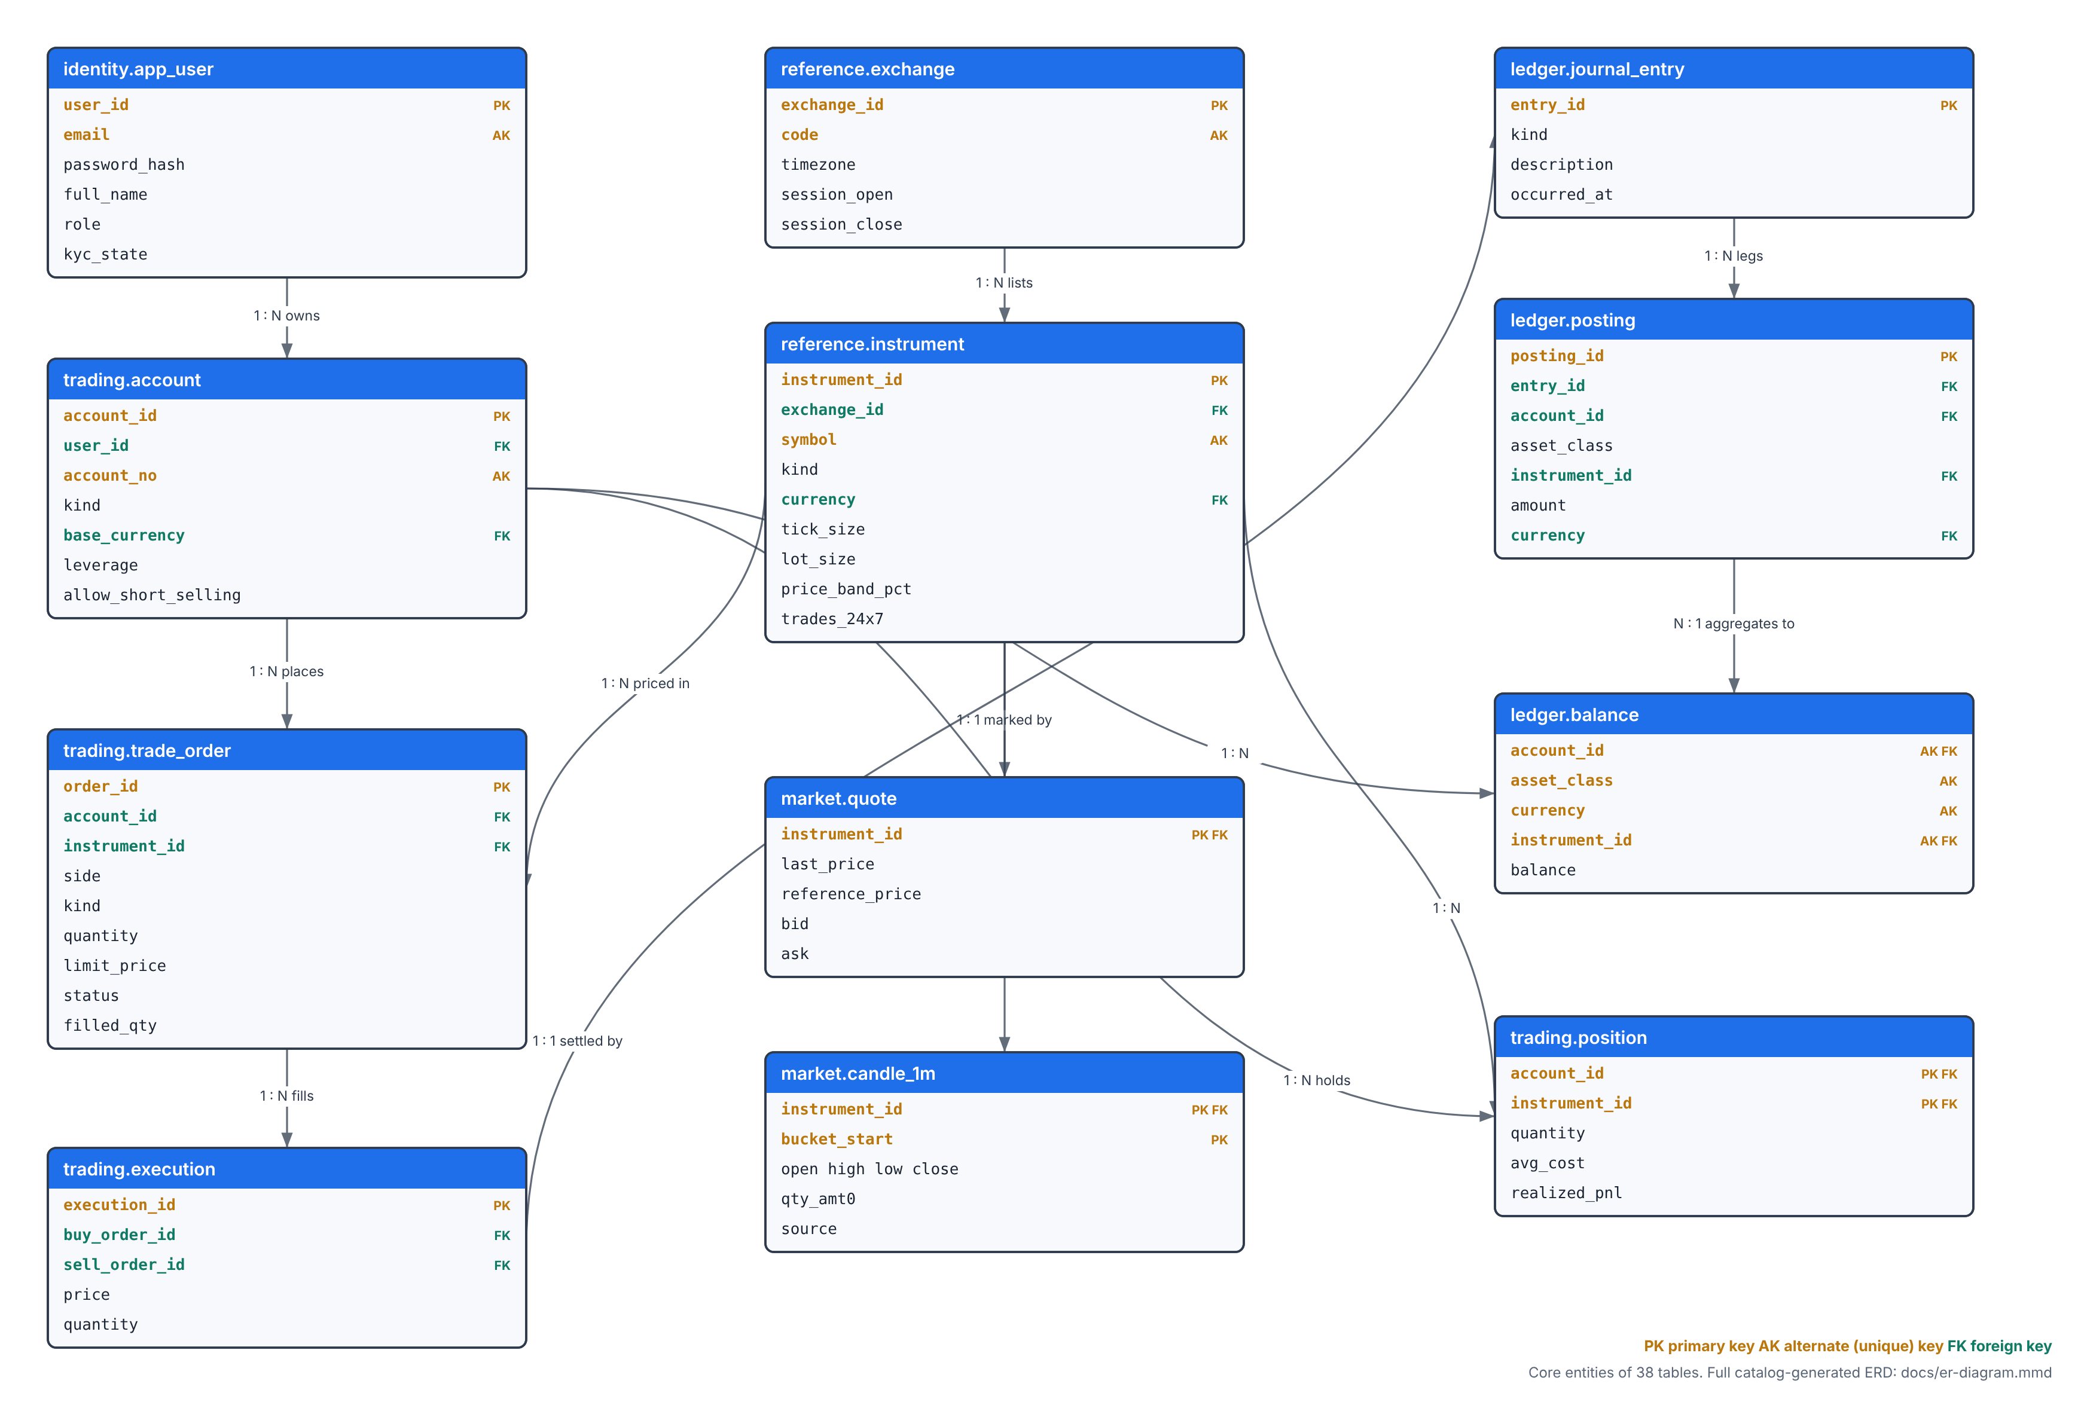
ER Diagram — core entities
PK primary key · AK alternate (unique) key · FK foreign key
Twelve of the 38 base tables: the ones a reader must follow to see how an order becomes a settled position. The full catalog-generated ERD is docs/er-diagram.mmd.
9

Slide 10
Relational Schema
Twelve bounded-context schemas, not one flat namespace
Schema
Responsibility
Representative objects
identity
Users, credentials, sessions
app_user, user_session, login_attempt
reference
Security master and calendars
instrument, exchange, currency, fx_rate
market
Market data
tick, quote, candle_1m (partitioned by month)
trading
Accounts, orders, fills, positions
account, trade_order, execution, position
ledger
The book of record
journal_entry, posting, balance
engine
Matching and settlement
submit_order, match_order, settle_fill
risk
Pre-trade control
pretrade_check, trading_halt, price_alert
surveil
Market-abuse detection
rule, alert
social
Copy trading and watchlists
strategy, copy_subscription, watchlist
analytics
Derived read models
v_portfolio, v_blotter, account_snapshot
audit
Immutable change log
activity_log
ops
Operations
health_check, schema_migration, partitions
Schemas give readable qualified names, a per-context GRANT surface, and a natural attachment point for security policies. The dependency direction is explicit: engine depends on ledger and risk, never the reverse.
10

Slide 11
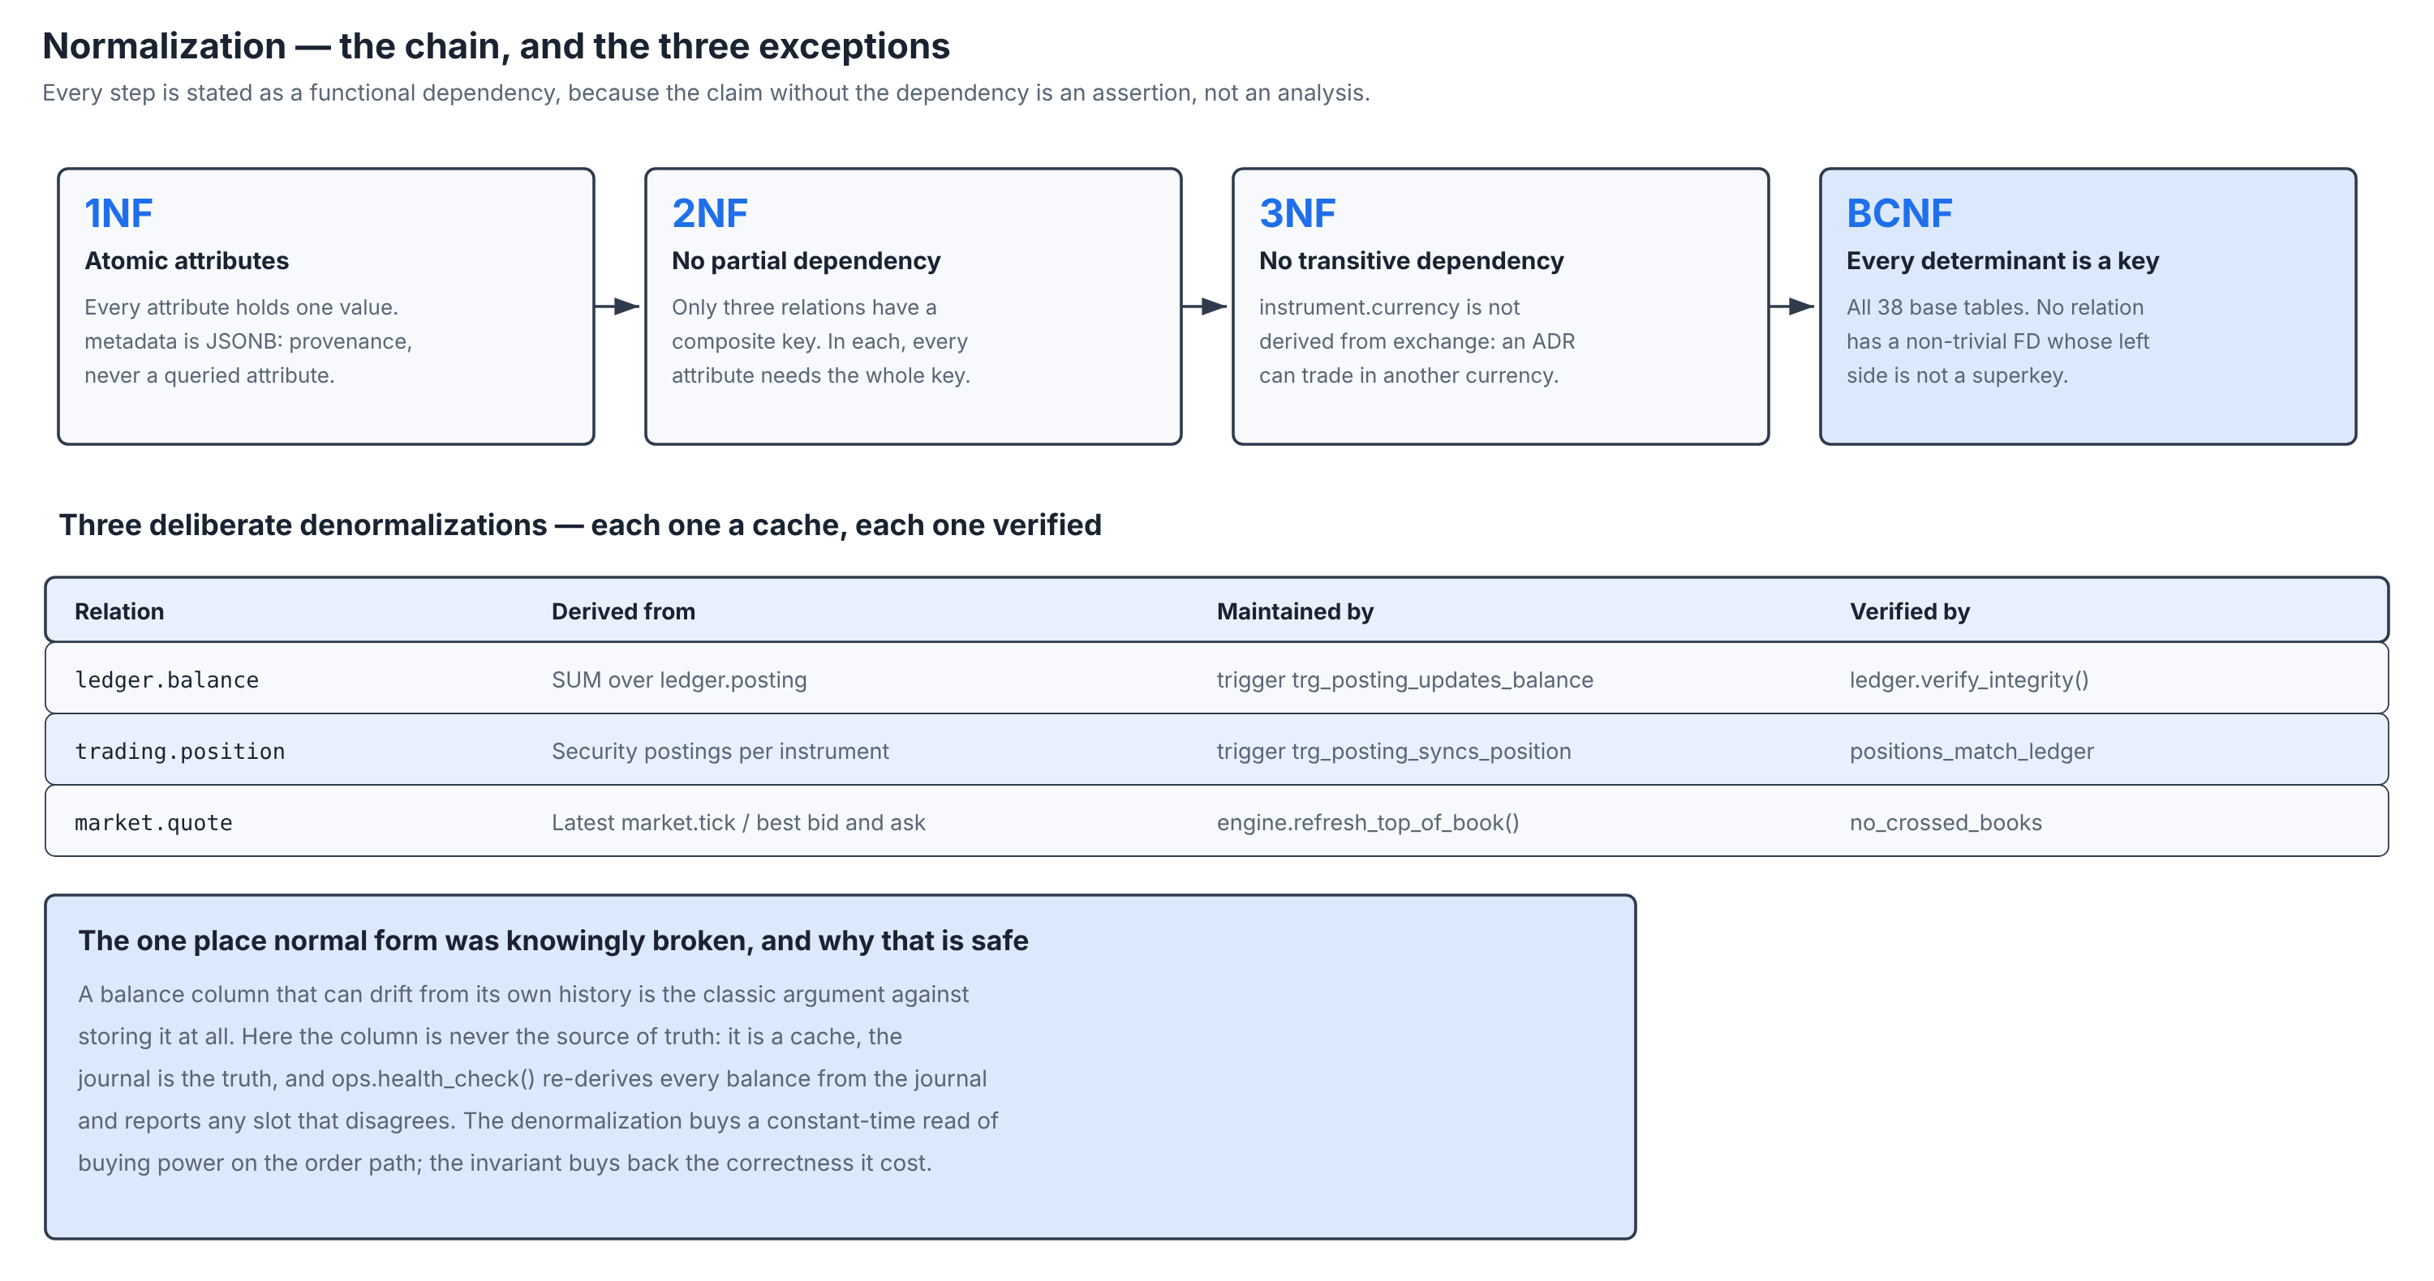
Normalization
Boyce-Codd Normal Form, and the three deliberate exceptions
A denormalization that cannot be checked is a defect awaiting discovery. Each of the three is a cache with a trigger that maintains it and an invariant that verifies it.
11

Slide 12
Database Implementation — CREATE TABLE
trading.trade_order
CREATE TABLE trading.trade_order (
order_id BIGINT GENERATED ALWAYS AS IDENTITY PRIMARY KEY,
-- Idempotency key: a retried POST cannot create a second order.
client_order_id UUID NOT NULL DEFAULT gen_random_uuid() UNIQUE,
-- The "time" in price-TIME priority. Timestamps can tie and can
-- move backwards under NTP; a sequence can do neither.
seq_no BIGINT NOT NULL DEFAULT nextval('engine.order_seq'),
account_id BIGINT NOT NULL REFERENCES trading.account(account_id),
instrument_id INTEGER NOT NULL REFERENCES reference.instrument(...),
side trading.order_side NOT NULL,
kind trading.order_kind NOT NULL,
tif trading.time_in_force NOT NULL DEFAULT 'day',
quantity qty_amt NOT NULL,
limit_price NUMERIC(20,8) CHECK (limit_price IS NULL OR > 0),
filled_qty qty_amt0 NOT NULL DEFAULT 0,
-- GENERATED: remaining size is arithmetic, not state.
leaves_qty NUMERIC(20,8) GENERATED ALWAYS AS
(quantity - filled_qty) STORED,
status trading.order_status NOT NULL DEFAULT 'pending',
CONSTRAINT limit_requires_price CHECK (
kind NOT IN ('limit','stop_limit') OR limit_price IS NOT NULL),
CONSTRAINT no_overfill CHECK (filled_qty <= quantity));
Constraints on show
• PRIMARY KEY identity column
• UNIQUE client_order_id
• FOREIGN KEY account, instrument
• NOT NULL on every required column
• CHECK two table-level rules
• GENERATED leaves_qty
Why a sequence, not a clock
• Two orders placed in the same millisecond tie on a timestamp.
• An NTP correction can move a clock backwards and reorder them.
• engine.order_seq gives a total order that nothing outside the database can disturb — which is what fairness means here.
12

Slide 13
Database Implementation — the ledger
ledger.posting, and the constraint that makes double entry a guarantee
CREATE TABLE ledger.posting (
posting_id BIGINT GENERATED ALWAYS AS IDENTITY PRIMARY KEY,
entry_id BIGINT NOT NULL REFERENCES ledger.journal_entry(entry_id)
ON DELETE CASCADE,
account_id BIGINT NOT NULL REFERENCES trading.account(account_id),
asset_class ledger.asset_class NOT NULL,
instrument_id INTEGER REFERENCES reference.instrument(instrument_id),
currency currency_code REFERENCES reference.currency(code),
-- Positive = value flows INTO this account, negative = OUT of it.
amount money_amt NOT NULL CHECK (amount <> 0),
CONSTRAINT asset_instrument_agreement CHECK (
(asset_class = 'cash' AND instrument_id IS NULL)
OR (asset_class = 'security' AND instrument_id IS NOT NULL)));
CREATE CONSTRAINT TRIGGER trg_posting_balanced
AFTER INSERT OR UPDATE OR DELETE ON ledger.posting
DEFERRABLE INITIALLY DEFERRED
FOR EACH ROW EXECUTE FUNCTION ledger.assert_entry_balanced();
The sign convention
• A posting is one leg of an entry.
• Positive flows in, negative flows out.
• An entry balances when its legs sum to zero — independently for cash and for every security.
Why DEFERRABLE
• Legs are inserted one row at a time, so the entry is legitimately unbalanced while that happens.
• A per-statement check would reject every correct entry.
• Deferring it to COMMIT is what lets the rule be absolute.
13

Slide 14
Database Implementation — partitioned market data
market.candle_1m
CREATE TABLE market.candle_1m (
instrument_id INTEGER NOT NULL REFERENCES reference.instrument(...),
bucket_start TIMESTAMPTZ NOT NULL,
open price_amt NOT NULL,
high price_amt NOT NULL,
low price_amt NOT NULL,
close price_amt NOT NULL,
qty_amt0 qty_amt0 NOT NULL DEFAULT 0,
trade_count INTEGER NOT NULL DEFAULT 0 CHECK (trade_count >= 0),
vwap NUMERIC(20,8),
PRIMARY KEY (instrument_id, bucket_start),
-- OHLC has an internal arithmetic truth. A feed defect that
-- violates it is rejected at write time, not discovered later
-- as an impossible candlestick on a chart.
CONSTRAINT ohlc_coherent CHECK (
high >= low AND high >= open AND high >= close
AND low <= open AND low <= close),
CONSTRAINT bucket_aligned CHECK (
date_trunc('minute', bucket_start) = bucket_start)
) PARTITION BY RANGE (bucket_start);
Domains do the repeating
• price_amt NUMERIC(20,8) CHECK (> 0)
• qty_amt0 NUMERIC(20,8) CHECK (>= 0)
• The constraint travels with the type, so it cannot be forgotten on a column that uses it.
Partitioning buys two things
• The planner prunes whole months at plan time — measured on a later slide.
• An expired month is detached in constant time instead of deleted row by row.
• ops.ensure_time_partitions keeps a runway of future partitions ahead of the data.
14

Slide 15
Constraints — counted from the catalogue, not claimed
540
NOT NULL
71
CHECK
57
FOREIGN KEY
37
PRIMARY KEY
11
UNIQUE
1
EXCLUDE
1
CONSTRAINT TRIGGER
kind | declared
--------------------+----------
NOT NULL | 540
CHECK | 71
FOREIGN KEY | 57
PRIMARY KEY | 37
UNIQUE | 11
EXCLUDE | 1
CONSTRAINT TRIGGER | 1
(7 rows)
The EXCLUDE constraint
• no_overlapping_halts, over GiST with btree_gist:
two trading halts on one instrument cannot overlap in time.
• A rule that would otherwise be a race condition in application code.
The CONSTRAINT trigger
• trg_posting_balanced, DEFERRABLE INITIALLY DEFERRED:
every journal entry sums to zero, verified at COMMIT.
• This single object is what makes the ledger provable.
15

Slide 16
Sample Data
Generated so that it is internally consistent, by ordinary SQL
INSERT INTO reference.currency (code, name, symbol, minor_units) VALUES
('USD','US Dollar','$',2), ('INR','Indian Rupee','₹',2),
('EUR','Euro','€',2), ('GBP','Pound Sterling','£',2)
ON CONFLICT (code) DO NOTHING;
INSERT INTO reference.instrument (symbol, exchange_id, name, sector,
currency, tick_size, lot_size,
price_band_pct, is_shortable)
VALUES ('AAPL', 1, 'Apple Inc.', 'Technology', 'USD', 0.01, 1, 20.0, TRUE);
-- The password is never stored: pgcrypto hashes it with a per-row salt.
INSERT INTO identity.app_user (email, password_hash, full_name, role, kyc_state)
VALUES ('samrender@apex.io', identity.hash_password('Apex@2026'),
'Samrender Singh Saini', 'trader', 'verified');
-- Funding an account is a LEDGER EVENT, not an UPDATE of a balance
-- column: the money is moved from the system bank account.
SELECT ledger.post_entry('deposit', 'Opening balance', ARRAY[
ROW(1, 'cash', NULL, -500000.00, 'funding')::ledger.leg,
ROW(375, 'cash', NULL, 500000.00, 'funding')::ledger.leg]);
relation | count
----------------------+--------
audit.activity_log | 704
identity.app_user | 8
ledger.balance | 148
ledger.journal_entry | 257
ledger.posting | 1130
market.candle_1m | 442080
market.tick | 7
reference.currency | 10
reference.fx_rate | 414
reference.instrument | 24
trading.account | 13
trading.execution | 174
trading.position | 123
trading.trade_order | 599
(14 rows)
Forty-five trading sessions. The market history is self-consistent: candles agree with the ticks they were aggregated from, every execution has a balanced journal entry, and every position equals the sum of its postings.
16

Slide 17
SQL Queries and Outputs — joins
A portfolio cannot be answered from one table
SELECT split_part(u.full_name,' ',1) AS trader, a.account_no, i.symbol,
round(p.quantity,2) AS qty, round(p.avg_cost,2) AS avg_cost,
round(q.last_price,2) AS last_px,
round((q.last_price - p.avg_cost) * p.quantity, 2) AS unrealised
FROM trading.position p
JOIN trading.account a ON a.account_id = p.account_id
JOIN identity.app_user u ON u.user_id = a.user_id
JOIN reference.instrument i ON i.instrument_id = p.instrument_id
JOIN market.quote q ON q.instrument_id = p.instrument_id
WHERE p.quantity <> 0 ORDER BY unrealised DESC LIMIT 8;
trader | account_no | symbol | qty | avg_cost | last_px | unrealised
-----------+------------+---------+--------+----------+---------+------------
Sam | APX-000345 | MSFT | 48.00 | 505.24 | 751.22 | 11807.04
Samrender | APX-000342 | TSLA | 58.00 | 383.71 | 561.33 | 10302.07
Vartika | APX-000343 | QQQ | 53.00 | 493.49 | 673.05 | 9516.93
Samrender | APX-000342 | SOL-USD | 62.26 | 192.75 | 313.62 | 7524.98
Ginni | APX-000346 | TSLA | 21.00 | 235.88 | 561.33 | 6834.45
Kumar | APX-000344 | QQQ | 30.00 | 464.38 | 673.05 | 6260.04
Vartika | APX-000343 | SPY | 87.00 | 555.51 | 617.20 | 5366.84
Samrender | APX-000342 | V | 171.00 | 281.71 | 298.58 | 2883.98
(8 rows)
Five tables from four bounded contexts. The join is the reason the data is normalised: the average cost lives in exactly one place and the live price in exactly one other.
17

Slide 18
SQL Queries and Outputs — aggregates and subqueries
GROUP BY, HAVING and the aggregate FILTER clause
Scalar, correlated and EXISTS subqueries in one statement
SELECT i.symbol, count(*) AS orders,
count(*) FILTER (WHERE o.side='buy') AS buys,
count(*) FILTER (WHERE o.side='sell') AS sells,
round(sum(o.filled_qty)) AS filled,
round(avg(o.avg_fill_price), 2) AS avg_px
FROM trading.trade_order o
JOIN reference.instrument i USING (instrument_id)
GROUP BY i.symbol HAVING count(*) >= 10
ORDER BY orders DESC LIMIT 8;
SELECT u.full_name,
-- scalar subquery
(SELECT count(*) FROM trading.trade_order o2
JOIN trading.account a2 USING (account_id)
WHERE a2.user_id = u.user_id) AS orders,
-- correlated subquery
(SELECT max(o3.placed_at) FROM trading.trade_order o3
JOIN trading.account a3 USING (account_id)
WHERE a3.user_id = u.user_id) AS last_order
FROM identity.app_user u
WHERE EXISTS (SELECT 1 FROM trading.account a
WHERE a.user_id = u.user_id)
AND u.role = 'trader' ORDER BY orders DESC;
symbol | orders | buys | sells | filled | avg_px
--------+--------+------+-------+--------+--------
DIS | 54 | 33 | 21 | 2400 | 98.74
INTC | 48 | 24 | 24 | 9748 | 43.05
NVDA | 36 | 18 | 18 | 2518 | 84.89
AMZN | 35 | 18 | 17 | 1112 | 177.28
AAPL | 35 | 20 | 15 | 934 | 186.33
AMD | 32 | 16 | 16 | 1090 | 166.98
SPY | 32 | 16 | 16 | 358 | 565.13
GOOGL | 30 | 15 | 15 | 1306 | 157.58
(8 rows)
full_name | orders | last_order
-----------------------+--------+-------------------------------
Samrender Singh Saini | 54 | 2026-10-18 22:58:09.641226+00
Vartika Chaudhary | 47 | 2026-10-18 22:58:08.626855+00
Ginni Kaur | 32 | 2026-10-18 19:57:48.123864+00
Kumar Paritosh | 30 | 2026-10-16 18:11:03+00
Pari Sharma | 19 | 2026-10-18 22:57:48.198088+00
Sam Saini | 16 | 2026-10-18 22:58:08.396372+00
(6 rows)
18

Slide 19
SQL Queries and Outputs — CTE and window functions
A running cash balance depends on every earlier row in the partition
WITH cash AS (
SELECT p.account_id, p.currency, p.amount, e.occurred_at
FROM ledger.posting p JOIN ledger.journal_entry e USING (entry_id)
WHERE p.asset_class = 'cash' AND p.account_id = :a_sam)
SELECT occurred_at::date AS on_date, currency, round(amount,2) AS amount,
round(sum(amount) OVER (PARTITION BY currency ORDER BY occurred_at
ROWS UNBOUNDED PRECEDING), 2) AS running_cash,
rank() OVER (ORDER BY abs(amount) DESC) AS size_rank
FROM cash ORDER BY occurred_at LIMIT 8;
on_date | currency | amount | running_cash | size_rank
------------+----------+-----------+--------------+-----------
2026-08-16 | USD | 500000.00 | 500000.00 | 1
2026-08-17 | USD | -19964.69 | 480035.31 | 11
2026-08-20 | USD | -19997.70 | 460037.61 | 10
2026-08-21 | USD | -7796.54 | 452241.07 | 28
2026-08-25 | USD | -20026.09 | 432214.98 | 6
2026-08-25 | USD | -2049.28 | 430165.71 | 42
2026-08-28 | USD | -2049.34 | 428116.37 | 41
2026-08-31 | USD | -12007.16 | 416109.21 | 16
(8 rows)
A correlated subquery would make this quadratic. The window frame ROWS UNBOUNDED PRECEDING computes it in one ordered pass.
19

Slide 20
INSERT, UPDATE and DELETE
Shown together in one transaction, then rolled back
BEGIN;
INSERT INTO social.watchlist_item (watchlist_id, instrument_id, note)
SELECT w.watchlist_id, i.instrument_id, 'added for the report'
FROM social.watchlist w, reference.instrument i
WHERE w.user_id = :u_sam AND w.is_default AND i.symbol = 'INTC'
RETURNING watchlist_id, instrument_id, note;
UPDATE risk.risk_limit
SET max_order_notional = max_order_notional * 1.10
WHERE account_id = :a_sam
RETURNING account_id, round(max_order_notional,2) AS new_cap;
DELETE FROM social.watchlist_item
WHERE watchlist_id IN (SELECT watchlist_id FROM social.watchlist
WHERE user_id = :u_sam)
AND note = 'added for the report'
RETURNING instrument_id, note;
ROLLBACK;
watchlist_id | instrument_id | note
--------------+---------------+----------------------
356 | 601 | added for the report
(1 row)
account_id | new_cap
------------+------------
375 | 1100000.00
(1 row)
instrument_id | note
---------------+----------------------
601 | added for the report
(1 row)
-- ROLLBACK issued: none of the three statements above is durable.
Why RETURNING
• It is not a convenience. It is the only way to learn a generated identity key without a second round trip that could race another session.
• The ROLLBACK leaves the database exactly as it was found.
20

Slide 21
The complete order round trip
Submission, matching, settlement and cancellation — all inside the database
-- (a) The Vartika account sends a limit SELL of 10 AAPL, asking 150.00.
-- The book already holds a better bid, so price-time priority
-- fills the aggressor AT THE RESTING PRICE, not at its own limit.
order_id | status | filled_qty | avg_fill_price | reject_reason
----------+--------+-------------+----------------+---------------
9713 | filled | 10.00000000 | 174.73000000 |
(1 row)
-- (b) The Samrender account bids 155.00, below the best ask, so the
-- order rests on the book in status working instead of filling.
order_id | status
----------+---------
9714 | working
(1 row)
-- (c) The execution row the engine wrote for (a)
execution_id | price | qty | aggressor_side | buyer | seller
--------------+--------+-------+----------------+-------+--------
4049 | 174.73 | 10.00 | sell | 4 | 376
(1 row)
The first order is instructive. It asks to sell at 150.00 and fills at 174.73 — not an error, but price-time priority awarding the aggressor the best resting price on the opposite side of the book, which here was a bid well above the seller’s own limit. The second order bids below the best ask, does not cross, and rests on the book in status working.
21

Slide 22
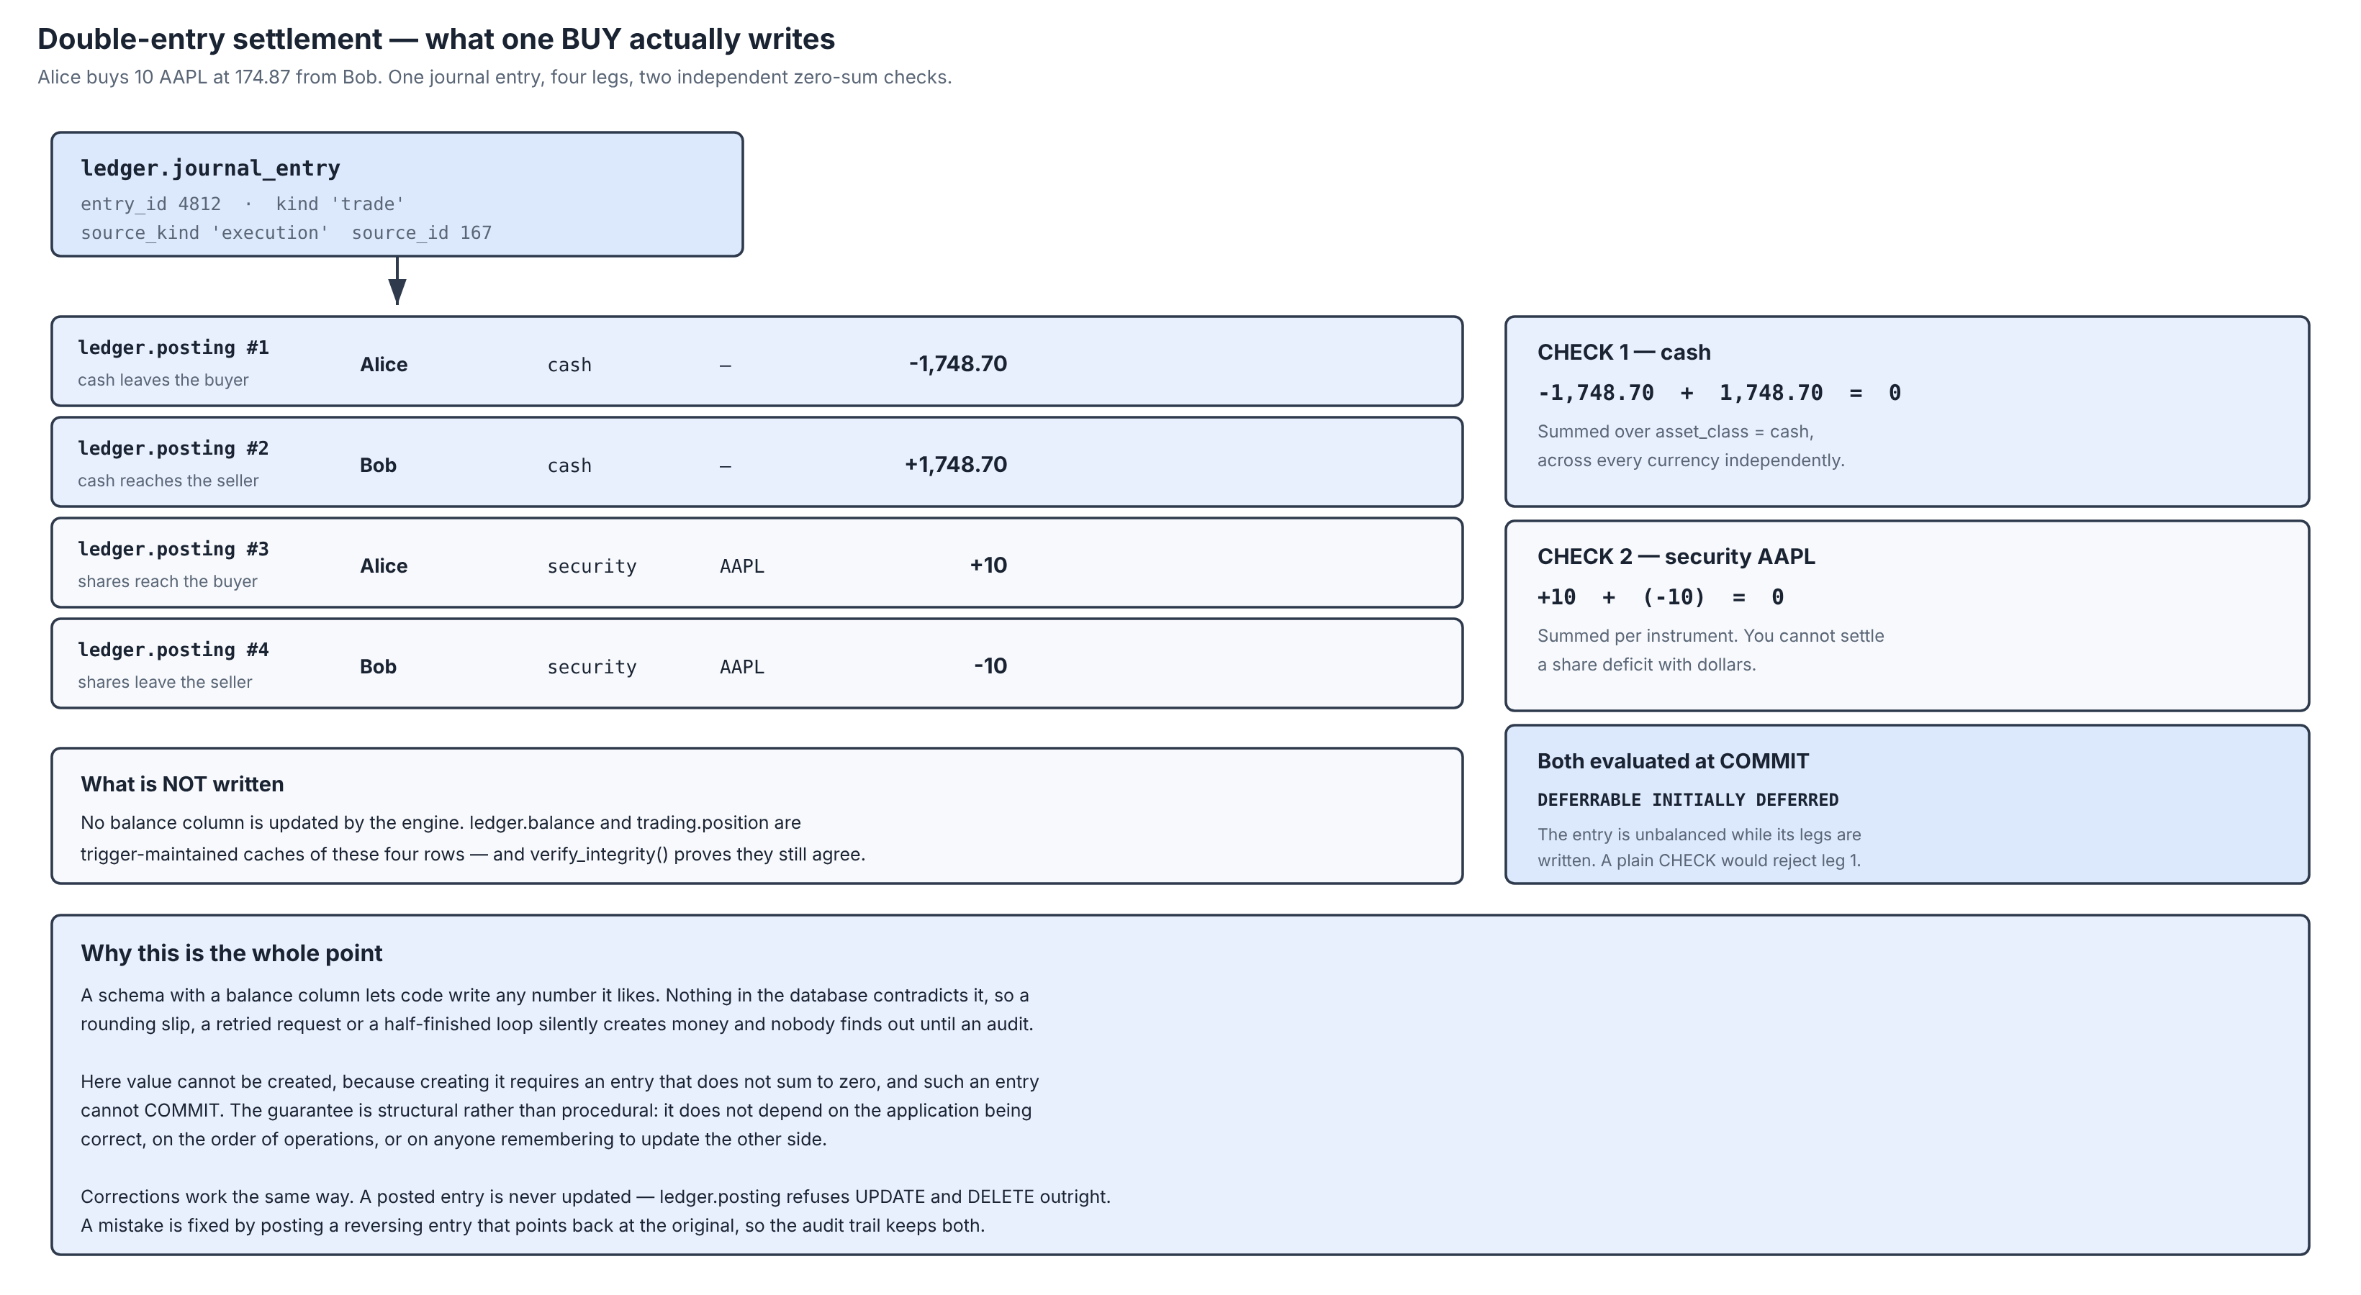
Settlement — one purchase, four legs, two zero-sum checks
account_id | asset_class | sym | currency | amount
------------+-------------+------+----------+----------
4 | cash | - | USD | -1747.65
376 | cash | - | USD | 1745.55
4 | security | AAPL | | 10.00
376 | security | AAPL | | -10.00
2 | cash | - | USD | 2.10
(5 rows)
asset_class | currency | must_be_zero
-------------+----------+--------------
cash | USD | 0.00000000
security | | 0.00000000
(2 rows)
Summed per asset class, the legs are exactly zero. That is the condition the deferred constraint checks at COMMIT.
22

Slide 23
Operations the database refuses
A system that only demonstrates success has demonstrated half its behaviour
-- (a) Selling stock the account does not hold, short selling off
status | reject_reason
----------+-------------------------------------------------------------------------------
rejected | cannot sell 5 NVDA: you hold 0. Short selling is not enabled on this account.
(1 row)
-- (b) A buy far beyond the single-order notional cap
status | reject_reason
----------+------------------------------------------------------------
rejected | order value 20000000 USD exceeds your limit of 1000000 USD
(1 row)
-- (c) A limit price outside the instrument price band
status | reject_reason
----------+------------------------------------------------
rejected | price 20 outside 20% band [139.8400, 209.7600]
(1 row)
Short-sale gate
• The account does not hold the stock and short selling is off.
• risk.pretrade_check compares the order against holdings and open sell exposure before anything reaches the book.
Notional cap
• Per-account single-order limit, held in risk.risk_limit.
• Converted into the account’s base currency first, so the cap means the same thing in INR and in USD.
Price band
• Per-instrument percentage band around the reference price.
• A rejected order is a normal business outcome, so the reason is RETURNED to the caller, not raised as an exception.
23

Slide 24
Transaction Control — a constraint that fires at COMMIT
-- The INSERT below is accepted: the check is DEFERRED.
posting_id | account_id | amount
------------+------------+---------------
24876 | 375 | 1000.00000000
(1 row)
-- COMMIT now runs the constraint trigger:
psql:q09_defer.sql:13: ERROR: ledger entry 5825 has 1 posting(s): double-entry requires at least two
HINT: value must move between two named accounts
CONTEXT: PL/pgSQL function ledger.assert_entry_balanced() line 11 at RAISE
What the listing shows
• The INSERT succeeds — the check is DEFERRED.
• The COMMIT fails, and the whole transaction is discarded.
• The entry had one leg; double entry requires at least two, and the legs must sum to zero per asset class.
Why this matters
• The ledger balances not by discipline in the application, and not by a nightly reconciliation job, but by a rule the database will not allow a transaction to violate.
• Any future code that writes to ledger.posting inherits the guarantee.
24

Slide 25
Transaction Control — COMMIT, ROLLBACK and SAVEPOINT
BEGIN;
INSERT INTO social.watchlist (user_id, name)
VALUES (:u_sam, 'Report A') RETURNING watchlist_id, name;
SAVEPOINT after_first;
INSERT INTO social.watchlist (user_id, name)
VALUES (:u_sam, 'Report B') RETURNING watchlist_id, name;
ROLLBACK TO SAVEPOINT after_first;
-- only Report A remains pending
SELECT name FROM social.watchlist
WHERE user_id = :u_sam AND name LIKE 'Report%';
ROLLBACK;
-- the demonstration leaves nothing behind
SELECT count(*) AS report_rows_left
FROM social.watchlist WHERE name LIKE 'Report%';
watchlist_id | name
--------------+----------
368 | Report A
(1 row)
watchlist_id | name
--------------+----------
369 | Report B
(1 row)
-- Rolled back to the savepoint: only Report A remains pending.
name
----------
Report A
(1 row)
-- Outer ROLLBACK: the demonstration leaves nothing behind.
report_rows_left
------------------
0
(1 row)
BEGIN
Opens the unit of work; the deferred constraint is now pending
SAVEPOINT name
Marks a point the transaction can be returned to
ROLLBACK TO SAVEPOINT
Undoes later statements, keeping the transaction open
COMMIT
Runs every deferred constraint, then makes the work durable
ROLLBACK
Discards the whole unit of work, leaving no trace
25

Slide 26
Advanced — Procedures and Functions
84 routines. They are not a convenience layer; they are where the rules live.
Routine
Language
Responsibility
engine.submit_order
PL/pgSQL
Validate, risk-check, persist, lock the book, match
engine.match_order
PL/pgSQL
The price-time priority matching loop
engine.settle_fill
PL/pgSQL
Write the execution and post the journal entry
engine.elect_stops
PL/pgSQL
Arm and elect stop and trailing-stop orders
ledger.post_entry
PL/pgSQL
Write an entry and its legs as one atomic unit
ledger.verify_integrity
PL/pgSQL
Re-derive every balance and report drift
risk.pretrade_check
PL/pgSQL
Buying power, short gate, cap, band, halts
market.candles
SQL
Any chart interval from the one-minute base table
market.candles_with_indicators
SQL
SMA, EMA, Bollinger bands and RSI by window
analytics.performance_stats
SQL
Return, drawdown, Sharpe ratio, win rate
surveil.run_all_scans
PL/pgSQL
Four market-abuse detections
ops.health_check
SQL
Evaluate the eighteen structural invariants
ops.end_of_day
PROCEDURE
Expire, snapshot, refresh, roll partitions
ops.end_of_day is a PROCEDURE rather than a function for a specific reason: a procedure may issue COMMIT, and the end-of-day run is a sequence of independent steps that should not be undone as a group if the last of them fails.
26

Slide 27
Advanced — the matching loop
Price-time priority expressed as an ORDER BY that an index can serve
-- Find the single best contra order.
-- The ORDER BY here *is* price-time priority, and it is served
-- directly by ix_book_bids / ix_book_asks with no sort step.
-- SKIP LOCKED is deliberately NOT used: skipping a locked order
-- would violate time priority by letting a later order jump the
-- queue, so we block and preserve fairness instead.
SELECT c.order_id, c.limit_price, c.leaves_qty, c.account_id
INTO v_contra
FROM trading.trade_order c
WHERE c.instrument_id = v_o.instrument_id
AND c.side = 'sell'
AND c.status IN ('working','partially_filled')
AND NOT c.stop_armed
AND c.limit_price IS NOT NULL
AND c.leaves_qty > 0
AND (v_limit IS NULL OR c.limit_price <= v_limit)
ORDER BY c.limit_price ASC, c.seq_no ASC
LIMIT 1
FOR UPDATE;
The index that serves it
• ix_book_asks is a PARTIAL B-tree over (instrument_id, limit_price, seq_no) WHERE the order is still resting.
• It covers only the live book, so it stays small no matter how much history accumulates.
FOR UPDATE, not SKIP LOCKED
• SKIP LOCKED is the usual advice for a queue. An order book is not a queue: skipping a locked order lets a later order jump ahead, which is exactly the fairness the venue exists to guarantee.
The serialisation point
• pg_advisory_xact_lock(hashtext('apex_book'), instrument_id)
27

Slide 28
Advanced — Triggers
Twenty on the base tables, in four groups
table_name | trigger_name | kind
--------------------------+-------------------------------+------------
identity.app_user | trg_audit_user | row
identity.app_user | trg_user_default_watchlist | row
ledger.journal_entry | trg_journal_immutable | row
ledger.posting | trg_posting_balanced | constraint
ledger.posting | trg_posting_immutable | row
ledger.posting | trg_posting_syncs_position | row
ledger.posting | trg_posting_updates_balance | row
social.copy_subscription | trg_no_self_copy | row
surveil.alert | trg_audit_alert | row
trading.account | trg_account_default_limits | row
trading.account | trg_audit_account | row
trading.execution | trg_block_self_match | row
trading.execution | trg_execution_enqueues_copies | row
trading.trade_order | trg_audit_order_material | row
trading.trade_order | trg_audit_order_write | row
(15 rows)
Maintain derived state
• trg_posting_updates_balance, trg_posting_syncs_position
Enforce an invariant
• trg_posting_balanced (deferred), trg_block_self_match, trg_no_self_copy
Make a table append-only
• trg_journal_immutable, trg_posting_immutable
Write the audit trail
• trg_audit_user, trg_audit_account, trg_audit_order_write
28

Slide 29
Advanced — Views and Materialized Views
and the security-mode defect that none of them reported
object_name | kind | runs_as
-------------------------+---------+---------
mv_instrument_daily | matview | definer
mv_strategy_leaderboard | matview | definer
quote_enriched | view | definer
v_account_summary | view | invoker
v_alert_queue | view | invoker
v_blotter | view | invoker
v_book_depth | view | definer
v_fx_board | view | definer
v_open_orders | view | invoker
v_portfolio | view | invoker
v_watchlist | view | invoker
(11 rows)
What the runs_as column records
• A view executes with the privileges of its OWNER, and a table owner is exempt from Row Level Security on its own tables.
• Every view over user data was therefore returning every user’s rows while the policies beneath it read as correct.
The fix, and the guard
• WITH (security_invoker = true) — the view now executes as the caller.
• ops.assert_rls_intact() fails if a view over a policy-protected table is ever created without it.
• The five definer-rights views expose only reference and market data, which is not user-specific.
29

Slide 30
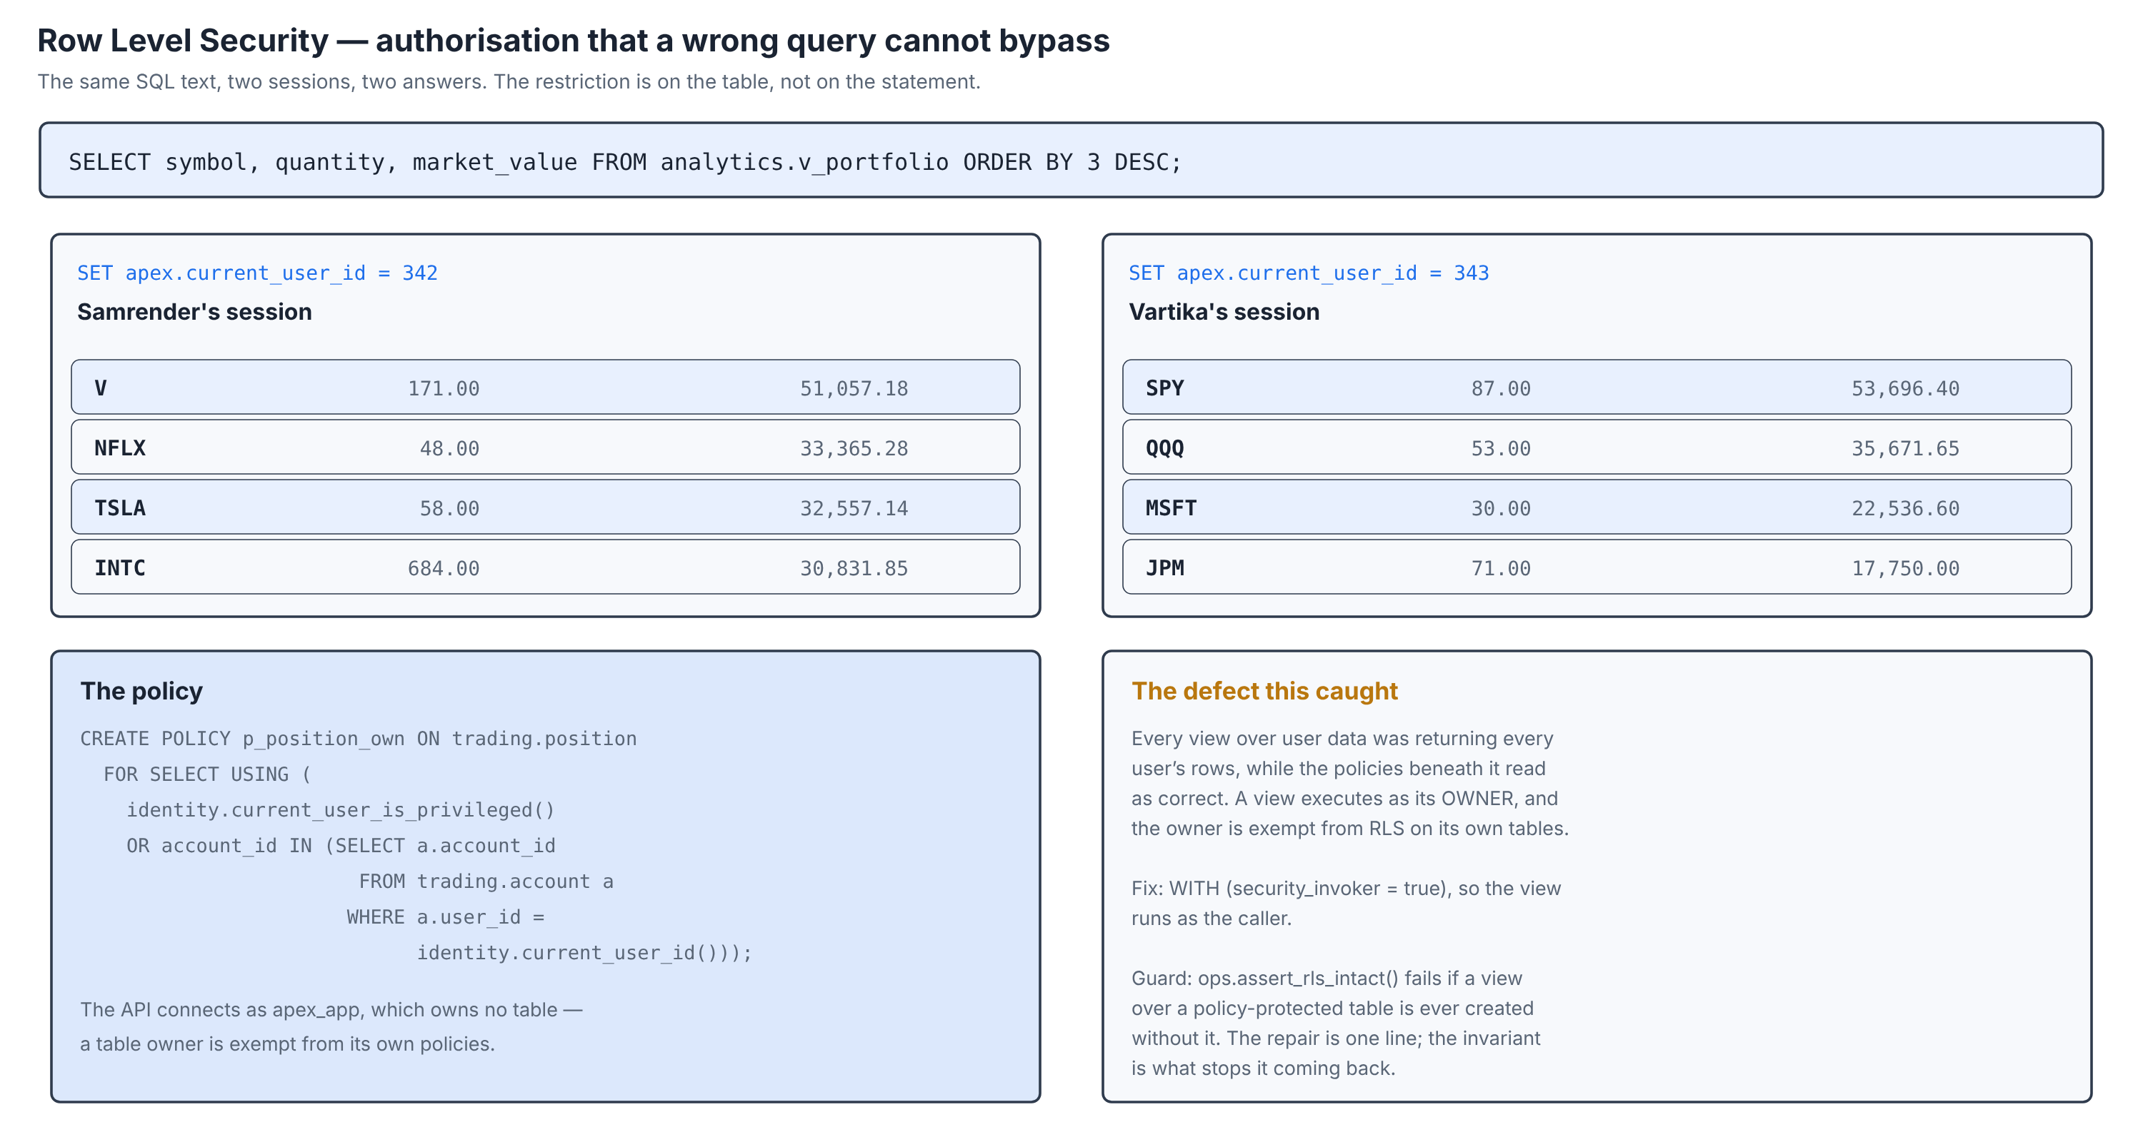
Advanced — Row Level Security
Connected as apex_app, the unprivileged role the API uses. A session can see exactly one account, and no query it can write will widen that.
30

Slide 31
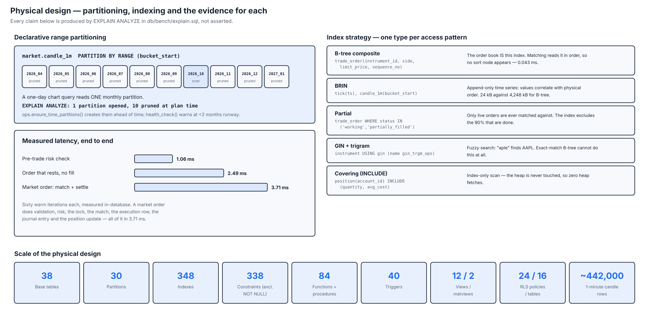
Advanced — Partitioning and the index strategy
QUERY PLAN
----------------------------------------------------------------------------------------------------------------------------------------------
------------------------------------------------
Limit (actual rows=100 loops=1)
-> Index Scan Backward using candle_1m_p202610_pkey on candle_1m_p202610 candle_1m (actual rows=100 loops=1)
Index Cond: ((instrument_id = 589) AND (bucket_start >= '2026-10-01 00:00:00+00'::timestamp with time zone) AND (bucket_start <
'2026-10-02 00:00:00+00'::timestamp with time zone))
Planning Time: 0.609 ms
Execution Time: 0.065 ms
(5 rows)
31

Slide 32
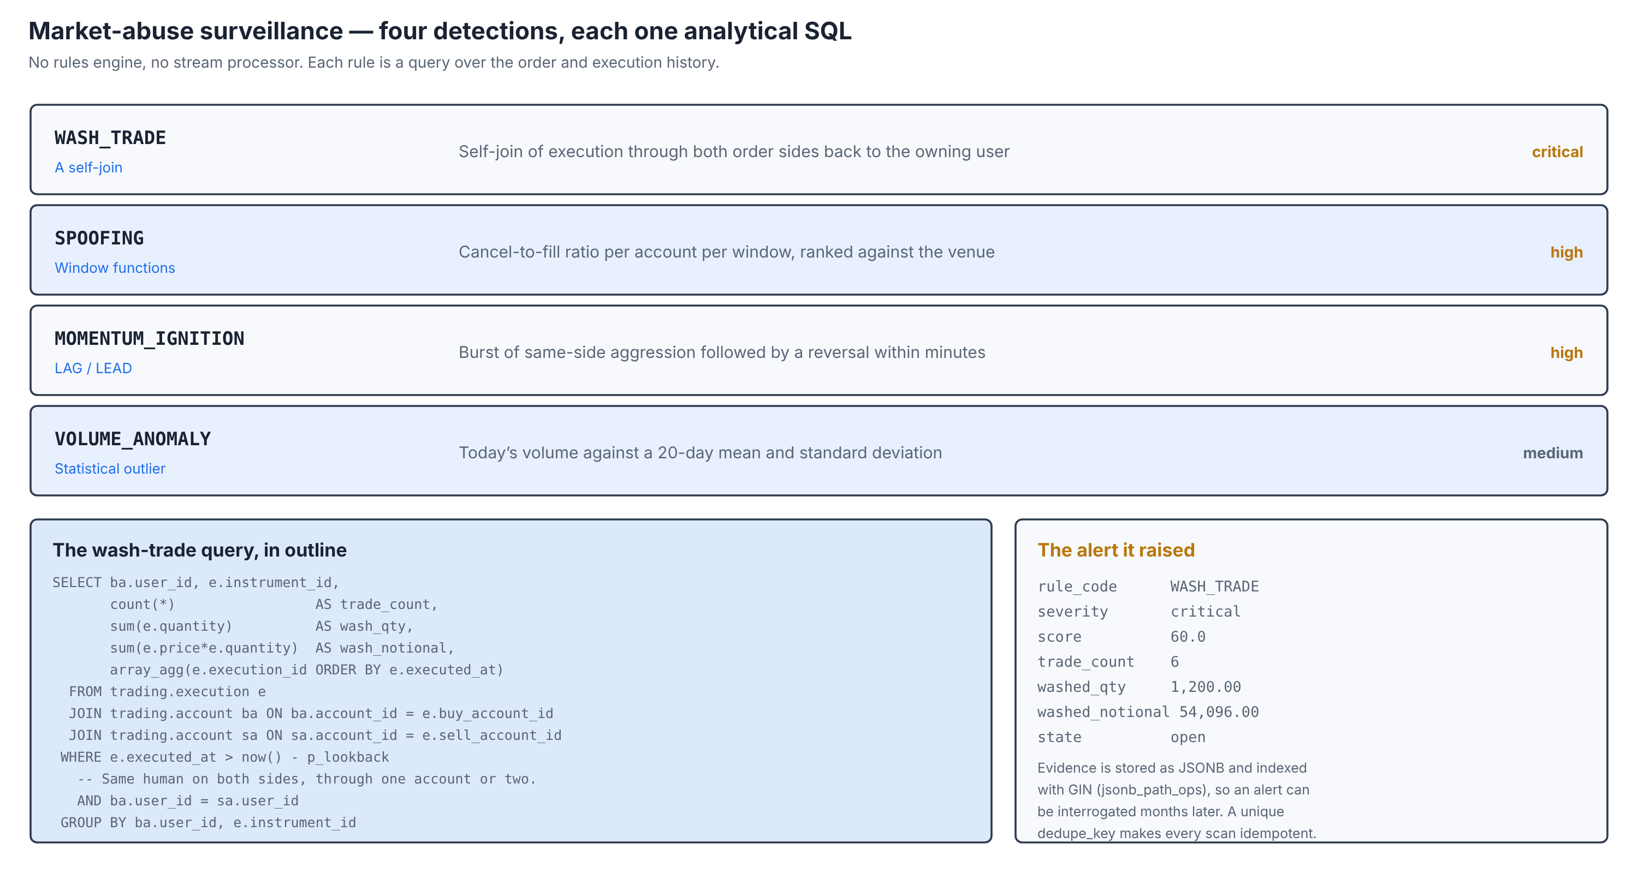
Advanced — Market-abuse surveillance
Evidence is stored as JSONB and indexed with GIN, so an alert raised today can still be interrogated months later.
32

Slide 33
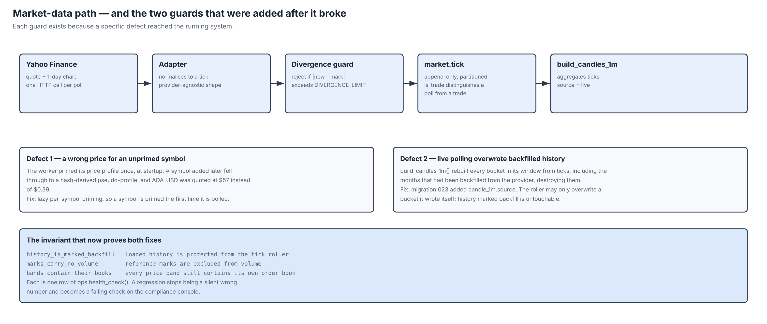
Market data — and the two guards added after it broke
Both defects produced wrong data rather than an error message. Both are now covered by an invariant that fails loudly.
33

Slide 34
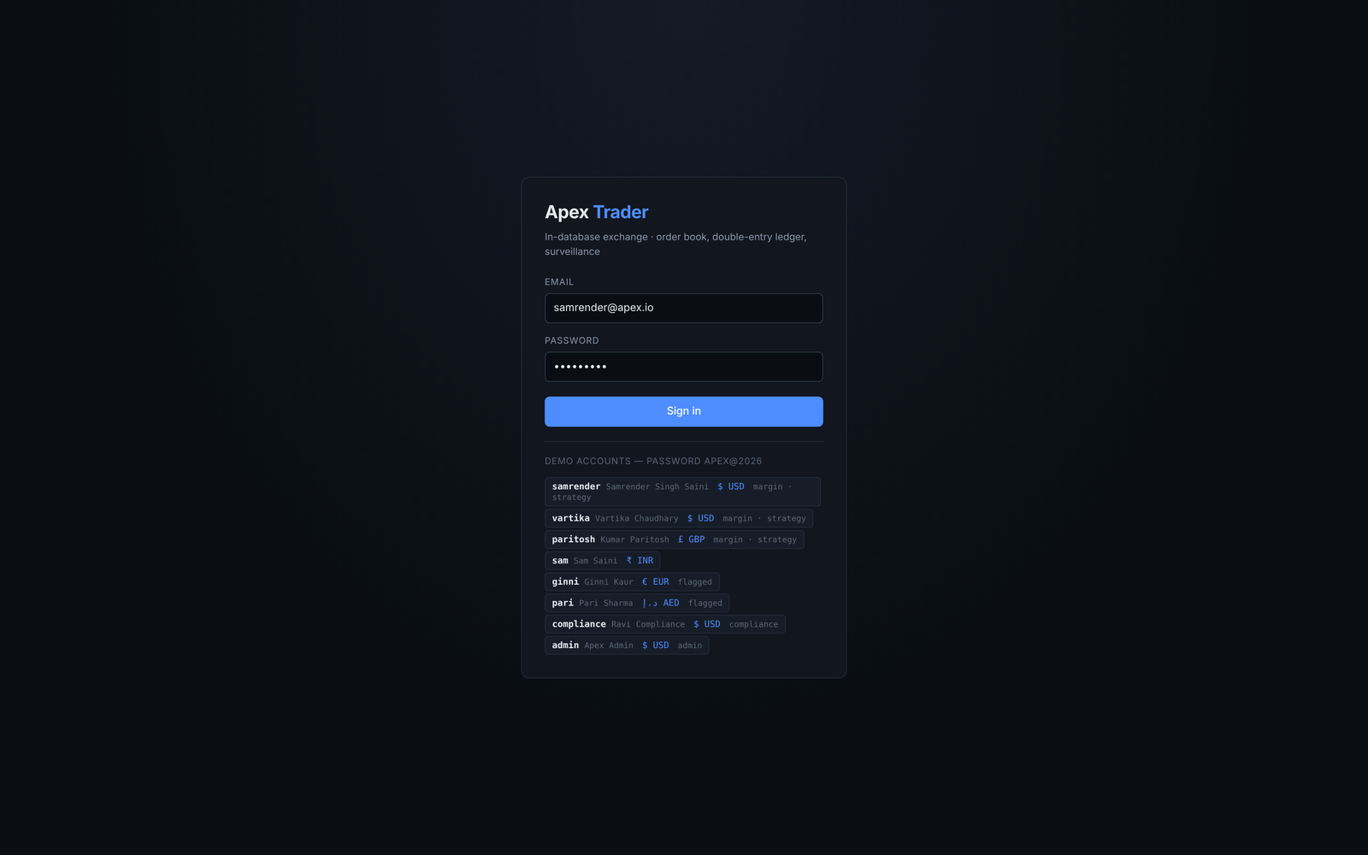
Application — authentication
Six named demonstration accounts, a compliance officer and an administrator. Passwords are hashed by pgcrypto with a per-row salt; identity.authenticate compares the hash, counts failures and applies a lockout, all in the database.
34

Slide 35
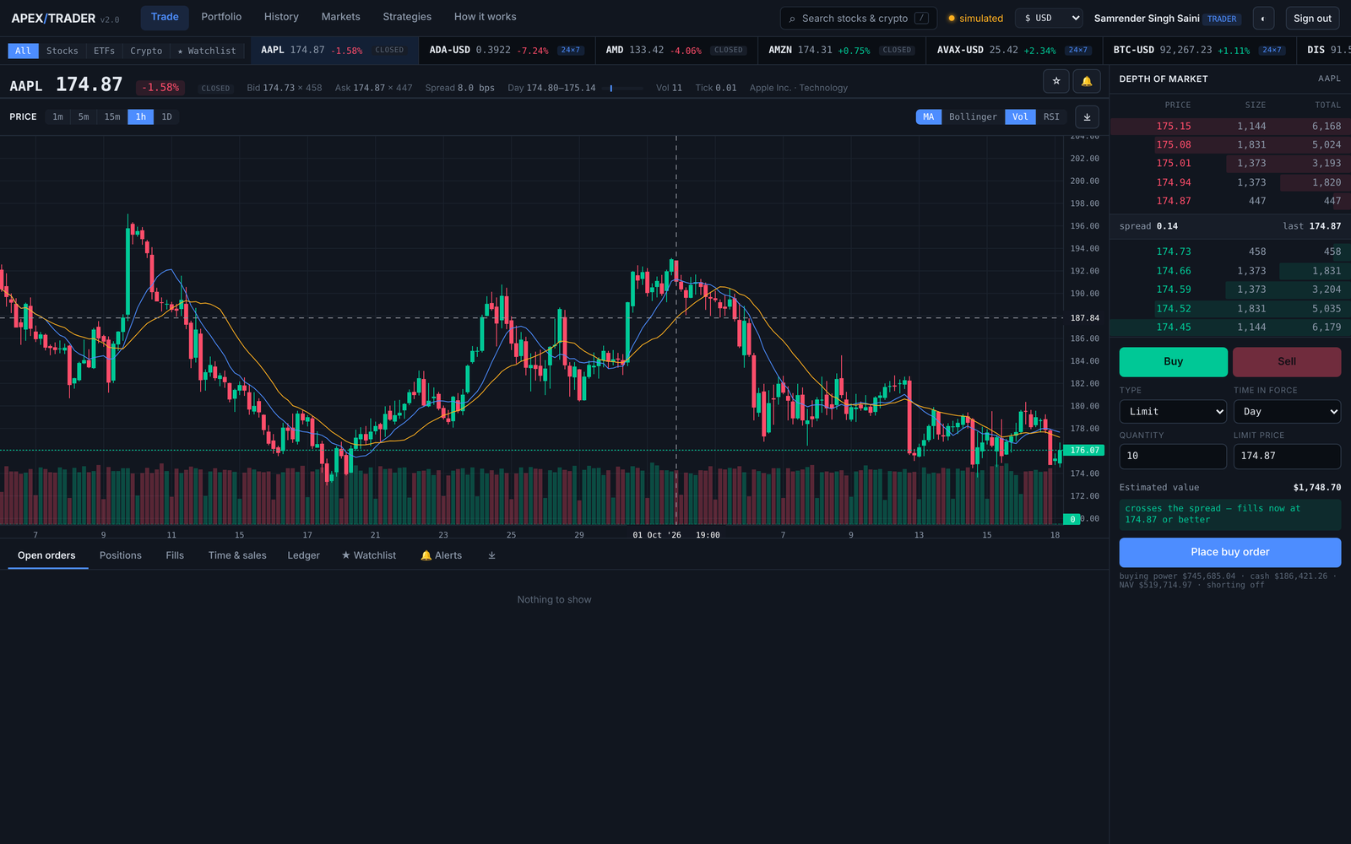
Application — the trading terminal
Candlestick chart with moving averages, Bollinger bands, volume and RSI, a live depth-of-market ladder, and the order ticket. The indicators are returned by market.candles_with_indicators, not computed in the browser.
35

Slide 36
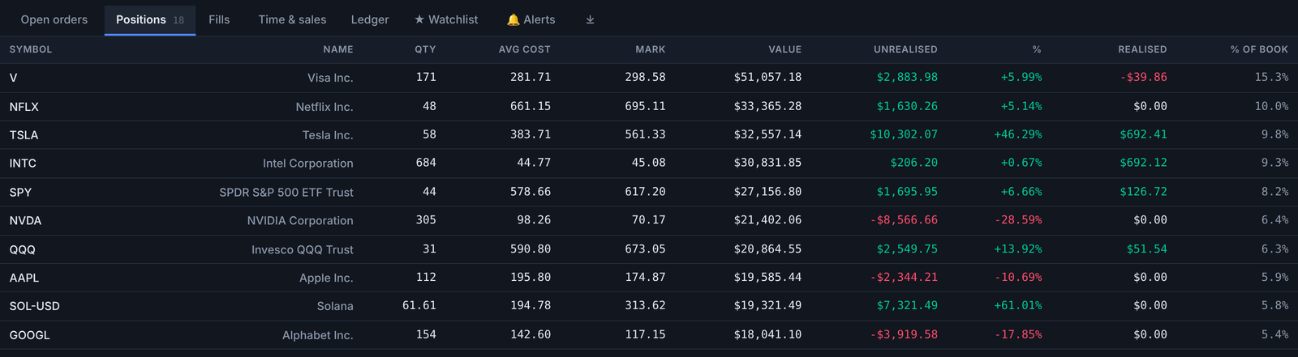
Application — positions and the ledger
The positions tab shows what the account holds; the ledger tab shows every journal entry that produced those holdings. The first is derived from the second.
36

Slide 37
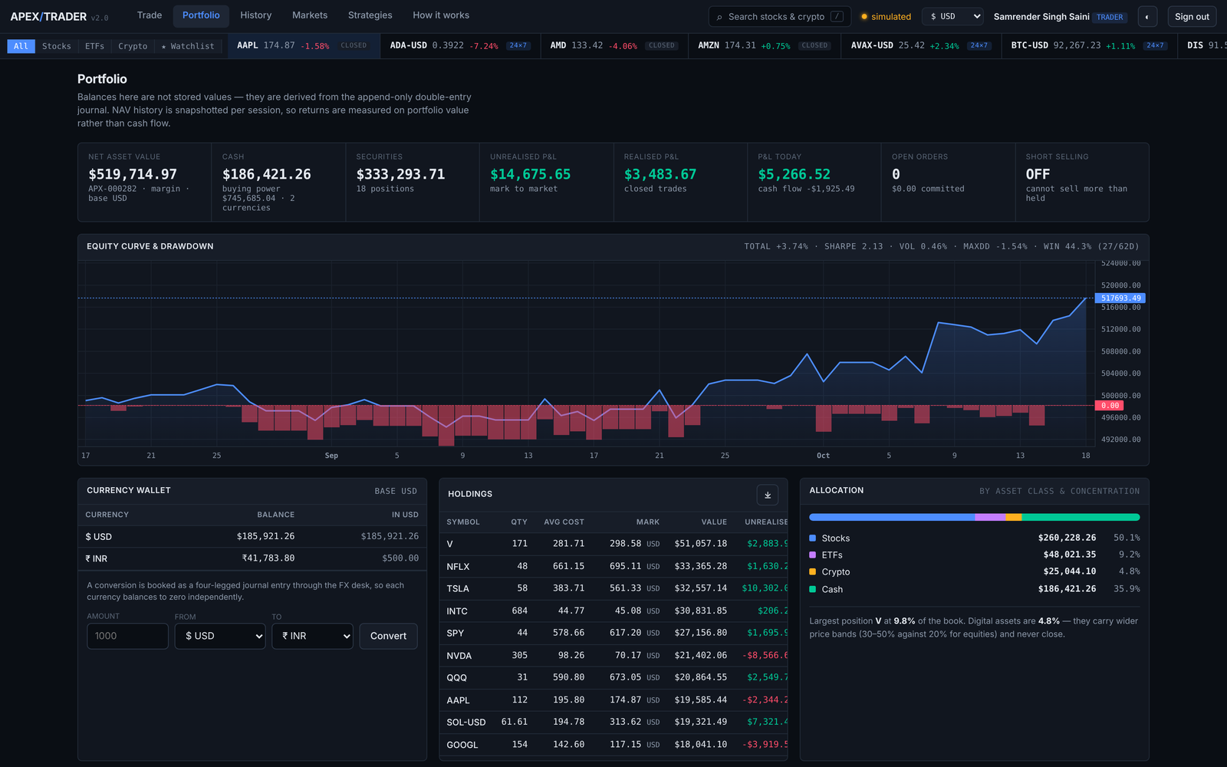
Application — portfolio and performance
Net asset value curve, allocation and performance statistics. Return, drawdown, Sharpe ratio and win rate come from analytics.performance_stats in one statement.
37

Slide 38
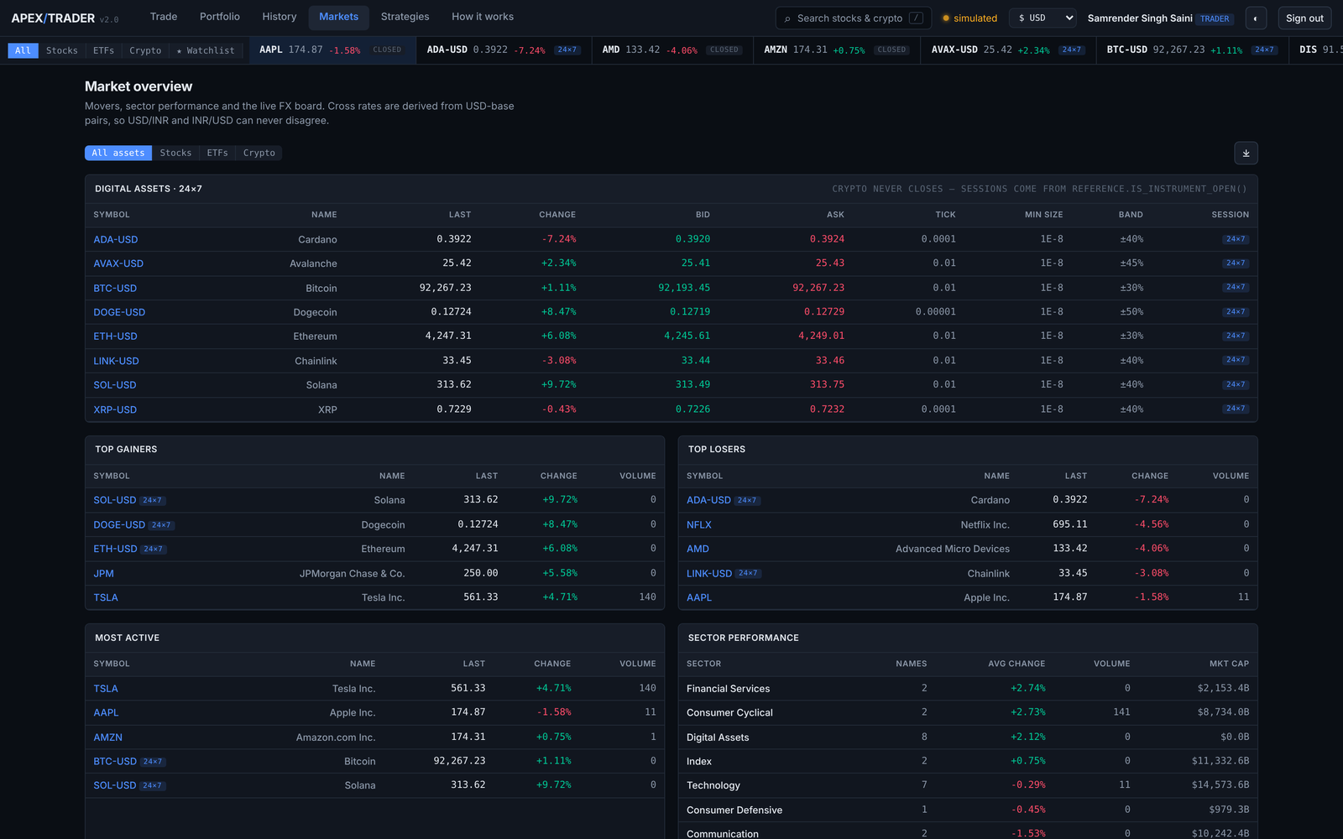
Application — markets, equities and crypto
Crypto instruments carry trades_24x7, so reference.is_instrument_open returns true at all hours while an equity is closed outside its session. The distinction is reference data, not a conditional in the application.
38

Slide 39
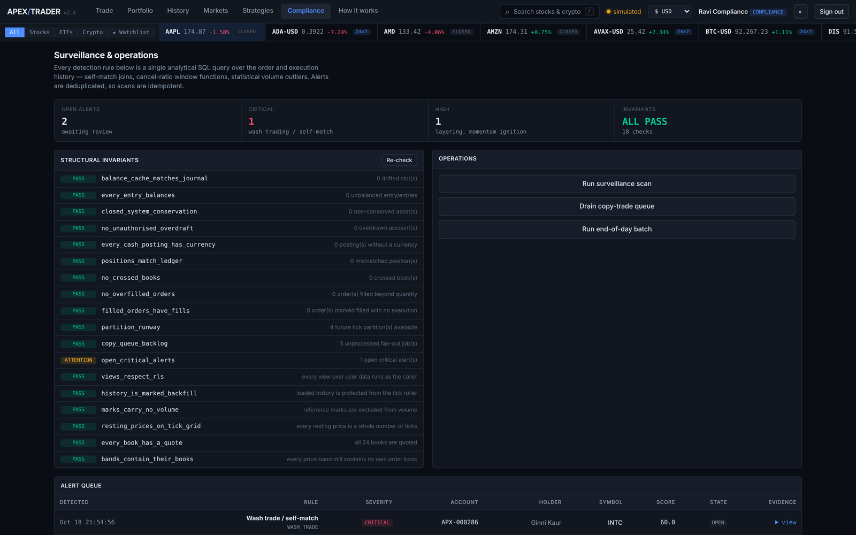
Application — the compliance console
The eighteen invariants with their current status, the open surveillance alerts with the evidence behind each, and the operational actions. Reachable only by a user whose role in identity.app_user is compliance or admin.
39

Slide 40
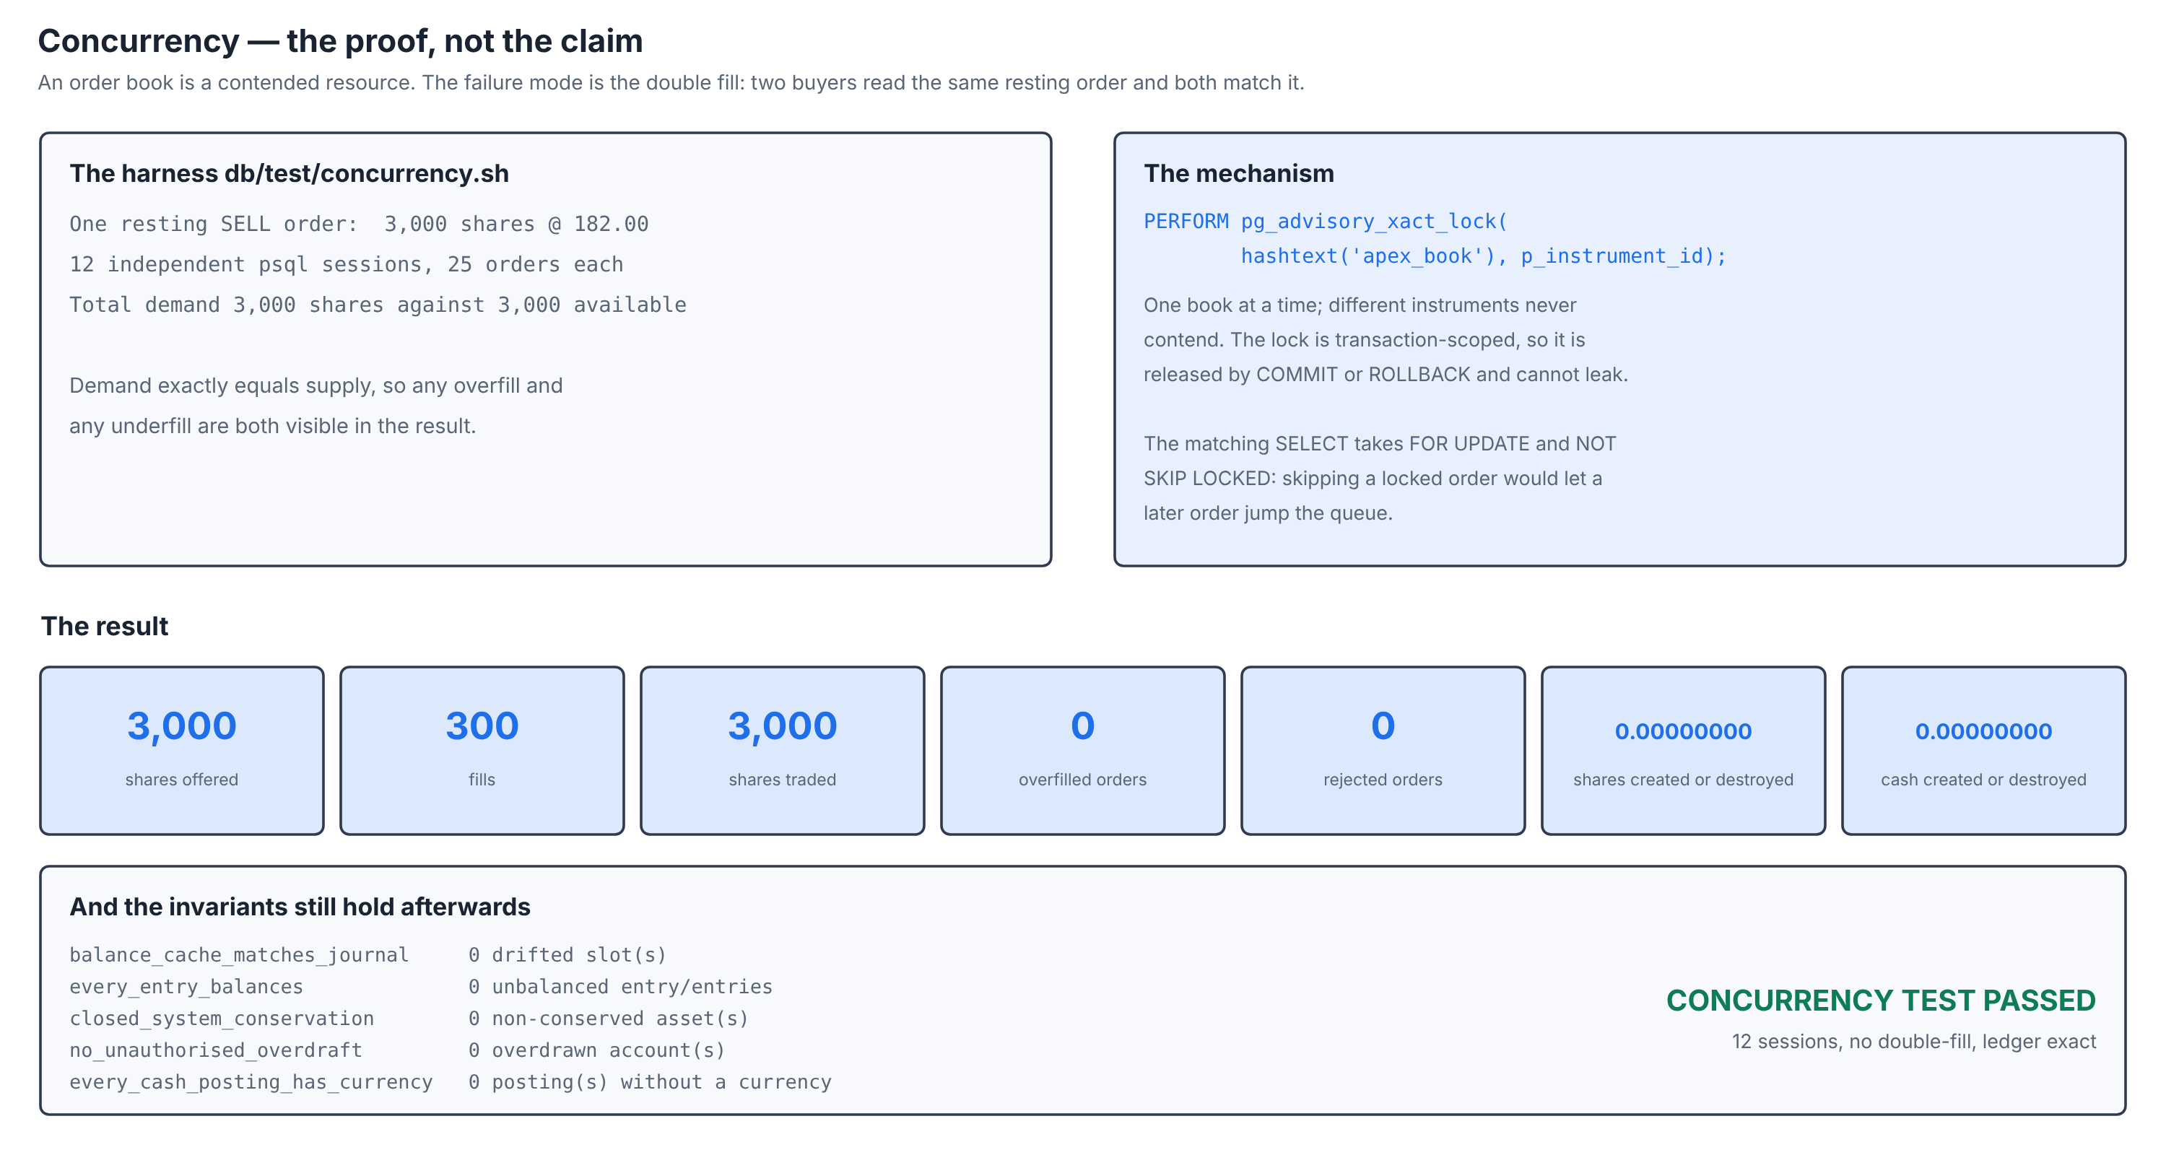
Testing and Results — concurrency
Total demand exactly equals available supply, so both an overfill and an underfill would be visible in the result.
40

Slide 41
Testing and Results — four independent suites
They check different things on purpose
Suite
What it exercises
Result
db/test (5 files)
Ledger, engine, risk, currency and crypto rules
150 assertions passed
db/test/concurrency.sh
12 sessions × 25 orders against one resting order
Passed, no double fill
scripts/api_smoke.py
Every REST path, authorisation and error case
118 checks passed
scripts/ui_check.py
Browser rendering of all seven screens
51 checks passed
ops.health_check()
Eighteen structural invariants, on live data
18 of 18 reporting
suite | passed | failed
----------+--------+--------
crypto | 31 | 0
currency | 32 | 0
engine | 32 | 0
ledger | 16 | 0
risk | 39 | 0
(5 rows)
all 150 assertions passed
check_name | status | deta
---------------------------------+-----------+----------------------
open_critical_alerts | ATTENTION | 1 open critical alert
balance_cache_matches_journal | PASS | 0 drifted slot(s)
bands_contain_their_books | PASS | every price band stil
closed_system_conservation | PASS | 0 non-conserved asset
copy_queue_backlog | PASS | 5 unprocessed fan-out
every_book_has_a_quote | PASS | all 24 books are quot
every_cash_posting_has_currency | PASS | 0 posting(s) without
every_entry_balances | PASS | 0 unbalanced entry/en
filled_orders_have_fills | PASS | 0 order(s) marked fil
The one ATTENTION row is the surveillance scanner doing its work: a wash trade was found and the alert is open.
41

Slide 42
What was learnt
Three defects, one shape: no error message, only a wrong answer
Every view bypassed Row Level Security
A view runs as its owner, and a table owner is exempt from its own policies. The policies were correct and the data was exposed anyway.
Fix: security_invoker. Guard: ops.assert_rls_intact().
The candle roller destroyed backfilled history
build_candles_1m rebuilt every bucket in its window from ticks — correct for live minutes, destructive for months loaded from the provider.
Fix: candle_1m.source. Guard: history_is_marked_backfill.
The test suite reported green while checking less
A type mismatch inside one helper raised an error that psql swallowed because ON_ERROR_STOP was not set.
Fix: the cast. Guard: test.sh now fails on any error psql reports.
In all three cases the correctness became something the database asserts, rather than something the authors remember.
42

Slide 43
Conclusion
Apex Trader is a complete, working trading system in which the database is not a store behind the application but the application itself. The service tier validates request shape and emits JSON; every rule that matters is below it, where a second client is subject to it without reimplementing any of it.
In-database matching with price-time priority
The book is correct under concurrency because the database serialises access to it
Double-entry ledger with derived balances
A balance cannot drift from its history, because the history is the balance
Deferred zero-sum constraint
Value can move between accounts but can never be created or destroyed
Row Level Security with security_invoker views
A forgotten predicate returns nothing rather than another trader’s rows
Declarative partitioning and a deliberate index strategy
The chart query opens one month of 442,000 rows in well under a millisecond
Eighteen invariants checked on live data
Defects that produce no error message are still detected
43

Slide 44
Future Enhancement
Enhancement
Approach
Logical replication to a read replica
Route analytics and chart reads to a replica; the write path is already one function call
Continuous aggregates for candles
Replace the scheduled rollup with an incrementally maintained aggregate
Options and futures
Reference data already models tick size, lot size and contract metadata; the ledger needs a third asset class
Settlement cycles (T+1)
The journal already carries occurred_at; a settlement date and a pending-settlement account complete it
Order-book depth beyond top of book
The resting-order index already supports it; only aggregation and transport are missing
Partition detachment to cold storage
ops.detach_old_partitions exists; the remaining work is archival and restore
Formal isolation testing with pgbench
Extend the concurrency proof to serialisation anomalies under REPEATABLE READ
44

Slide 45
References
[1] Elmasri, R. and Navathe, S. B., Fundamentals of Database Systems, 7th ed., Pearson, 2016.
[2] Silberschatz, A., Korth, H. F. and Sudarshan, S., Database System Concepts, 7th ed., McGraw-Hill, 2019.
[3] Date, C. J., An Introduction to Database Systems, 8th ed., Addison-Wesley, 2003.
[4] Codd, E. F., "A Relational Model of Data for Large Shared Data Banks", CACM 13(6), 1970.
[5] Codd, E. F., "Recent Investigations into Relational Data Base Systems", IFIP Congress, 1974.
[6] Kleppmann, M., Designing Data-Intensive Applications, O’Reilly, 2017.
[7] PostgreSQL 16 Documentation — Row Security Policies, Table Partitioning, CREATE TRIGGER, SET CONSTRAINTS, Advisory Locks, BRIN and GIN indexes, pgcrypto.
[8] Harris, L., Trading and Exchanges: Market Microstructure for Practitioners, OUP, 2003.
[9] Johnson, B., Algorithmic Trading and DMA, 4Myeloma Press, 2010.
[10] ISO 4217 Currency codes; ISO 6166 ISIN. FIX Protocol Specification 4.4.
[11] SEBI, Master Circular on Surveillance of Securities Market, 2023.
[12] FastAPI, asyncpg and TradingView Lightweight Charts documentation.
[13] Yahoo Finance market data endpoints, accessed October 2026.
45

Slide 46
Thank you
Apex Trader — BCSE302P Database Systems Lab
Kumar Paritosh · Samrender Singh Saini · Vartika Chaudhary
Under the guidance of Prof. Nithya N S

