Slide 1

AGENDA
APP PERSISTENT
YEALTH
APP SETTING
YOGA AND HEALTH
USER STATISTIC
MDP PROJECT - TEAM 2 - 2022

Slide 2
YEALTH
TEAM
AGENDA
1. Team & Role
2. Project Overview : 2.1. The Product 2.2. Persona 2.3. Usability
3. App Architecture : 3.1. Layout 3.2. App Persistent 3.3. Dependency
4. App Demo
5. Project Repository
6. SCI & PROJECT
MDP PROJECT - TEAM 2 - 2022
YOGA AND HEALTH
APP PERSISTENT
APP FLOW
APP RESOURCES
ONBOARDING
COROUTINES
USER SETTING
MEDIA RESOURCES
CALCULATOR
USER STATISTIC
ARTICLE SCREEN
CONTENTS PLAYER
USER DATA

Slide 3
YEALTH
AGENDA
TEAM
KONURALP
SAMRETH
SILVANA
SOKCHEA
APP PERSISTENT
APP FLOW
APP RESOURCES
ONBOARDING
COROUTINES
USER SETTING
MEDIA RESOURCES
CALCULATOR
USER STATISTIC
ARTICLE SCREEN
CONTENTS PLAYER
USER DATA
MDP PROJECT - TEAM 2 - 2022
YOGA AND HEALTH

Slide 4
YOGA INSTRUCTIONS
WELLNESS CALCULATING
USABILITY
PRODUCT
A yoga mobile application with convenience/smooth UI and light weight storage which allows users to practice yoga easily and provides them additional wellness functionalities for tracking their health and reaching wellness related articles.
PERSONA
Our users are people who enjoy doing yoga at their flexible times and prefer light, simple mobile application with enough functionalities instead of heavy application with complex UI.
MDP PROJECT - TEAM 2 - 2022
USER STATISTIC TRACKING
WITH BUILT-IN HEALTH ARTICLES

Slide 5
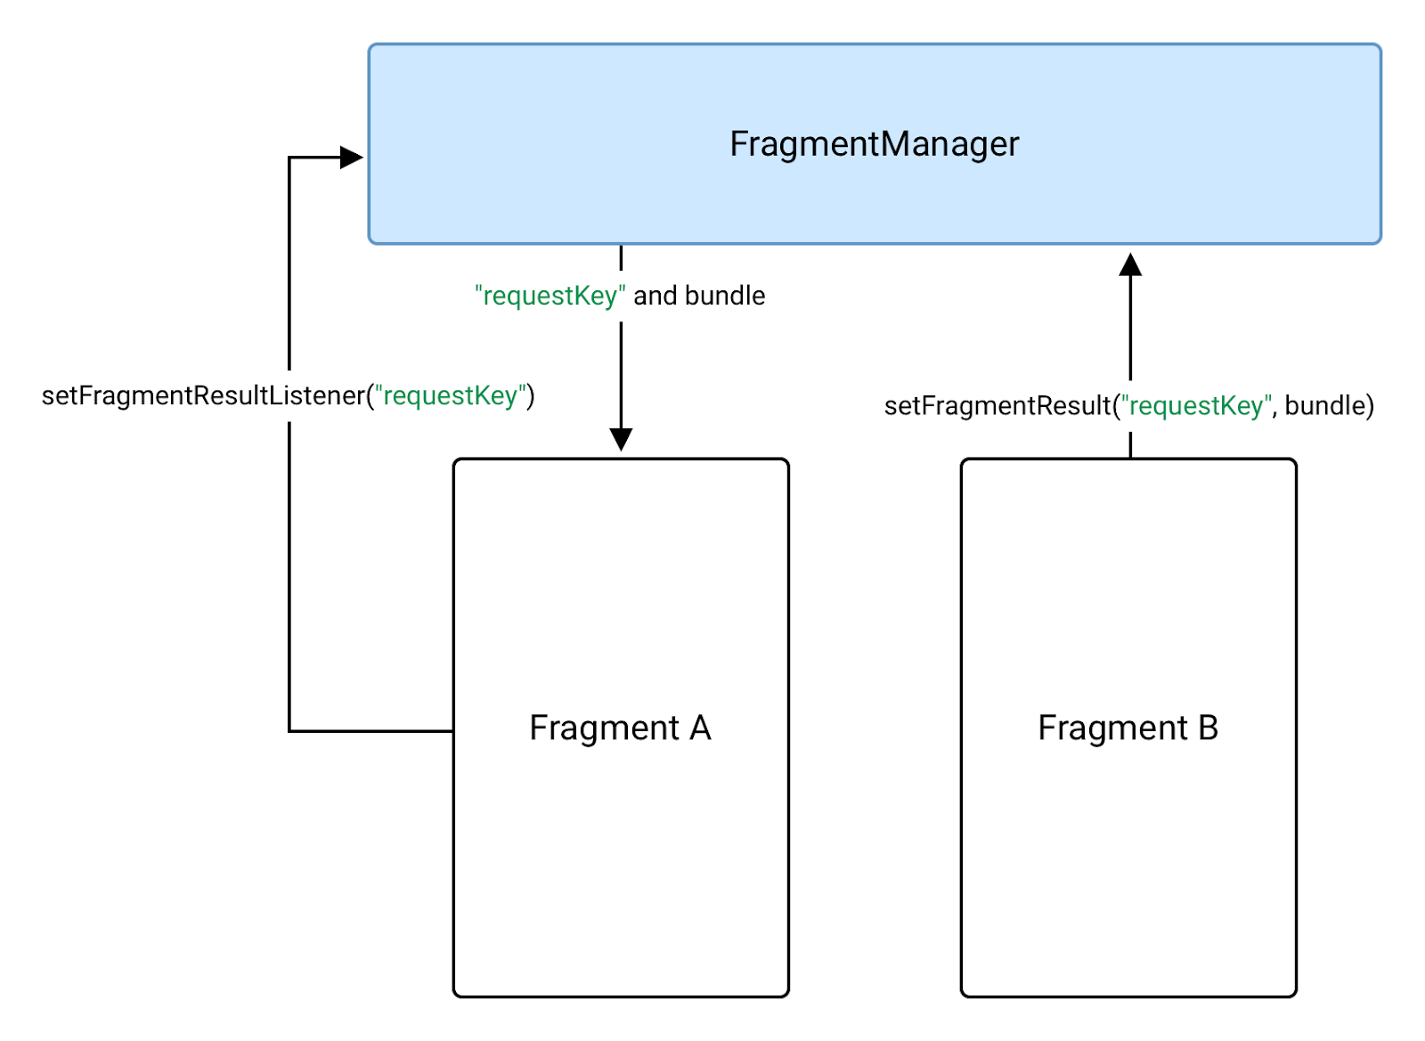
ARCHITECTURE
USABILITY
YOGA INSTRUCTIONS
USER STATISTIC TRACKING
WELLNESS CALCULATING
WITH BUILT-IN HEALTH ARTICLES
MDP PROJECT - TEAM 2 - 2022
FRAGMENT MANAGER
All Screens Handling
Our Main App Flow

Slide 6
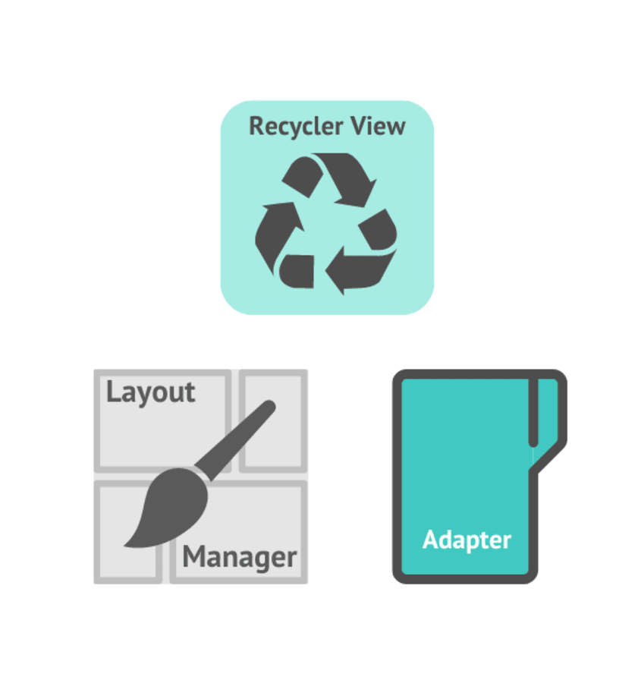
USABILITY
ARCHITECTURE
FRAGMENT MANAGER
All Screens Handling
Our Main App Flow
MDP PROJECT - TEAM 2 - 2022
RECYCLEVIEW
Articles View
Yoga Instructions View

Slide 7
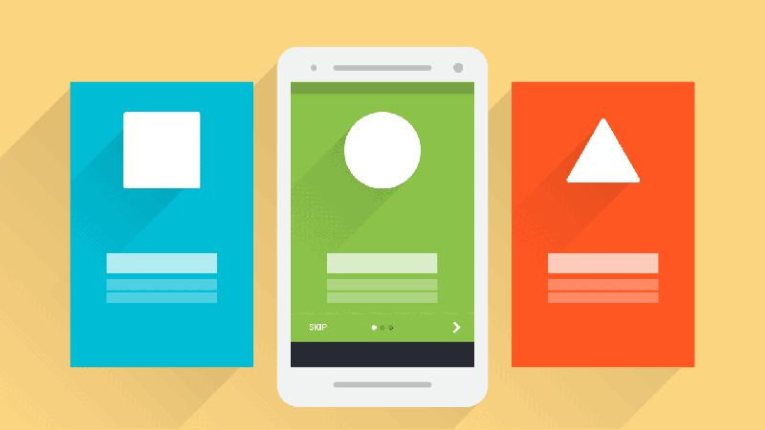
FRAGMENT MANAGER
All Screens Handling
Our Main App Flow
DESIGN PATTERN
ARCHITECTURE
RECYCLEVIEW
Articles View
Yoga Instructions View
MDP PROJECT - TEAM 2 - 2022
VIEW PAGER
Onboarding Screens

Slide 8
XML (PROFILE)
USER’S PROFILE
STRING
ROOMDB
XML (DATA)
USER’S DATA
STATISTIC
RECYCLEVIEW
Articles View
Yoga Instructions View
APP PERSISTENT
DESIGN PATTERN
ARCHITECTURE
VIEW PAGER
Onboarding Screens
MDP PROJECT - TEAM 2 - 2022

Slide 9
DEPENDENCY
ARCHITECTURE
APP PERSISTENT
APP PERSISTENT
User’s data as SP
User’s profile as SP
Statistic data as RoomDB
USER’S DATA
USER’S PROFILE
STATISTIC
STRING
XML (DATA)
ROOMDB
XML (PROFILE)
MDP PROJECT - TEAM 2 - 2022

Slide 10
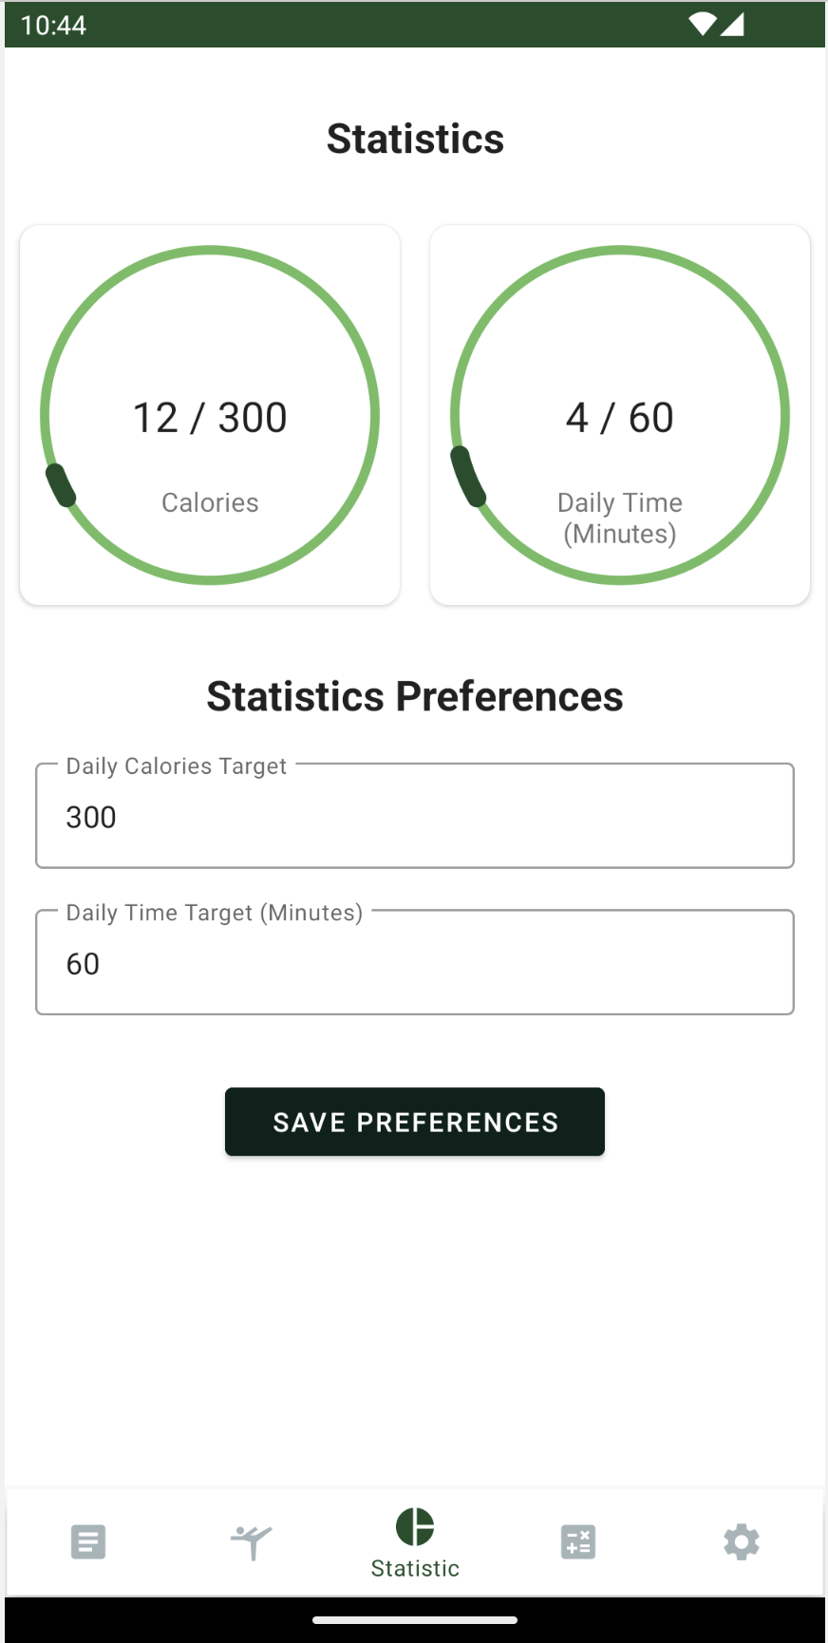
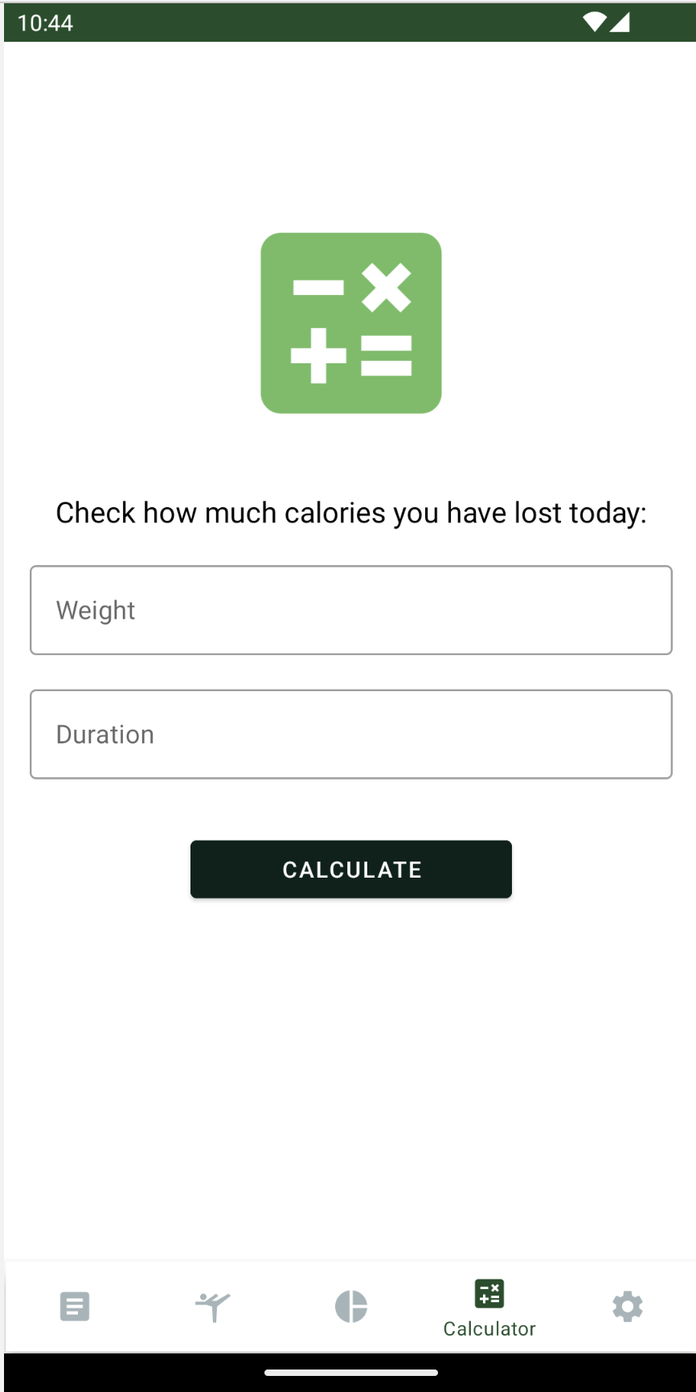
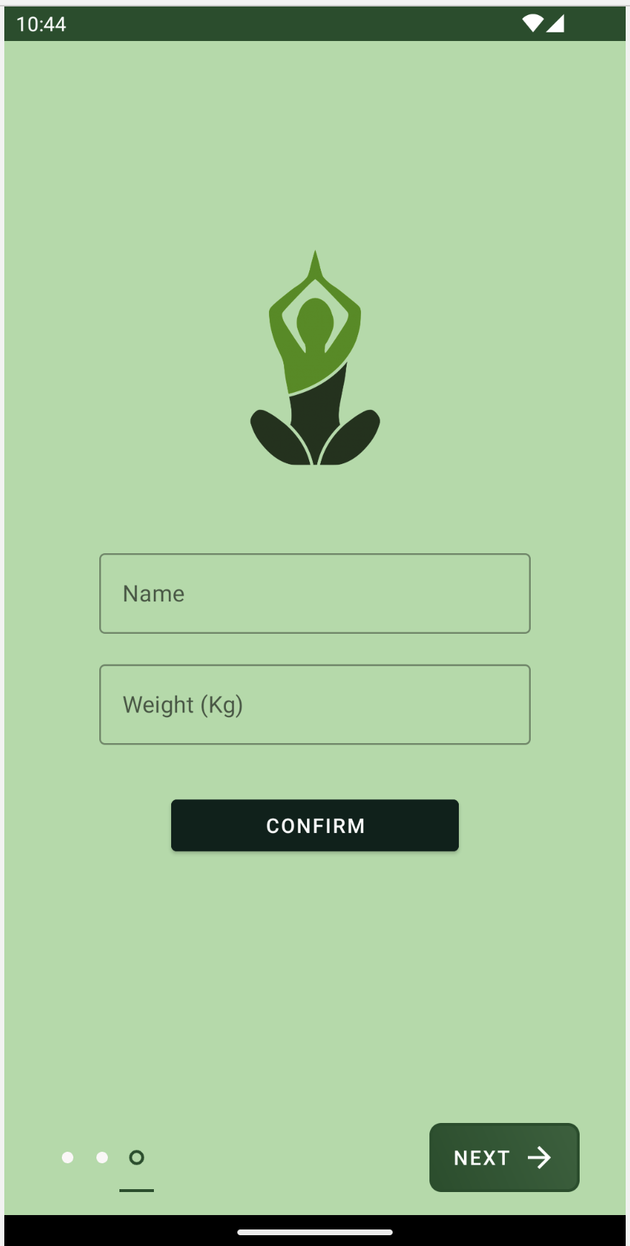
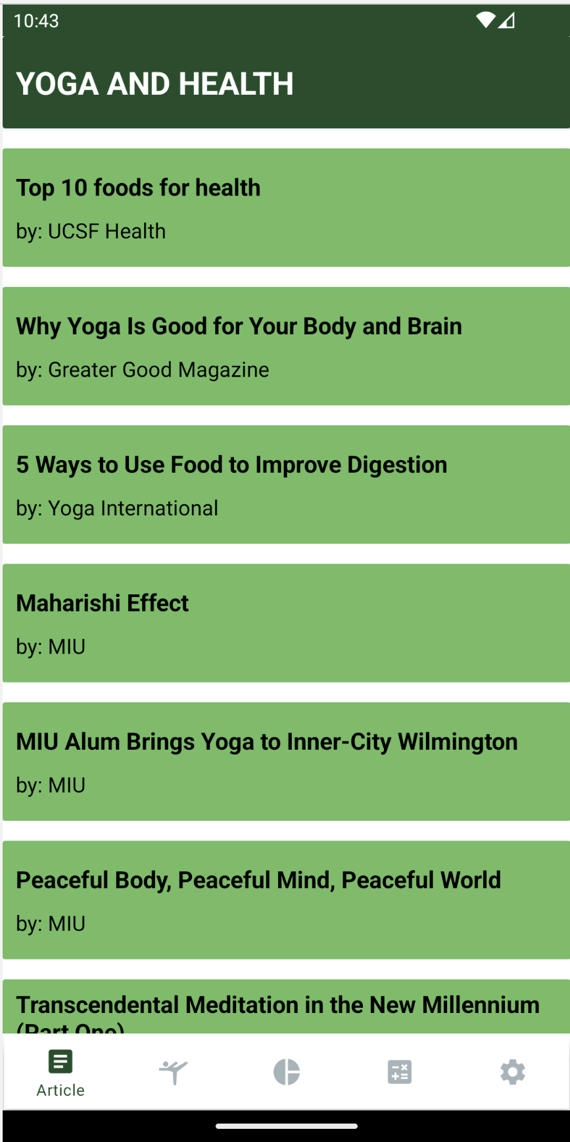
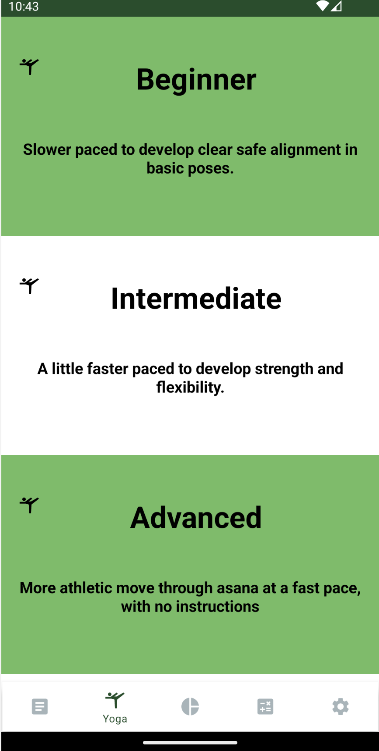
APP DEMO
APP PERSISTENT
DEPENDENCY
ANDROID
Room Database
Coroutines
Material
Kotlin
Gson
Progress Bar (mikhaellopez)
USER’S DATA
USER’S PROFILE
STATISTIC
MDP PROJECT - TEAM 2 - 2022
STRING
XML (DATA)
ROOMDB
XML (PROFILE)

Slide 11

REPOSITORY
DEPENDENCY
APP DEMO
MDP PROJECT - TEAM 2 - 2022

Slide 12
SCI & PROJECT
APP DEMO
REPOSITORY
GitHub:
https://github.com/team2-mdp/yoga-app
team2-mdp
MDP PROJECT - TEAM 2 - 2022

Slide 13
REPOSITORY
SCI & PROJECT
Our Yealth app is built successfully and powered by many layers of android components and frameworks. We engineered it with layers of abstractions and design patterns.
Likewise, life is found in layers. Each layer is consciousness in different disguises and conform to different law/protocol. Balance and success life occur when we are able to freely access and control these layers.
MDP PROJECT - TEAM 2 - 2022

Slide 14
SCI & PROJECT
This project allows us to understand that working as a team brings us more intelligent knowledges as well as achievements. Without a great teamwork, the expected result won’t be achieved.
According to the SCI principles of creative intelligences, the whole is more than the sum of its parts; consciousness and deep knowledges can be achieved greater as a group.
MDP PROJECT - TEAM 2 - 2022

Slide 15

SCI & PROJECT
THANK YOU FOR YOUR TIME !!!
MDP PROJECT - TEAM 2 - 2022

