Slide 1
Advancing AI/ML in Retail: A Comparative Analysis of SARIMA and Linear Regression for Sales Prediction
Final Thesis
July 9th , 2024
Notes:
Thank all for joining and liestiing to my final thesis presentation

Slide 2
Student Name : Richard Kanagaraj Samuel
Course Name : LJMU Masters in ML and AI - October 2023
Student ID : 1109800
Project Name: Advancing AI/ML in Retail: A Comparative Analysis of SARIMA and Linear Regression for Sales Prediction
Thesis Supervisor Name : Dr. Ankit Bharatkumar Desai
Details

Slide 3
Aim & Objective
Improve accuracy and effectiveness of sales predictions in supermarkets and shopping centers
Compare performance of SARIMA (Seasonal Autoregressive Integrated Moving Average) and Linear Regression models.
Address challenges posed by fluctuating sales patterns and changing consumer preferences.
Use sales data to enhance inventory management and support strategic decision-making in marketing and sales.
Background
The study explores retail consumer behavior for 10 shopping mall in Istanbul
Istanbul is a central economic and cultural hub in Turkey
Inflation Challenges escalating from 57.68% in January 2023 to 64.77% in December 2023
Notes:
Data from www.kaggle.com

Slide 4

Literature Review
Sales Forecasting
1
Traditional and Hybrid Time Series Forecasting:
ARIMA Models: Effective for capturing linear trends, Limitation: Struggle with non-linear patterns.
Hybrid Models: Combine ARIMA with neural networks for improved accuracy, Limitation: Increased complexity and computational requirements.
Reference: Smith and Liu (2023): Hybrid ARIMA and neural networks improve accuracy in economic and financial forecasting.
2
Machine Learning Techniques:
LSTM Networks: Excel at capturing complex temporal patterns, valuable for dynamic markets (Brown and Zhang, 2023).
Prophet Models: User-friendly, captures seasonality and holiday impacts, suitable for quick implementation (Facebook's Prophet model).
Meta-Learning Frameworks: Adapt dynamically to diverse datasets, improving forecasting model performance (Jones et al., 2023).
3
Big Data Analytics
Integration: Utilizing diverse data sources (transaction records, social media, demographics) enhances demand forecasting accuracy (Kim and Morales, 2023).
Impact: Leads to better inventory management and increased customer satisfaction through improved product availability.

Slide 5
Gaps in the Literature Review
Sales Forecasting
A
D
Data Quality and Quantity:
Impact of External Factors:
Many studies highlight the importance of high-quality and extensive datasets for accurate forecasting. Insufficient data points hinder the performance of models, especially complex ones like SARIMA​​.
Struggle to account for sudden market shifts caused by external factors such as economic changes, pandemics, or natural disasters. Models can dynamically adapt to such disruptions​​.
B
E
Model Complexity and Overfitting
Sector-Specific Challenges:
While advanced models like SARIMA and LSTM can handle complex patterns, they are prone to overfitting, especially with limited or noisy data. There is a need for balancing model complexity with the simplicity to avoid overfitting and ensure generalizability​​.
Different retail sectors face unique forecasting challenges. For instance, the fashion industry requires models that can quickly adapt to changing trends and consumer preferences. There is a need for more research focused on developing agile and sector-specific forecasting models​​.
C
Integration of Real-Time Data
Indicates a gap in the integration of real-time data into forecasting models. Real-time data can significantly enhance the accuracy and relevance of forecasts, particularly in dynamic retail environments​​.

Slide 6
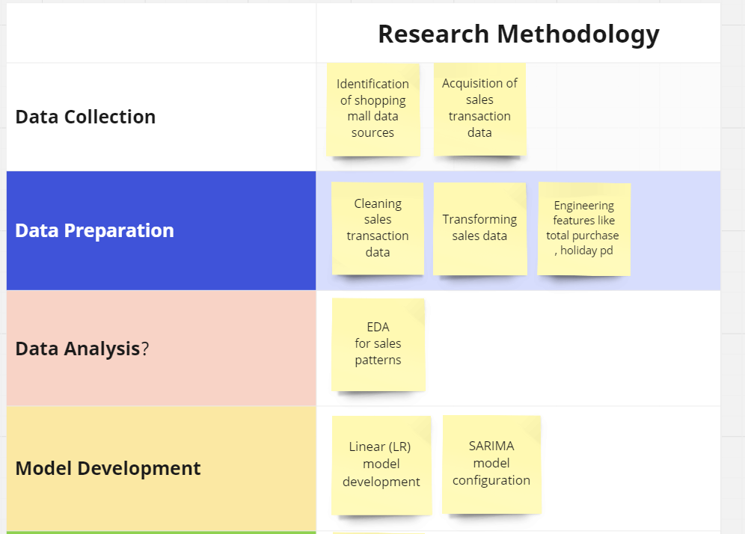
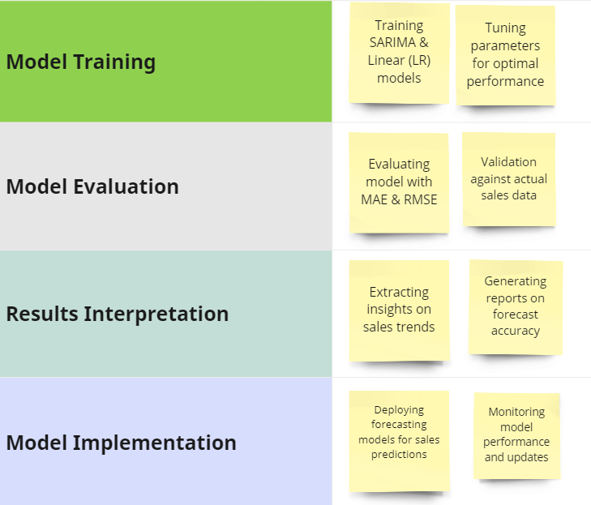

Research Methodology
Sales Forecasting
Notes:
www.kaggle.com

Slide 7
Data Preparation
Sales Forecasting
1. Data Cleaning
3. Feature Engineering
Duplicate Removal: Ensured no duplicate records to maintain data accuracy.
Handling Missing Values: Replaced missing values in critical columns like price or quantity with the mean value. Significant missing data records were excluded to prevent bias​​.
Total Purchase Amount: Created a new feature by multiplying price by quantity to measure the total value of each transaction.
Day of the Week: Added a feature to indicate the day of the week, helping analyze weekly sales patterns.
Holiday Periods: Added a binary feature to indicate whether a transaction took place during a holiday period to capture sales spikes during holiday
2. Data Transformation
4. Categorization
Date Conversion: Converted invoice_date from object type to datetime type for effective time series analysis.
Encoding Categorical Variables: Applied one-hot encoding to variables like gender, category, payment_method, & shopping_mall to make them suitable for machine learning models​​.
Product Grouping: Sorted products into categories like clothing, shoes, electronics, etc., to examine sales trends within specific product categories
.
Customer Segmentation: Divided customers based on demographics such as age and gender to analyze spending patterns across different groups.
Temporal Categorization: Classified transactions based on the day of the week (weekday vs. weekend) to understand how sales trends differ on different days​​.

Slide 8
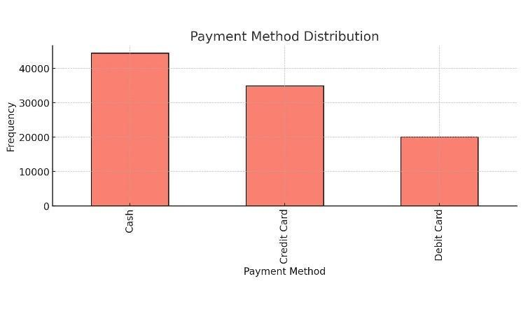
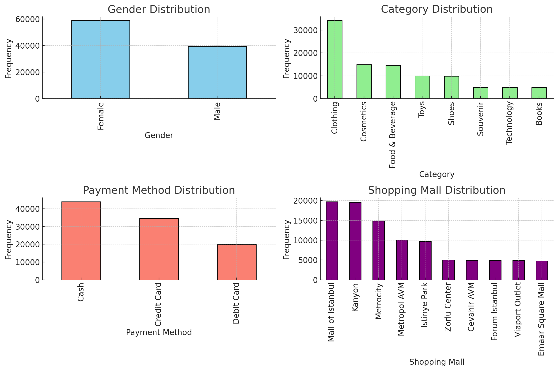
Exploratory Analysis: Key Observations
Sales Forecasting
1. Payment Method Distribution
3. Category Distribution
Cash & Credit Card are the most common payment methods, followed by Debit Card.
Popular categories include Clothing, Cosmetics, Food & Beverage, and Toys.
2. Gender Distribution
4. Mall Distribution
Number of female customers is quite high compared to males.
Shoppers spread their purchases across shopping malls with Mall of Istanbul & Kanyon being the popular choices

Slide 9
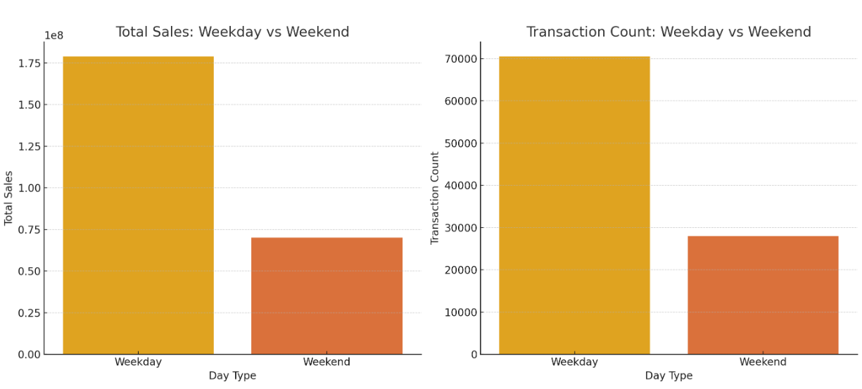
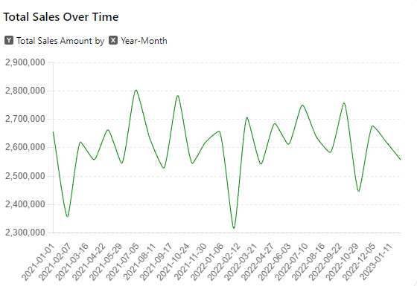
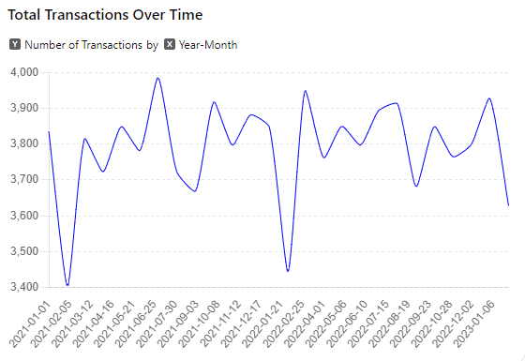
Exploratory Analysis: Key Observations
Sales Forecasting
1. Trend Analysis
Noticeable ups and downs indicating variations in customer activity over different months. These variations may stem from shopping patterns, special promotions or other factors impacting consumer habits
2. Weekday vs Weekend
Weekday sales surpass weekend sales, These findings indicate that most sales and transactions take place on weekdays. This data can be valuable, for planning marketing strategies and allocating resources effectively

Slide 10
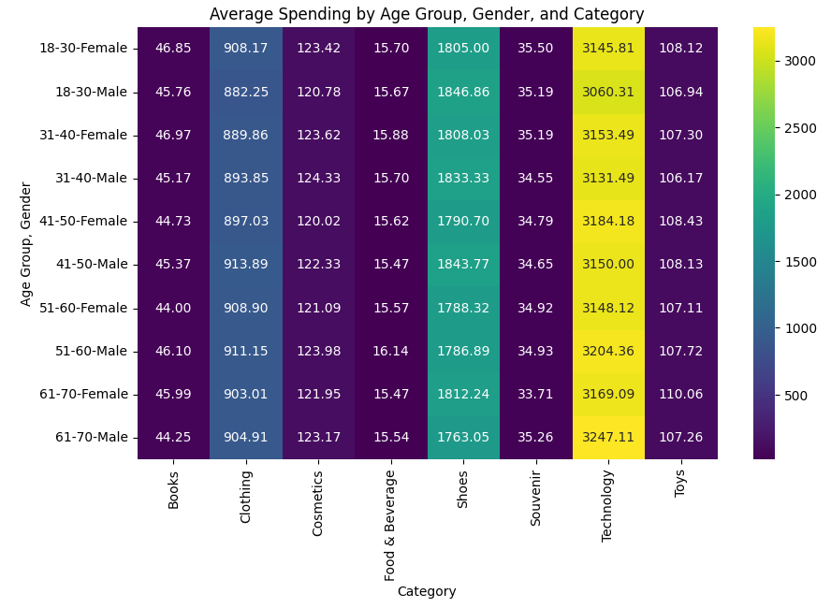
Exploratory Analysis: Key Observations
Sales Forecasting
Average Spending by Age Group, Gender and Category:
Younger age groups (18-40) tend to allocate their funds towards Technology and Shoes. On the hand older age groups (51-70) also exhibit expenditures on Technology with a slight decrease in spending on Shoes. Moreover, males generally tend to invest in high ticket items, like Technology and Shoes compared to females

Slide 11


Sales Forecasting
Model Building
Linear Regression
SARIMA
Ridge Regression
Lasso Regression
2024
2025
2026
Purpose
features, assuming a linear relationship
Handle seasonality and trends in time series data.
overfitting and multicollinearity issues through regularization techniques. L2 regularization
overfitting and multicollinearity issues through regularization techniques. L1 regularization
Parameter Selection / Feature Selection
Techniques such as Recursive Feature Elimination (RFE) and Variance Inflation Factor (VIF) were applied to identify the most relevant features.
Parameters (order and seasonal order) were chosen based on Autocorrelation Function (ACF) and Partial Autocorrelation Function (PACF) plots.
Implemented using statsmodels library.
Adjusted the L2 regularization parameter (alpha) to control coefficient shrinkage.
Models were built using the scikit-learn
Hyperparameters were tuned using cross-validation to find the optimal values.
Adjusted the L1 regularization parameter (alpha) to promote sparsity in the model.
Models were built using the scikit-learn
Hyperparameters were tuned using cross-validation to find the optimal values.
Performance
Demonstrated weak performance with monthly data due to low correlations among input features.
Achieved exceptional results with weekly data, indicating that data granularity significantly impacts model performance
Despite its theoretical suitability, SARIMA struggled to effectively capture the sales trends, possibly due to data complexity and inadequate parameter selection
Showed improved performance over Linear Regression with lower error metrics and high R² values.
Outperformed both Linear and Ridge Regression, displaying the lowest error metrics and perfect R² values, thanks to its ability to eliminate irrelevant features
Notes:
L2 regularization to penalize large coefficients, promoting generalization to new data.
L1 regularization to force some coefficients to zero, effectively performing feature selection

Slide 12
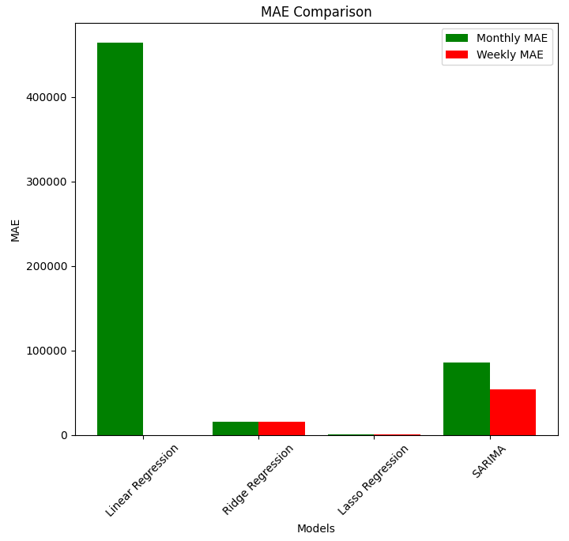
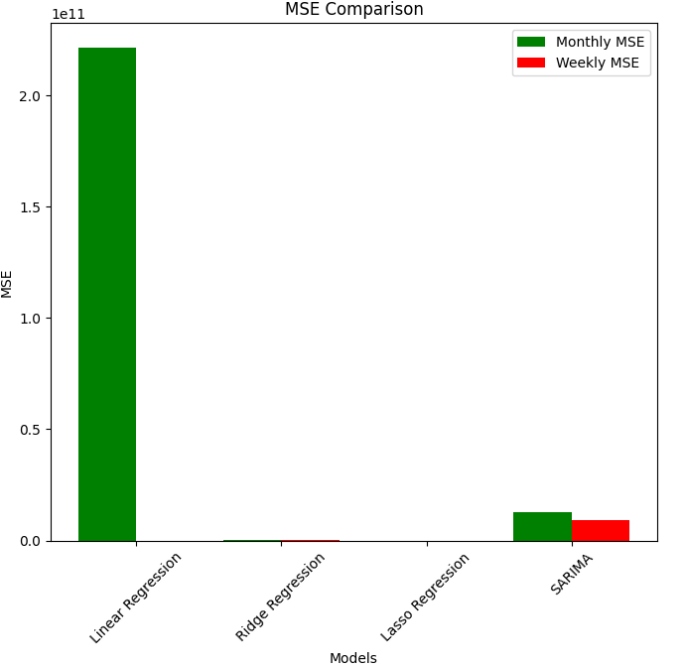
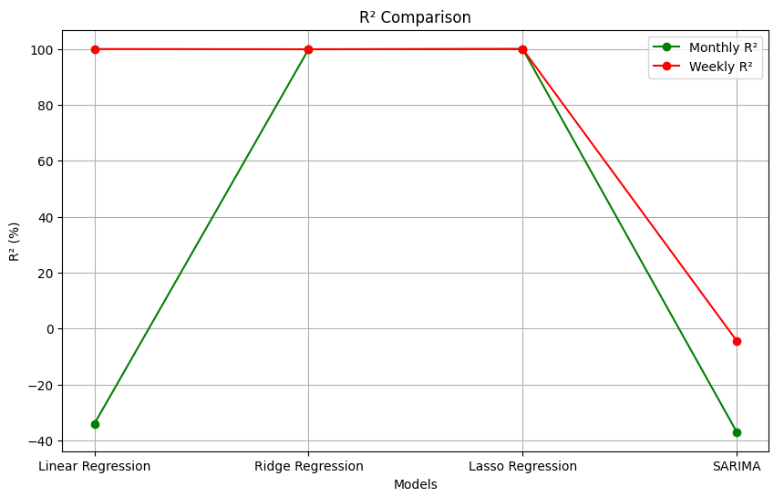
Sales Forecasting
Model Results
Results
Data Granularity Matters:
Performance between monthly and weekly data for Linear Regression highlights the importance of data granularity.
Regularization is Effective:
Both Ridge and Lasso regression benefited from regularization, which helped in mitigating overfitting and improving predictive accuracy.
SARIMA's Complexity:
The SARIMA model, while theoretically adept at handling seasonality, underperformed due to possibly insufficient data.
Hyperparameter Tuning:
The importance of hyperparameter tuning is evident from the improved performance of Ridge and Lasso regressions.
Limitation
Data Quality and Quantity:
The dataset may have had insufficient data points, particularly for the SARIMA model, affecting its ability to accurately forecast sales.
Model Complexity:
Simpler models like Linear Regression struggled with the complexity of the data. More complex models like SARIMA required more data to perform well.
Model | Monthly MAE | Weekly MAE | Monthly MSE | Weekly MSE | Monthly R² (%) | Weekly R² (%)
Linear Regression | 464,287.23 (67.4%) | 1.77e-10 | 221,416,608,226 | 4.65e-20 | -34.0 | 100.0
Ridge Regression | 15,627.89 (2.27%) | 15,627.89 (2.27%) | 315,514,384 | 315,514,384 | 99.9 | 99.9
Lasso Regression | 93.59 (0.014%) | 93.59 (0.014%) | 11,719 | 11,719 | 99.999996 | 99.999996
SARIMA | 85,401.66 (12.4%) | 53,620 (8.4%) | 12,608,689,533 | 9,263,221,076 | -37.0 | -4.4

Slide 13
Conclusions & Future Recommendations
Conclusions
Sales Forecasting
Explore integration of real-time data into forecasting models
Conduct comprehensive comparative studies on the effectiveness of Long Short-Term Memory (LSTM) networks and Prophet models in sales forecasting
Develop models that dynamically adapt to sudden market shifts caused by external factors
Simpler models like Linear Regression are effective with granular data (e.g., weekly data)
Regularization methods improve model robustness and accuracy
Complex models like SARIMA require extensive data and careful parameter tuning
Importance of tailoring forecasting models to data characteristics and needs
Further Research

