Slide 1
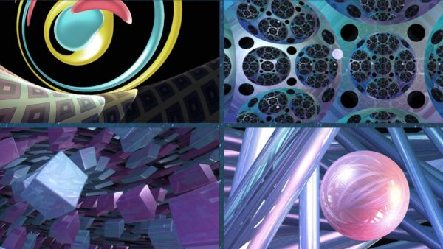
Rethinking Cosmic Symmetries :
Thurston Spacetimes
Raghav Kumawat
Integrated PhD
Physics'23
IISERB

Slide 2
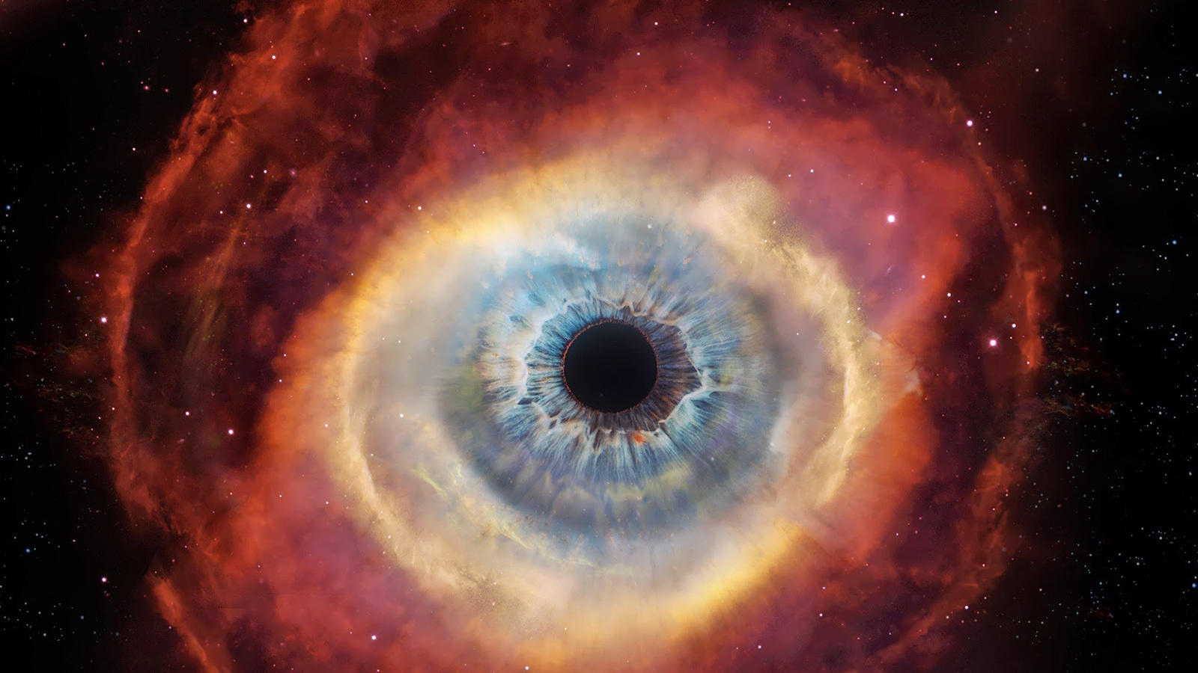
Cosmos Vs universe
Ancient Greek : kósmos : meaning ORDER !
The original Greek term kósmos meant "ornaments, decoration," and later came to mean "order of the universe", first used in this sense by the philosopher Pythagoras. (source : wiki )
Usage of the word in Cosmology implies viewing the universe not as chaos, but as an orderly and structured system.
Cosmology is the study of the cosmos, and in its broadest sense covers a variety of very different approaches: scientific, religious and philosophical.
All cosmologies have in common an attempt to understand the implicit order within the whole of being. In this way, most religions and philosophical systems have a cosmology.

Slide 3
Cosmologies
Physical cosmology : is the scientific study of the universe, from the beginning of its physical existence. The term cosmos is often used in a technical way, referring to a particular spacetime continuum within a (postulated) multiverse. The particular cosmos in which humans live, the observable universe, is generally capitalized as the Cosmos.
Philosophical cosmology : is a branch of metaphysics that deals with the nature of the universe, a theory or doctrine describing the natural order of the universe. The basic definition of Cosmology is the science of the origin and development of the universe. In modern astronomy, the Big Bang theory is the dominant postulation.
Religious cosmology : is an explanation of the origin, evolution, and eventual fate of the universe from a religious perspective. May include descriptions of an act or process of creation by a creator deity or a larger pantheon of deities, explanations of the transformation of chaos into order.. There are various traditions in religion or religious mythology asserting how and why everything is the way it is.

Slide 4
CosmologY
Cosmogony Eschatology
Origin Fate
How did it all Begin ? How will it all end ?

Slide 5
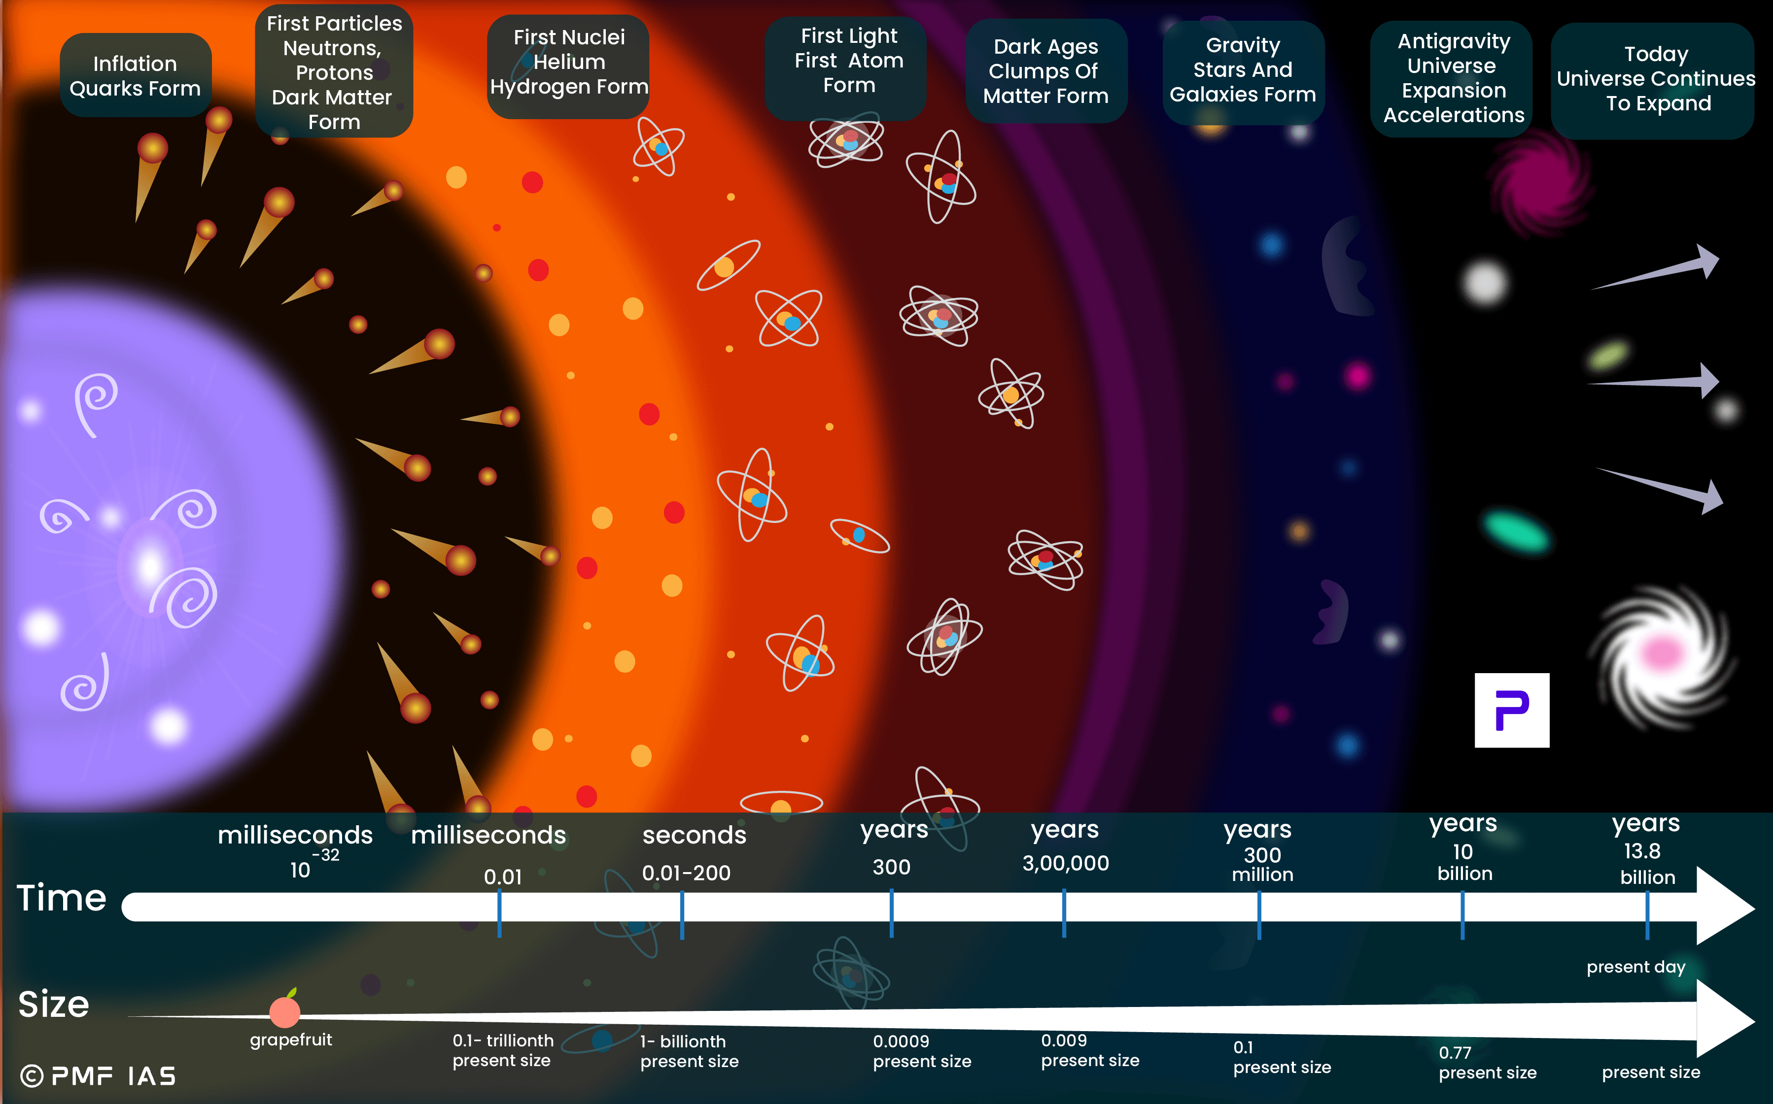
Physical
Cosmology
It is a scientific approach to understand our Cosmos, the (ordered?) Universe or Multiverse, through the laws of physics. All its History, Present and the Ultimate Fate !
Question is …. is it really ORDERED ? How do you define ordering ?
By Laws ? By Symmetries ? Entropy ?
Cosmology as a physical science originated with the Copernican principle, which in some manner says that celestial bodies obey identical physical laws to those on Earth, and Newtonian mechanics, which first allowed those physical laws to be understood.
And thus we now understand that most of universe follow certain laws or rules :
We can say it is somehow ordered in a sense that it follow those perfect laws.
But it's not always the case - we have many systems under chaos.
There enters The science of chaos !

Slide 6
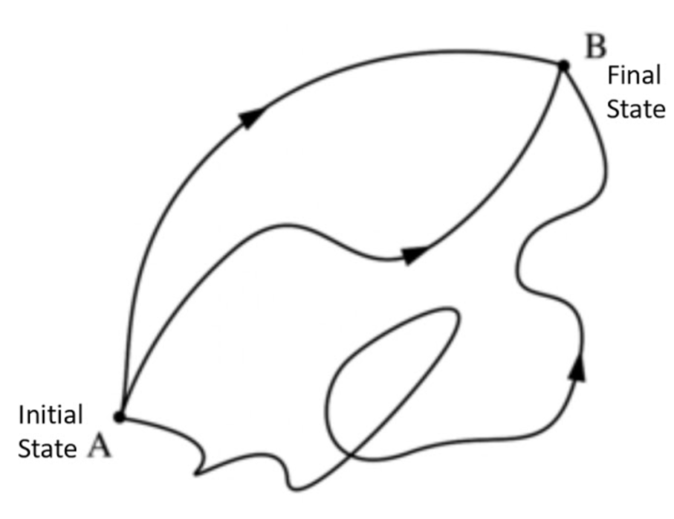
Least Action And
Symmetries
The Principle of Least Action states that a physical system
will always follow the path between two points that minimizes a quantity called
"action," essentially choosing the most efficient or "easiest" route possible.
Symmetries bring order to the universe . In essence, a symmetry means a system remains unchanged after a transformation.
This concept is powerfully linked to the laws of the universe through Noether's Theorem, which states that for every continuous symmetry in nature, there is a corresponding conservation law.
For instance, the fact that the laws of physics are the same today as they were yesterday (symmetry in time) gives rise to the conservation of energy. Similarly, the uniformity of physical laws throughout space (translational symmetry) leads to the conservation of momentum.

Slide 7
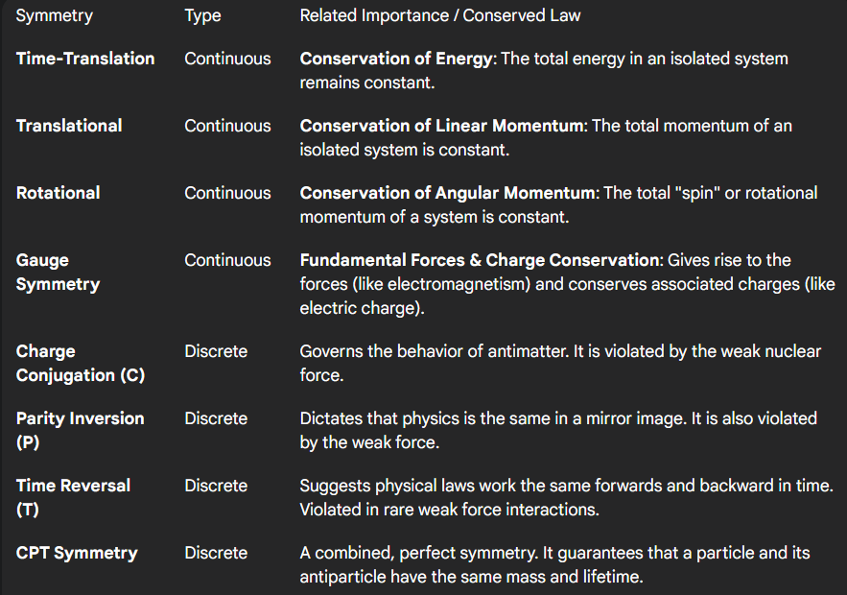














Define 'Order' in the Universe

Slide 8
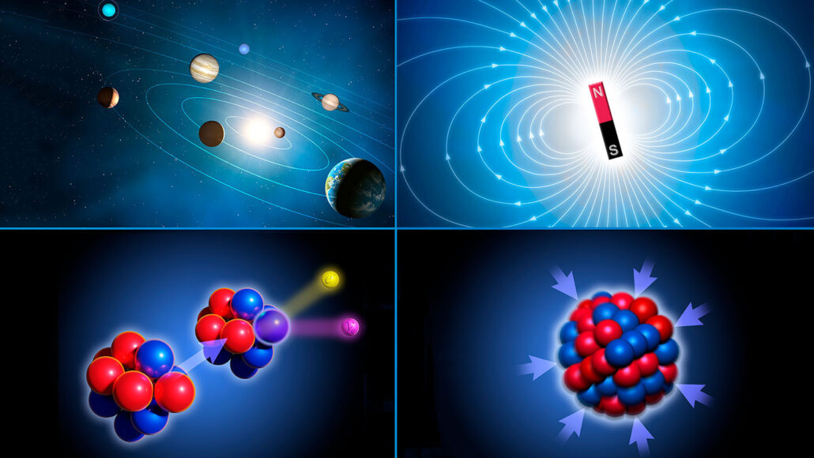

Define 'Order' in the Universe
For now we can define ' ORDER ' in the universe as a hierarchy :
We define it by the existence of maximum no. of Symmetries
that create the foundational consistency,
which gives rise to unbreakable Conservation Laws,
which in turn shape the predictable Physical Laws
that govern every interaction in the cosmos !

Slide 9
ORder at Largest Scales :
We search for cosmic Symmetries !

Slide 10
Space
HOMOGENEITY
Things are same at every given spatial point. Valid at large scales >> 100 Mpc.
This is Translational Symmetry. It means the laws of physics are the same here as they are in a distant galaxy.
Because of this symmetry, the Law of Conservation of Linear Momentum must be true.
The universe is NOT homogenous in time at large scales !
The evolutionary path is often called the Arrow of Time, driven by the second law of thermodynamics (the principle that entropy, or disorder, tends to increase). The universe of the past looks vastly different from the universe of today.
time

Slide 11
Space
ISOTROPY
Things are same in all directions from any given point. Also valid at large scales >> 100 Mpc.
This is Rotational Symmetry.
Because of this symmetry, the Law of Conservation of Angular Momentum must be true.
The universe is NOT isotropic in time at large scales !
Time has a clear and undeniable directionality (Arrow of Time) which is again a consequence of 2nd law of thermodynamics.
Anisotropy in a single dimension of time means that moving forward is different from moving backward.
time

Slide 12
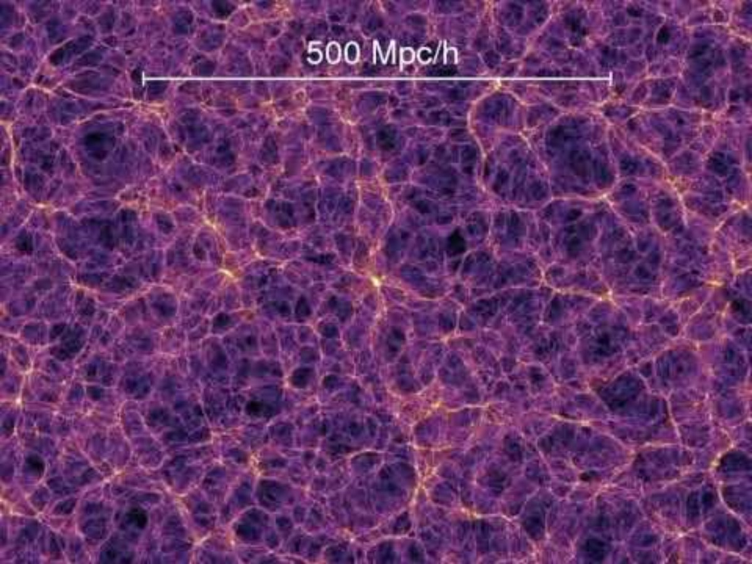
Interactive Simulation

Slide 13
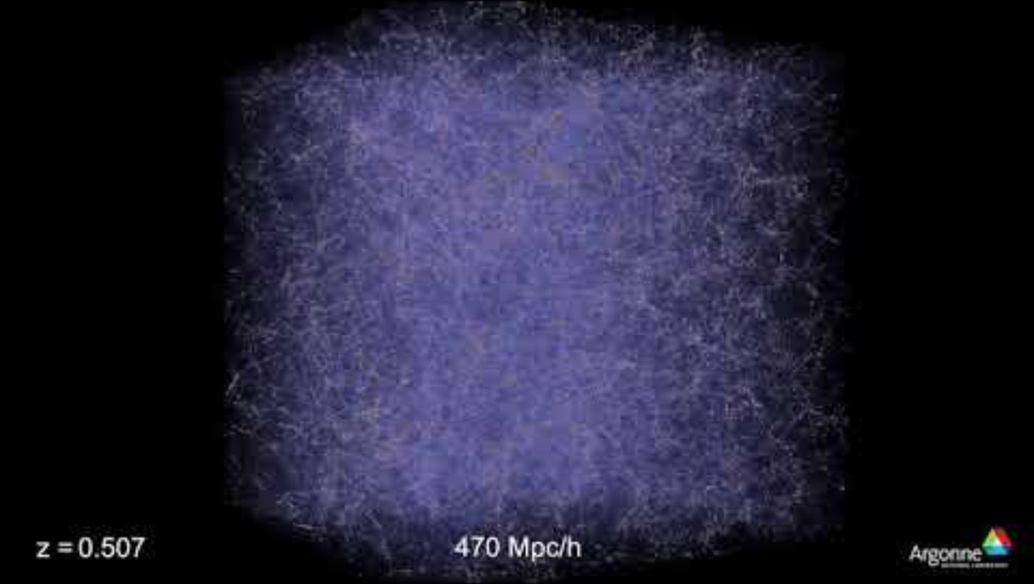
Interactive Simulation

Slide 14
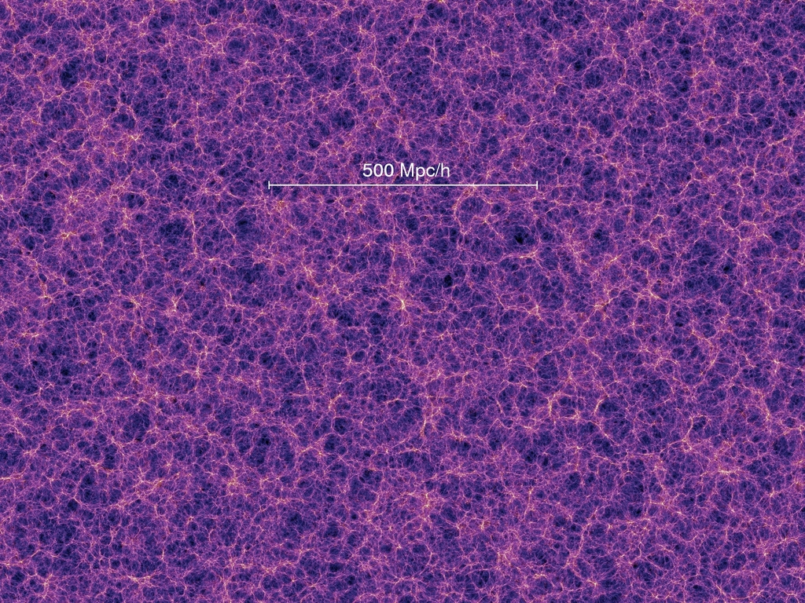
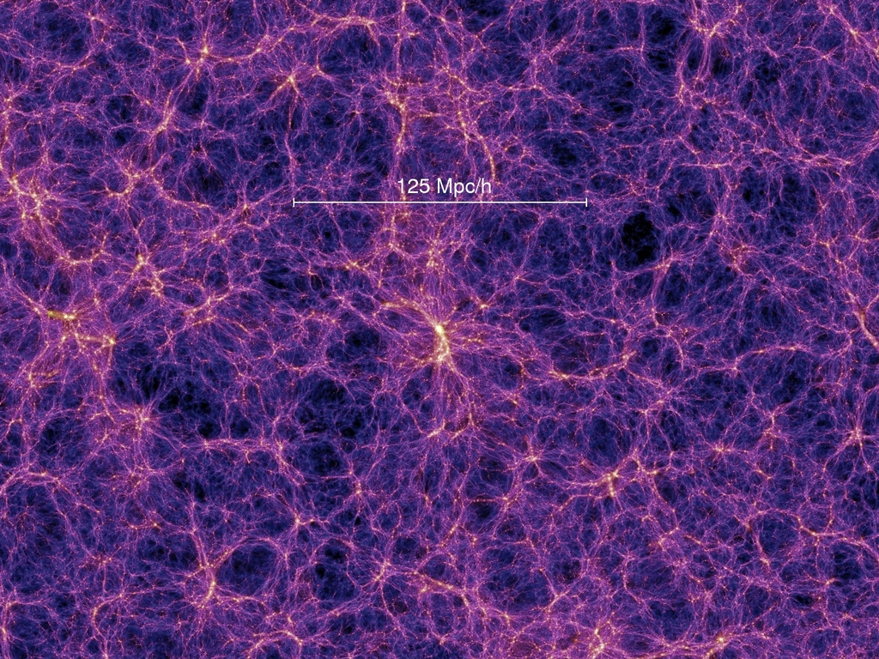
Cosmological Principle
" Universe at largest scale (> 100 Mpc),
is spatially homogenous and isotropic. "

Slide 15
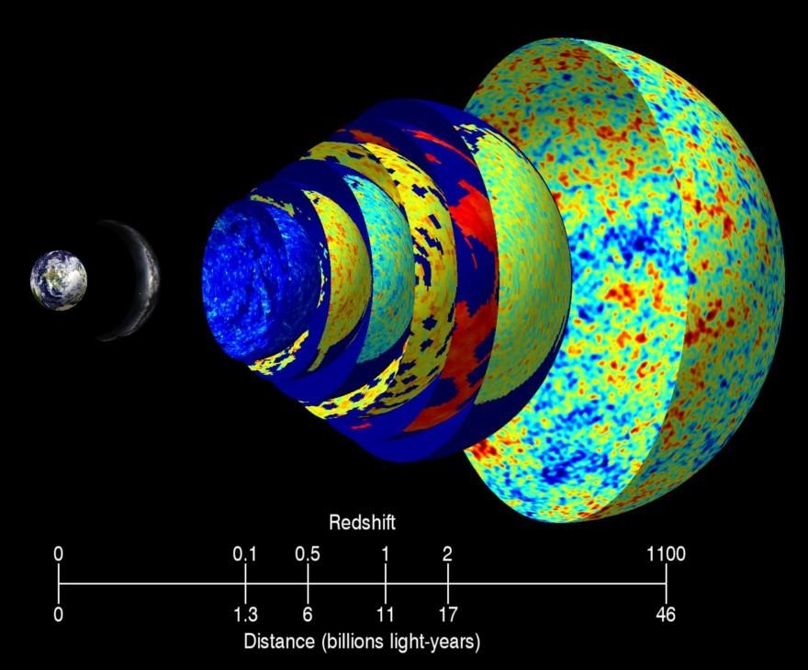
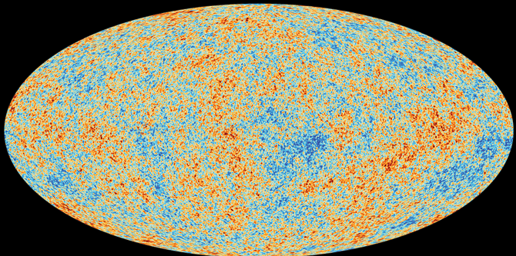
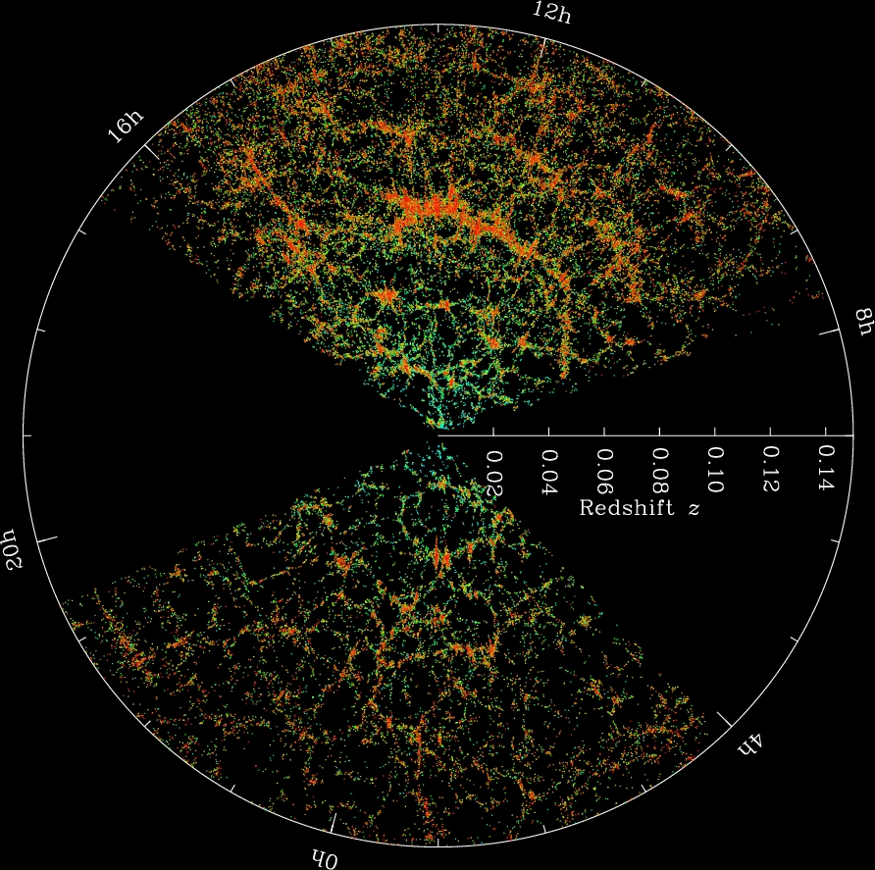
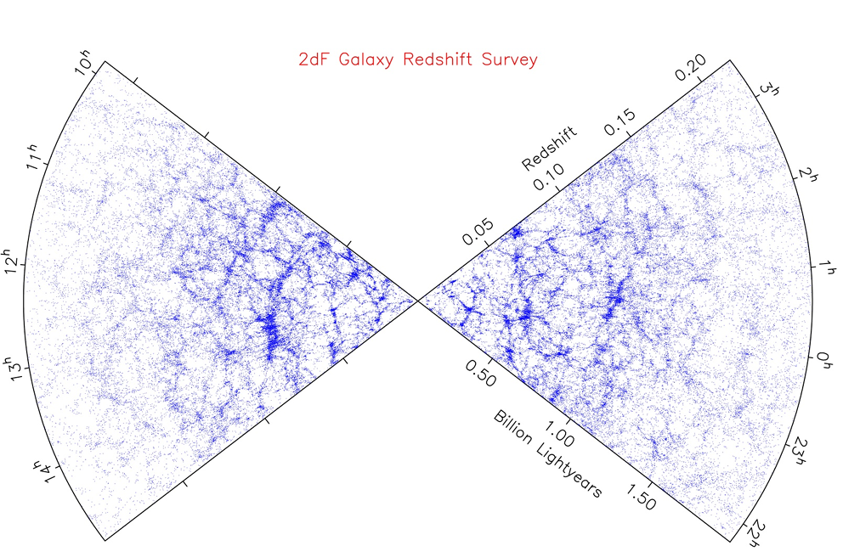
Supporting Evidences !
C
M
B
ESA/Planck Collaboration
Earth: NASA/BlueEarth; Milky Way: ESO/S. Brunier; CMB: NASA/WMAP
R
E
D
S
H
I
F
T
Sloan Digital
Sky Survey
2dF Redshift Survey

Slide 16
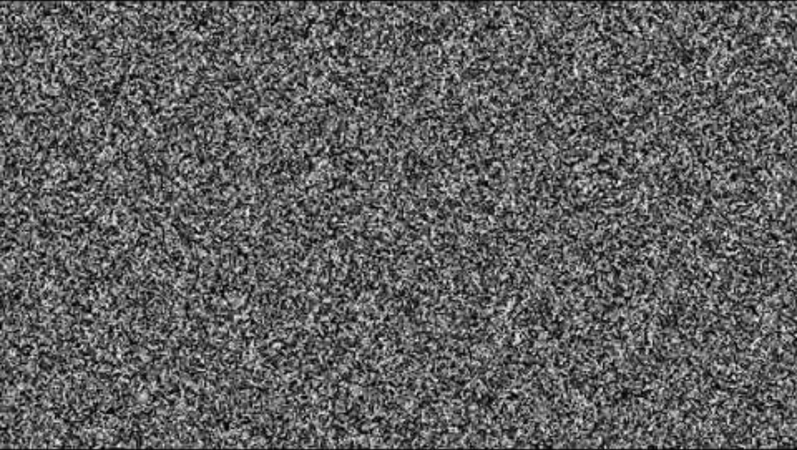
OOOps !!

Slide 17
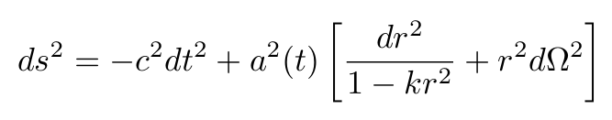
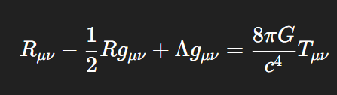
Standard Model Of Cosmology
C.P greatly simplifies our model : maximally symmetric 3-space
It implies that Universe's Large scale geometry can be described by simple FLRW metric :
The cosmological principle is our starting point for building the simplest possible model of the Universe.
Einstein Field Equations :

Slide 18



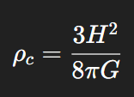



Important equations in standard Cosmology
Equation of State :
1st Friedmann Equations :
2nd Friedmann Equations :
Critical Density :
Cosmological Redshift :
Growth of Perturbations :
Continuity Equation :

Slide 19
Standard Paradigms of ΛCDM (Standard) Model :
General Relativity governs gravity
Cosmological Principle
Expanding Universe
Hot Big Bang origin
Inflationary Epoch
Cold Dark Matter (CDM)
Cosmological Constant (Λ) / Dark Energy
Primordial Perturbations
Structure Formation via Gravitational Instability
Flat Geometry

Slide 20
Chronology Of Universe

Slide 21
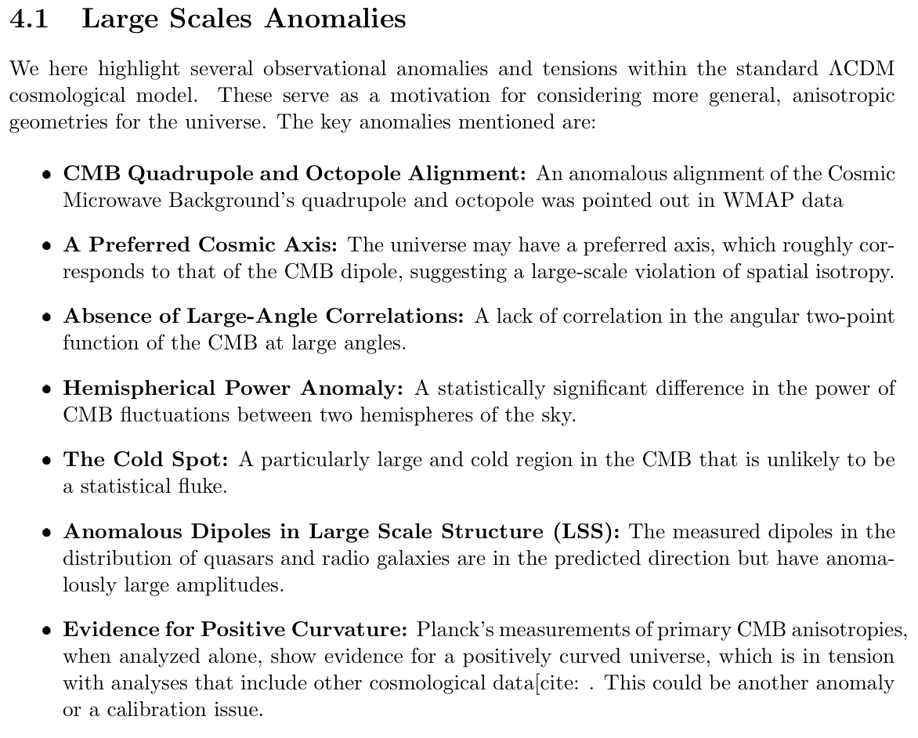
Anisotropies: Breaking C.P.

Slide 22
Is Cosmos really kósmos ?
Is it really ordered in terms of symmetries ?

Slide 23
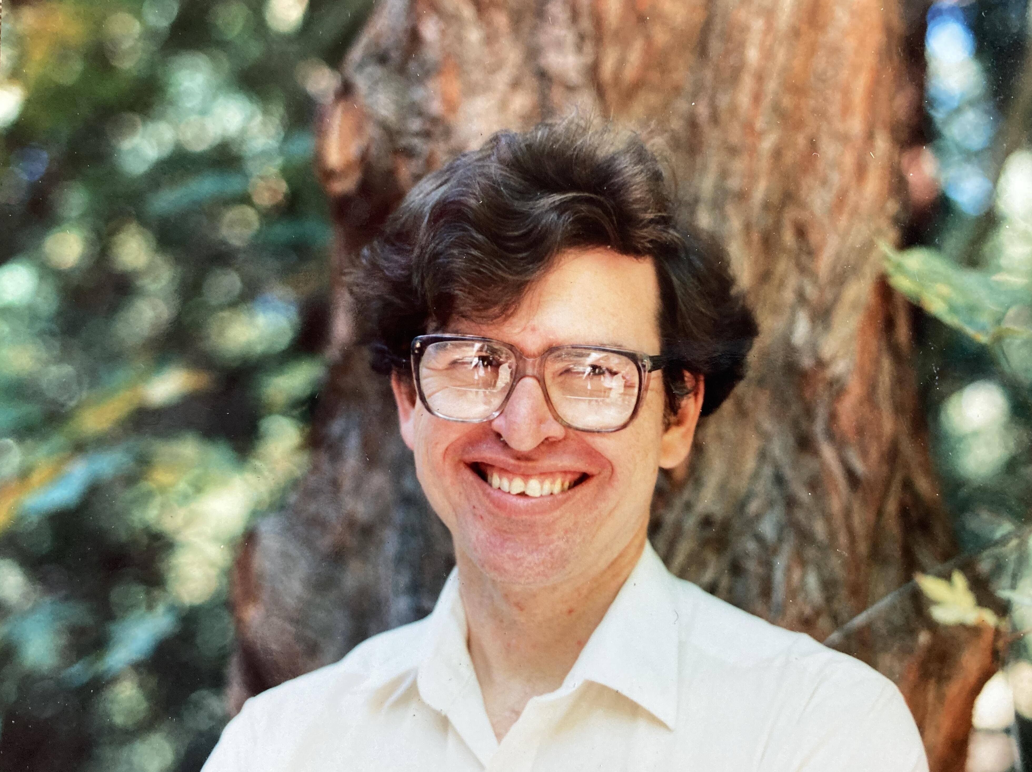
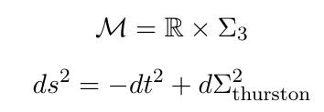
Thurston Geometries
Conjectured by William Thurston in 1982 and proven by Grigori Perelman in 2003, it fundamentally changed the study of 3D topology.
" Any compact 3-manifold can be canonically decomposed into pieces,
each of which admits one of eight fundamental, homogeneous geometries. "
The Uniformization Theorem, a precursor to Thurston's work, states that
any compact 2D surface can be given one of three basic geometries:
Spherical (Positive Curvature), Euclidean (Zero Curvature), Hyperbolic (Negative Curvature)
We decompose spacetime at large scales as :-

Slide 24
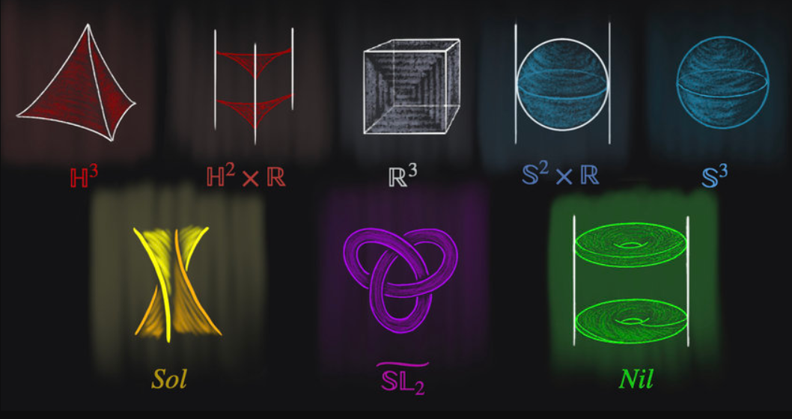
The Eight Geometries

Slide 25
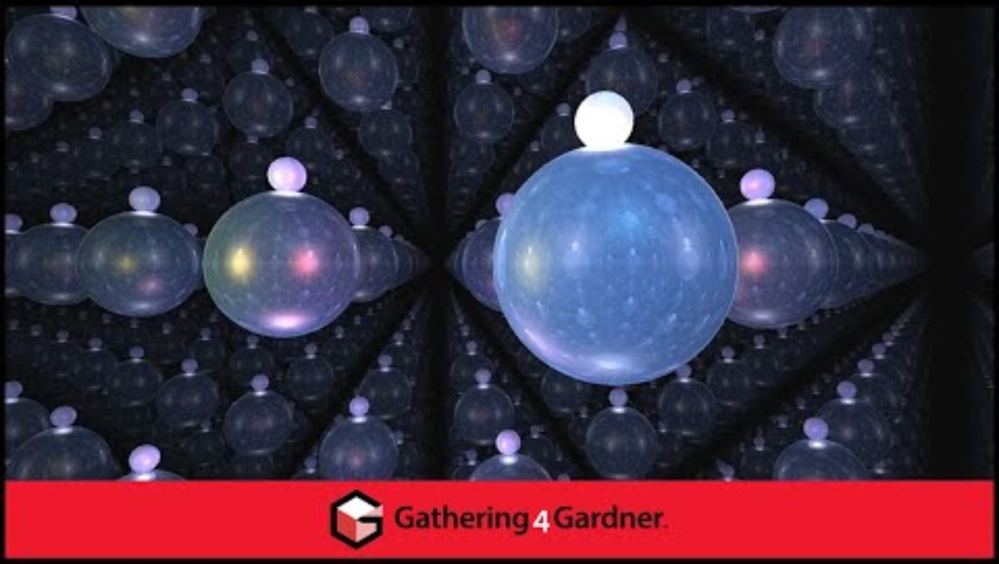
Interactive Video

Slide 26
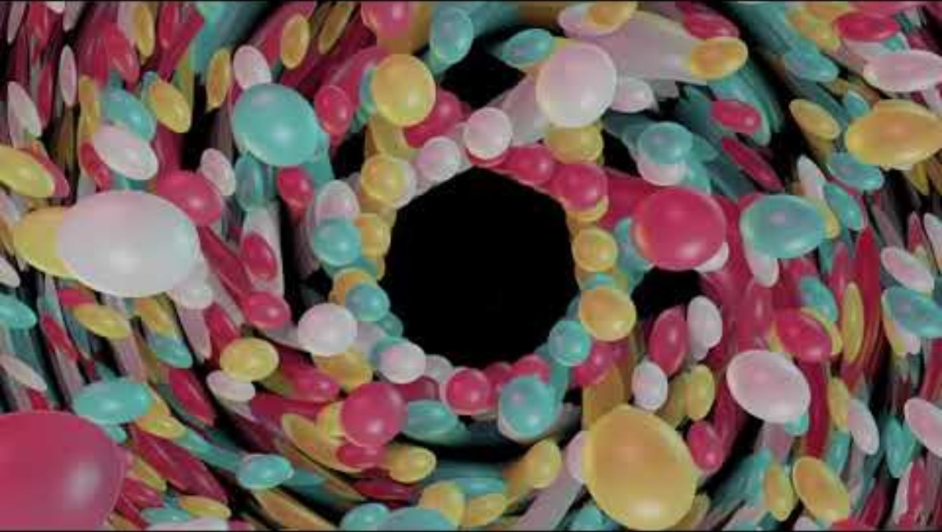
Interactive Video

Slide 27
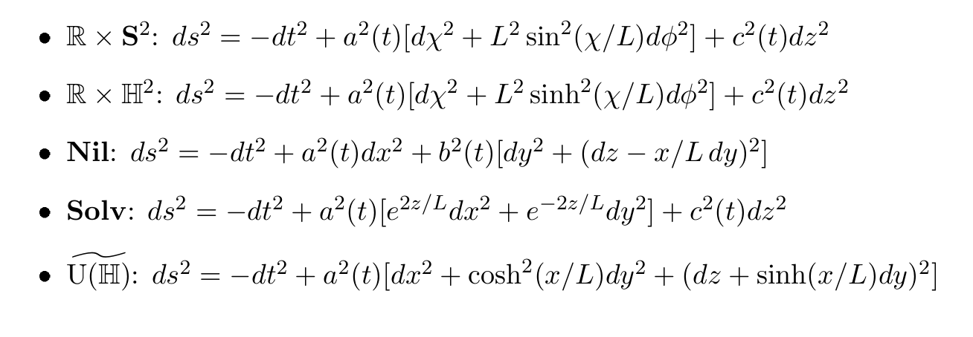
Thurston Spacetimes (anisotropic)

Slide 28
How do we see effects of these anisotropic geometries on these large scales ?
By coupling an anisotropic background (gravity)
to elementary particles/fields.
And check what physics arises !
Lastly we match with current observations.
Or suggest … how should we look in sky for signatures suggested by these
geometries.

Slide 29
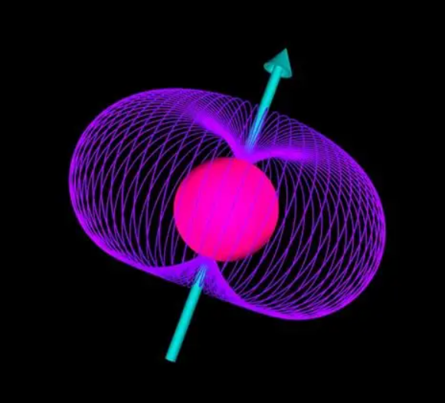

My Research
Is to couple fermionic fields to these anisotropic Thurston backgrounds.
Describes the spin-connection coupling of fermions to gravity
Check if whether the matter-antimatter asymmetry is spontaneously arising from anisotropic background through CPT violation.

Slide 30

Thank You

