Slide 1

INFOSYS
Springboard Internship 5.0 Batch 2
Learning and Development (LGD) Management Application
PRESENTED BY
SAMARPITA DAS
TEAM LEADER (GROUP D)
04-NOV-24 — 07-JAN-25

Slide 2

MILESTONE 1
MODULE 1 : User Authentication and Role Management
Description:
Implementation of user authentication and role-based access control for different users (account managers, admins, and employees).

Slide 3
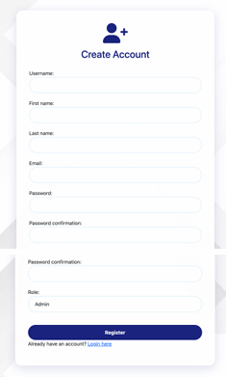
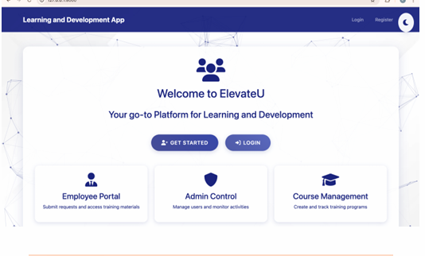
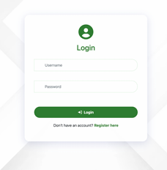


Slide 4
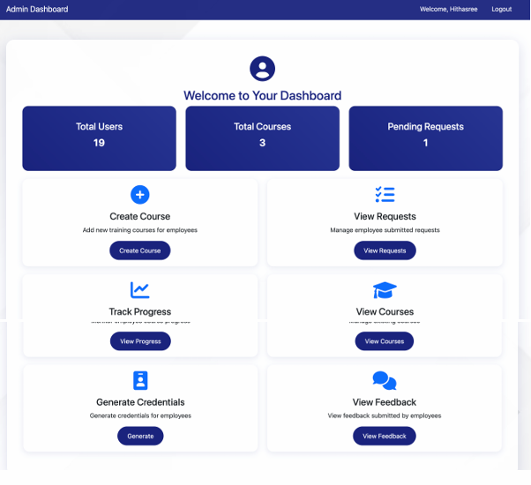


Slide 5
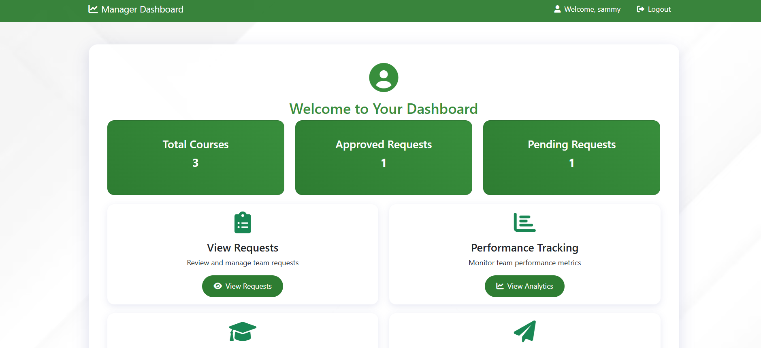
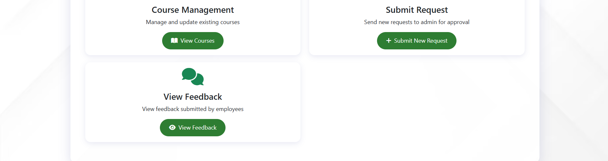


Slide 6
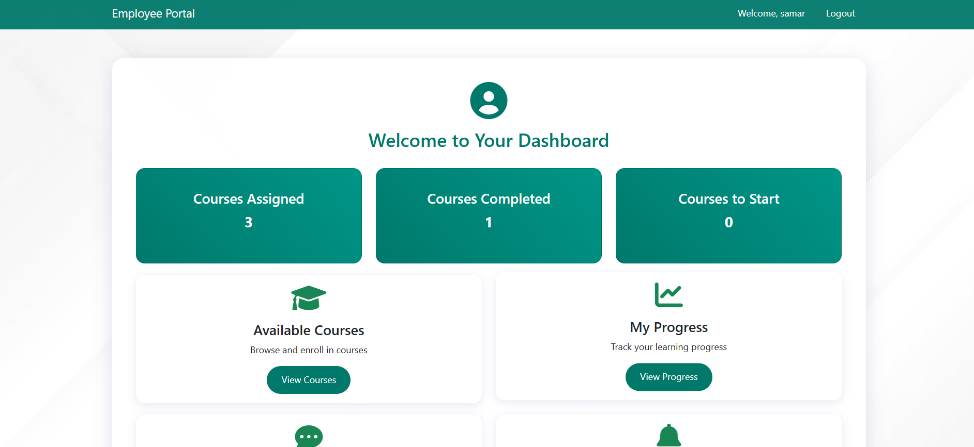



Slide 7

MILESTONE 1
MODULE 2: Training Request and Management
Description:
Account managers can submit training requests, and admins review, approve, and create training programs based on the requests.

Slide 8
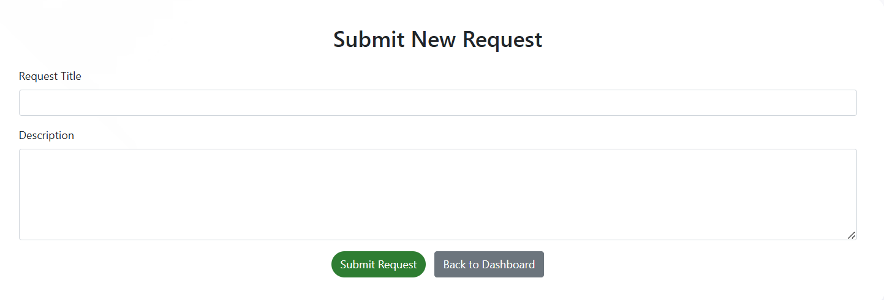
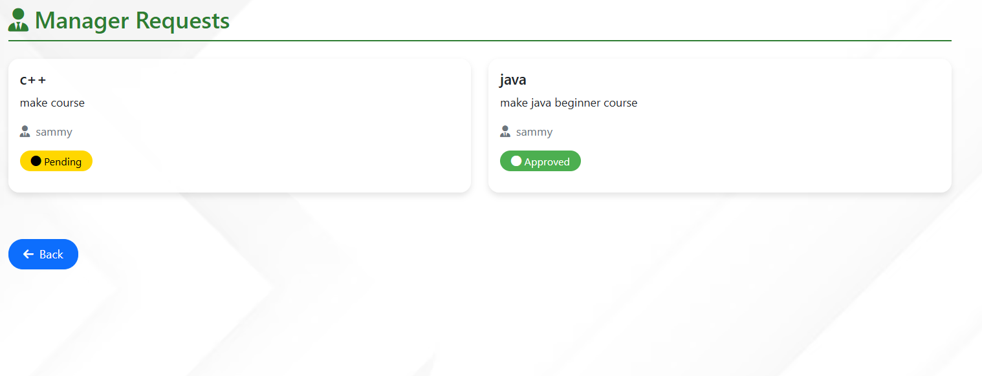


Slide 9
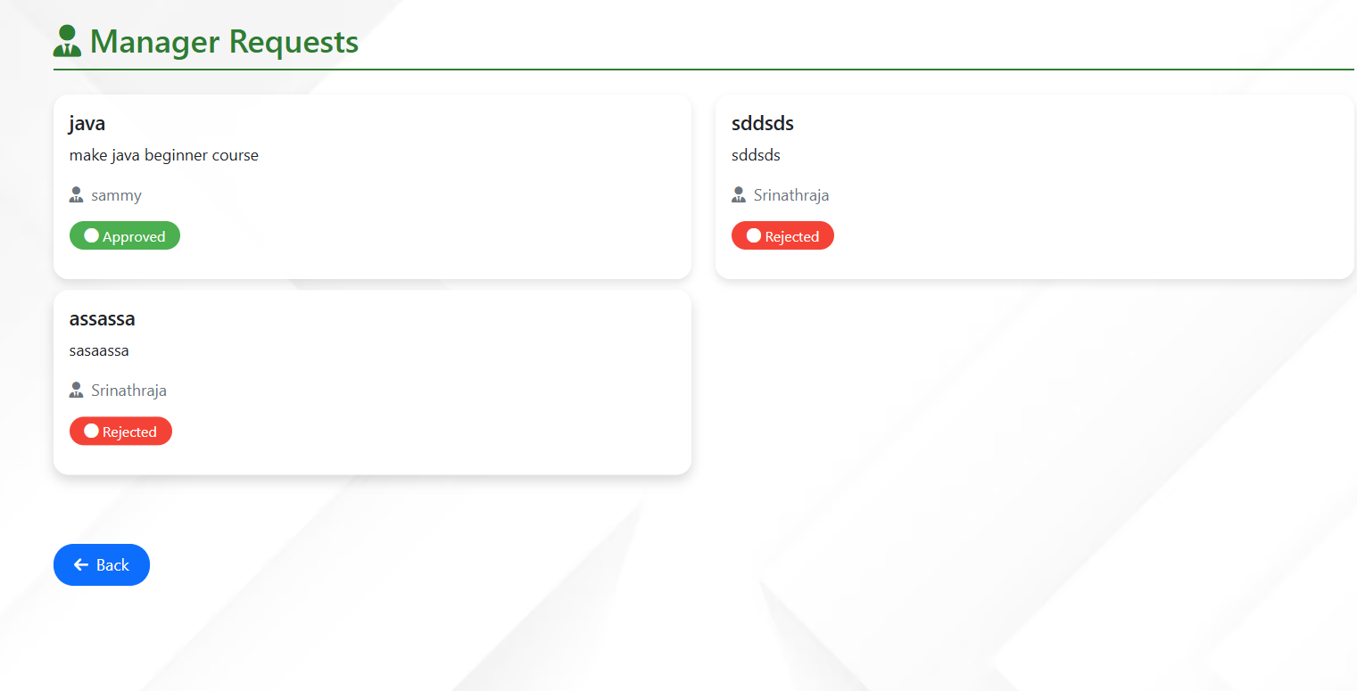


Slide 10
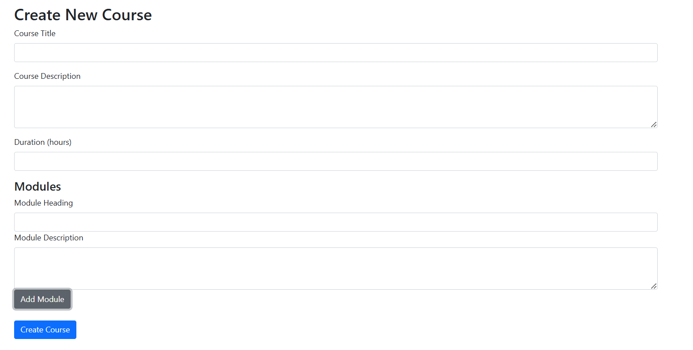


Slide 11
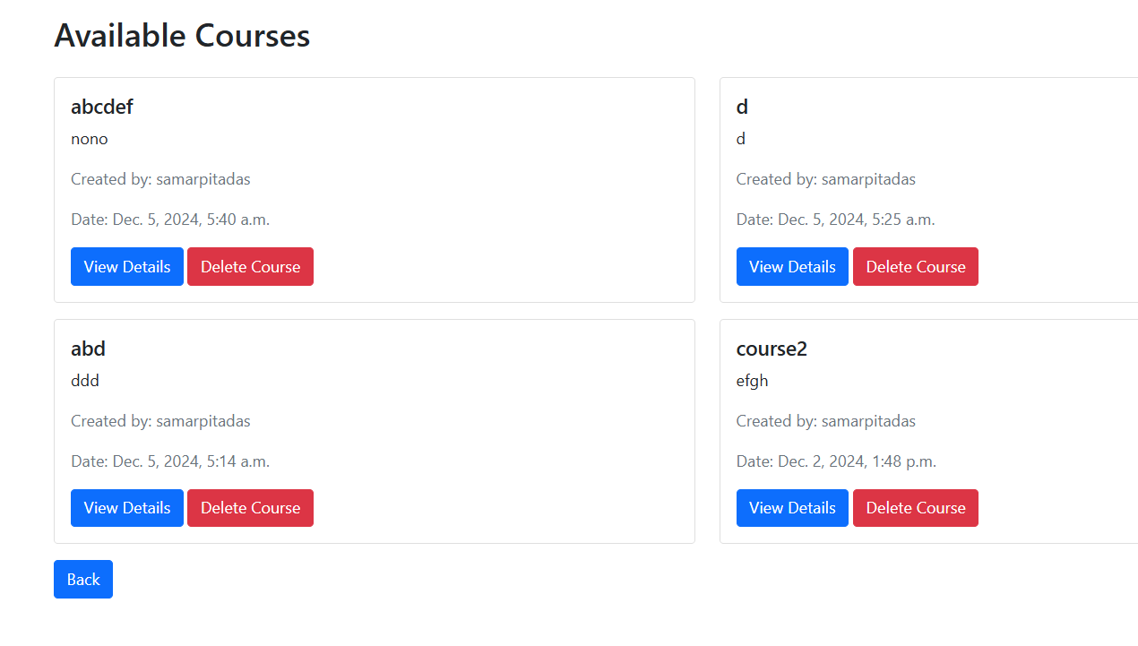


Slide 12
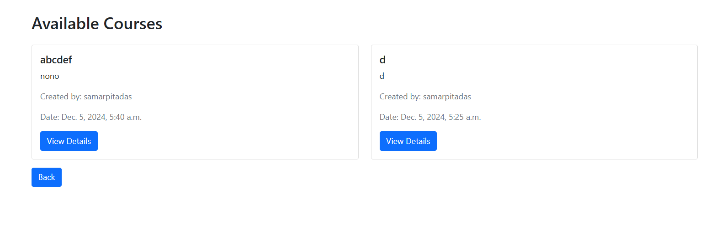


Slide 13

MILESTONE 2
MODULE 3: Course Creation and Assignment
Description:
Admins create courses based on approved requests, generate employee credentials, and assign courses.

Slide 14
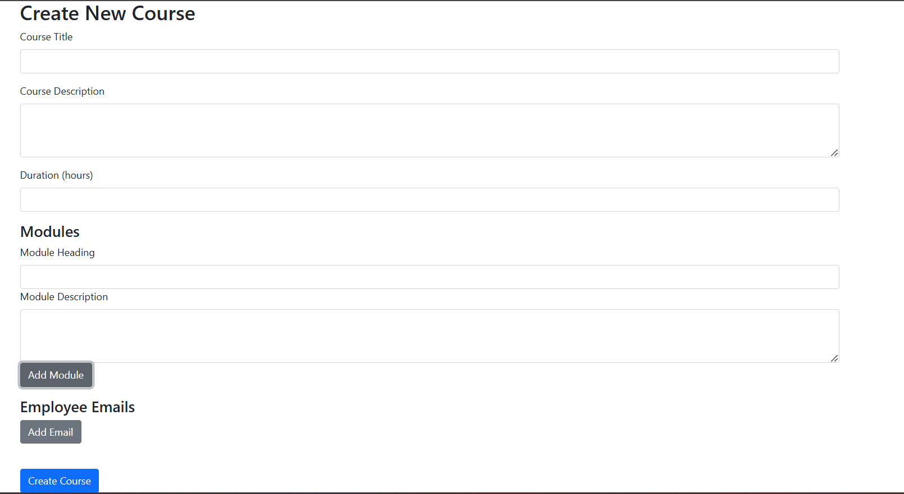


Slide 15
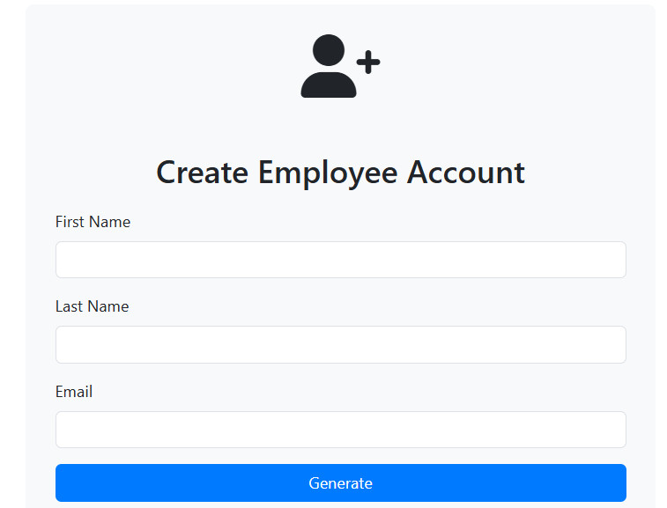


Slide 16
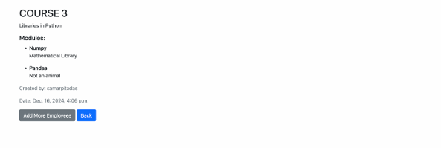


Slide 17



Slide 18

MILESTONE 2
MODULE 4: Employee Progress Tracking
Description:
Admins can track the progress of employees in their assigned courses.

Slide 19
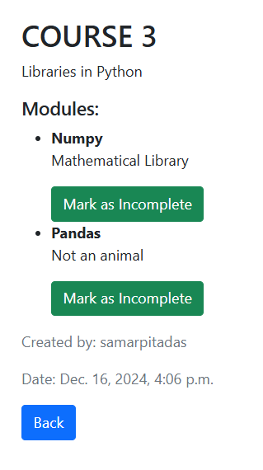
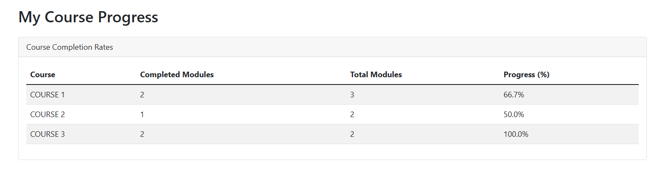

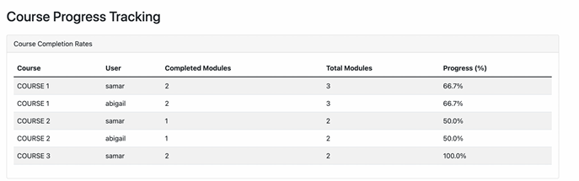


Slide 20
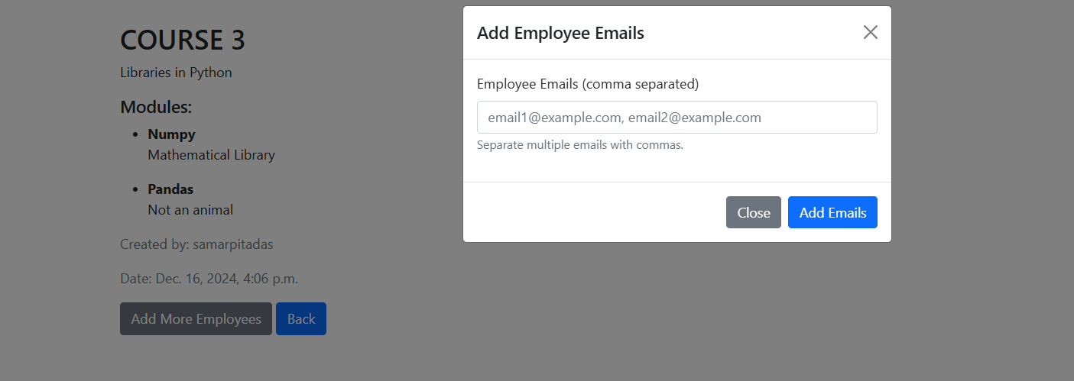


Slide 21

MILESTONE 3
MODULE 5: Feedback Collection and Reporting
Description:
Employees provide feedback after completing each course, and admins analyze it to improve course content and structure.

Slide 22
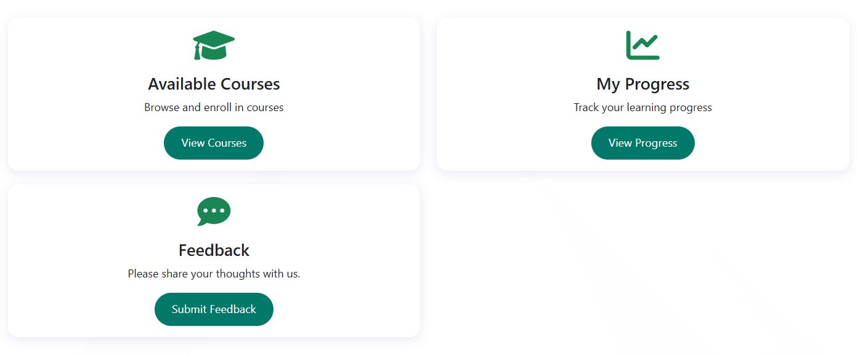
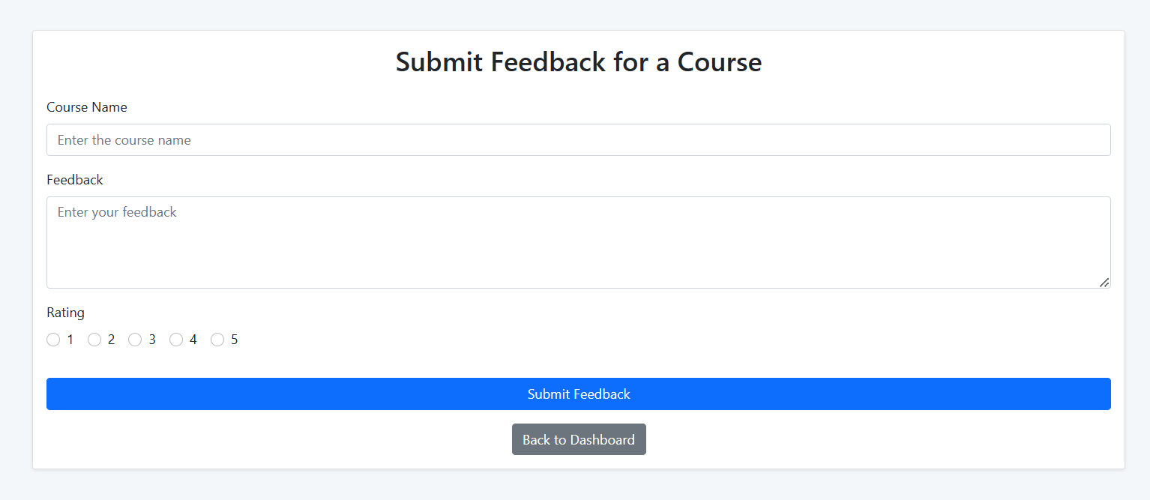


Slide 23
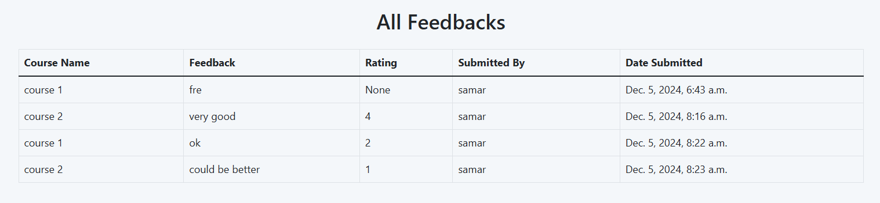
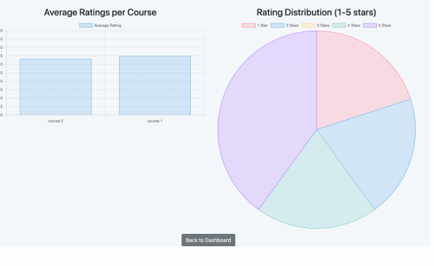


Slide 24

MILESTONE 3
MODULE 6: Dashboard Overview and Reporting
Description:
A central dashboard provides a snapshot of course statistics and employee progress, offering high level reporting..

Slide 25
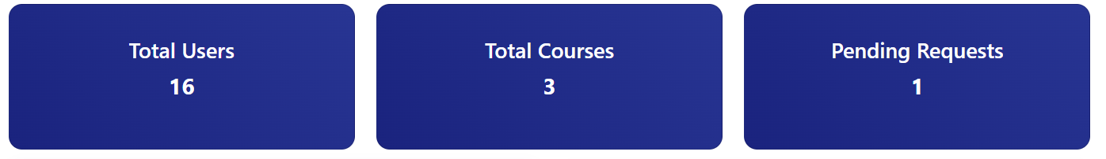
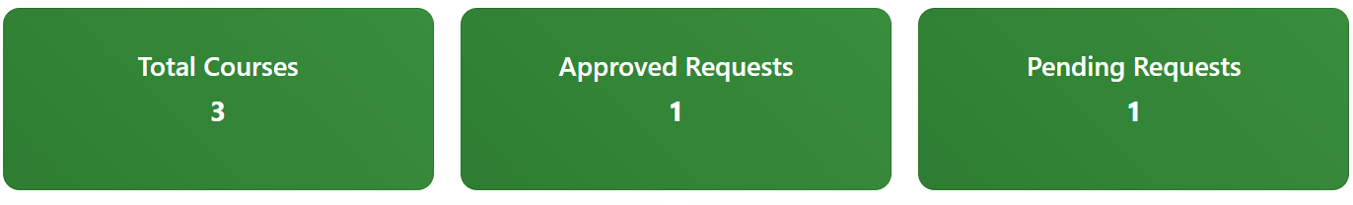
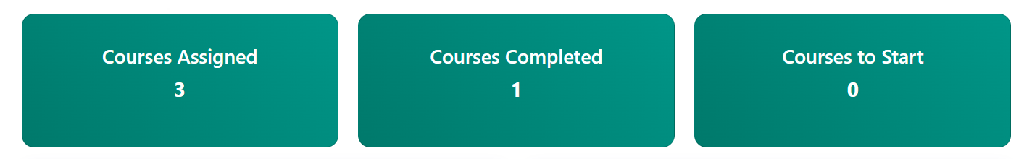


Slide 26

MILESTONE 4
MODULE 7: Notification System
Description:
Sends automated notifications for course assignments, deadlines, and feedback submission reminders to employees.

Slide 27
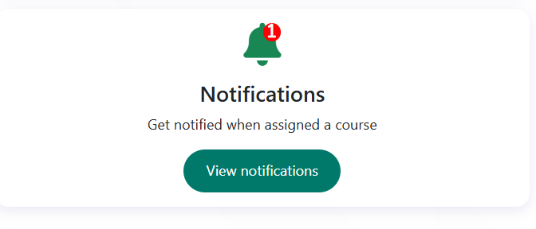
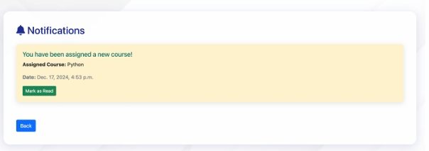


Slide 28

MILESTONE 4
MODULE 8: Course Progress Analytics
Description:
Provides analytics on employee performance across courses, allowing admins to monitorand adjust training effectiveness.

Slide 29
