Slide 1
WEB APPLICATION
YOURSTATS
BY: RAVENCLAW

Slide 2
INTRODUCTION
This Web Application helps the state government to ensure that good facilities are provided to the school going students.
It uses machine learning algorithms to determine the resources that needs to be added or improved in all the schools of a state. This model gives the analysis of five basic requirements for any school namely: availability of drinking water, electricity supply, separate washrooms for boys and girls and computer facilities.
It gives the percentage of all these facilities in all the schools of a state which helps the government to decide the amount to invest in and things to work upon.
This application would ensure that the literacy rate of the state remains high and that the future of the country is well nourished and highly informed.

Slide 3
DATASET
The datasets used in these experiments consists of 100 rows of data.
The dataset contains the following columns:-
State
Year
Percentage

Slide 4
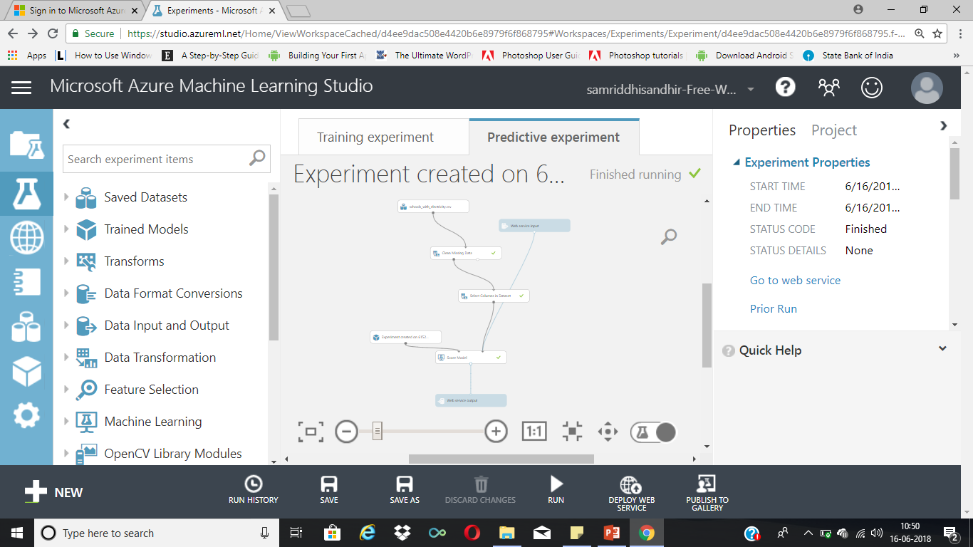
EXPERIMENT 1
This model is trained to predict the amount of electricity that is supplied to all the schools of a particular state.
Based on these predictions the state government decides the amount of money it needs to spend on that particular facility.

Slide 5
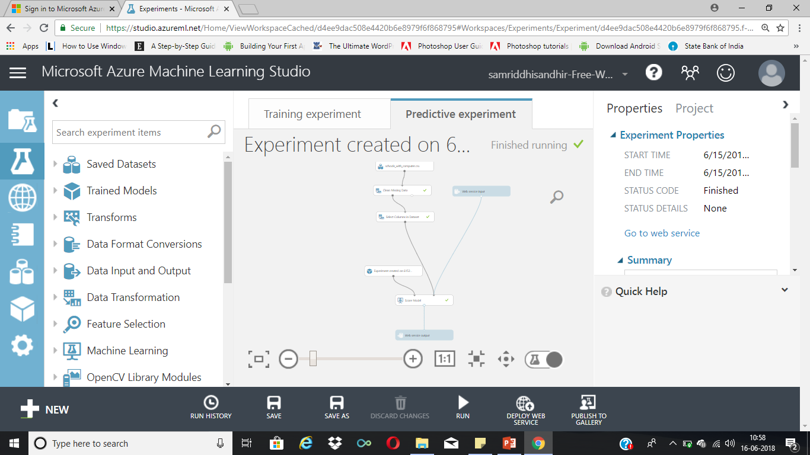
EXPERIMENT 2
This model is trained to predict the availability of computers in all the schools of a particular state.
Based on these predictions the state government decides the amount of money it needs to spend on that particular facility.

Slide 6

EXPERIMENT 3
This model is trained to predict the percentage of clean drinking water available in all the schools of a particular state. This is clearly the most important of all and plays a major role in determining the literacy rate.
Based on these predictions the state government decides the amount of money it needs to spend on that particular facility.

Slide 7

EXPERIMENT 4
This model is trained to predict the availability of girls washroom in all the schools of a particular state.
This is one of the major factors deciding the girl population in a school.
Based on these predictions the state government decides the amount of money it needs to spend on that particular facility.

Slide 8
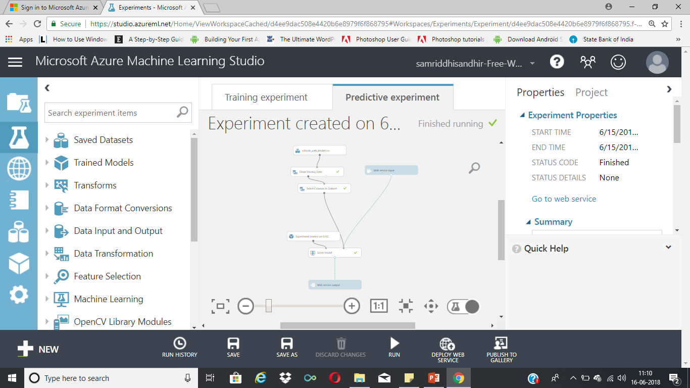
EXPERIMENT 5
This model is trained to predict the availability of boys washrooms in all the schools of a particular state.
This is important for maintaining hygiene in the schools.
Based on these predictions the state government decides the amount of money it needs to spend on that particular facility.

Slide 9
USAGE
This Web Application will be sold to the State Government so that it can focus on the specific areas that needs more concern and investment.
This Web Application can be sold to the Central Government so that it can keep a check on the amount of money being used for these facilities.

Slide 10
UPGRADES
This Web Application can be used to see the data of individual schools(registered) for each state.
This app can generate the yearly growth and keep a check on how the govt is utilising the money.

Slide 11
Thank You

