Slide 1
SCHOOL OF COMPUTER SCIENCE AND ENGINEERING (SCOPE)
BCSE307P COMPILER DESIGN LAB PROJECT
Interactive GUI for Operator Precedence Parsing
and Conversion of RE to DFA using Direct Method
PROJECT REVIEW 2
Samriddhi Tiwary
23BCE0661
Vellore Institute of Technology
PROJECT 8 • BCSE307P • REVIEW 2
1

Slide 2
2. INTRODUCTION
Introduction
Project context
Review 2 emphasis
Operator-precedence parsing is a bottom-up parsing technique for a restricted class of operator grammars.
Generic tokenization
Review 1 implemented grammar validation, LEADING/TRAILING computation, precedence-table construction, and conflict detection.
Topmost-terminal comparison
SHIFT / REDUCE decisions
Review 2 extends the same system toward complete step-by-step string parsing using the generated precedence table.
Correct handle detection
The parser is designed to derive its behavior from the user-entered grammar rather than from hard-coded E/T/F rules.
Production-aware reduction
Detailed ACCEPT / REJECT trace
PROJECT 8 • BCSE307P • REVIEW 2
2

Slide 3
3. OBJECTIVES
Objectives
01
Preserve Review-1 analysis
Reuse grammar validation, LEADING/TRAILING, and precedence-table generation.
02
Generalize grammar handling
Support different non-terminal names and multi-character terminals/non-terminals.
03
Implement full parsing
Perform SHIFT/REDUCE parsing using the generated precedence relations.
04
Explain every step
Show stack, input, relation, action, handle, production, and reason.
05
Reject safely
Detect unknown tokens, missing relations, conflicts, invalid handles, and parser cycles.
06
Prepare for final integration
Keep RE-to-DFA direct conversion for Review 3.
PROJECT 8 • BCSE307P • REVIEW 2
3

Slide 4
4. LITERATURE REVIEW
Literature Review
R1
Aho, Lam, Sethi & Ullman
Operator-precedence relations and bottom-up parsing provide the theoretical basis for shift/reduce decisions and handle recognition.
R2
Cooper & Torczon
Compiler front ends should separate lexical/token handling from parsing logic, supporting the modular design used in this project.
R3
Appel
Implementation-oriented compiler construction motivates keeping grammar algorithms independent from the presentation layer.
These sources support the parser theory, modular architecture, and grammar-driven implementation used in Review 2.
PROJECT 8 • BCSE307P • REVIEW 2
4

Slide 5
5. RESEARCH GAPS
Research Gaps
1
Single-character assumptions
Many classroom tools fail on symbols such as Expr, Term, id, num.
2
Final result only
Several implementations show ACCEPT/REJECT without explaining intermediate parsing decisions.
3
Hard-coded reductions
A parser tied to one expression grammar cannot demonstrate grammar independence.
4
Weak error reporting
Missing relations, conflicts, unknown tokens, and invalid handles are often not reported precisely.
5
Potential infinite loops
Unit productions and repeated reductions can cause non-progressing parser states if not guarded.
PROJECT 8 • BCSE307P • REVIEW 2
5

Slide 6
6. PROPOSED METHODOLOGY
Proposed Methodology
Overall methodology • Dataset(s) used • Data collection/preprocessing
Grammar
Input
Validate
LEADING /
TRAILING
Precedence
Table
Input
Tokenize
Parse &
Trace
Overall methodology
Preprocessing
Grammar-driven pipeline
Normalize grammar notation
Stage-gated processing
Tokenize RHS symbols
Step logs for visualization
Extract terminals/non-terminals
Exact error reporting
Longest-match input tokenization
PROJECT 8 • BCSE307P • REVIEW 2
6

Slide 7
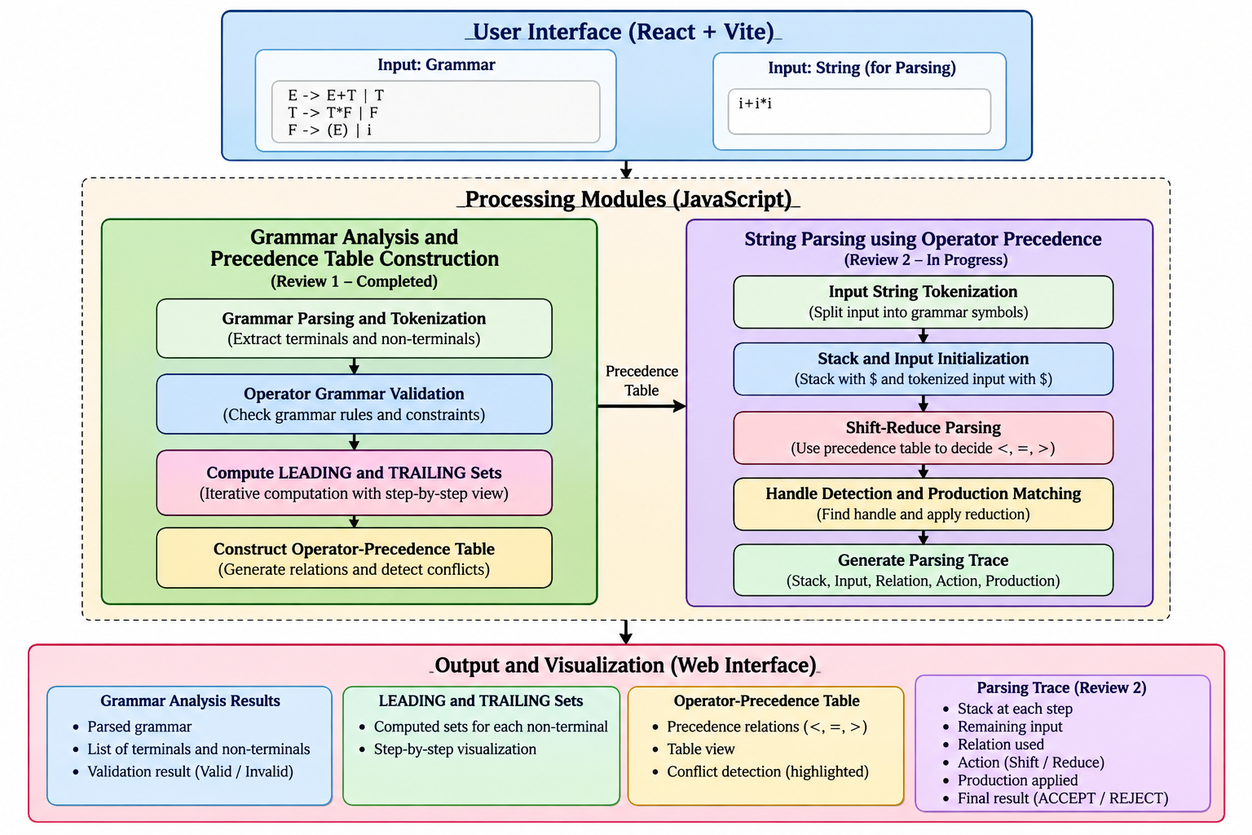
7. SYSTEM / MODEL ARCHITECTURE
System / Model Architecture
Architecture diagram and workflow
2
GRAMMAR ANALYSIS
Tokenizer • Validator • Symbol extraction
3
PRECEDENCE ENGINE
LEADING • TRAILING • Relation table • Conflict detection
4
PARSER ENGINE
Input tokenizer • Topmost terminal • Handle finder • Production matcher
5
RESULT LAYER
Trace table • Explanation • ACCEPT / REJECT
PROJECT 8 • BCSE307P • REVIEW 2
7

Slide 8
8. IMPLEMENTATION
Implementation
Tools and technologies used • Important implementation details
Tools & technologies
Implemented and verified
Review 2 extension
React
UI components
Grammar input + start symbol
Generic input tokenization
Vite
Build/dev server
Operator-grammar validation
SHIFT / REDUCE engine
LEADING computation
Handle boundary detection
JavaScript
Compiler algorithms
TRAILING computation
Production matching
CSS
Styling
Step-by-step set visualization
Parsing trace
Vitest
Unit testing
Precedence-table construction
Cycle protection
Conflict detection
PROJECT 8 • BCSE307P • REVIEW 2
8

Slide 9
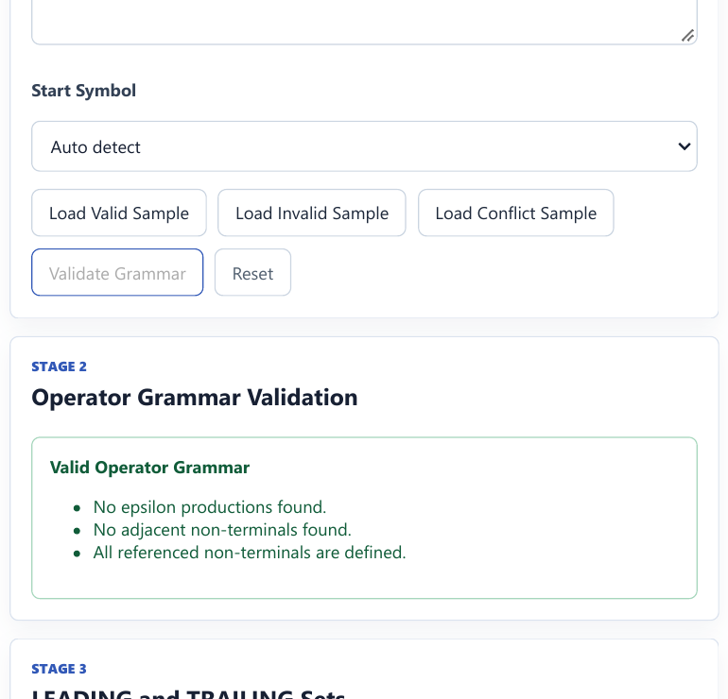
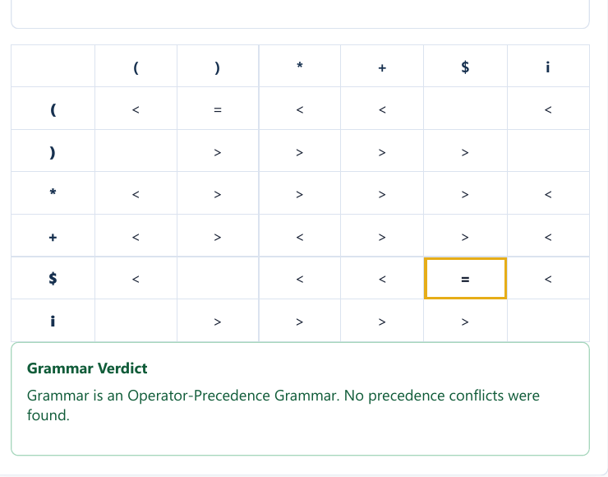
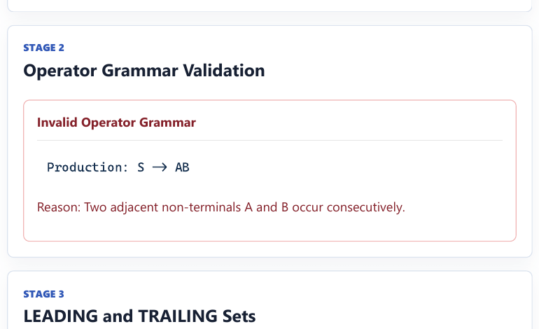
9. RESULTS AND DISCUSSION
Results and Discussion
Results obtained so far • Screenshots • Test evidence
Valid grammar
Precedence table
Invalid grammar
Validation passes; later stages become available.
Table generated with a conflict-free grammar verdict.
S → AB is rejected because adjacent non-terminals are not allowed.
PROJECT 8 • BCSE307P • REVIEW 2
9

Slide 10
10. PROJECT STATUS
Project Status
Work completed • Work currently in progress • Remaining work
WORK COMPLETED
CURRENTLY IN PROGRESS
REMAINING WORK
Grammar parser
Generic input tokenization
Complete Review-2 parser verification
Operator grammar validation
SHIFT / REDUCE parser
Insert actual parser screenshots
LEADING / TRAILING
Handle detection
RE syntax tree
Step-by-step set visualization
Production matching
nullable / firstpos / lastpos
Precedence-table construction
Parser trace UI
followpos
Conflict detection
Additional edge-case tests
Direct DFA construction
Multiple Review-1 test cases
Final integration
PROJECT 8 • BCSE307P • REVIEW 2
10

Slide 11
11. CONCLUSION
Conclusion
Review 2 extends the project from precedence-table generation toward a complete grammar-driven operator-precedence parser.
The design preserves the verified Review-1 modules and adds generic tokenization, SHIFT/REDUCE logic, handle detection, production matching, detailed trace generation, and safe rejection conditions.
Generic
Explainable
Safe
Not tied to E/T/F
Every decision is traceable
Invalid/conflicting grammars are blocked
Final Review 3 milestone: complete RE → DFA direct method and integrate both branches.
PROJECT 8 • BCSE307P • REVIEW 2
11

Slide 12
12. REFERENCES
References
[1] Aho, A. V., Lam, M. S., Sethi, R., & Ullman, J. D. (2006). Compilers: Principles, Techniques, and Tools (2nd ed.). Addison-Wesley.
[2] Cooper, K. D., & Torczon, L. (2011). Engineering a Compiler (2nd ed.). Morgan Kaufmann.
[3] Appel, A. W. (2002). Modern Compiler Implementation in Java (2nd ed.). Cambridge University Press.
All references are presented in APA-style book format, consistent with the report template.
PROJECT 8 • BCSE307P • REVIEW 2
12

