Slide 1

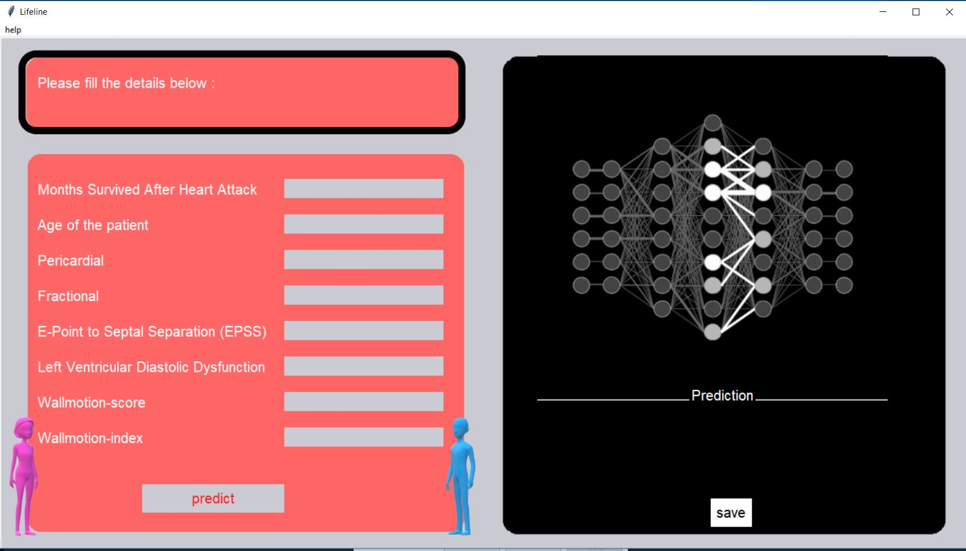
AMITY INTERNATIONAL SCHOOL, MAYUR VIHAR
LIFELINE
Based On K-nearest neighbor Supervised Machine Learning Algorithm

Slide 2
INTRODUCTION
All the patients who suffered heart attacks at some point in the past are still alive and some are not.
The problem addressed by past researchers was to predict from the other variables whether or not the patient will survive at least one year. The most difficult part of this problem is correctly predicting that the patient will NOT survive.
Therefore LifeLine takes several inputs like(Days that patient has already survived , age , pericardial effusion , fraction shortening , E-Point septal separation, Left ventricular end-diastolic dimension etc.) and classifies if patients requires special observation/care in the following one year of heart attack using k-nearest neighbors (KNN) algorithm which is a supervised machine learning algorithm.
.

Slide 3
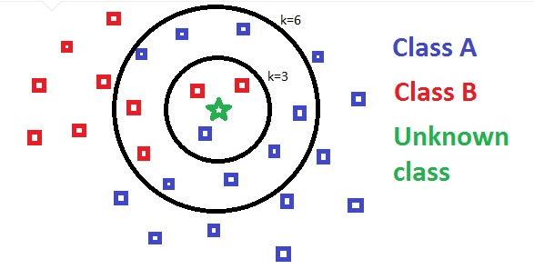
WORKING OF K-NEAREST NEIGHBOR ALGORITHM
A supervised machine learning algorithm one that relies on labeled training data in order to predict the label of unknown
Data provided to it.
The KNN algorithm assumes that similar things exist in close proximity. In other words, similar things are near to each other.

Slide 4
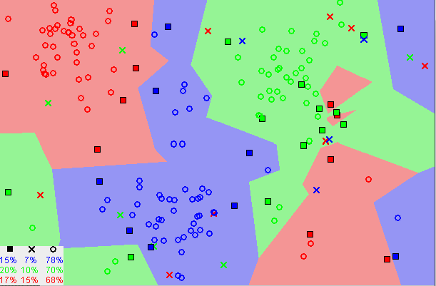
KNN assumes that most of the time, similar data points are close to each other. The KNN algorithm hinges on this assumption being true enough for the algorithm to be useful. KNN captures the idea of similarity (sometimes called distance, proximity, or closeness) with some mathematics we might have learned in our childhood— calculating the distance between points on a graph.

Slide 5
DATASET USED
1 | Survival | The number of months patient survived (has survived, if patient is still alive). Because all the patients had their heart attacks at different times, it is possible that some patients have survived less than one year but they are still alive. Check the second variable to confirm this. Such patients cannot be used for the prediction task mentioned above
2 | Age at heart attack | Age in years when heart attack occurred
3 | Pericardial-effusion | Binary. Pericardial effusion is fluid around the heart. 0=no fluid, 1=fluid
4 | Fractional-shortening | A measure of contractility around the heart lower numbers are increasingly abnormal
5 | EPSS | E-point septal separation, another measure of contractility. Larger numbers are increasingly abnormal.
6 | LVDD | Left ventricular end-diastolic dimension. This is a measure of the size of the heart at end-diastole. Large hearts tend to be sick hearts.
7 | Wall-motion-score | A measure of how the segments of the left ventricle are moving
8 | Wall-motion-index | Equals wall-motion-score divided by number of segments seen. Usually 12-13 segments are seen in an echocardiogram. Use this variable INSTEAD of the wall motion score.
9 | Alive-at-1 | Boolean-valued. Derived from the first two attributes. 0 means patient was either dead after 1 year or had been followed for less than 1 year. 1 means patient was alive at 1 year. This data has been used as target(label) in our program, which means that all the data from survival to wall-motion-index has been added in value set and all the points in this alive-at-1 has been used as label for data in value set

Slide 6

TESTING THE ALGORITHM
The next step was testing whether our software was able to produce reliable output with data which we have used to produce reliable predictions which could be used in real-life situations.
How we Tested the Algorithm :
We first split the training data in ratio of 75 : 25 where the 75% was training data with corresponding labels and remaining 25% was test data without labels.
The Algorithm used the training data to predict the test data’s appropriate labels.
The Algorithm was required to predict the labels(status)of the remaining 25% data and the labels of this data were stored separately in order to check the accuracy of the algorithm
Once the algorithm provided labels to all the data-points they were compared with actual labels for those data points in order predict how accurately the algorithm predicted the labels of test data.

Slide 7
ACCURACY
Our Software’s Algorithm performed positively and gave an outstanding Test Score of 92% over the Training Set
92%

Slide 8
THANK YOU!

