Slide 1

Hospital Patient Management System
OOTs Using JAVA
(BCSEH0352)
Department of Computer Science and Engineering
CSE IN CYBER SECURITY
(Submitted To: Mr. Aritra mitra)
Group Members
Name of Member | Roll Number | Role | Department & Section
Mani Shankar Jha | 0251dcys182 | Coding And Designing | Cyber Security - B
Pakhi Agrawal | 2401331720087 | Documentation & Designing | Cyber Security - B
Samridhi Shahi | 2401331720110 | Documentation & Designing | Cyber Security - B

Slide 2

Index
Introduction
Literature Survey/Existing System
Problem Statement
Proposed Methodology
Flowchart
Architecture & Modules
Hardware /Software Requirement
Results and Conclusion
References
Live Demonstration of Project with screenshots in ppt

Slide 3
Introduction
Hospitals routinely manage large volumes of patient and doctor information.
Manual data handling systems are slow, error-prone, and unreliable.
Digital management solutions are required for efficiency and accuracy.
Effective data management improves patient care and administrative workflow.
Java Swing provides a flexible GUI for such management needs.
Hospital Patient Management System replaces paper-based processes..
Enables timely decisions and better resource management.

Slide 4
Literature Survey / Existing Systems
Paper-based workflows hamper quick data retrieval and sharing.
Computers with Excel/Word allow basic storage but lack integration.
ERPs (SAP, Oracle) cater to large hospitals but require extensive setup.
Open-source systems (OpenMRS, GNU Health) are complex for small clinics.
Security and backup issues are common in manual and simple digital systems.
Multiple staff users cause record management challenges.
Prior solutions did not address ease-of-use for non-technical staff.

Slide 5
Problem Statement
Hospitals face difficulties managing appointments and resources manually.
Errors and scheduling clashes frequently occur in paper-based systems.
Staff experience challenges updating, searching, and sharing data reliably.
Existing solutions tend to be either too simplistic or excessively complex.
Small and medium hospitals require tailored solutions, not heavy ERPs.
Records need to be secure, quickly accessible, and editable.
Integration of patient, doctor, and appointment modules needed.

Slide 6
Objectives & Scope
Provide error-free patient record management.
Ensure accurate doctor data storage and utilization.
Allow easy appointment scheduling and management.
Automate core administrative workflows.
Minimize staff training time through an intuitive user interface.
Support customizable modules for various hospital needs.
Deployable for clinics, small and medium hospitals.

Slide 7
Proposed Methodology
Java Swing GUI forms and tables for user interaction.
Data held in ArrayList/HashMap for efficient record management.
Local persistence with Java Serialization for reliability.
CRUD operations covering patient, doctor, appointment modules.
Real-time search, update, and deletion functionalities.
PDF export using iText library for reporting and sharing records.
User-friendly workflow for adding/editing/removing records.

Slide 8
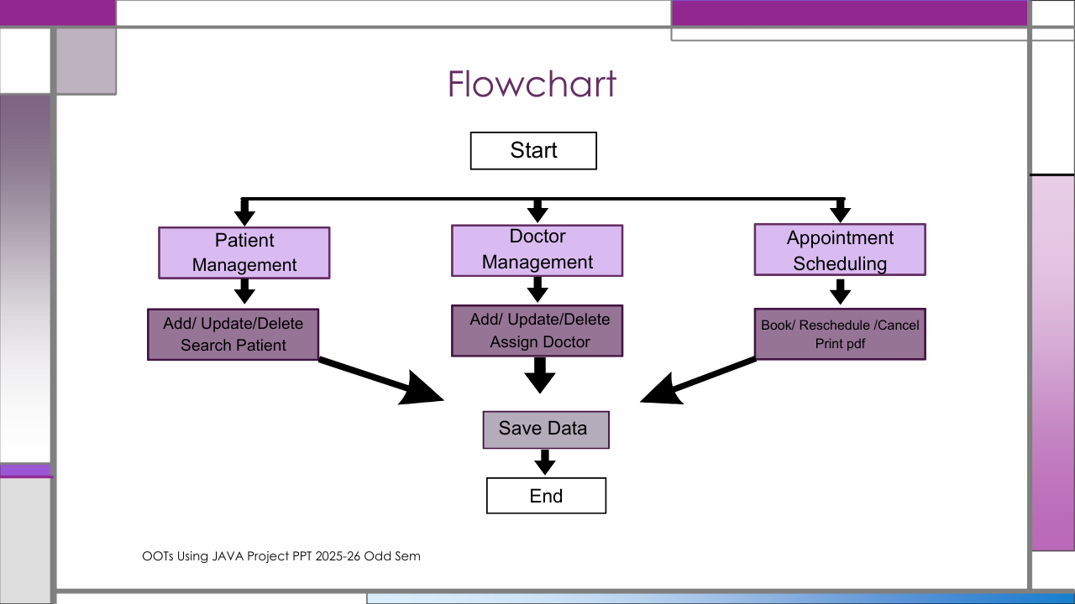

Slide 9
Architecture & Modules
Patient Module manages registration, data update, and search.
Doctor Module creates and edits doctor profiles/schedules.
Appointment Module links patients with doctors, manages bookings.
Unique IDs ensure correct record association and retrieval.
Data flows ensure accuracy and modular accessibility.
Error checking blocks double bookings and redundant entries.
Architecture supports future module integration (lab, billing).

Slide 10
Feasibility Study
Technically feasible: pure Java implementation, low resource needs.
Operational feasibility: easy for both technical and non-technical staff.
Economically sustainable: zero cost for licensing/software.
Hardware needs are modest; runs on standard PCs/laptops.
Maintains integrity with secure local file storage.
Future database integration supported by modular design.
Reduces operational costs compared to manual systems.

Slide 11
Hardware /Software Requirement
Hardware: standard computer or laptop.
Software: JDK, Maven, Swing, iText PDF.
No dependency on external server/database initially.
User functions include add/update/delete/search for records.
Appointment management integrated with patient and doctor modules.
GUI supports multiple users with simple navigation.
Data files stored locally for privacy and reliability.

Slide 12
Results
Faster access to patient and doctor records.
Automated error checking for reliable scheduling.
Easy appointment booking and management.
Printed reports available through PDF export.
Increased efficiency for hospital administrative tasks.
Staff adaptation is quick due to intuitive UI.
Easily expandable to include more functionalities.

Slide 13
Conclusion & Future Scope
Streamlines administrative operations and recordkeeping.
Makes hospital management paperless and efficient.
Reliable data management improves patient service delivery.
Future plans include JDBC/database/cloud expansion.
Will add pharmacy, billing, inventory modules.
Option for web-based access and remote management.
Potential for analytics dashboards for hospital management decisions.

Slide 14
References
Oracle Java Swing documentation
Joshua Bloch, Effective Java
iText PDF official guides
Healthcare management research papers
Tutorials on Java Collections and Serialization
Published articles on digital hospital systems
Online resources for software design best practices
Git Repository :- Hospital Patient Management System

Slide 15
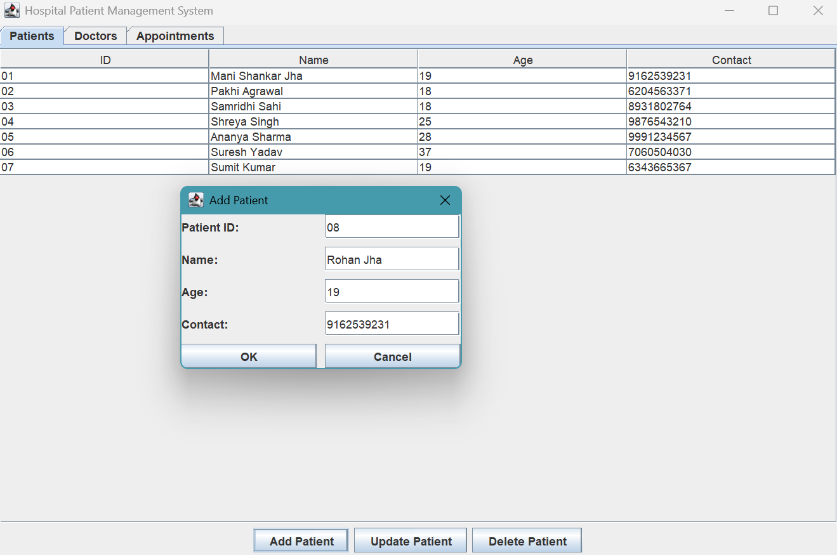
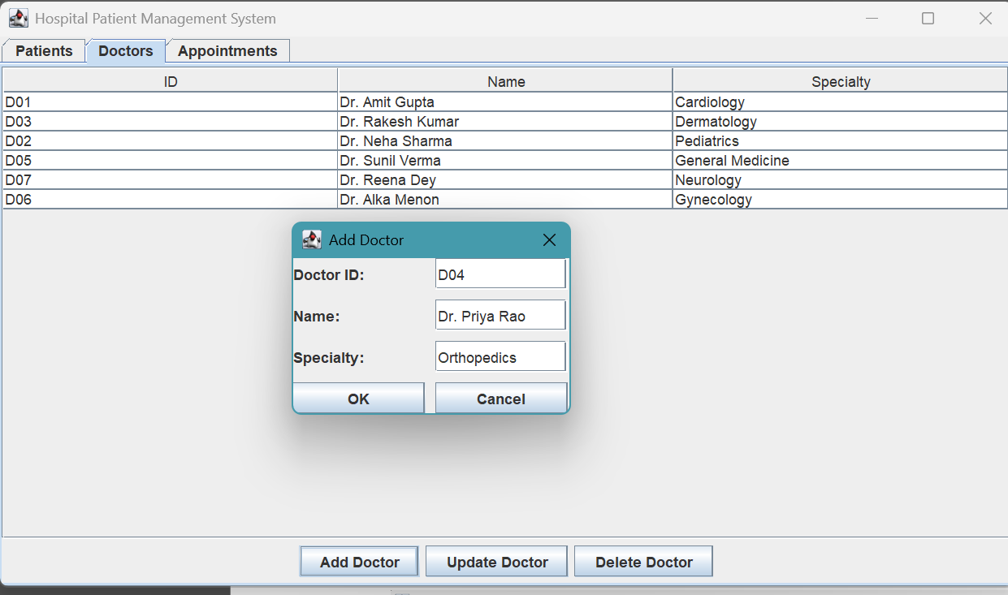
Live Demonstration of Project with screenshots in ppt
Main Dashboard Patient Dashboard and registration form:
Doctor management Dashboard and registration form:

Slide 16
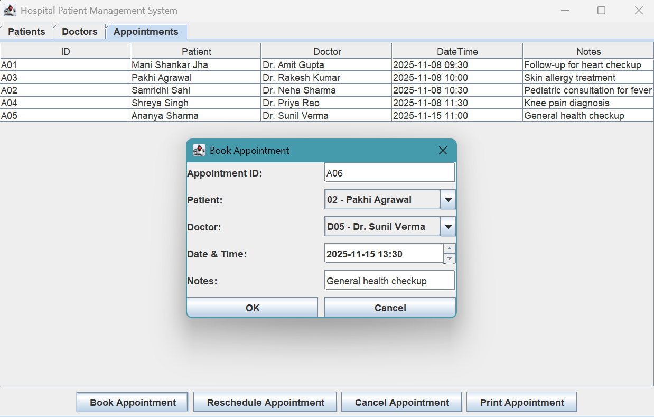
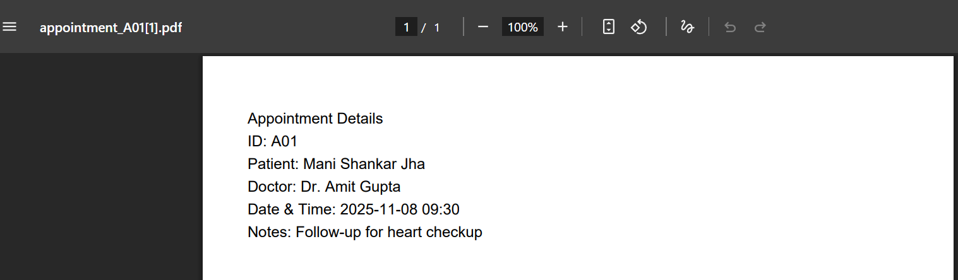
Live Demonstration of Project with screenshots in ppt
Appointment schedulers Dashboard and registration form:
THIS IS THE PRINT OF APPOINTMENT:

Slide 17
Thank You

Slide 18
Ask Any Question

