Slide 1
Customer Review Analysis
– Samridhi Agrawal

Slide 2
Problem Statement
Big retail companies such as Walmart, Amazon, Costco need to engage their customers over all channels of interaction like emails, voice, chat and reviews.
But they do not have the man-power to manually respond to each and every interaction.

Slide 3

Solution
A review response system that helps companies engage their end customers in near real-time increasing the overall customer satisfaction.

Slide 4
Components of the solution
ML model based on topic modelling and sentiment analysis to process the reviews.
Features to construct a response such as purchase details, customer sentiment, customer intent.
Annotated datasets to train the model.

Slide 5
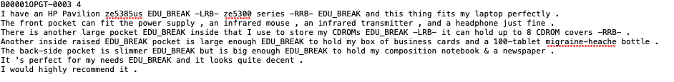
Dataset example
OpoSum – Dataset for training and evaluation of Opinion Summarization models which contains Amazon products reviews.
Downsampling from the Amazon Product Dataset

Slide 6
Related works
[1] S. Angelidis and M. Lapata, “Summarizing Opinions: Aspect Extraction Meets Sentiment Prediction and They Are Both Weakly Supervised.” 2018.
[2] E. Diaz-Aviles, M. Georgescu, A. Stewart, and W. Nejdl, “LDA for On-the-Fly Auto Tagging,” in Proceedings of the Fourth ACM Conference on Recommender Systems, 2010, pp. 309–312. doi: 10.1145/1864708.1864774.
[3] Z. Xue, “Scalable Text Analysis,” in Proceedings of the Tenth ACM International Conference on Web Search and Data Mining, 2017, p. 835. doi: 10.1145/3018661.3022750.
[4] Y. Yiran and S. Srivastava, “Aspect-Based Sentiment Analysis on Mobile Phone Reviews with LDA,” in Proceedings of the 2019 4th International Conference on Machine Learning Technologies, 2019, pp. 101–105. doi: 10.1145/3340997.3341012.

Slide 7
Project goals
Learn NLP techniques like data cleaning, tokenizing, wordcloud
Successfully predict sentiments on customer reviews
Analysis of customer review through topic modelling
Create a response for each customer review

Slide 8
Efforts towards the project
Learned how to use Tensor Flow libraries
Ran multiple experimentation on Google Collab
Interacted with customer experience executives
Optimized the pipeline for BERT by selecting pre-trained models
Revised the number of topics created by revisiting the data inputs
Customized the approach to pre-processing each data type

Slide 9
Architecture

Slide 10
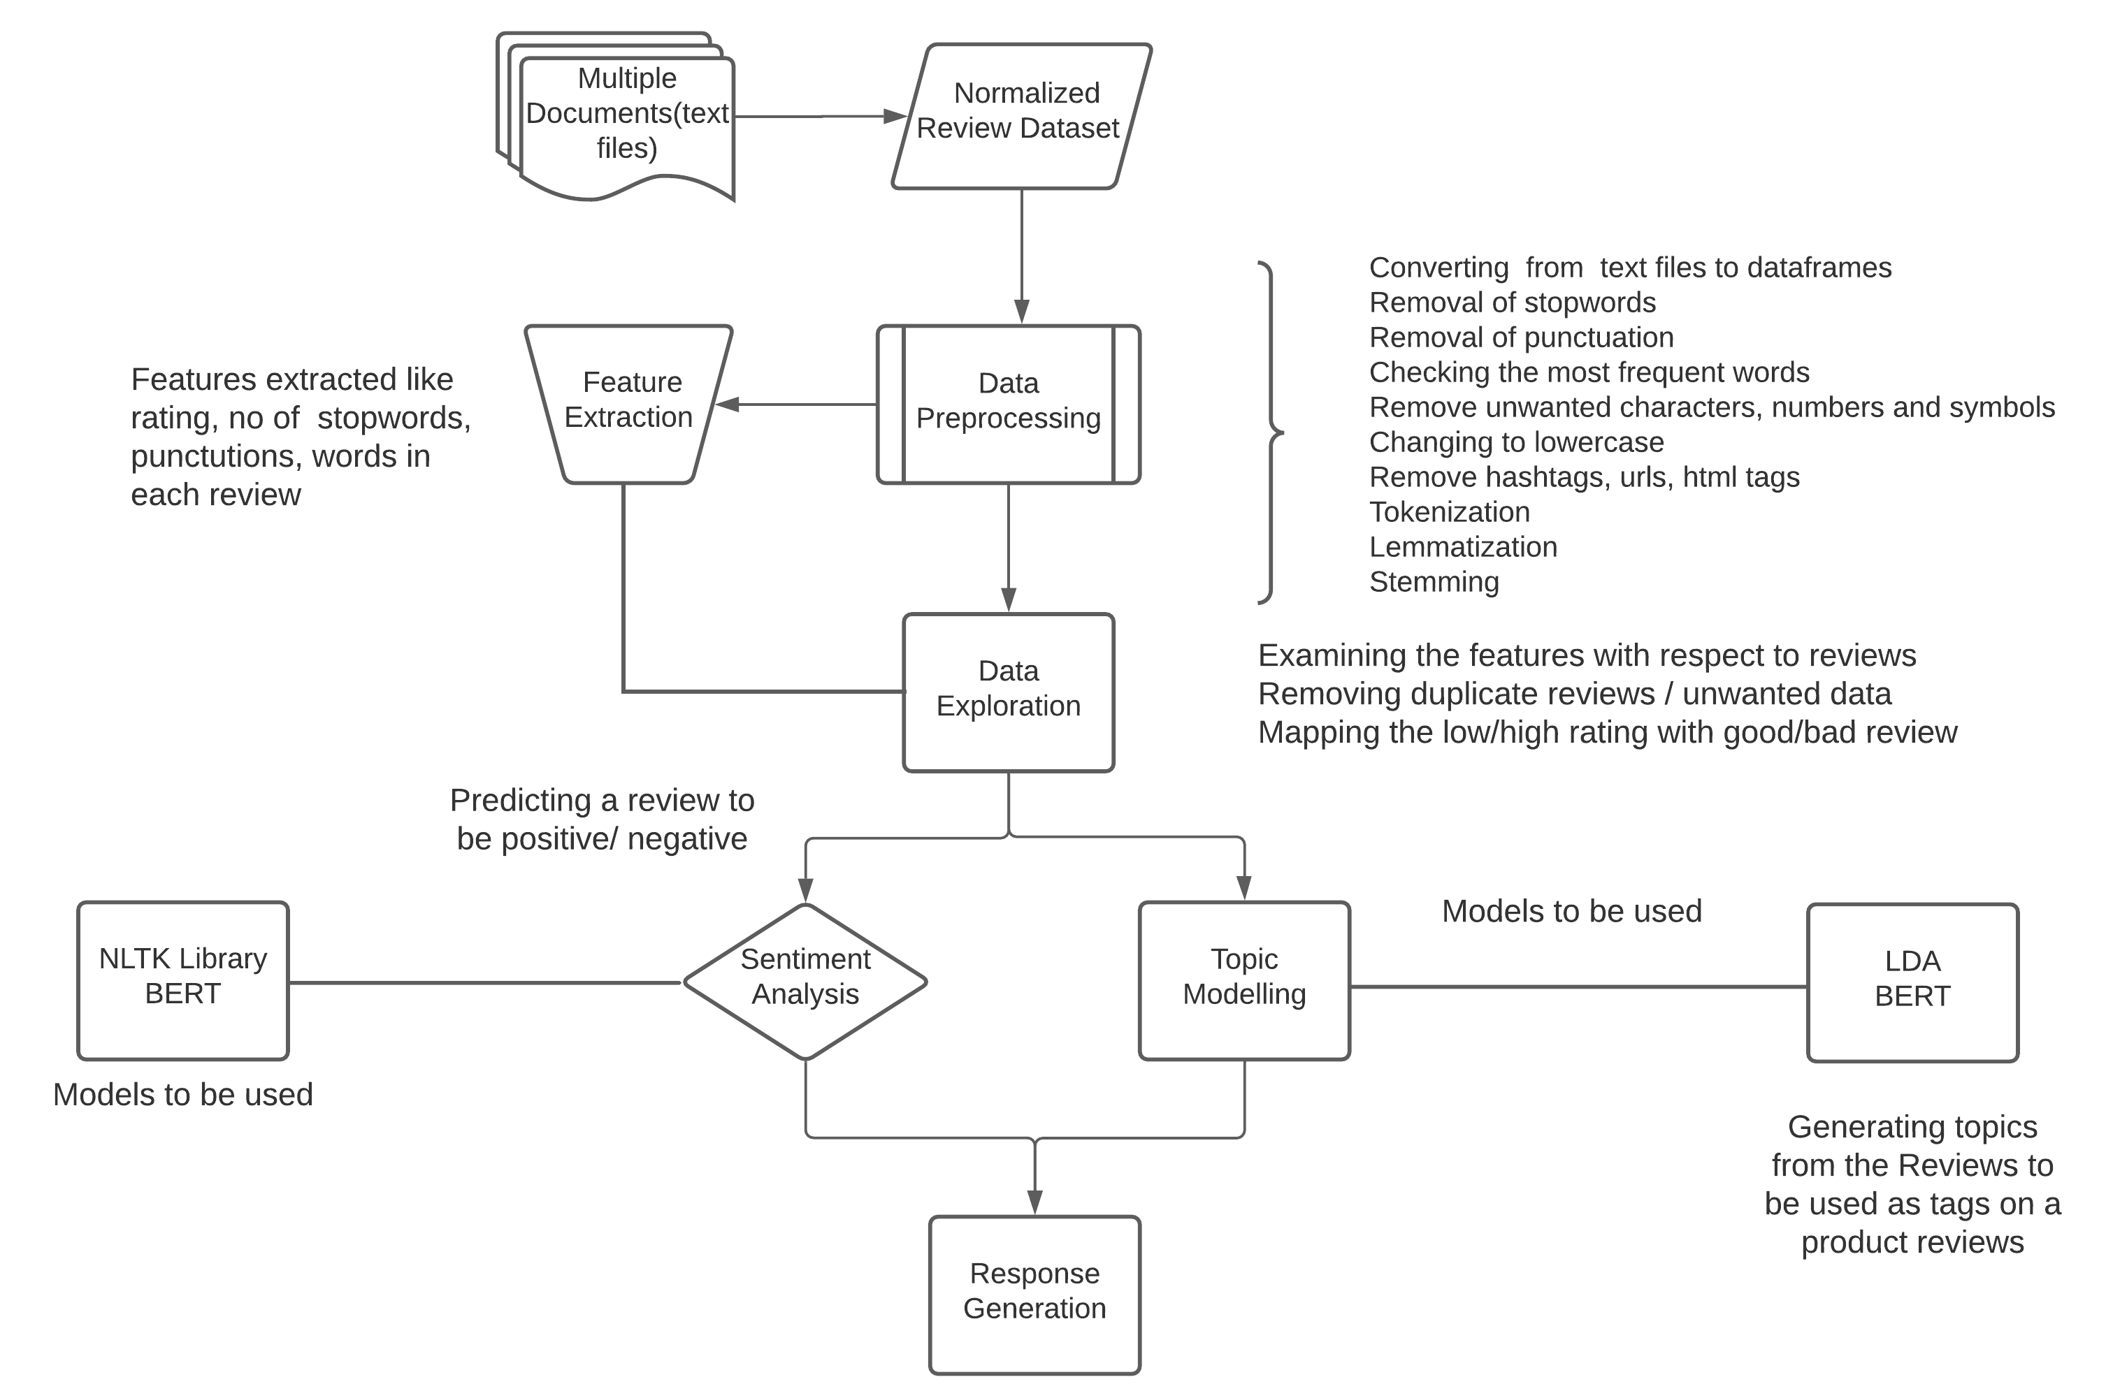

Slide 11
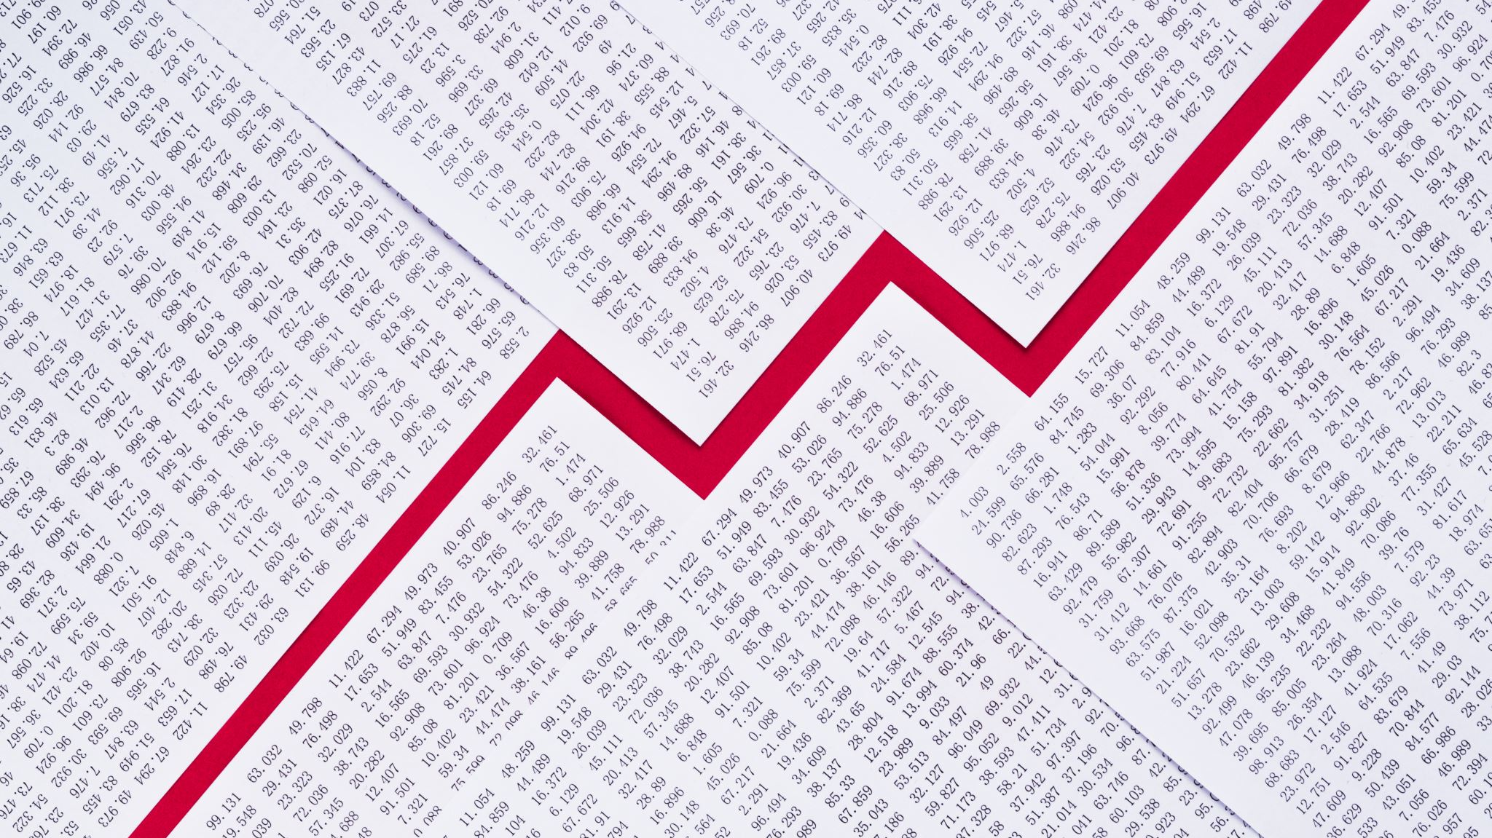
RESULTS

Slide 12
Results – Sentiment Analysis prediction with different models
Model | Accuracy | Precision | Recall | F1-score
LR | 83% | 0.85 | 0.91 | 0.83
GaussianNB | 74% | 0.86 | 0.73 | 0.74
MultinomialNB | 78% | 0.78 | 0.95 | 0.78
BernoulliNB | 78% | 0.85 | 0.83 | 0.78

Slide 13
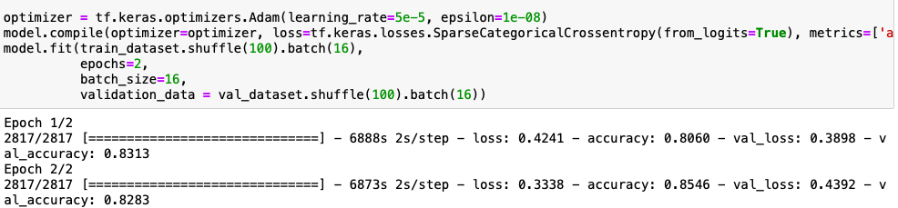
BERT model for Sentiment Analysis

Slide 14
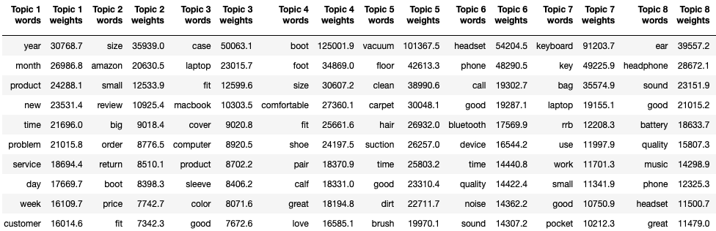
Topic Modelling with LDA

Slide 15
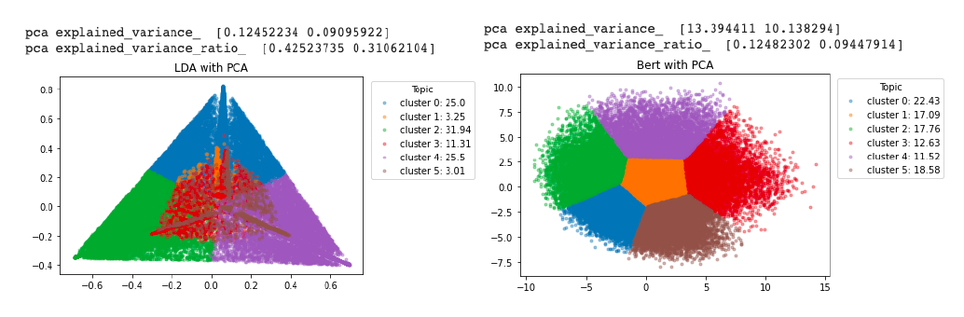
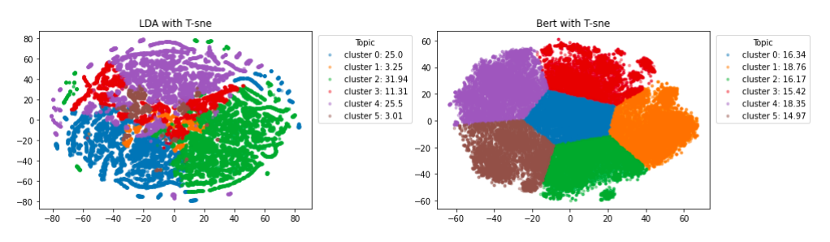
Topic Modelling with LDA and BERT

Slide 16

Response Created for Customer review

Slide 17
Future work
[Application Building] Automatic response generation using NLP by analyzing the topics of the review and creating intelligent response to engage the customer
[Feature Engineering] Testing the project on another dataset from Amazon, Walmart and other e-commerce platforms to inform new features for the model
[Automated Pipeline Annotation] Taking a random samples from datasets to create FM scores and measure precision values for model feedback

Slide 18
Challenges
The model took more than 4-5 hours to complete execution
Plotting the BERT graphs requires GPU resources which was mitigated using Google Collab
Ensemble methods did not complete execution in Google Collab or my local even with repeated attempts

Slide 19
DEMO

Slide 20
Thank you!

