Slide 1

Employee management System
Samridhi Agrawal

Slide 2


Abstract
An Employee Management System is designed to simplify the process of record maintenance of employees in an organisation. It helps in managing the information of employees for HR functions. In general, EMS is a part of a comprehensive Human Resource Management System. Most modern companies use computers to collect this information, making their system more accurate and problem-free. A database is often used to collect the information required.

Slide 3
Application Functionalities
Login into account using email and password
Create Employee
Search Employee
Delete Employee
Update Employee
EMS Menu

Slide 4
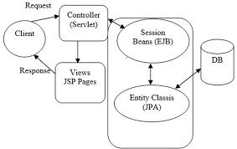
Architectural design
Servlet: LoginServlet CreateServlet SearchServlet
Bean: UserBean EmployeeBean
Human Resource Team
MySQL DB
Tables:
Login EmployeeDetails
Login.jsp CreateEmployee.jsp SerachEmployee.jsp UpdateEmployee.jsp …
Entity: User, Employee

Slide 5

SPRINT REview
EPICs | Tasks | Description/Status
Architecture Design | 2 | Completed
Database Setup | 2 | Completed
Authentication | 2 | Completed
Create Employee | 3 | Completed
Search Employee | 3 | Completed
Update Employee | 3 | Completed
Delete Employee | 3 | Completed
Platform Testing | 3 | Completed
User Acceptance Testing | 3 | Completed

Slide 6
Demo

Slide 7


Thank You

