Slide 1
Classification and measures of strengths and Positive outcomes
Rucha Sarwate

Slide 2
Background
Karl Menninger (1893-1990) attempted to change the view of diagnostic systems from the state of sickness to a process that results from unmet needs.
Emphasised the Sublime expressions of human instinct: hope, faith love
Human strengths:
Capacity for feeling, thinking and behaving in a way that allows optimal functioning in the pursuit of valued outcomes (Linley and Harrington, 2006)
The earliest attempt to define a set of virtues: by Confucius (500 B.C.)
At present, three classification systems for strengths or positive outcomes are present:
The Gallup themes of Talent
The Values in Action (VIA) classification of strength
The Search Institute’s 40 developmental assets
Notes:
https://psycnet.apa.org/record/2006-05322-016

Slide 3
Gallup’s Clifton Strengths finder
Studied Success across business and education domains
Operationalization of talent
Naturally recurring patterns of thoughts, feelings and behaviours that can be productively applied and manifested in life experiences by yearnings, rapid learning, satisfaction and timelessness
Product of normal, healthy development and successful childhood and adolescent experiences
Strengths: extensions of talent. Combination of talent (more like a trait) with associated knowledge and skills
It is the ability to provide consistent, near-perfect performance in a specific task
Clifton created empirically based semi-structured interviews for identifying talents
Craeted more objective measure of talents in mid-1990s

Slide 4
Success:
personal talents
Strengths
Analytical intelligence

Slide 5
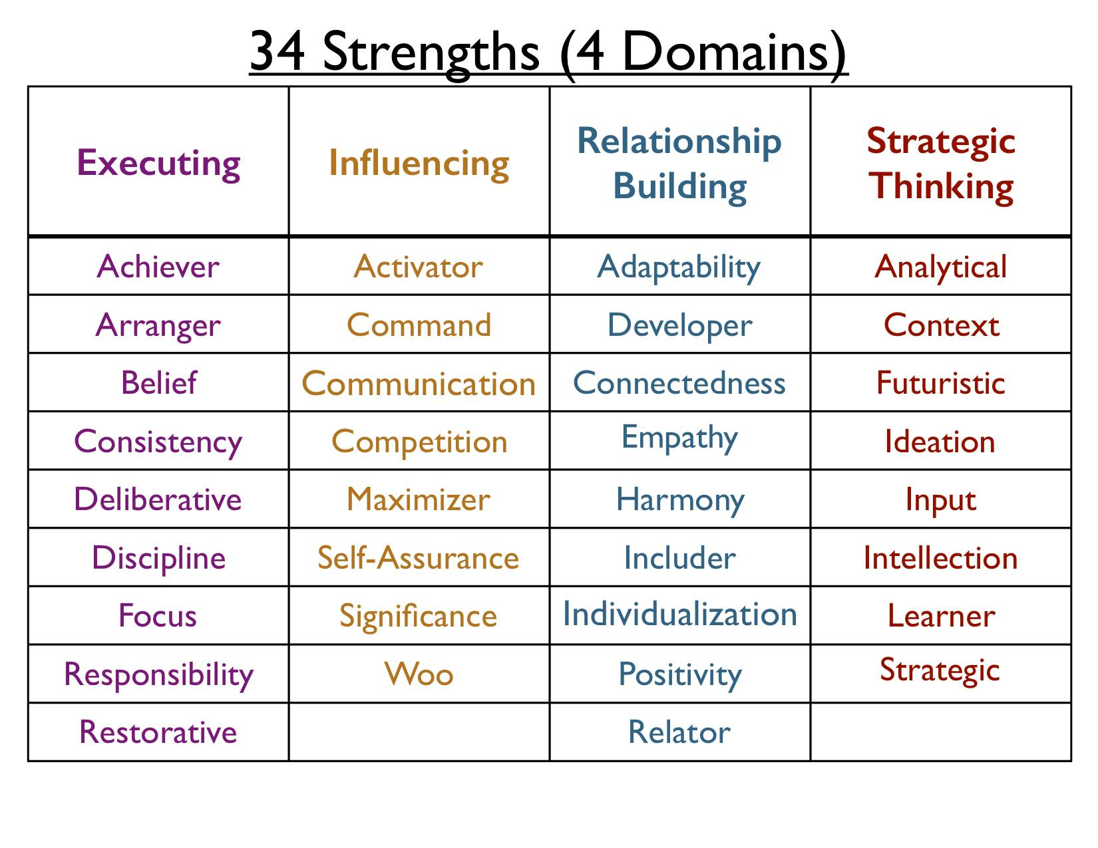
The 34 Clifton StrengthsFinder themes
Executing:
How do you make things happen?" These strengths may help you turn ideas into reality.
Influencing:
How do you influence others?" They may help you take charge, speak up and make sure others are heard.
Relationship building:
How do you build and nurture strong relationships?" They may help you hold a team together.
Strategic thinking domain:
How do you absorb, think about and analyze information and situations?" They may help you make better decisions and create better outcomes.

Slide 6
Character strength
Positive traits reflected in thoughts, feelings and behaviours
Exist in degrees
Can be measured as individual differences
Biologically grounded
Selected through the process of evaluation

Slide 7
Values in action (VIA)
Serves as antithesis of the DSM
Encourages more strength-based approach to diagnosis
Answered two basic questions:
How can one define the concepts of strength and highest potential
How we can tell if positive youth development has succeeded in meeting the goals
Identified 6 virtues and 24 strengths of character
Virtues are core characteristics valued by moral philosophers, religious thinkers, everyday folks, etc.
Disposition to act, feel and desire
Leads to recognisable human excellence /instance of human flourishing
Character strengths: Family of positive traits: related synonyms, have subtle connotations
More intentional than automatic,
Involves choosing virtues for itself
http://thrivetraining.pro.viasurvey.org/

Slide 8
Criteria for a character strength
1. Ubiquity (commonness) —is widely recognized across cultures.
2. Fulfilling—contributes to individual fulfillment, satisfaction, and happiness broadly construed.
3. Morally valued—is valued in its own right and not for tangible outcomes it may produce.
4. Does not diminish others—elevates others who witness it, producing admiration, not jealousy.
5. Nonfelicitous opposite—has obvious antonyms that are “negative.”
6. Trait like—is an individual difference with demonstrable generality and stability.
7. Measurable—has been successfully measured by researchers as an individual difference.
8. Distinctiveness—is not redundant (conceptually or empirically) with other character strengths.
9. Paragons—is strikingly embodied in some individuals.
10. Prodigies—is precociously shown by some children or youth.
11. Selective absence—is missing altogether in some individuals.
12. Institutions—is the deliberate target of societal practices and rituals that try to cultivate it.

Slide 9
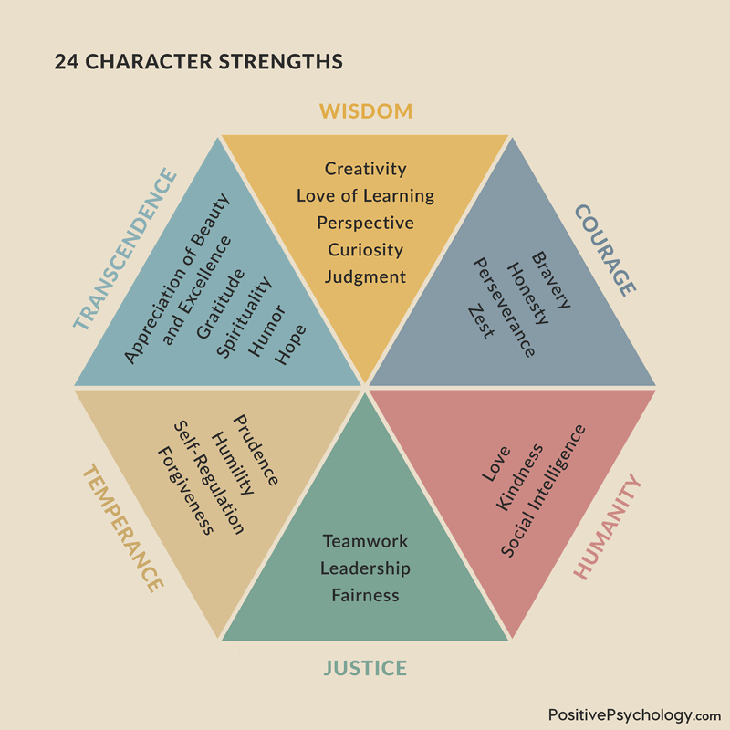

Slide 10
VIA- IS (inventory of strengths)
Set of statements reflecting each strength
An individual is asked to report the degree to which statements apply to themselves

Slide 11
The SEARCH Institute’s 40 developmental assets
Developed during the 1980s
Tried to answer the question: What protects children from today’s problems?
Considers internal and external variables that contribute to a child’s thriving
Commonsense, positive experiences and qualities
Reflects primary contributors to the thriving of young people
40 positive supports and strengths that young people need to succeed.
Half of the assets are external, focusing on the relationships and opportunities they need in their families, schools, and communities.
The other half are internal, focusing on the social-emotional strengths, values, and commitments that are nurtured within young people.
Categorizes assets according to external and internal assets
external: positive experiences that children and youth gain through interactions with people and institutions
Internal: personal characteristics and behaviours that stimulate the positive development of young people

Slide 12
When young people have more Developmental Assets they are more likely to thrive now and in the future, less likely to engage in a wide range of high-risk behaviours, and more likely to be resilient in the face of challenges.

Slide 13
Satisfaction with life scale
Indicate your agreement for each statement on the scale of 1-7
____ In most ways my life is close to my ideal.
____ The conditions of my life are excellent.
____ I am satisfied with my life.
____ So far I have gotten the important things I want in life.
____ If I could live my life over, I would change almost nothing.
Notes:
• 7 - Strongly agree
• 6 - Agree
• 5 - Slightly agree
• 4 - Neither agree nor disagree
• 3 - Slightly disagree
• 2 - Disagree
• 1 - Strongly disagree

Slide 14
Scoring
31 - 35 Extremely satisfied
26 - 30 Satisfied
21 - 25 Slightly satisfied
20 Neutral
15 - 19 Slightly dissatisfied
10 - 14 Dissatisfied
5 - 9 Extremely dissatisfied

Slide 15
Dimensions of well- being
Well- being
Happiness (spontaneous reflection of pleasant- unpleasant feelings in immediate experience)
Realizing one’s potential
Perusing the interests
Nurturing others
Leading authentic lives
Life satisfaction (sense of contentment and peace with small gap between wants and needs)
Notes:
Spontaneous reflections of pleasant and unpleasant feelings

Slide 16
Both subjective (emotional well-being) and objective (psychological and social well-being) descriptions together reflect a better way to describe mental health
Emotional well-being: Studies have shown that emotional well-being consists of perceptions of avowed happiness and satisfaction with life, along with the balance of positive and negative affect
Objective well-being
Psychological (Ryff): Well-being is a multidimensional model with six independent dimensions
Social: (Keyes): coherence, integration, actualization, contribution, acceptance
Individuals with high levels of all three aspects are described as flourishing
Languishing (no mental Illness, but low levels of well- being)
Role of intervention

Slide 17
Elements of well- being
Psychological well being
Self- acceptance
Purpose in life
Social well- being
Social acceptance
Emotional well- being
Positive affect
(Absence) of negative affect
Personal growth
Environmental mastery
Autonomy
Positive relations with others
Social actualization
Social contribution
Social integration
Life satisfaction
Happiness

Slide 18
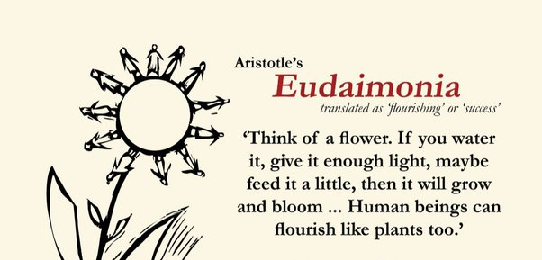
Reflections:
Eudemonia is the condition of humans flourishing or living well; happiness is not an eventual consequence of virtuous actions but is inherent in such actions.
Life satisfaction is the property of the life lived well by certain strengths of character
Targeting character strengths

