Slide 1
CREDORA
Zomato Business Intelligence & Delivery Time Prediction Platform

Slide 2
Project Overview
Credora is a data analytics and machine learning project based on Zomato business data.
The project focuses on:
Analyzing customer and order data.
Understanding revenue and restaurant performance.
Studying delivery time patterns.
Analyzing customer churn.
Using PostgreSQL for database analysis.
Building a Power BI dashboard.
Applying machine learning models for prediction.
Main Goal: To convert raw business data into meaningful insights that support better decision-making.

Slide 3
Problem statement
Large amounts of raw business data.
Difficulty identifying business trends.
Need to understand delivery performance.
Need to analyze customer purchasing behaviour.
Requirement for data-driven decision-making.

Slide 4
Dataset description
- Total Datasets: 12
- Total Raw Records: 159,077
- Total Columns: Multiple
- Business Domain: Food Delivery
Datasets Include:
Customers, Orders, Restaurants, Cities, Menu, Delivery Partners, Traffic, Weather, Order Items, Customer Feedback, Payments and Promotions.

Slide 5
Technologies used
Python
Google Colab
Pandas and NumPy
Matplotlib and Seaborn
Scikit-learn
Neon PostgreSQL
SQL
Microsoft Power BI

Slide 6
Data preprocessing
Dataset inspection
Missing-value analysis
Duplicate identification and removal
Data type inspection
Data cleaning
Feature preparation

Slide 7
SQL Analysis
Customer analysis
Revenue analysis
Payment method analysis
Order status analysis
Top-selling food items
Delivery partner analysis
Customer feedback analysis

Slide 8
Exploratory Data Analysis
Monthly revenue trends
Order distribution
Delivery time patterns
Customer behaviour
Payment trends
Restaurant performance
Approximately 30 visualizations

Slide 9
Machine learning
Delivery Time Prediction – Regression
Linear Regression
Decision Tree
Random Forest
Gradient Boosting
Customer Churn Analysis – Classification
Logistic Regression
Decision Tree
Random Forest

Slide 10
Model Evaluation
- Regression Results Classification Results
.
Model | MAE | RMSE | R² Score
Linear Regression | 12.05 | 23.67 | -0.0001
Decision Tree | 12.59 | 24.24 | -0.0485
Random Forest | 12.39 | 23.91 | -0.0202
Gradient Boosting | 12.22 | 23.99 | -0.0266
Model | Accuracy | F1 Score
Logistic Regression | 53.11% | 0.6699
Decision Tree | 37.05% | 0.4777
Random Forest | 74.74% | 0.8528

Slide 11
Key findings
- Total Customers: 12,000
- Total Orders: 20,500
- Total Revenue: ₹79,07,304
- Average Order Value: ₹391.94
- Total Restaurants: 1,200
- Total Food Items: 8,997
Additional Insights:
- Highest monthly revenue: January 2024.
- Peak ordering hour: 7 PM.
- Delivered orders: 11,407.

Slide 12
Project outcomes
Power BI Dashboard
The interactive dashboard presents business performance through:
- KPI Cards
- Delivery Time Analysis
- Monthly Revenue Analysis
- Order Status Analysis
- Payment Method Analysis
- Top Restaurants Analysis
Purpose: To make business insights easier to understand through visual reporting.

Slide 13
Conclusion
Credora demonstrates how Python, SQL, Machine Learning and Power BI can be combined to analyze food delivery business data.
The project provides business insights into customer behaviour, revenue, orders and delivery performance.
Although the predictive models have limitations, the project provides a practical foundation for further improvement

Slide 14
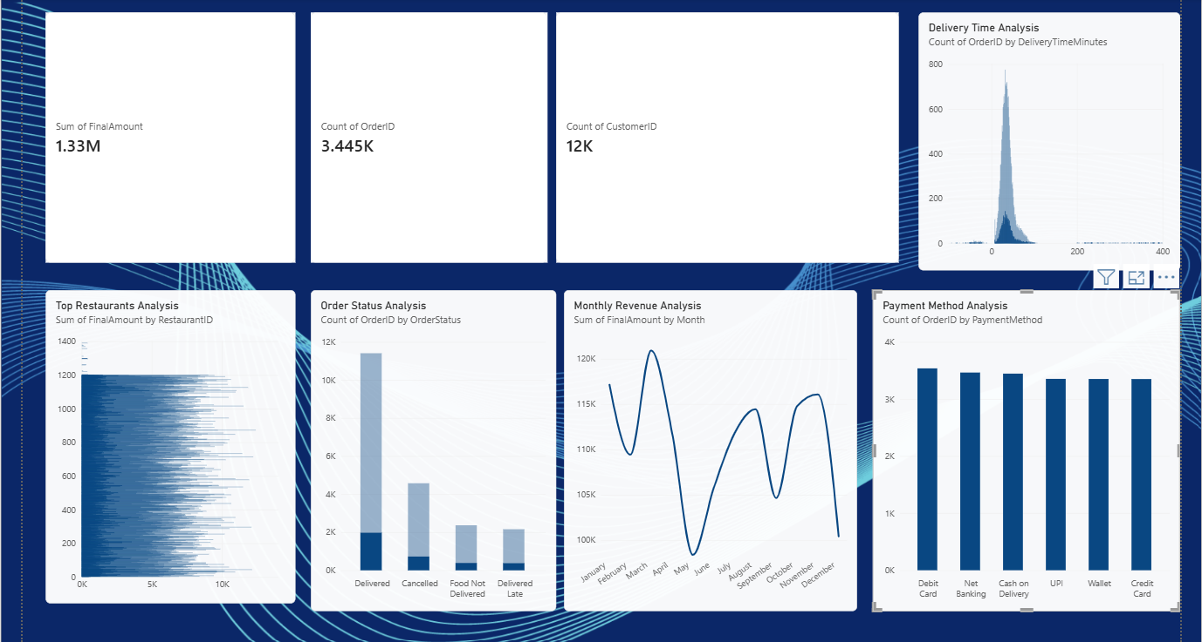

Slide 15
THANK YOU
Credora – Zomato Business Intelligence & Delivery Time Prediction Platform
Presented by: SAMRIDHI SINGH

