Slide 1
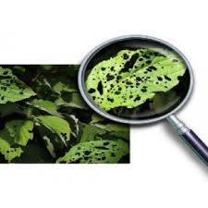
Detection of pests in Agriculture by using Image Processing and IoT.
Presented by: Samreen Begum
Roll no:19311D5807
Guided by: Dr. H. Balaji

Slide 2
Content
Abstract
Introduction
Existing System
Disadvantage
Proposed System
Advantages
Software & Hardware Requirements
Working
Conclusion

Slide 3
Abstract
Internet of Things and Image processing have been so far been applied for various applications independently. Their individual application in the field of agriculture exists and has achieved certain degree of success, however the combination of both these technology so far is non-existent. This paper describes an approach to combine loT and image processing in order to determine the environmental factor or man-made factor (pesticides/fertilizers) which is specifically hindering the growth of the plant. Using a loT sensing network which takes the readings of the crucial environmental factors and the image of the leaf lattice, it is processed under MATLAB software by the help of histogram analysis to arrive at conclusive results.

Slide 4
Introduction
The Internet of Things is the network of physical objects-devices, vehicles, buildings and other items embedded with electronics, software, sensors, and network connectivity-that enables these objects to collect and exchange data. Digital image processing makes use of various computer algorithms to perform image processing on digital images. It is widely used for classification, pattern recognition ,feature extraction ,multi-scale signal analysis and projection .

Slide 5
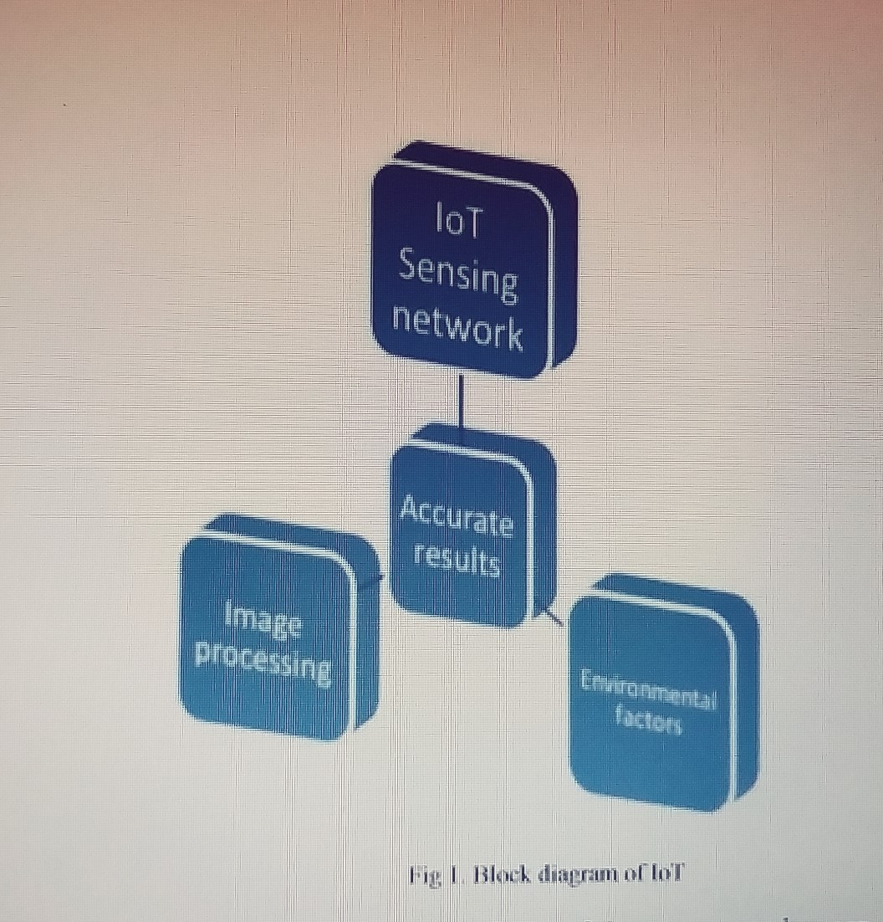
loT and Image processing can be used in the agricultural domain to have higher quality produce and thus reduce crop failure. We aim at reducing crop failure by letting the farmers know what environmental conditions such as temperature, humidity, light, soil moisture is most suitable for the crop and what are the effects of the fertilizer used. This is done by constantly monitoring the crops using a loT based circuit that includes Arduino, sensors for the different environmental factors and a camera that will capture images of the crops at regular intervals.

Slide 6
Existing System
The basic idea is to combine the concepts of Internet of things along with the techniques of image processing to arrive at accurate results. It is known that temperature, humidity, soil moisture and light intensity lead to subtle to drastic changes in the health of the plant.
Here it uses the DHT11(Temperature and Humidity) algorithm , Algorithm for Soil Moisture sensor and Algorithm for Image Capturing using serial JPEG camera module and storing it on the SD Card.

Slide 7
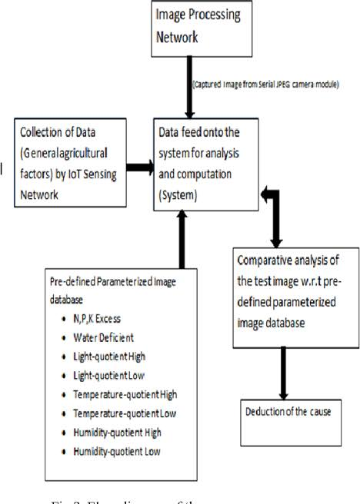
fig1: Flow diagram of the process

Slide 8
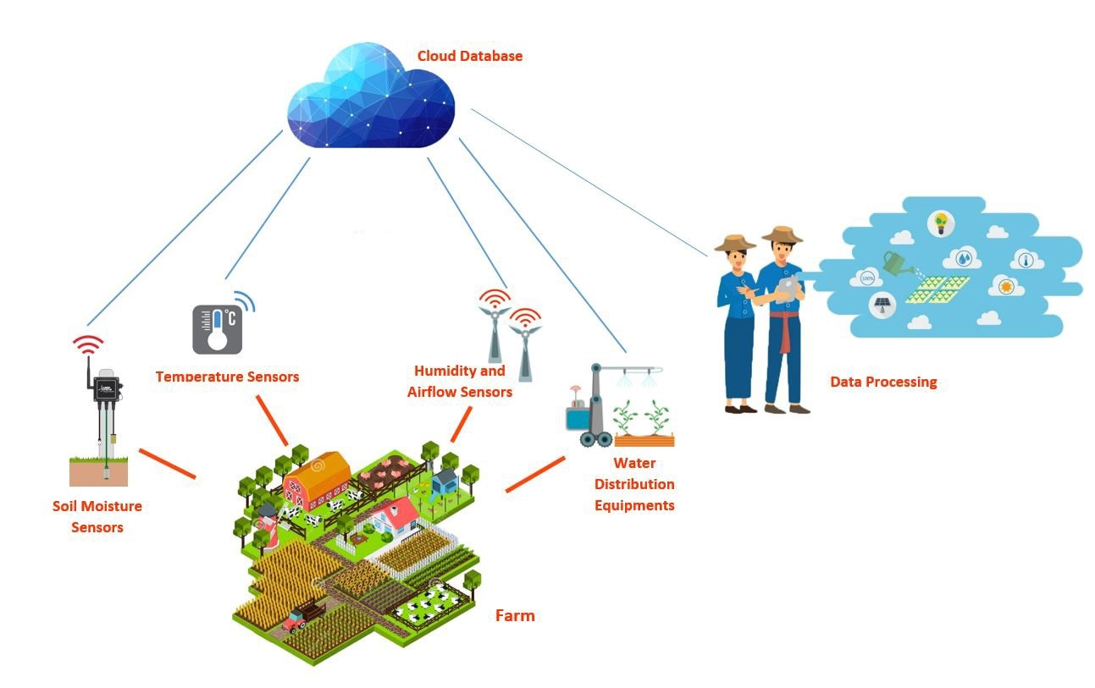
Fig 2: Overview of Working

Slide 9
Disadvantages
The farmer won't be helped 24/7 if they don't yield
It will lead to long-term loss of yield and productivity of early detection of plant disease.
An agricultural drone will provide information that may be useful for increasing crop yield and agricultural production.

Slide 10
Proposed System
The disease detection in plants plays an important role in agriculture field, as having disease in plants are quite natural.
If proper care is not taken in this area then it causes serious effects on plants and due to which respective product quality, quantity or productivity is affected.
Usually, the diseases or its symptoms such as colored spots or streaks can be seen on the leaves or on the stem of the plants.

Slide 11
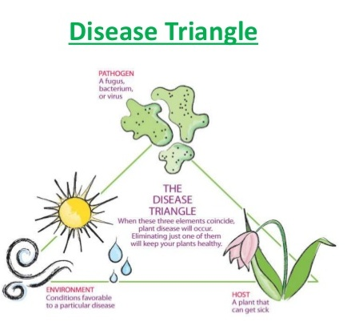

Slide 12
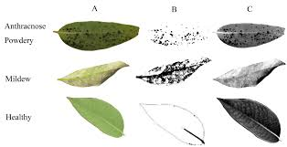
In plants, most of the leaf diseases are caused by fungi, bacteria, and viruses. The disease caused due to these organisms is characterized by different visual symptoms that could be observed in the leaves or stem of a plant. By using Thresholding algorithm and K-Means clustering algorithm ,we can detect the plant disease by considering the values based on healthy plant and dead plant and this can be achieved for multivariate purpose.

Slide 13
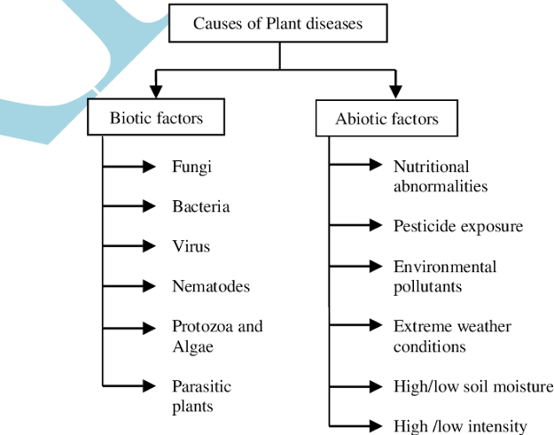
Fig 3: Classification of diseases in plants

Slide 14
Drones are used not only in crop and field research, but also in speed planting and plant nutrients shooting in the soil. drones can identify which parts of the land are dry and thereby assessing an irrigation plan becomes easier.

Slide 15
Advantages
Drone will monitor the environmental factor and data collected.
If they aren't on yield, it will help farmers 24/7.
Using the GSM / CDMA protocol, data collection and contact with farmers.
Plant disease can be detected at an early stage so that it does not result in huge yield and productivity losses.

Slide 16
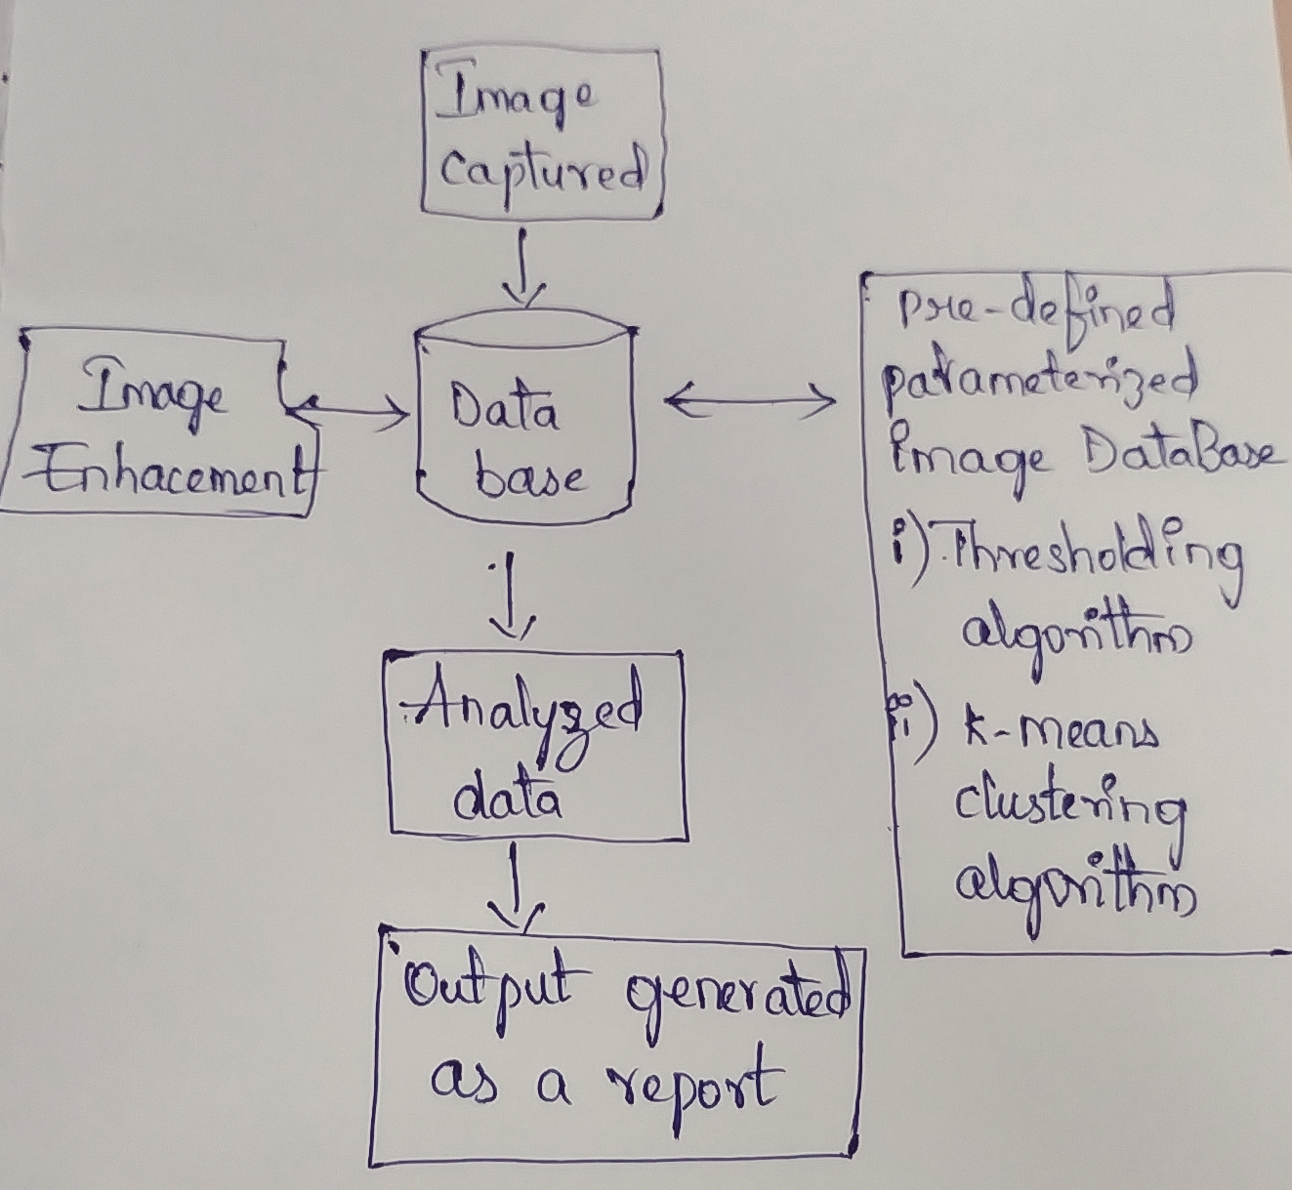
Working
Fig 4: Working on Disease plant detection

Slide 17
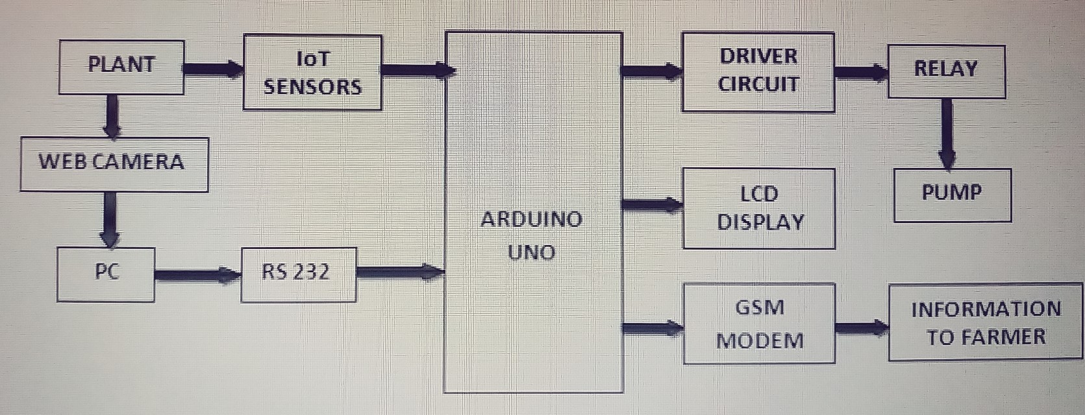
Fig 5: Working of Drone

Slide 18
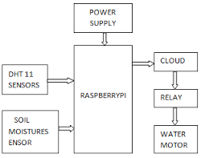
Fig 6: Working of Drone for sensors.

Slide 19
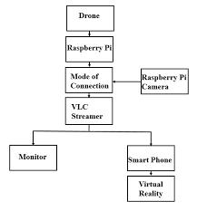
Fig 7: Working of Drone for capturing an Image.

Slide 20
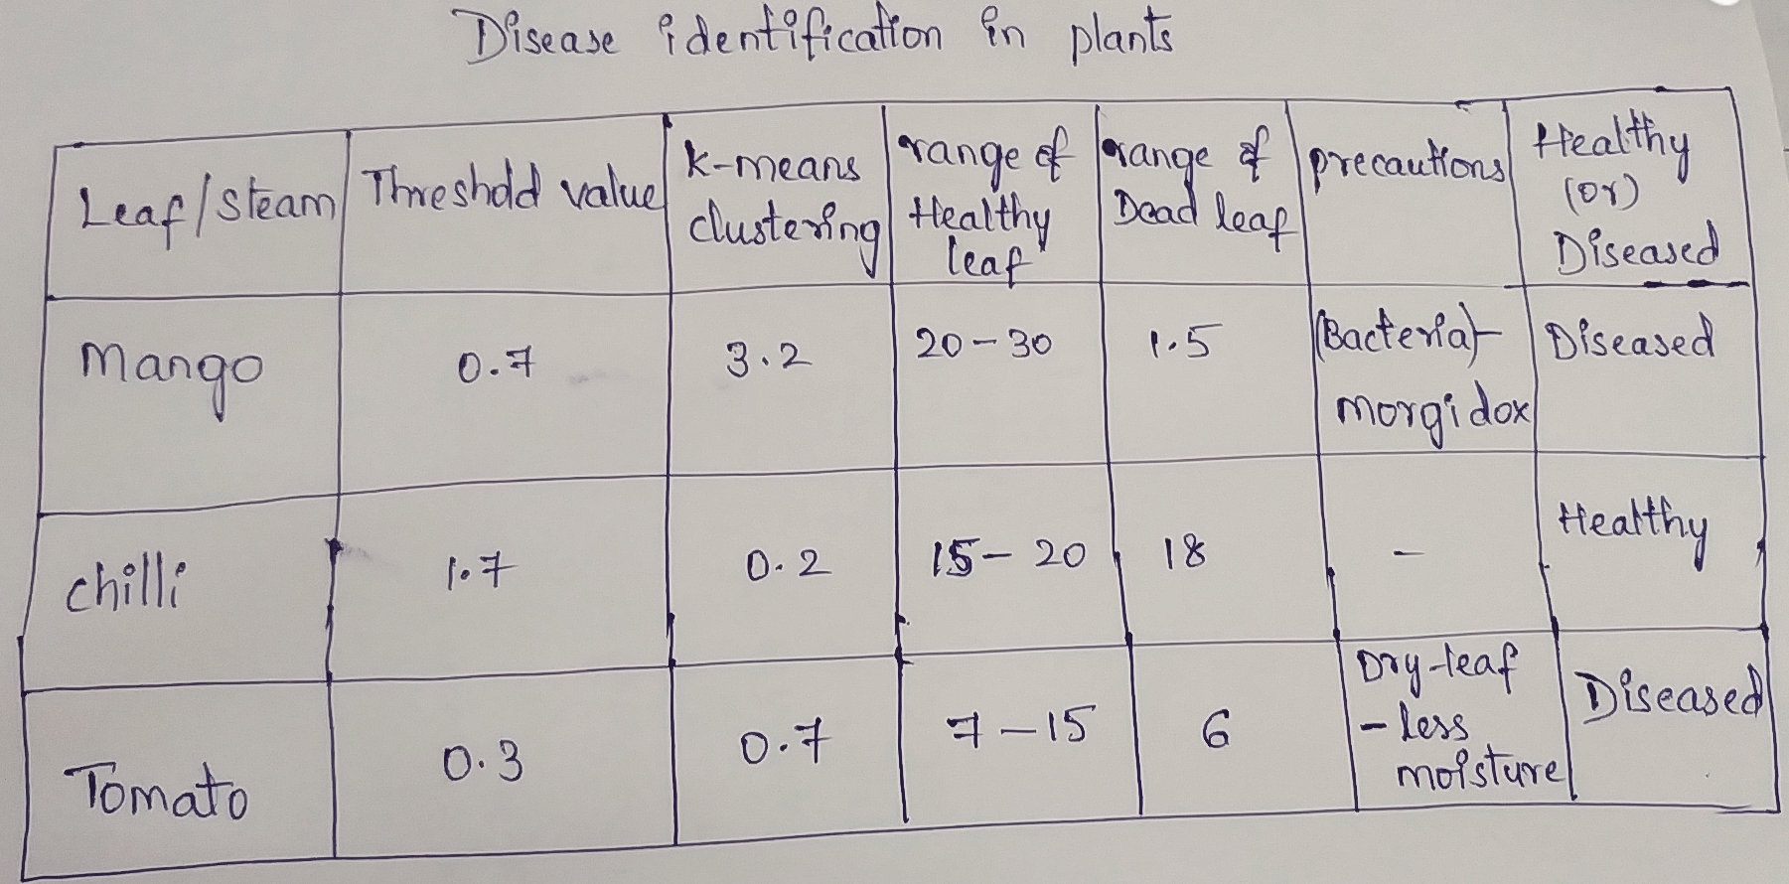
Fig 6:Output generated

Slide 21
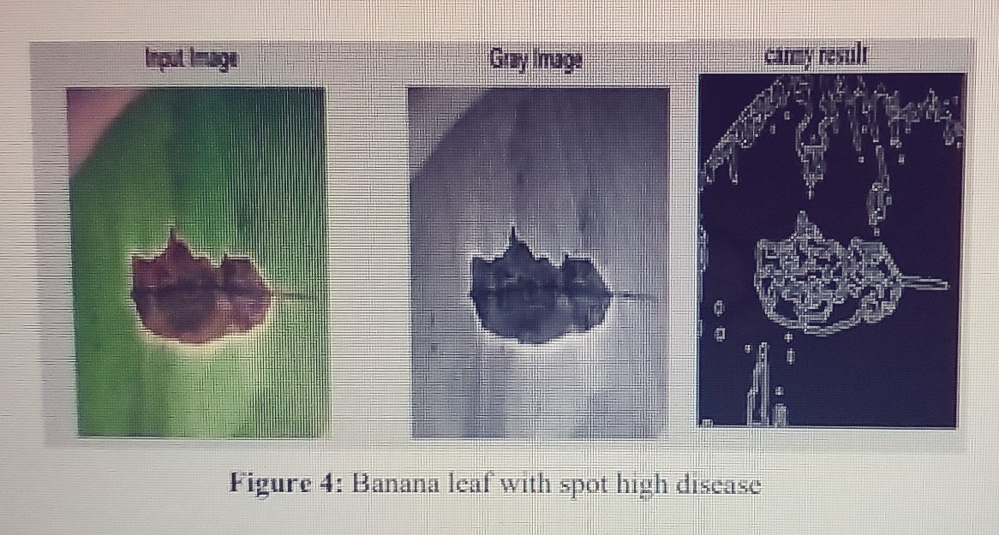

Slide 22
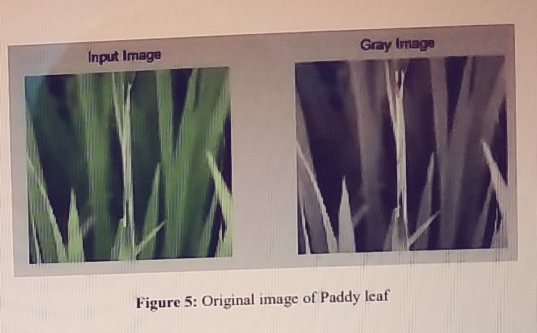

Slide 23
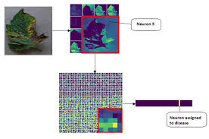
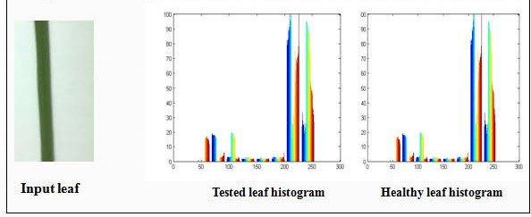

Slide 24
Software Requirements
Programming language : Python , MATLAB or Android
Backend technologies : MySQL, SQLite
IDE : NetBeans

Slide 25
Hardware Requirements
Operating System : Windows , Linux
System : Pentium IV 2.4 GHz.
Hard Disk :500 GB.
Floppy Drive : 1.44 Mb.
Monitor : 15 VGA Colour.
Mouse : Logitech.
Ram : 512 Mb.
Sensors : Temperature ,Soil Moisture ,Humidity
Drone
High resolution Camera
Raspberry Pi6
Connectors

Slide 26
Conclusion
In the future, other image processing techniques may be used to enable the detection and extraction more efficient and accurate.
How Internet of Things and Image Processing can be combined and implanted in the field of agriculture to get satisfactory results.
This gives rise to the possibility of constant monitoring of the fields and the environmental factors. The loT sensing network so established can easily be mounted on a rover to monitor and collect data of the field on a regular basis.
This will immensely help the farmers as they cannot be on their field 24/7. The information collected can be communicated to the farmers. The rovers can have the specific amount of pesticides, fertilizers on board.
Plant disease can be detected by using some more Algorithms.

Slide 27
References
Ying yang, Bo Peng, Jianbing Wang, “A System for Detection and Recognition of Pests in Stored-Grain Based on Video Analysis”, IFIP Advances in Information and Communication Technology,2011, Vol. 344, pp 119-124.
2. Murali Krishnan, jabber G, “Pest Control in Agricultural Plantation Using Image Processing”, IOSR Journal of Electronics and Communication Engineering (IOSR-JECE) e-ISSN: 2278-2834,Volume 6, Issue 4(May. - Jun. 2013), p- ISSN: 2278-8735, pp 68-74.
3. Ganesh Badiane , Sapna Sharma and Vijay B. Neckar, “Early Pest Identification in Agricultural Crops using Image Processing Techniques", International Journal of Electrical, Electronics and Computer Engineering 2(2): 7 -82(2013),ISN No. (Online): 27-2626.

Slide 28


