Slide 1
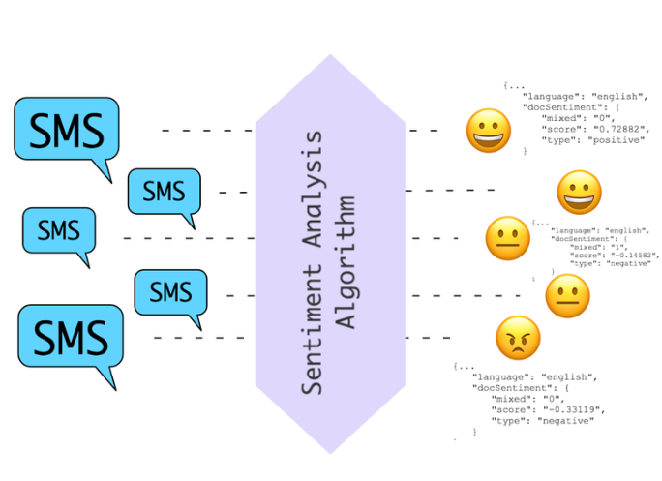
Sentimental Analysis
Samriti Malhotra

Slide 2
What is Sentimental Analysis
Sentiment Analysis also known as Opinion Mining is a field within Natural Language Processing (NLP) that builds systems that try to identify and extract opinions within text. Usually, besides identifying the opinion, these systems extract attributes of the expression e.g.:
Polarity: if the speaker express a positive or negative opinion,
Subject: the thing that is being talked about,
Opinion holder: the person, or entity that expresses the opinion.

Slide 3
Types of Sentimental Analysis
Fine-grained Sentiment Analysis
When analysis has to be precise about the level of polarity of the opinion , so instead of just talking about positive, neutral, or negative opinions you could consider the following categories:
Very positive , Positive , Neutral ,Negative , Very negative
This is usually referred to as fine-grained sentiment analysis. This could be, for example, mapped onto a 5-star rating in a review, e.g.: Very Positive = 5 stars and Very Negative = 1 star.
Emotion detection
Emotion detection aims at detecting emotions like, happiness, frustration, anger, sadness, and the like. Many emotion detection systems resort to lexicons (i.e. lists of words and the emotions they convey) or complex machine learning algorithms.
Aspect-based Sentiment Analysis
allows to associate specific sentiments with different aspects of a product or service. Sentiments: positive or negative opinions about a particular aspect. Aspects: the thing or topic that is being talked about.

Slide 4
How Does Sentiment Analysis Work?
Sentiment Analysis Algorithms
There are many methods and algorithms to implement sentiment analysis systems, which can be classified as:
Rule-based systems that perform sentiment analysis based on a set of manually crafted rules.
Automatic systems that rely on machine learning techniques to learn from data.
Hybrid systems that combine both rule based and automatic approaches.

Slide 5
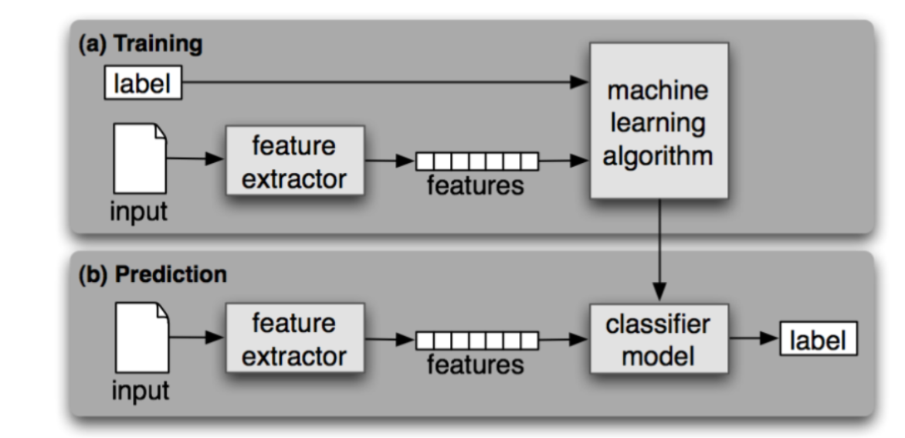
Machine learning classifier can implemented with the following steps and components:
In the training process (a), our model learns to associate a particular input
(i.e. a text) to the corresponding output (tag) based on the test samples used for training.
In the prediction process (b), the feature extractor is used to transform unseen text inputs into feature vectors.

Slide 6
Bag-of-words or bag-of-ngrams
Feature Extraction from Text
The first step in a machine learning text classifier is to transform the text into a numerical representation, usually a vector. Usually, each component of the vector represents the frequency of a word or expression in a predefined dictionary (e.g. a lexicon of polarized words). This process is known as feature extraction or text vectorization and the classical approach has been bag-of-words or bag-of-ngrams with their frequency.
A bag-of-words is a representation of text that describes the occurrence of words within a document. It involves two things:
A vocabulary of known words.
A measure of the presence of known words.
It is called a “bag” of words, because any information about the order or structure of words in the document is discarded. The model is only concerned with whether known words occur in the document, not where in the document.

Slide 7
Classification Algorithms
The classification step usually involves a statistical model like Naïve Bayes, Logistic Regression, Support Vector Machines, or Neural Networks:
Naïve Bayes: a family of probabilistic algorithms that uses Bayes’s Theorem to predict the category of a text.
Linear Regression: a very well-known algorithm in statistics used to predict some value (Y) given a set of features (X).
Support Vector Machines: a non-probabilistic model which uses a representation of text examples as points in a multidimensional space. These examples are mapped so that the examples of the different categories (sentiments) belong to distinct regions of that space.. Then, new texts are mapped onto that same space and predicted to belong to a category based on which region they fall into.
Deep Learning: a diverse set of algorithms that attempts to imitate how the human brain works by employing artificial neural networks to process data.

Slide 8
Use of sentimental Analysis
Use of sentiment analysis in the following:
Social media monitoring
Brand monitoring
Voice of customer (VoC)
Customer service
Workforce analytics and voice of employee
Product analytics
Market research and analysis

