Slide 1
Project Scope and Introduction
This project is a personal effort of its author, Sam Kenney, to learn and practice the R coding language. All materials referenced in the creation of this R project file were open-source at the time of access. They include, but are limited to the websites: Stack Overflow, Geeks for Geeks, Statistics Globe, and YouTube.
This project intends to address the question of whether changes in certain common indicators of economic development may predict information regarding certain other economic indicators over time.
World Bank time-series data were downloaded for every country in the world from 1980 to 2022 covering several common indicators of economic development, including: Gross National Income per Capita (PPP-adjusted); Manufacturing, value added (% of GDP); and GDP growth (%); among others.
After visualizing the data, the Granger Causality test were applied at different orders (i.e. "lag" periods, e.g. 1 year, 2 years) to each possible pairing of WB indicators for each country.
The ADF and KPSS tests were applied to each country-indicator series to ensure that Granger stationarity requirements are met.
Data series that fail the stationarity tests are transformed using the difference method and retested for stationarity.
Data series that pass both rounds of stationarity testing are analyzed using the Granger Causality test from the lmtest library.
The number of successful (p<0.05) Granger Causality tests among all countries will form the basis of determining which economic development indicators (if any) are broadly beneficial in predicting information about other economic development indicators.

Slide 2
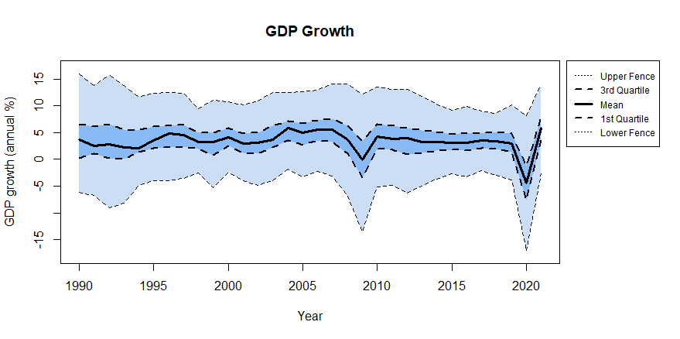
Visualization: GDP Growth

Slide 3
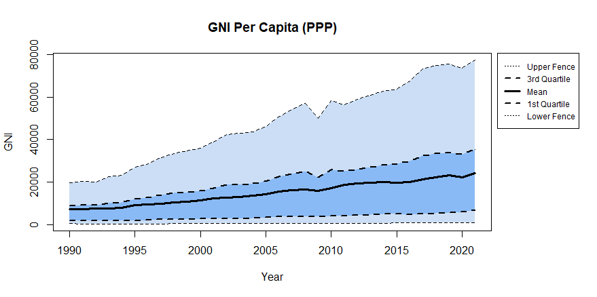
Visualization: GNI per Capita (PPP)

Slide 4
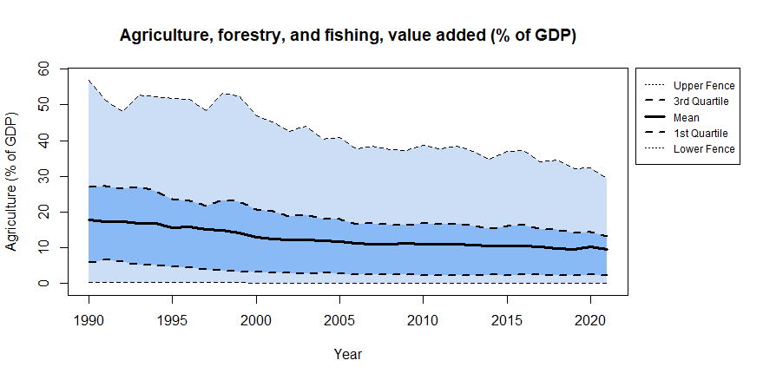
Visualization: Agriculture, Forestry, and Fishing, value added (% of GDP)

Slide 5
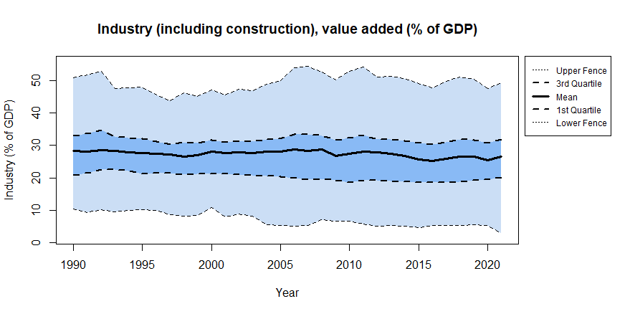
Visualization: Industry (including construction), value added (% of GDP)

Slide 6
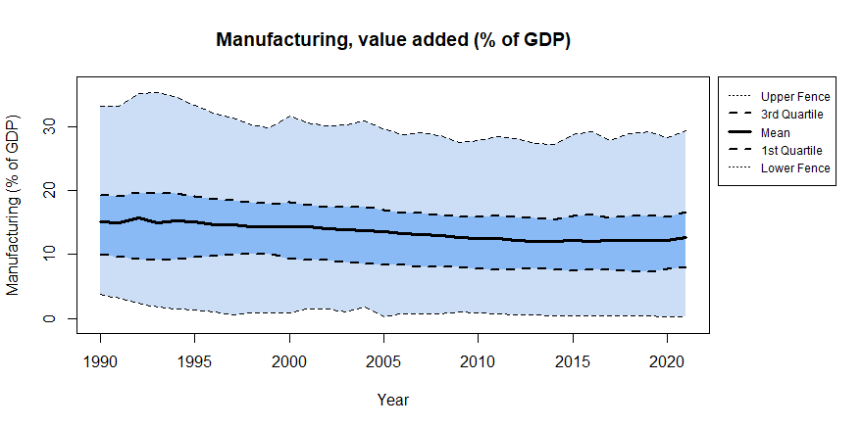
Visualization: Manufacturing, value added (% of GDP)

Slide 7
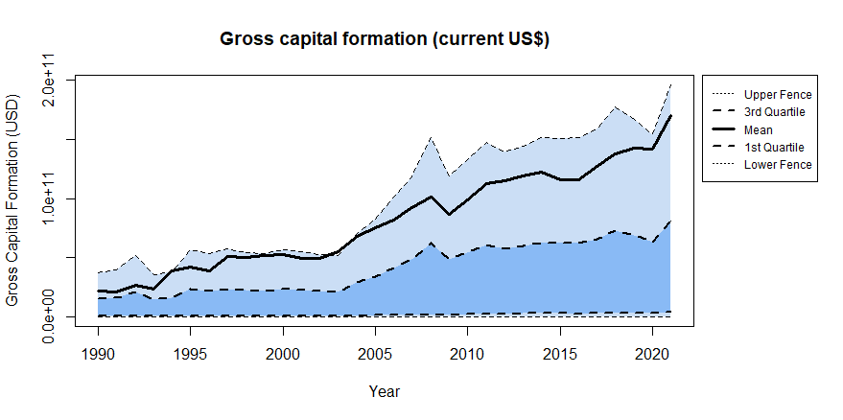
Visualization: Gross Capital Formation (May 2023 US$)

Slide 8
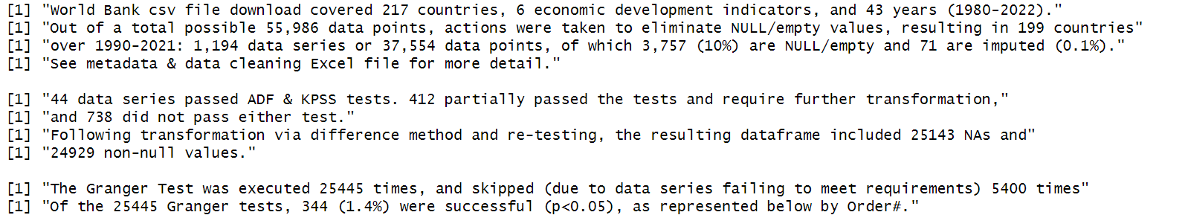
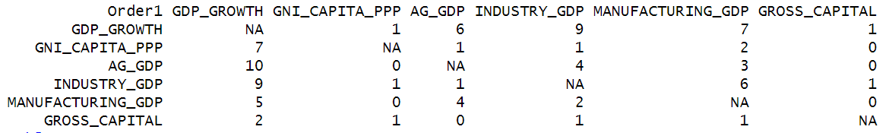
Result: A very small observable effect in subset of data appropriate for analysis

Slide 9
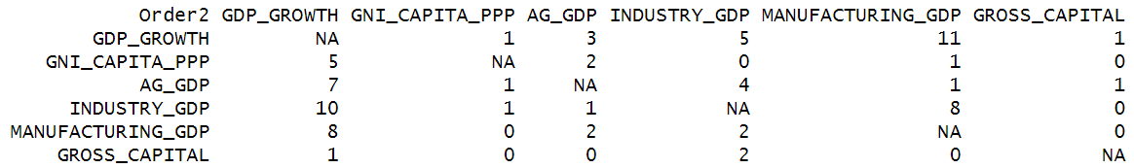
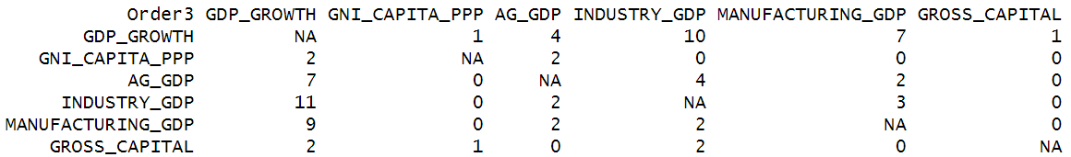
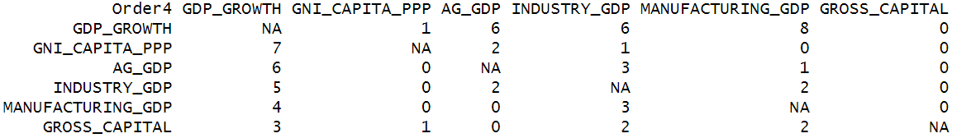
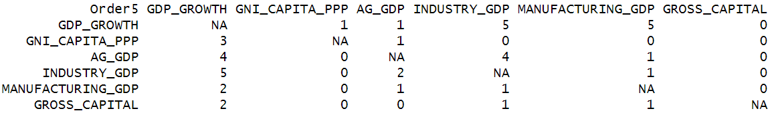
Result: A very small observable effect in subset of data appropriate for analysis

