Slide 1
Project Scope and Introduction
This project is a personal effort of its author, Sam Kenney, to learn and practice the R coding language. All materials referenced in the creation of this R project file were open-source at the time of access. They include, but are not limited to, the websites: Stack Overflow, Geeks for Geeks, Statistics Globe, and YouTube.
This project attempts to address the question of whether changes in certain common indicators of economic development may predict information regarding certain other economic indicators over time.
World Bank time-series data were downloaded for every country in the world from 1980 to 2022 covering several common indicators of economic development, including: Gross National Income per Capita (PPP-adjusted); Manufacturing, value added (% of GDP); and GDP growth (%); among others.
After visualizing the data, the Granger Causality test was applied at different orders (i.e. "lag" periods, e.g. 1 year, 2 years) to each possible pairing of WB indicators for each country.
The ADF and KPSS tests were applied to each country-indicator series to ensure that Granger stationarity requirements are met.
Data series that fail the stationarity tests were transformed using the difference method and retested for stationarity.
Data series that passed both rounds of stationarity testing were analyzed using the Granger Causality test from the lmtest library.
The number of successful (p<0.05) Granger Causality tests among all countries may form the basis of determining which economic development indicators (if any) are broadly beneficial in predicting information about other economic development indicators.

Slide 2
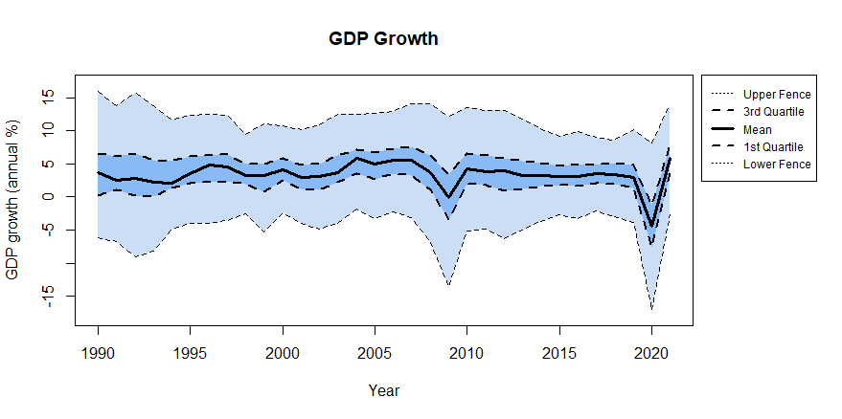
Visualization: GDP Growth Across all Granger-Tested Countries

Slide 3
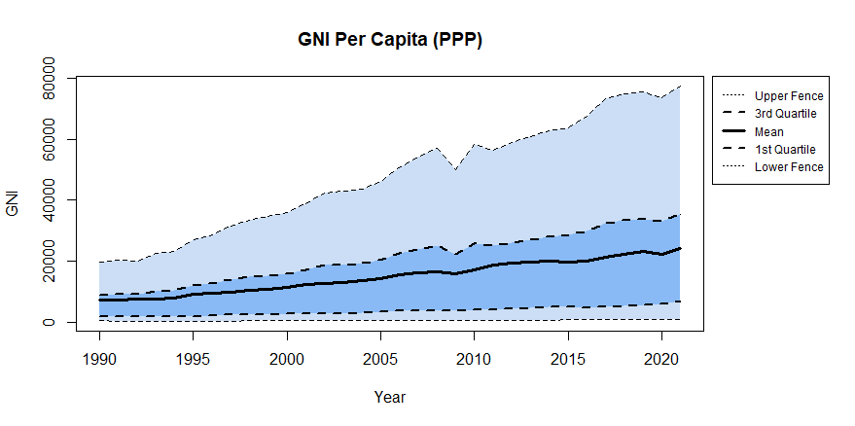
Visualization: GNI per Capita (PPP) Across all Granger-Tested Countries

Slide 4
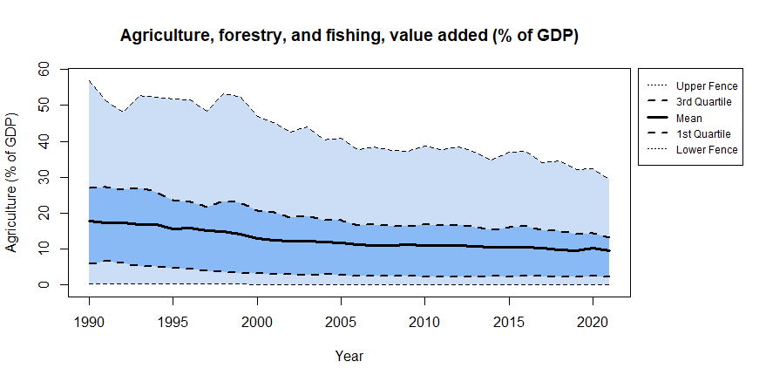
Visualization: Agriculture, Forestry, and Fishing, value added (% of GDP) Across all Granger-Tested Countries

Slide 5
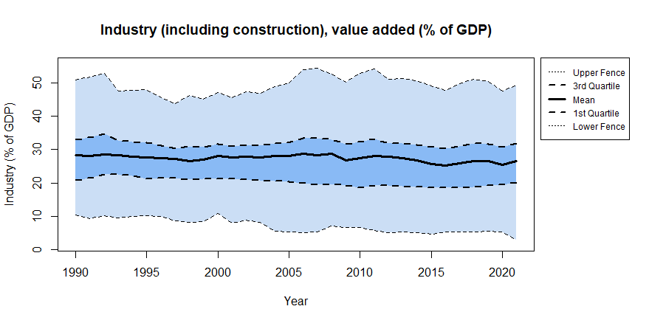
Visualization: Industry (including construction), value added (% of GDP) Across all Granger-Tested Countries

Slide 6
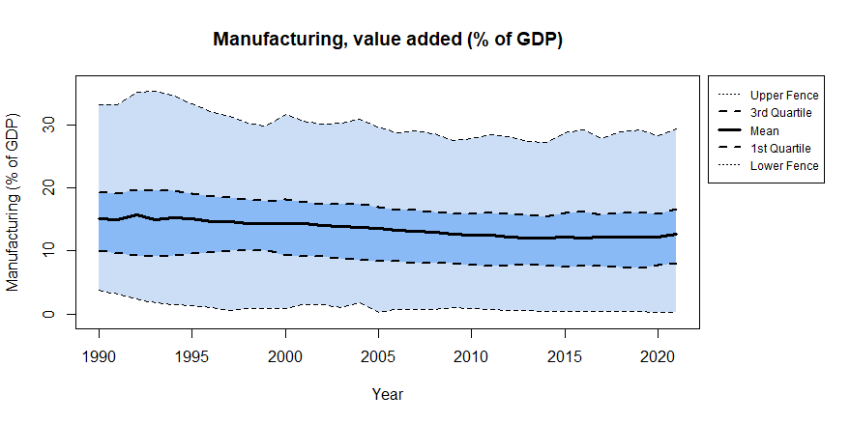
Visualization: Manufacturing, value added (% of GDP) Across all Granger-Tested Countries

Slide 7
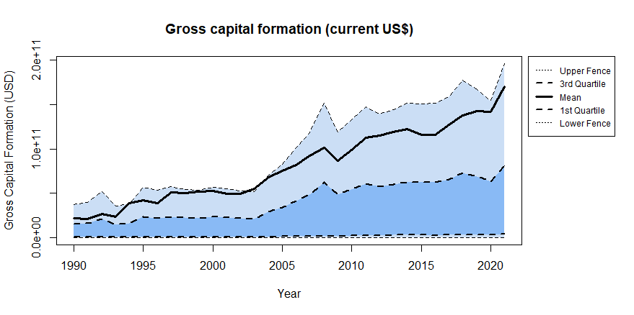
Visualization: Gross Capital Formation (May 2023 US$) Across all Granger-Tested Countries

Slide 8
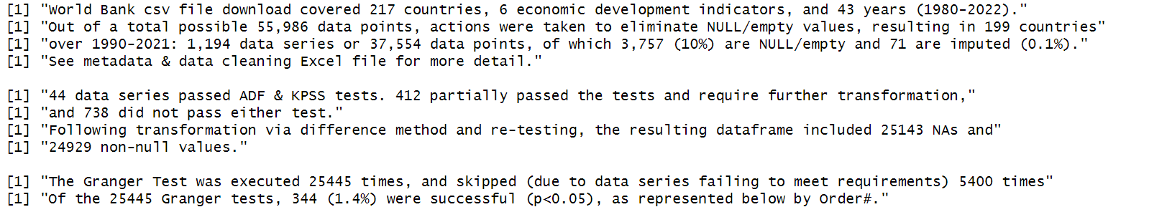
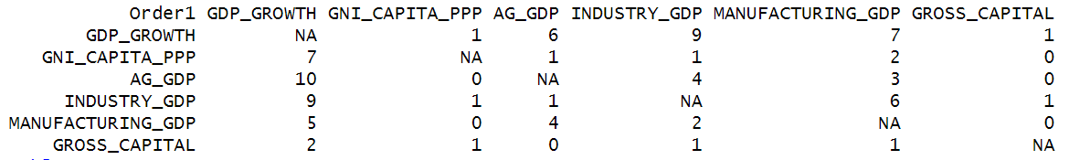
Result: A very small observable effect in subset of data appropriate for analysis

Slide 9
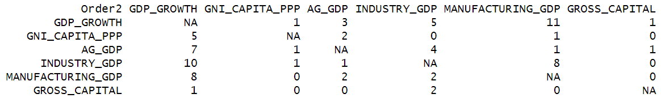
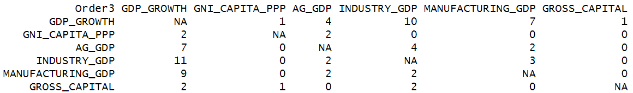
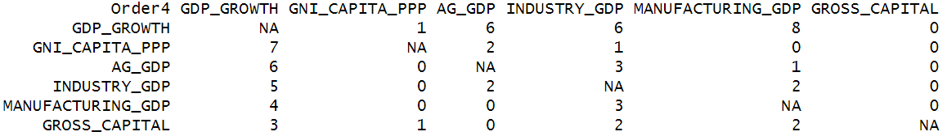
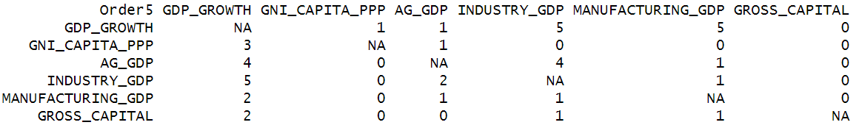
Result: A very small observable effect in subset of data appropriate for analysis

