Slide 1
Project Background
This program draws on randomized data gathered through a fictitious RFP process for procurement of new capital equipment. The fictional details are as follows:
Four vendors submitted proposals in response to this RFP with different possible solutions to the user's capital equipment needs.
Vendor proposals detail various pricing and discounting schemes across the two RFP product categories - here labeled as 'device' and 'instrument'
This program allows the user to forecast a 5-year expense associated with different procurement scenarios: 0-3 device procurements and 0-3 instrument procurements, for a total of 0-6 capital product procurements.
This program asks users to choose which vendor, device(s), and instrument(s) they would like to forecast. The user-input defined variables are as follows:
Vendors: V1, V2, V3, V4
V1 Devices: Device_A, Device_B
V1 Instruments: Instrument_A, Instrument_B, Instrument_C
V2 Devices: Device_C, Device_D
V2 Instrument: Instrument_D
V3 Devices: Device_E, Device_F
V3 Instrument: Instrument_E
V4 Devices: Device_G, Device_H
V4 Instrument: Instrument_F
V1 only offers the following bundles: (Device_A, Instrument_A), (Device_B, Instrument_B), (Device_B, Instrument_C)
Other details
The program draws from four .csv files that contain a 5-year cost estimate corresponding to each permutation of devices and instruments.
Vendor A offers an additional 5% discount for each additional unit (pair) of products – detailed in .py program.

Slide 2
Example program output
For the following user-input variable values:
Vendor = “V2”
D1 = “Device_C”
D2 = “Device_D”
D3 = NULL
I1 = “Instrument_D”
I2 = NULL
I3 = NULL
One set of outputs is a set of statistics describing the forecasted value relative to similar outcomes:
You have elected to forecast the expense of procuring 2 device(s) and 1 instrument(s) from V2, as follows: ['Device_C', 'Device_D', 'Instrument_D']
Out of all four vendors, there exist 713 possible product-procurement scenarios. The forecasted expense for procuring ['Device_C', 'Device_D', 'Instrument_D'] is 1155594 USD, which is in the 20 percentile of all scenarios.
For V2, there exist 217 possible product-procurement scenarios. The forecasted expense of 1155594 USD is in the 46 percentile of all possible product-procurement scenarios for V2.
1155594 USD is in the 25 percentile of all possible product procurement scenarios across the four vendors, given selection of 2 device(s) and 1 instrument(s).
1155594 USD is in the 75 percentile of all possible product procurement scenarios for V2, given selection of 2 device(s) and 1 instrument(s).
The program also outputs 5 histograms to visually represent the previously mentioned statistics (next 5 slides)

Slide 3
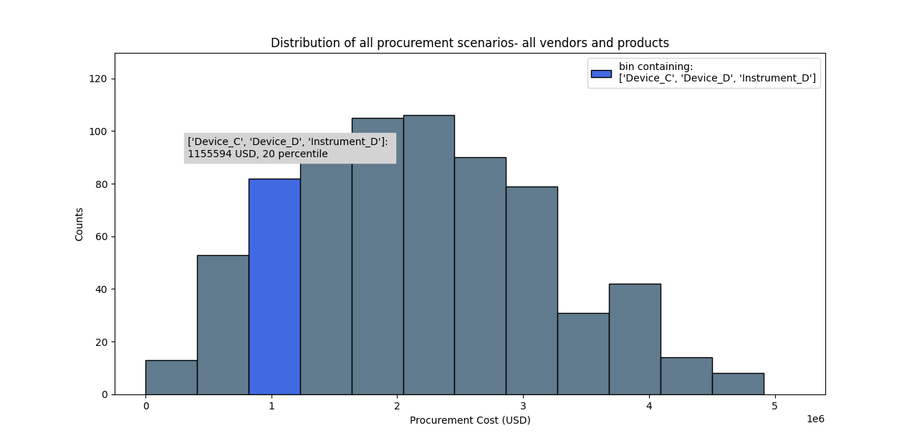
Example program output: Histogram 1

Slide 4
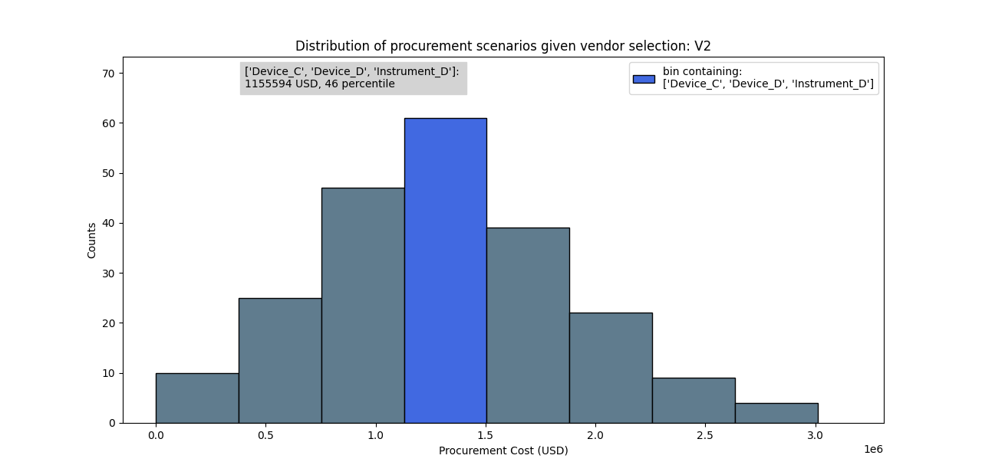
Example program output: Histogram 2

Slide 5
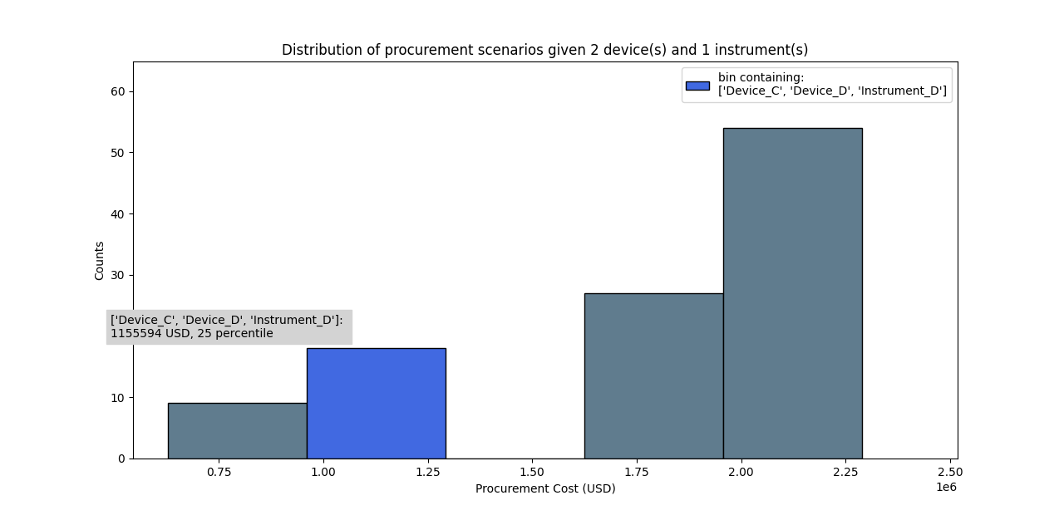
Example program output: Histogram 3

Slide 6
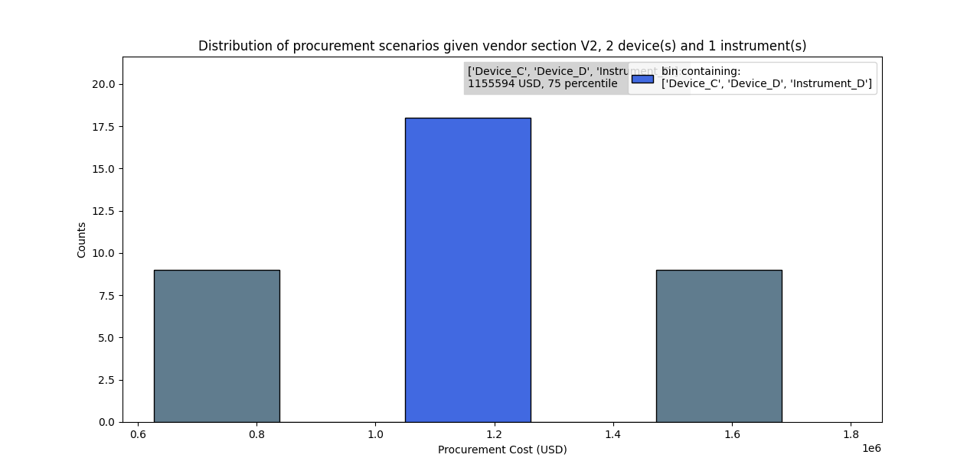
Example program output: Histogram 4

Slide 7
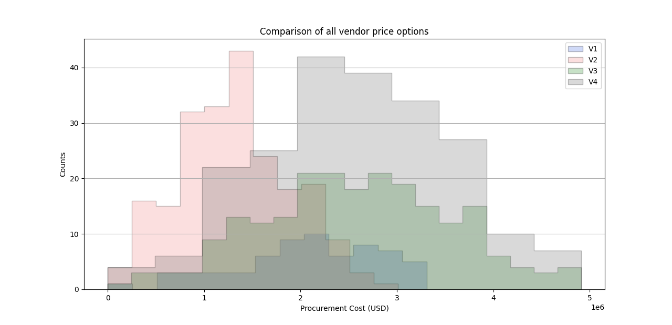
Example program output: Histogram 5

