Slide 1
The Kronos Incident:
A Kidnapping and Historical Analysis
Sam Roberts-Baca
University of Denver, COMP4449
Spring 2022

Slide 2
Presentation Outline
Problem Statement
Background Information
Research Questions
Description of Datasets
Methodology
Results
Conclusion

Slide 3
Problem Statement
In January 2014, the leaders of fictitious GAStech celebrated the initial public offering (IPO) of their very successful company. During this celebration, several employees of GAStech went missing. An organization known as the Protectors of Kronos (POK) is the chief suspect in the disappearance. However, in the business world, things may not be what they seem.
The objective of this project is to inform law enforcement about the current organization of the POK: the structure of the organization, how it has changed over time, and the events that characterize the disappearance of GAStech employees.

Slide 4
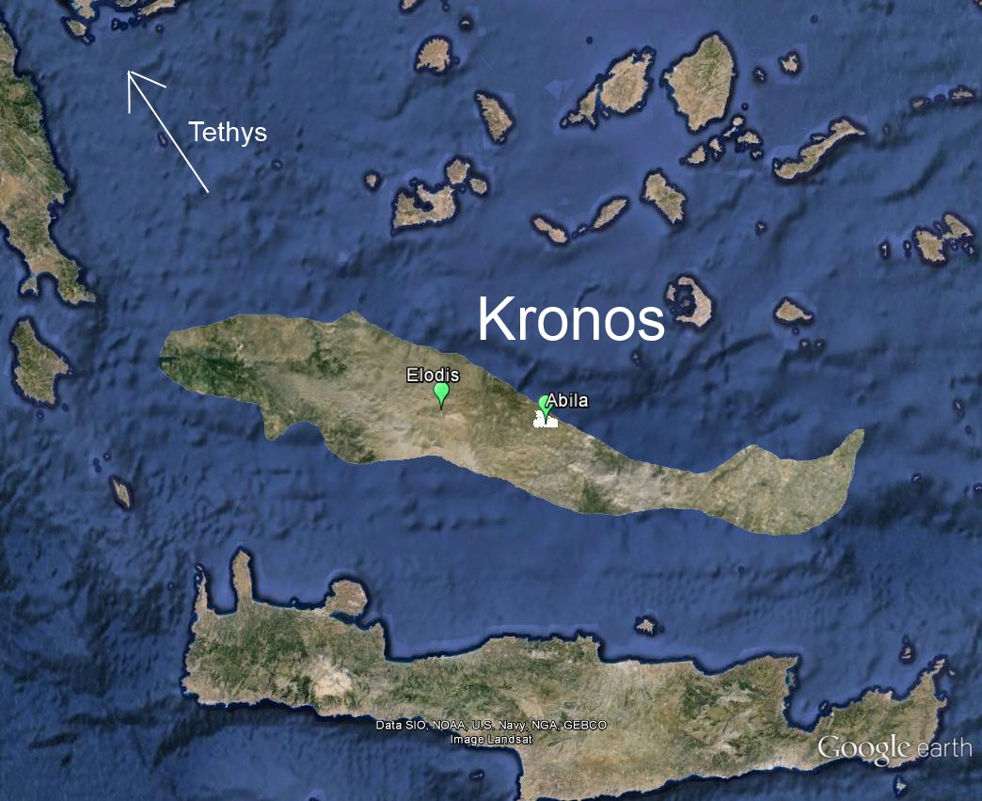
Background Information
Tethys
Location: Western Europe, bordering the Mediterranean Sea, between France and Italy
Population: 32,975,805 (July 2013 est.)
Unemployment rate: 7.8% (2012 est.)
Population below poverty line: 5.8%
Kronos
Location: Middle East, island in the Mediterranean Sea, north of Egypt
Population: 783,305 (July 2013 est.)
Unemployment rate: 23.7% (2012 est.)
Population below poverty line: 70%
Map of Kronos

Slide 5
Research Questions
Provide a clear analysis of the structure of the Protectors of Kronos network, with supporting evidence.
a. Who are the leaders?
b. Who is part of the extended network?
c. How has the group structure and organization changed over time?
d. Where are the potential connections between the POK and GAStech?
Describe the events of January 20-21, 2014. What are the events? What is the timeline of events?
Provide at least two possible explanations why the GAStech employees may be missing. What evidence do you have to support each of these explanations?

Slide 6
Why this project?
Forensic Data Analysis - Using disparate data sources to construct a narrative argument
Text Analysis Techniques - used to streamline/minimize manual searching of data and categorization/clustering of data under similar attributes

Slide 7
Description of Datasets Used
The data provided consists of a collection of text-based files. These files were verified for accuracy by data scientists at the University of Denver and pertain to the kidnapping of GASTech employees by members of the social movement group POK.
Two (2) historical reports and descriptions of the countries involved, in Microsoft Word format;
A map of Kronos;
A chart describing the local GAStech organization, in PDF format;
A spreadsheet of GAStech employee records, in Microsoft Excel format;
Email headers from two weeks (1/6/2014 - 1/17/2014) of internal GAStech company email, in comma-separated values (CSV) format;
Resumes and short biographies of many, (but not all), of the GAStech employees, in Microsoft Word format;
Relevant current and historical news reports from multiple domestic and translated foreign sources, in text file format.

Slide 8
Description of Methodology
Manual review of the historical documents and Kronos/Tethys factbooks
Analysis of article text data using Latent Dirichlet Allocation (LDA) and Named Entity Recognition (NER)
Analysis of internal GASTech email header data using network graphing

Slide 9
Historical Document Manual Analysis
Two historical documents manually reviewed to determine the basic chronology of events of POK up to 2009:
“The Application and Validation of a Social Movement Model in Understanding the Evolution and State of One Grassroots Social Movement in Kronos: Protectors of Kronos”
“History of the Protectors of Kronos”
Two country fact books were also examined:
Kronos Factbook
Tethys Factbook
These documents serve as a foundational overview of the sociopolitical climate of the Kronos and Tethys regions and basic chronology of the first ten years of the POK.

Slide 10
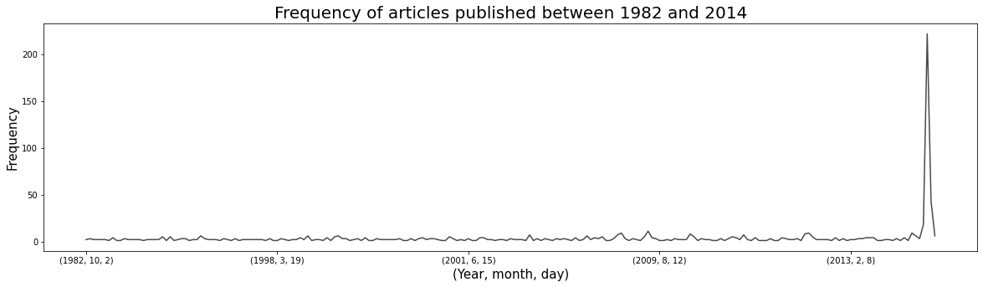
Article Data Analysis
After the initial consideration of the historical and regional factbook documents, an analysis was performed of the article data to determine the events of the POK between 2009-2014.
845 total articles collected; published between 1982 and 2014.
Data Fields:
Article ID#
Publication Name
Article Title
Article Author
Date of Publication
Article Body Text
Frequency of Articles Published between 1982 and 2014

Slide 11
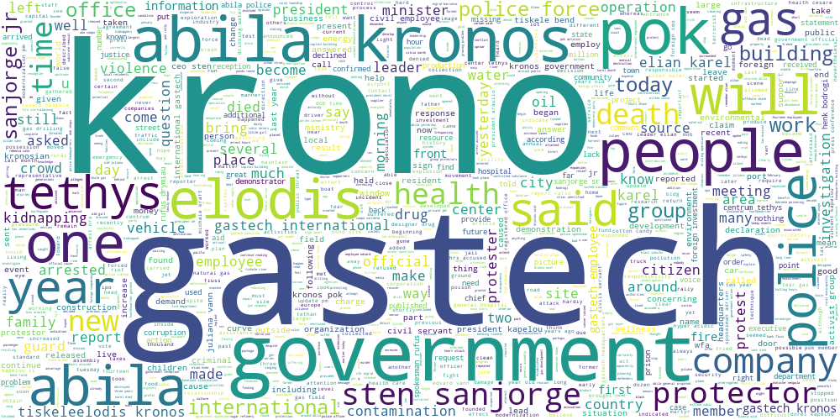
Article Data Analysis - Latent Dirichlet Allocation (LDA)
Latent Dirichlet Allocation (LDA) was implemented to provide an exploratory overview and categorization of the kinds of topics present in the news articles.
LDA is a machine learning model that generates grouped topics based on commonly used terms within a body of documents, in this case news articles.
Stop words and punctuation removed
All words were converted to lowercase
Bigrams were created of most commonly-used two word phrases in the text
Lemmatized to only include the root words of nouns, adjectives, verbs and adverbs
Corpus of commonly used terms created
Five topics were selected for the LDA model, which was implemented with the gensim package in Python
Word Cloud of Most Common Words in Article Data

Slide 12
Article Analysis - Latent Dirichlet Allocation (LDA) Results
The following topics were generated by the Latent Dirichlet Allocation model:
Topic | Inferred Topic Name | Top Ten Terms | Term weight
1 | Arrest/Protests associated with Elias Karel | pok police government karel force protest arrest crowd kronos krono | 0.028 0.028 0.022 0.019 0.019 0.014 0.011 0.009 0.009 0.008
2 | Kronos Government | krono kronos government president foreign people clean today announce recent | 0.036 0.022 0.020 0.015 0.011 0.011 0.010 0.010 0.008 0.008
3 | Elias Karel Death | ceo year family death die say force krono leader organization | 0.020 0.018 0.017 0.017 0.015 0.015 0.013 0.013 0.012 0.010
Topic | Inferred Topic Name | Top Ten Terms | Term weight
4 | GAStech / Tethys Government Drug Involvement | work foreign company drug gas say much tethy year country | 0.014 0.013 0.012 0.012 0.012 0.009 0.009 0.008 0.008 0.008
5 | GAStech Kidnappings | gastech employee police government krono abila kidnapping sanjorge group elodis | 0.029 0.019 0.014 0.013 0.013 0.011 0.011 0.010 0.010 0.009
Model Perplexity: -7.361612872531304
Model Coherence Score: 0.4070625824341964

Slide 13
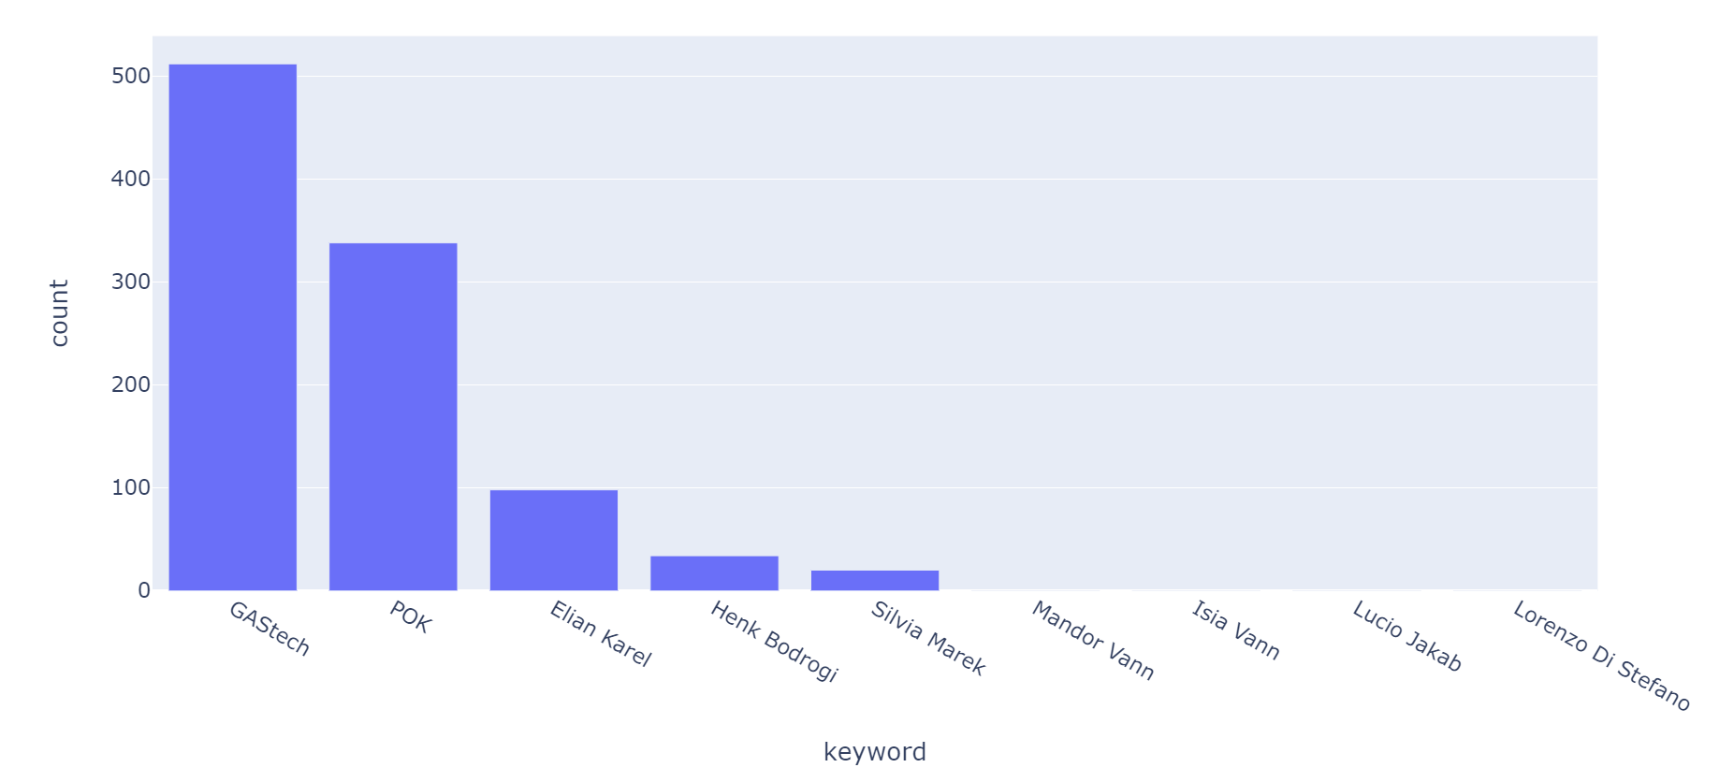
Article Data Analysis, Cont. - Initial Keyword Search
This article analysis was an interactive process consisting of:
(a) searching through article body data for keywords of interest,
(b) filtering the data based on those selected keywords,
(c) manually reviewing the data to summarize the events leading to the GAStech kidnappings,
(d) discovering new keywords of interest, and
(e) repeating the process.
Article Keyword Search Counts
Initial search keywords of interest: “Henk Bodrogi”, “Elian Karel”, “Silvia Marek”, “Mandor Vann”, “Isia Vann”, “Lucio Jakab”, “Lorenzo Di Stefano”, “POK”, “GAStech”.

Slide 14
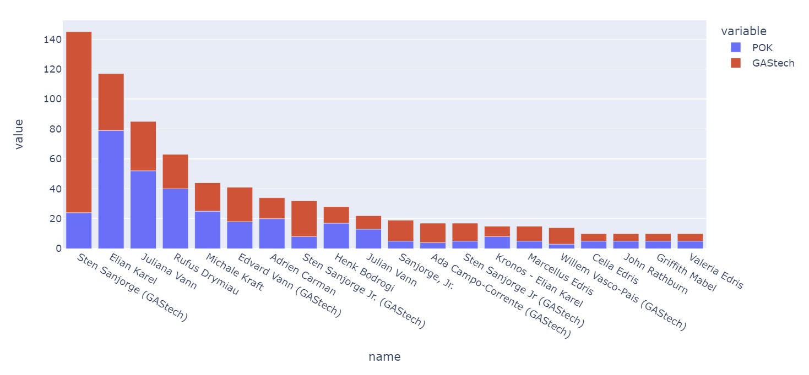
Article Data Analysis, Cont. - Named Entity Recognition
Articles grouped under the “POK” and “GAStech” categories were labeled with additional names discovered in the documents by using Named Entity Recognition (NER), a natural language processing (NLP) technique which deals with identifying and classifying people, places, organizations, times, objects, or geographic entities.
Top 20 POK/GAStech Named Entity Recognition (NER) Results

Slide 15
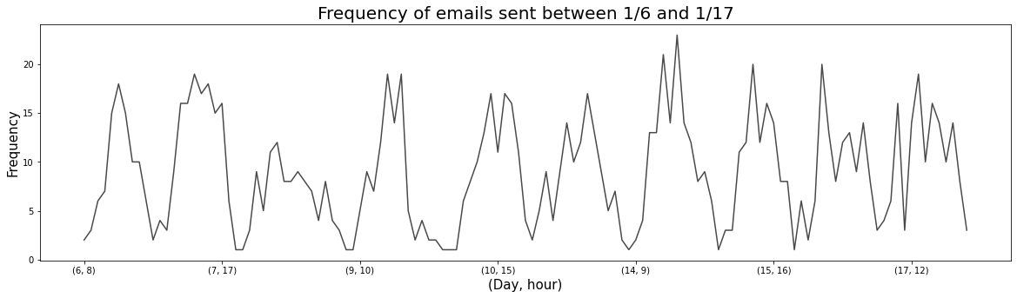
GAStech Internal Email Header Analysis
The email headers CSV file included a bulk of internal emails from GAStech between January 6 2014 and January 17 2014 – just days before the kidnapping of GAStech employees on January 20. The email header data contained 1170 observations.
Data Fields:
From (email)
To (list of emails)
Date
Subject
Frequency of GASTech Internal Emails sent between January 6 and January 17, 2014

Slide 16
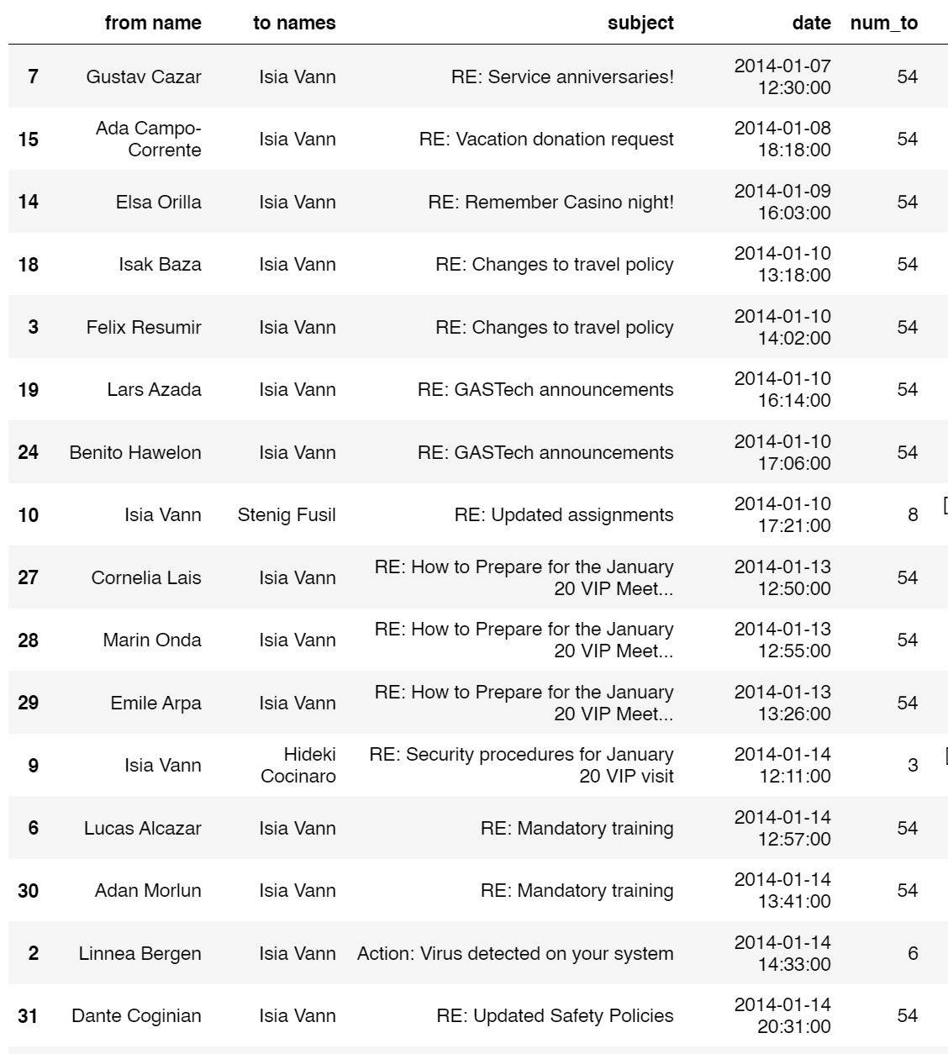
GAStech Internal Email Header Analysis, Cont.
Data Preparation: the From and To email address columns were first converted to the full names of the employees with those email addresses using the Employee Records data.
The email header data was converted to a network graph data structure using the Python NetworkX package.
Specific GAStech employees and email threads were queried
Overall employee communication structure examined
Example of Condensed Email Data Profile: Isia Vann

Slide 17
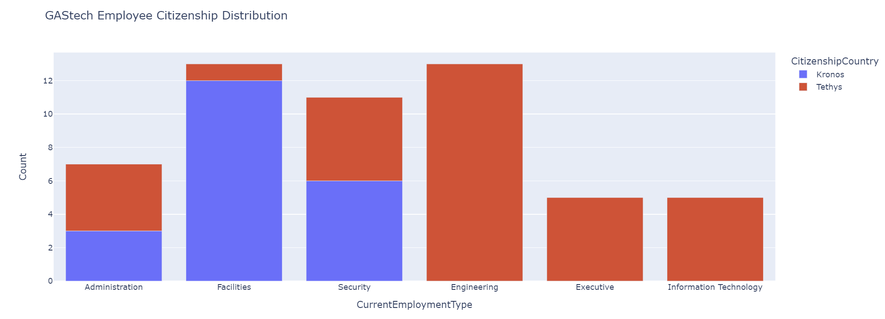
GAStech Employee Citizenship Distribution,
Employee Records Data

Slide 18
Results, Research Question 1
Provide a clear analysis of the structure of the Protectors of Kronos network, with supporting evidence.
How has the group structure and organization changed over time?
1997 - POK founded as small grassroots organization in Elodis by Henk Bodrogi. Initial team consisted of Bodrogi, Carmine Osvaldo, Jeroen Karel, Ale L. Hanne, Valentine Mies, Yanick Cato, Joreto Katell.
1998 - Death of Juliana Vann (leukemia associated with benzene toxicity)
1999 - POK relocates to Abila, begins staging series of public rallies.
2001 - Henk Bodrogi steps down along with original members, replaced by Elian Karel, son of Jeroen Karel. Elian Karel’s team composed of Silvia Marek, Lucio Jakab, Mandor Vann, Isia Vann, Lorenzo Di Stefano. Peaceful protests continue.
2005 - Tiskele River near Elodis catches fire, tone of POK shifts dramatically.
March 12, 2009 - Elian Karel arrested on charges of tax evasion following protest.
June 19, 2009 - Elian Karel dies in prison under mysterious circumstances. Silvia Marek replaces Karel as leader of POK.
2009 - 2011 - POK protests become increasingly violent. POK described as a “public threat” by Kronos govt.
June 30, 2011 - President Kapelou declares the POK to be a terrorist group.
2013 - POK demonstrators set fire to Kronos government buildings in November. Two police patrol officers assaulted in December.

Slide 19
Results, Research Question 1
Who are the leaders?
Silvia Marek is current leader of POK.
Co-founder of Save Our Wildlands
Replaced Elian Karel after his death in 2009
Believes in persistent and peaceful protest
Leadership has not been effective in controlling violence, criminal activities of POK

Slide 20
Results, Research Question 1
Who is part of the extended network?
Part of leadership network:
Lucio Jakab – also a member and co-founder of Save Our Wildlands, activist who believes habitat of wildlife unique to Kronos is imperiled by drilling, logging, pollution, media communications professional, responsible for many handbills, signs, banners, and slogans used by POK.
Mandor Vann – ex Kronos military service since 2004 and uncle to Isia and Juliana Vann. POK's top political strategist.
Isia Vann – the older brother of Julianna Vann, one of several POK members who advocate for a more forceful approach to gaining attention. He has been arrested several times for civil disobedience, trespassing during POK rallies. Also a member of the GAStech corporation, as a security guard (GAStech employee records CSV).
Lorenzo Di Stefano – professor of environmental science at University of Abila, author of several scientific articles on environmental contamination associated with Hyper Acidic Substrate Removal (HASR)
Others:
Mestache Vardshvna (demonstrator involved in several protests)

Slide 21
Results, Research Question 1 Cont.
Where are the potential connections between the POK and GAStech?
Isia Vann is a member of the GAStech corporation working as a perimeter control security guard, as listed in the GAStech employee records CSV.

Slide 22
Results, Research Question 2: Timeline of Events of January 20-21, 2014
January 20, 2014
C-Suite members Sten Sanjorge, Jr., Ingrid Barranco, Ada Campo-Corrente, Orhan Strum, and Willem Vasco-Pais met at the GAStech office for a corporate meeting (Article 240, Article 481)
Departed to meet with Kronos government officials for reception around 10:00 am.
A fire alarm sounded around same time in the GAStech headquarters (Article 107). It is not clear whether a fire actually went off (Article 142).
Kidnapping took place as GAStech employees in transit between the GAStech headquarters and the Kronos government capitol building (Article 481, Article 107).
Edvard Vann, a GAStech employee from Security group, was questioned for six hours by authorities after the incident, because of his shared family name with several known POK members (Article 29).

Slide 23
Results, Research Question 2: Timeline of Events of January 20-21, 2014
January 21, 2014
Between ten and fourteen GAStech employees are reported missing (Article 460, Article 583).
POK claims responsibility for the kidnapping of the missing GAStech employees
POK publicly demands a ransom of 20 million dollars for the release of the president and CEO Sten Sanjorge, Jr. (Article 536).
Sanjorge Jr. was reported to have returned safely to Tethys (Article 556, Article 536).

Slide 24
Results, Research Question 3: Explanations of Missing GAStech Employees
Explanation 1: Internal Hacking/Security Hijacking by Isia Vann, Loreto Bodrogi, Hideki Cocinaro, Varja Lagos
The email chain “Security Procedures for January 20 visit” was sent on January 9th, 2014 by Edvard Vann to Kanon Herrero, Minke Mies, Hennie Osvaldo, Inga Ferro, and Felix Resumir of the security team.
However, another email with the exact same header was sent by Loreto Bodrogi to Hideki Cocinaro, Varja Lagos, and Isia Vann, also members of the security team, on January 14th, who were none of the original six recipients.
Supporting Evidence:
“ARISE - Inspiration for Defenders of Kronos” - January 13, 2014 4:48 PM
Ruscella Mies Haber to Inga Ferro, Loreto Bodrogi, Isia Vann, Hennie Osvaldo, and Minke Mies
"Seeing strange network activity" - January 14th, 2014 10:49 AM
Lucas Alcazar to Isak Baza, Nils Calixto, and Sven Flecha
"Action: Virus detected on your system" - January 14th, 2014 2:33 PM
Linnea Bergen to Inga Ferro, Loreto Bodrogi, Isia Vann, Hennie Osvaldo, Minke Mies, and Ruscella Mies Haber

Slide 25
Results, Research Question 3: Explanations of Missing GAStech Employees
Explanation 2: External Hacking / Intentional GAStech Staging
“GT website under attack” was sent from Lucas Alcazar to Isak Baza on January 9th, 2014. It could suggest that there was an external hack that had nothing to do with an internal source. The following email on the 9th, “Security patches needed”, sent from Nils Calixto to Lucas Alcazar, may be related to remediations involving the hacking event the previous day.
There is the possibility that the kidnapping itself was staged by GAStech. Even though POK claimed responsibility for the kidnapping and demanded a 20 million dollar ransom for the release of CEO Sten Sanjorge, Jr., there is evidence that he was never actually kidnapped. Something is inconsistent with what was stated and what occurred.
Also, although ten to fourteen employees were reported kidnapped, the only employees mentioned in article news reports were the GAStech executives.

Slide 26
Conclusions
When dealing with this kind of investigative research problem, regardless of how many analytical data science techniques are applied the primary goal is to establish a narrative of events that can be validated as evidenced by the data itself.
Thorough exploratory data analysis is essential in this type of problem.
Project Time Breakdown:
50% reading and gathering evidence in relevant historical documents, articles, resumes and emails
30% data analysis techniques
20% annotating, reworking code, bug fixing & troubleshooting
Future Work
Additional work on reducing duplicate data
Using this particular project data to aid in responding to other activities/events, such as that captured in the “The Kronos Incident: Geospatial-Temporal Patterns of Life Analysis” and “Return to Kronos” scenarios.

Slide 27
Thank you! Questions?

