Slide 1
Scaling developer onboarding
in Fortune 50 and smaller organizations
Sam Gleske – Integral Ad Science

Slide 2

integralads.com

Slide 3
The developer onboarding experience
Eye candy

Slide 4
Basics of self service
Read documentation; add a basic YAML file to repository master branch.
Visit Jenkins and generate jobs with two button clicks.
Iterate and improve release process in a pull request.

Slide 5


Slide 6
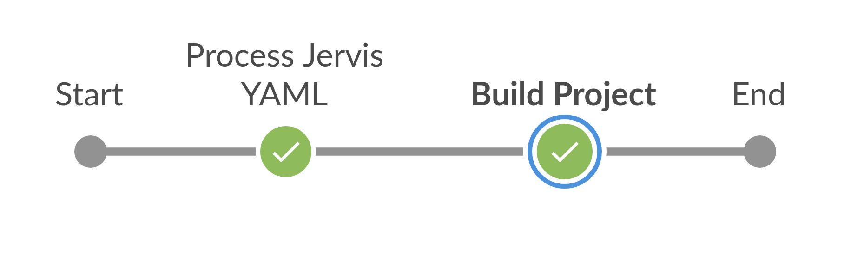

Slide 7
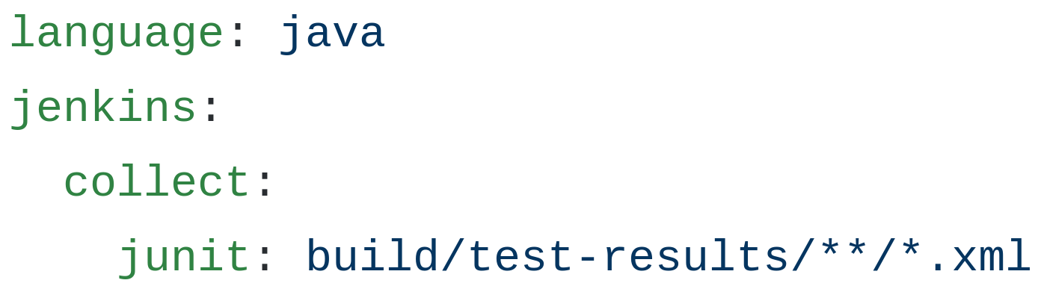

Slide 8
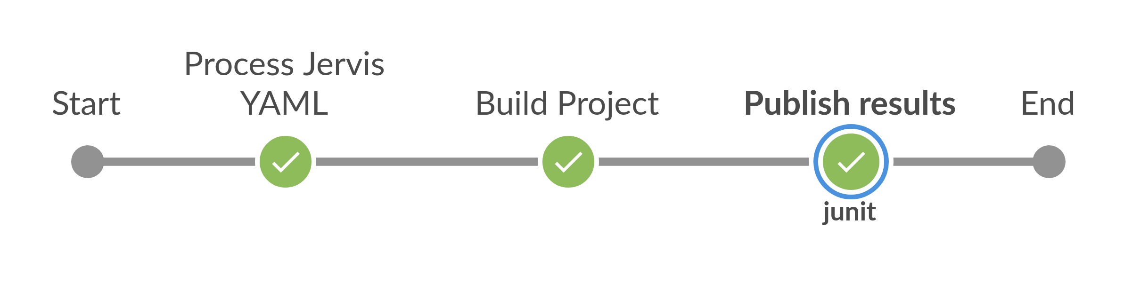

Slide 9
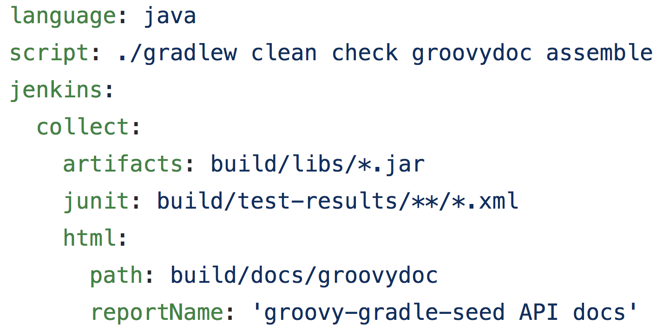

Slide 10
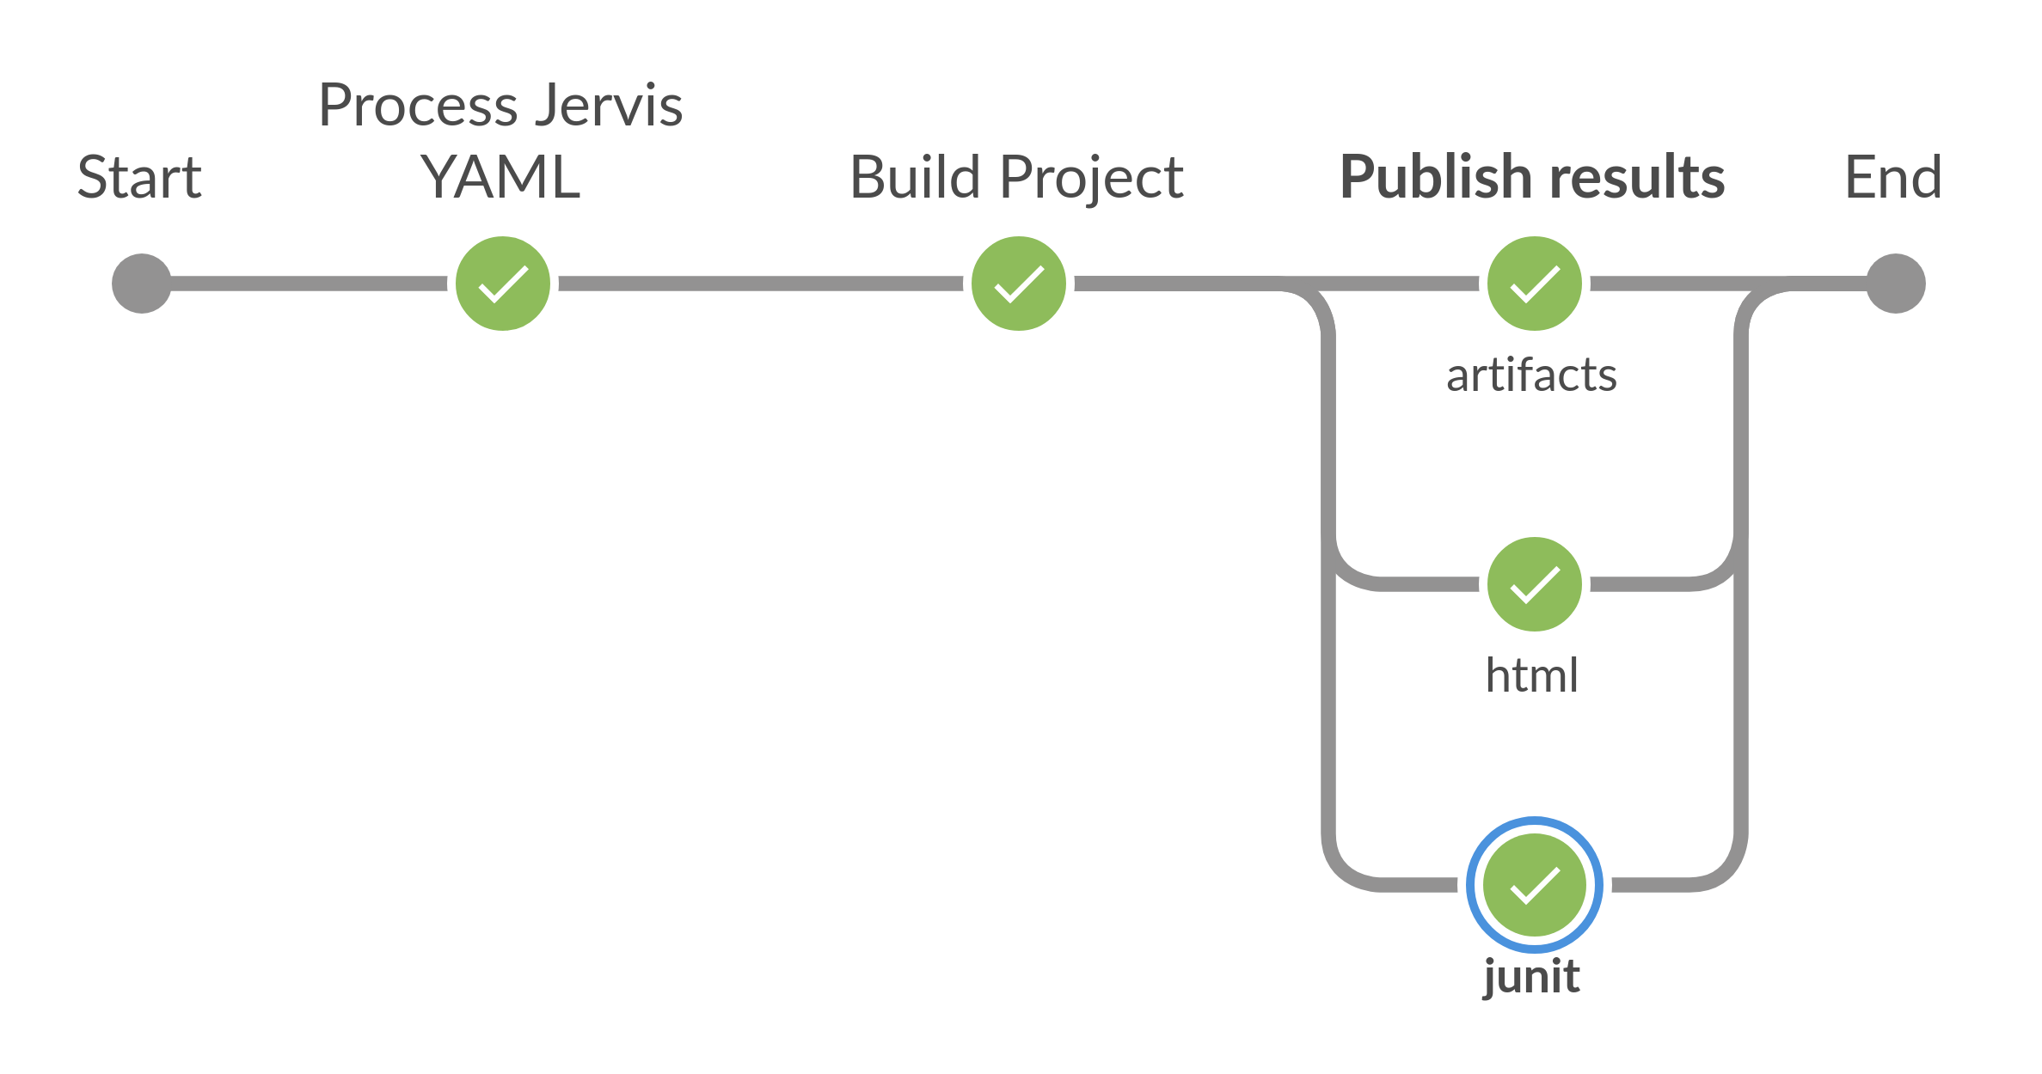

Slide 11
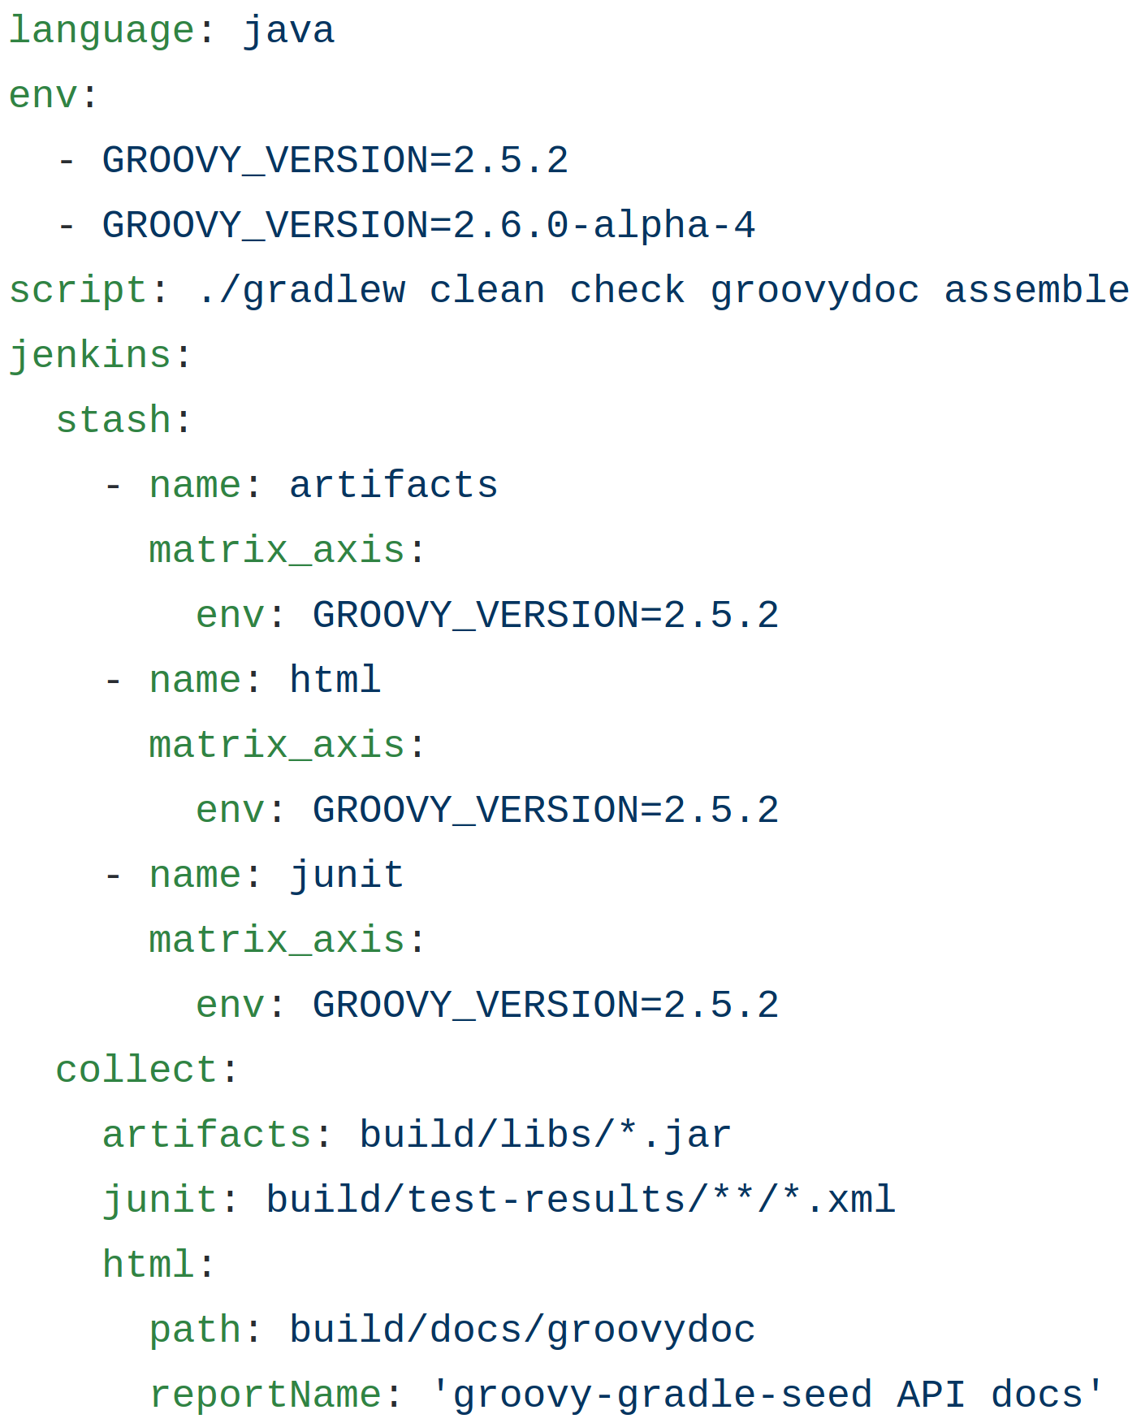

Slide 12
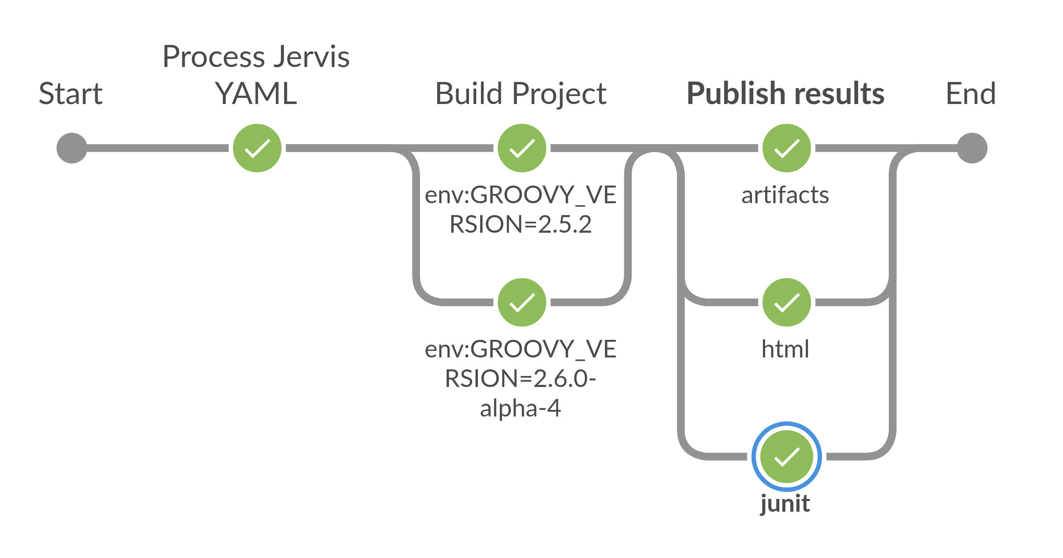

Slide 13
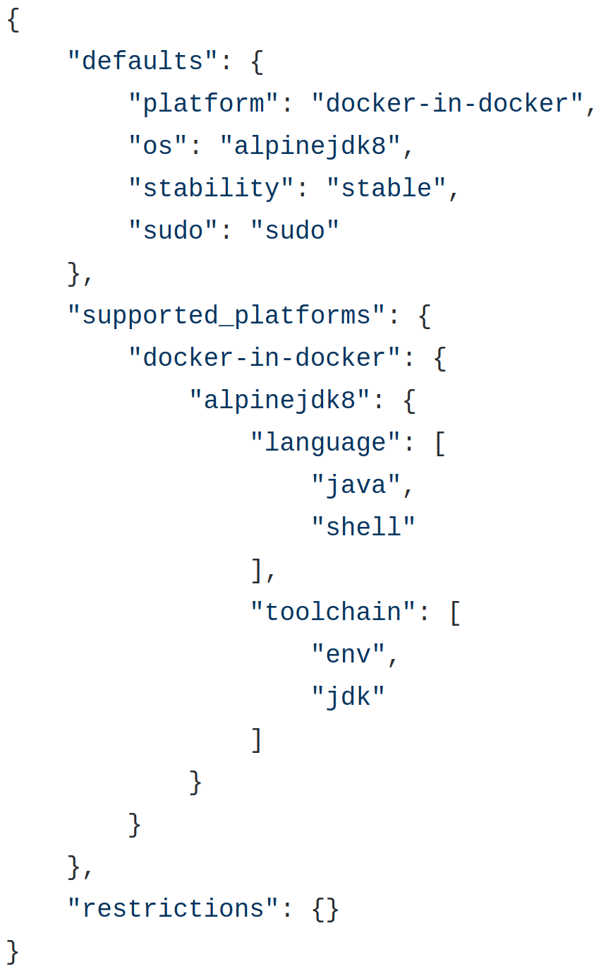
Platforms

Slide 14
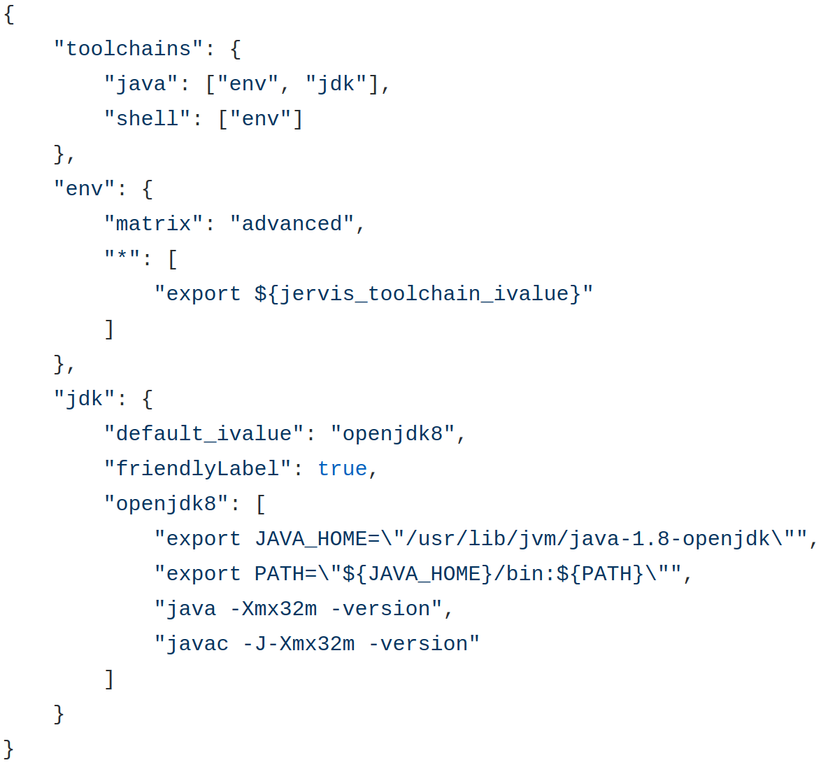
Toolchains

Slide 15
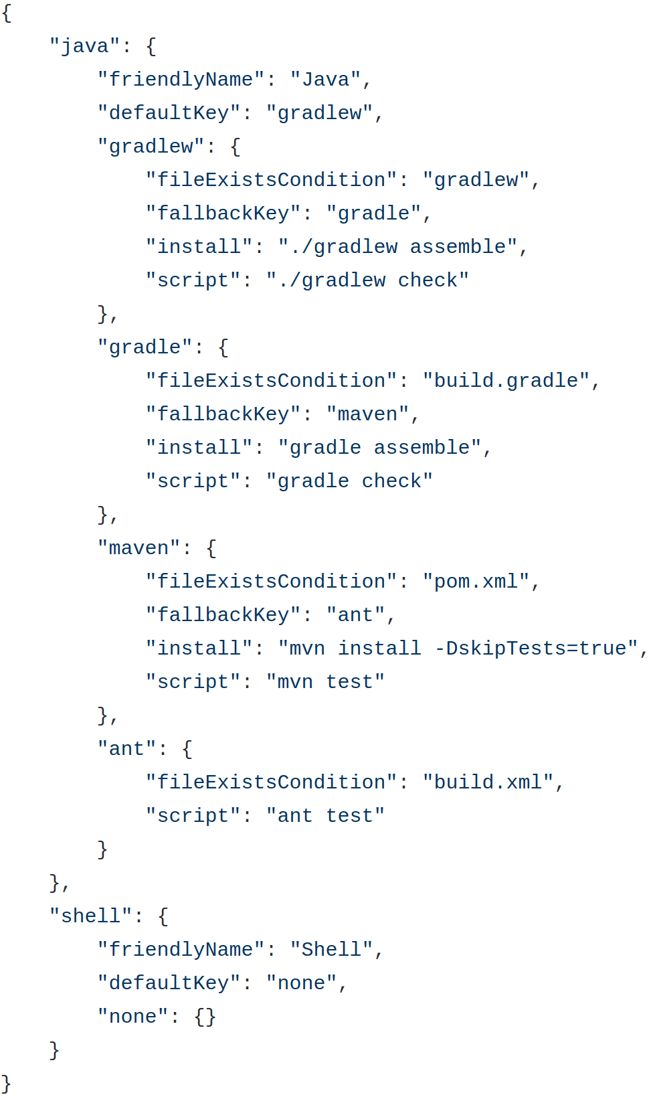
Lifecycles

Slide 16
Jenkins development announcements

Slide 17
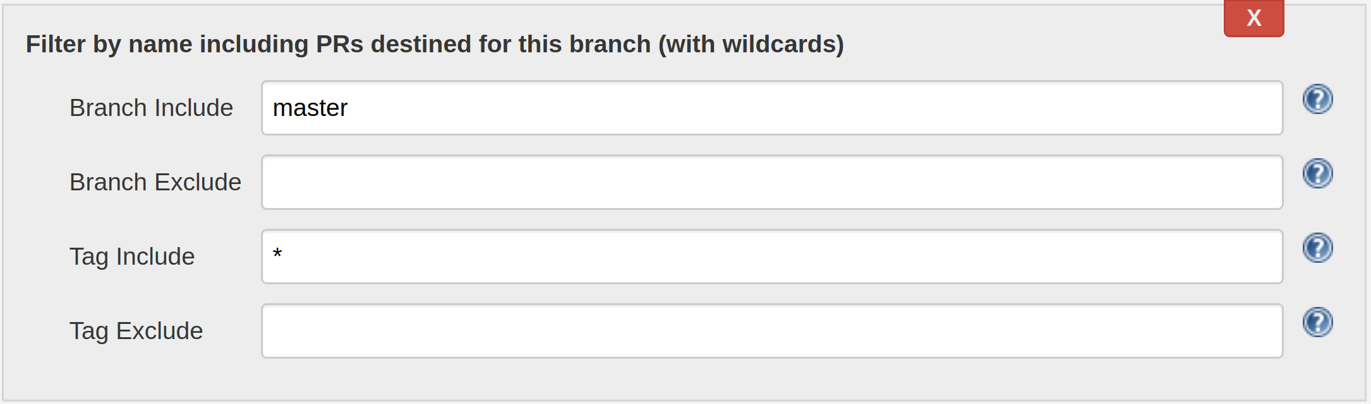
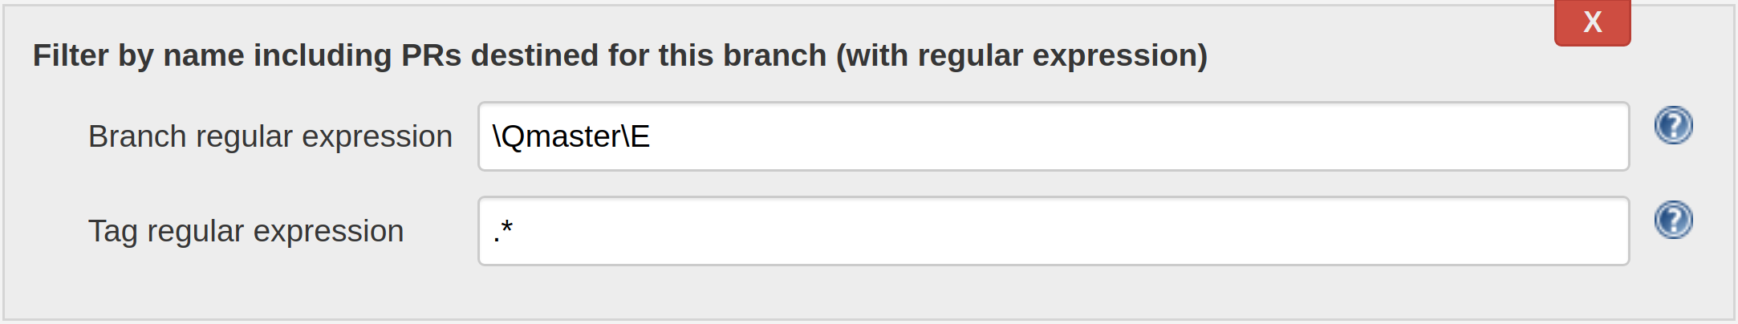
New Jenkins Plugin: SCM Filter Branch PR

Slide 18
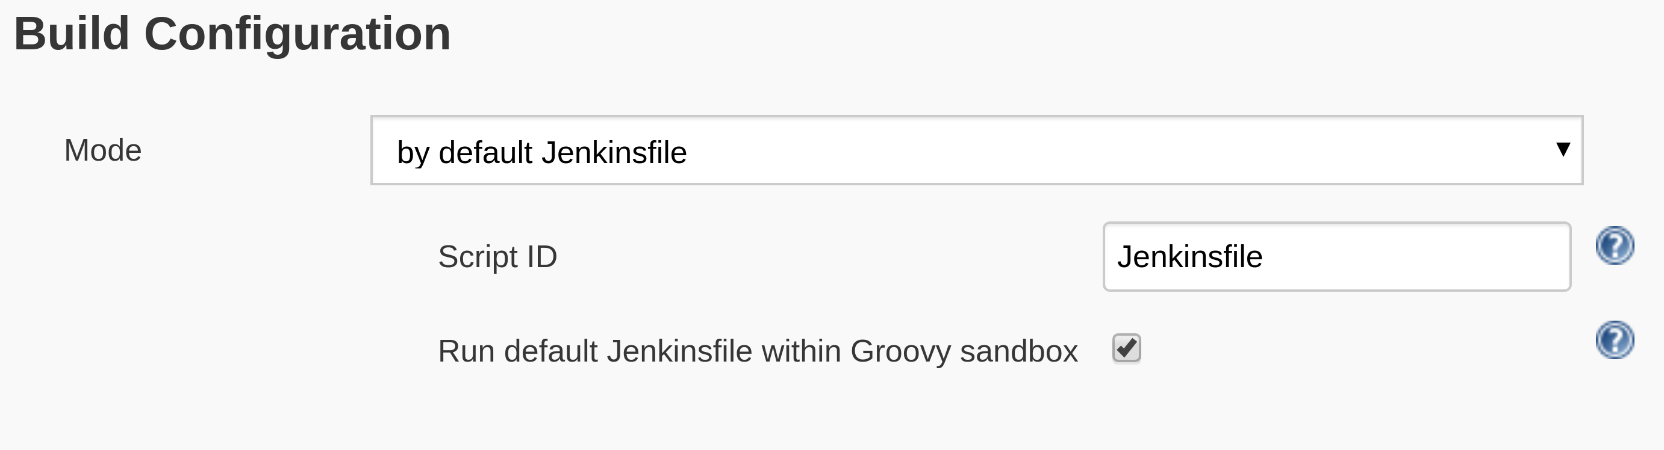
Coming Soon: Pipeline Multibranch With Defaults Sandbox

Slide 19
Jervis has passed 1.0 release
Job DSL library for generating jobs
100% multi-branch pipeline build execution
Shared pipeline library provides isPRBuild() and isTagBuild() conditionals.
Provides IS_PR_BUILD and IS_TAG_BUILD shell variables.
Extensible
  Modify Job DSL scripts via Groovy bindings.
  Shared pipeline library via hasGlobalVar() pipeline step.

Slide 20
Development workflow for delivering software
at scale

Slide 21
Assumptions (or life will be harder)
Nobody wants to “learn Jenkins”
Every project uses pinned versions of dependencies.
  Java-esque (don’t rely on -SNAPSHOT)
  NodeJS (npm shrinkwrap or just use yarn; if using gulp then same applies)
  Python (pip freeze)
  Ruby (Gemfile.lock)
Cache dependencies from the Internet.
Always think about idempotency. Not just for infrastructure but for release flows as well. Ask yourself questions:
  What if someone re-runs this Jenkins pipeline? e.g. Rollbacks or branches.
  What if the step I’m executing is already my desired state? Check state and skip it.

Slide 22
Slicing the explanation
Code repository perspective (development flow)
Events and interactions perspective
System architecture perspective

Slide 23
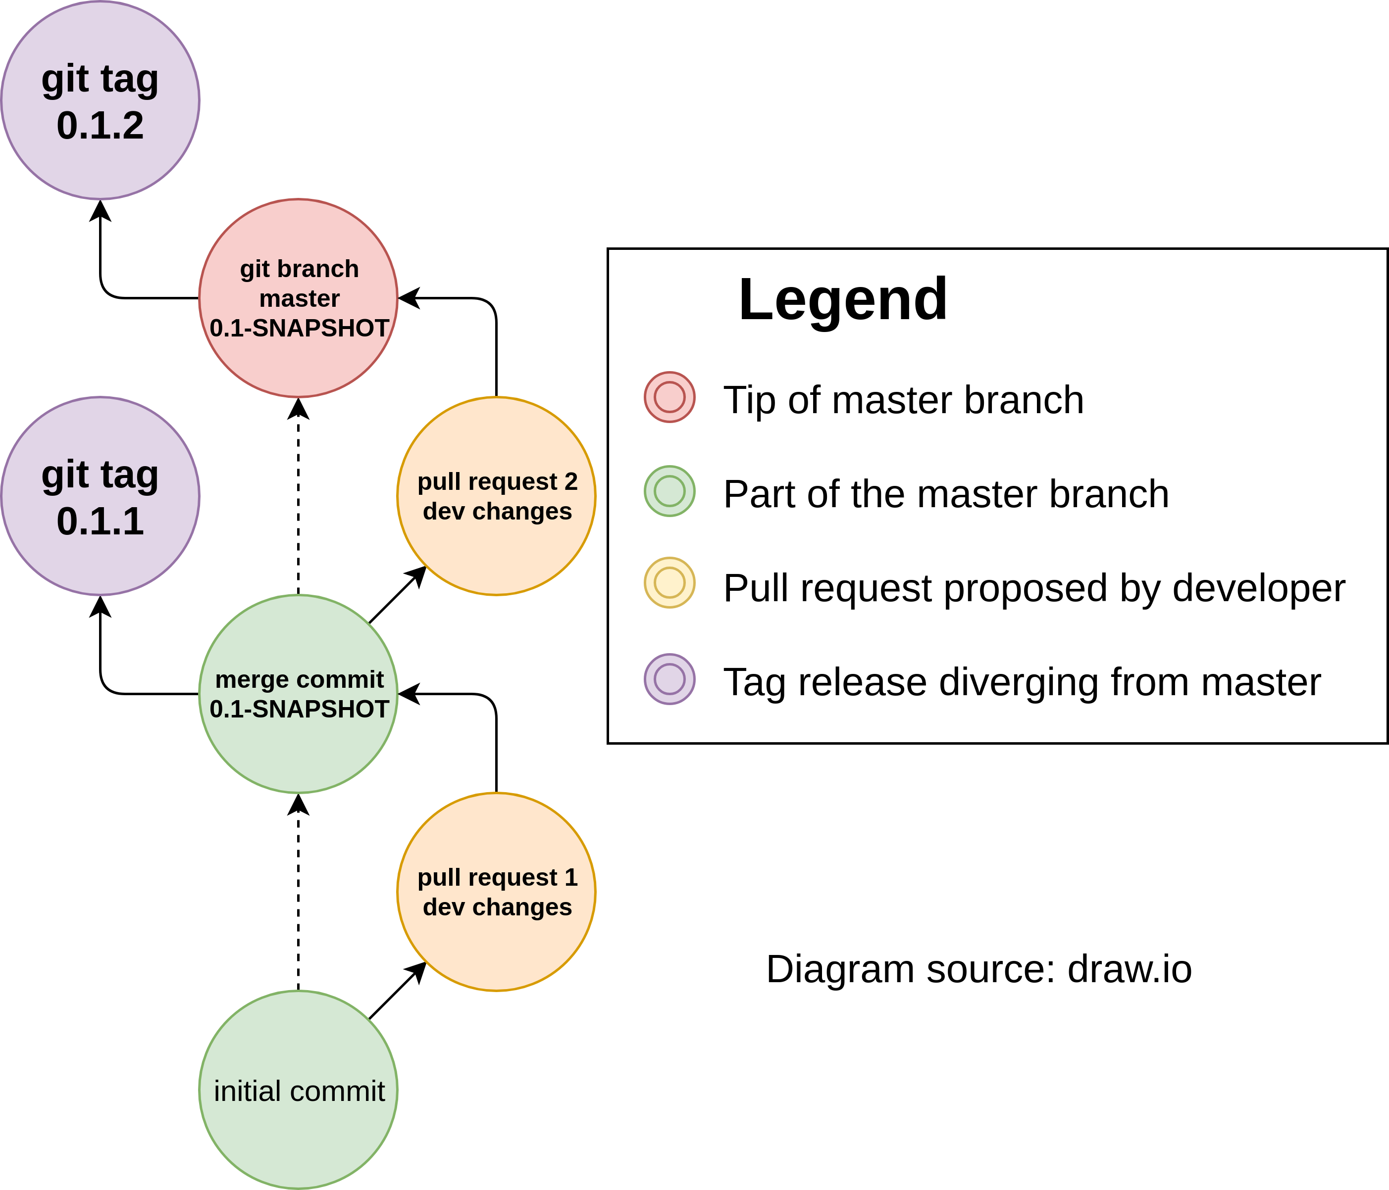
Multi-Member Project Workflow (GitHub Flow With Releases)

Slide 24
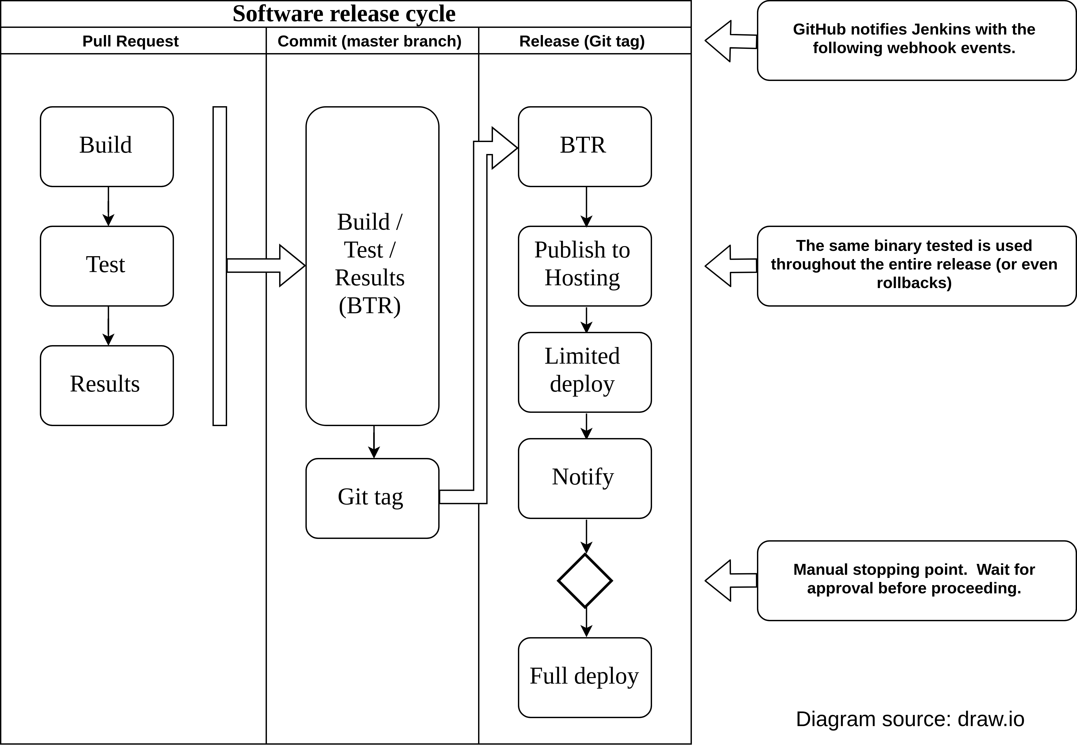
Jenkins Multibranch Pipelines Running GitHub Flow

Slide 25
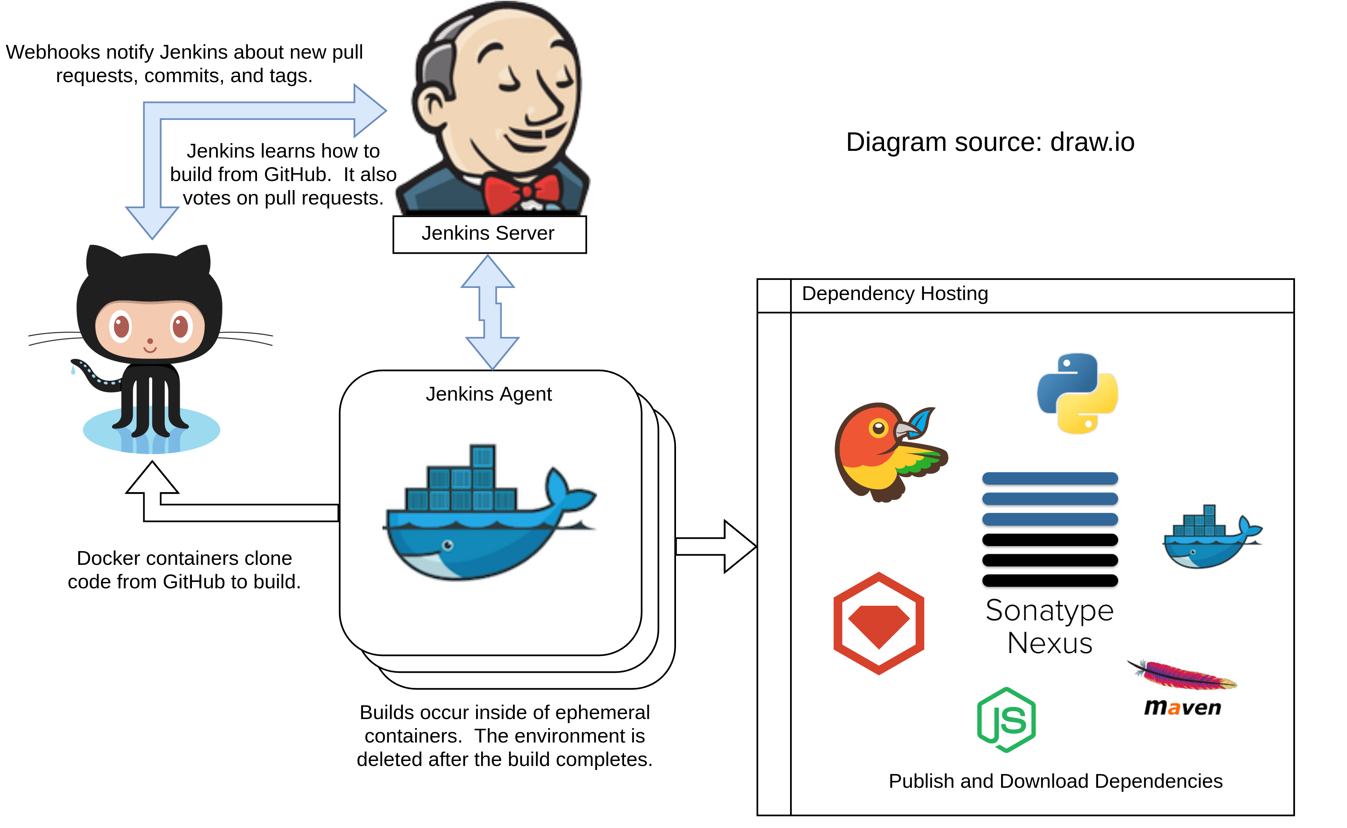
Overview of interactions between Jenkins and GitHub

Slide 26
Managing immutable infrastructure
Jenkins as a Service

Slide 27
Code examples
https://github.com/samrocketman/jenkins-bootstrap-shared
https://github.com/samrocketman/jenkins-bootstrap-jervis
https://github.com/samrocketman/demo-jenkins-world-2018-jenkins-bootstrap
https://github.com/samrocketman/demo-jenkins-world-2018-groovy-jar

Slide 28
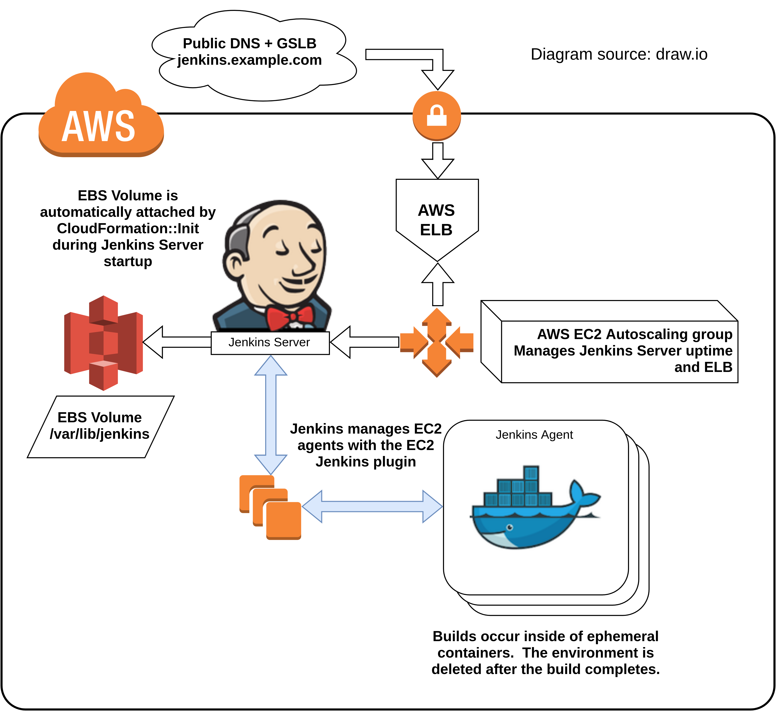
High availability Jenkins
https://medium.com/@sebolabs/jenkins-ha-aws-cd55d82057c8

Slide 29
What do I need to learn?
Let’s be real

Slide 30
Where to start learning...
Jenkins World 2017: Mastering the Jenkins Script Console
Jenkins World 2017: Pipelines At Scale
Groovy and Java programming languages.
Job DSL Scripting (Groovy-based).
Pipeline DSL Scripting (Groovy-based).
Learn how to read Java stack traces.
Familiarize with the Jenkins core code base.
Explore Jenkins plugin code bases as needed.

Slide 31
Tech Demo
Show and tell a real workflow

Slide 32

Organizational impact
Less development down time
Reduced cost of operation
More auditing and security
Reduced time to market
Improved customer experience
https://openclipart.org/detail/186813/profit-high-five-graph-in-perspective

