Slide 1
Scaling developer onboarding
in Fortune 50 and smaller organizations
Sam Gleske – Integral Ad Science

Slide 2

integralads.com

Slide 3
The developer onboarding experience
Eye candy

Slide 4
Basics of self service
Read documentation; add a basic YAML file to repository master branch.
Visit Jenkins and generate jobs with two button clicks.
Iterate and improve release process in a pull request.

Slide 5
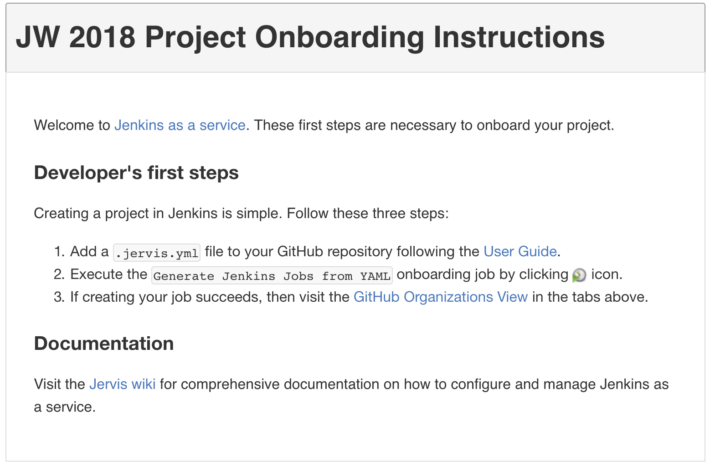
Screenshot of onboarding

Slide 6


Slide 7
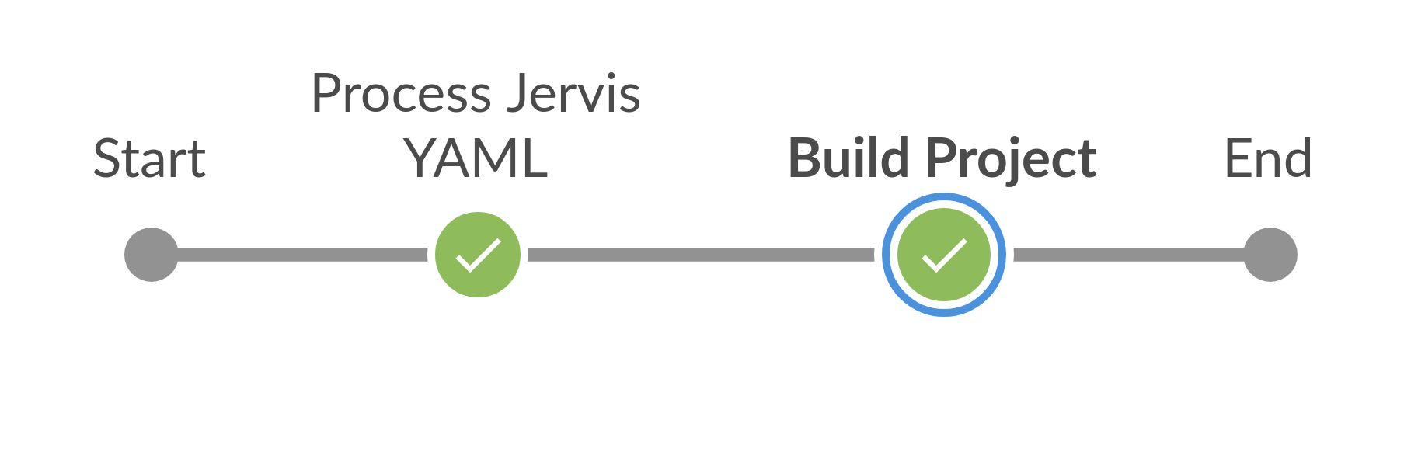

Slide 8
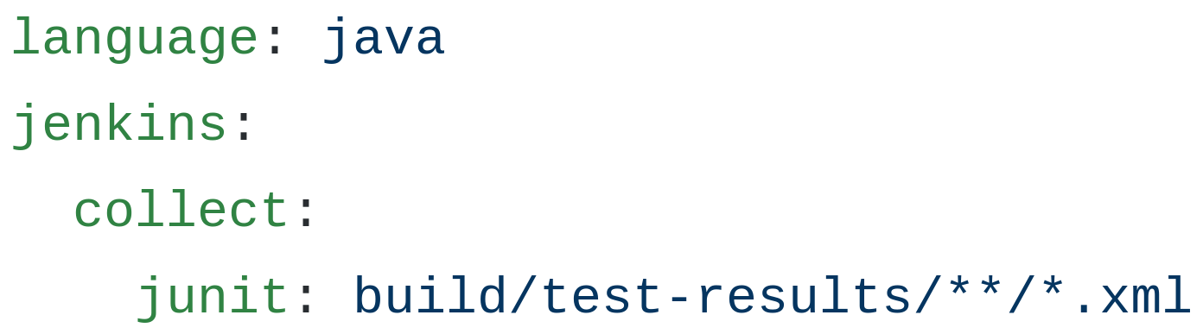

Slide 9
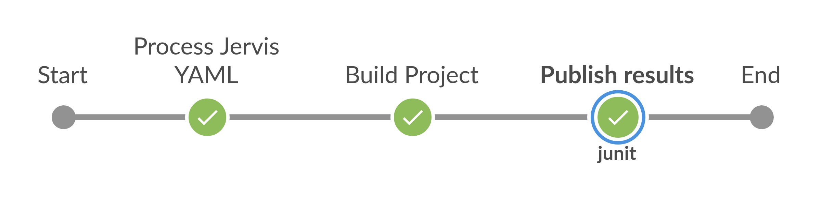

Slide 10
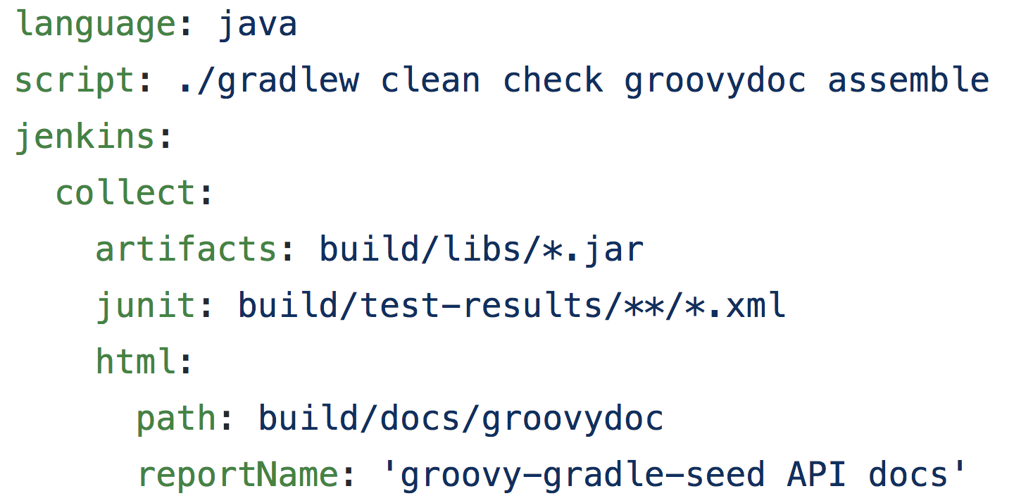

Slide 11
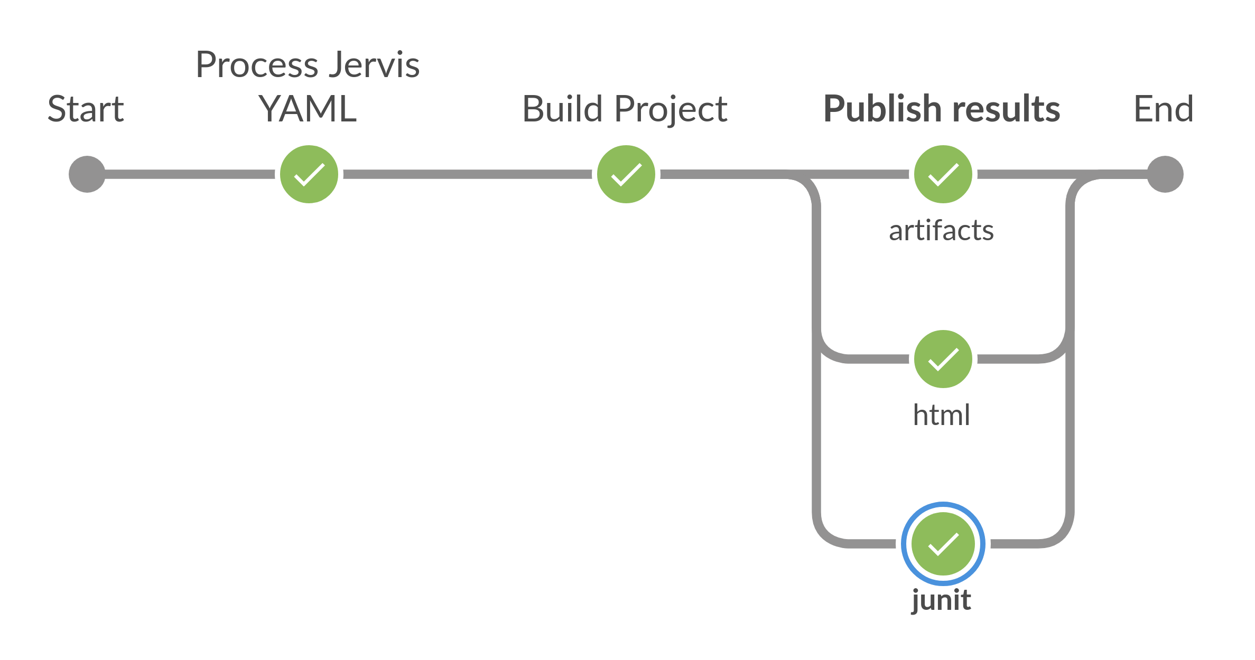

Slide 12
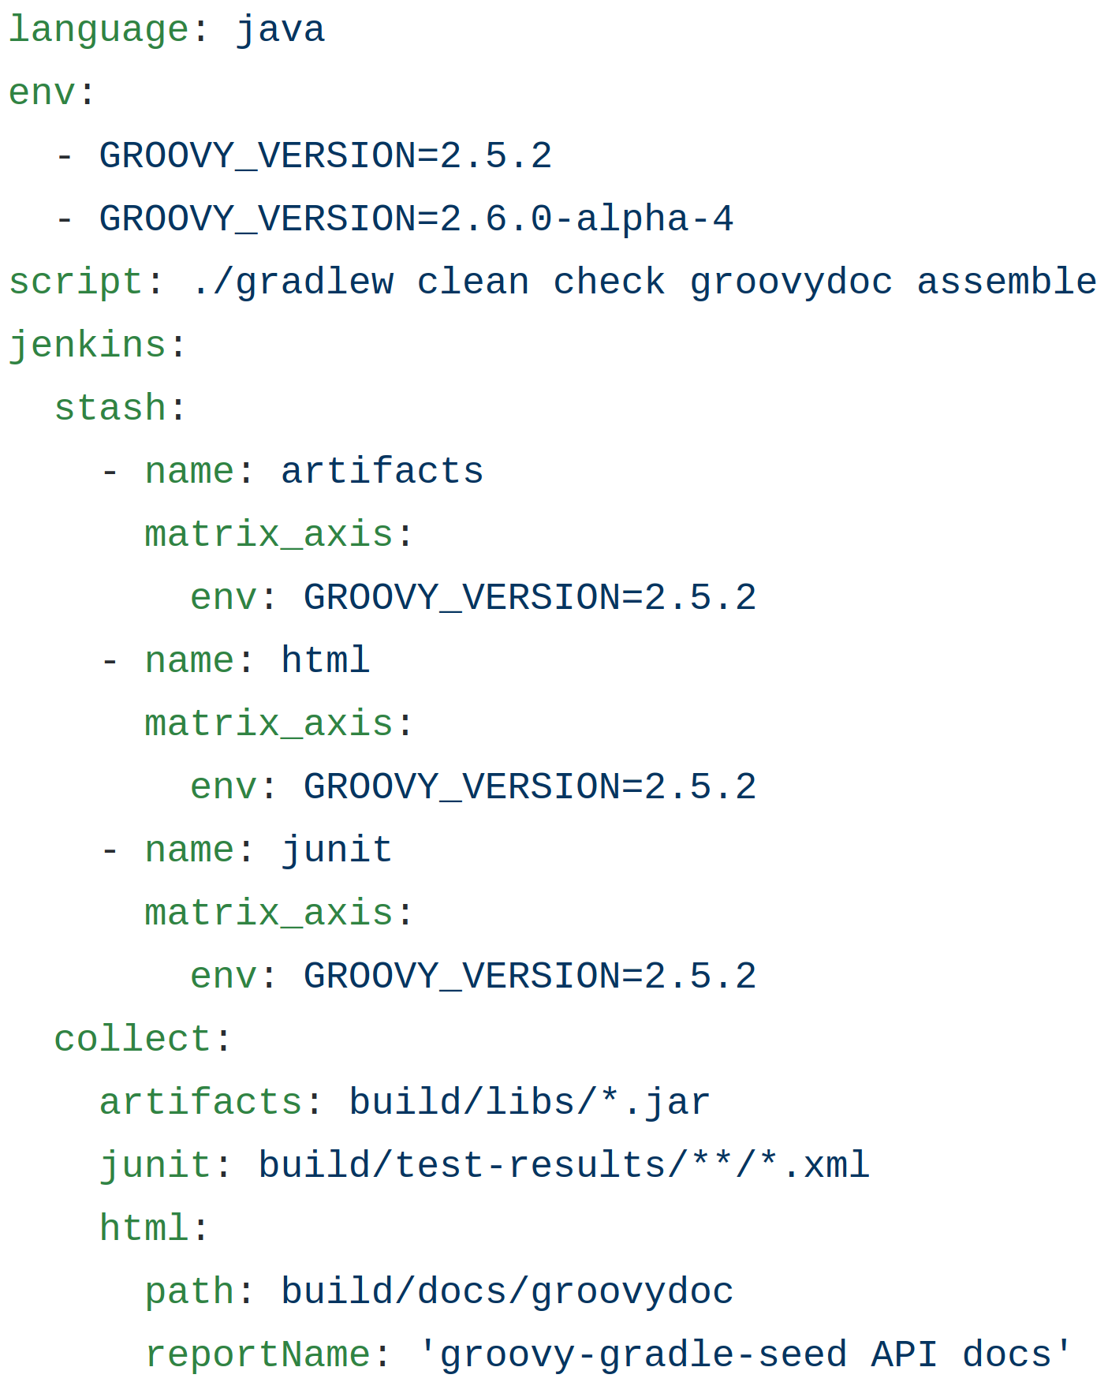

Slide 13
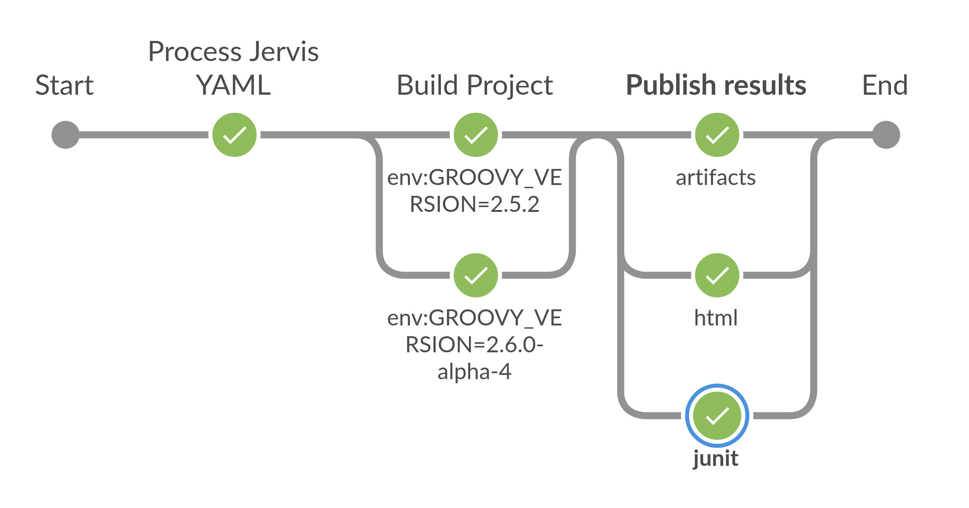

Slide 14
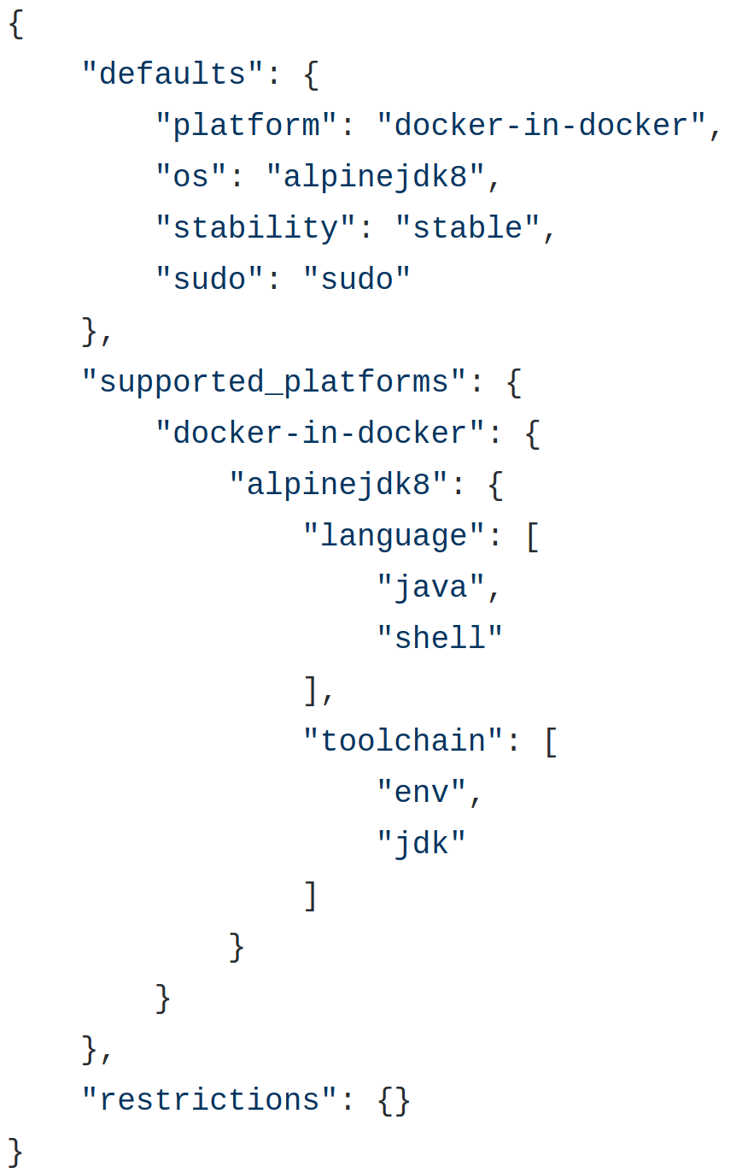
Platforms

Slide 15
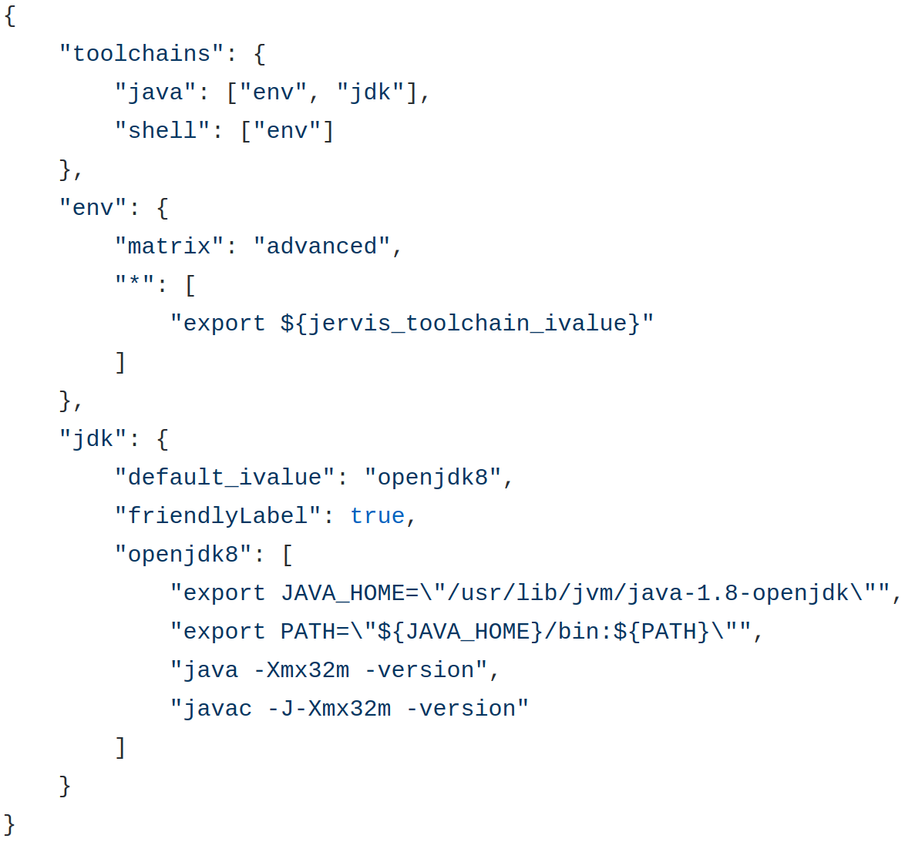
Toolchains

Slide 16
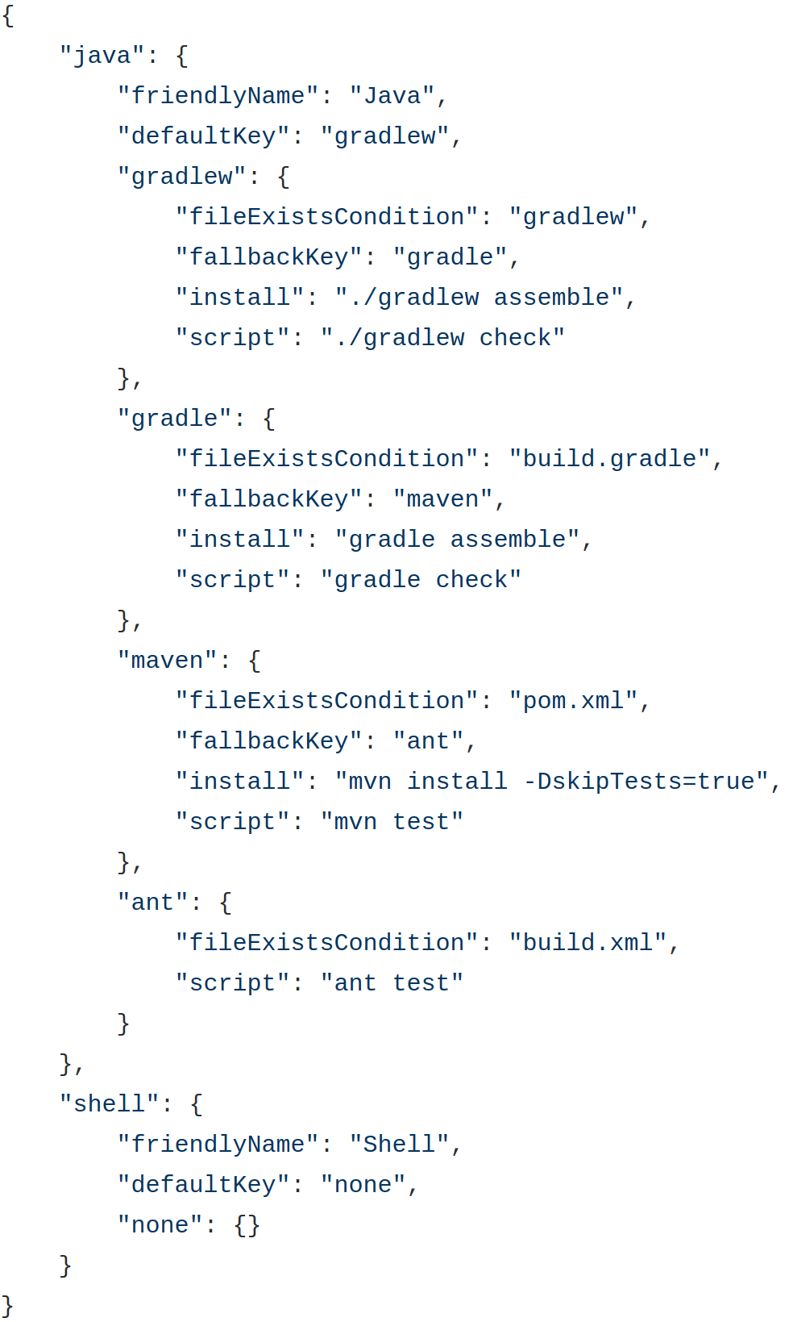
Lifecycles

Slide 17
Jenkins development announcements

Slide 18
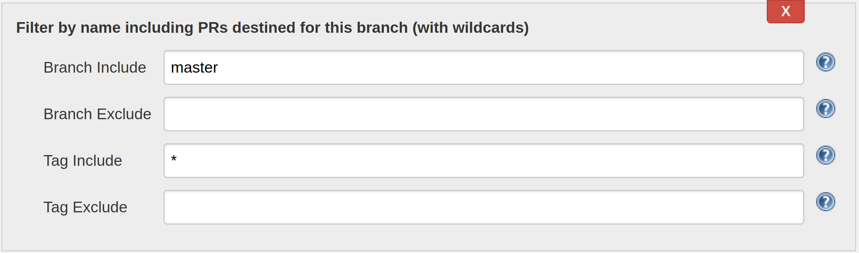
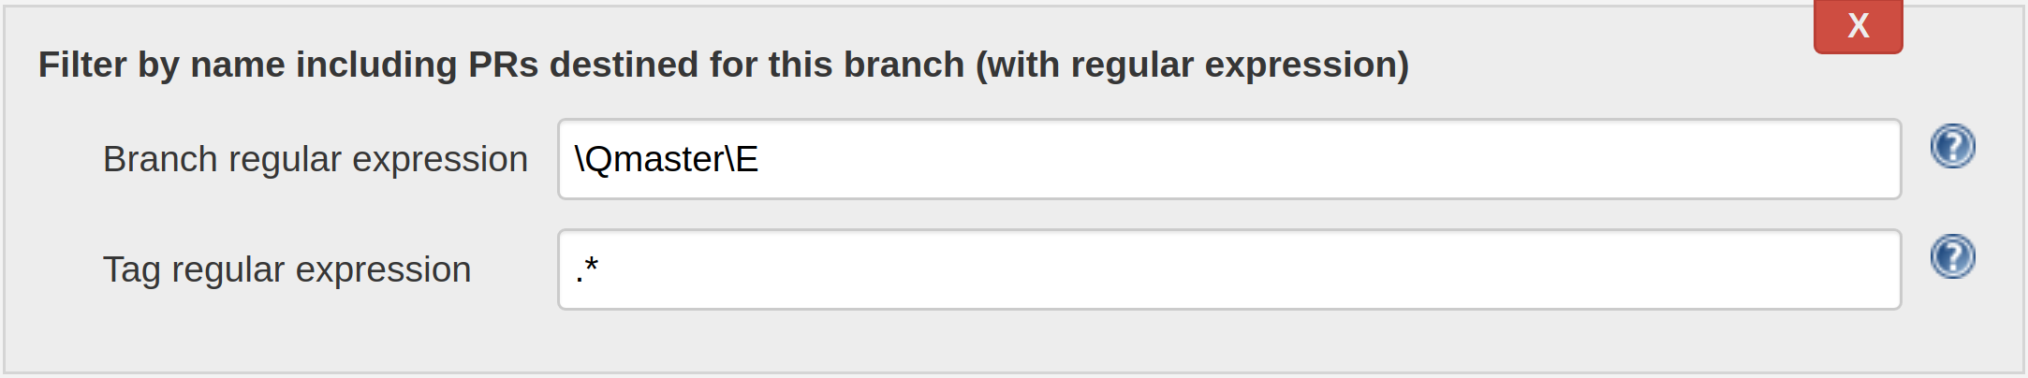
New Jenkins Plugin: SCM Filter Branch PR

Slide 19
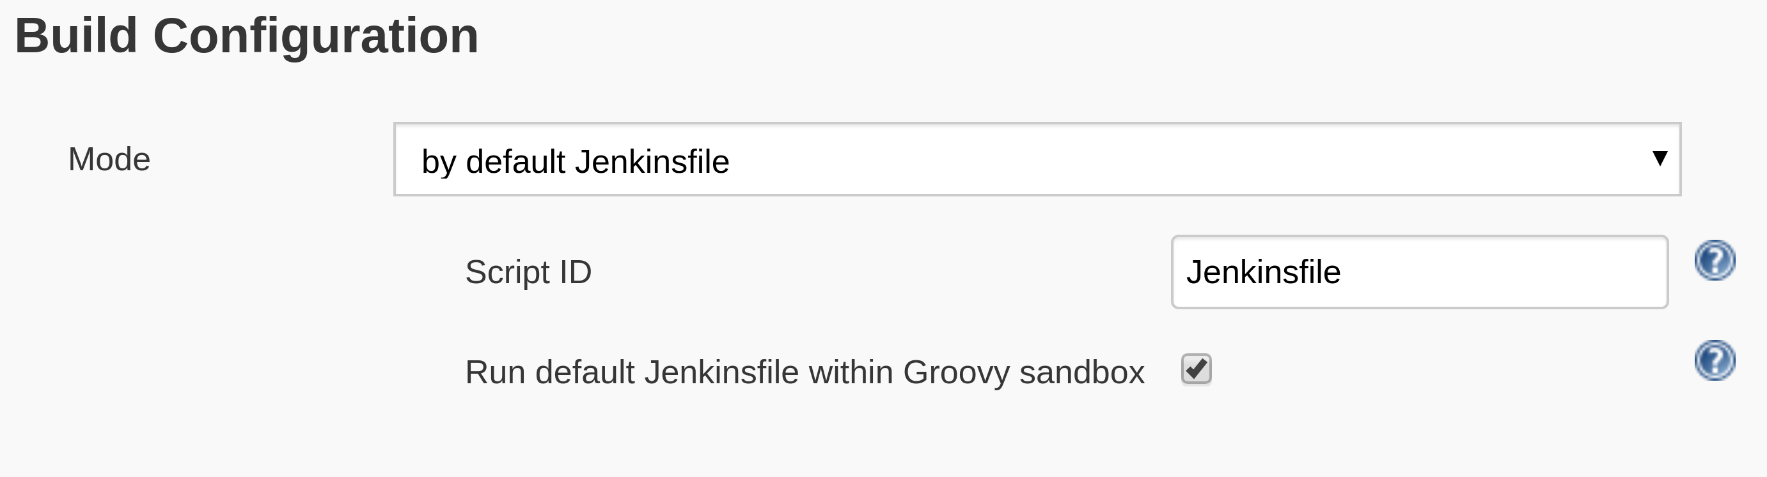
Coming Soon: Pipeline Multibranch With Defaults Sandbox

Slide 20
Jervis 1.0 Is Generally Available
Job DSL library for generating jobs
100% multi-branch pipeline build execution
Shared pipeline library provides isPRBuild() and isTagBuild() conditionals.
Provides IS_PR_BUILD and IS_TAG_BUILD shell variables.
Extensible
  Modify Job DSL scripts via Groovy bindings.
  Shared pipeline library via hasGlobalVar() pipeline step.

Slide 21
Development workflow for delivering software
at scale

Slide 22
Assumptions (and good practices)
In a large organization, engineers don’t want to “learn Jenkins”.
Features of onboarding should be documented to reflect what engineers really know and want out of a CI and CD system
  They know where their code is hosted.
  They know how their project builds.
  They know where their project will end up.

Slide 23
Assumptions (and good practices) Continued
Every project uses pinned versions of dependencies.
  Java-esque (don’t rely on -SNAPSHOT)
  NodeJS (npm shrinkwrap; npm or yarn lock files; if using gulp then same applies)
  Python (pip freeze)
  Ruby (Gemfile.lock)
Cache dependencies from the Internet.
  Insulation
  Reliability
  Archival

Slide 24
Assumptions (and good practices) Continued
Always think about idempotency.
  Configuration as code
  Infastructure as code
  Release pipeline as code
Not just for infrastructure but for release flows as well.
Ask yourself questions:
  What if someone re-runs this Jenkins pipeline? e.g. Rollbacks or branches.
  What if the step I’m executing is already my desired state? Check state and skip it.

Slide 25
Evangelizing a project development workflow
Code repository perspective (development flow)
Events and interactions perspective
System architecture perspective

Slide 26
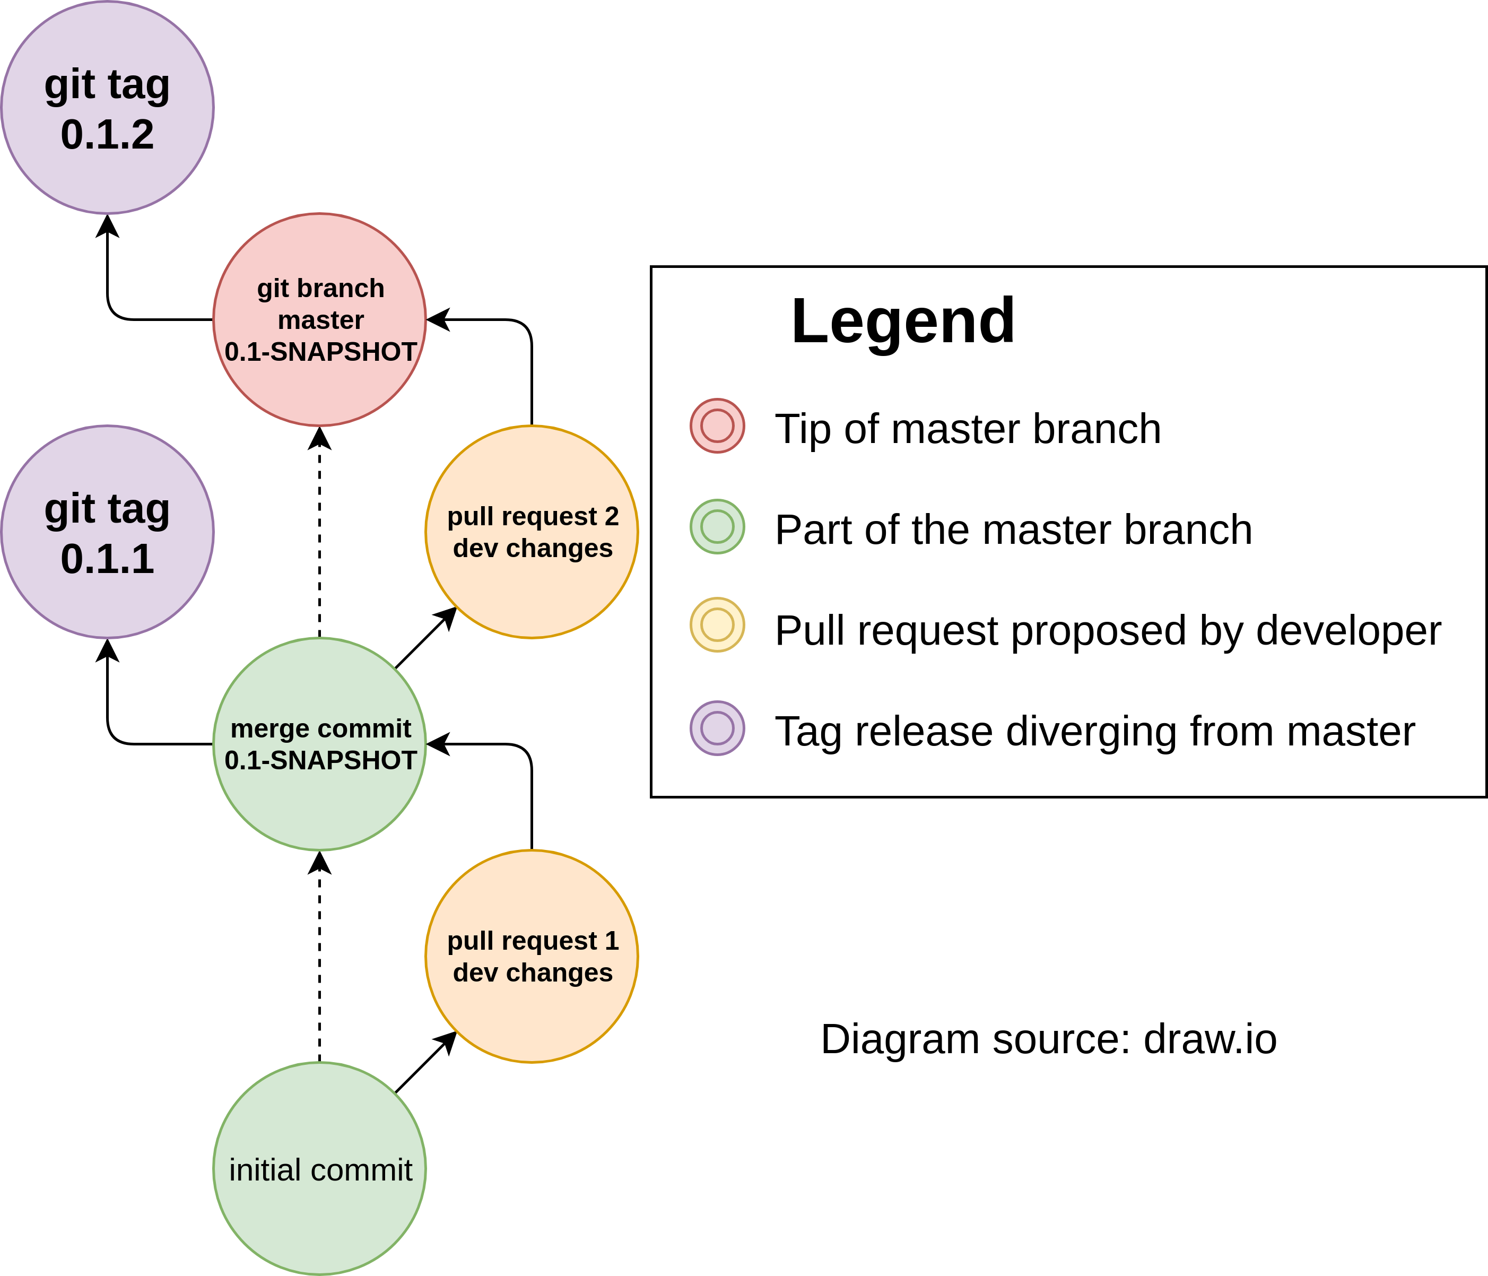
Multi-Member Project Workflow (GitHub Flow With Releases)

Slide 27
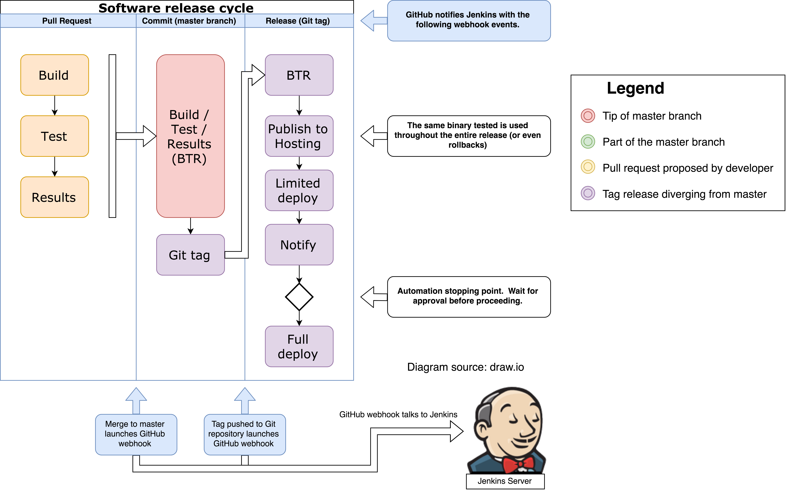
Jenkins Multibranch Pipelines Running GitHub Flow

Slide 28
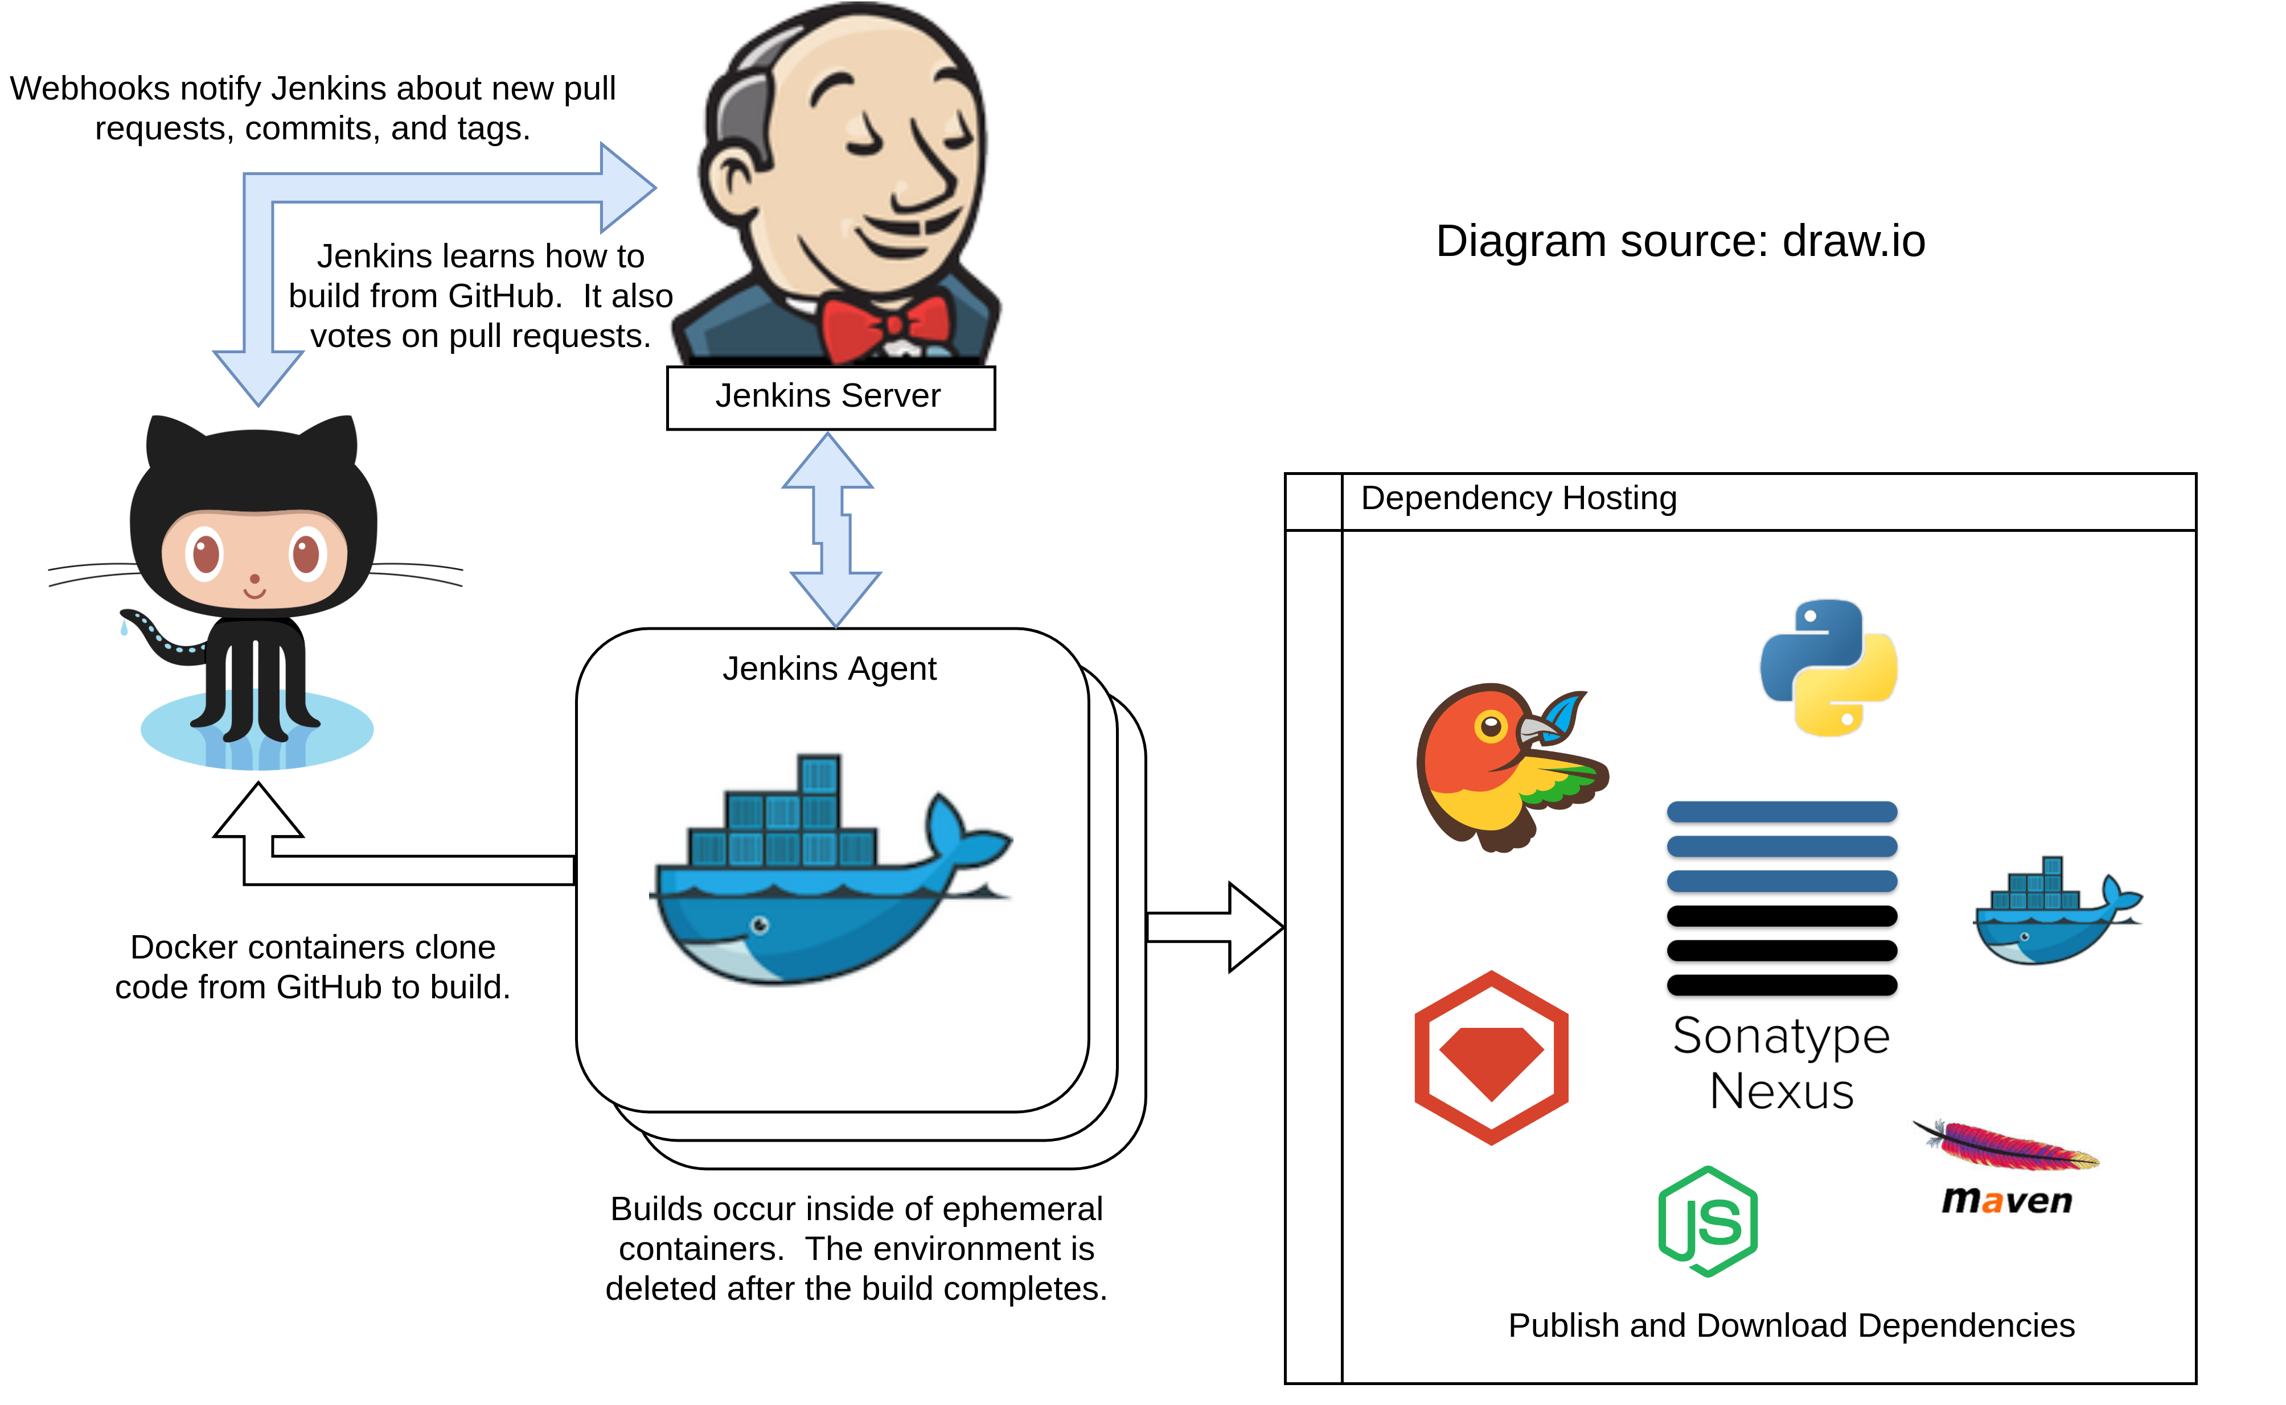
Overview of interactions between Jenkins and GitHub

Slide 29
Managing immutable infrastructure
Jenkins as a Service

Slide 30
Code examples
https://github.com/samrocketman/jervis
https://github.com/samrocketman/jenkins-bootstrap-shared
https://github.com/samrocketman/jenkins-bootstrap-jervis
https://github.com/samrocketman/docker-jenkins-jervis
https://github.com/samrocketman/demo-jenkins-world-2018-jenkins-bootstrap
https://github.com/samrocketman/demo-jenkins-world-2018-groovy-jar

Slide 31
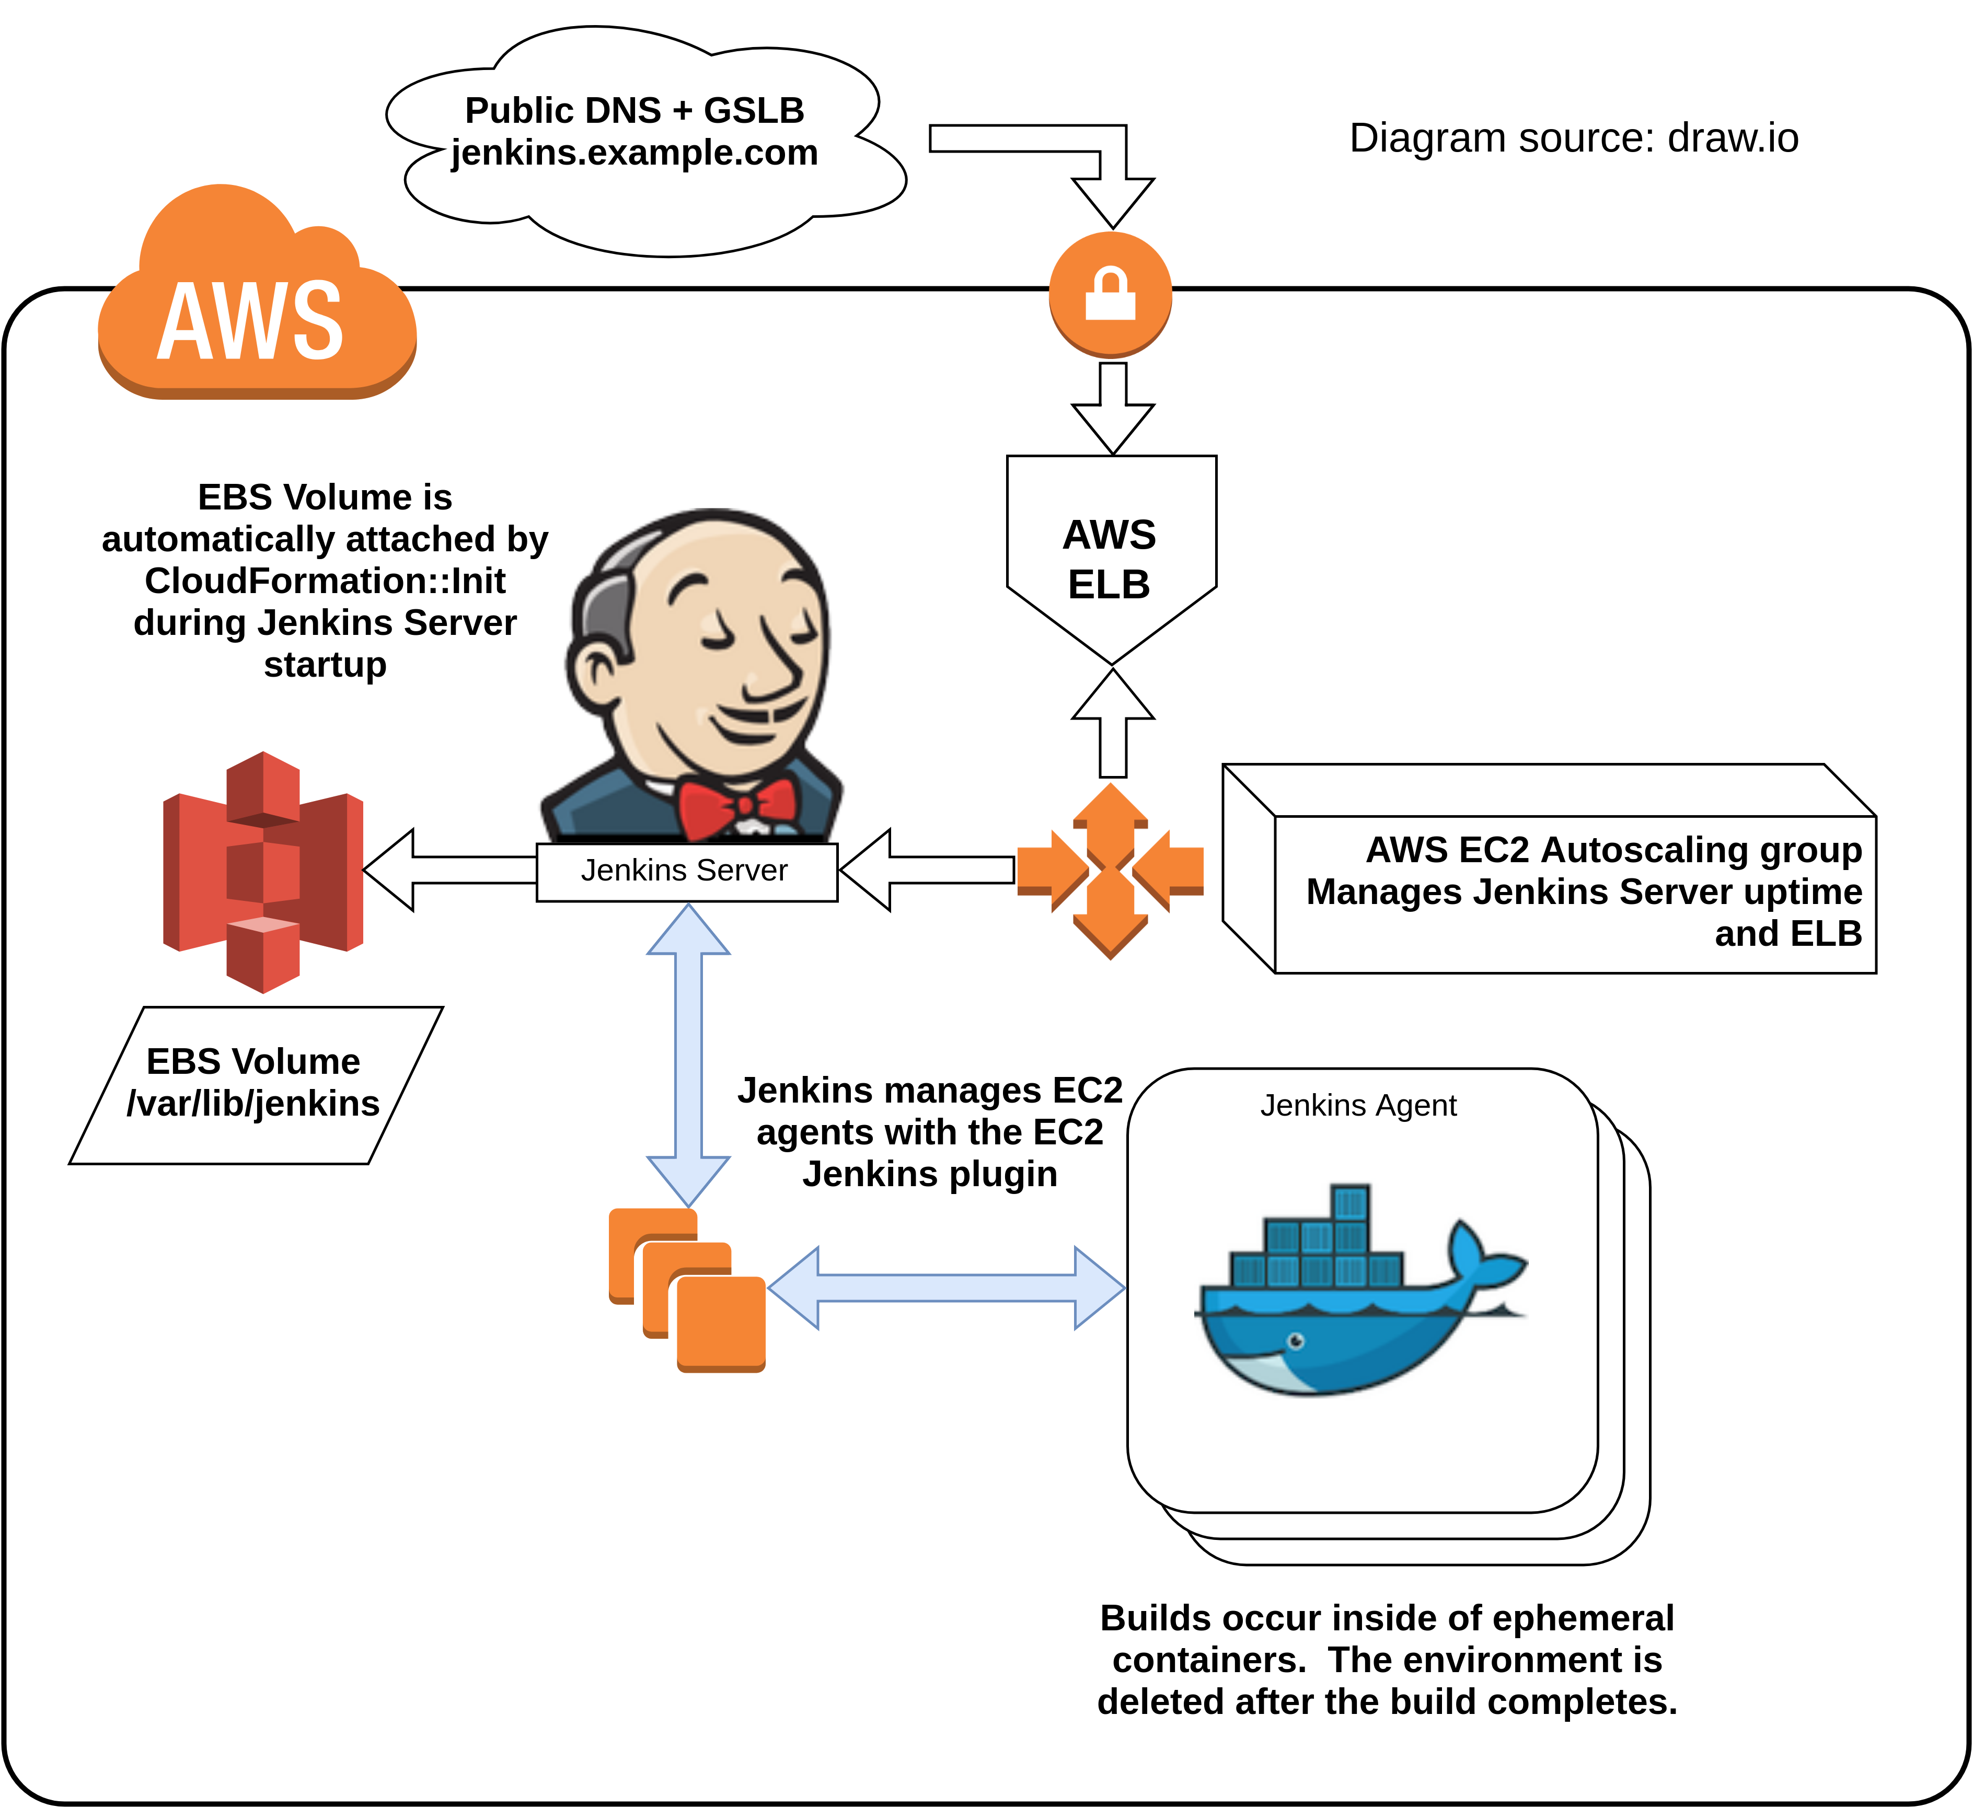
High availability Jenkins
https://medium.com/@sebolabs/jenkins-ha-aws-cd55d82057c8

Slide 32
What do I need to learn?
Let’s be real

Slide 33
Where to start learning...
Jenkins World 2017: Mastering the Jenkins Script Console
Jenkins World 2017: Pipelines At Scale
Groovy and Java programming languages.
Job DSL Scripting (Groovy-based).
Pipeline DSL Scripting (Groovy-based).
Learn how to read Java stack traces.
Familiarize with the Jenkins core code base.
Explore Jenkins plugin code bases as needed.

Slide 34
Tech Demo
Show and tell a real workflow

Slide 35

Organizational impact
Less development down time
Reduced cost of operation
More auditing and security
Reduced time to market
Improved customer experience
https://openclipart.org/detail/186813/profit-high-five-graph-in-perspective

