Slide 1
Interpretable Data Models
Understanding the Why Behind Data-Driven Predictions

Slide 2
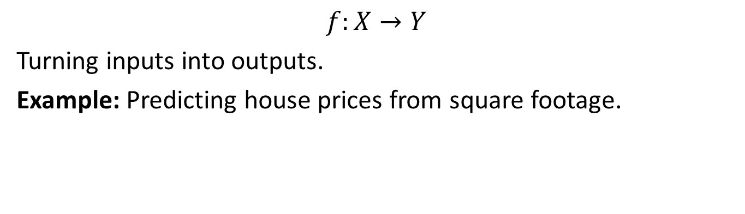
The Core Idea
Data Models as Functions
A data model is a function that represents how variables relate.
$$f:X→Y$$
Turning inputs into outputs.
Example: Predicting house prices from square footage.
Notes:
Data models can take different functional forms - either direct mappings or probability distributions.

Slide 3
What is Interpretability?
One-Liner Definition
An interpretable data model is a function whose structure is simple enough that humans can understand the relationships it encodes.
Notes:
The key is that the structure must be simple enough for human understanding.

Slide 4
Key Characteristics
Clear structure: easily understood relationships
Human-scale parameters: coefficients, thresholds that make intuitive sense
Traceable reasoning: ability to explain how predictions were reached
Notes:
These three characteristics make a model interpretable to humans.

Slide 5
Interpretability vs Explainability
Interpretability
Definition: The degree to which a model’s internal structure, parameters, and decision-making process can be understood by humans without requiring additional explanation tools.
Focus: Built-in transparency of the model itself.
Notes:
Interpretability is about the model’s inherent transparency.

Slide 6
Interpretability vs Explainability
Explainability (strictre concept than interpretability)
Definition: The ability to provide clear, causal reasoning for why a model made a specific prediction.
Focus: Post-hoc analysis and explanation of model decisions.
Notes:
Explainability comes after the fact and requires causal understanding.

Slide 7
The Causal Reasoning Challenge
Correlation vs. Causation in Explanations
Most “explanations” from data models are actually just descriptions of correlations.
True explainability requires causal reasoning.
Notes:
This is a critical distinction - correlation is not causation.

Slide 8
Example: Correlation vs Causation
Correlational explanation: “Maternal Tylenol use during pregnancy is associated with autism diagnosis in children”
Causal explanation: “Maternal symptoms X, Y, and Z during pregnancy lead to both increased Tylenol use and increased autism risk in the child.”
Notes:
The difference matters for actionability and trust.

Slide 9
Why Interpretability Matters
The Core Benefits
Trust: Users and stakeholders can validate and believe results
Actionability: Insights can be acted on because the logic is clear
Debuggability: Problems can be identified and corrected
Ethics: Transparency helps detect bias and unintended consequences
Notes:
These four benefits make interpretability crucial for real-world applications.

Slide 10
The Problem with Black Boxes
“The problem is that a single metric, such as classification accuracy, is an incomplete description of most real-world tasks.” - Doshi-Velez and Kim (2017)
Notes:
Accuracy alone doesn’t tell the whole story about model performance.

Slide 11
The Trade-off
Do you just want to know what is predicted?
Or do you want to know why the prediction was made and possibly pay for the interpretability with a drop in predictive performance?
Notes:
This is the fundamental trade-off in model selection.

Slide 12
Key Reasons for Interpretability
Human Curiosity & Learning
Humans have a mental model of their environment that is updated when something unexpected happens.
This update is performed by finding an explanation for the unexpected event.
Notes:
Humans naturally seek explanations to update their understanding.

Slide 13
Example: Human Learning
A human feels unexpectedly sick and asks, “Why do I feel so sick?”
They learn that they get sick every time they eat those red berries.
They update their mental model and decide that the berries caused the sickness.
Notes:
This is how humans naturally learn through explanation.

Slide 14
Scientific Discovery
In many scientific disciplines, there is a change from qualitative to quantitative methods, and also towards data-driven modeling.
The goal of science is to gain knowledge, but many problems are solved with big datasets and complex statistical models.
Notes:
Science is moving toward data-driven approaches.

Slide 15
The Model as Knowledge Source
The model itself becomes the source of knowledge instead of the data.
Interpretability makes it possible to extract this additional knowledge captured by the model.
Notes:
Models can capture knowledge that goes beyond the original data.

Slide 16
Safety & Testing
Data models take on real-world tasks that require safety measures and testing.
Example: A self-driving car automatically detects cyclists based on a computer vision system.
You want to be 100% sure that the abstraction the system has learned is error-free because running over cyclists is very bad.
Notes:
Safety-critical applications require interpretability for validation.

Slide 17
Bias Detection
By default, data models pick up biases from the training data.
This could make your models discriminate against underrepresented groups.
Interpretability is a useful debugging tool for detecting bias in data models.
Notes:
Bias detection is crucial for fair AI systems.

Slide 18
Social Acceptance
The process of integrating machines and algorithms into our daily lives requires interpretability to increase social acceptance.
Example: Our vacuum cleaner “DustBot” gets stuck. As an explanation for the accident, DustBot tells us that it needs to be on an even surface. This creates shared meaning and trust.
Notes:
Explanations help build trust between humans and AI systems.

Slide 19
When Do We NOT Need Interpretability?
Low-Impact Scenarios
Interpretability is not required if the consequences of being wrong are minimal or acceptable.
Example: Sarah’s personal Spotify playlist predictor that suggests songs she might like based on her listening history.
Notes:
Low-stakes applications may not need interpretability.

Slide 20
Well-Studied Problems
Some applications have been sufficiently well studied so that there is enough practical experience with the model.
Example: Statistical models for optical character recognition that process images of envelopes and extract addresses.
These systems have been in use for many years, and it’s clear that they work.
Notes:
Proven applications may not need additional interpretability.

Slide 21
Gaming Prevention
Interpretability might enable people or programs to manipulate the system.
Example: Facebook’s content ranking algorithm where users might manipulate their posts to game the system if they know which features affect visibility in their friends’ feeds.
Notes:
Sometimes transparency can be exploited.

Slide 22
What Makes a Good Explanation?
Characteristics of Human-Friendly Explanations
Notes:
These characteristics make explanations more effective for humans.

Slide 23
Contrastive
Humans usually don’t ask why a certain prediction was made, but why this prediction was made instead of another prediction.
Example: For a house price prediction, the house owner might be interested in why does this beautiful house seem so cheap?
Notes:
People want to understand why one outcome occurred instead of another.

Slide 24
Selected
People don’t expect explanations that cover the actual and complete list of causes of an event.
We are used to selecting one or two causes from a variety of possible causes as THE explanation.
What it means for data modeling: Make the explanation short, give only 1 to 3 reasons, even if the world is more complex.
Notes:
Humans prefer simple explanations over complex ones.

Slide 25
Audience-focused
Explanations are part of a conversation or interaction between the explainer and the receiver of the explanation.
Example: Explaining cryptocurrencies to a technical person vs. to your grandmother would be completely different.
Notes:
Good explanations are tailored to the audience.

Slide 26
Focus on Abnormal
People focus more on abnormal causes to explain events.
These are causes or effects that were not expected but nevertheless happened.
Example: Viagra was originally developed as a heart medication, but researchers discovered its unexpected side effect during clinical trials.
Notes:
Unexpected outcomes get more attention in explanations.

Slide 27
Truthful
Good explanations prove to be true in reality (i.e., in other situations).
Example: GPS satellites need to account for time dilation effects from Einstein’s theory of relativity.
The satellites’ clocks run faster in orbit due to weaker gravity, and this relativistic effect would cause GPS to be off by about 11 kilometers per day if not corrected.
Notes:
Truthful explanations have predictive power.

Slide 28
Consistent with Prior Beliefs
Humans often judge arguments by whether the conclusion fits their beliefs, rather than whether both their assumptions and their the reasoning are logically valid.
This is called the belief bias effect.
Notes:
People tend to accept explanations that align with their existing beliefs.

Slide 29
Classic Experiment (Evans, Barston & Pollard, 1983)
Premise 1: All mammals can walk.
Premise 2: Whales are mammals.
Conclusion: Whales can walk.
Although the conclusion is logically valid, it is completely unbelievable. Despite this, approximately 50% of participants would judge conclusions like this as true.
Notes:
This demonstrates how beliefs can override logical reasoning.

Slide 30
The Dark Side
While belief consistency makes explanations more “human-friendly,” it’s arguably not very friendly to our future as a society.
We’re essentially designing systems that reinforce existing biases rather than challenging them.
Notes:
This is a critical ethical consideration for AI systems.

Slide 31
Example: Loan Approval Model
The Problem
A bank uses a statistical model to approve or reject loan applications.
The model performs well on test data, but applicants (and regulators) want to understand why decisions are made.
Notes:
This is a real-world example where interpretability is crucial.

Slide 32
Without Interpretability
Applicant: “Why was my loan rejected?”
Bank: “The model said no.”
Result: Frustration, lack of trust, potential discrimination
Notes:
Black box decisions lead to problems.

Slide 33
With Interpretability
Applicant: “Why was my loan rejected?”
Bank: “Your application was rejected because your debt-to-income ratio is 45% (our threshold is 40%) and you have two recent late payments. If you can reduce your debt-to-income ratio to below 40% and maintain on-time payments for 6 months, you would likely be approved.”
Result: Clear guidance, trust, actionable steps
Notes:
Interpretable decisions provide clear guidance and build trust.

Slide 34
Legal Requirements
Banks Must Provide Interpretability
Equal Credit Opportunity Act (ECOA) - Requires lenders to provide “adverse action notices” that explain why credit was denied, including the specific reasons for the decision.
Notes:
This is a legal requirement, not just a best practice.

Slide 35
Interpretable Models
Linear regression: Clear coefficients and additive structure
Decision trees: Simple if-then rules
Simple Bayesian models: Transparent conditional probabilities
Rule-based systems: Explicit logical statements
Notes:
These model types are inherently interpretable.

Slide 36
Less Interpretable Models
Deep neural networks: Complex non-linear transformations
Ensemble models: Random forests, gradient boosting (without explanation tools)
Support vector machines: High-dimensional transformations
Complex statistical models: Many interactions and non-linearities
Notes:
These models are harder to interpret but may be more accurate.

Slide 37
In Short
Interpretability means models aren’t just accurate — they’re understandable.
Notes:
This is the key takeaway from the interpretability discussion.

Slide 38
Linear Regression Example
BuildIt Inc. House Flipping
BuildIt Inc. flips houses - they buy houses to quickly renovate and then sell.
Their specialty is building additions on to existing houses in established neighborhoods and then selling the home at prices above their total investment.
Notes:
This is a practical business example of using interpretable models.

Slide 39
BuildIt’s Decision Criteria
BuildIt’s decision to move into a neighborhood is based on how sales price fluctuates with square footage.
If sales price seems to increase by more than $120 per additional square foot, then they consider that neighborhood to be a good candidate for buying houses.
Notes:
They have a clear business rule based on interpretable metrics.

Slide 40
BuildIt’s Data
Here is the python code that creates a dataframe with BuildIt’s data (note: salesPrice is in thousands of dollars):
## make two data arrays representing observations ## of six home sales salesPrice = [160, 220, 190, 250, 290, 240] sqFootage = [960, 1285, 1350, 1600, 1850, 1900]
Notes:
This is the actual data they collected.

Slide 41
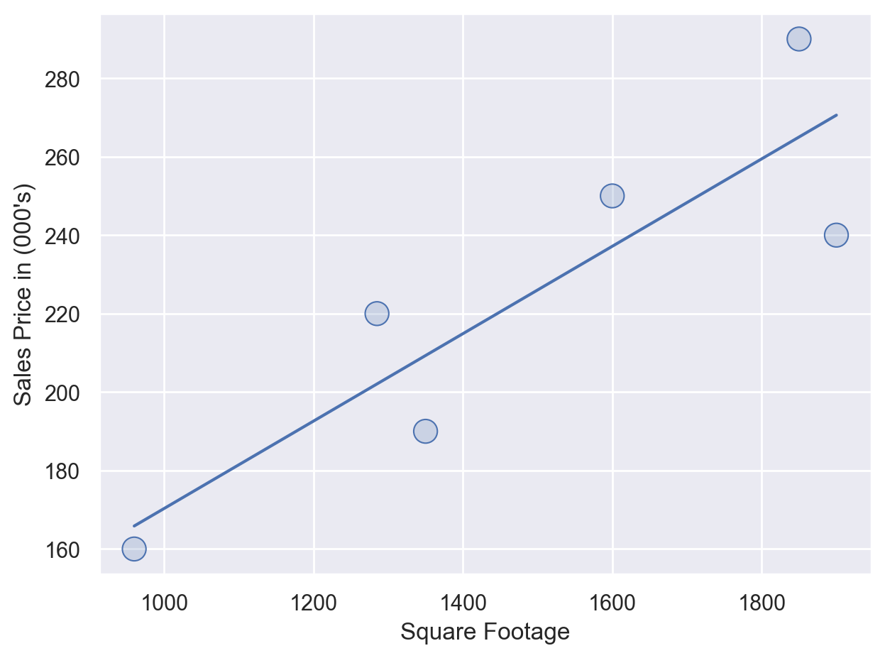
Visualizing the Relationship
Visually, we can confirm what appears to be a linear relationship between square footage and sales prices by creating a scatterplot with a linear regression line drawn in blue:
Notes:
The visualization helps confirm the linear relationship.

Slide 42
BuildIt’s Key Question
BuildIt is interested in the slope of this line which gives the estimated change in mean sales price for each unit change in square footage.
For BuildIt, they want to know if this slope is above $120 per square foot because at that price point the firm is confident it can make money?
Notes:
The slope is the key business metric they need to understand.

Slide 43
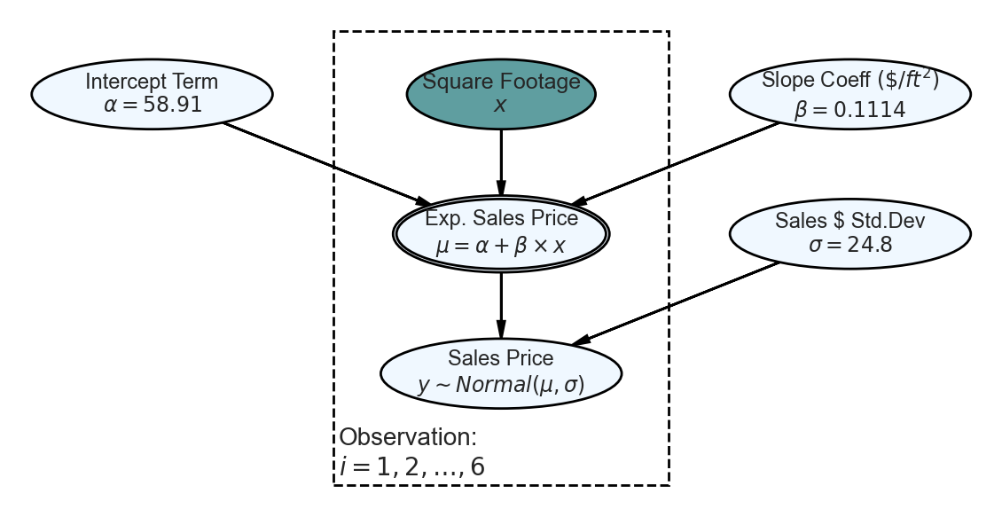

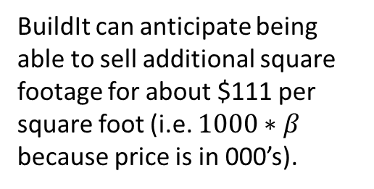
Based on the output, the following linear equation is the so-called “best” line:
$$μ_{i}=58.91+0.1114×x_{i}$$
BuildIt can anticipate being able to sell additional square footage for about $111 per square foot (i.e. $1000∗β$ because price is in 000’s).
Notes:
This is the mathematical model that describes the relationship.

