Slide 1


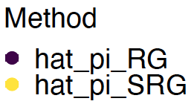
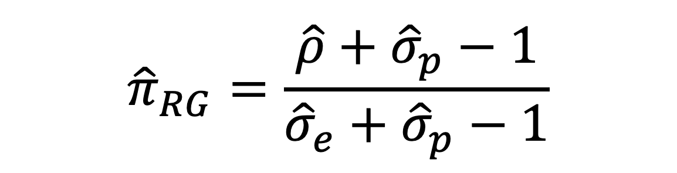
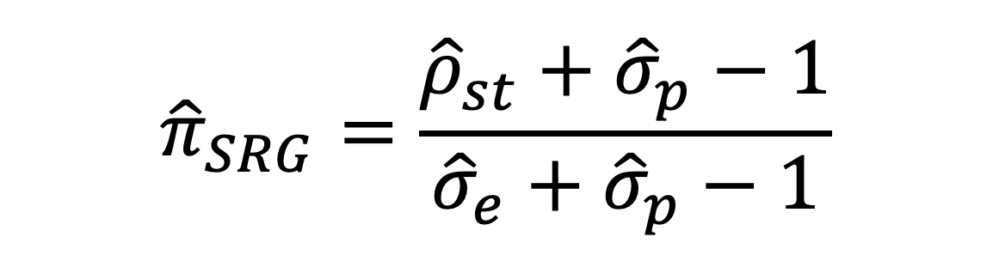



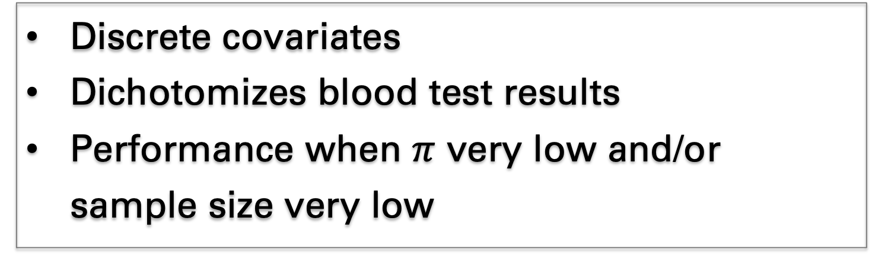



Estimating SARS-CoV-2 Seroprevalence,
Addressing Measurement Error and Selection Bias
Samuel Rosin and Michael G. Hudgens | Dept. of Biostatistics, U. of North Carolina at Chapel Hill
Research Questions
Measurement Error
Selection bias
ScreenNC
Estimators exist for measurement error, selection bias
Combine the two?
Large-sample properties?
Variance estimation?
Example
Prevalence $π$ 1%
Blood test 100 people
Sensitivity $σ_{e}=1$
Specificity $σ_{p}$ .95
Results: 1 true $+$s, 4 false $+$s,
95 true $−$s: $\hat{ρ}=0.05≠0.01$
Estimator: MLE (R & G, 1978):
Direct standardization on discrete covariates Z
${\hat{ρ}}_{j}$ proportion in stratum j
$P\left(Z=z_{j}\right)$ known from target population
Estimator:
Assume stratified random sample on Z from infinite target pop, other regularity conditions:
${\hat{π}}_{SRG}$ consistent, asymptotically Normal with simple empirical variance estimator
Convenience sample in UNC Health Network
Standardized by age (7 strata), race (5), sex (2)
Estimates with 95% CIs:
${\hat{π}}_{RG}$: 0% (0%, 1.0%)
${\hat{π}}_{SRG}$: 0% (0%, 1.1%)*
${\hat{π}}_{SRGM}$: 0% (0%, 4.1%)
*Target population excluded 3 strata
$${\hat{ρ}}_{st}=∑{ \hat{ρ}}_{j} × P(Z=z_{j})$$
$${\hat{π}}_{SRG}=\frac{{\hat{ρ}}_{st}+{\hat{σ}}_{p}−1}{{\hat{σ}}_{e}+{\hat{σ}}_{p}−1}$$
Problem Setup
Estimand: prevalence $π$,
but $π≠ρ=P\left(Test+\right)$ mostly
Three datasets:
Sensitivity $σ_{e}=P\left(Test+ | +\right)$ estimated from true $+$s
Specificity$σ_{p}=P\left(Test− | −\right)$ from true $−$s
$π$ from main study
$${\hat{π}}_{RG}=\frac{\hat{ρ}+{\hat{σ}}_{p}−1}{{\hat{σ}}_{e}+{\hat{σ}}_{p}−1}$$
Limitations
Discrete covariates
Dichotomizes blood test results
Performance when $π$ very low and/or sample size very low
Simulations
One scenario
2 strata
$σ_{e}=.95$, main study size$5000$
$σ_{p}$, $π$, sens/spec sample sizes vary
Not pictured:
${\hat{π}}_{SRG}$ also less biased than ${\hat{π}}_{RG}$ when $π>.05,$ sample sizes larger
References & Acknowledgements
We thank the ScreenNC participants and research team. The content is solely the responsibility of the authors.
References and acknowledgements of financial support can be found in the slide notes.
Code at https://github.com/samrosin/rgStandardized
Notes:
References:
(1) Barzin, A., Schmitz, J. L., Rosin, S., et al. (2020). SARS-CoV-2 Seroprevalence among a Southern U.S. Population Indicates Limited Asymptomatic Spread under Physical Distancing Measures. MBio, 11 (5), e02426-20. https://doi.org/10.1128/mBio.02426-20.
(2) Rogan, W. J., & Gladen, B. (1978). Estimating Prevalence from the Results of a Screening Test. American Journal of Epidemiology, 107 (1).
Acknowledgments: This research was supported by the National Institutes of Health (Grant R01 AI085073), the University of North Carolina at Chapel Hill Center for AIDS Research (Grant P30 AI050410), and the National Science Foundation (Grant GRFP DGE-1650116).

