Slide 1

A Case Study on Coronary Heart Disease using Machine Learning Techniques
This presentation explores the application of machine learning techniques to predict coronary heart disease (CHD), analyzing a real-world case study with rich medical data. Discover how predictive models are used for early detection, personalized treatment, and improving patient outcomes.

Slide 2
Introduction to Coronary Heart Disease (CHD)
What is CHD?
Impact of CHD
Coronary Heart Disease (CHD) occurs when the coronary arteries become narrowed or blocked, leading to reduced blood flow to the heart.
CHD is one of the leading causes of death worldwide, affecting millions of people.

Slide 3

Machine Learning Overview
1
Machine Learning
2
Types of Machine Learning
3
Machine Learning in Healthcare
A method of data analysis that automates analytical model building. It enables computers to learn from data without explicit programming.
Supervised, Unsupervised, and Reinforcement Learning are the main types of machine learning algorithms.
Machine learning models can identify patterns in medical data that are difficult to detect through traditional methods.

Slide 4
Data Used in CHD Prediction
Dataset
Target Variable
The case study uses a dataset of patient records with features such as age, gender, blood pressure, cholesterol levels, smoking status, diabetes status, family history, and ECG results.
The presence of CHD is the target variable: 0 = No, 1 = Yes. The goal is to predict this based on the other features.

Slide 5
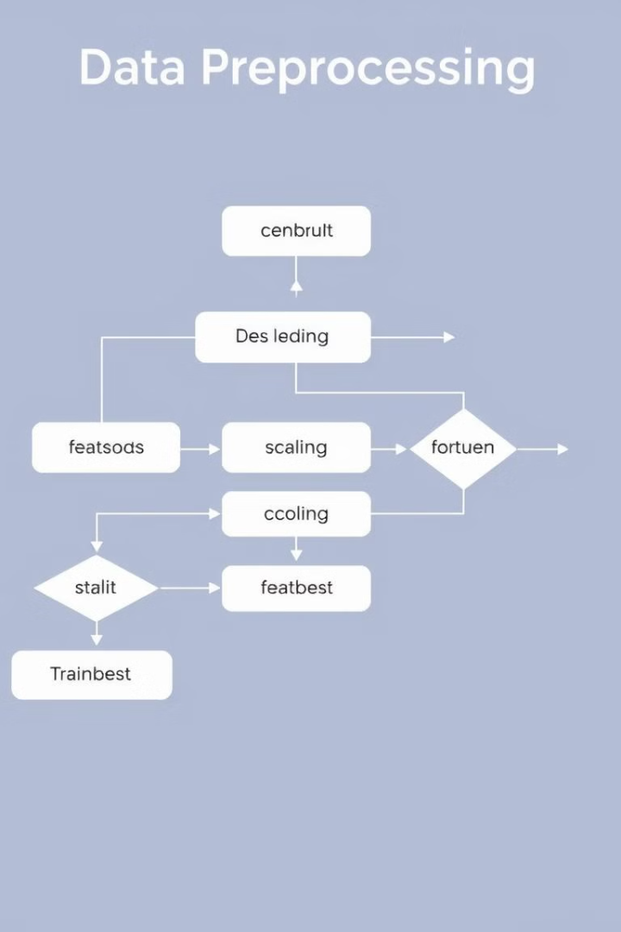
Preprocessing the Data
Data Cleaning
Feature Scaling
Handling missing values and removing duplicate entries is essential for accurate model training.
Normalization of numerical features like age and cholesterol levels ensures all features have a similar range.
Encoding
Train-Test Split
Categorical data (gender, smoking status) is converted into numeric form to be used by machine learning models.
The data is split into training and testing sets for model validation and performance evaluation.

Slide 6
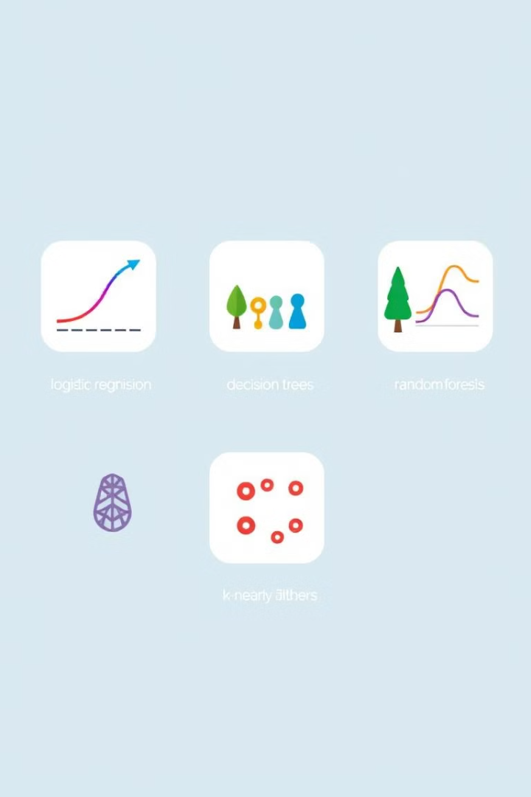




Machine Learning Models Applied
Logistic Regression
Decision Trees
A simple linear model for binary classification, predicting whether a patient has CHD (Yes or No) based on the input features.
Used for understanding the decision-making process in classification, visually illustrating the rules for predicting CHD.
Random Forests
Support Vector Machine (SVM)
Ensemble learning technique to improve classification accuracy by combining multiple decision trees for robust prediction.
A powerful classifier for large, complex datasets, finding optimal hyperplanes to separate CHD cases from non-cases.

Slide 7




Model Evaluation Metrics
Accuracy
1
The proportion of correctly classified instances, indicating the overall performance of the model.
Precision & Recall
2
Precision focuses on true positives among predicted positives, while recall measures the model’s ability to detect positives.
F1-Score
3
The harmonic mean of precision and recall, balancing the trade-off between these two metrics, especially for imbalanced classes.
ROC Curve & AUC
4
Evaluating classifier performance across different thresholds, plotting the true positive rate against the false positive rate.

Slide 8
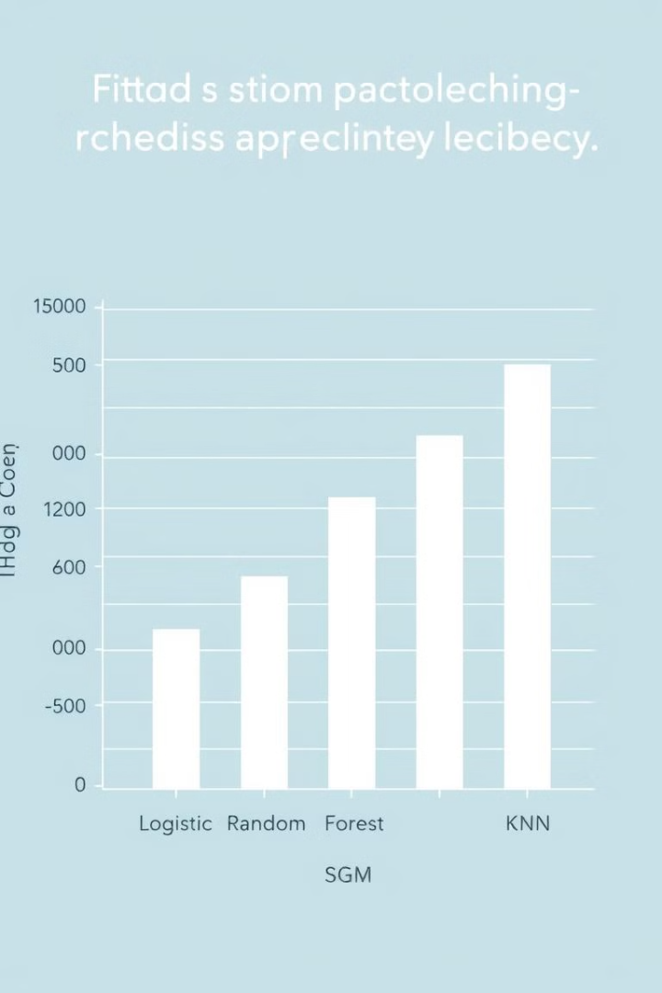
Results & Findings
85%
92%
Logistic Regression
Random Forest
88%
84%
SVM
KNN

Slide 9
Challenges & Limitations
Imbalanced Data
1
Many cases might not have CHD, requiring careful handling of class imbalance for reliable model training.
Data Quality
2
Missing or inconsistent data can negatively impact model accuracy and prediction reliability.
Interpretability
3
Complex models like Random Forests, while accurate, can be difficult to understand and interpret the decision-making process.
Overfitting
4
Carefully tuning models is crucial to avoid overfitting on training data, ensuring generalizability to new patients.

Slide 10



Conclusion & Future Directions
Conclusion
Machine learning techniques, particularly Random Forest, demonstrated high accuracy in predicting CHD, offering potential for better preventive care and improved patient outcomes.
Future Directions
Exploring deep learning models, incorporating real-time data, and enhancing collaboration between healthcare professionals and data scientists are promising avenues for future advancements in CHD prediction.

