Slide 1


ZEAL POLYTECHNIC NARHE ,PUNE-41
“Feed Happiness”
by
Sr.no | Name
1 | Shruti M. Bhapkar.
2 | Tanvi C. Dhage.
3 | Mrunal A.Bhosale
4 | Samruddhi S. Desai.
.

Slide 2
Problem statements.
There is no such platform which connect donor and NGO with each other for various donations The one major similarity between them is that they only work on one specific donation (e.g. Food donation, funding, clothes etc.).and the process of taking and placing donation is time consuming.
2

Slide 3
Solution:
The process of taking and placing donations is done quickly because they are directly connected to each other. all types of donations will be proceed as per the requirements.
3

Slide 4
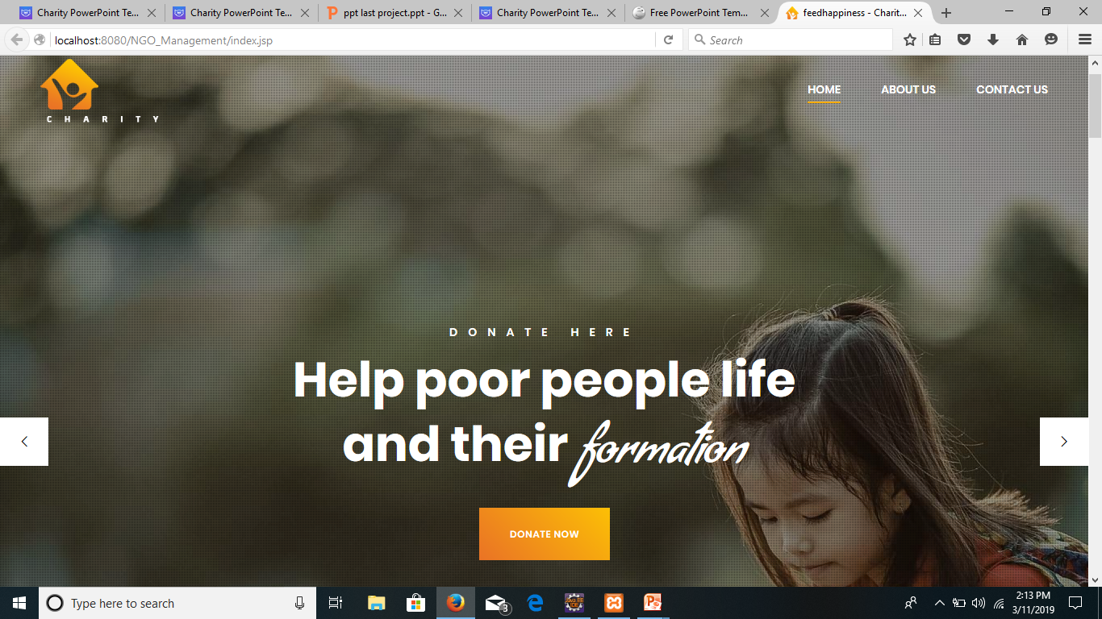
Module: Home Page
10

Slide 5
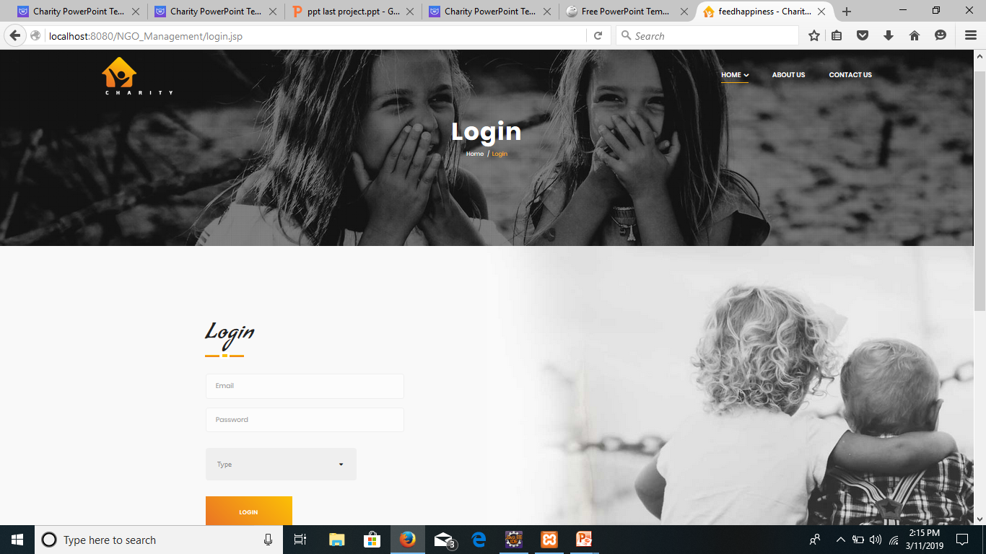
Module : Login Page
9

Slide 6
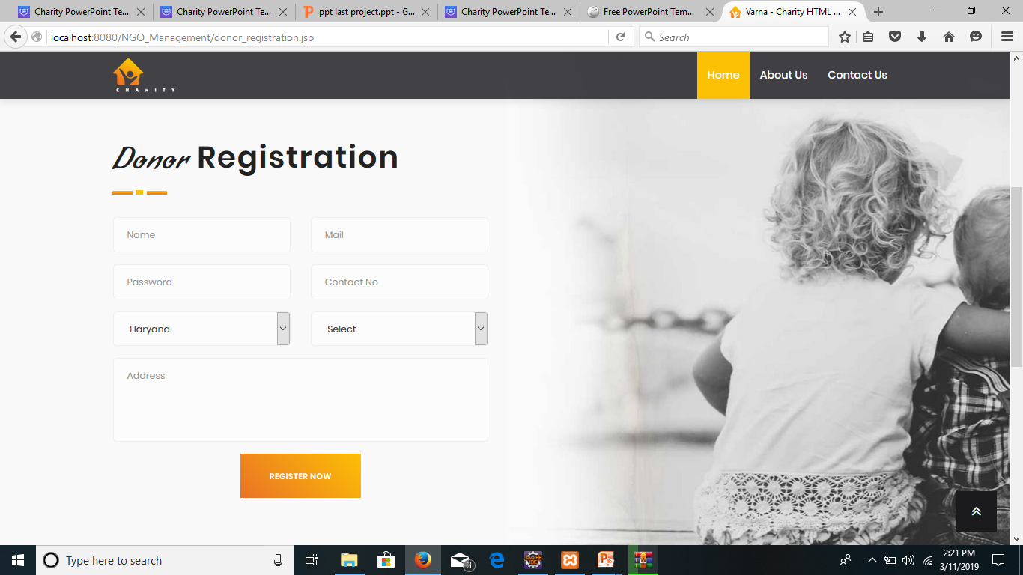
Module: Registration page

Slide 7
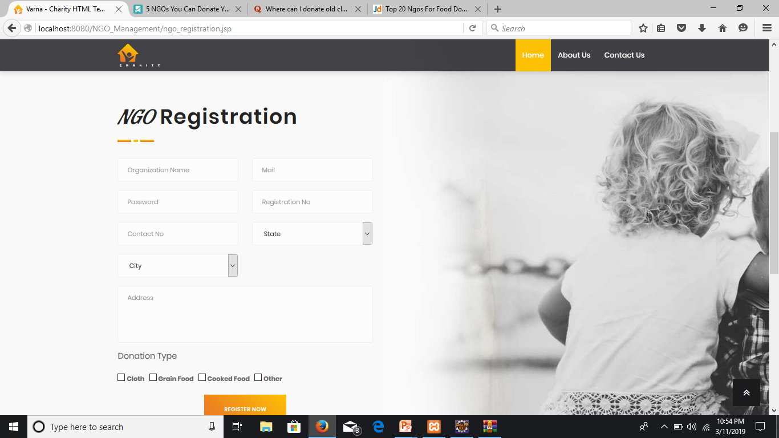
Module: Registration page
Module : Login Page

Slide 8
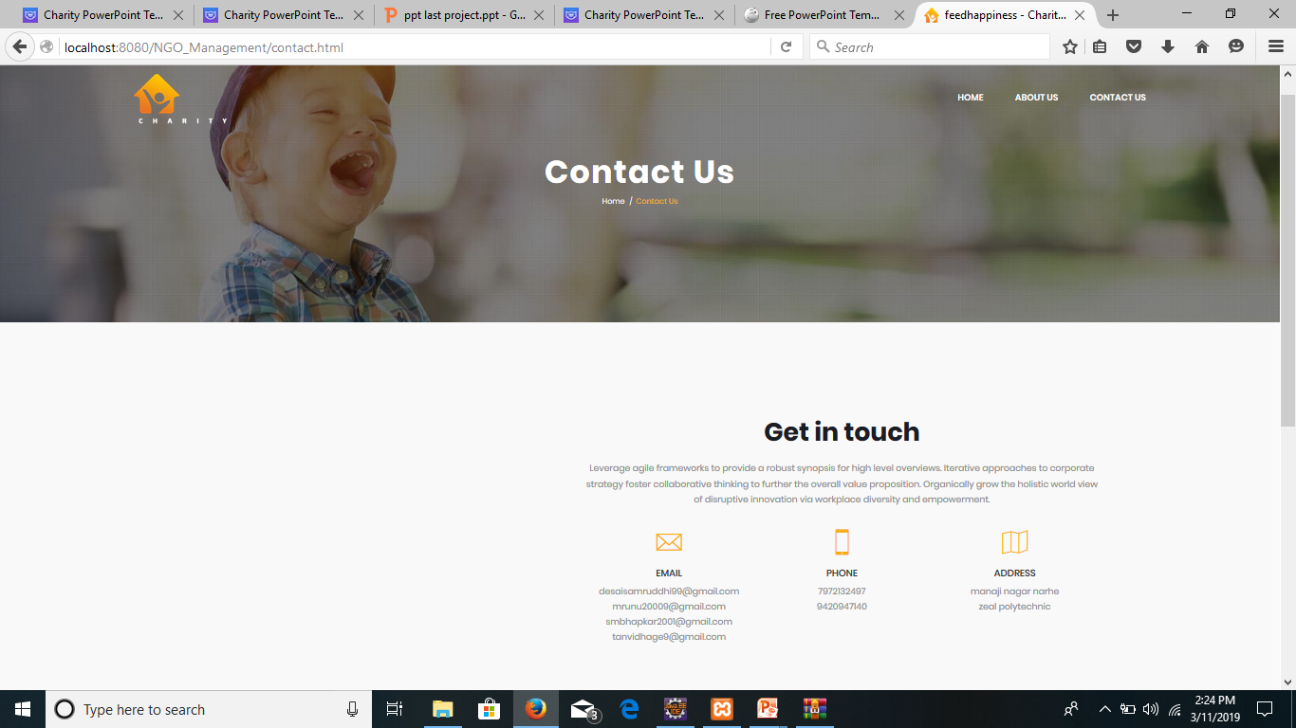
Module: Contact us page

Slide 9
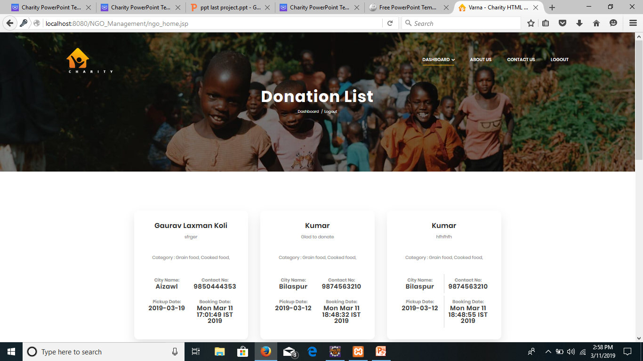
Module: donators list page

Slide 10
Conclusion:
The main goal is to make process of taking and placing donation easier and faster.
It will provide many benefits to community.
By making it online it provide strong platform to accept any type of donations.
Reference:
www.feedingindia.com
www.kitto.org
12

Slide 11
Thank You……….

