Slide 1
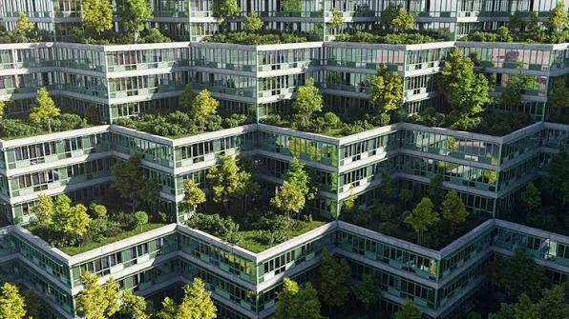

IoT-Based Smart Urban Heat Island Monitoring and Mitigation System
Literature review, comparative analysis, and proposed solution
Focus: urban heat monitoring, hotspot identification, and mitigation
Research basis: 12 studies covering India and international case studies
Names: Bhagyashri Ahire(02), Ketaki Bhagat(18), Shweta Birle(23), Samruddhi Chavan(26).
Group No.: 02
Class: CSDS-A

Slide 2
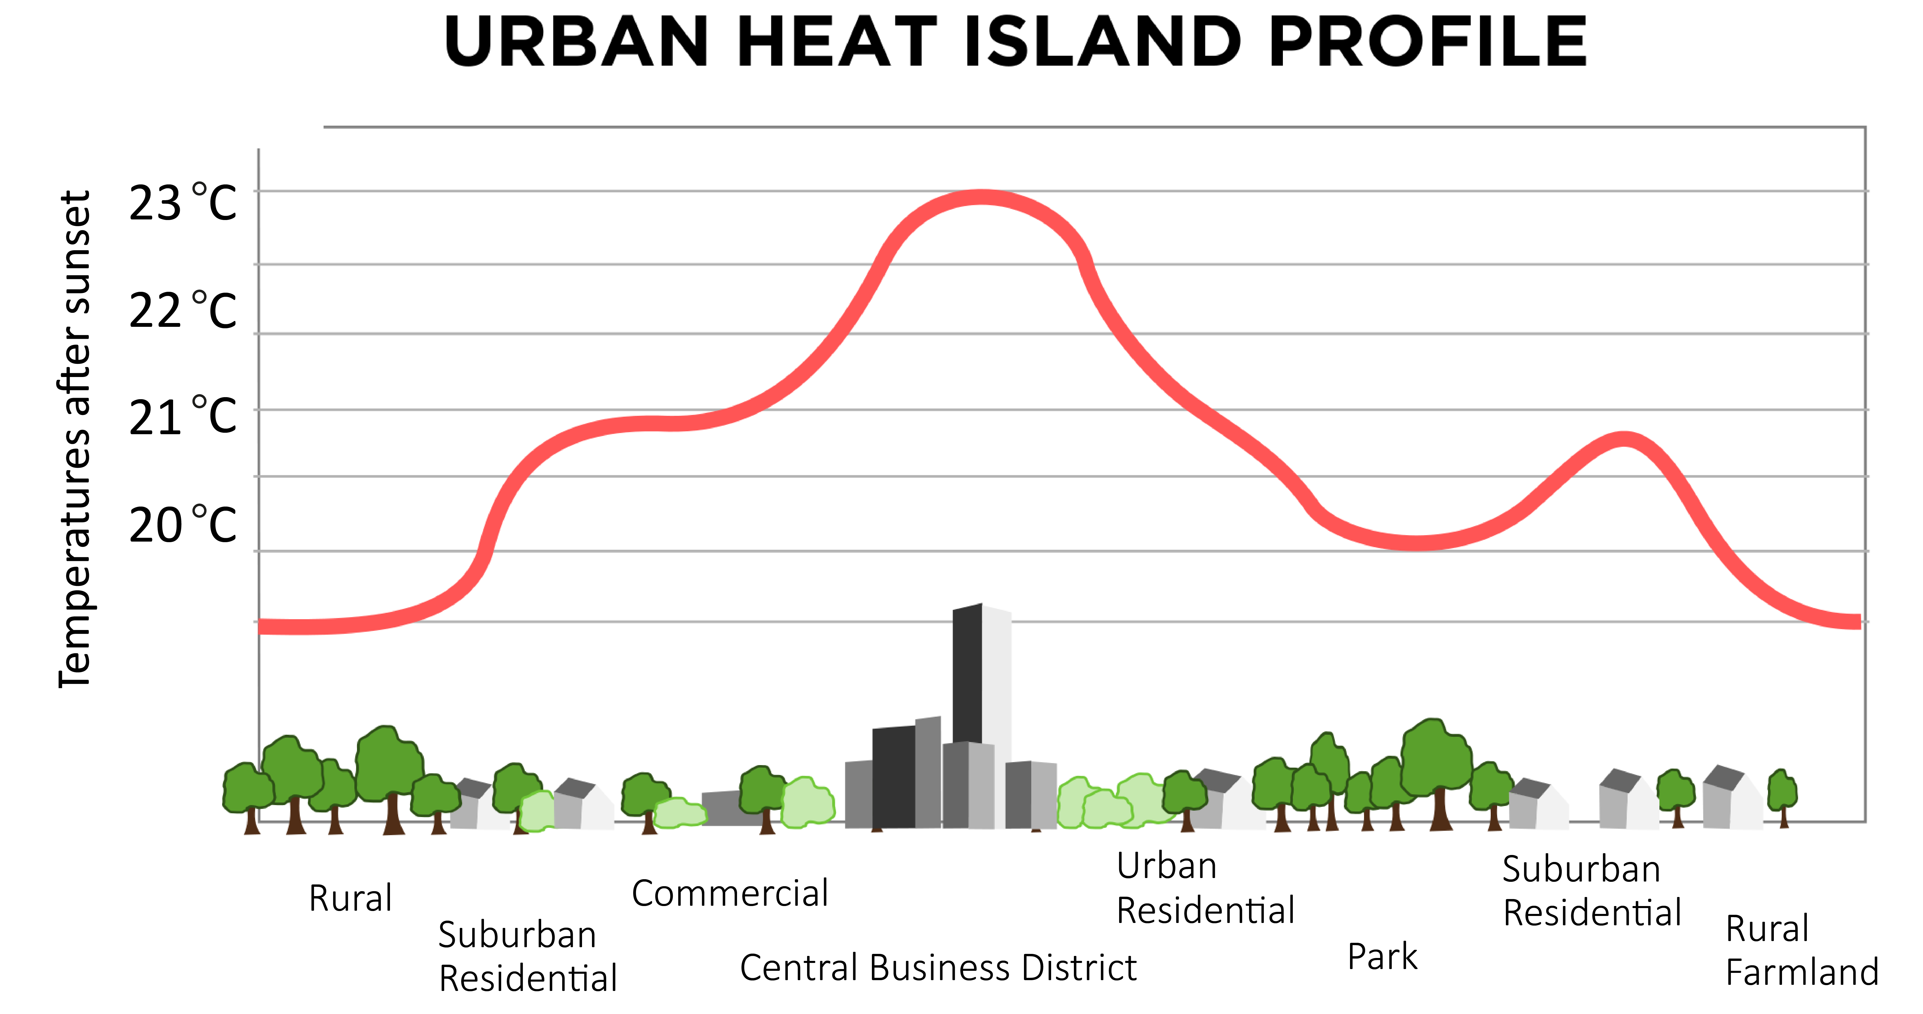
Introduction and background
Urban Heat Islands (UHI) occur when urban areas become warmer than nearby less-developed areas.
Concrete, asphalt, rooftops, dense buildings, and limited greenery contribute to heat accumulation.
Global warming raises the long-term baseline temperature, increasing concerns about extreme heat.
El Niño is a natural ocean–atmosphere climate pattern that can influence regional temperatures and rainfall.
Key distinction: UHI is a local urban effect; global warming is long-term global warming; El Niño is a naturally recurring climate pattern. They can influence heat risk in different ways, but they are not the same phenomenon.

Slide 3




Problem statement
The problem: Urban heat is unevenly distributed, but understanding exactly where, when, and why dangerous hotspots develop remains challenging.
Some neighbourhoods have more heat-absorbing surfaces and less vegetation than others.
Satellite-based studies provide valuable spatial information but may not provide continuous, real-time local readings.
Heat measurements from different locations, seasons, and methods are difficult to compare directly.
Mitigation measures may be proposed without enough continuous before-and-after monitoring to measure their effectiveness.

Slide 4
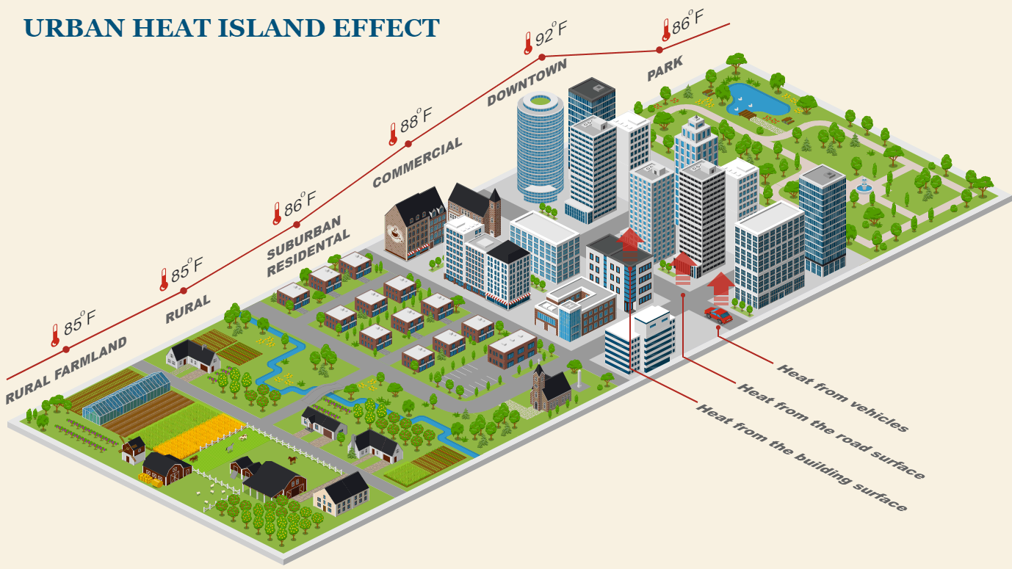
Research objectives
Review existing research on UHI mapping, prediction, risk assessment, and mitigation.
Compare the data, methods, results, and limitations of 12 selected research papers.
Identify the research gaps that matter for real-time urban heat monitoring.
Propose an IoT-based architecture for collecting and analysing environmental data.
Explore how the system could help prioritise cooling interventions and evaluate their results.

Slide 5
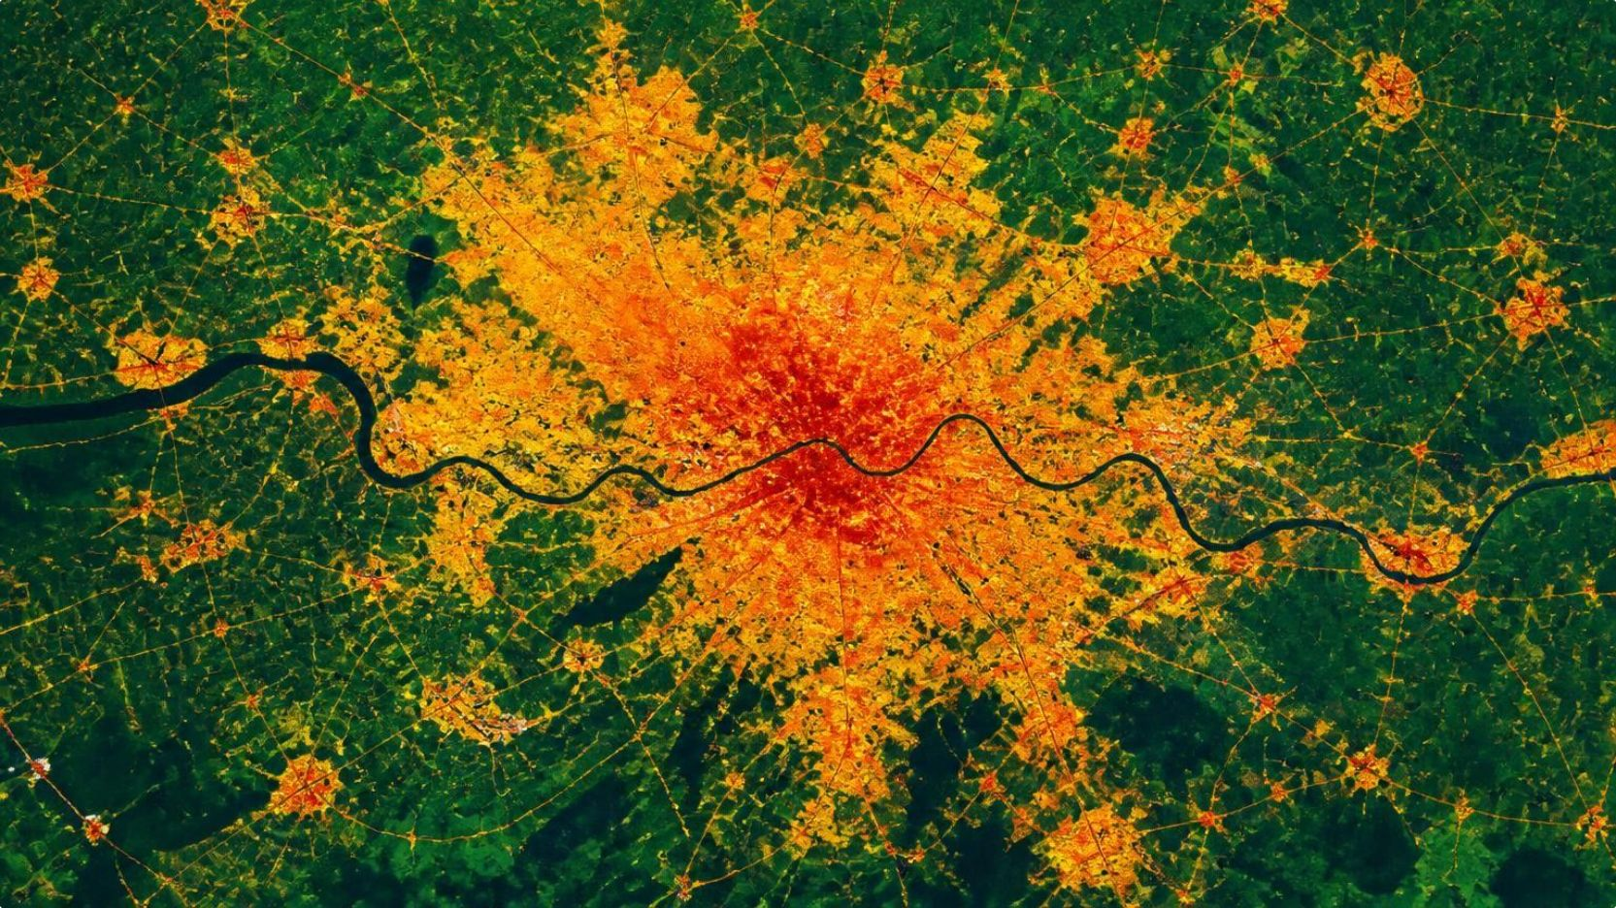
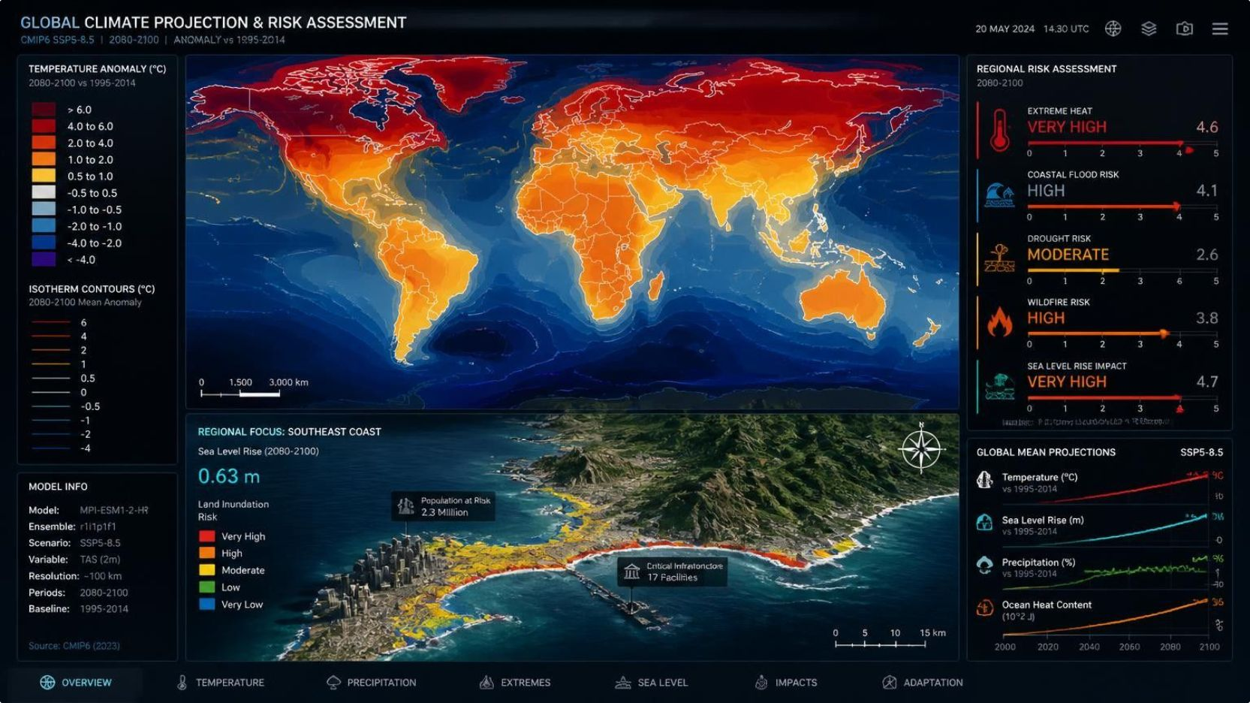
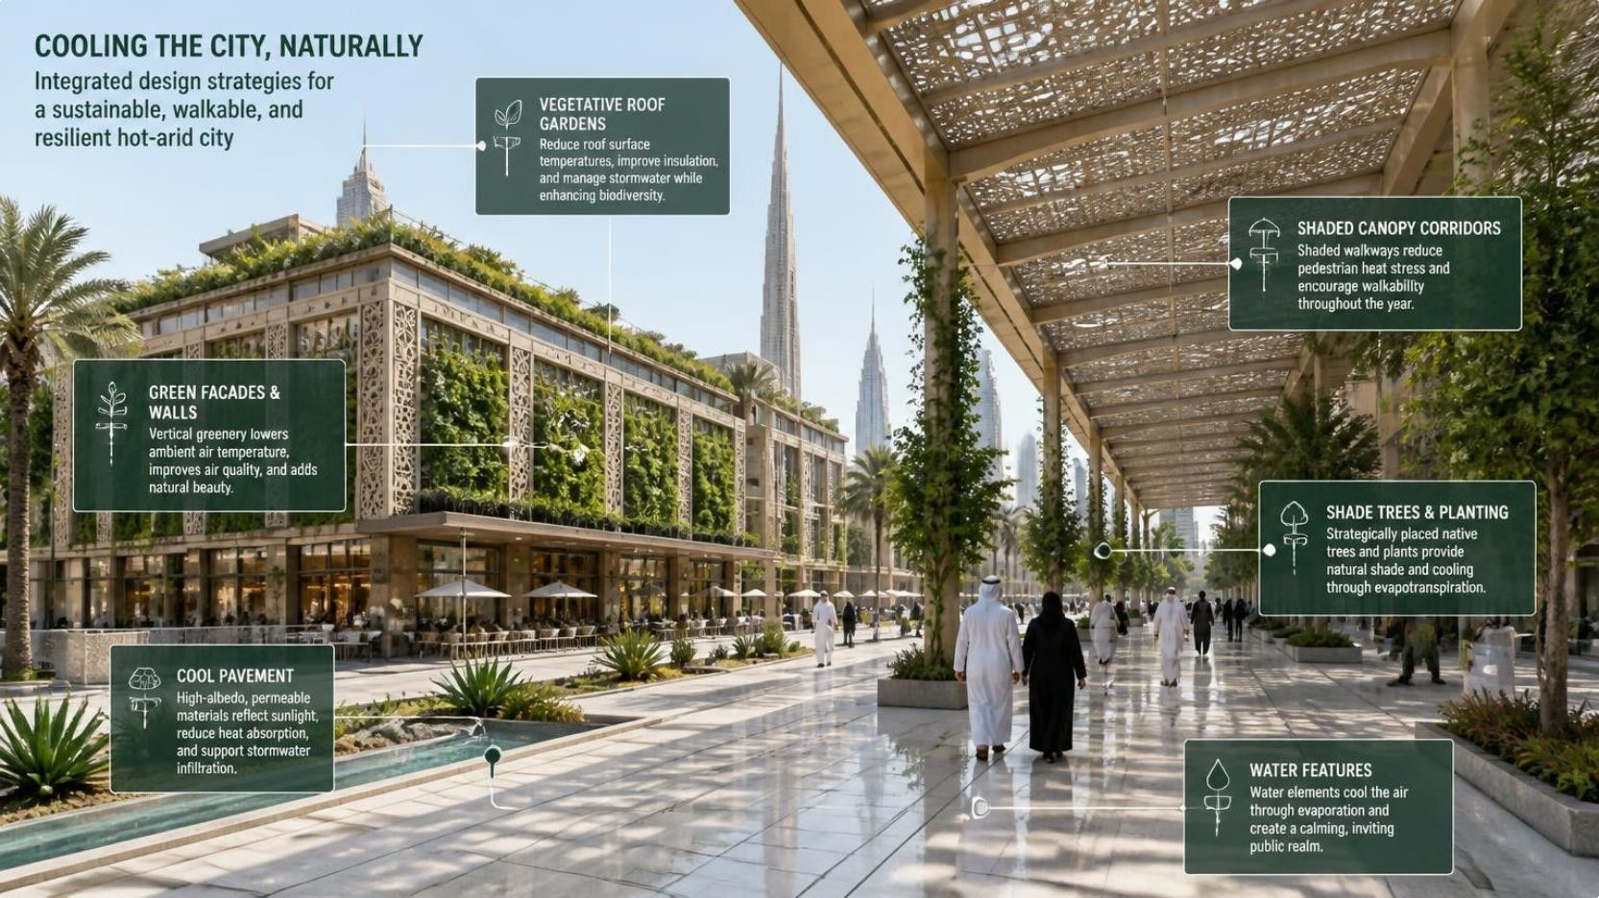
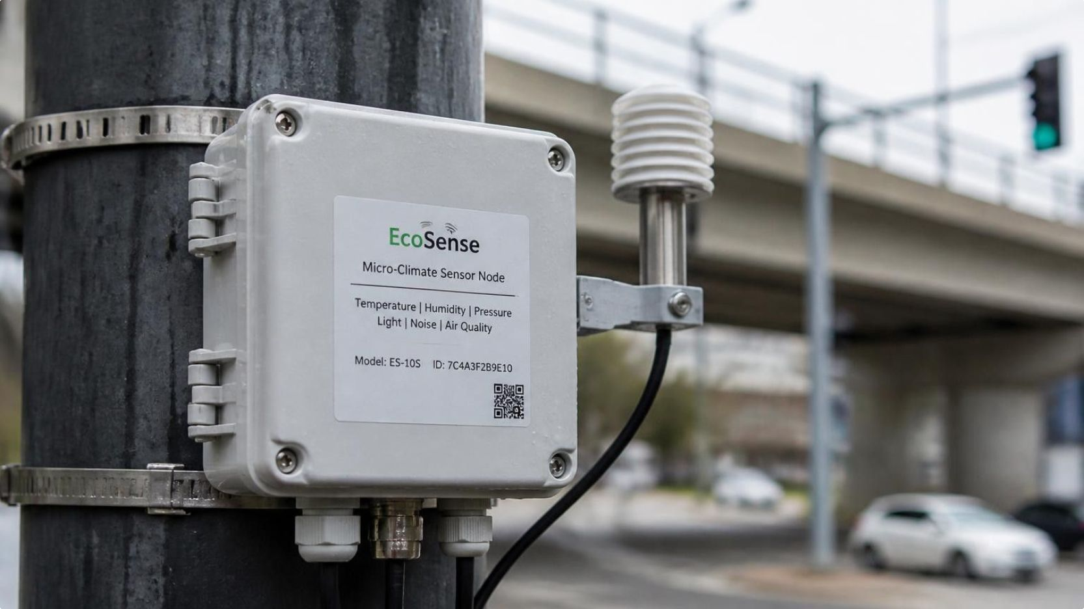
LITERATURE TAXONOMY
Related work / literature review
Organise the 12 papers into four research themes rather than reading out all 12 titles.
Studies of Beijing, Chengdu, Bangalore, Thanjavur–Tiruchirappalli, and Makati use satellite imagery, land-surface temperature (LST), vegetation indices, or built-up-area indicators to map urban heat patterns.
The UAE warming assessment and Attica future heat-risk study investigate future heat conditions and the factors that may influence risk.
1. Remote sensing and UHI mapping:
2. Climate projections and heat-risk assessment:
Studies of suburban India and hot-arid urban design examine surface treatments, vegetation, and other strategies to reduce heat.
The manhole heat study explores IoT-driven sensing with recurrent neural networks; the India temperature-anomaly study examines prediction and heatstroke risk; Zhengzhou investigates high-resolution thermal observations.
3. Mitigation and urban design:
4. IoT, prediction, and heat vulnerability:

Slide 6
SYSTEMATIC SYNTHESIS · 12 PAPERS
Comparison of key papers and results
STUDY | MAIN APPROACH | REPORTED FINDING
UAE warming assessment (2022) | Weather stations and climate-model scenarios | Projected warming across future periods, with larger increases under RCP8.5
Thanjavur–Tiruchirappalli (2025) | MODIS LST, 2012–2022 | Tiruchirappalli consistently showed higher UHI intensity
Beijing (2019) | Summer LST, 2005–2015 | UHI patterns expanded; urbanisation indicators were associated with LST at township scale
Attica, Greece (2024) | Future Heat Risk Index | Examined future heat risk using climate scenarios, population, and tree-canopy information
Suburban India mitigation (2022) | ENVI-met simulation | Evaluated local-scale surface-heat mitigation options
Zhengzhou (2025) | Low-altitude thermal and hyperspectral sensing | Produced high-resolution surface-temperature analysis
IoT manhole heat (2024) | IoT sensing and RNN | Investigated heat monitoring and forecasting; exact performance should be checked in the paper
India temperature anomalies (2025) | Regression and time-series methods | Compared predictive approaches and examined links to heatstroke deaths
Hot-arid urban design (2024) | ENVI-met and walkway treatments | All three treatments lowered temperature versus the baseline; overall differences between treatments were not statistically significant
Chengdu (2022) | Land-cover analysis and WRF simulation | Urban expansion and UHI expansion increased together over the study period
Makati (2025) | Landsat, vegetation/built-up indices, vulnerability and field validation | Identified spatial differences in surface heat and heat vulnerability
Bangalore (2021) | Landsat LST, NDVI and NDBI | Built-up surfaces related positively to LST; vegetation related negatively, more strongly in March than November

Slide 7
Comparison and research loopholes
The literature reveals several opportunities for further work.
RESEARCH GAP | WHY IT MATTERS | PROPOSED DIRECTION
Limited continuous local monitoring | Satellite observations and periodic surveys may miss short-term changes | Combine IoT readings with satellite-derived heat maps
Different temperature measurements | Surface temperature, air temperature, and subsurface temperature measure different things | Clearly label and analyse each measurement separately
Limited mitigation validation | A proposed cooling strategy may not perform equally well everywhere | Compare conditions before and after interventions
Separate analysis of heat and vulnerability | A hot location is not necessarily the location with the greatest human vulnerability | Combine heat data with population and vulnerability indicators
Limited integration of monitoring and action | Identifying hotspots does not automatically lead to mitigation | Link alerts to prioritised, locally suitable interventions
Climate-context integration | Local heat, long-term warming, and El Niño operate at different scales | Examine local sensor data alongside relevant climate information

Slide 8





ARCHITECTURE BLUEPRINT
1. Environmental data collection
Research area and proposed system
Air temperature, humidity, surface temperature, and location
2. IoT sensors and communication
Sensor nodes → Wi-Fi / LoRaWAN → gateway
Research area: IoT-based environmental monitoring, urban heat-risk analysis, and data-driven mitigation.
3. Local or server-side analysis
Data validation, hotspot detection, trends, and risk indicators
4. Dashboard and heat map
Visualise hotspots, trends, alerts, and priority locations
5. Mitigation and evaluation
Support decisions on trees, cool roofs, reflective materials, and irrigation

Slide 9

VALUE PROPOSITION
Why IoT is important
Continuous monitoring:
Localised information:
Early alerts:
Collects readings at regular intervals rather than relying only on occasional surveys.
Sensors placed at selected sites help reveal differences between neighbourhoods.
Threshold-based alerts can flag unusual heat conditions.
Data integration:
Mitigation evaluation:
Scalability:
Sensor readings can be combined with satellite maps, vegetation data, and weather information.
Repeated measurements can help assess whether an intervention improves local conditions.
More sensor nodes can be added as the monitoring area grows.
IoT does not replace satellite remote sensing. The two approaches can complement each other: satellites provide broader spatial coverage, while ground sensors provide local measurements over time.

Slide 10
DELIVERABLES & IMPACT
Proposed problems overcome and expected results
Separate results already reported by researchers from the outcomes your proposed system aims to achieve.
FOUNDATION EVIDENCE
SYSTEM OBJECTIVES
What previous studies have demonstrated
What our proposed system aims to deliver
Urban expansion is associated with changing UHI patterns in studies such as Beijing and Chengdu.
Vegetation and built-up surfaces show different relationships with land-surface temperature.
Heat vulnerability can differ between neighbourhoods, as illustrated by the Makati study.
Simulated surface treatments can reduce temperature relative to an untreated baseline.
A time-stamped dataset of local temperature and humidity readings.
A dashboard showing sensor readings and location-based hotspots.
Alerts when configured heat thresholds are exceeded.
Before-and-after comparisons for selected mitigation interventions.
Evidence to help planners prioritise locations for further investigation.

Slide 11
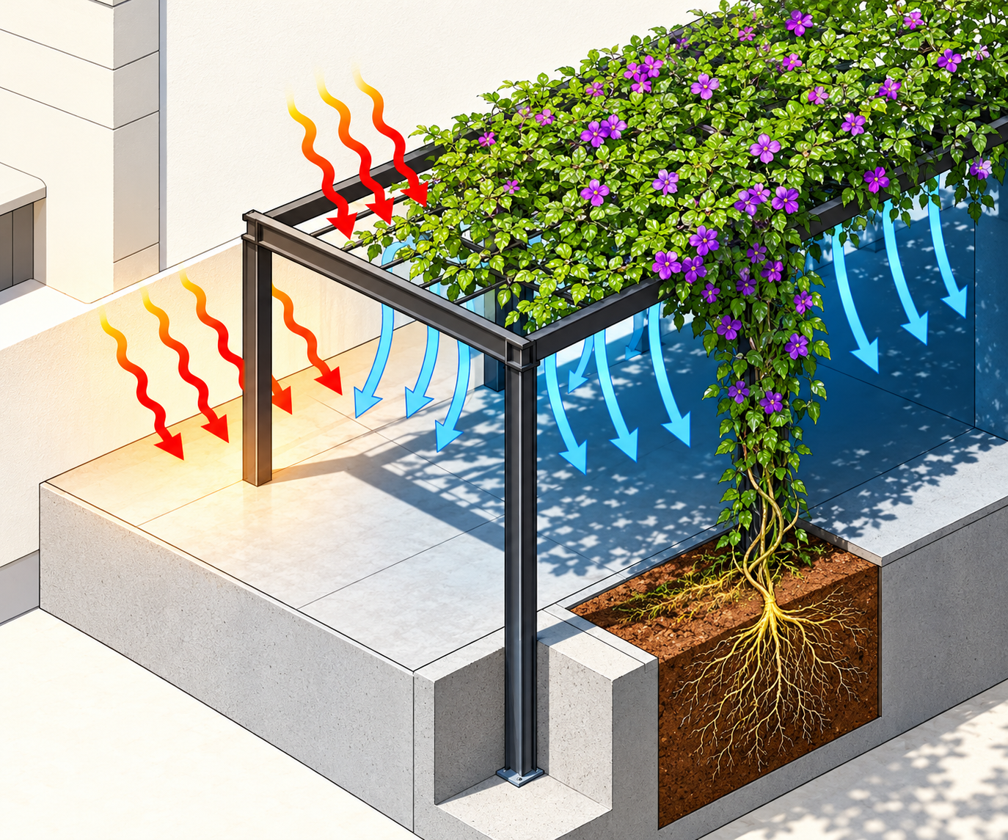
ROADMAP
Future scope and remaining challenges
Predictive heat alerts: Add a forecasting model after collecting enough reliable historical sensor data.
Satellite–IoT integration: Combine large-area heat maps with continuous measurements at selected sites.
Heat-vulnerability mapping: Incorporate population characteristics and access to cooling resources using suitable, privacy-conscious data.
Adaptive mitigation: Test whether irrigation schedules or other interventions should change in response to local measurements.
Climate-context analysis: Investigate whether heat patterns differ during El Niño and neutral periods using a longer, appropriately controlled dataset.
Expansion to more locations: Test different urban layouts, seasons, and climates before generalising results.
Real-world validation: Compare the system against calibrated instruments and assess cost, connectivity, maintenance, and data quality.

Slide 12
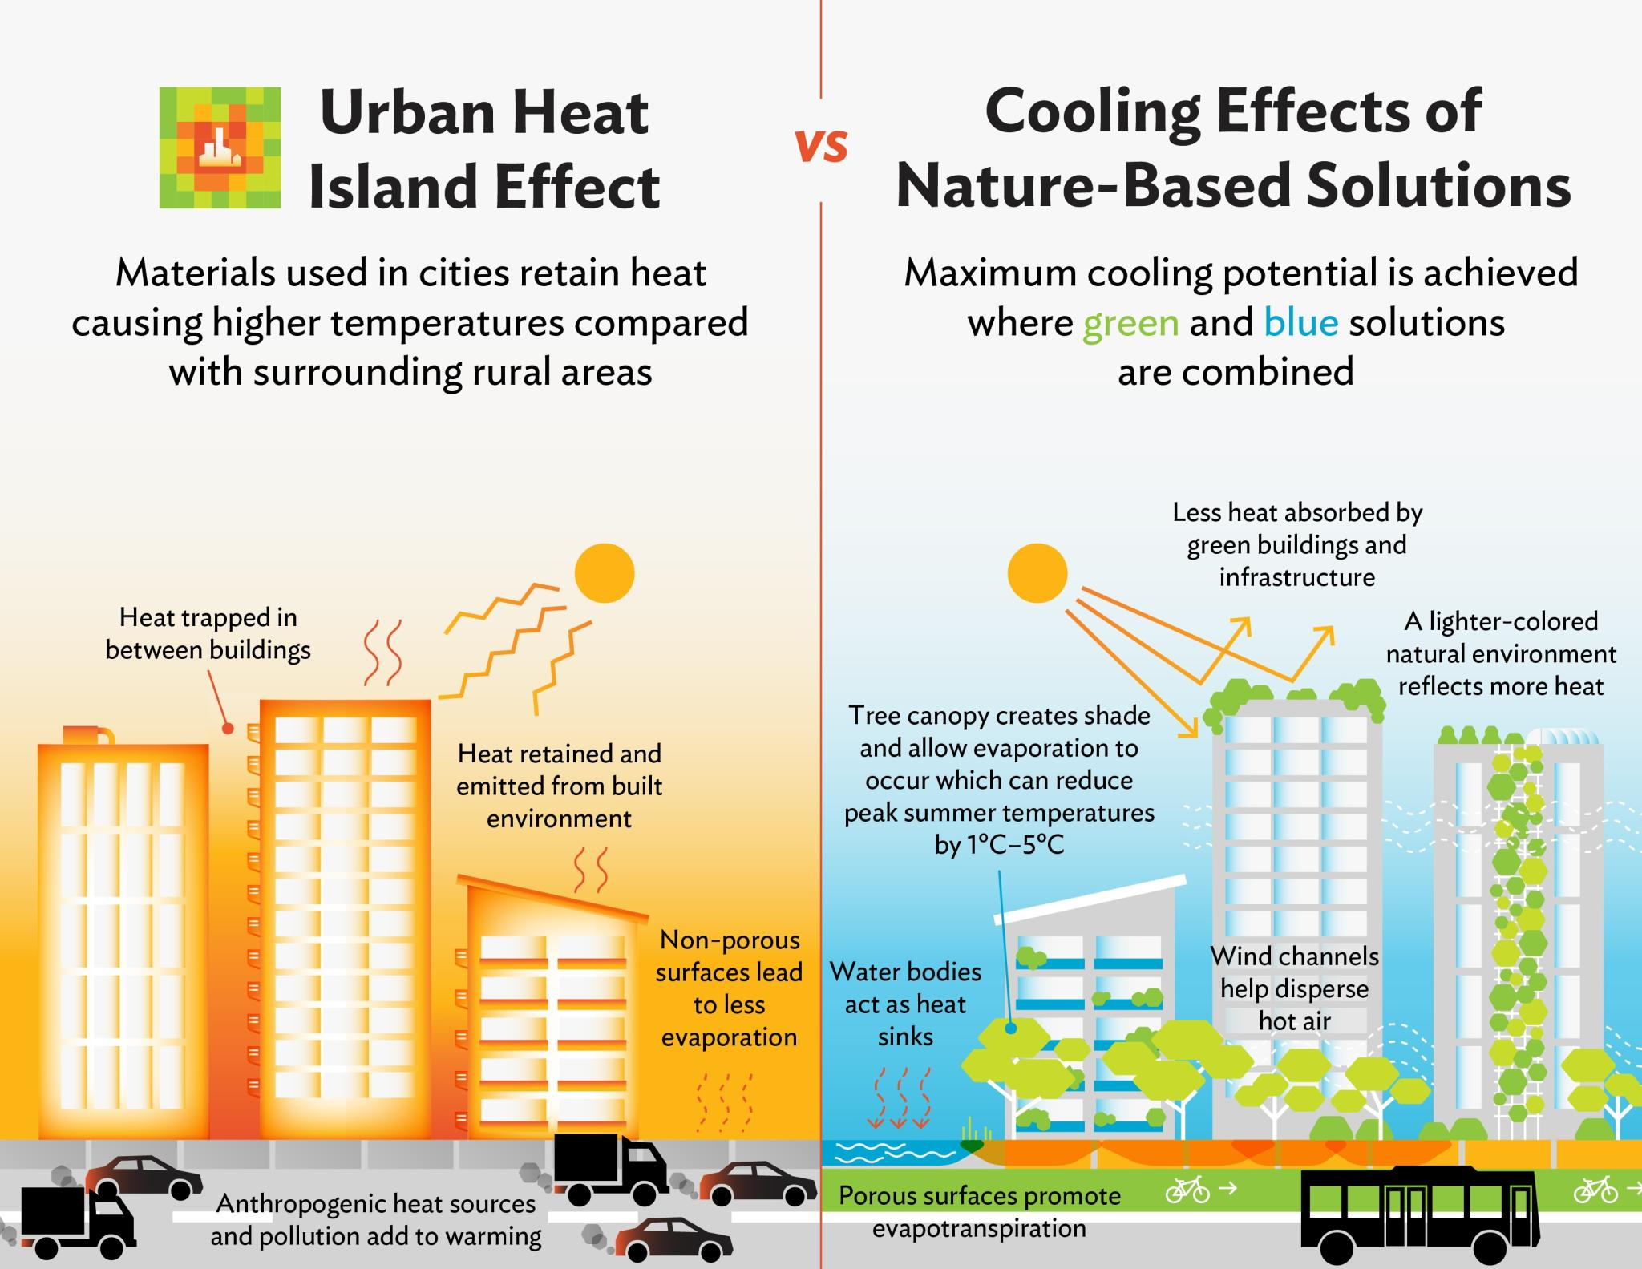
SYNTHESIS
Conclusion
The 12 reviewed papers show that UHI is studied using remote sensing, climate modelling, environmental sensors, forecasting, vulnerability assessment, and mitigation simulations.
The findings indicate that urban form, vegetation, surface characteristics, and location influence heat patterns.
The key opportunity is to connect heat measurement with continuous monitoring, risk interpretation, and evaluation of real mitigation actions.
The proposed IoT-based system aims to support better heat awareness and evidence-based decisions, rather than claim to eliminate UHI.
“From mapping urban heat to monitoring it continuously and evaluating what actually cools our cities.”

