Slide 1
Urban-Edge Stylist: AI-Powered Fashion Recommendation System
Final Project Submission
Samruddhi Magdum
Recommending outfits based on style vibes using RAG & semantic search

Slide 2
Project Overview
Objective
Key Technologies
Build an AI system that suggests fashion outfits based on user-described style vibes (e.g., minimalist, edgy).
Python
FAISS
Sentence Transformers
JSON metadata
Why This Project
Combines semantic search, AI routing, and metadata for intelligent recommendations.
Project Modules
01
02
03
04
Day11_Task
Day12_Task
Day13_Task
Day14_Task
Data engineering: vector store, retriever
Agentic logic: router, prompts
Red-teaming & testing
Performance optimization
05
Day15_Task
Streamlit app frontend

Slide 3
Problem Statement
Challenge
Solution
Impact
Traditional fashion recommendations are keyword-based and lack context for style vibes.
Use semantic embeddings and FAISS for vibe-aware suggestions, with intent routing for dynamic responses.
Provides personalized, context-aware fashion advice using AI.

Slide 4


System Architecture
User Input
Intent Router
Metadata Enrich
Safety Layer
Embedding → FAISS
The architecture outlines the sequential processing of user queries to deliver personalized fashion recommendations.
Safety Check
Intent Router
FAISS
Filters invalid queries
Classifies query type (recommendation, trend, general)
Fast vector similarity search
Metadata
Data Flow
Tags for style, category, color
Embeddings from sentence-transformers model

Slide 5
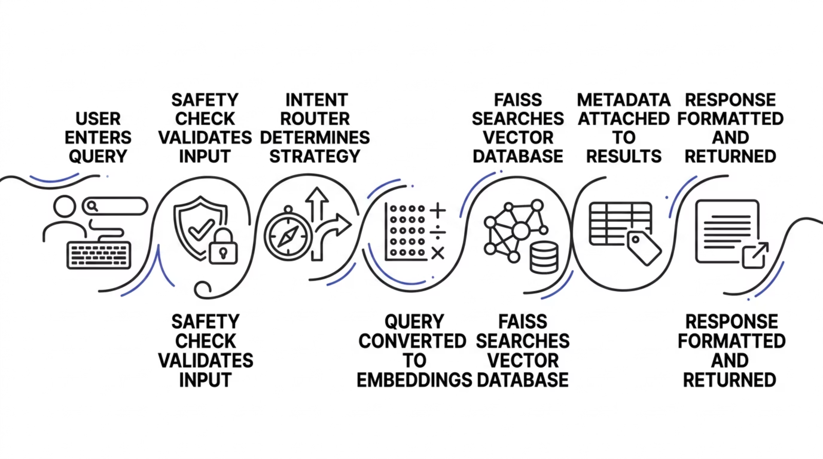

Workflow Sequence
Key: Semantic search ensures vibe-matching, not exact keywords

Slide 6
Algorithm / Pseudocode
Core Recommendation Algorithm
FAISS Search Pseudocode
FUNCTION RecommendOutfits(user_query_string): // 1. Convert user query to embedding query_embedding = sentence_transformers.encode(user_query_string) // 2. Search FAISS index for top K similar vectors similar_vector_indices, distances = FAISS_index.search(query_embedding, K=5) // 3. Retrieve metadata for matched items matched_items_metadata = [] FOR each index IN similar_vector_indices: item_metadata = retrieve_metadata_from_database(index) matched_items_metadata.ADD(item_metadata) // 4. Enrich results with style, category, color tags enriched_results = [] FOR each item IN matched_items_metadata: enriched_item = enrich_with_tags(item, "style", "category", "color") enriched_results.ADD(enriched_item) // 5. Format and return results RETURN format_recommendations(enriched_results)
Handles embedding, search, and enrichment for accurate recommendations.

Slide 7
Documentation: Tech Stack & Setup
Here’s an overview of the technical components and how to set up the Urban-Edge Stylist project.
Technologies
Python: Core language
FAISS: Vector database for similarity search
Sentence Transformers (all-MiniLM-L6-v2): For embeddings
NumPy & JSON: Data handling
Installation Steps
Clone repo: git clone <repo-url>
Install dependencies: pip install faiss-cpu sentence-transformers numpy
Build vector store: python Day11_Task/vector_store.py
Run system: python -m Day12_Task.main
Project Structure
A structured, technical layout with clear sections for easy navigation and understanding.

Slide 8
Documentation: Features & Demo
Key Features
Semantic search (not keyword)
Agentic intent routing
Metadata tagging
Safety layer
Multi-prompt system
Example Query
"minimalist outfit"
Sample Output
Basic Black T-Shirt → Style: minimalist
Black Oversized Hoodie → Style: minimalist
Minimalist Beige Hoodie → Style: minimalist

Slide 9
Testing & Evaluation
Red-Teaming (Day13_Task)
Performance (Day14_Task)
Results
System handles diverse queries robustly
Tested against adversarial inputs (e.g., invalid queries, edge cases)
Optimized for speed and cost

Slide 10
Challenges & Learnings
Challenges
Learnings
Future Improvements
Integrating FAISS with metadata
Handling embeddings
Importance of semantic search over keywords
Value of intent routing
Add user feedback loop
Expand dataset

Slide 11
Conclusion
Summary
Satisfies Requirements
Urban-Edge Stylist delivers AI-driven fashion recommendations via RAG
Includes workflow sequence, pseudocode, and full documentation
Thank You!

