Slide 1

CONSUMER GOODS
10 Ad_Hoc Request which I Run Using SQL

Slide 2
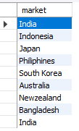
1) Provide the list of markets in which customer "Atliq Exclusive" operates its business in the APAC region.

Slide 3
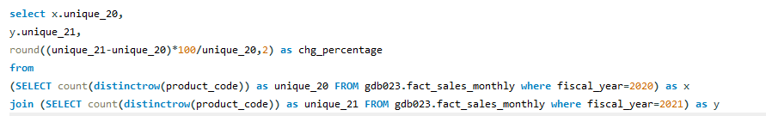

2) What is the percentage of unique product increase in 2021 vs. 2020?

Slide 4
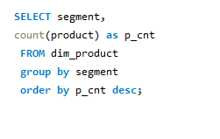
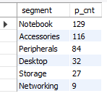
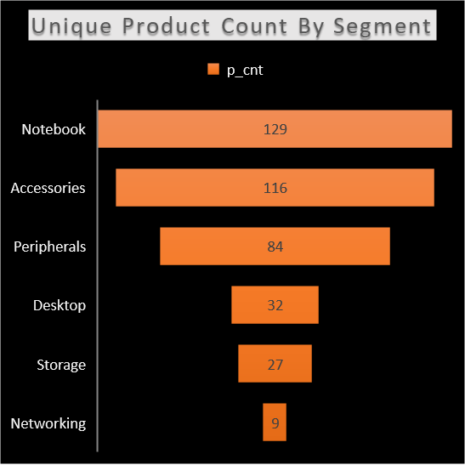
3) Provide a report with all the unique product counts for each segment and sort them in descending order of product counts.

Slide 5
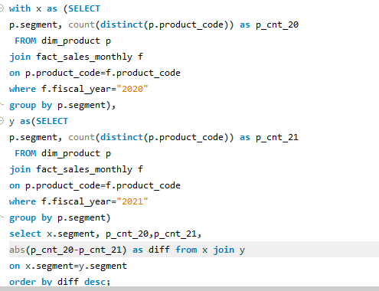
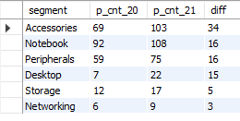
4) Which segment had the most increase in unique products in 2021 vs 2020?

Slide 6
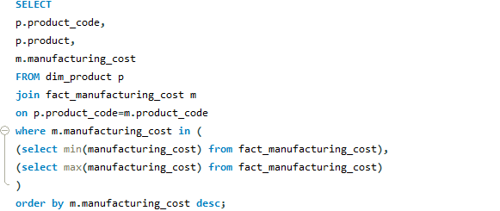

5) Get the products that have the highest and lowest manufacturing costs.

Slide 7
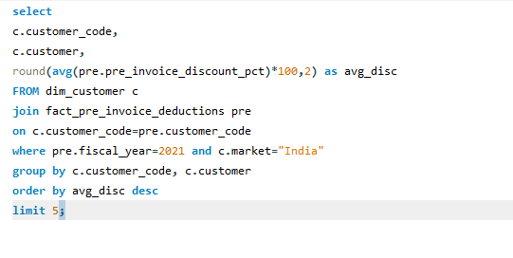
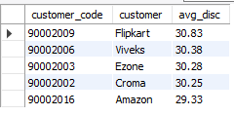
6) Generate a report which contains the top 5 customers who received an average high pre_invoice_discount_pct for the fiscal year 2021 and in the Indian market.

Slide 8
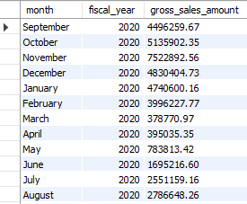
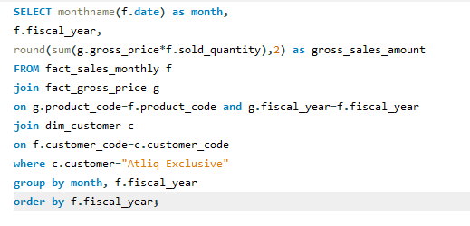
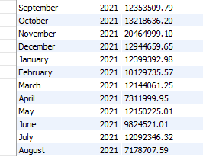
7) Get the complete report of the Gross sales amount for the customer “Atliq Exclusive” for each month.

Slide 10
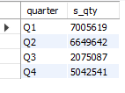
8) In which quarter of 2020, got the maximum total_sold_quantity?

Slide 11
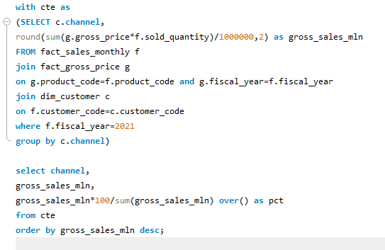

9) Which channel helped to bring more gross sales in the fiscal year 2021 and the percentage of contribution?

Slide 12
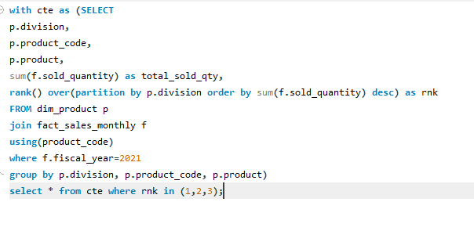
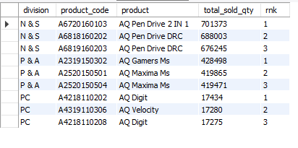
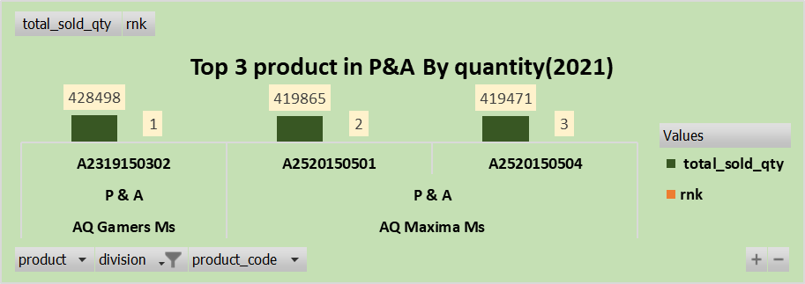
10) Get the Top 3 products in each division that have a high total_sold_quantity in the fiscal_year 2021?

