Slide 1
Microsoft Fabric
The Unified Analytics Platform
MADSC301 — Business Intelligence | Mid-Term Presentation
Rohit Kalotra · Samruddhi Subash Karpe
Prof. Hachem Sfar · Term 3 AY 2025/26 · 21 May 2026

Slide 2
Today's Journey
1
What is Microsoft Fabric?
2
OneLake & the 7 Workloads
and why Microsoft built it
the core architecture
3
Lakehouse + Direct Lake
4
LIVE DEMO
the signature feature
Wikipedia → Fabric → Charts
5
Use Cases & Comparison
6
Pros, Limitations & Q&A
Fabric vs Databricks/Snowflake
honest take + your questions

Slide 3
What is Microsoft Fabric?
An end-to-end, SaaS analytics platform that unifies every data role on a single foundation.
SaaS, not PaaS
No infrastructure to manage — Microsoft handles servers, scaling,
patching.
Launched May 2023
Public preview May '23. Generally Available November 2023.
Unified Platform
Data Factory + Synapse + Power BI + Data Activator + OneLake — together.
Capacity Pricing
One subscription (CU-based) covers all workloads — not pay-per-service.

Slide 4
Why Microsoft Built Fabric
BEFORE — 5 disconnected tools
AFTER — One Fabric platform
Azure Data Factory (ingestion)
Microsoft Fabric
One workspace · One billing · One storage layer · One security model
Azure Synapse (warehouse)
Azure Databricks (data engineering)
→
Power BI (visualization)
Azure Stream Analytics (real-time)
Each had its own storage, billing, access controls. Data engineers spent hours moving data between them.

Slide 5
The 7 Fabric Workloads
All workloads share one storage layer (OneLake) and one security model.
1
Data Factory
Ingest & orchestrate
2
Synapse Data Engineering
Spark notebooks
3
Synapse Data Warehouse
SQL-based DWH
4
Synapse Data Science
Machine learning
5
Real-Time Intelligence
Streaming events
6
Power BI
Dashboards & reports
7
Data Activator
Trigger alerts on data

Slide 6
OneLake — "OneDrive for Data"
One storage layer underneath every workload. Open format. Tenant-wide.
Single Storage
Every Fabric workload reads & writes the same data — no copies, no duplication.
1
Open Delta-Parquet
Industry-standard format. Readable by Snowflake, Databricks, even Python.
OneLake
Delta · Parquet Open format
2
Shortcuts & Governance
Zero-copy data sharing across workspaces. Tenant-wide security.
3

Slide 7

Lakehouse + Direct Lake
Data Lake
Cheap, flexible
Stores raw files
Schema-on-read
Hard to query
Data Warehouse
Fast, structured
Strict schema
Fast SQL queries
Expensive storage
LAKEHOUSE
Best of both
Cheap file storage
Warehouse-fast queries
ACID transactions
Direct Lake Mode — Power BI queries Delta files in OneLake DIRECTLY. No import, no refresh, sub-second response.

Slide 8
LIVE DEMO: End-to-End BI Pipeline
Real data, real code, real Fabric — running in your screen.
Extract
Transform
Load
Query
Visualize
Wikipedia
+ BS4 scrape
→
Clean +
Star Schema
→
Delta tables
in OneLake
→
SQL with
JOINs / CTEs
→
Charts +
World map
Each stage maps to a Prof. Sfar lecture:
Extract → Week 1 slide 66 (BS4) · Transform → slides 33–42 (Star Schema) · Load → slide 48 (Parquet) · Query → SQL workshop Unit 4 Power BI
· Visualize →

Slide 9
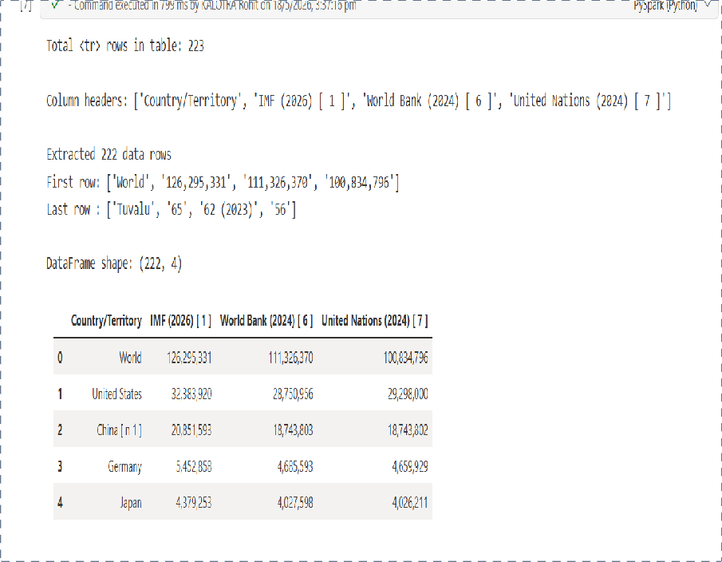
Step 1: Extract — BeautifulSoup Scraping
What's happening
Target: Wikipedia 'List of countries by GDP (nominal)'
Library: Python requests + BeautifulSoup
Output: 222 country rows with GDP from 3 sources
Runtime: ≈ 4 seconds inside a Fabric notebook
[ Drop screenshot here ]
Notebook · Cell 1 + Cell 2 (BS4 scraping with HTTP 200, 'Extracted 222 data rows')
Course alignment
Mirrors Prof. Sfar's Week 1 slide 66 — find_all, get_text — applied inside Fabric.

Slide 10
Step 2: Transform — Star Schema
dim_country (221)
 | FK
fact_gdp (595 rows)
 | FK
dim_source (3)
Kimball's classic pattern
Fact table holds the numerical measurements — GDP values, one row per country-source pair.
Dimension tables hold the descriptive attributes — country names, source organizations.
Foreign Keys link them — exactly the pattern from Prof's slide 30.
Course alignment: Prof. Sfar's slides 33–42 (Dimensional Modelling)

Slide 11
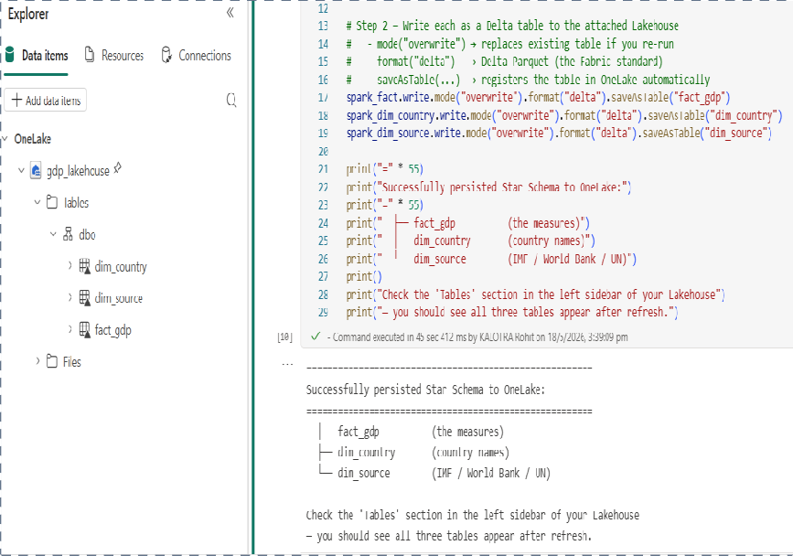
Step 3: Load — Delta Tables in OneLake
From in-memory pandas → persistent Delta-Parquet in OneLake — 3 lines of code.
spark_fact.write
.mode("overwrite")
.format("delta")
.saveAsTable("fact_gdp")
# repeat for dim_country, dim_source
[ Drop screenshot here ]
Lakehouse view showing fact_gdp,
dim_country, dim_source in OneLake
Delta = Parquet + ACID transactions
Open format — Snowflake, Databricks, pandas can all read these files.

Slide 12
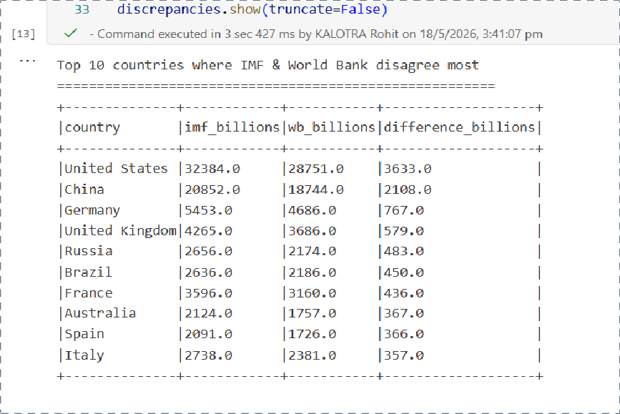
Step 4: Query — SQL with JOINs & CTEs
WITH imf AS (
SELECT f.country_id, f.gdp_millions_usd
FROM fact_gdp f
JOIN dim_source s ON f.source_id=s.source_id
WHERE s.source_name = 'IMF'
)
SELECT c.country, imf.gdp_millions_usd
FROM imf
JOIN dim_country c ON
imf.country_id=c.country_id
ORDER BY imf.gdp_millions_usd DESC
[ Drop screenshot here ]
SQL output table
showing top 10 economies (Cell 6 or Cell 8)
Course alignment: SQL Workshop — JOINs, GROUP BY, CTE (slides 17–19)

Slide 13
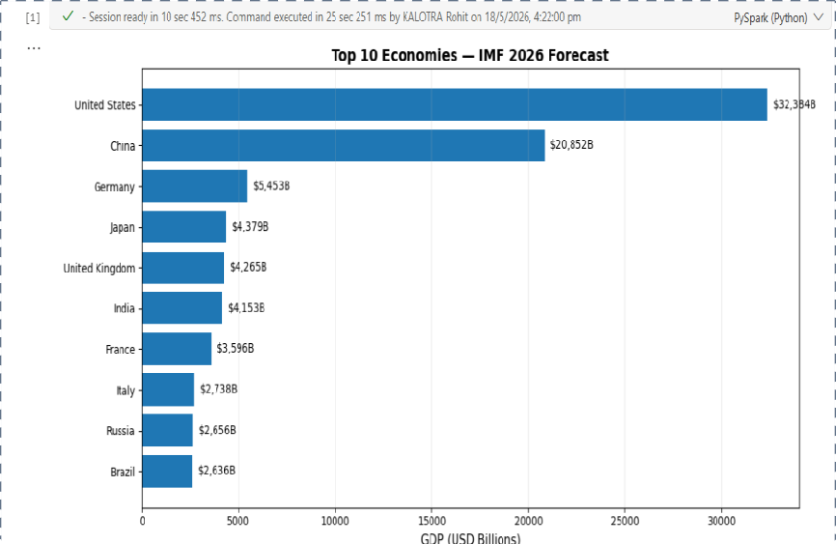
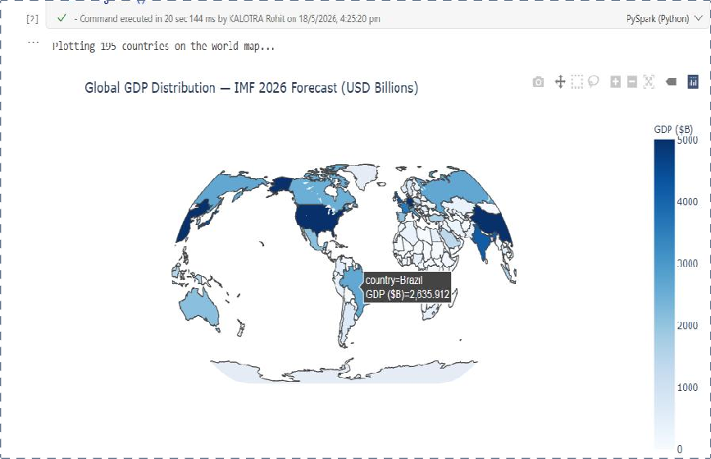
Step 5: Visualize — Interactive Charts
Same data, same queries — rendered as decision-grade visuals.
[ Drop screenshot here ]
[ Drop screenshot here ]
Top 10 Economies (bar chart — Cell 9)
World Map of GDP (plotly choropleth — Cell 10)
In a production tenant, these same queries would power a Power BI Direct Lake report at the click of a button.

Slide 14
Who Actually Uses Microsoft Fabric?
Retail
Finance
Multi-source sales dashboards combining POS, e-commerce, and supply chain in one Lakehouse.
Regulatory reporting pipelines where IMF/WB-style multi-source comparison matters.
Manufacturing
Healthcare
Real-time IoT telemetry from factory floors visualised alongside ERP data.
HIPAA-compliant patient analytics; OneLake's tenant governance simplifies audits.

Slide 15
Fabric vs Databricks vs Snowflake
Dimension | Microsoft Fabric | Databricks | Snowflake
Model | All-in-one SaaS | Lakehouse + ML | Cloud Data Warehouse
Storage | OneLake (Delta) | Delta Lake / Iceberg | Proprietary FDN
Power BI | Native + Direct Lake | Connector | Connector
Pricing | Capacity (CU) | Compute + Storage | Credits + Storage
Best for | Microsoft-heavy orgs | ML + Streaming | Pure analytics SQL
Fabric's edge: deep Power BI / Excel / Teams integration + capacity-based simplicity. Trade-off: heavy Microsoft lock-in.

Slide 16
Honest Take: Pros & Limitations
Strengths
✗ Limitations
Unified workspace
All workloads on one storage layer
Direct Lake speed
Power BI on raw Delta files — no refresh
Open format
Delta-Parquet — readable by any tool
Capacity pricing
One SKU covers everything
Microsoft lock-in
Tight coupling to Azure AD / M365
Capacity complexity
Sizing CUs requires planning
Learning curve
7 workloads — lots to master
Maturity
GA only since Nov 2023 — newer than rivals

Slide 17
Three Things to Remember
Unified Platform
Fabric collapses 5 Azure services into one SaaS — ingestion, storage, transformation, modelling, and visualization in one workspace.
1
OneLake is the Foundation
A single open Delta-Parquet storage layer makes every workload work on the same data — no copies, no syncing.
2
Direct Lake is the Killer Feature
Power BI queries OneLake directly. Sub-second BI on raw data — no import, no refresh.
3

Slide 18
Questions?
Microsoft Fabric — your turn
Rohit Kalotra · Samruddhi Subash Karpe

Slide 19
References
Course Materials
Sfar, H. (2026) MADSC301 Business Intelligence — Week 1: Introduction to BI. EU Business School.
Sfar, H. (2026) MADSC301 Business Intelligence — Week 2: Databases & Data Handling. EU Business School.
Sfar, H. (2026) MADSC301 Business Intelligence — SQL Workshop. EU Business School.
Microsoft Documentation
Microsoft (2024) What is Microsoft Fabric? Available at: https://learn.microsoft.com/fabric/get-started (Accessed: 18 May 2026). Microsoft (2024) OneLake — the OneDrive for Data. Available at: https://learn.microsoft.com/fabric/onelake (Accessed: 18 May 2026).
Microsoft (2024) Direct Lake overview. Available at: https://learn.microsoft.com/power-bi/enterprise/directlake-overview (Accessed: 18 May 2026).
Other Sources
Kimball, R. and Ross, M. (2013) The Data Warehouse Toolkit: The Definitive Guide to Dimensional Modeling. 3rd edn. Wiley.
Wikipedia contributors (2026) List of countries by GDP (nominal). Available at: https://en.wikipedia.org/wiki/List_of_countries_by_GDP_(nominal) (Accessed: 18 May 2026).

Slide 20
AI Use Disclosure
Per the MADSC301 assignment AI policy, we disclose the following:
Tool used: Claude (Anthropic)
Used for:
Research support — clarifying Microsoft Fabric architecture and OneLake semantics
Brainstorming — discussing demo design and choice of dataset (Wikipedia GDP)
Code review — verifying our BeautifulSoup scraping and Star Schema modeling logic
Outline assistance — drafting slide structure aligned to course lecture content
NOT used for:
✗ Generating the entire presentation without our own input or analysis
✗ Fabricating data, references, or live-demo screenshots — all are from our own work
✗ Replacing our personal understanding — both presenters can explain every cell, slide, and concept independently

