Slide 1

Customer Insights Dashboard Analysis
Samruddhi Karpe
24 March 2025
Ignasi Alcalde
Data Visualization & Communication

Slide 2
Table of Contents
  Purpose of the Dashboard
  Key Metrics Overview
  Customer Segmentation
  Product Category Analysis
  Satisfaction & Return Rate Insights
  Sentiment Distribution Insights
  Recommendations & Conclusion

Slide 3
Purpose of Dashboard
The aim of creating interactive dashboard is to derive valuable insights from the provided dataset of retail company. The company can use these insights to improve customer experience, product strategy, and overall business growth.

Slide 4

Key Performance Indicators (KPIs)
Total Customers: 9,270
The core analysis is performed on these 9,270 datasets. The count highlights the total number of customers in the provided dataset.
Average Spend: $521.56
The average spend of each customer is over $500. This insight indicates a strong customer purchasing power.
Purchase Frequency: 10.02
Clients make around 10 purchases showcasing their engagement and repeat buying behaviour.

Slide 5
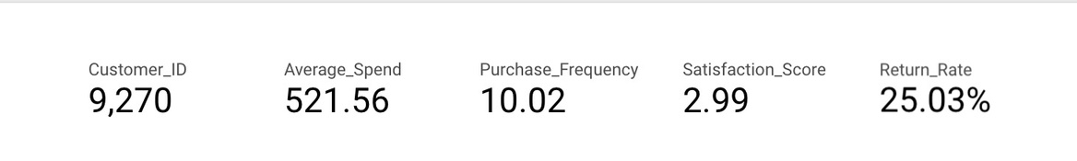
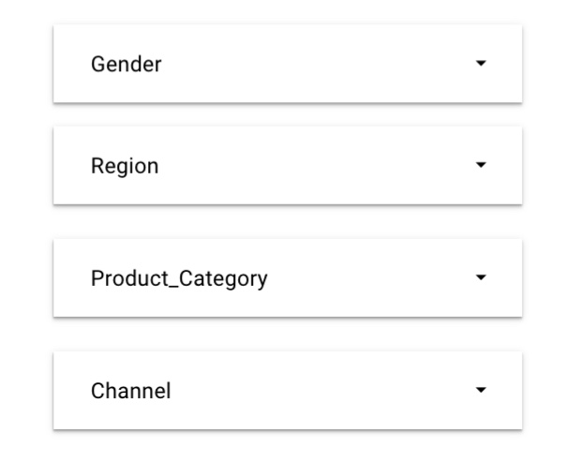
Key Performance Indicators (KPIs)
Satisfaction Score: 2.99 (out of 5):
The moderate score showcases a scope of improvement in overall customer experience.
Return Rate: 25.03%
Indicates potential issues with product quality, return policy loopholes, etc.

Slide 6
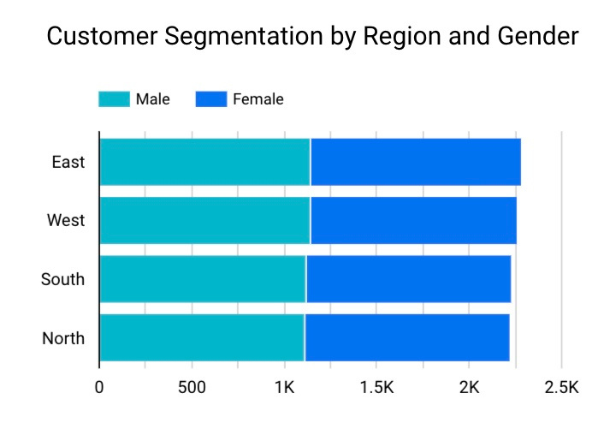
Customer Segmentation by Region and Gender
The visualization indicates how customers are distributed across genders and regions. The Eastern region has a significant portion of customers, with both genders well represented. The Northern and Southern regions lack in customers highlighting opportunities for targeted marketing and expansion. The company is advised to develop region-specific campaigns specially for North or South regions. This approach will advance engagement and consumer acquisition.

Slide 7
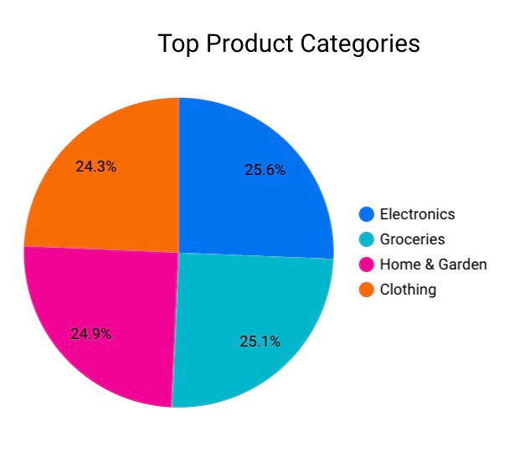
What People Are Buying: Top Product Categories
This visual shows distribution of purchases across product categories.
  Electronics: 25.6%
  Groceries: 25.1%
  Home & Garden: 24.9%
  Clothing: 24.3%
Electronics category is the top-selling sector which is closely followed by other markets. This chart indicates a well-balanced product portfolio. The company can continue optimization in the electronics sector. Whereas the company can explore growth opportunities in Clothing and Home & Garden categories. This can be done through product diversification and marketing campaigns.

Slide 8
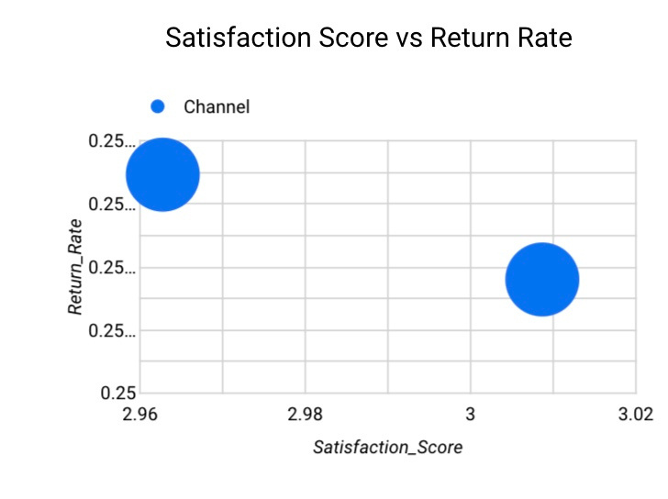
Connecting the Dots: Satisfaction vs Return Rates
  This scatter plot chart compares Satisfaction score and return rate. The bubble size represents purchase frequency.
  The western region indicates higher satisfaction score but also a high return rate. This showcases that customers may be satisfied with service but face product issues requiring returns. The northern and southern regions showcase lower satisfaction score with lower return rates. This indicates signal disengagement or low product penetration. The company can investigate why customers have high return rates in the western regions. Also, it can improve customer experience and engagement in north and south region through improved customer support.

Slide 9
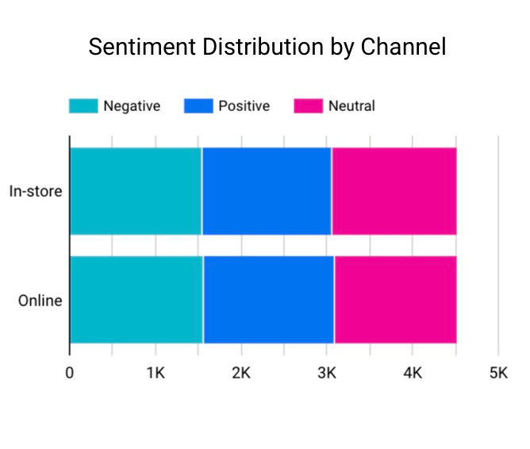
What Customers Are Saying: Sentiment by Shopping Channel
  This chart breaks down customer sentiment by channel based on the count of customer IDs.
  In-store purchases receive more positive feedback indicating a strong shopping experience in-store. On the other hand, online purchases show a higher share of negative feedback indicating issues in delivery or customer experience. Company can optimize online delivery customer experience by improving product descriptions, delivery processes, etc. Leverage in-store experiences by encouraging cross-channel promotions or online-to-offline engagement strategies.

Slide 10

Strategic Recommendations
  Enhance customer experience in northern and southern regions that contribute to lower satisfaction scores.
  Focus on reducing return rates in western regions and boost online customer experience.
  Target regions with lower customer counts with marketing campaigns and promote best-selling categories such as Electronics to drive revenue.

Slide 11

Conclusion
The visuals presented in the dashboard provide insights that the retail company can use to improve customer service. In conclusion, by following the provided recommendations the company can enhance overall business growth.
The audience is encouraged to ask questions that may arise. Audience feedback is welcome.
Thank you!

