Slide 1

MADSC101: DATA SCIENCE & ANALYTICS IN BUSINESS
Shaohui Wang
Group Members
Praveen Raja – 24049964
Merve Saglanmak Yamanoglu – 24050254
Samruddhi Karpe – 24050214
Malyala Venu Madhav - 24053434

Slide 2
DATA VISUALIZATION FOR BUSINESS
PRAVEEN RAJA
MERVE SAGLANMAK YAMANOGLU
SAMRUDDHI KARPE
Malyala Venu Madhav

Slide 3

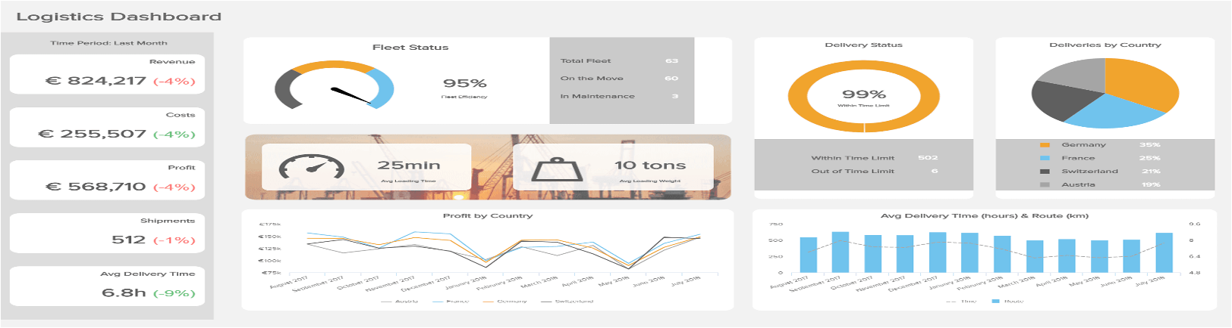
WHAT IS DATA VISUALIZATION AND WHY ITS IMPORTANT IN BUSINESS?
Data visualization is the visual visualization of information and data using charts and dashboards to help the analyst and managers fast detect patterns, trends and information in order to make informed decisions. As an illustration, Airbnb has interactive data dashboards to understand the booking trends, customer preferences, and regional demand to enable the business optimize pricing strategies and enhance user experiences in various markets.”

Slide 4
IMPORTANCE OF DATA VISUALIZATION
  Business insights will not be possible without data visualization since they will help simplify complex data, simplifying the process of understanding and interpreting the large volumes of data.
  Transforming raw numbers into cognitively significant images can help organizations cut the cognitive load on any decision-makers and concentrate on important insights that lead to action
  It is also efficient in displaying patterns and trends and correlations that may be concealed in spreadsheets, enabling analysts to spot outliers or new opportunities in little time.
  Visualization enhances business decisions because leaders can act in response to changes in the market faster and track internal performance indicators in real-time.
Examples:
  A retail firm that envisions the monthly sales in a bar chart will easily see regions where it is performing poorly than one that has to go through hundreds of data rows.
  A heat map that a logistics company employs would enable it to instantly identify which areas of the delivery are experiencing the greatest delays, and they may implement targeted changes.

Slide 5
BUSINESS IMPACT OF VISUALIZATION
Visualization of data is essential in refining the real-world business processes by transforming complex business information into deliverable information.
Contributes to Strategic Decisions: Visual aids like forecasting charts and trend lines are used by businesses to plan inventory, budgets and future objectives. An example is a retail company that is studying the trends in customer demand and is then able to forecast the number of sales they are likely to make and then change the inventory to match the demand.
Improves Communication: Images are used to bridge the divide between technical analysts and non-technical managers. In meetings, charts and dashboards simplify complicated data so that any member, both executives and team leaders can comprehend the insights and make informed decisions in a short time.
Allows Monitoring of Performance: KPIs like growth of revenue, ROI, and customer satisfaction can be monitored at all times with the help of dashboards. As an illustration, an industrial company can have a Power BI dashboard to track their production efficiency and identify the downtime in real-time, which will result in quicker problem-solving and higher efficiency.

Slide 6
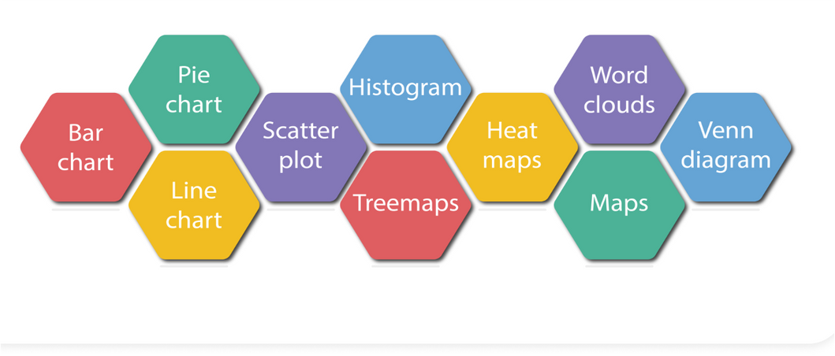
TYPES OF DATA VISUALIZATION
Charts
  Bar Chart: Compare categories (e.g., sales by region)
  Line Chart: Track changes over time (e.g., monthly profit growth)
  Pie Chart: Show proportions (e.g., market share by brand) give this in short para format
Advanced Visuals
  Heat Map: Show data density or intensity (e.g., sales by area)
  Scatter Plot: Show relationships between two variables (e.g., advertising spend vs. revenue)
  Tree Map: Show hierarchical data (e.g., product category sales)
  Geo Map: Display data across geographic regions.
Best Use
  Comparison → Bar,
  Column Trend Over Time → Line
  Proportion → Pie
  Distribution → Scatter, Box Plot
  Geographic → Map

Slide 7




TOOLS FOR VISUALIZATION
There are several popular tools available for creating effective data visualizations, each with unique benefit
Tableau is ideal for building interactive dashboards using a simple drag-and-drop interface, making it easy to explore and present data visually.
Power BI (Microsoft, 2023) integrates seamlessly with Excel and other Microsoft services, providing powerful business reporting and analytics capabilities.
Google Looker Studio is a cloud-based platform that enables real-time collaboration and easy sharing of interactive dashboards.

Slide 8
DATA VISUALIZATION FOR BUSINESS
PRAVEEN RAJA
MERVE SAGLANMAK YAMANOGLU
SAMRUDDHI KARPE
Malyala Venu Madhav

Slide 9

CORE THEORETICAL FRAMEWORK
ROADMAP
Visualization Methods
  Fundamental Chart Types
  Complex Analytical Visualizations
  Integrated Dashboard Systems
Principles Of Visualization
  Core Design Rules
  Cognitive Science Foundations & Gestalt
Visualization Technology Landscape
Summary: Integrating The Framework

Slide 10
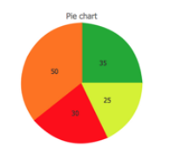
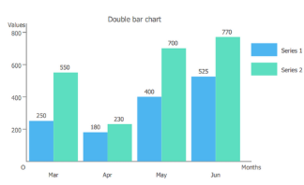
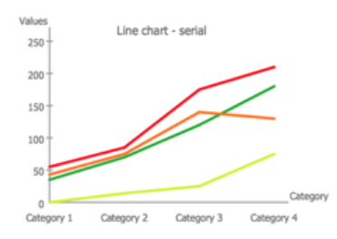
VISUALIZATION METHODS I: FUNDAMENTAL CHART TYPES
The type of chart should be determined by the analytical question, not by the beauty of its shape.
Kirk (2016) identifies three foundational chart types:
PIE CHART
A pie chart is a circular statistical graph that shows parts of a whole or a proportional distribution of categorical data.
For optimal use, the pie chart should be limited to 5-7 categories. (Miller, 1956)
BAR CHART
A bar chart is a data visualization tool that uses the length or height of rectangular bars to compare values ​​of different categories.
Comparing length is more accurate than comparing angles (Cleveland and McGill, 1984)
LINE CHART
A line chart is a graph that uses lines connecting points to show trends and changes in data, typically over time or in sequential categories.
It is preferred to observe changes in the same data over time.
Figure 1:(CS Odessa Corp., 2025)

Slide 11
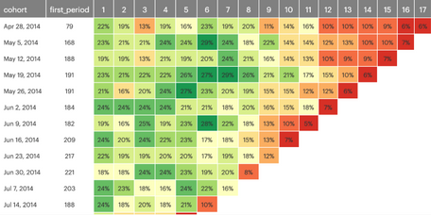
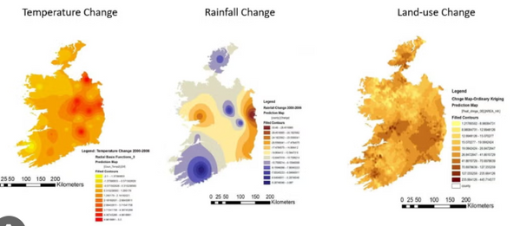
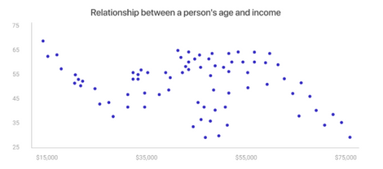

VISUALIZATION METHODS II: COMPLEX ANALYTICAL VISUALIZATIONS
HEAT MAPS
These show areas where data is concentrated using darker colors. They are usually two-dimensional tables.
Figure 4: Example of a Heatmap (Source: Grigoryan, 2025)
GEOSPATIAL VISUALIZATIONS
These graphs display data on a map, allowing us to understand events or distributions in settlements.
Figure 5: Geospatial Visualization(Source: University of Illinois Chicago, 2025).
SCATTER PLOTS
These are graphs drawn with dots to show how two different things relate to each other.
Figure 6: Example of a Scatter Plot (Source: Afrin, n.d.).
NETWORK DIAGRAMS
These graphs show interconnected people, systems, or ideas using dots and lines. They allow us to more easily see the relationships between them.
Figure 7: Network Diagram (Source: Visme, 2025).

Slide 12
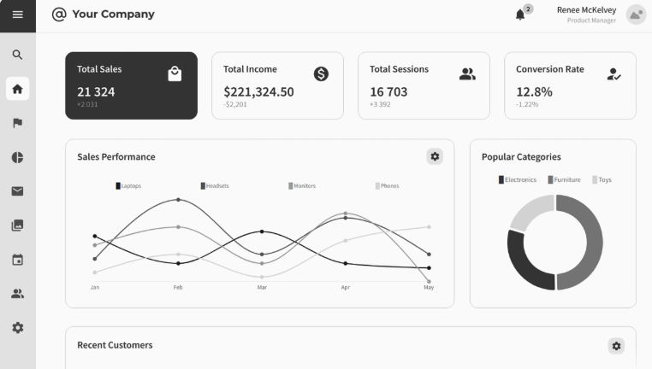
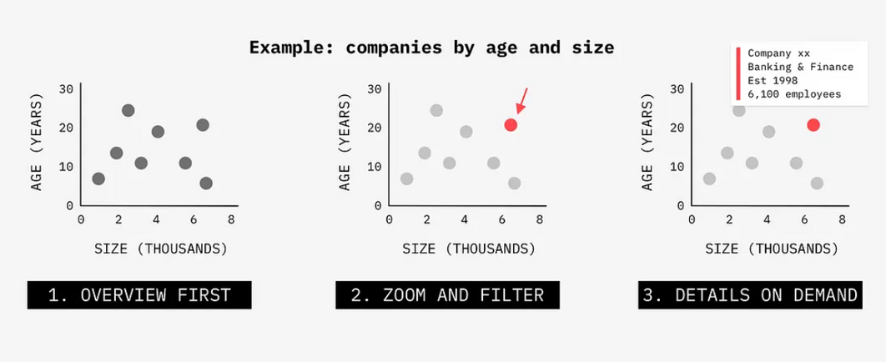
VISUALIZATION METHODS III: INTEGRATED DASHBOARD SYSTEMS
Few (2013) defines dashboards as visual displays that are combined to monitor data in real time.
IDS’ Features
  Multi-visualization integration
  Real-time data streaming
  Interactive exploration
The Shneiderman Principle
The Shneiderman Principle defines the functionality of these systems and forms the basis of the field of human-computer interaction.
This principle is based on the following steps:
Figure 8: Dashboard (Source: Moqups, n.d.)
Figure 9: Data Presentation (Source: Rachel, 2020)

Slide 13

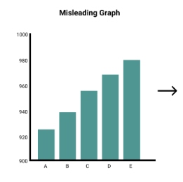
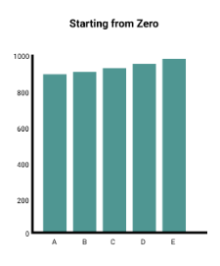
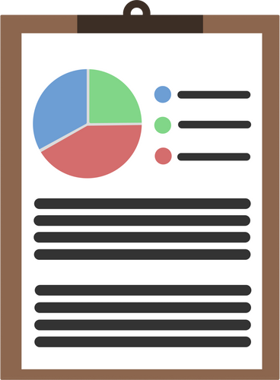
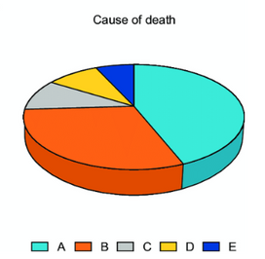
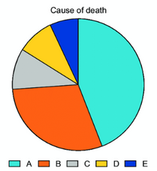
PRINCIPLES OF VISUALIZATION I: CORE DESIGN RULES
CLARITY: The viewer should be able to immediately and easily understand the visual message.
SIMPLICITY: Only essential and necessary information should be presented, reducing mental confusion.
Visualizing without considering the principle of accuracy can lead to costly business mistakes.
ACCURACY: Data should not be distorted, and facts should be presented as they are.
CONSISTENCY: Encoding methods such as colors and symbols must be standardized among graphics.
RELEVANCE: The design should be appropriate for the business purpose and the user's needs
Figure 10: Example of a Misleading Graph (Source: Grootendorst, 2021)

Slide 14
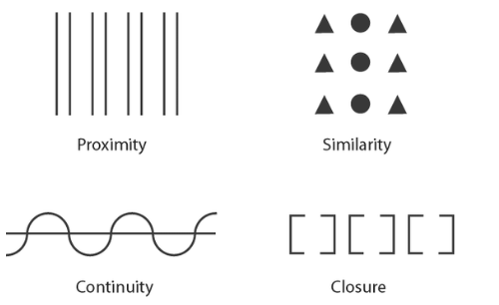
PRINCIPLES OF VISUALIZATION II: COGNITIVE SCIENCE FOUNDATIONS & GESTALT
Gestalt principles explain how the human brain perceives, simplifies, and organizes visual information.
Thanks to these principles, we can base the reasons why designs are perceived as "clear" or "simple" on a scientific basis (Ware, 2020).
Key Principles
Proximity: Objects physically located close together are perceived as a related group (e.g., clusters in a scatter plot).
Similarity: Objects with similar characteristics, such as color, shape, or size, are perceived as a group (e.g., all "Sales" data in a chart being blue).
Figure 11:Gestalt Principles (Source: Burkhard, 2005)
Continuity: The eye tends to follow connected and uninterrupted paths or lines. This is why line charts are effective.
Closure: The brain prefers to see familiar and complete shapes. Therefore, it tends to fill in missing information.

Slide 15






VISUALIZATION TECHNOLOGY LANDSCAPE
Various tools are available to help us use theoretical concepts and principles more easily and accurately.
Business Intelligence and Dashboard Platforms:
These tools’ interfaces typically use drag-and-drop. They allow the creation of real-time dashboards. Examples: Tableau, Microsoft Power BI, Google Data Studio.
Programming Libraries:
These tools are for more advanced users, such as developers. They allow users to create complex and unique visuals by writing code.
Examples: D3.js, Scikit-learn / Matplotlib
Basic Analysis and Reporting Tools:
These tools are used to quickly create basic graphics.
Examples: Microsoft Excel, KNIME.

Slide 16
SUMMARY: INTEGRATING THE THEORETICAL FRAMEWORK
For successful data visualization, it is crucial to include all theoretical layers in the process.
The following steps should be followed for effective insight.
PURPOSE (Strategy): What will I use this chart for? For example, for quick decision-making, for performance tracking, etc.
TYPE (Method): Plan the chart before physically drawing it. Use basic design rules and make it clean, simple, and accurate.
TYPE (Method): Choose the right chart to visualize your data. For example, a bar chart for comparison, a line chart for trends, etc.
TOOL (Technology): Choose the right software (such as Tableau, Power BI, or Code).

Slide 17
REFERENCES
  Visme (2025) Basic - Network Diagram Template. [online] Available at: https://www.visme.co/templates/infographics/basic-network-diagram-1425283762/ (Accessed: 9 November 2025).
  Grigoryan, S. (2025) What is a Heatmap and Why It's a Game-Changer for Data Visualization. [online] Userpilot. Available at: https://userpilot.com/blog/what-is-a-heatmap/ (Accessed: 9 November 2025).
  Rachel (2020) Presenting data visualization to engage your audience. [online] Medium: UX Collective. Available at: https://uxdesign.cc/presenting-data-visualization-to-engage-your-audience-815eb6a43a62 (Accessed: 9 November 2025).
  Moqups (n.d.) Admin Dashboard Wireframe Template. [online] Available at: https://moqups.com/templates/wireframes-mockups/admin-dashboards/admin-dashboard-wireframe/ (Accessed: 9 November 2025).
  Grootendorst, M. (2021) Stop Using Misleading Graphs. [online] Maarten Grootendorst. Available at: https://www.maartengrootendorst.com/blog/misleading/ (Accessed: 9 November 2025).
  CS Odessa Corp. (2025) Table column bar pie line scatter examples. [online] Available at: https://www.conceptdraw.com/examples/table-column-bar-pie-line-scatter (Accessed: 9 November 2025).
  Ware, C. (2020) Information Visualization: Perception for Design. 4th ed. Morgan Kaufmann.
  Burkhard, R.A. (2005) Gestalt Principles present how we perceive objects and groups of objects. [online] ResearchGate. Available at: https://www.researchgate.net/figure/Gestalt-Principles-present-how-we-perceive-objects-and-groups-of-objects-Proximity_fig5_36382932 (Accessed: 9 November 2025).
  Kirk, A. (2016) Data visualisation: a handbook for data driven design. London: SAGE Publications.
  Miller, G.A. (1956) 'The magical number seven, plus or minus two: Some limits on our capacity for processing information', Psychological Review, 63(2), pp. 81-97.
  Cleveland, W.S. and McGill, R. (1984) 'Graphical perception: Theory, experimentation, and application to the development of graphical methods', Journal of the American Statistical Association, 79(387), pp. 531-554.
  Few, S. (2013) Information dashboard design: displaying data for at-a-glance monitoring. 2nd edn. Burlingame: Analytics Press.
  University of Illinois Chicago (2025) Geospatial Analysis and Visualization (GSAV) Certificate. [online] Available at: https://cuppa.uic.edu/academics/upp/upp-programs/certificates/gsav-certificate/ (Accessed: 9 November 2025).
  Afrin, M.A. (n.d.) How Are Scatter Plots Useful in Business?. [online] Mokkup.ai. Available at: https://www.mokkup.ai/blogs/what-are-scatter-plots/ (Accessed: 9 November 2025).

Slide 18
DATA VISUALIZATION FOR BUSINESS
PRAVEEN RAJA
MERVE SAGLANMAK YAMANOGLU
SAMRUDDHI KARPE
Malyala Venu Madhav

Slide 19
Analysis and Theory
Data Visualization help viewers extract relevant and actionable insights in a precise and unbiased way. It plays an important role in effective communication provided that the content is tailored to the audience.
An effective data visualization should transform raw data into insightful data that the audience may not have been able to understand easily with raw data sets.
There are different types of visualizations for different types of audiences. For instance:
Visualizations for general public need not be very complex to understand. General audience does not require delving into the details and nuances of large data sets. In such cases, highlighting only the main conclusion can make a greater impact. On contrary, technical teams require detailed charts that help them to take informed decisions.
In addition, the designer must also consider the colour palette of the visualization. This helps colour blind audience to understand the data without facing difficulties.
Other things to keep in mind while preparing data according to the audience would be right chart type, appropriate story flow, interactive charts, etc.
Source:
Klassen, N., Mehra, S., Sanders, L., & Simmons, J. (2021) 'Tailoring visualizations to suit your audience', AIR, 19 August. Available at: https://www.airweb.org/article/2021/08/19/tailoring-visualizations-to-suit-your-audience (Accessed: 2 November 2025).
Cikara, M., Botvinick, M., & Falk, E.B. (2021) ‘The neuroscience of race’, Perspectives on Psychological Science, 16(6), pp. 1153–1167. Available at: https://journals.sagepub.com/doi/10.1177/15291006211051956 (Accessed: 5 November 2025).
Product in Data (2024) ‘Inside Netflix infrastructure for real-time data handling’, Product in Data, 12 November. Available at: https://productindata.com/2024/11/12/inside-netflix-infrastructure-for-real-time-data-handling/ (Accessed: 6 November 2025).

Slide 20
How Do Industries Use Data Visualization
In any type of industry, analysis of customer behaviour plays a significant role that assists the businesses in making effective as well as calculated business decisions. Trends and patterns are identified by the businesses from the data, which they implement to refine their business strategies. This process becomes pivotal in driving business growth and success positively. The conclusions obtained from well-crafted data visualization can be leveraged to enhance customer loyalty, optimize revenue, and maintain a competitive advantage.
The below example will showcase an instance of how retail industry will benefit from the use of data visualization. The insights include data regarding what kind of visualization is employed, what kind of information is extracted from the visualization, and offer strategic suggestions for the company. The data was cleaned and uploaded in Google Looker Studio, where various types of visualizations were created to derive insights. The right type of data visualization was chosen to best represent the data that is to be communicated.

Slide 21
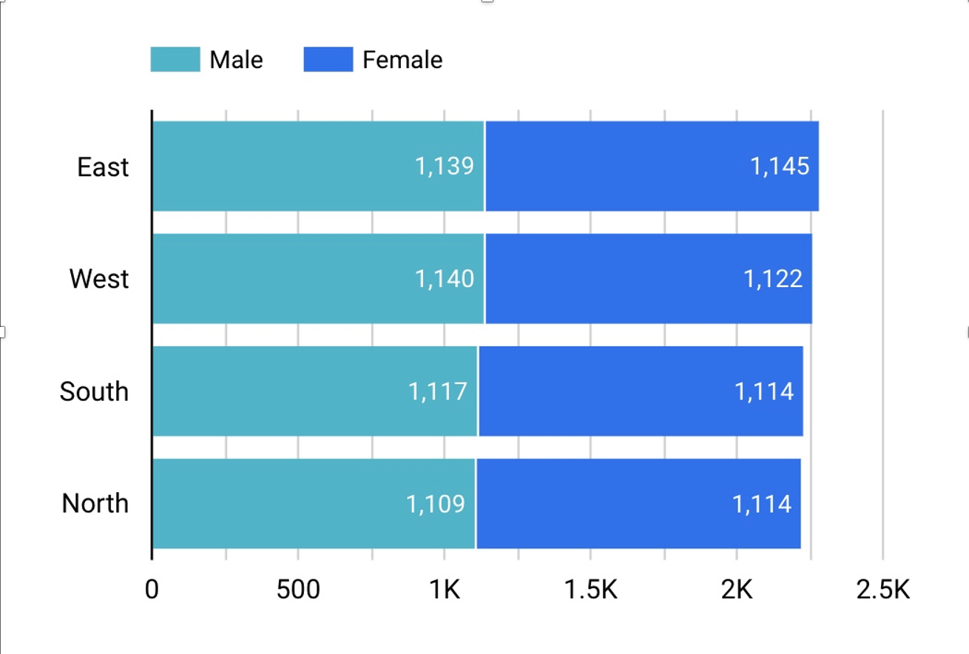
How Do Industries Use Data Visualization
Bar Chart: Customer Segmentation by Region and Gender
Chart selection: A bar chart is an ideal option for the provided data as it shows an easy comparison of consumer distribution across regions and genders. In addition, the bar chart effectively summarizes a large data set into meaningful data.
Expected insights: The expected result from using these attributes (region and gender) was to highlight which consumer groups come from what particular regions. Moreover, the combination of these data points is most important because consumer behavior tends to differ by region based on economic conditions, cultural variations, etc. The desired outcome of this chart and data is to realize that customer distribution makes it possible for more targeted marketing campaigns.
Chart Description: The chart illustrates customer distribution in terms of male and female across four regions. (East, West, North, South). (count: 0 to 2.5K). According to the chart, the East and the West regions showcase a large portion of customers. On the other hand, the gender distribution is relatively equal across all the regions.
Recommendations: Company can enhance localized marketing strategies in high-density regions like East and West, whereas they explore untapped growth opportunities in lower-density areas. The latter include North and South.

Slide 22
Real-World Applications
Case Study:
https://www.kaggle.com/datasets/shivamb/netflix-shows
Data Fields Included:
show_id: Unique identifier
title: Movie/TV show name
type: Movie or TV Series
director: Creator name(s)
cast: Actor names
country: Production country
date_added: When added to Netflix
release_year: Original release year
rating: Content rating (G, PG, PG-13, R, TV-MA, etc.)
duration: Length (minutes for movies, seasons for TV)
listed_in: Genre(s)
description: Plot summary
Dataset:
Netflix Movies & TV Shows
Focus:
Content strategy analysis

Slide 23
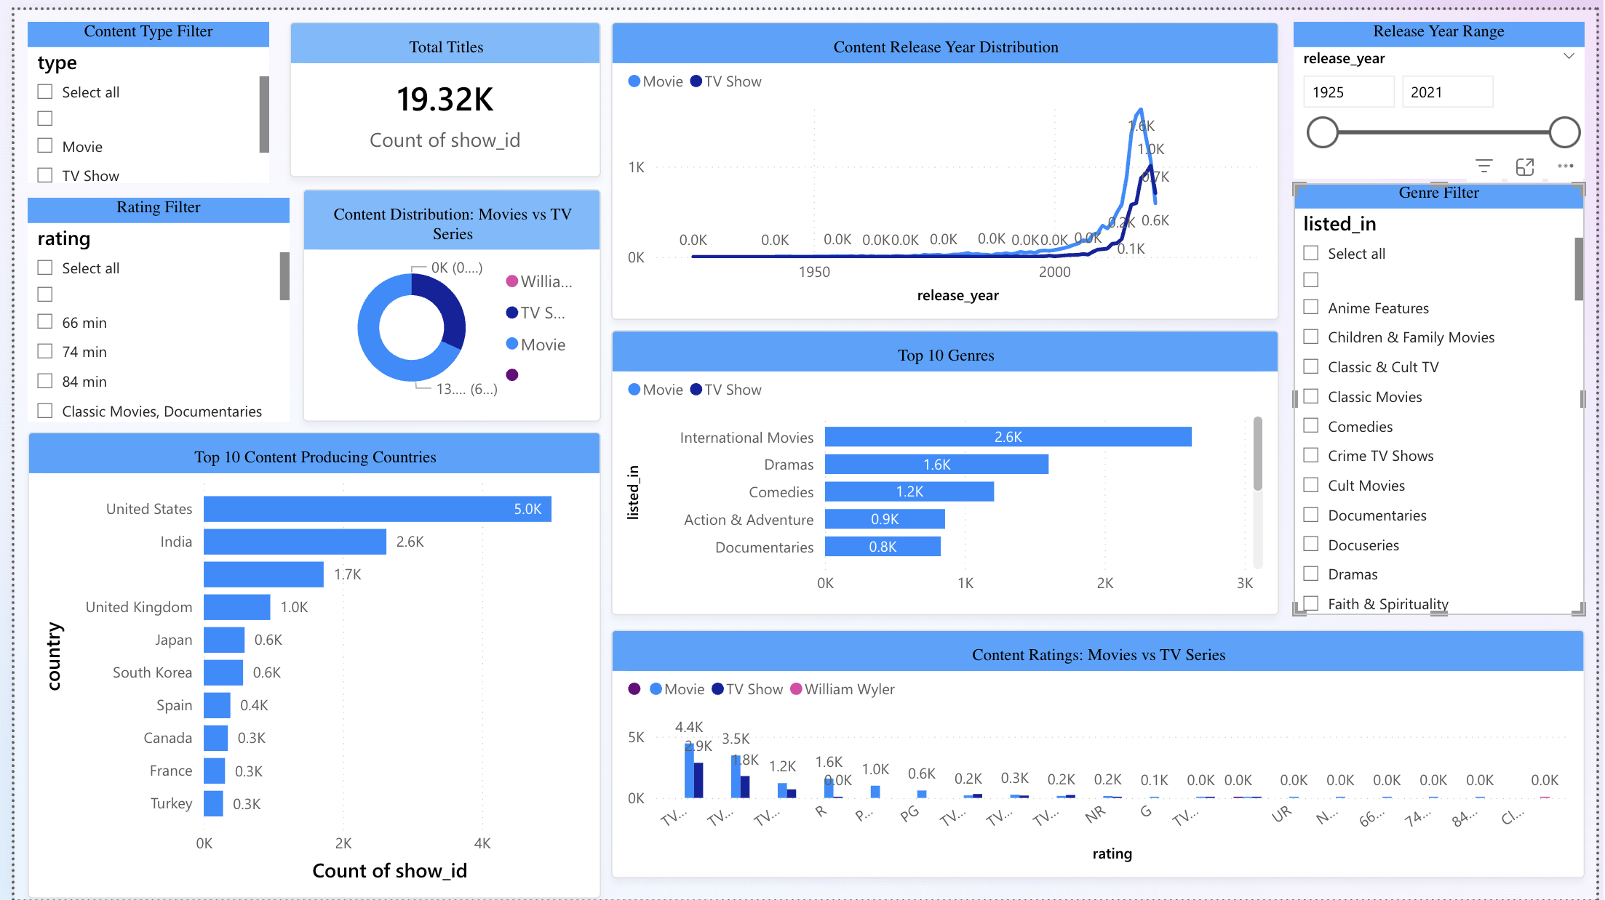
Netflix Content Strategy Dashboard

Slide 24
How Do Industries Use Data Visualization
Insights from Each Chart
1. Total Titles (KPI Card)
Netflix has 19,000 titles.
2. Content Type Distribution (Donut Chart)
Movies capture largest share of about 68%, while TV Shows are in the minority. TV shows capture over 32% of content type.
Why cleaning the data is necessary: The value "William Wyler" is an example of misclassified or dirty data.
3. Content Release Year Distribution (Line Chart)
After 2000, most content was produced. In addition, movie production peaked around 2016–2017.
TV show production is expected to grow in recent years. Thus, the company can use this as an insight to invest in original series and new releases.
4. Top 10 Genres (Horizontal Bar Chart)
Company’s most frequent genres: “International Movies,” “Dramas,” and “Comedies”. This showcases that the company focuses on both global and story-driven content.
The diversity in genre is broad which indicates wide audience preferences.
5. Content Ratings Distribution (Clustered Bar Chart)
By using this insight, the company can target teen and adult audience. (TV-MA (Mature) and TV-14)
Currently, majority of genres cater to mature viewers. However, the company still includes a large amount of family and teen content.
6. Top 10 Content Producing Countries (Horizontal Bar Chart)
United States holds the first rank in content production producing over 5,000 titles.
India, the UK, Japan, and South Korea are rising contributors.

Slide 25
DATA VISUALIZATION FOR BUSINESS
PRAVEEN RAJA
MERVE SAGLANMAK YAMANOGLU
SAMRUDDHI KARPE
Malyala Venu Madhav

Slide 26
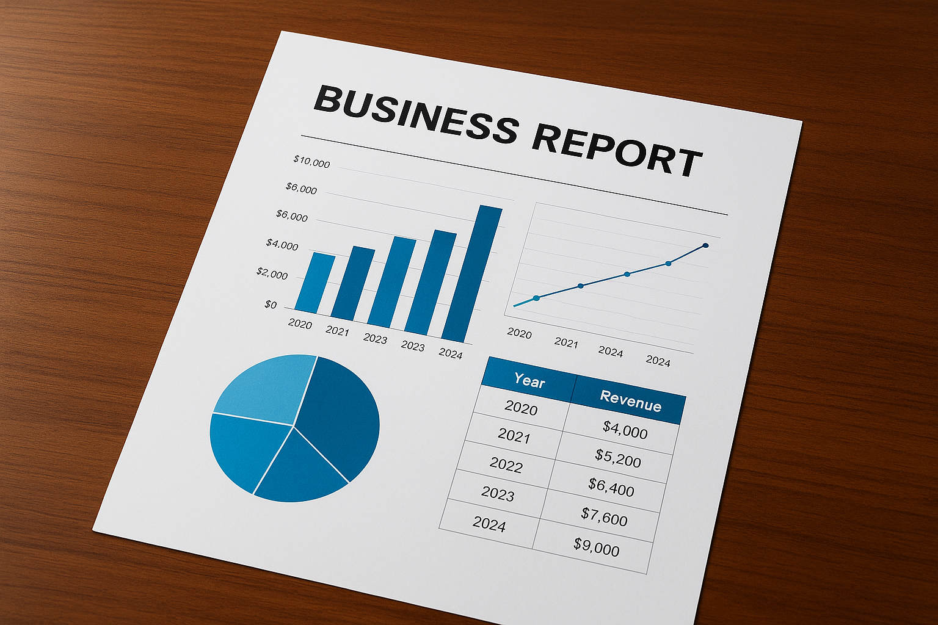
Summary of Key Insights
(Bringing It All Together)
Data visualization transforms raw data into something that can be acted upon thus improving the interpretability of complex data.
This process has the effect of connecting the outcome of analysis to the overall business strategy in such a manner that the strategic decision making is made with sound data analysis.
Moreover, it presents high-speed, information-driven decision-making activities in a multitude of fields, which facilitates flexibility and knowledgeable management.
Notes:
Speaker Notes:
Let’s begin with a quick summary of our key takeaways. Data visualization turns complexity into clarity. It bridges analytics and business strategy — enabling leaders to make smarter, faster decisions in every industry.
Visual Idea: Simple flow infographic → Data → Visualization → Insight → Decision.

Slide 27
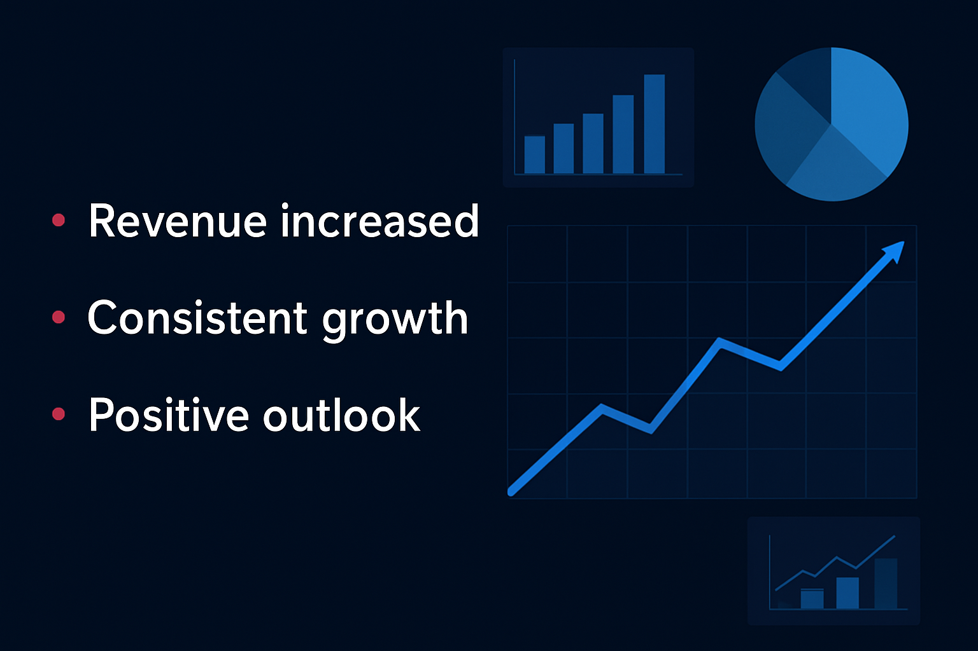
The Strategic Value of Visualization
( From Insights to Strategy)
Enables constant tracking of performance measures.
Encourages technical and business division interoperability.
Improves strategic planning and forecasting.
Notes:
Speaker Notes:
Visualization is a strategic tool, not just a reporting method. It aligns departments, tracks performance live, and supports informed planning based on clear evidence.
Visual Idea: Dashboard mockup showing KPIs (sales ↑, revenue ↑, costs ↓).

Slide 28
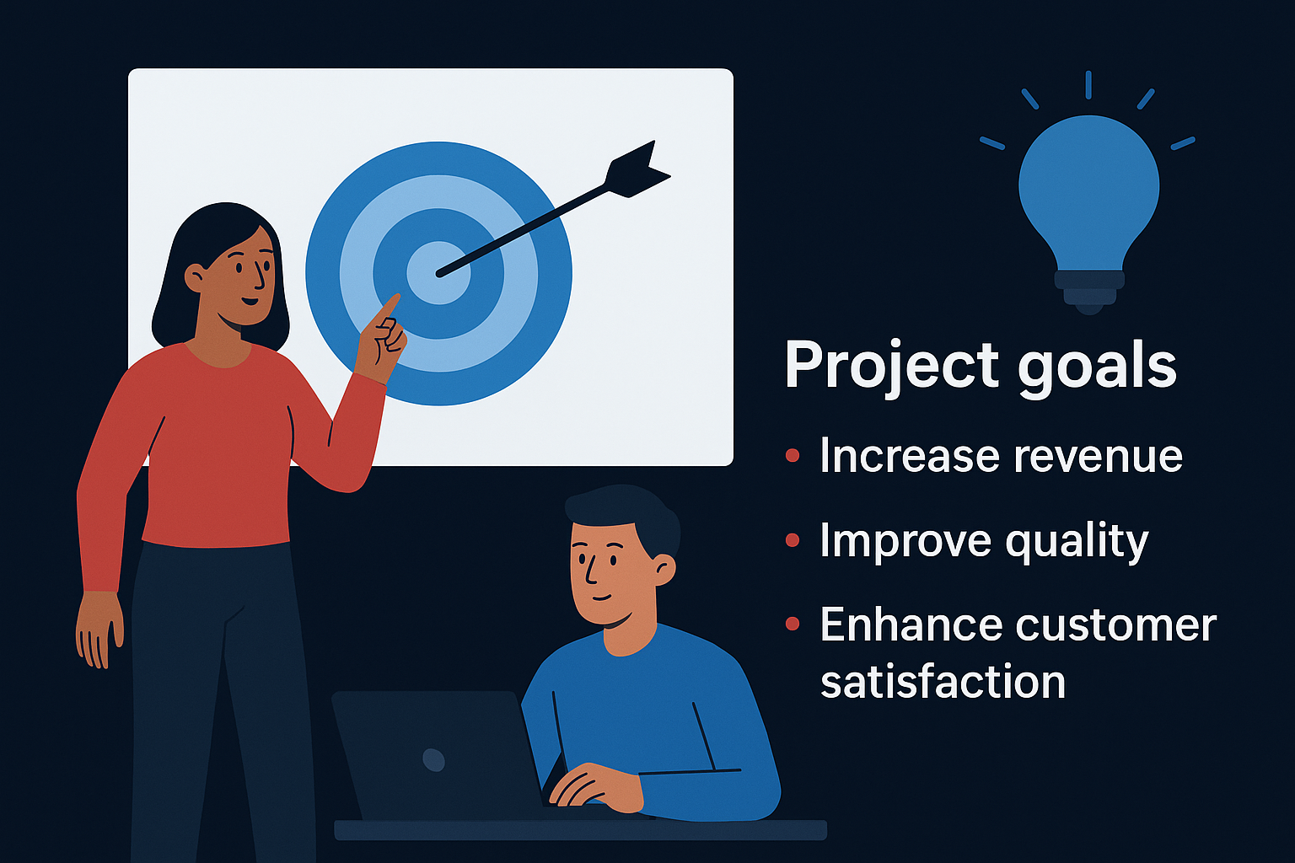
The Future of Data Visualization
(Emerging Trends Shaping the Future)
Dashboard automation using artificial intelligence.
Intelligent analytics and voice-based technologies.
Flawless connectivity with the Internet of Things and live data feeds.
Notes:
Speaker Notes:
The future of visualization is intelligent and interactive. AI will automate insight discovery, while IoT and real-time data make dashboards continuously responsive.
Visual Idea: Futuristic timeline (2025 → 2030) highlighting AI, IoT, Automation.

Slide 29
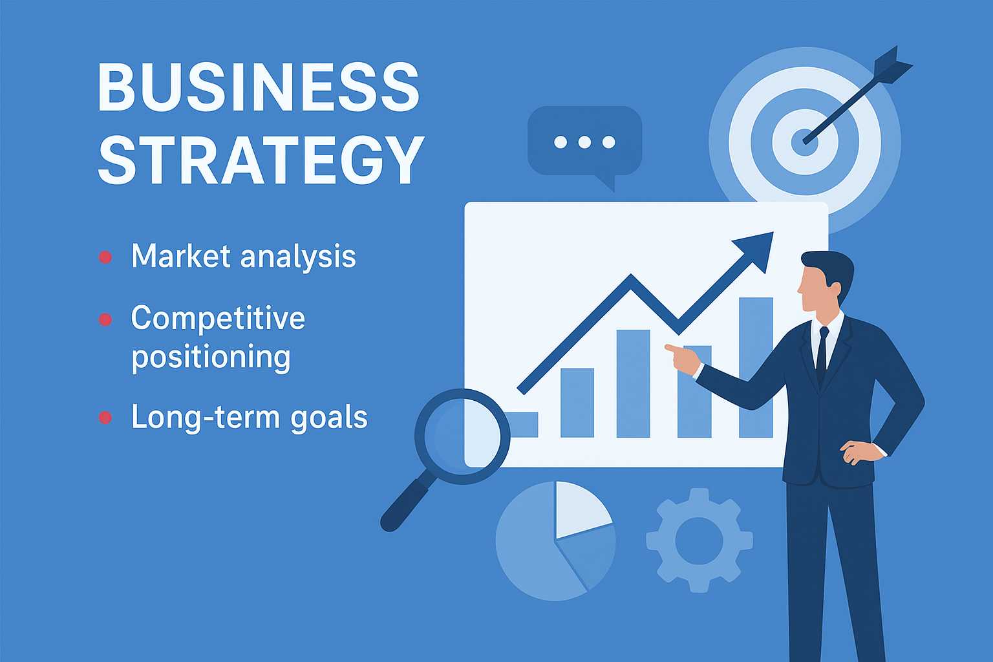
Rise of Data Storytelling
(Turning Numbers into Narratives)
Combines visual, contextual and plot structures.
Explains the rationality back of data.
Creates unpleasing connection and drives behaviour.
Notes:
Speaker Notes:
Storytelling gives life to data. A good visualization doesn’t just show numbers — it tells a story that inspires understanding and action.
Visual Idea: Data Story Arc diagram → Problem → Data → Insight → Action.

Slide 30

The Role of Ethics in Visualization
(Ethics and Data Integrity)
Eliminate the use of deceptive charts or biased graphs.
Assure ultimate openness and accuracy.
Secrecy of individual privacy and maintenance of compliance to the regulatory requirements.
Notes:
Speaker Notes:
As visuals grow more persuasive, ethics become crucial. A distorted chart can lead to wrong business choices — so clarity and honesty must always come first.
Visual Idea: Scale icon balancing 'Truth' vs 'Manipulation'.

Slide 31

Challenges to Overcome
(Challenges in the Evolving Landscape)
Information overload and dashboard clutters is also one of the common issues in modern information systems.
Poor visualization literacy is another restrictive factor forming a major obstacle towards the proper interpretation and utilization of analytic outputs.
Assimilation of various, fragmented data sources is still a relevant challenge to obtaining holistic analysis.
Notes:
Speaker Notes:
Even with powerful tools, challenges persist — too much data, too little understanding. Businesses need both smarter systems and better-trained people.
Visual Idea: Icons: database overflow → person → broken link.

Slide 32
The Future Skillset for Professionals
(What Skills Will Matter Most?)
As essential skills in the modern data-driven environment, data literacy and storytelling cannot be neglected by those professionals who need to turn the disorganized data into meaningful and practical stories.
Ethical design in visualization comprises one of the essential elements of the process of the responsible data communication as the designers closely follow the principles that foster transparency, accuracy, and inclusiveness in visual representations.
Effective application of business intelligence tools, like Tableau and Power BI, allows analysts to embrace the power of analytic tools, automate the process of data integration, and create interactive dashboards to make informed decisions.
Notes:
Speaker Notes:
Tomorrow’s analysts must merge technical and communication skills — translating data into ethical, engaging stories that inspire confident action.
Visual Idea: Silhouette of professional encircled by icons (data, ethics, design, AI).

Slide 33
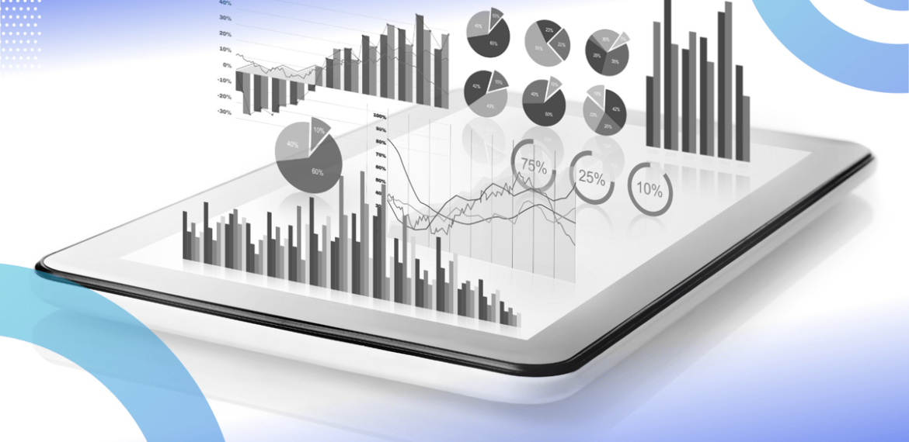
Final Thoughts
(The Future is Visual)
Visualization serves as a direct flow connecting the empirical data to strategic decision making.
The success of visualization activities is reserved with the concomitant clarity, creativity, and ethical considerations.
An excellent visualization is not detected, but understood.
Notes:
Speaker Notes:
To wrap up — visualization will keep redefining how organizations decide and compete. The future belongs to those who can see and show data clearly. Thank you.
Visual Idea: Minimal, bright design — lightbulb or eye icon with the quote overlayed.

