Slide 1

MADSC101: DATA SCIENCE & ANALYTICS IN BUSINESS
Shaohui Wang
Group Members
Praveen Raja – 24049964
Merve Saglanmak Yamanoglu – 24050254
Samruddhi Karpe – 24050214
Malyala Venu Madhav - 24053434

Slide 2

VENU MADHAV
Understanding the Telecom Churn Problem
This paper addresses the critical challenge of customer churn within the telecom industry. Our company faces a significant 29.6% churn rate, indicating a loss of nearly a third of our customer base annually.
High Attrition in First 12 Months
Suggests issues with onboarding and initial engagement.
High-Spending Customers at Risk
Small numbers of high-value customers are being lost, necessitating targeted retention.
A data-science approach is essential to identify churn determinants and predict future churn effectively.

Slide 3


VENU MADHAV
Problem Statement & Business Motivation
Customer acquisition in telecom is capital-intensive; losing a customer impacts both current revenue and initial investment (Gupta and Lehmann, 2004).
Experience is Key
Churn Indicators
Minor demographic shifts between churned and retained customers suggest experience, not demographics, drives churn.
Low satisfaction scores, frequent support calls, and increased monthly spending correlate with customer departures.
Uncontrolled Churn Leads To:
Revenue instability
Higher promotional costs
Reduced Customer Lifetime Value (CLV)
Competitive disadvantage
Strategic relevance: Less churn directly increases profitability and forecasting accuracy.

Slide 4





VENU MADHAV
Data Science in Solving Churn
Data science provides a systematic understanding of churn through various analytical approaches:
Descriptive Analytics
Identifies trends based on gender, income, spend, tenure, and service type. Churn is equally distributed by gender but concentrated among low-satisfaction customers.
Diagnostic Analytics
Demystifies causal variables by examining relationships (e.g., satisfaction vs. churn, support calls vs. churn). Churners often have low satisfaction scores (1-10) and make repeated calls.
Predictive Analytics
Uses logistic regression and other models to assign a churn probability. High recall (approx. 99%) ensures identification of nearly all churners for proactive intervention.
Strategic Decision Support
Data-backed insights inform targeted retention, early-warning strategies, and resource allocation.

Slide 5
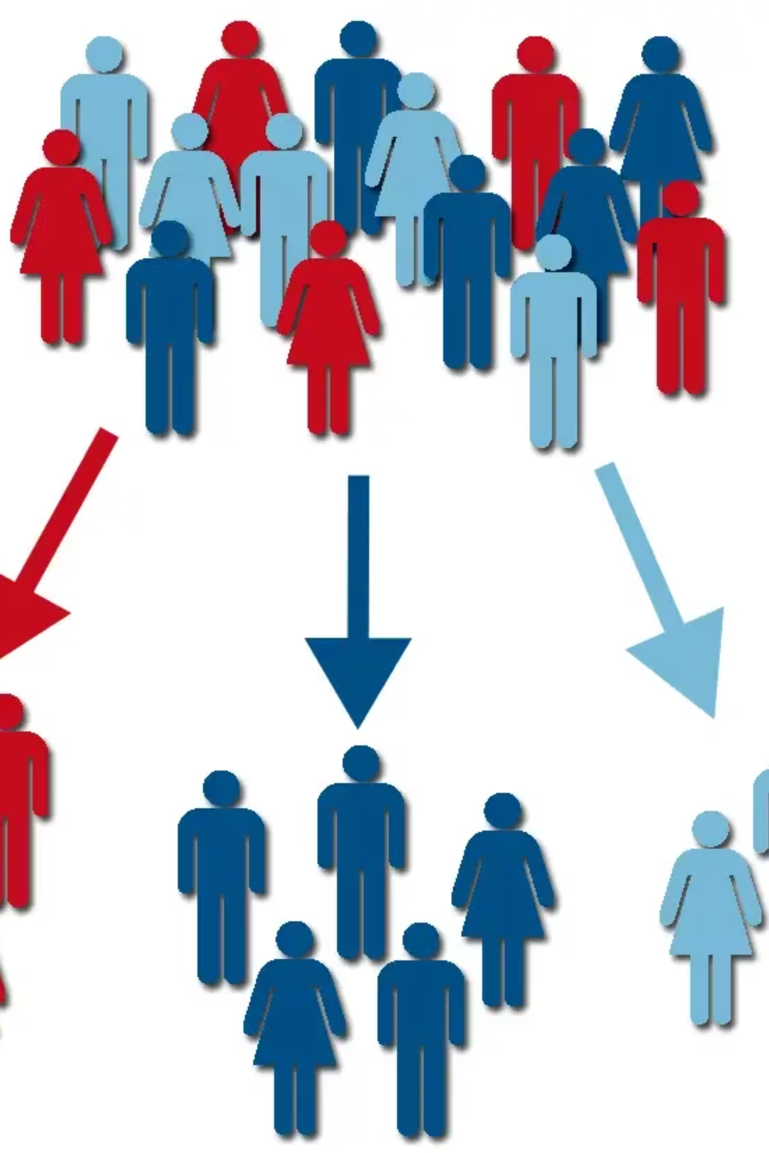
VENU MADHAV
Project Objectives: Telecom Churn Study
1
Customer Profiling
Review demographics (income, age, gender) and usage history (tenure, spend, service type) to contextualize churn behavior.
2
Experience Evaluation
Compare satisfaction scores and support call frequency as measures of service quality and customer frustration.
3
Predictive Modeling
Build a churn prediction model to assess risk and identify key drivers (e.g., satisfaction, monthly spend).
4
Retention Actionable Insights
Translate findings into strategic recommendations to minimize churn and enhance customer loyalty.
Outcome:
An all-encompassing, information-based view to shift from reactive loss management to proactive customer retention.

Slide 6
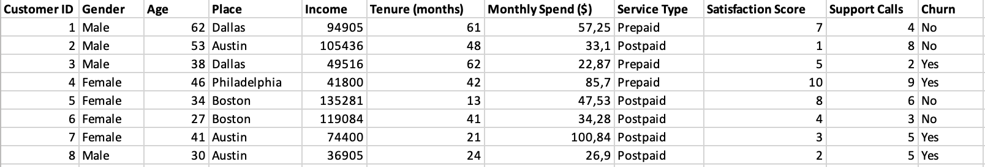
Merve Saglanmak
Yamanoglu
Overview
This dataset shows customer portfolio of a Telecommunication company. The purpose of the analysis inspecting the demographic and customer interaction data from the dataset and showing the levels of churn rates and related patterns.
Dataset includes 1000 unique customers (rows) and 11 different variables (Columns)
Attributes:
Demographic Data: Customer ID, Age, Gender, City, and Income
Service Usage Data: Tenure in months, Monthly Spend, Service Type (Prepaid/Postpaid)
Customer Interaction Data: Satisfaction Score (1-10), number of Support Calls (1-9)
Target: Churn (Yes/No)

Slide 7
Merve Saglanmak
Yamanoglu
Generation-Based Customer Distribution
& Churn Rates
Gen Z (18-28)
Gen Y (29-44)
Gen X (45-60)
Baby Boomer (61-79)
The highest churn rate belongs to Baby Boomer Generation(33.4%) and the lowest is Gen X (26.6%).
Most of our customers are Baby Boomers, and the smallest group is Gen Z.

Slide 8
Merve Saglanmak
Yamanoglu
Churn Tendency:
Tenure, Income and Service Type
Churn rate is 27% in customers’ first year and most of them are postpaid users. In the following years, our prepaid customers has a higher churn rate than postpaid customers. Data shows that our postpaid and prepaid packages(such as the number of minutes or internet speed/reception) may have quality issues or our competitors may have better packages.
There may be a relation between the income level and churn rates for the Gen Y. Data shows lower income group made their decision based on costs.
On the contrary, high income Baby Boomers tend to churn more. That shows us their service expectations may not be met, or our competitors offer more premium packages.

Slide 9
Merve Saglanmak
Yamanoglu
Customer Satisfaction
& Gender-Based Churn Analysis
Average satisfaction scores proves the analysis before:
Baby Boomer and GenZ groups that churn has lower satisfaction scores than the ones that don’t churn. Data shows the unsatisfaction of these groups.
For Gen X group, high satisfied group has higher churn rates, this situation could be related to competitors offering better prices for similar or superior packages
Gen Z male group tend to play games (Newzoo, 2023). High Churn rate on the graph shows this group high ping and data consumption(because of Twitch-Youtube) may be a problem for them.

Slide 10



CUSTOMER CHURN ANALYSIS
(Power BI)
──────────────────────────────────────────────────
1️⃣ DATA PREPARATION
──────────────────────────────────────────────────
• Load dataset into Power BI
• Clean data types (text, numeric, categories)
• Create Churn Flag (0 = No, 1 = Yes)
• Ensure columns are ready for visualization
│
▼
2️⃣ KPI SUMMARY
──────────────────────────────────────────────────
• Total Customers
• Total Churned Customers
• Churn Percentage (%)
• Overview of customer base
│
▼
──────────────────────────────────────────────────
3️⃣ CHURN DISTRIBUTION & BASIC VISUALS
──────────────────────────────────────────────────
• Donut Chart → Churn vs Non-Churn
• Bar Chart → Churn by Gender
• Bar Chart → Churn by Service Type
• Line/Column Chart → Churn vs Support Calls
PRAVEEN RAJA

Slide 11

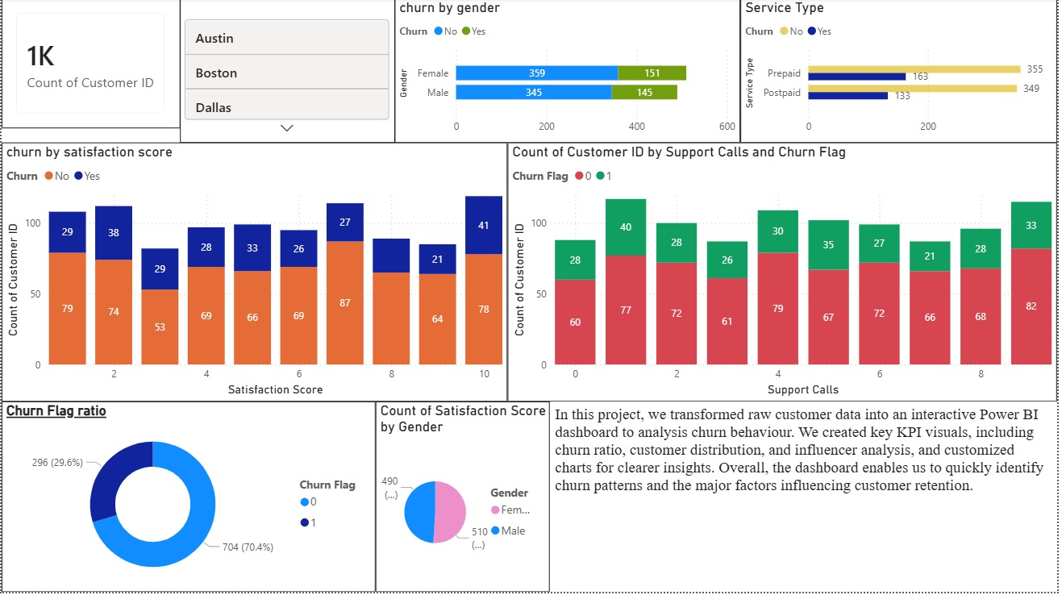

──────────────────────────────────────────────────────────────
4️⃣ CHURN DRIVERS & CUSTOMER BEHAVIOUR
──────────────────────────────────────────────────────────────
• Churn by Satisfaction Score
• Churn by Tenure (Months)
• Churn by Monthly Spend
• Churn by Income / Age groups
• Identify which behaviour groups churn more
│
▼
───────────────────────────────────────────────────────────────────────────
5️⃣ FINAL DASHBOARD DESIGN
───────────────────────────────────────────────────────────────────────────
• Combine KPIs + charts on one page
• Add slides (Gender, Service Type, Location)
• Use clean color themes
• Maked layout professional and easy to read
│
▼
───────────────────────────────────────────────────────────────────────────
6️⃣ KEY INSIGHTS
───────────────────────────────────────────────────────────────────────────
• Low satisfaction → higher churn
• More support calls → higher churn
• Prepaid customers → higher churn
• Lower tenure → higher churn
• High spend + low satisfaction → risk group
PRAVEEN RAJA

Slide 12
DASHBOARD BOARD:
PRAVEEN RAJA
The file is hear you click to view the dashboard

Slide 13
Power bi document
PRAVEEN RAJA

Slide 14
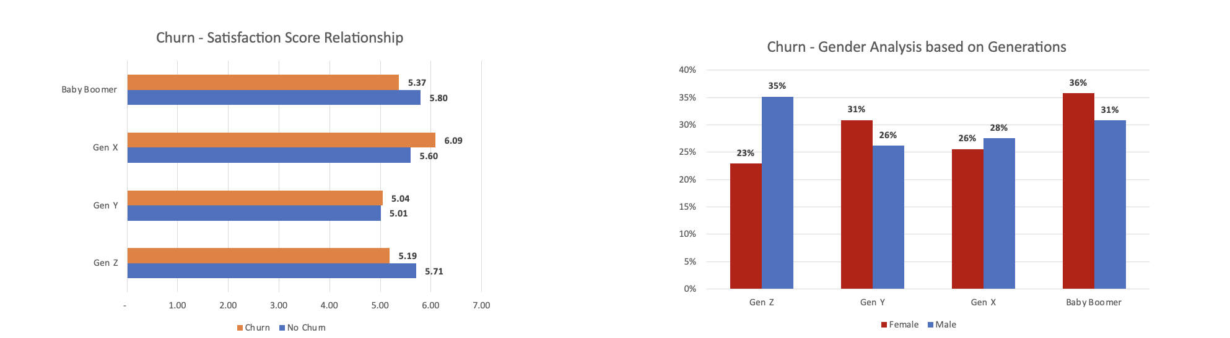
Key Insights & Visualization Highlights
Samruddhi Karpe
Insight 1: Generational CSAT & Churn
Chart Type: Dual bar chart + Gender-based churn bar chart
Key Learnings:
Generation X Outlier: Higher CSAT for those who have churned compared to for those who did not churn. This means that even though some were satisfied, they left to find better value.
Generation Z Situation: Lowest CSAT for those who have churned and highest for those who did not churn.
Gender Breakdown: More women than men churn in Generation Z and Baby Boomers. On the other hand, men have more churn in Generation X.
What Caused This: The service level of customer experience has a mismatch with the level of expectation by generation. Moreover, premium customers’ service level expectation has not been met in Generation X. In addition, digital customers’ service level expectation has not been met in Generation Z.
Actions to take:
For Generation Z: Create a digital-first, gaming-bundled, data/speed based service offering.
For Generation X: Create a competitive offering for premium packages that addresses the differences in perception of service quality.
For females in Generation Z and Baby Boomers: Develop gender-based support and retention program.

Slide 15
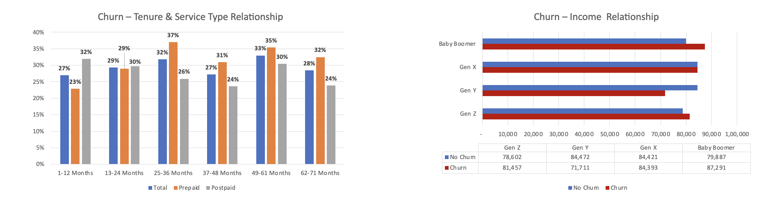
Key Insights & Visualization Highlights
Samruddhi Karpe
Insight 2: Prepaid vs. Postpaid Type
Chart Type: Grouped bar chart + Horizontal bar
Prepaid Type Churn Is 38.46% In Year One. Overall, It has Elevated To 29%-37% After 12 Months Due To No Commitment Lock.
Postpaid Spike in Churn second Year is 37% from Month 37-48 d/t Customer Frustration with Billing, Service Degradation
Income Paradox: High Income Boomers Have a Churn Rate. While Gen Y has lower churn rate.
Indicates: Cost Is Not The Primary Driver, Satisfaction & Service Expectations Are
Root Cause For Prepaid: Customers Have A Frictionless Exit; Postpaid: Customers Encounter Billing/Service Issues After Year 3
Action Required Prepaid: Develop Loyalty Programs for Months 12+ (Discounts, Unlocking New Features). Transition to 12-Month Prepaid Bundles.
Action Required Postpaid: Perform Proactive Outreach to Customers 30 to 36 Months to Address Customer Pain Point Issues and Improve Customer Transparency on Billing/Satisfaction/service review

Slide 16
Key Insights & Visualization Highlights
Samruddhi Karpe
Insight 3: Tenure is the Churn Driver
Chart Type: Line graph
Major Insights:
The first year is very important for establishing customer loyalty - where 27% of customers cancel their services within the first 12 months, in this timeframe is where a brand establishes itself with loyalty throughout a customer's entire lifetime.
There is no "recovery" phase following the 1st or 2nd year. Churn rates do not decline by a significant percentage once the customer enters their 2nd or 3rd year with that brand. The churn percentage remains relatively unchanged throughout; 27-35% churn.
Prepaid services appear to have consistently high churn between 29-37% for the first calendar year after the initial subscription was purchased. Postpaid service has a much higher churn percentage when compared with prepaid services. The average postpaid service customer cancels after approximately 3 years. This is a concerning figure.
The main reason why customers leave a company is due to lack of good customer onboarding processes for new customers. Lack of attractive messaging to motivate loyal clients.
Next Steps:
0-6 Months - Develop and implement an onboarding process for all new customers. Send monthly check-ins and offer customers welcome bonuses and educate them on their service.
12-18 Months - Contact customers regarding their upcoming renewal and offer loyalty bonuses to help keep them engaged throughout the renewal process.
30-36 Months - Implement proactive engagement with customers before they experience a spike in their postpaid churn rate. Contact customers regularly to discuss service quality and send them service reviews.

Slide 17
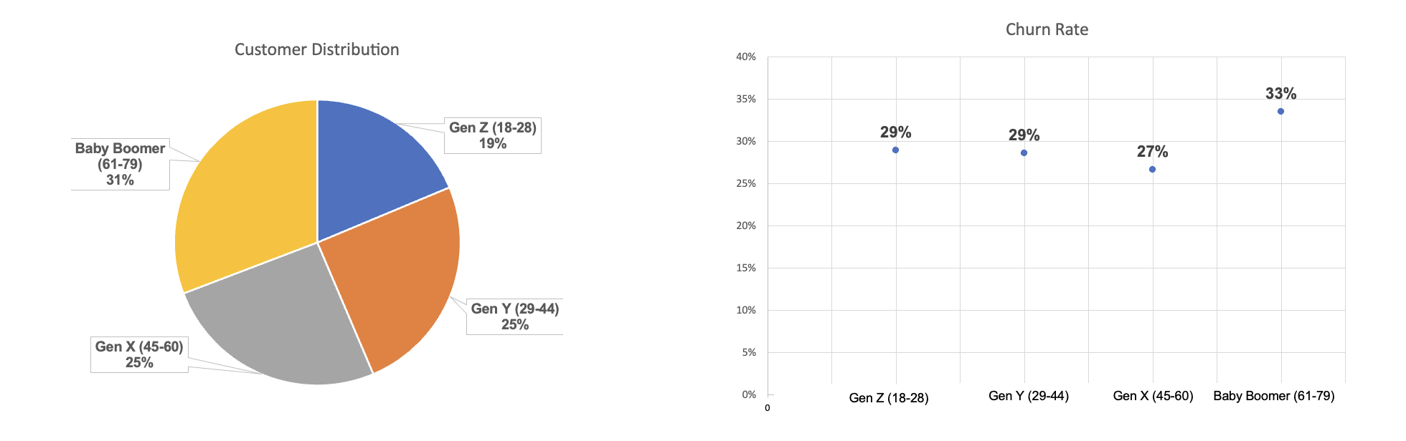
Key Insights & Visualization Highlights
Samruddhi Karpe
Insight 4: Baby Boomer Churn Crisis & Generational Portfolio Risk
Chart Type: Pie chart + Scatter plot
High Rate Of Baby Boomers Leaving (31%) With Highest Churn Rate (33%) - Losing Revenue Fastest
Gen Y (25%) With High Churn Rate Of 29% (Mid-Career Instability)
Gen Z (19%) Has Lowest Base With Average Churn Rate 29% (Same As Gen Y); Risk Of Losing Future Cohort
Gen X (27%) Was Relative Stable; Despite Low Churn (Lowest); Still Steady But At Risk Due To Gen X Anomaly (Satisfaction-Switching Paradox)
Root Cause Is Lack Of Generational Segmentation In Retention Strategy; One-Size-Fits-All Approach Does Not Work For Each Cohort Differently
Action Steps:
Baby Boomers - Main Focus (Senior-Friendly Support, Simpler Billing/Payment Options, Community/Social Features, Loyalty/Discount Programs For Seniors)
Gen X - Premium Bundles
Gen Y - Flexible Plans; Bundled Services; Marketing Strategy
Gen Z - Future Focus (Bundles/Products Related To Gaming; Community/Social Features; Data And Speed Benefits For Consumers; Influencer Partnerships/Offers).

Slide 18
Strategic Recommendations & Business Impact
Samruddhi Karpe
Recommendation 1: Baby Boomer Premium Retention Program (PRIORITY 1)
Why This Matters:
  31% of our customers are Baby Boomers, with the highest churn rate at 33%.
  Baby Boomers also have the highest income (average: $87K), yet they have the most churn.
  This is a crisis of revenue due to the loss of valuable long-term customers.
The Recommendation:
  Introducing "Silver Plus". This will include additional support options such as simplified billing, senior discounts, enhanced support.
  We will assign each customer a Personal Account Manager that is trained to assist Baby Boomers and their families and provide a separate dedicated phone line for them.
  Loyalty Rewards: Each customer will earn points for their loyalty to us and after 24 months, they will receive at no charge an upgrade of our service to a higher tier.
  Community Features: We will create Community Engagement Tools that will allow for the formation of groups of customers and provide discounts for members of these groups.
Potential Impact:
  The goal of our efforts will be to reduce Baby Boomers' current churn rate from 33% to 25%, representing an 8% improvement. Approximately 2,500 customers will be retained annually.
  Revenue = ~$12.5 million in coming years.
  Payback period = six to nine months.
Implementation Timeline:
  Design Premium Tier and train Support staff= Q1 2026
  Soft Launch (Pilot) with 10% of Baby Boomers= Q2 2026
  Track Metrics= Q3 2026

Slide 19
Strategic Recommendations & Business Impact
Samruddhi Karpe
Recommendation 2: Intensive Early Tenure Onboarding Program (PRIORITY 1)
Importance:
  27% of customers in their first year are very likely to leave because they don't feel connected to us and breakdown their initial relationship during this timeframe. The lifetime value is created within this timeframe with respect to the average $600 annual gross margin per customer.
  Weak onboarding will directly lead to revenue decrease.
Recommendation:
  "I am a New Customer" Welcome Experience - telephone call from someone on the onboarding team, education about service features, and free offerings.
  "Engagement Boost" - Monthly check-in from the onboarding team, recommendations on how to optimize service for greatest benefit, and loyalty incentives.
  12-Month Loyalty Bonus - Discounted Upgrade for a 2-Year Loyalty.
Tactical Steps:
  Automated SMS/email reminders every fixed interval with service feature bonus.
  Proactive Monitoring of Early Support Calls; Early Support Representatives need to escalate to the Retention Teams if there is any issue with the
  customer's experience.
  Incentives - Free Month of Service or 10% Discount for Staying for 6+ Months.
Estimated Outcome:
  Reduction in first-year churn (27% to 18%).
  Retaining up to 3,600 new customers each year (assuming an annual base of 40,000 new customers).
  Revenue Impact = $18 Million Over 5 Years.
  Payback = 4-6 Months.
Timeline for Implementation:
  Q1 2026 - Build Automation/CRM Workflows
  Q2 2026 - Train Onboarding Team.
  Q3 2026 - Track Performance.

Slide 20
Strategic Recommendations & Business Impact
Samruddhi Karpe
Recommendation 3: Shift from Prepaid-to-Postpaid (PRIORITY 2)
Reasons for It To Be Important:
  The Churn Rate for Pre-Paid Customers is 38.46% which is greater than the Churn Rate for Post-Paid Customers by 10.34%.
  Pre-Paid does not have any commitment barriers, therefore Customers may leave at any time during the billing cycle.
  If Customers convert to Post-Paid or Bundled Plans they will generate and commit revenue and therefore lessen volatility in the churn rate.
Recommendation:
  Pre-Paid Conversion Program: This program will provide a 12%-15% discount for switching to a 12-Month Post-Paid Plan.
  Bundled Services Package Deals will include Internet, Phone and TV services for a lower price provided for committing to an annual Contract.
  Loyalty Milestone Bonuses for Pre-Paid Users: Customers may receive a free month or an upgraded feature after 6, 12 and 24 months of being a Pre-Paid User.
Tactical Details:
  Our target is to convert between 30%-40% of our Pre-Paid Customer Base into Annual and Multi-Month Plans.
  We will advertise: "No Surprise Bills", "Better Value", "Exclusive Perks"
  There will be a one-time-only Conversion Offer that will be valid for 60 days and Auto-Renewal at the expiration of the Contract term.
Expected Impact:
  To Shift 40% of Pre-Paid Customers to Post-Paid (Reducing Churn Risk associated with Pre-Paid Customers).
  Expected to reduce Overall Pre-Paid Churn Rate from 38.46% to 30% = 8% Improvement.
  Expected Annual Retention of Approximately 1,500 Pre-Paid Customers.
  Expected Improvement in Revenue Predictability (Annual vs. Month-to-Month).
  Projected Revenue Impact Over 5 Years Approximates $7.5 Million.
  Expected Payback will be 8-12 Months.
Implementation Timeline.
  Q1 2026: Change in Pricing, Marketing Plan.
  Q2 2026: Soft Launch with E-Mail Campaign to Top 20% of the Pre-Paid Customer Base.
  Q3 2026: Roll Out Full Campaign

Slide 21
Strategic Recommendations & Business Impact
Samruddhi Karpe
Recommendation 4: Service Quality & Support Model Redesign (PRIORITY 2) (1/2)
Importance of This:
  During the months 37 to 48 (year 3), postpaid churn increased to 37%, indicating that customers are experiencing issues with billing or service.
  Gen Y customers are experiencing a 37% churn rate even though they typically earn less than Gen X customers, suggesting that they are satisfied with the service they receive, and not price.
  Gen Z customers experience the 2.52 CSAT-churn gap, due to having the lowest satisfaction levels and highest frustration levels.
Recommended Actions:
  First Contact Resolution (FCR) Initiative: The support staff will be trained to resolve over 80% of all support issues on the first call.
  Proactive Service Monitoring: Any customer who has called for support 3 or more times in a 30-day period will be flagged for review by a retention specialist.
  Billing Transparency: All monthly statements will have data regarding service usage and value earned. In addition, any loyalty rewards earned.
  Service Quality Reviews: Quarterly outreach to all customers, especially those between months 30 and 36, will occur to gauge overall customer satisfaction.
Operational Details:
  Create a knowledge base to aid in training staff on reducing repeat calls.
  Survey customers after providing support if the concerns were solved.
  Regularly contact clients who have reached out to them several times.
  Value messaging.

Slide 22
Strategic Recommendations & Business Impact
Samruddhi Karpe
Recommendation 4: Service Quality & Support Model Redefinition (2/2)
Anticipated Results:
  Support calls for every customer will reduce by 15%–20%.
  CSAT scores increase by an average of 1– 2 points.
  The postpaid churn lift in third Year will be minimized. (37% to 28%)
  Around 1,800 clients will be retained in a year.
  20% reduction in support costs.
  Over $9,000,000 in revenue for the coming years.
  Cost savings will be regained in 6 months.
Timeline for Implementation:
  Jan - Mar 2026: Training of Staff
  Apr - May 2026: Change in Billing Process
  Jun - Dec 2026: Monitoring System Setup

Slide 23
REFERENCES
Newzoo (2023) How and why different generations engage with video games in 2023. Available at: https://newzoo.com/resources/blog/how-and-why-different-generations-engage-with-video-games-in-2023 (Accessed: 12 December 2025).

Slide 24
APPENDIX

Slide 25
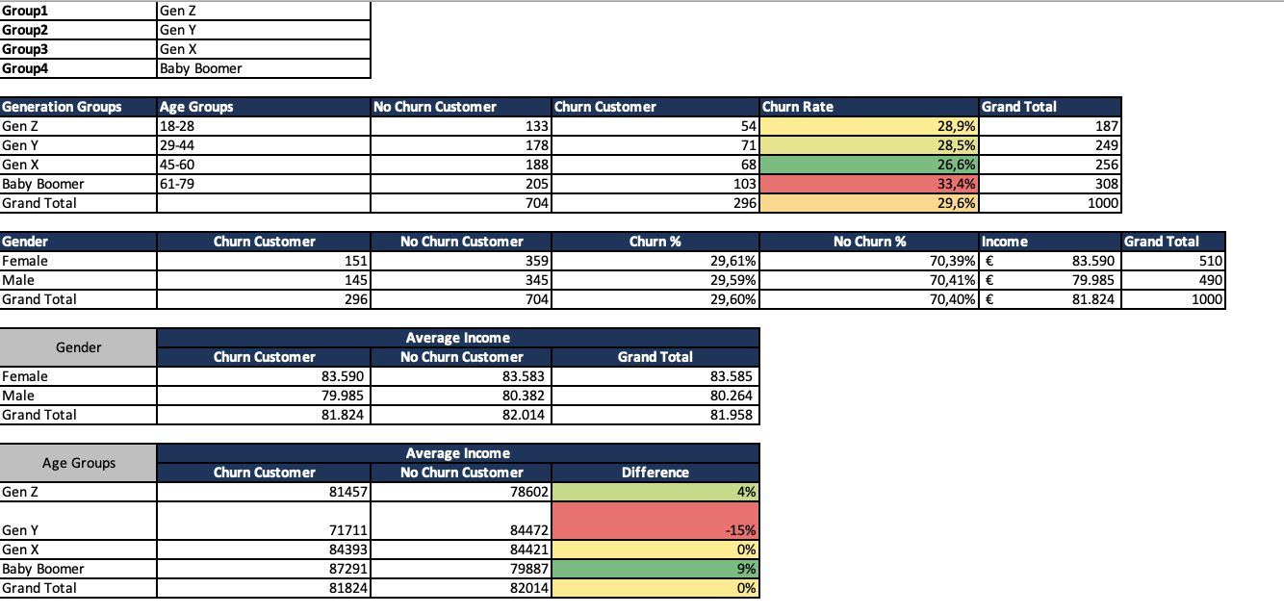
Analysis
Merve Saglanmak
Yamanoglu
Link for my excel document:
telecom_customer_churn_data_group3-Final (1).xlsx

Slide 26
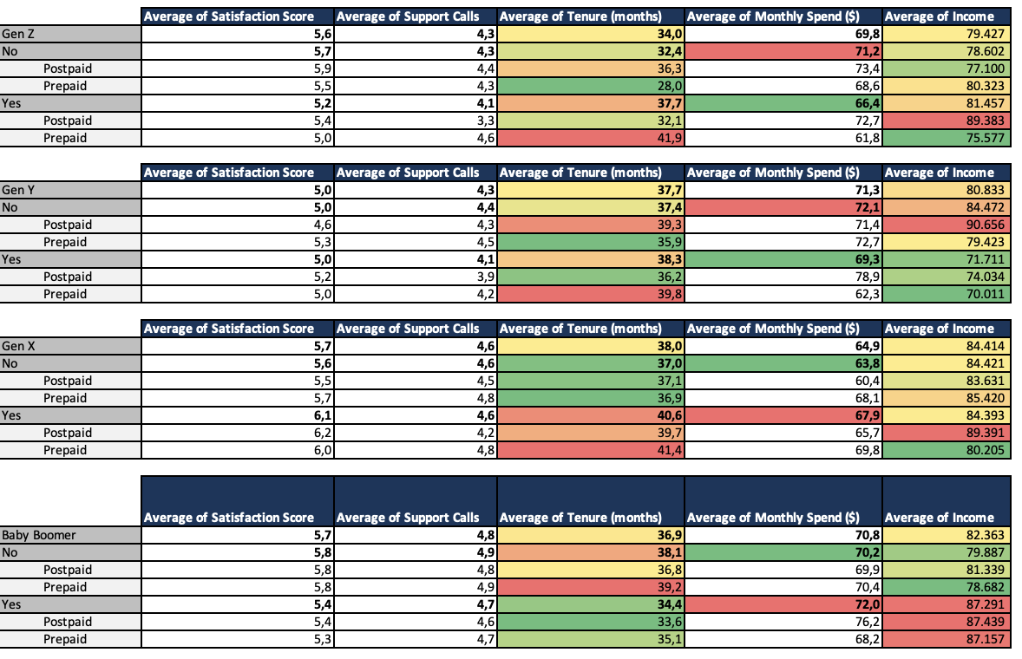
Analysis
Merve Saglanmak
Yamanoglu

Slide 27
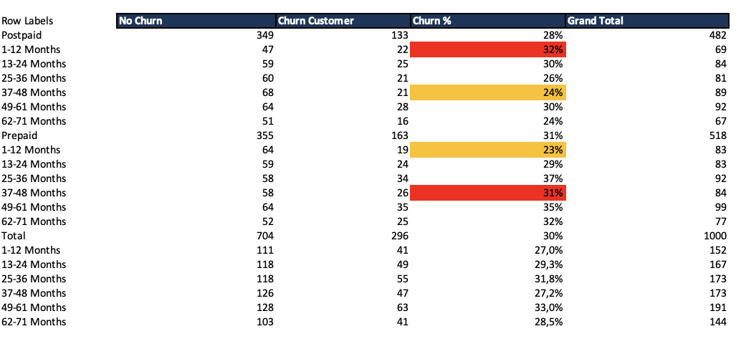
Analysis
Merve Saglanmak
Yamanoglu

